Slide 1
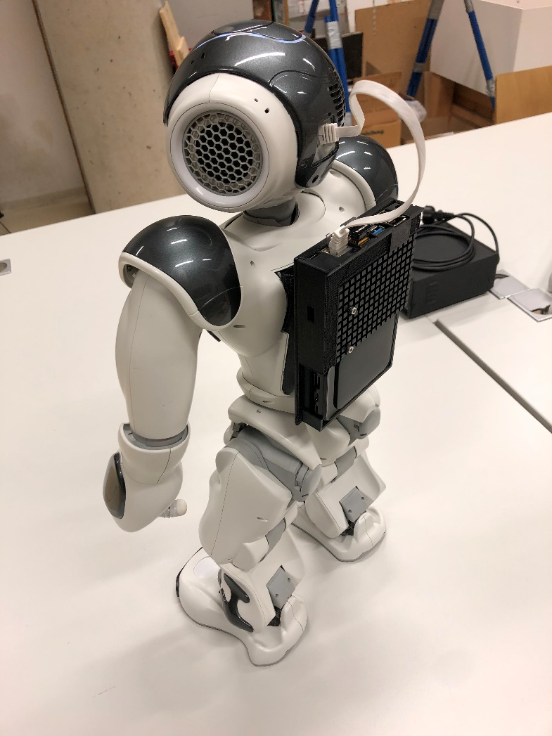
Nano-backpack designed for humanoid NAO robot
11.12.2020
Barth, Wagner
Slide 1

Slide 2
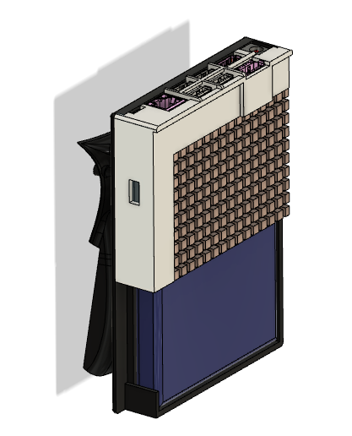
Mechanical design
Battery cover integrated in printed backpack
Access to all Nano connectors
Improved heat sink
Barth, Wagner
Nano-backpack designed for humanoid NAO robot
11.12.2020
Slide 2

Slide 3
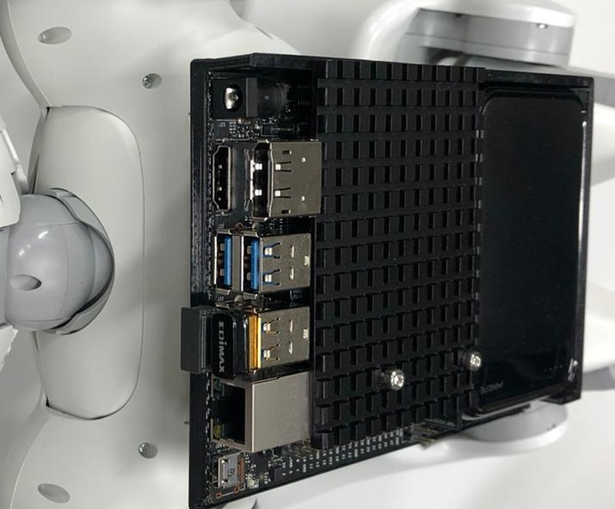
Nano
Modern Linux environment
Overcome NAO hardware limitations
Onboard power supply in the backpack
GPU for greater possibilities in computer vision
Barth, Wagner
Nano-backpack designed for humanoid NAO robot
11.12.2020
Slide 3

Slide 4
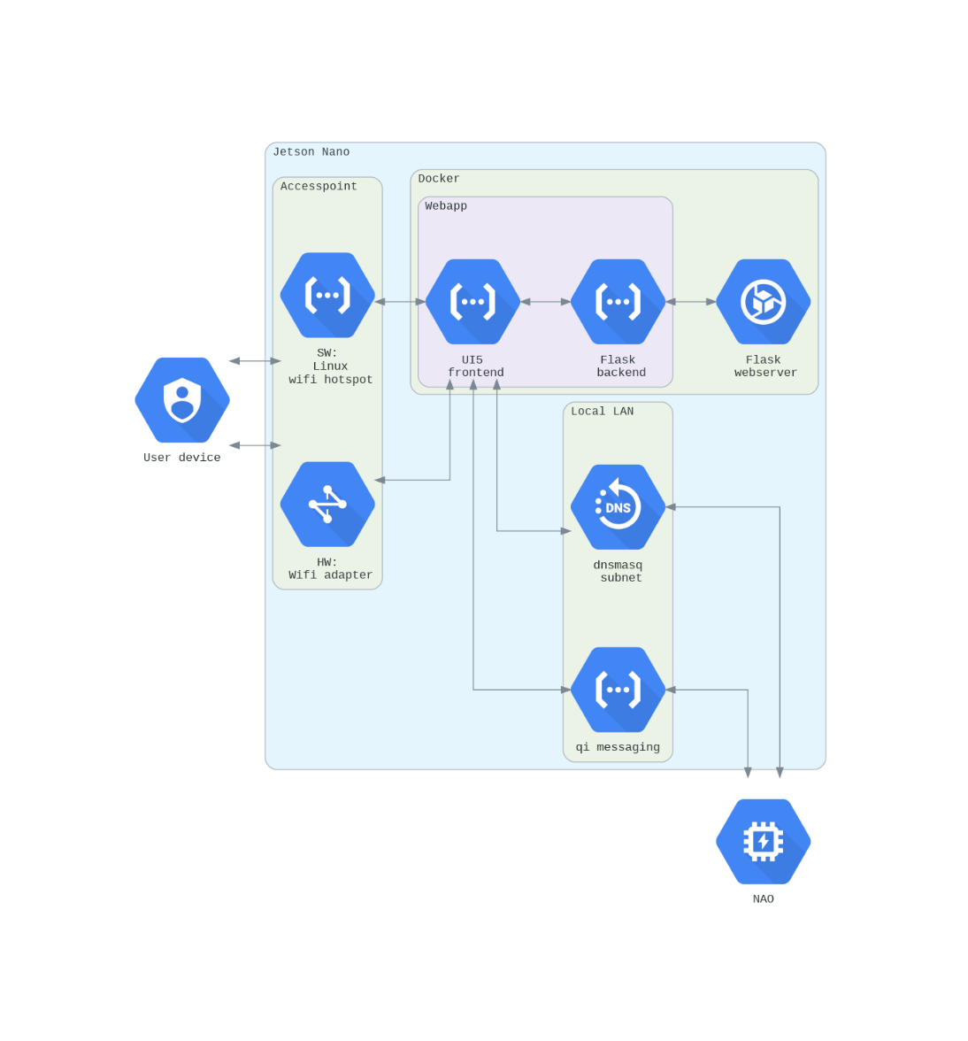
System architecture
Access Nano remotely
Docker container runs web app
Barth, Wagner
Nano-backpack designed for humanoid NAO robot
11.12.2020
Slide 4

Slide 5
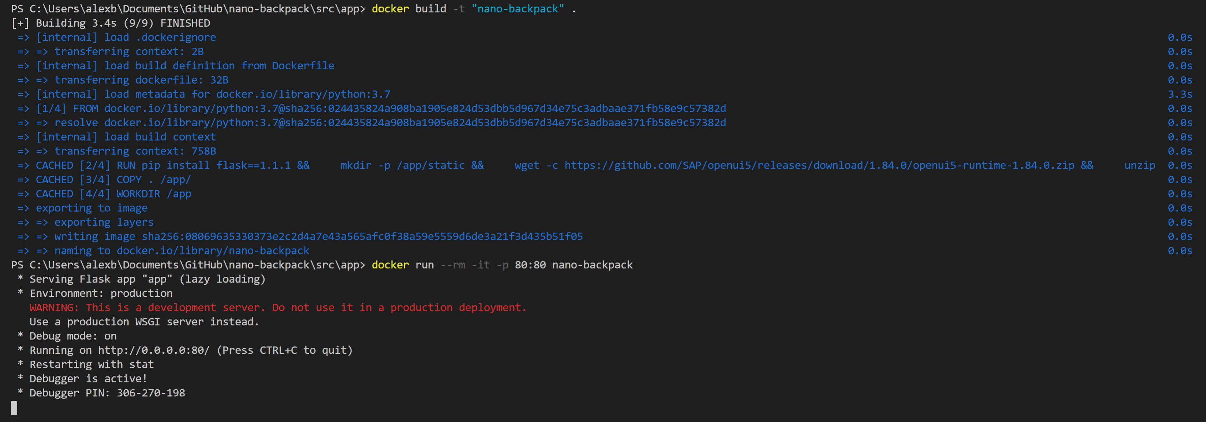
Docker
Caching → build in few seconds, no internet access required
Barth, Wagner
Nano-backpack designed for humanoid NAO robot
11.12.2020
Slide 5

Slide 6
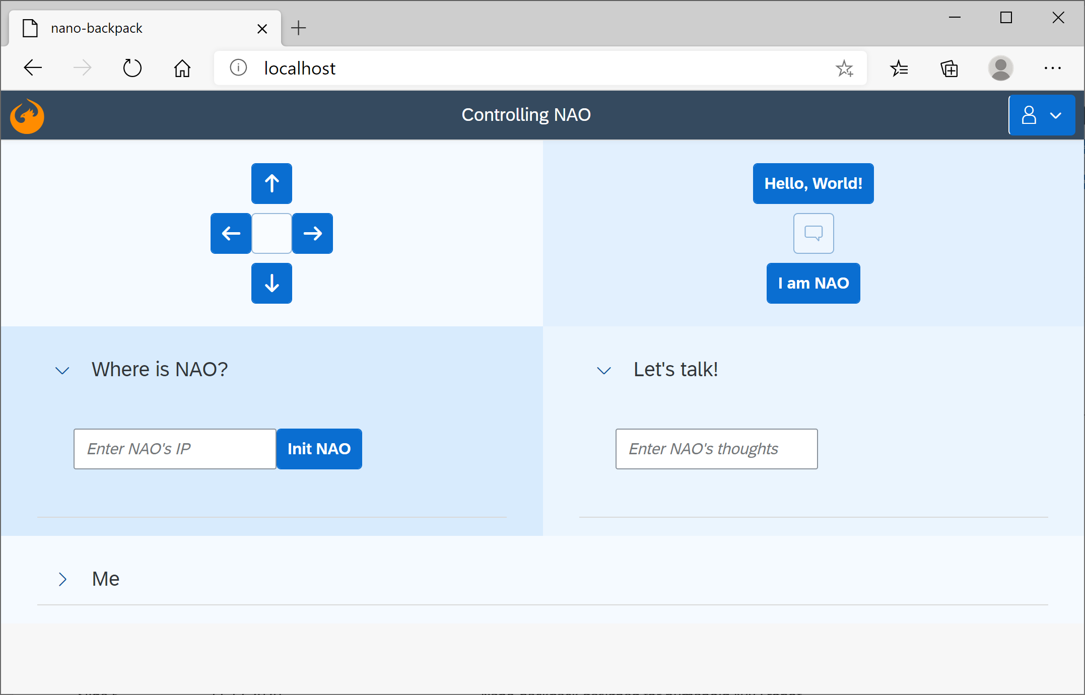
Webapp
UI5 front-end (JS)
Flask back-end (Python)
See video
Barth, Wagner
Nano-backpack designed for humanoid NAO robot
11.12.2020
Slide 6

Slide 7
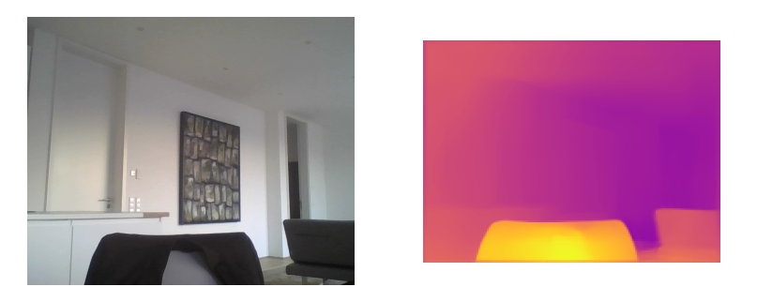
Depth estimation in video stream
Custom dataclass to handle video input
Can later be combined with ALVideoDevice of the NAOqi-API
Barth, Wagner
Nano-backpack designed for humanoid NAO robot
11.12.2020
Slide 7

Slide 8
Benefits
Overcome previous hardware limitations
Easy start with step-by-step instructions
Reuse, modify, extend webapp and Docker image
State-of-the-art development environment
Ready-to-use depth estimation in video stream
Barth, Wagner
Nano-backpack designed for humanoid NAO robot
11.12.2020
Slide 8

