Slide 1
ISSUES

Slide 2
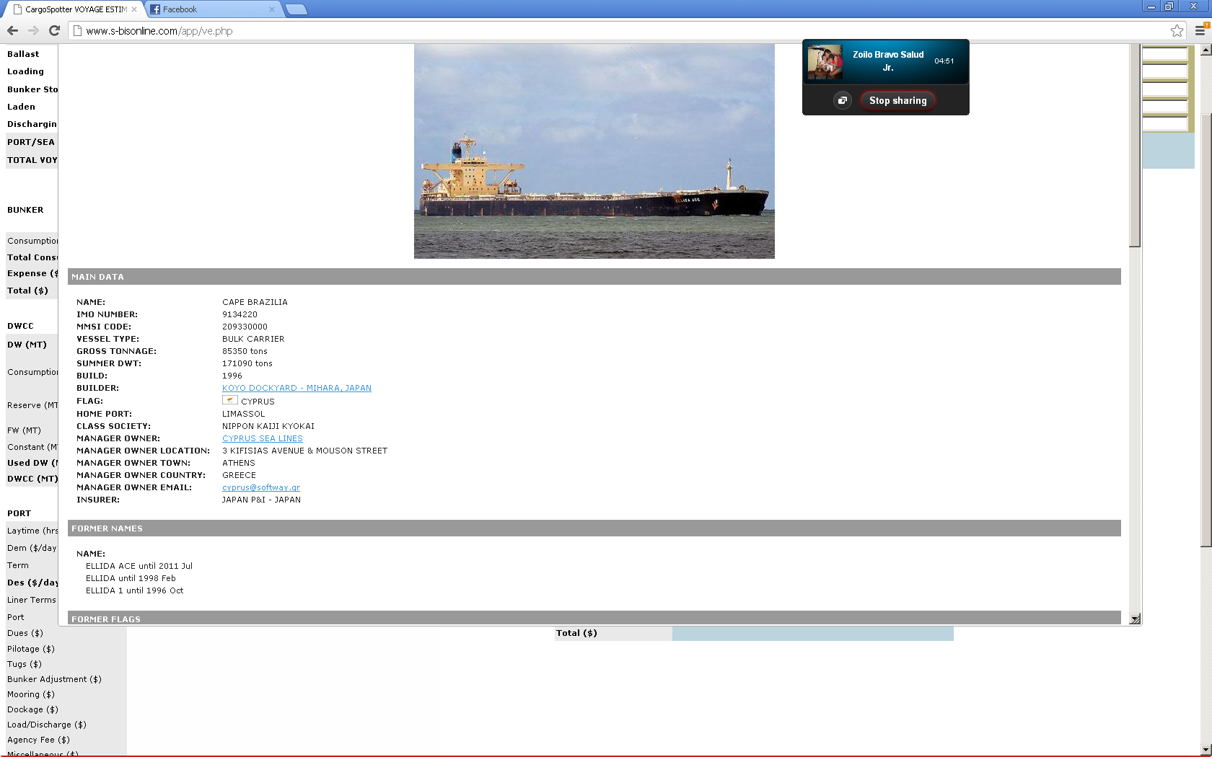
Links do not work

Slide 3
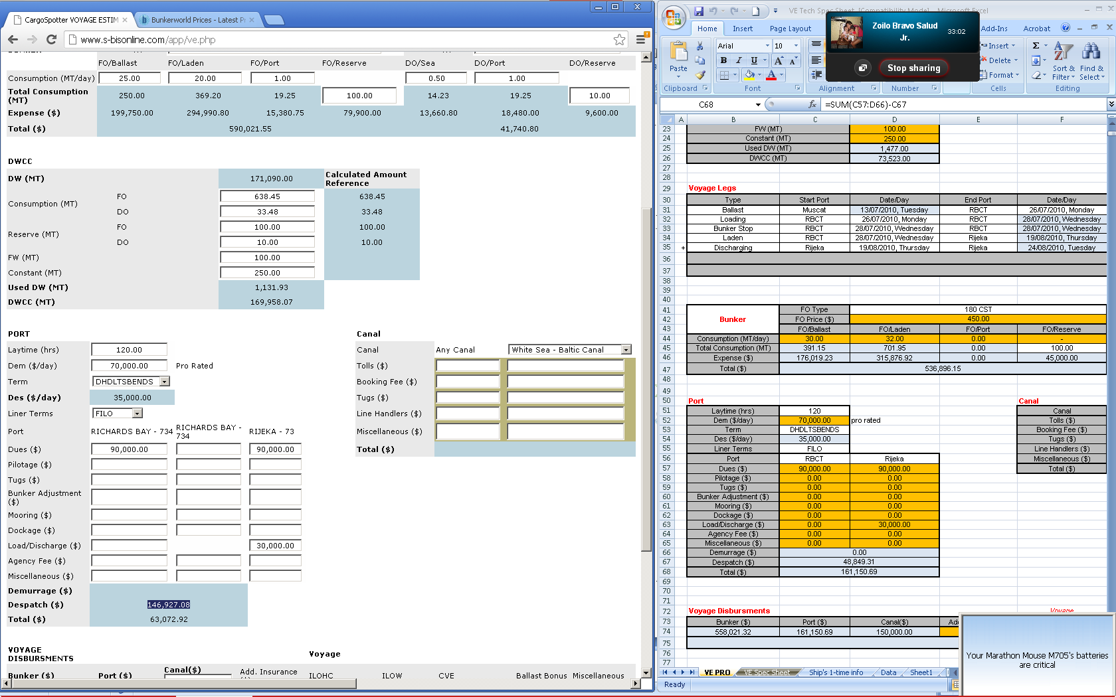
Check formulae

Slide 4
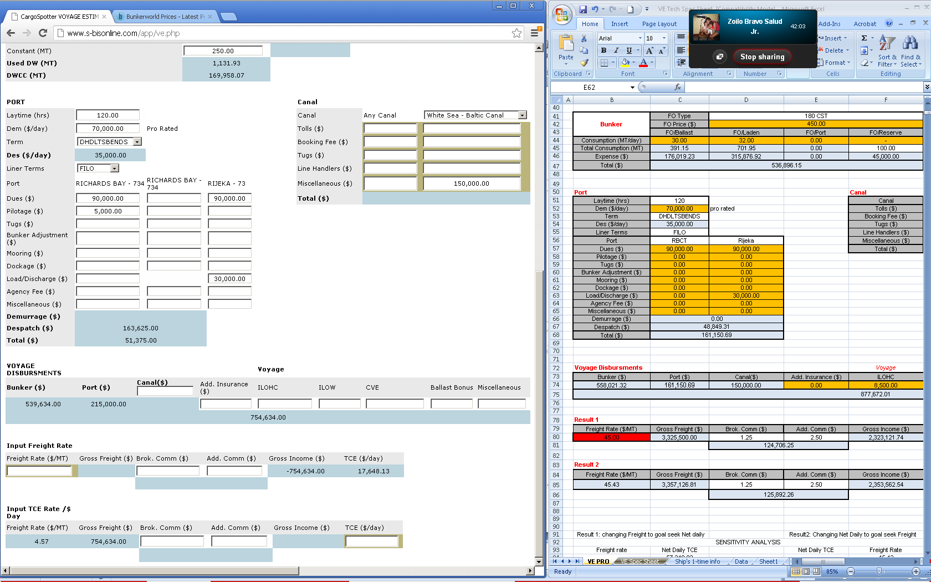
Total not adding

