Slide 1
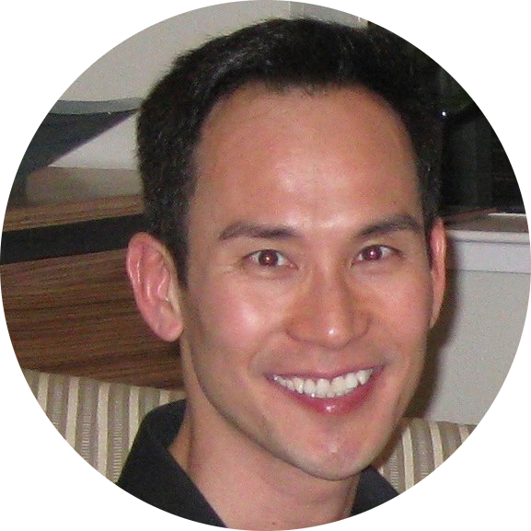

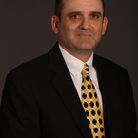


A Cloud Solution for Telemetry Data
Monday April 3rd, 2017
Thong Bui
Roy Gvirtsman
Geoffrey Link
Zhongqiao Jin
Happiness Munedzimwe

Slide 2
What is Telemetry?
A collection of sensor reads over time
Regular or Irregular Reads (eg., storm outages)
Key-Value pairs: { “point”: 180, “epoch”: 1234567, “value”: 14.6}
Examples: Temperature, Wind Direction, Alerts, GPS Coordinates

Slide 3
How is Telemetry used?
Monitor and Control
SCADA or Supervisory Control and Data Acquisition
Alerts, Troubleshooting, Emergency Response
Operational efficiency: KPI, Decision Support
Predictive maintenance

Slide 4
Target Audience & Usage
Remote Operators
Respond to alerts
Troubleshoot and recover from equipment failures
Operations Manager
Monitor operator efficiency
Quantify lost opportunity
Preventative maintenance
Handle escalated operational issues
Market scheduler
Profitability
Respond to grid operator’s instructions

Slide 5
Project Objectives
Create a reporting framework that has the ability to ingest billions of reads from tens of thousands of devices (noisy crickets)
Easily scalable
Fully Hosted in the Cloud (Zero Cap-Ex Platform)
Use only open-source tools
Each device (or cricket) will emit a basic output that can be transmitted over Radio Frequency or Wi-Fi or Cellular

Slide 6
Data processing requirements
Data Generation (Crickets)
Data Summarization (Grafana)
Graphing and Reporting (D3.js)
Retention policy (InfluxDB)
Resilient and Scalable (InflxuDB)
Event Subscription (Slack)
Alerts and Notifications (Kapacitor)
Predictive Maintenance (Spark Streaming,if time permits)

Slide 7

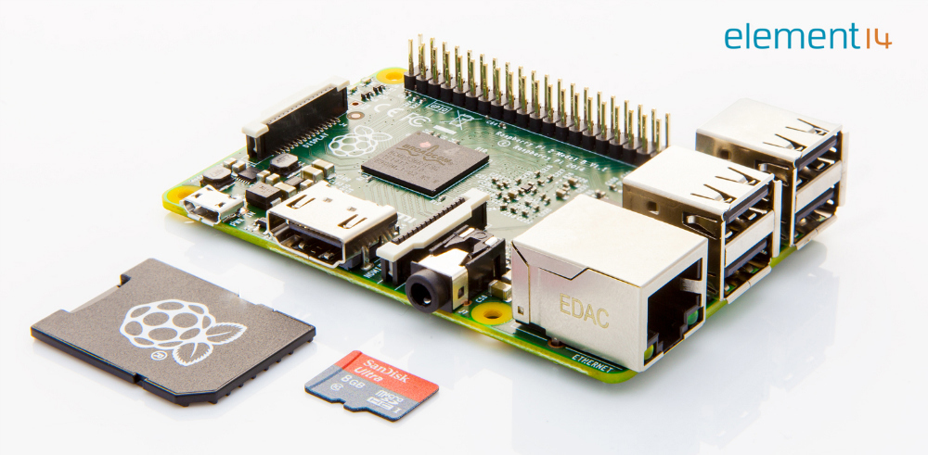
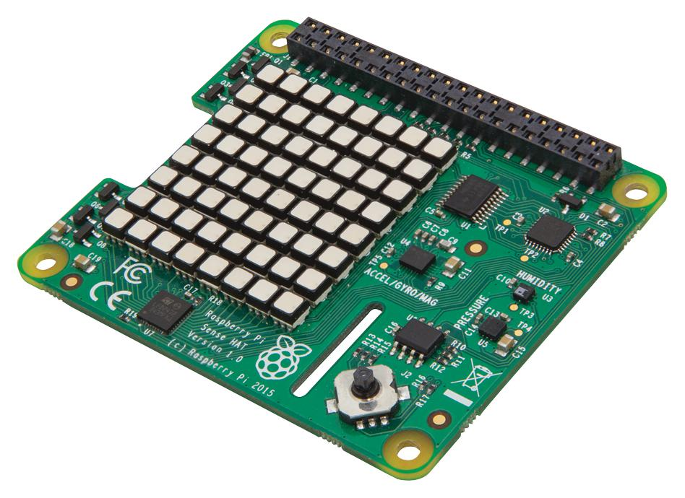
What is a cricket? Edge Computing!
A Cricket is a device that can transmit data over Radio Frequency or Wi-Fi or Cellular
A common example is the highly versatile Raspberry Pi ($30).
Raspberry Pi Sense HAT with Orientation, Pressure, Humidity, and Temperature Sensors ($30).

Slide 8
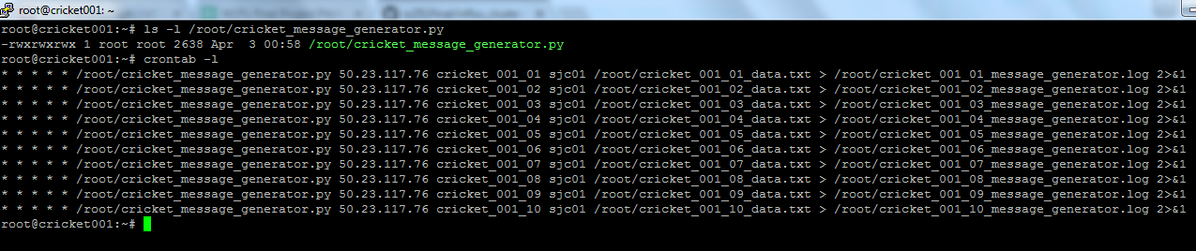
Did we buy 10,000 Raspberry Pi? No.
We used Softlayer Cloud to simulate crickets across the globe.
Amsterdam 01 ams01
Amsterdam 03 ams03
Chennai che01
Dallas 01 dal01
Dallas 02 dal02
Dallas 05 dal05
Dallas 06 dal06
Dallas 07 dal07
Dallas 09 dal09
Dallas 10 dal10
Dallas 12 dal12
Dallas 13 dal13
Frankfurt fra02
Hong Kong hkg02
Houston hou02
London lon02
Melbourne mel01
Milan mil01
Montreal mon01
Oslo osl01
Paris par01
Querétaro mex01
San Jose 01 sjc01
San Jose 03 sjc03
Sao Paulo sao01
Seattle sea01
Seoul 01 seo01
Singapore sng01
Sydney syd01
Tokyo tok02
Toronto tor01
Washington, D.C. 01 wdc01
Washington, D.C. 04 wdc04

Slide 9
Architecture Overview

Slide 10
Technology Stack

Slide 11
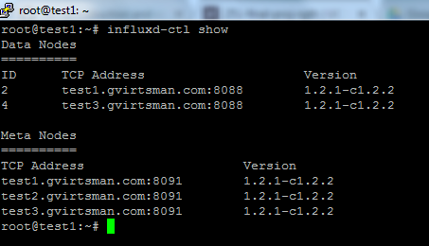
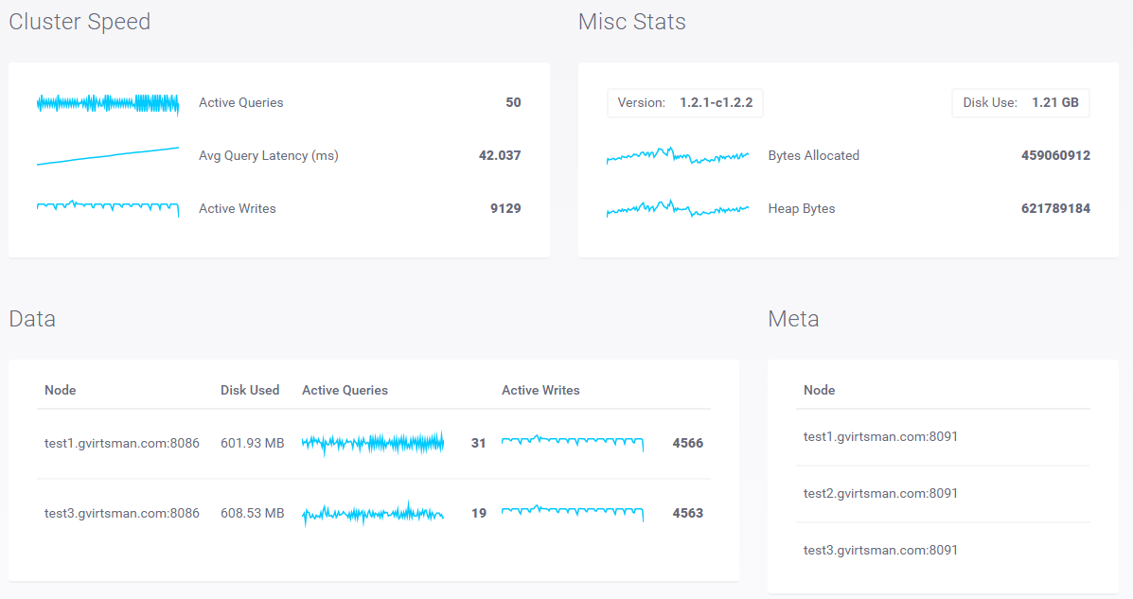
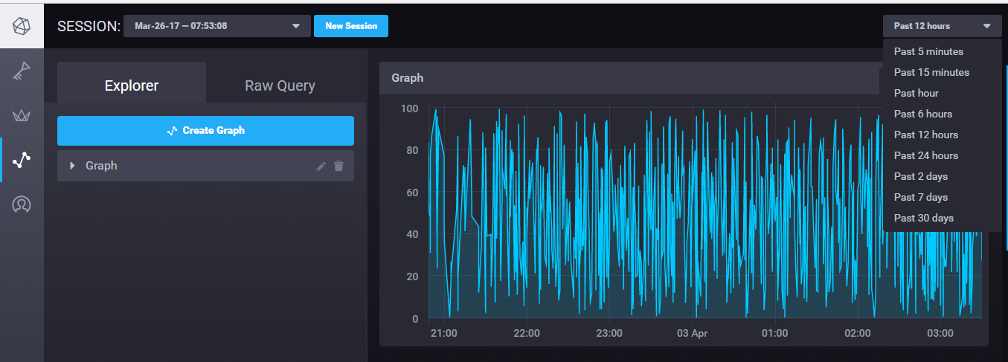
InfluxDB Cluster Monitor

Slide 12
InfluxDB Query Performance

Slide 13
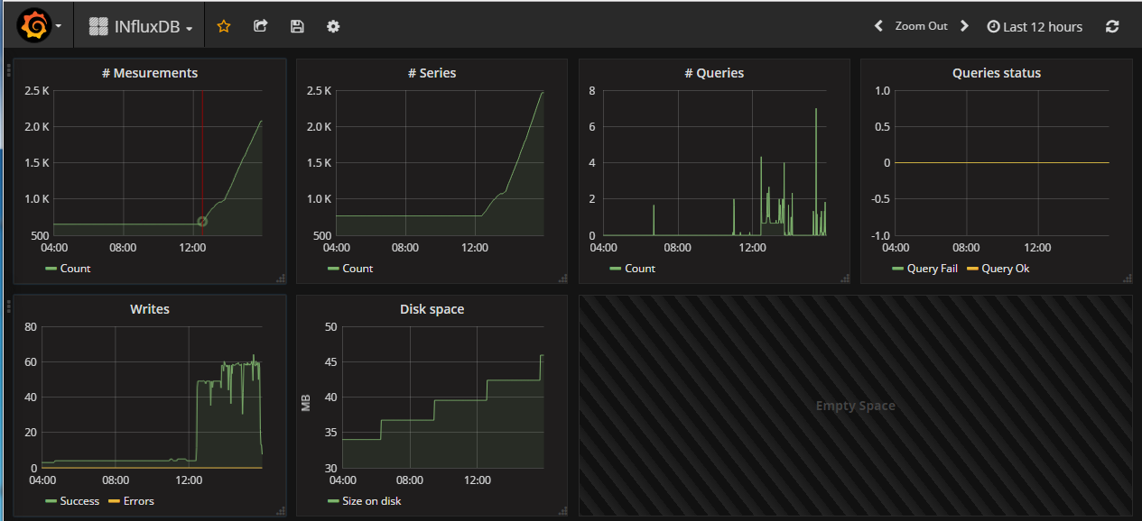
Grafana Dashboard

Slide 14
Lessons Learned (so far!)
Softlayer Message Queues are very slow (we now write directly to InfluxDB)
Softlayer Load Balancer is slow (need an upgrade!)
InfluxDB allows only 2 database nodes (need an upgrade!)

