Slide 1
Data Analyst Internship — Dashboard Design
Power BI deliverables: dataset, DAX measures, report build steps, and sample visuals

Slide 2
Project Overview
Objective: Design an interactive dashboard for business stakeholders using Power BI.
Deliverables included in this package:
- sales_financial_dataset.csv (synthetic, Superstore-like)
- dashboard_summary.pptx (this file) with sample charts
- Detailed Power BI instructions and DAX measures (in accompanying chat message)

Slide 3
Key KPIs (Synthetic Dataset)
Total Sales: 3,066,263.81
Total Profit: 403,320.72
Total Orders: 1200
Avg Order Value: 2,555.22

Slide 4
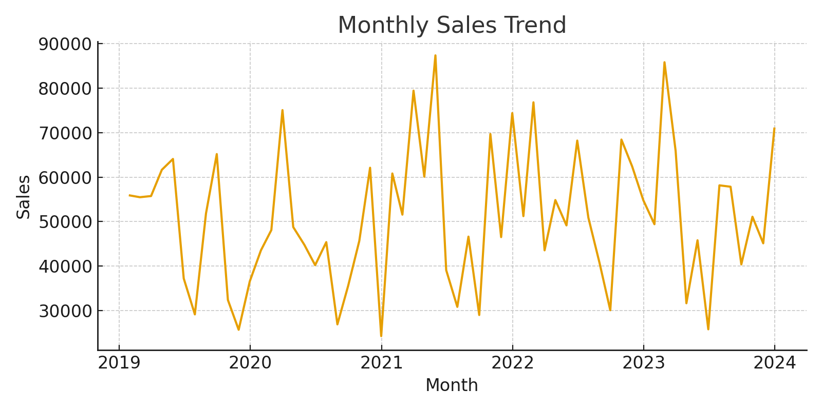
Monthly Sales Trend

Slide 5
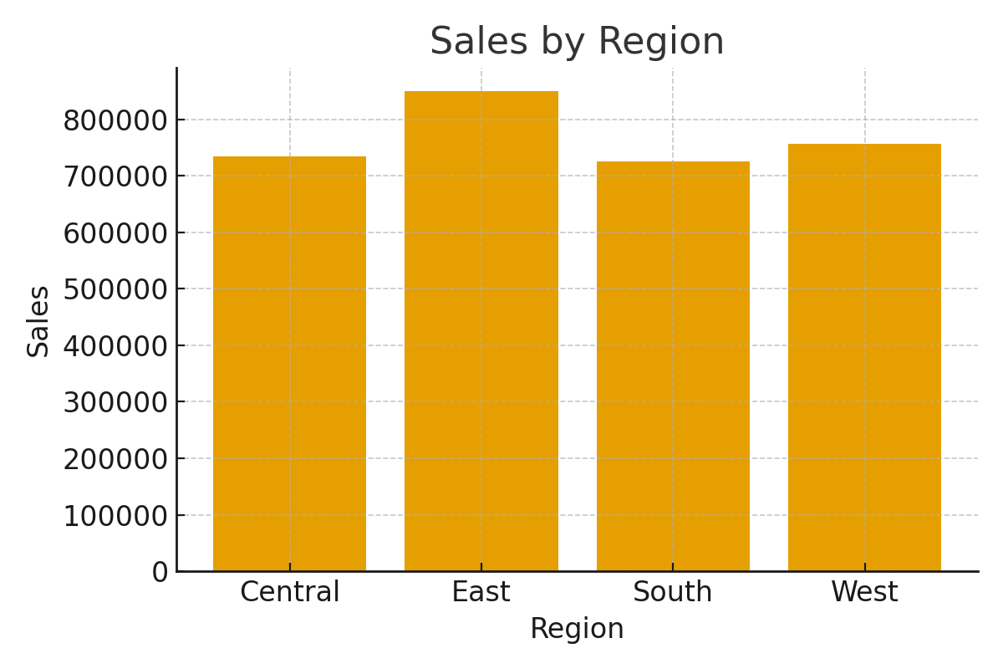
Sales by Region

Slide 6
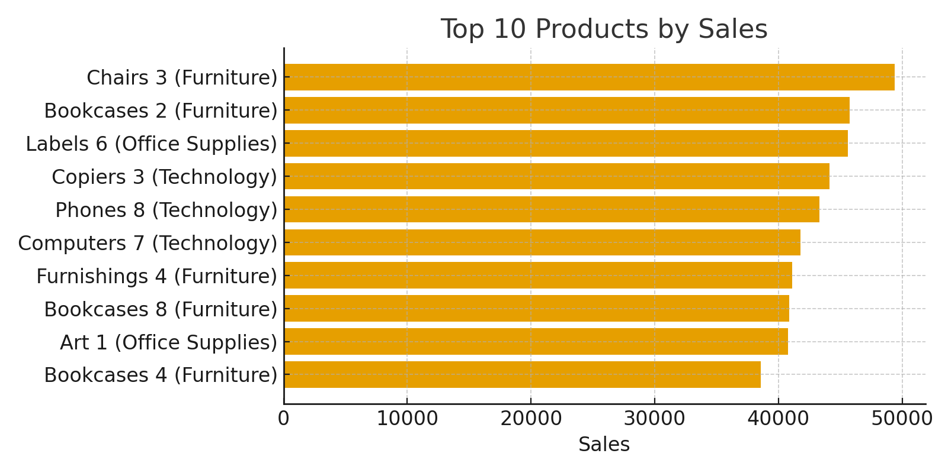
Top 10 Products by Sales

Slide 7
Dashboard Overview (Power BI Design)
This page summarizes the most important KPIs and overall business performance.
Suggested Visuals:
- KPI Cards: Total Sales, Total Profit, Total Orders, Avg Order Value, Profit Margin
- Line Chart: Monthly Sales Trend
- Bar Chart: Sales by Region
- Slicers: Region, Category, Year

Slide 8
Sales Deep Dive Page
This page provides a deeper look into sales performance by product and category.
Suggested Visuals:
- Stacked Column Chart: Sales by Category over Time
- Matrix: Product-wise Sales, Quantity, Profit
- Bar Chart: Top 10 Products by Sales
- Slicers: Sub-Category, Product

Slide 9
Profit & Growth Page
This page focuses on profitability and growth trends.
Suggested Visuals:
- Line Chart: Monthly Profit Trend
- Waterfall Chart: YoY Sales Change
- KPI Visual: Sales YoY %
- Tooltip: Profit Margin on hover

Slide 10
Insights & Recommendations
From the synthetic dataset analysis, potential insights include:
- East and West regions may be leading in sales while South lags.
- Technology category often contributes most to revenue.
- Certain products (e.g., Computers, Chairs) dominate top-10 sales.
- Profit margin varies significantly depending on discount levels.
Recommendations: Focus marketing spend on high-performing regions, optimize discounts, and invest in top categories.

