Slide 1


SECRET REVERSE SHELL

Slide 2

PREFACE
In general, What is a REVERSE SHELL attack ?

Slide 3
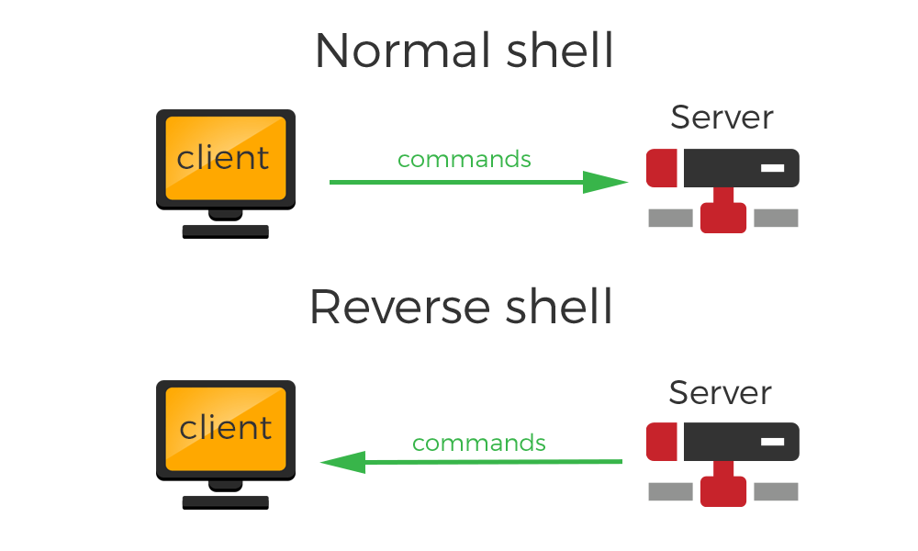

The “traditional” REVERSE SHELL attack
Terminal/CMD
Terminal/CMD
Attacker

Slide 4
Our “SECRET REVERSE SHELL”
Our objective is doing it in a new and original secret way!
We used port numbers as a secret way to represent ascii chars. We used AES encryption to add strength and confidentiality. And we made sure the attacker remain anonimus.
In Our scenario the hacker already got the script run on the attacked pc.
C’mon let’s go!

Slide 5


Let’s Dive In!
Change every and any char to ascii
“some command”
A
B
C
D
65
66
67
68
Send pkt to port “65+62343”
The attacked pc sniff’s the packets and rebuilds the message
Encrypted it and got:
………………… “66+62343”
Decrypt
“ABCD”
………………… “67+62343”
………………… “68+62343”

Slide 6
BUT HOW IT PRACTICALLY WORKS???
How the two sides actually communicate?
Unique, pre-implemented, fake IP’s

Slide 7
BUT HOW IT PRACTICALLY WORKS???
How the two sides will know the length of the incoming message?
1 Type of Pkt to inform about the length of incoming message
Source port meaning: length of incoming message +10
And a 2’nd type of Pkt to represent by its port an ascii char value
Source port meaning: ascii value of one char of incoming message +62343

Slide 8
BUT HOW IT PRACTICALLY WORKS???
How we ensure that the message will be rebuilt correctly?
Source port meaning: ascii value of one char of incoming message +62343
Destination port meaning: tells us about the place of the current char in the message
Pkt to represent by its port an ascii char value

Slide 9
FINAL OVER-VIEW
The attacker types a command and encrypt it
Then, we transform it to a text message
We inform the other side about the num of pkts to come
Now, For each char we send a packet with its source port containing the char’s ascii value
The attacked pc sniffs the message and rebuild’s it
After decrypting it, it is typed to the terminal
The “answer” from the terminal gets encrypted, sliced, and is sent in the same method.

Slide 10
ANOTHER LOOK
SHELL
Attacked pc
Attacker
D()
E(command)
command
D()
E(command)

Slide 11

So, Questions?

