Slide 1
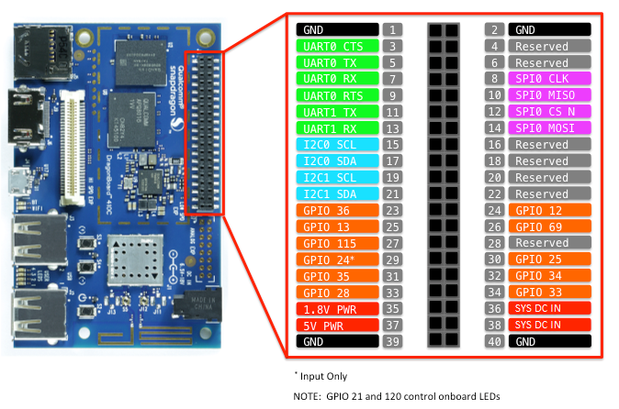
DB410C | 96BoardGPIO | DB410c | 96BoardGPIO
GPIO-A | GPIO 36 | GPIO-B | GPIO 12
GPIO-B | GPIO 13 | GPIO-D | GPIO 69
GPIO-E | GPIO 115 | GPIO-F | GPIO 507
GPIO-G | GPIO 24 | GPIO-H | GPIO 25
GPIO-I | GPIO 35 | GPIO-J | GPIO 34
GPIO-K | GPIO 28 | GPIO-L | GPIO 33

