Slide 1
Graph Algorithms (Artificial Intelligence)

Slide 2
Graph Algorithms in A.I.
why do we need graphs in artificial intelligence?
many artificial intelligence related problems can be reduced to the problem of finding a path in a given G(V,E) graph

Slide 3
Graph Algorithms in A.I.
GAMES
most of the computer games rely extremely heavily on graph algorithms – such as Diablo or Warcraft

Slide 4
Graph Algorithms in A.I.
GAMES
most of the computer games rely extremely heavily on graph algorithms – such as Diablo or Warcraft
ROBOTICS
robots, autonomous vacuum cleaners or war dogs
rely heavily on graph algorithms such as A* search or BFS

Slide 5
Graph Algorithms in A.I.
GAMES
most of the computer games rely extremely heavily on graph algorithms – such as Diablo or Warcraft
ROBOTICS
robots, autonomous vacuum cleaners or war dogs
rely heavily on graph algorithms such as A* search or BFS
CHESS AND TIC-TAC-TOE
in two-player games we can generate a so-called
game tree – that is essentially a graph

Slide 6
A* Search Algorithm (Artificial Intelligence)

Slide 7
A* Search Algorithm
it was first published by Nils Nilsson and Peter Hart back in 1968
widely used in path-finding and graph traversal
maybe the best approach if the graph can not be pre-processed and there is no memory constraint
usually Dijkstra’s shortest path approach is better
BUT DIJKSTRA’S ALGORITHM CONSIDERS
EVERY NODE OF THE GRAPH
even the nodes that are extremely far away from the target

Slide 8
A* Search Algorithm
the motivation behind A* search is to guide the general direction of the search algorithm
hence we can eliminate unnecessary checks and states
A* search uses heuristic

Slide 9
A* Search Algorithm

Slide 10
A* Search Algorithm

Slide 11
A* Search Algorithm
„Heuristic is a technique designed for solving a problem more quickly when classic methods are too slow or for finding an approximate solution when classic methods fail to find any exact solution”

Slide 12
A* Search Algorithm
g(x) is the cost of
moving from the starting
point to a given x state
f(x) = g(x) + h(x)
the A* algorithm makes the
next step according to
this f(x) cost-function value
THE LOWER THE
VALUE THE BETTER !!!
h(x) is the approximated movement cost
(heuristic estimate) from x to the destination
IT IT THE HEURISTIC ITSELF SO AN EDUCATED GUESS
we don’t know the actual distance to the destionation
because obstacles may be in the way

Slide 13
A* Search Algorithm
what if the cost-function is f(x) = g(x)?
in this case we do not care about the heuristic – we pick the move that has the lowest cost from the starting node
this is exactly how shortest path algorithms work such as Dijkstra’s algorithm

Slide 14
A* Search Algorithm
Constructing a good h(x) heuristic function is crucial
1.) the h(x) heuristic function is admissible if it never overestimates the disance between state x and the target
IF THE H(X) HEURISTIC FUNCTION IS ADMISSIBLE THEN IT
ALWAYS YIELDS THE OPTIMAL SOLUTION

Slide 15
A* Search Algorithm
Constructing a good h(x) heuristic function is crucial
2.) the h(x) heuristic function is consistent if for every 2 neighboring nodes it is true that c(A,B) + h(B) ≥ h(A) where c(A,B) is the edge weight between vertex A and vertex B
IF AN H(x) HEURISTIC FUNCTION IS CONSISTENT THEN
IT IS ADMISSIBLE AS WELL

Slide 16
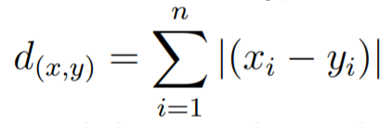
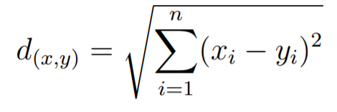
A* Search Algorithm
„Manhattan-distance”
„Euclidean-distance”

Slide 17
A* Search Algorithm
MANHATTAN DISTANCE
it is the sum of the vertical and
horizontal differences of the points
We can calculate this
heuristic function quite fast
it is not admissible – it has the
tendency to overestimate
the distance
EUCLIDEAN DISTANCE
it yields the exact
distance between two points
not always efficient because of the
square root operation
it is admissible as an h(x)
heuristic function

Slide 18
A* Search Algorithm
(20,40)
(50,40)
C
30
G
10
(40,30)
(10,20)
10
E
10
B
10
20
50
10
D
(50,10)
(0,0)
F
A
80
50
(30,10)

Slide 19
A* Search Algorithm
(20,40)
(50,40)
C
30
G
10
(40,30)
(10,20)
10
E
10
B
10
20
50
10
D
(50,10)
(0,0)
F
A
80
50
(30,10)

Slide 20
Brute Force Search (Artificial Intelligence)

Slide 21
Brute-Force Search
what is the motivation behind brute-force search?
we want to find the minimum (or maximum) of a given function
the function is usually called cost-function

Slide 22
Brute-Force Search
QUADRATIC OPTIMIZATION
when we want to find the optimal solution for the travelling salesman problem or vehicle routing problem etc.

Slide 23
Brute-Force Search
QUADRATIC OPTIMIZATION
when we want to find the optimal solution for the travelling salesman problem or vehicle routing problem etc.
FINANCE
the optimal number of stocks in a portfolio etc.

Slide 24
Brute-Force Search
QUADRATIC OPTIMIZATION
when we want to find the optimal solution for the travelling salesman problem or vehicle routing problem etc.
FINANCE
the optimal number of stocks in a portfolio etc.
NEURAL NETWORKS
when we train the neural network (tuning the weights) to make sure the network will make better and better predictions

Slide 25
Brute-Force Search
what is the motivation behind brute-force search?
we want to find the minimum (or maximum) of a given function
the function is usually called cost-function
we consider all the possible states one by one – because of this it always finds the optimal solution
IT IS AN EXTREMELY SLOW PROCESS

Slide 26
Combinatorial Explosion
„The main disadvantage of the brute-force method is that for many real-world problems the number of natural candidates is prohibitively large”

Slide 27
Brute-Force Search
f(x)
x

Slide 28
Brute-Force Search
we divide the search space
(in this case x axis) into
reasonably small dx intervals
WE EVALUATE THE f(x) FUNCTION
AT EVERY LOCATION
f(x)
x

Slide 29
Brute-Force Search
we divide the search space
(in this case x axis) into
reasonably small dx intervals
WE EVALUATE THE f(x) FUNCTION
AT EVERY LOCATION
f(x)
x

Slide 30
Brute-Force Search
we divide the search space
(in this case x axis) into
reasonably small dx intervals
WE EVALUATE THE f(x) FUNCTION
AT EVERY LOCATION
f(x)
x

Slide 31
Brute-Force Search
we divide the search space
(in this case x axis) into
reasonably small dx intervals
WE EVALUATE THE f(x) FUNCTION
AT EVERY LOCATION
f(x)
x

Slide 32
Brute-Force Search
we divide the search space
(in this case x axis) into
reasonably small dx intervals
WE EVALUATE THE f(x) FUNCTION
AT EVERY LOCATION
f(x)
x

Slide 33
Brute-Force Search
we divide the search space
(in this case x axis) into
reasonably small dx intervals
WE EVALUATE THE f(x) FUNCTION
AT EVERY LOCATION
f(x)
x

Slide 34
Brute-Force Search
we divide the search space
(in this case x axis) into
reasonably small dx intervals
WE EVALUATE THE f(x) FUNCTION
AT EVERY LOCATION
f(x)
x

Slide 35
Brute-Force Search
we divide the search space
(in this case x axis) into
reasonably small dx intervals
WE EVALUATE THE f(x) FUNCTION
AT EVERY LOCATION
f(x)
x

Slide 36
Brute-Force Search
we divide the search space
(in this case x axis) into
reasonably small dx intervals
WE EVALUATE THE f(x) FUNCTION
AT EVERY LOCATION
f(x)
x

Slide 37
Brute-Force Search
we divide the search space
(in this case x axis) into
reasonably small dx intervals
WE EVALUATE THE f(x) FUNCTION
AT EVERY LOCATION
f(x)
x

Slide 38
Brute-Force Search
we divide the search space
(in this case x axis) into
reasonably small dx intervals
WE EVALUATE THE f(x) FUNCTION
AT EVERY LOCATION
f(x)
x

Slide 39
Brute-Force Search
we divide the search space
(in this case x axis) into
reasonably small dx intervals
WE EVALUATE THE f(x) FUNCTION
AT EVERY LOCATION
f(x)
x

Slide 40
Brute-Force Search
we divide the search space
(in this case x axis) into
reasonably small dx intervals
WE EVALUATE THE f(x) FUNCTION
AT EVERY LOCATION
f(x)
x

Slide 41
Brute-Force Search
we divide the search space
(in this case x axis) into
reasonably small dx intervals
WE EVALUATE THE f(x) FUNCTION
AT EVERY LOCATION
f(x)
x

Slide 42
Brute-Force Search
we divide the search space
(in this case x axis) into
reasonably small dx intervals
WE EVALUATE THE f(x) FUNCTION
AT EVERY LOCATION
f(x)
x

Slide 43
Brute-Force Search
we divide the search space
(in this case x axis) into
reasonably small dx intervals
WE EVALUATE THE f(x) FUNCTION
AT EVERY LOCATION
f(x)
x

Slide 44
Brute-Force Search
we divide the search space
(in this case x axis) into
reasonably small dx intervals
WE EVALUATE THE f(x) FUNCTION
AT EVERY LOCATION
f(x)
x

Slide 45
Brute-Force Search
we divide the search space
(in this case x axis) into
reasonably small dx intervals
WE EVALUATE THE f(x) FUNCTION
AT EVERY LOCATION
f(x)
x

Slide 46
Brute-Force Search
we divide the search space
(in this case x axis) into
reasonably small dx intervals
WE EVALUATE THE f(x) FUNCTION
AT EVERY LOCATION
f(x)
x

Slide 47
Hill Climbing Algorithm (Artificial Intelligence)

Slide 48
Hill Climbing Algorithm
hill climbing is maybe the simplest optimization algorithm
it is a local search algorithm which continuously moves in the direction of increasing f(x) value
of course the aim is to find the peak of the cost-function - which is the best solution to the problem
it terminates when it reaches a peak value (maximum) where no neighbor has a higher value

Slide 49
Hill Climbing Algorithm
f(x)
x

Slide 50
Hill Climbing Algorithm
f(x)
x

Slide 51
Hill Climbing Algorithm
f(x)
x

Slide 52
Hill Climbing Algorithm
f(x)
x

Slide 53
Hill Climbing Algorithm
f(x)
x

Slide 54
Hill Climbing Algorithm
f(x)
x

Slide 55
Hill Climbing Algorithm
this is why usually
it is unable to find
the global optimum
the problem is that
it is a local maximum
and hill climbing can not
get futher
f(x)
x

Slide 56
Hill Climbing Algorithm
this is why usually
it is unable to find
the global optimum
the problem is that
it is a local maximum
and hill climbing can not
get futher
f(x)
x

Slide 57
Hill Climbing Algorithm
hill climbing is working fine with convex problems – when the cost-function has single maximum (or minimum)
otherwise it has the tendency to stuck at local optimums
simplex algorithm uses hill climbing to solve convex optimization problems

Slide 58
Hill Climbing Algorithm
f(x)
f(x)
x
x
this is a convex f(x)
cost-function so hill climbing
algorithm works fine
this is a non-convex f(x)
cost-function so hill climbing
algorithm will not work fine

Slide 59
Simulated Annealing (Artificial Intelligence)

Slide 60
Simulated Annealing
what is the motivation behind simulated annealing?
the problem with hill climbing algorithm is that it tends to converge to the local optimum (instead of the global optimum)

Slide 61
Simulated Annealing
what is the motivation behind simulated annealing?
the problem with hill climbing algorithm is that it tends to converge to the local optimum (instead of the global optimum)
f(x)
x

Slide 62
Simulated Annealing
we have considered hill climbing algorithm it has the tendency to stuck at local optimum
what can be the solution?
simulated annealing tries to avoid local optimum and finding the global optimum instead
it mimics the annealing process to solve an optimization problem
lots of applications uses simulated annealing – travelling salesman problem or training neural nets
HELPS TO AVOID LOCAL OPTIMUM

Slide 63
Simulated Annealing
we definitely want to avoid stucking
at local optimums but how?
WE SHOULD ACCEPT BAD MOVES AT
THE BEGINNING OF THE ALGORITHM
AND LATER ON WE KEEP
DECREASING THE PROBABILITY
OF BAD MOVES
this is why we can define the T temperature
as a parameter of simulated annealing
if T is high then we can accept bad moves as well and if T is
low then we keep accepting good moves
exclusively as with hill climbing
temperature (T)
iterations (n)

Slide 64
Simulated Annealing
the T temperature parameter typically starts off high and is slowly lowered in every iteration
at each iteration a new candidate state is generated (randomly for example) and its distance from the current point is proportional to the temperature
if the new point is better (larger or smaller) it replaces the current point – as the actual best so far
it is possible to accept and move forward with a worse state
the probability of doing so is directly dependent on the T temperature – it may help to find a new search region (maybe with the global optimum)

Slide 65
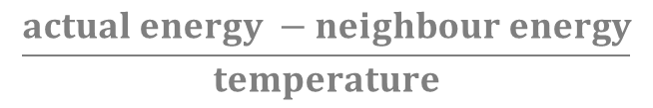
Simulated Annealing
$$\frac{actual energy −neighbour energy}{temperature}$$
e > random(0,1)
We check use the Metropolis-function to check whether the neighbour state is better
than our current solution (so the actual state) or not:
→ if the neighbor state is better then we accept it
→ if the neighbour state is not better: we may still accept it
based on the Mertopolis-function and the T temperature
HIGH TEMPERATURE MEANS WE ACCEPT BAD STATES
WITH HIGH PROBABILITY AS WELL

Slide 66
Simulated Annealing
1.) we set the initial T temperature and create a random initial solution
2.) we iterate until a stop condition is met – such as the system has
sufficiently cooled or an approximated solution has been found
3.) generate a neighbor – we can make a minor change to the actual
state or we can generate new states at random
4.) we decide whether to move to that neighbor state
with the help of the Metropolis-function
5.) decrease the T temperature + looping (repeate from step 2)

Slide 67
Simulated Annealing
there are several advantages of simulated annelaing
the initial state (starting point) does not influence much the final solution – unlike hill climbing algorithm

Slide 68
Genetic Algorithms (Artificial Intelligence)

Slide 69
Genetic Algorithms
what is the motivation behind genetic algorithms?
the problem with hill climbing algorithm is that it tends to converge to the local optimum (instead of the global optimum)
we want to avoid local optimums and find the global optimum

Slide 70
Genetic Algorithms
”Genetic algorithms are inspired by the process of natural selection - relying on biologically inspired operators such as mutation, crossover and selection”

Slide 71
Genetic Algorithms
genetic algorithms are search heuristics that mimic the process of natural selection
natural selection is the process through which species adapt to their environments – it is the engine that drives evolution
it generate solutions to optimization problems using techniques inspired by natural evolution such as mutation and crossover
a candidate solution is evolved toward better and better solutions
each candidate solution has a set of properties (genes) which can be mutated and altered
USUALLY THE SOLUTIONS ARE REPRESENTED IN BINARY

Slide 72
Genetic Algorithms
the evolution starts from a population of randomly generated individuals
it is an iterative process – the population in each iteration called a generation
in each generation the fitness of every individual in the population is evaluated with the fitness function
the fitness is usually the value of the cost function in the optimization problem being solved

Slide 73
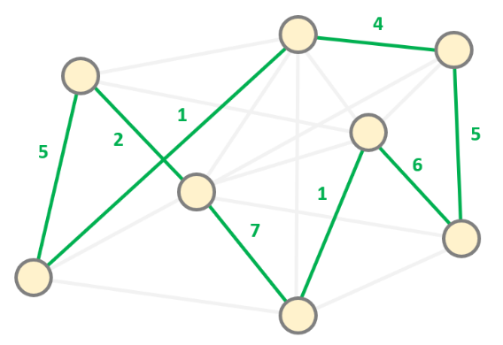
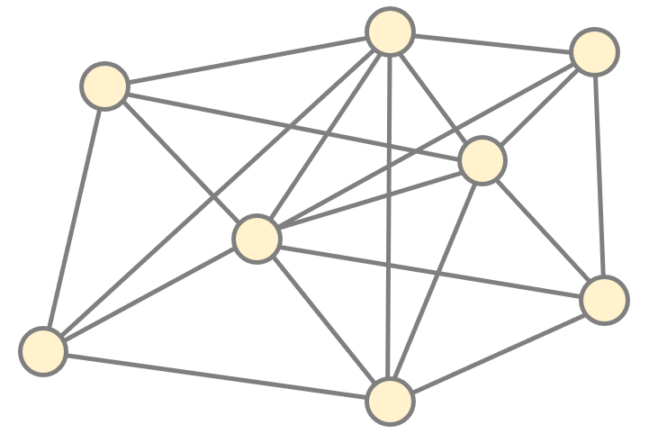
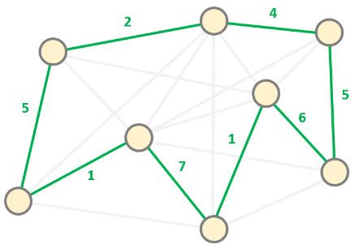
Genetic Algorithms
we can use the fitness
function to evaluate different
hamiltonian cycles
FITTEST INDIVIDUALS
HAVE LOWER COST FUNCTION
VALUES
this is the initial state
and we want to find
the hamiltonian cycle
with the lowest sum of
edge weights
TRAVELLING SALESMAN PROBLEM
after several iterations
(with mutations and crossovers)
we can find the
fittest individual

Slide 74
Genetic Algorithms
the more fit individuals are selected from the current populationa and each individual's genome is modified
recombined and possibly randomly mutated to form a new generation
the new generation of candidate solutions is then used in the next iteration
the algorithm terminates when either a maximum number of generations has been produced or a satisfactory fitness level has been reached for the population

Slide 75
Chromosome Representation
in order to use genetic algorithm – first we have to encode any potential solution
usually we use a string of integers or more often a binary bit string
at the beginning of the algorithm a large population of random chromosomes is created
each chromosome represent a different solution
the fitness function tells us how good that chromosome is

Slide 76
Chromosome Representation
this is not a good
representation of the states
we have to make sure the
individuals can be mutated easily
THIS IS WHY WE SHOULD USE BINARY STRINGS !!!
binary values can be
mutated easiy
(double can not)
f(x)
x
1.2 3 4.9 6 7.8 9 12.1

Slide 77
Chromosome Representation
this is not a good
representation of the states
we have to make sure the
individuals can be mutated easily
THIS IS WHY WE SHOULD USE BINARY STRINGS !!!
binary values can be
mutated easiy
(double can not)
f(x)
x
0001 0101 0110 1010 1110 1100 0100

Slide 78
Chromosome Representation
100011011010111011000001
100010011110100011011001
001000000111111111000000
111000100111000111010101

Slide 79
Chromosome Representation
100011011010111011000001
we represent every single
state with a so-called
chromosome
MULTIPLE CHROMOSOMES
FORM A POPULATION
100010011110100011011001
001000000111111111000000
111000100111000111010101

Slide 80
Chromosome Representation
100011011010111011000001
the popuation made
up of multiple individuals
we represent the individuals
with chromosomes
GENETIC ALGORITHMS
SELECT THE FITTEST CHROMOSOME AS THE SOLUTION
100010011110100011011001
001000000111111111000000
111000100111000111010101

Slide 81
Chromosome Representation
every chromosome
is made up of multiple genes
a gene can have the value
O or 1 (binary values)
MUTATION AND CROSSOVER
WILL CHANGE THE
GENES IN THE
CHROMOSOMES
100011011010111011000001
100010011110100011011001
001000000111111111000000
111000100111000111010101

Slide 82
Crossover
crossover (or recombination) is a genetic operator
the algorithm combines the genetic information (chromosome bits) of two parent (chromosomes) to generate a new offspring
new individuals are usually mutatated before being added to the populatiom

Slide 83
Crossover
we have two chromosomes
and we can use crossover
to mix the genes
we can generate an index
in the range [0, length]
and swap the bits
accordingly
MUTATION AND CROSSOVER
WILL CHANGE THE
GENES IN THE
CHROMOSOMES
1 0 0 1 0 1 0 1
PARENTS
0 0 0 1 1 0 0 0
CHILDREN

Slide 84
Crossover
we have two chromosomes
and we can use crossover
to mix the genes
we can generate an index
in the range [0, length]
and swap the bits
accordingly
MUTATION AND CROSSOVER
WILL CHANGE THE
GENES IN THE
CHROMOSOMES
1 0 0 1 0 1 0 1
PARENTS
0 0 0 1 1 0 0 0
CHILDREN

Slide 85
Crossover
we have two chromosomes
and we can use crossover
to mix the genes
we can generate an index
in the range [0, length]
and swap the bits
accordingly
MUTATION AND CROSSOVER
WILL CHANGE THE
GENES IN THE
CHROMOSOMES
1 0 0 1 0 1 0 1
PARENTS
0 0 0 1 1 0 0 0
1 0 0 1 0
0 0 0
CHILDREN
0 0 0 1 1
1 0 1

Slide 86
Crossover
another approach is to
mix the genes
of the parents at random
GENERATE A RANDOM VALUE
IN THE RANGE [0,1]
sometimes we take the
gene of the first parent
sometimes we take the gene
of the second parent
1 0 0 1 0 1 0 1
PARENTS
0 0 0 1 1 0 0 0
CHILD
0 0 0 1 0 1 0 0

Slide 87
Crossover
another approach is to
mix the genes
of the parents at random
GENERATE A RANDOM VALUE
IN THE RANGE [0,1]
sometimes we take the
gene of the first parent
sometimes we take the gene
of the second parent
1 0 0 1 0 1 0 1
PARENTS
0 0 0 1 1 0 0 0
CHILD
0 0 0 1 0 1 0 0

Slide 88
Crossover
another approach is to
mix the genes
of the parents at random
GENERATE A RANDOM VALUE
IN THE RANGE [0,1]
sometimes we take the
gene of the first parent
sometimes we take the gene
of the second parent
1 0 0 1 0 1 0 1
PARENTS
0 0 0 1 1 0 0 0
CHILD
0 0 0 1 0 1 0 0

Slide 89
Crossover
another approach is to
mix the genes
of the parents at random
GENERATE A RANDOM VALUE
IN THE RANGE [0,1]
sometimes we take the
gene of the first parent
sometimes we take the gene
of the second parent
1 0 0 1 0 1 0 1
PARENTS
0 0 0 1 1 0 0 0
CHILD
0 0 0 1 0 1 0 0

Slide 90
Crossover
another approach is to
mix the genes
of the parents at random
GENERATE A RANDOM VALUE
IN THE RANGE [0,1]
sometimes we take the
gene of the first parent
sometimes we take the gene
of the second parent
1 0 0 1 0 1 0 1
PARENTS
0 0 0 1 1 0 0 0
CHILD
0 0 0 1 0 1 0 0

Slide 91
Crossover
another approach is to
mix the genes
of the parents at random
GENERATE A RANDOM VALUE
IN THE RANGE [0,1]
sometimes we take the
gene of the first parent
sometimes we take the gene
of the second parent
1 0 0 1 0 1 0 1
PARENTS
0 0 0 1 1 0 0 0
CHILD
0 0 0 1 0 1 0 0

Slide 92
Crossover
another approach is to
mix the genes
of the parents at random
GENERATE A RANDOM VALUE
IN THE RANGE [0,1]
sometimes we take the
gene of the first parent
sometimes we take the gene
of the second parent
1 0 0 1 0 1 0 1
PARENTS
0 0 0 1 1 0 0 0
CHILD
0 0 0 1 0 1 0 0

Slide 93
Crossover
another approach is to
mix the genes
of the parents at random
GENERATE A RANDOM VALUE
IN THE RANGE [0,1]
sometimes we take the
gene of the first parent
sometimes we take the gene
of the second parent
1 0 0 1 0 1 0 1
PARENTS
0 0 0 1 1 0 0 0
CHILD
0 0 0 1 0 1 0 0

Slide 94
Crossover
another approach is to
mix the genes
of the parents at random
GENERATE A RANDOM VALUE
IN THE RANGE [0,1]
sometimes we take the
gene of the first parent
sometimes we take the gene
of the second parent
1 0 0 1 0 1 0 1
PARENTS
0 0 0 1 1 0 0 0
CHILD
0 0 0 1 0 1 0 0

Slide 95
Mutation
mutation is a genetic operator used to maintain genetic diversity from one generation of chromosomes to the next
we make mutations to the single chromosomes – usually after the crossover operation
the chromosomes represent the solutions so with mutations we can change the solution may entirely change

Slide 96
Mutation
Sometimes we have to
make mutations to the genes
(usually after crossover)
GENERATE A RANDOM VALUE
RANDOM(0,1)
flip the bit if the
random value > 0.5
otherwise we do not flip
0 0 0 1 1 0 0 0

Slide 97
Mutation
Sometimes we have to
make mutations to the genes
(usually after crossover)
GENERATE A RANDOM VALUE
RANDOM(0,1)
flip the bit if the
random value > 0.5
otherwise we do not flip
0 0 0 1 1 0 0 0

Slide 98
Mutation
Sometimes we have to
make mutations to the genes
(usually after crossover)
GENERATE A RANDOM VALUE
RANDOM(0,1)
flip the bit if the
random value > 0.5
otherwise we do not flip
0 0 0 1 1 0 0 0

Slide 99
Mutation
Sometimes we have to
make mutations to the genes
(usually after crossover)
GENERATE A RANDOM VALUE
RANDOM(0,1)
flip the bit if the
random value > 0.5
otherwise we do not flip
0 1 0 1 1 0 0 0

Slide 100
Mutation
Sometimes we have to
make mutations to the genes
(usually after crossover)
GENERATE A RANDOM VALUE
RANDOM(0,1)
flip the bit if the
random value > 0.5
otherwise we do not flip
0 1 0 1 1 0 0 0

Slide 101
Mutation
Sometimes we have to
make mutations to the genes
(usually after crossover)
GENERATE A RANDOM VALUE
RANDOM(0,1)
flip the bit if the
random value > 0.5
otherwise we do not flip
0 1 0 1 1 0 0 0

Slide 102
Mutation
Sometimes we have to
make mutations to the genes
(usually after crossover)
GENERATE A RANDOM VALUE
RANDOM(0,1)
flip the bit if the
random value > 0.5
otherwise we do not flip
0 1 0 1 1 0 0 0

Slide 103
Mutation
Sometimes we have to
make mutations to the genes
(usually after crossover)
GENERATE A RANDOM VALUE
RANDOM(0,1)
flip the bit if the
random value > 0.5
otherwise we do not flip
0 1 0 1 0 0 0 0

Slide 104
Mutation
Sometimes we have to
make mutations to the genes
(usually after crossover)
GENERATE A RANDOM VALUE
RANDOM(0,1)
flip the bit if the
random value > 0.5
otherwise we do not flip
0 1 0 1 0 0 0 0

Slide 105
Mutation
Sometimes we have to
make mutations to the genes
(usually after crossover)
GENERATE A RANDOM VALUE
RANDOM(0,1)
flip the bit if the
random value > 0.5
otherwise we do not flip
0 1 0 1 0 0 0 0

Slide 106
Mutation
Sometimes we have to
make mutations to the genes
(usually after crossover)
GENERATE A RANDOM VALUE
RANDOM(0,1)
flip the bit if the
random value > 0.5
otherwise we do not flip
0 1 0 1 0 0 1 0

Slide 107
Mutation
Sometimes we have to
make mutations to the genes
(usually after crossover)
GENERATE A RANDOM VALUE
RANDOM(0,1)
flip the bit if the
random value > 0.5
otherwise we do not flip
0 1 0 1 0 0 1 0

Slide 108
Mutation
Sometimes we have to
make mutations to the genes
(usually after crossover)
GENERATE A RANDOM VALUE
RANDOM(0,1)
flip the bit if the
random value > 0.5
otherwise we do not flip
0 1 0 1 0 0 1 1

Slide 109
Mutation
we can apply the so-called
swap mutation
2 RANDOM GENES
ARE GENERATED !!!
2 genes are randomly selected and
their values are swapped
0 0 0 1 1 0 0 0

Slide 110
Mutation
we can apply the so-called
swap mutation
2 RANDOM GENES
ARE GENERATED !!!
2 genes are randomly selected and
their values are swapped
0 0 0 1 1 0 0 0

Slide 111
Mutation
we can apply the so-called
swap mutation
2 RANDOM GENES
ARE GENERATED !!!
2 genes are randomly selected and
their values are swapped
0 1 0 1 0 0 0 0

Slide 112
Mutation
we can apply the so-called
swap mutation
2 RANDOM GENES
ARE GENERATED !!!
2 genes are randomly selected and
their values are swapped
0 1 0 1 0 0 0 0

Slide 113
Mutation
sometimes we have to
make mutations to the genes
(usually after crossover)
RANDOM SEQUENCE OF GENES
IS SELECTED !!!
the order of the genes in the
qequence is reversed
0 1 0 1 0 0 1 1

Slide 114
Mutation
sometimes we have to
make mutations to the genes
(usually after crossover)
RANDOM SEQUENCE OF GENES
IS SELECTED !!!
the order of the genes in the
qequence is reversed
0 1 0 1 0 0 1 1

Slide 115
Mutation
sometimes we have to
make mutations to the genes
(usually after crossover)
RANDOM SEQUENCE OF GENES
IS SELECTED !!!
the order of the genes in the
qequence is reversed
0 1 1 0 0 1 0 1

Slide 116
Mutation
sometimes we have to
make mutations to the genes
(usually after crossover)
RANDOM SEQUENCE OF GENES
IS SELECTED !!!
the order of the genes in the
qequence is reversed
0 1 1 0 0 1 0 1

Slide 117
Selection
selection is used at the beginning of each cycle of the genetic algorithm
this is when we select individuals from the actual population that will be used as parents in the next generation
THE SELECTION PROCESS IS PROBABILITY-BASED !!!
the higher the fitness value of an individual the higher the probability it will be selected for the next generation

Slide 118
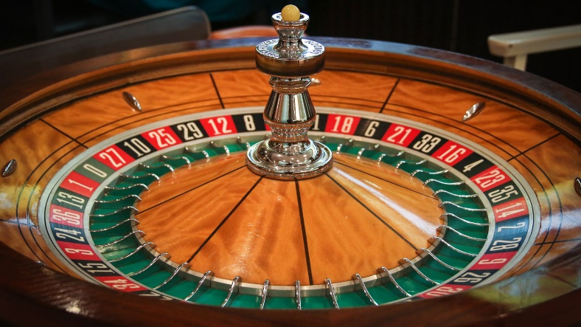
Selection
ROULETTE WHEEL SELECTION
→ during roulette wheel selection (or fitness proportionate selection) the probability of selecting an individual is directly
proportionate to its fitness value
→ it is like a roulette wheel in casinos when we assign each individual a portion of the wheel proportional to its fitness value

Slide 119
Selection
ROULETTE WHEEL SELECTION
INDIVIDUAL | FITNESS | RELATIVE PORTION
#1 | 8 | 18%
#2 | 19 | 42%
#3 | 12 | 27%
#4 | 6 | 13%

Slide 120
Selection
ROULETTE WHEEL SELECTION

Slide 121
Selection
ROULETTE WHEEL SELECTION
each time the wheel is turned
we use this selection point to select
an individual from the population
(as many turns as the number of
Individuals we want to select)

Slide 122
Selection
ROULETTE WHEEL SELECTION
each time the wheel is turned
we use this selection point to select
an individual from the population
(as many turns as the number of
Individuals we want to select)

Slide 123
Selection
TOURNAMENT SELECTION
→ in each round of the tournament selection method two or more individuals are randomly picked from the population
→ of course the one with the highest fitness score wins and gets selected
(we make as many iterations as the number of indivudals needed)

Slide 124
Selection
TOURNAMENT SELECTION
INDIVIDUAL | FITNESS
#1 | 8
#2 | 19
#3 | 12
#4 | 6
#5 | 22
#6 | 15

Slide 125
Selection
TOURNAMENT SELECTION
INDIVIDUAL | FITNESS
#1 | 8
#2 | 19
#3 | 12
#4 | 6
#5 | 22
#6 | 15

Slide 126
Selection
TOURNAMENT SELECTION
INDIVIDUAL | FITNESS
#1 | 8
#2 | 19
#3 | 12
#4 | 6
#5 | 22
#6 | 15

Slide 127
Selection
TOURNAMENT SELECTION
INDIVIDUAL | FITNESS
#1 | 8
#2 | 19
#3 | 12
#4 | 6
#5 | 22
#6 | 15

Slide 128
Selection
TOURNAMENT SELECTION
INDIVIDUAL | FITNESS
#1 | 8
#2 | 19
#3 | 12
#4 | 6
#5 | 22
#6 | 15

Slide 129
Selection
TOURNAMENT SELECTION
INDIVIDUAL | FITNESS
#1 | 8
#2 | 19
#3 | 12
#4 | 6
#5 | 22
#6 | 15

Slide 130
Selection
TOURNAMENT SELECTION
INDIVIDUAL | FITNESS
#1 | 8
#2 | 19
#3 | 12
#4 | 6
#5 | 22
#6 | 15

Slide 131
Crossover and Mutation
Crossover an mutation perform two different roles in genetic algorithms
→ crossover is an operation which drive the population
towards a local maximum (or minimum)
If we use only crossover it will yield approximately the same
result as hill-climbing algorithm !!!
→ mutation it is a so-called divergence operation
Force one or more indivudals of the population to discover
other regions of the search space
So it is essential in order to find the global optimum !!!
Crossover is a more frequent operation than mutation
+ mutation only affects few members of the population

Slide 132
Algorithm
1.) first have to encode the possible solutions as a string of bits
So we have to construct the chromosomes for the problem
2.) have to define a fitness function – of course better solutions have a higher fitness value (this is how we can compare chromosomes)
3.) while the solution is not found
→ select a random sub-population
→ perform crossovers and mutation operations
→ calculate fitness of the sub-population and
store the best individual so far

Slide 133
Advantages of Genetic Algorithms
applying genetic algorithms to a new problem is very simple
we just have to define a new fitness function best suited to the new problem
it will not often get stuck in a local optimum because the crossover and mutation processes produce radically different chromosomes
„survival of the fittest” principle is quite effective
it scales well even in high dimensions !!!!

Slide 134
Elitism (Artificial Intelligence)

Slide 135
Elitism
100011011010111011000001
we represent every single
state with a so-called
chromosome
MULTIPLE CHROMOSOMES
FORM A POPULATION
100010011110100011011001
001000000111111111000000
111000100111000111010101

Slide 136
Elitism
TOURNAMENT SELECTION
INDIVIDUAL | FITNESS
#1 | 8
#2 | 19
#3 | 12
#4 | 6
#5 | 22
#6 | 15

Slide 137
Elitism
TOURNAMENT SELECTION
INDIVIDUAL | FITNESS
#1 | 8
#2 | 19
#3 | 12
#4 | 6
#5 | 22
#6 | 15

Slide 138
Elitism
TOURNAMENT SELECTION
INDIVIDUAL | FITNESS
#1 | 8
#2 | 19
#3 | 12
#4 | 6
#5 | 22
#6 | 15

Slide 139
Elitism
it may happen that we select individuals with smaller fitness values in the next iteration (next generation)
SO THE OVERALL FITNESS MAY DECREASE DURING THE ALGORITHM
this is why elitism came to be when we make sure the overall fitness does not decrease
we always save the top N indivuduals (with highest fitness values) to the next generation

Slide 140
Elitism
100011011010111011000001
100010011110100011011001
001000000111111111000000
111000100111000111010101
100110011010111001000001
100011111110100011000001
001000000111111111000111
111111100111000111011111
ACTUAL GENERATION

Slide 141
Elitism
100011011010111011000001
100010011110100011011001
001000000111111111000000
111000100111000111010101
100110011010111001000001
100011111110100011000001
001000000111111111000111
111111100111000111011111
ACTUAL GENERATION
NEXT GENERATION

Slide 142
Elitism
100011011010111011000001
100011011010111011000001
100010011110100011011001
100110011010111001000001
001000000111111111000000
111111100111000111011111
111000100111000111010101
100110011010111001000001
100011111110100011000001
001000000111111111000111
111111100111000111011111
ACTUAL GENERATION
NEXT GENERATION

Slide 143
N Queens Problem (Artificial Intelligence)

Slide 144

N Queens Problem
we need random states for genetic algorithms
let’s put the N queens on the chessboard at random
of course we need to define a fitness() function to be able to compare the given states
WE CAN MEASURE THE NUMBER OF COLLISIONS !!!

Slide 145
N Queens Problem
we need random states for genetic algorithms
let’s put the N queens on the chessboard at random
of course we need to define a fitness() function to be able to compare the given states
WE CAN MEASURE THE NUMBER OF COLLISIONS !!!

Slide 146
N Queens Problem
we need random states for genetic algorithms
let’s put the N queens on the chessboard at random
of course we need to define a fitness() function to be able to compare the given states
WE CAN MEASURE THE NUMBER OF COLLISIONS !!!

Slide 147
N Queens Problem
we need random states for genetic algorithms
let’s put the N queens on the chessboard at random
of course we need to define a fitness() function to be able to compare the given states
WE CAN MEASURE THE NUMBER OF COLLISIONS !!!

Slide 148
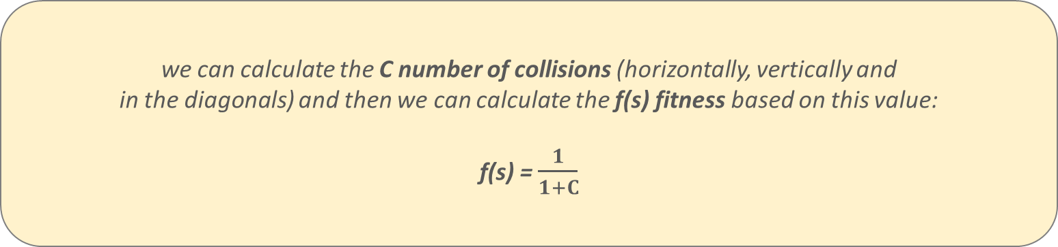
N Queens Problem
we need random states for genetic algorithms
let’s put the N queens on the chessboard at random
of course we need to define a fitness() function to be able to compare the given states
WE CAN MEASURE THE NUMBER OF COLLISIONS !!!
we can calculate the C number of collisions (horizontally, vertically and
in the diagonals) and then we can calculate the f(s) fitness based on this value:
f(s) = $\frac{1}{1+C}$

Slide 149


N Queens Problem
# COLLISIONS: 6
FITNESS:
# COLLISIONS: 10
FITNESS:
$$\frac{1}{7}$$
$$\frac{1}{11}$$

Slide 150
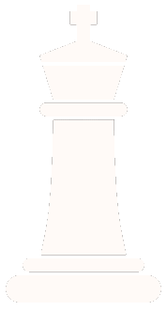

N Queens Problem
this state is better because
it has a higher fitness value
(so genetic algorithm prefer
this state during the iterations)
# COLLISIONS: 6
FITNESS:
# COLLISIONS: 10
FITNESS:
$$\frac{1}{7}$$
$$\frac{1}{11}$$

Slide 151
Knapsack Problem (Artificial Intelligence)

Slide 152
Knapsack Problem
it is a combinatorial optimization related problem
given a set of n items – usually numbered from 1 to n
each of these item has a mass w_{i} and a value v_{i}
determine the number of each item to include in a collection so that the total weight M is less than or equal to a given limit and the total value is as large as possible
the problem often arises in resource allocation where there are financial constraints

Slide 153
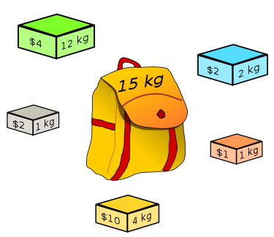
Knapsack Problem

Slide 154
Knapsack Problem
knapsack problem has several applications of course
finding the least wasteful way to cut raw materials
selection of investments and portfolios
selection of assets for asset-backed securitization
construction and scoring of tests in which the test-takers have a choice as to which questions they answer

Slide 155
Knapsack Problem
DIVISIBLE KNAPSACK PROBLEM
(we can take fractions of the
given items – fast algorithm)
0-1 KNAPSACK PROBLEM
(either we take a given item
or do not take – complex solution)

Slide 156
Divisible Knapsack Problem
if we can take fractions of the given items then the greedy approach can be used
sort the items according to their values - can be done in O(NlogN)
start with the item that is the most valuable and take as much as possible – starting with highest v_{i} item
than try with the next item from our sorted list – we make a linear search in O(N) time complexity
overall running time is O(NlogN) + O(N) = O(NlogN)
so we can solve the divisible knapsack problem quite fast

Slide 157
0-1 Knapsack Problem
in this case we are not able to take fractions - we have to decide whether to take an item (x=1) or not (x=0)
the greedy algorithm will not provide the optimal result
another approach would be to sort by cost per unit weight and include from highest on down until knapsack is full but again not a good solution
how many possible solutions are there with N items? The brute-force approach has O(2^{N}) exponential running time
we should use dynamic programming instead

Slide 158
0-1 Knapsack Problem
solves larger problem by relating it to overlapping subproblems and then solves the subproblems
it works through the exponential set of solutions, but does not examine them all explicitly
stores intermediate results so that they are not recomputed – this is called memoization
solution to original problem is easily computed from the solutions to the subproblems

Slide 159
0-1 Knapsack Problem
W₁ = 5kg
x₁ v₁ = $10
W₂ = 7kg
x₂ v₂ = $13
W₃ = 9kg
x₃ v₃ = $19
KNAPSACK
M = 10 kg
W₄ = 2kg
x₄ v₄ = $4

Slide 160
0-1 Knapsack Problem
W₁ = 5kg
x₁ v₁ = $10
W₂ = 7kg
x₂ v₂ = $13
W₄ = 2kg
W₃ = 9kg
x₃ v₃ = $19
KNAPSACK
M = 10 kg
x₄ v₄ = $4

Slide 161
0-1 Knapsack Problem
x₁ v₁ = $10
W₄ = 2kg
W₂ = 7kg
x₂ v₂ = $13
W₁ = 5kg
W₃ = 9kg
x₃ v₃ = $19
KNAPSACK
M = 10 kg
x₄ v₄ = $4

Slide 162
0-1 Knapsack Problem
W₁ = 5kg
x₁ v₁ = $10
W₂ = 7kg
x₂ v₂ = $13
W₃ = 9kg
x₃ v₃ = $19
KNAPSACK
M = 10 kg
W₄ = 2kg
x₄ v₄ = $4

Slide 163
0-1 Knapsack Problem
W₁ = 5kg
x₁ v₁ = $10
W₄ = 2kg
x₂ v₂ = $13
W₂ = 7kg
W₃ = 9kg
x₃ v₃ = $19
KNAPSACK
M = 10 kg
x₄ v₄ = $4

Slide 164
0-1 Knapsack Problem
W₁ = 5kg
x₁ v₁ = $10
W₂ = 7kg
x₂ v₂ = $13
W₃ = 9kg
x₃ v₃ = $19
KNAPSACK
M = 10 kg
W₄ = 2kg
x₄ v₄ = $4

Slide 165
0-1 Knapsack Problem
W₁ = 5kg
x₁ v₁ = $10
W₂ = 7kg
x₂ v₂ = $13
W₃ = 9kg
x₃ v₃ = $19
KNAPSACK
M = 10 kg
W₄ = 2kg
x₄ v₄ = $4

Slide 166
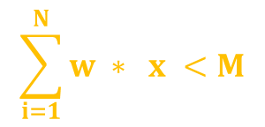
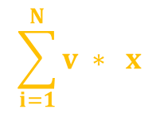
0-1 Knapsack Problem
x_{i} whether we take item i or not (1 or 0 accordingly)
v_{i} value of the i-th item
w_{i} weight of the i-th item
M maximum capacity of knapsack
-------------------------------------------------------------------------------------
$$\sum_{i=1}^{N}{v ∗ x}$$
$$\sum_{i=1}^{N}{w ∗ x <M}$$
maximize
subject to
i
i
i
i

Slide 167
0-1 Knapsack Problem
we have to define subproblems: we have N items so we have to make N decisions whether to take the item with given index or not
subproblems: the solution considering every possible combination of remaining items and remaining weight
S[i][w] the solution to the subproblem corresponding to the first i items and available weight w
S[i][w] is the maximum cost of items that fit inside a knapsack of size (weight) w, choosing from the first i items
we have to decide whether to take the item or not

Slide 168
0-1 Knapsack Problem
If we consider all subsets of the items – there may be 2 cases:
1.) the given item is included in the solution (optimal subset)
2.) the given item is not included
So the maximum value (solution) can be reduced to smaller and
smaller subproblems – and these subproblems overlap
1.) the i-th item is not included which means that the max value is
obtained by the previous N-1 items (and M total weights)
2.) the i-th item is included – max value is v_{i} plus the values obtained
by the previous N-1 items (and M-w_{i} total weights)

Slide 169
0-1 Knapsack Problem
S[i][w] = Math.max( S[i-1][w] ; v_{i} + S[i-1][w-w_{i}] )
the maximum profit that fit inside
a knapsack of weight w,
choosing from the first i items
do not take
i-th item
we take
i-th item
we have to use this S[][] two-dimensional array (list)
we are only considering S[i-1][w-w_{i}] if it can fit w > w_{i}
if there is not room for it: the answer is just S[i-1][w] !!!

Slide 170
0-1 Knapsack Problem
running time of Knapsack: O(nM)
but it is not polynomial – it is so-called pseudo-polynomial
numeric algorithm runs in pseudo-polynomial time if its running time is polynomial in the numeric value of the input - but is exponential in the length of the input (so the number of bits required to represent it )

Slide 171
Advantages and Limitations of Genetic Algorithms (Artificial Intelligence)

Slide 172
Genetic Algorithms
f(x)
gradient-based approaches are prone to
getting stuck in a local maximum rather
than finding the global one
GENETIC ALGOITHMS ARE LESS SENSITIVE TO THIS PHENOMENON !!!
we have to maintain the diversity of
the population and avoid
premature convergence
x

Slide 173
Advantages of Genetic Algorithms
there is no need to understand the complex mathematical background for the given problems (we just need to implement the fitness function and the problem represenation)

Slide 174
Advantages of Genetic Algorithms
there is no need to understand the complex mathematical background for the given problems (we just need to implement the fitness function and the problem represenation)
genetic algorithms are resilient to noise thanks to the repetitive operation of re-assembling and re-evaluating the individuals

Slide 175
Advantages of Genetic Algorithms
there is no need to understand the complex mathematical background for the given problems (we just need to implement the fitness function and the problem represenation)
genetic algorithms are resilient to noise thanks to the repetitive operation of re-assembling and re-evaluating the individuals
fitness is calculated independently for each individual – we can execute most of the operation in parallel

Slide 176
Limitations of Genetic Algorithms
finding suitable representation of the problem (and designing the fitness function) is not always an easy task

Slide 177
Limitations of Genetic Algorithms
finding suitable representation of the problem (and designing the fitness function) is not always an easy task
there are several parameters for the algorithm we have to tune such as population size, corssover rate, mutation rate etc.

Slide 178
Limitations of Genetic Algorithms
finding suitable representation of the problem (and designing the fitness function) is not always an easy task
there are several parameters for the algorithm we have to tune such as population size, corssover rate, mutation rate etc.
sometimes a single individual (because of the high fitness) takes over the entire population that can lead to the genetic algorithm getting prematurely stuck in a local maximum

Slide 179
Swarm Intelligence (Artificial Intelligence)

Slide 180
Swarm Intelligence
swarm intelligence is the collective behavior of decentralized and self-organized systems
it was first introduced by Gerardo Beni and Jing Wang back in 1989
the inspiration comes from nature and biological systems

Slide 181
Swarm Intelligence
the independent agents (birds)
follow very simple rules
without a centralized
control system
INTERACTIONS BETWEEN ENTITIES
LIKE THESE MAY LEAD TO EMERGENCE
OF INTELLIGENCE
they make local interactions with
each other and globally they
act quite intelligently

Slide 182
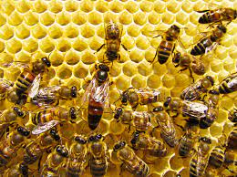
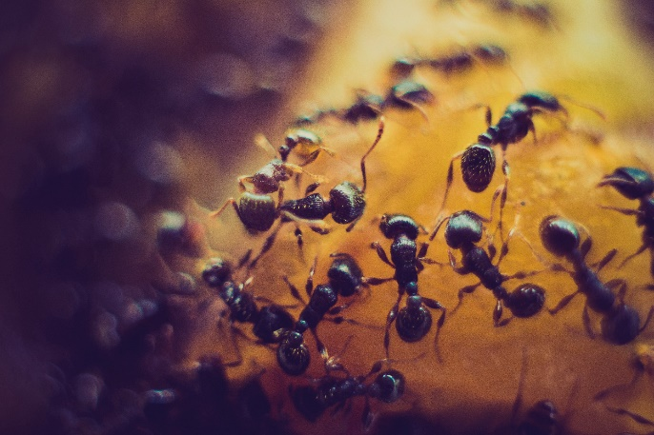
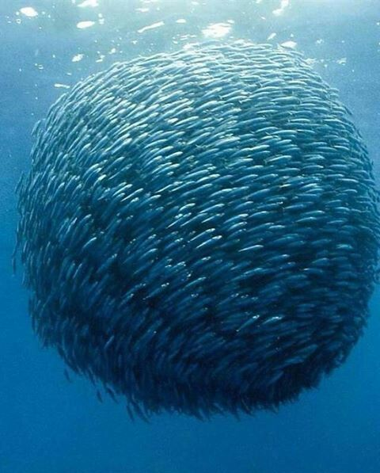
Swarm Intelligence
ANT COLONIES can optimize
routes and shortest paths
(ant colony optimization)
BEE COLONIES can find the
location of their nest in
an extremely
efficient manner
FISH SCHOOLING
swarm of fish is another
example for swarm intelligence

Slide 183
Swarm Intelligence
The typical swarm intelligence systems have the following properties:
there are several components (agents or individuals) in the system
the individuals are quite similar (homoegenous) to each other – usually there are all identical
individuals exploit local information exclusively
overall behaviour of the system results from the interactions of individuals with each other and with their environment

Slide 184
Complexity Theory
our universe is full of complex phenomena – but how does this complexity arise?
if we have a system with a large number of independent individuals that perform local interactions with each other
we may get an extremely complex system
THIS IS CALLED EMERGENCE

Slide 185
Complexity Theory
Game of Life is a simple
simulation created by
John Conway back in 1970
EXAMPLE FOR EMERGENCE
AND COMPLEXITY
a huge number of agents (cells) and
rather simple rules can
lead to extremely complex
patterns and structures

Slide 186
Particle Swarm Optimization (Artificial Intelligence)

Slide 187
Particle Swarm Optimization
the aim is to find the
global maximum
of an f(x) cost-function
OPTIMIZATION IS EXTREMELY EXPENSIVE IN HIGER DIMENSIONS !!!
it is reltively easy in lower dimensions
but what if we are dealing
with > 100 dimensions?
f(x)
x

Slide 188
Particle Swarm Optimization
particle swarm optimization is method that optimizes a problem by iteratively trying to improve a candidate solution with regard to a given measure of quality
we will define several parameters such as x position and v velocity of a given particle
there are other swarm intelligence algorithms such as ant colony optimization or bee colony optimization

Slide 189
Particle Swarm Optimization
swarm intelligence is the collective behavior of decentralized, self-organized systems
the inspiration often comes from biological systems
consists typically of a population of simple agents such as particles
agents are interacting locally with one another and with their environment as well
the agents follow very simple rules that can lead to the emergence of intelligent global behavior unknown to the individual agents

Slide 190
Particle Swarm Optimization
create artificial particles and move them around the search-space
(we can change the particles’ x positions and v velocities)
- every particle is influenced by its (usually) local optimum -

Slide 191
Particle Swarm Optimization
create artificial particles and move them around the search-space
(we can change the particles’ x positions and v velocities)
- every particle is influenced by its (usually) local optimum -
each particle is guided toward the best known positions in the search-space which are updated as better positions are
found by other particles (move swarm toward the best solution)

Slide 192
Particle Swarm Optimization
create artificial particles and move them around the search-space
(we can change the particles’ x positions and v velocities)
- every particle is influenced by its (usually) local optimum -
each particle is guided toward the best known positions in the search-space which are updated as better positions are
found by other particles (move swarm toward the best solution)
we do not need the gradient of the cost-function to find
the optimum (minimum or maximum location)

Slide 193
Particle Swarm Optimization (Artificial Intelligence)

Slide 194

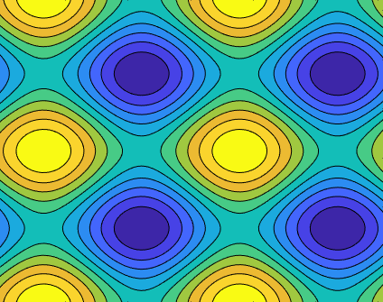
Particle Swarm Optimization
the aim is to find the
global maximum
of an f(x) : R^{n} cost-function
WE CREATE SEVERAL ARTIFICIAL PARTICLES !!!
we have to track the x locations
and the v velocities of the particles

Slide 195
Particle Swarm Optimization
S – number of particles in the swarm

Slide 196
Particle Swarm Optimization
S – number of particles in the swarm
x_{i} – location (position) of particle i

Slide 197
Particle Swarm Optimization
S – number of particles in the swarm
x_{i} – location (position) of particle i
v_{i} – velocity of particle i

Slide 198
Particle Swarm Optimization
S – number of particles in the swarm
x_{i} – location (position) of particle i
v_{i} – velocity of particle i
p_{i} – best know position of particle i

Slide 199
Particle Swarm Optimization
S – number of particles in the swarm
x_{i} – location (position) of particle i
v_{i} – velocity of particle i
p_{i} – best know position of particle i
g – best know position of entire swarm

Slide 200
Particle Swarm Optimization
for every particle i=1 , 2 ... S:
initialize the x_{i} position for every particle
initialize the v_{i} velocity for every particle
initialize the particle best known position p_{i} ← x_{i}
update best position of the swarm
if f(p_{i}) < f(g)
g ← p_{i}

Slide 201
Particle Swarm Optimization
first we have to update the v velocity values
such that we have to consider all the i=1 ... S particles
and we have to consider all the d = 1 ... n dimensions
v_{i,d} ← w * v_{i,d} + c₁ * r_{p} ( p_{i,d} - x_{i,d} ) + c₂ * r_{g} ( g_{d} – x_{i,d} )
and then we have to update the x locations
or positions based on the v velocity values
x_{i} ← x_{i} + v_{i}

Slide 202
Particle Swarm Optimization
c₂ is the global weight that defines the
tendency to move towards the
neighborhood's best previous position
THIS IS THE SO-CALLED REPELLENT
the w inertia weight define the
memory of the system – how significant
is the last step
v_{i,d} ← w * v_{i,d} + c₁ * r_{p} ( p_{i,d} - x_{i,d} ) + c₂ * r_{g} ( g_{d} – x_{i,d} )
c₁ is the local weight that defines the tendency to return
to the particle’s best previous position
THIS IS THE SO-CALLED ATTRACTOR

Slide 203
Particle Swarm Optimization
v_{i,d} ← w * v_{i,d} + c₁ * r_{p} ( p_{i,d} - x_{i,d} ) + c₂ * r_{g} ( g_{d} – x_{i,d} )
it controls how to
deal with the local
neighborhood

Slide 204
Particle Swarm Optimization
it controls how to
deal with the global
neighborhood
v_{i,d} ← w * v_{i,d} + c₁ * r_{p} ( p_{i,d} - x_{i,d} ) + c₂ * r_{g} ( g_{d} – x_{i,d} )

Slide 205
Particle Swarm Optimization
if w inertia weight is small then local search is dominant while the algorithm does a global search with high w values
c₁ is called the cognitive weight (or local weight) as it controls how to handle the local values and optimums
c₂ is called the social weight (or global weight) as it controls how to handle the global values and optimums

Slide 206
Particle Swarm Intelligence Visualization (Artificial Intelligence)

Slide 207
Particle Swarm Optimization
x₂
global
best location
actual particle’s
best location
actual particle
p_{i} and v_{i}
x₁

Slide 208
Particle Swarm Optimization
x₂
global
best location
actual particle’s
best location
actual particle
p_{i} and v_{i}
x₁

Slide 209
Particle Swarm Optimization
x₂
global
best location
actual particle’s
best location
actual particle
p_{i} and v_{i}
x₁

Slide 210
Particle Swarm Optimization
x₂
global
best location
actual particle’s
best location
actual particle
p_{i} and v_{i}
x₁

Slide 211
Particle Swarm Optimization
x₂
global
best location
actual particle
p_{i} and v_{i}
actual particle’s
best location
x₁

Slide 212
Particle Swarm Optimization
x₂
WHY TO USE RANDOM VALUES?
because this is how we make sure the length of these vectors are random
(sometimes the particle’s best position is the dominating factor, sometimes the global best position is dominating but there are cases when we do not care about the best locations)
global
best location
actual particle
p_{i} and v_{i}
actual particle’s
best location
x₁

Slide 213
Particle Swarm Optimization
the w inertia weight controls
exploration and exploitation trade-off
v_{i,d} ← w * v_{i,d} + c₁ * r_{p} ( p_{i,d} - x_{i,d} ) + c₂ * r_{g} ( g_{d} – x_{i,d} )
w is large: this is called exploration. The particles scan the whole search space
and looking for new states (in order to find the best one)
w is small: this is called exploitation. The particles scan the states near to the global best location
so they exploit the information available at the moment
(the algorithm converges faster but maybe it misses the global optimum)

Slide 214
Particle Swarm Optimization
the w inertia weight controls
exploration and exploitation trade-off
EXPLORATION AND EXPLOITATION TRADE-OFF
because both of the approaches are essential this is why the best approach is to start
with high w values and decrease the value of w during the algorithm !!!
v_{i,d} ← w * v_{i,d} + c₁ * r_{p} ( p_{i,d} - x_{i,d} ) + c₂ * r_{g} ( g_{d} – x_{i,d} )
w is large: this is called exploration. The particles scan the whole search space
and looking for new states (in order to find the best one)
w is small: this is called exploitation. The particles scan the states near to the global best location
so they exploit the information available at the moment
(the algorithm converges faster but maybe it misses the global optimum)

Slide 215
Ant Colony Optimization (Artificial Intelligence)

Slide 216
Ant Colony Optimization
x₂
global
best location
actual particle
p_{i} and v_{i}
actual particle’s
best location
x₁

Slide 217
Game Trees (Artificial Intelligence)

Slide 218
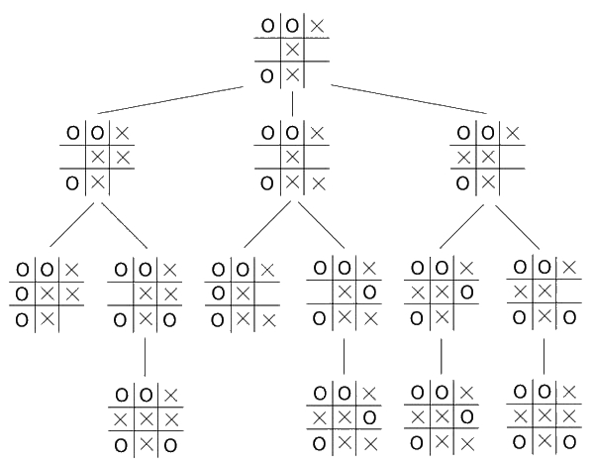
Game Trees
it is a directed G(V,E) graph that represents the game – the complete game tree include every possible outcomes
the V nodes are the positions in the game and the E edges are the moves

Slide 219
Game Trees
it is a directed G(V,E) graph that represents the game – the complete game tree include every possible outcomes
the V nodes are the positions in the game and the E edges are the moves
OUR TURN

Slide 220
Game Trees
it is a directed G(V,E) graph that represents the game – the complete game tree include every possible outcomes
the V nodes are the positions in the game and the E edges are the moves
COMPUTER’S TURN

Slide 221
Game Trees
it is a directed G(V,E) graph that represents the game – the complete game tree include every possible outcomes
the V nodes are the positions in the game and the E edges are the moves
OUR TURN

Slide 222
Game Trees
it is a directed G(V,E) graph that represents the game – the complete game tree include every possible outcomes
the V nodes are the positions in the game and the E edges are the moves
COMPUTER’S TURN

Slide 223
Game Trees
it is a directed G(V,E) graph that represents the game – the complete game tree include every possible outcomes
the V nodes are the positions in the game and the E edges are the moves
usually it is impossible to build the whole game tree because there are a huge number of possible states – the tree can get large with only a few moves
for large games such as chess the algorithm is forced to estimate who is winning or losing by sampling just a small portion of the entire tree
so we just construct the first few levels of the tree and have a guess with the help of a heuristic function

Slide 224
Game Trees
games are important in artificial intelligence
if we want to get the best move in a game then we have to construct an effective search algorithm that will scan the game tree
an important approach is called minimax algorithm that is essentially a depth-first search

Slide 225
Game Trees
the root node of the G(V,E)
game tree is the initial state

Slide 226
Game Trees
X
X
X
X
X
X
X
X
X

Slide 227
Game Trees
X
X
X
X
X
X
X
X
X
O
O
O
X
X
X
O
X
O
X
X
X
X
O
O
O

Slide 228
Game Trees
we know that games are important in artificial intelligence and that we can scan the game tree to find the optimal next step
but how to find out the complexity of a given game?
we can measure the complexity of a game with the size of the constructed G(V,E) game tree

Slide 229
Game Trees
– TIC TAC TOE –
255 000 leaf nodes

Slide 230
Game Trees
– TIC TAC TOE –
255 000 leaf nodes
– CHESS –
10¹²⁰ leaf nodes

Slide 231
Minimax Algorithm (Artificial Intelligence)

Slide 232
Minimax Algorithm
minimax is a decision rule in decision theory and game theory
the minimax algorithm is used for minimizing the possible loss for a maximum loss scenario
the algorithm has the assumption that both players will play to the best of their ability

Slide 233
Minimax Algorithm
minimax is a decision rule in decision theory and game theory
the minimax algorithm is used for minimizing the possible loss for a maximum loss scenario
the algorithm has the assumption that both players will play to the best of their ability
– MAX –
we would like to maximize our probability of winning

Slide 234
Minimax Algorithm
minimax is a decision rule in decision theory and game theory
the minimax algorithm is used for minimizing the possible loss for a maximum loss scenario
the algorithm has the assumption that both players will play to the best of their ability
– MAX –
we would like to maximize our probability of winning
– MIN –
we want to minimize the other player’s probability of winning

Slide 235
Minimax Algorithm
minimax algorithm is a recursive algorithm for choosing the next move in a game
a value is associated with each leaf nodes (terminal nodes) of the game – of course leaf nodes represent complete games
complete game mean that either we or the opponent win
we construct a tree like structure with as many branches as the number of possible outcomes

Slide 236
Minimax Algorithm
minimax algorithm is a
recursive algorithm for choosing the
next move in a game
a value is associated with each position
or state of the game
+1 win situation
0 neutral situation
-1 lose situation
we construct a tree like structure
with as many branches as the number
of possible outcomes

Slide 237
Minimax Algorithm
minimax algorithm is a
recursive algorithm for choosing the
next move in a game
a value is associated with each position
or state of the game
+1 win situation
0 neutral situation
-1 lose situation
we construct a tree like structure
with as many branches as the number
of possible outcomes
+1
-1
0
+1
-1
0
+1

Slide 238
Minimax Algorithm
for small games we can construct the full tree at the beginning – there are only 9! different scenarios for Tic Tac Toe
but for chess it would be impossible because of the enormous number of different scenarios (state space)
we have to use heuristics
for example IBM’s Deep Blue looked ahead at least 12 plies then applied a heuristic evaluation function
this function predicts whether that situation is a +1 win situation or 0 neutral situation or -1 lose situation

Slide 239
Minimax Algorithm (Artificial Intelligence)

Slide 240
Minimax Algorithm
-1
1
-1
0
1
-1
1
0
0
-1

Slide 241
Minimax Algorithm
COMPUTER’S MOVE
-1
1
-1
0
1
-1
1
0
0
-1

Slide 242
Minimax Algorithm
PLAYER’S MOVE
-1
1
-1
0
1
-1
1
0
0
-1

Slide 243
Minimax Algorithm
COMPUTER’S MOVE
-1
1
-1
0
1
-1
1
0
0
-1

Slide 244
Minimax Algorithm
MAXIMIZE
-1
1
-1
0
1
-1
1
0
0
-1

Slide 245
Minimax Algorithm
MINIMIZE
-1
1
-1
0
1
-1
1
0
0
-1

Slide 246
Minimax Algorithm
MAXIMIZE
-1
1
-1
0
1
-1
1
0
0
-1

Slide 247
Minimax Algorithm
-1
1
-1
0
1
-1
1
0
0
-1
MINIMIZE

Slide 248
Minimax Algorithm
-1
1
-1
0
1
-1
1
0
0
-1

Slide 249
Minimax Algorithm
-1
1
-1
0
1
-1
1
0
0
-1

Slide 250
Minimax Algorithm
-1
1
-1
0
1
-1
1
0
0
-1

Slide 251
Minimax Algorithm
-1
1
-1
0
1
-1
1
0
0
-1

Slide 252
Minimax Algorithm
-1
1
-1
0
1
-1
1
0
0
-1

Slide 253
Minimax Algorithm
-1
1
-1
0
1
-1
1
0
0
-1

Slide 254
Minimax Algorithm
-1
1
-1
0
1
-1
1
0
0
-1

Slide 255
Minimax Algorithm
-1
1
-1
0
1
-1
1
0
0
-1

Slide 256
Minimax Algorithm
-1
1
-1
0
1
-1
1
0
0
-1

Slide 257
Minimax Algorithm
-1
1
-1
0
1
-1
1
0
0
-1

Slide 258
Minimax Algorithm
1
-1
1
-1
0
1
-1
1
0
0
-1

Slide 259
Minimax Algorithm
1
-1
1
-1
0
1
-1
1
0
0
-1

Slide 260
Minimax Algorithm
1
-1
1
-1
0
1
-1
1
0
0
-1

Slide 261
Minimax Algorithm
1
-1
1
-1
0
1
-1
1
0
0
-1

Slide 262
Minimax Algorithm
1
-1
1
-1
0
1
-1
1
0
0
-1

Slide 263
Minimax Algorithm
1
-1
1
-1
0
1
-1
1
0
0
-1

Slide 264
Minimax Algorithm
1
-1
1
-1
0
1
-1
1
0
0
-1

Slide 265
Minimax Algorithm
1
-1
1
-1
0
1
-1
1
0
0
-1

Slide 266
Minimax Algorithm
1
-1
1
-1
0
1
-1
1
0
0
-1

Slide 267
Minimax Algorithm
1
0
-1
1
-1
0
1
-1
1
0
0
-1

Slide 268
Minimax Algorithm
1
0
-1
1
-1
0
1
-1
1
0
0
-1

Slide 269
Minimax Algorithm
0
1
0
-1
1
-1
0
1
-1
1
0
0
-1

Slide 270
Minimax Algorithm
0
1
0
-1
1
-1
0
1
-1
1
0
0
-1

Slide 271
Minimax Algorithm
0
1
0
-1
1
-1
0
1
-1
1
0
0
-1

Slide 272
Minimax Algorithm
0
1
0
-1
1
-1
0
1
-1
1
0
0
-1

Slide 273
Minimax Algorithm
0
1
0
-1
1
-1
0
1
-1
1
0
0
-1

Slide 274
Minimax Algorithm
0
1
0
-1
1
-1
0
1
-1
1
0
0
-1

Slide 275
Minimax Algorithm
0
1
0
-1
1
-1
0
1
-1
1
0
0
-1

Slide 276
Minimax Algorithm
0
1
0
-1
1
-1
0
1
-1
1
0
0
-1

Slide 277
Minimax Algorithm
0
1
0
-1
1
-1
0
1
-1
1
0
0
-1

Slide 278
Minimax Algorithm
0
1
0
-1
1
-1
0
1
-1
1
0
0
-1

Slide 279
Minimax Algorithm
0
1
0
-1
1
-1
0
1
-1
1
0
0
-1

Slide 280
Minimax Algorithm
0
1
0
1
-1
1
-1
0
1
-1
1
0
0
-1

Slide 281
Minimax Algorithm
0
1
0
1
-1
1
-1
0
1
-1
1
0
0
-1

Slide 282
Minimax Algorithm
0
1
1
0
1
-1
1
-1
0
1
-1
1
0
0
-1

Slide 283
Minimax Algorithm
0
1
1
0
1
-1
1
-1
0
1
-1
1
0
0
-1

Slide 284
Minimax Algorithm
0
1
1
0
1
-1
1
-1
0
1
-1
1
0
0
-1

Slide 285
Minimax Algorithm
0
1
1
0
1
-1
1
-1
0
1
-1
1
0
0
-1

Slide 286
Minimax Algorithm
0
1
1
0
1
-1
1
-1
0
1
-1
1
0
0
-1

Slide 287
Minimax Algorithm
0
1
1
0
1
-1
1
-1
0
1
-1
1
0
0
-1

Slide 288
Minimax Algorithm
0
1
1
0
1
-1
1
-1
0
1
-1
1
0
0
-1

Slide 289
Minimax Algorithm
0
1
1
0
1
1
-1
1
-1
0
1
-1
1
0
0
-1

Slide 290
Minimax Algorithm
0
1
1
0
1
1
-1
1
-1
0
1
-1
1
0
0
-1

Slide 291
Minimax Algorithm
0
1
1
0
1
1
-1
1
-1
0
1
-1
1
0
0
-1

Slide 292
Minimax Algorithm
0
1
1
0
1
1
-1
1
-1
0
1
-1
1
0
0
-1

Slide 293
Minimax Algorithm
0
1
1
0
1
1
-1
1
-1
0
1
-1
1
0
0
-1

Slide 294
Minimax Algorithm
0
1
1
0
1
1
-1
1
-1
0
1
-1
1
0
0
-1

Slide 295
Minimax Algorithm
0
1
1
0
1
1
-1
1
-1
0
1
-1
1
0
0
-1

Slide 296
Minimax Algorithm
0
1
1
0
1
1
-1
1
-1
0
1
-1
1
0
0
-1

Slide 297
Minimax Algorithm
0
1
1
0
1
1
-1
1
-1
0
1
-1
1
0
0
-1

Slide 298
Minimax Algorithm
0
1
1
0
1
1
-1
1
-1
0
1
-1
1
0
0
-1

Slide 299
Minimax Algorithm
0
1
1
0
1
1
-1
1
-1
0
1
-1
1
0
0
-1

Slide 300
Minimax Algorithm
0
1
1
0
1
1
-1
1
-1
0
1
-1
1
0
0
-1

Slide 301
Minimax Algorithm
0
1
1
0
1
1
0
-1
1
-1
0
1
-1
1
0
0
-1

Slide 302
Minimax Algorithm
0
1
1
0
1
1
0
-1
1
-1
0
1
-1
1
0
0
-1

Slide 303
Minimax Algorithm
0
1
0
1
0
1
1
0
-1
1
-1
0
1
-1
1
0
0
-1

Slide 304
Minimax Algorithm
0
1
0
1
0
1
1
0
-1
1
-1
0
1
-1
1
0
0
-1

Slide 305
Minimax Algorithm
1
0
1
0
1
0
1
1
0
-1
1
-1
0
1
-1
1
0
0
-1

Slide 306
Minimax Algorithm
the highes minimax
value shows the optimal
next move
-1
1
-1
0
1
-1
1
0
0
-1

Slide 307
Minimax Algorithm Example (Artificial Intelligence)

Slide 308
Minimax Algorithm
X
O
O
O
X
X
X
O
O
X
O
X
O
O
O
O
O
O
O
X
X
O
X
X
O
X
X
X
O
O
X
O
O
X
X
O
X
O
O
X
O
X
O
O
O
X
O
O
X
X
O
X
X
O
X
X
O
X
X
X
O
O
X
X
O
O
O
X
O
O
O
O
X
X
O
X
X

Slide 309
Minimax Algorithm
X
O
O
O
X
X
X
O
O
X
O
X
O
O
O
O
O
O
O
X
X
O
X
X
O
X
X
computer wins
+1
X
O
O
X
O
O
X
X
O
X
O
O
X
O
X
O
O
O
X
O
O
X
X
O
X
X
O
X
X
O
X
X
player wins
-1
player wins
-1
X
O
O
X
X
O
O
O
X
O
O
O
O
X
X
O
X
X
computer wins
+1
computer wins
+1

Slide 310
Minimax Algorithm
+1
-1
-1
+1
+1

Slide 311
Minimax Algorithm
+1
-1
-1
+1
+1

Slide 312
Minimax Algorithm
+1
-1
-1
+1
+1

Slide 313
Minimax Algorithm
+1
-1
-1
+1
+1

Slide 314
Minimax Algorithm
+1
-1
-1
+1
+1

Slide 315
Minimax Algorithm
+1
-1
-1
+1
+1

Slide 316
Minimax Algorithm
+1
-1
-1
+1
+1

Slide 317
Minimax Algorithm
+1
-1
-1
+1
+1

Slide 318
Minimax Algorithm
+1
-1
-1
+1
+1

Slide 319
Minimax Algorithm
+1
-1
-1
+1
+1

Slide 320
Minimax Algorithm
+1
-1
+1
-1
+1
+1

Slide 321
Minimax Algorithm
+1
-1
+1
-1
+1
+1

Slide 322
Minimax Algorithm
-1
+1
-1
+1
-1
+1
+1

Slide 323
Minimax Algorithm
-1
+1
-1
+1
-1
+1
+1

Slide 324
Minimax Algorithm
-1
+1
-1
+1
-1
+1
+1

Slide 325
Minimax Algorithm
-1
+1
-1
+1
-1
+1
+1

Slide 326
Minimax Algorithm
-1
+1
-1
+1
-1
+1
+1

Slide 327
Minimax Algorithm
-1
+1
-1
+1
-1
+1
+1

Slide 328
Minimax Algorithm
-1
+1
-1
+1
-1
+1
+1

Slide 329
Minimax Algorithm
-1
+1
-1
+1
-1
+1
+1

Slide 330
Minimax Algorithm
-1
+1
-1
+1
-1
+1
+1

Slide 331
Minimax Algorithm
-1
+1
-1
+1
-1
+1
+1

Slide 332
Minimax Algorithm
-1
+1
-1
+1
+1
-1
+1
+1

Slide 333
Minimax Algorithm
-1
+1
-1
+1
+1
-1
+1
+1

Slide 334
Minimax Algorithm
-1
+1
-1
+1
+1
-1
+1
+1

Slide 335
Minimax Algorithm
-1
+1
-1
+1
+1
-1
+1
+1

Slide 336
Minimax Algorithm
-1
+1
-1
+1
+1
-1
+1
+1

Slide 337
Minimax Algorithm
-1
+1
-1
-1
+1
+1
-1
+1
+1

Slide 338
Minimax Algorithm
-1
+1
-1
-1
+1
+1
-1
+1
+1

Slide 339
Minimax Algorithm
+1
-1
+1
-1
-1
+1
+1
-1
+1
+1

Slide 340
Minimax Algorithm
+1
-1
+1
-1
-1
+1
+1
-1
+1
+1

Slide 341
Chess Algorithms (Artificial Intelligence)

Slide 342
Chess Algorithms
chess is a zero-sum two player game – one person's gain is equivalent to another's loss
it is a game of perfect information which means that all information is know to both players at the beginning
and the players know about each other’s moves

Slide 343


Chess Algorithms
IBM’S DEEP BLUE MACHINE
we can construct the game tree and use minimax algorithm to evalutae the states one by one
the problem is that the state space is enormous (10¹²⁰ games)
heuristics were invented to get the solution by considering just a few layers of the game tree
PARALLEL APPROACHES WERE INTRODUCED

Slide 344
Chess Algorithms
IBM’S DEEP BLUE MACHINE
in 1997 Deep Blue managed to beat Garry Kasparov the actual world chess champion
it was the first time a computer beated a human chess player

Slide 345

Chess Algorithms
GOOGLE’S ALPHA ZERO
it relies heavily on reinforcement learning and deep neural networks
the policy network selects the optimal next move
the value network predicts the winner of the game starting with an actual state
during the training procedure it plays with itself to learn how to play ☺

