Slide 1
Project:
Securing the Perimeter
Directions and
Submission Template
[RP]:
[20/04/24]

Slide 2
Section 1
Designing a Secure Network Architecture

Slide 3
Section 1: Designing the Network
Time to tackle XYZ's perimeter challenges. You've identified that the first thing to do is design a secure network architecture for XYZ. XYZ has provided you a list of business requirements so you can get started on designing a secure layout. Your first task is to incorporate all the requirements securely in a network design.
Use https://app.diagrams.net/ to design a secure network architecture.
Include and label the following requirements in your design:
1) An on-premise network that has 3 workstations in it.
2) A Virtual Network with the following segments:
Public DMZ with two web servers and a load balancer in it.
Private DMZ with two database servers.
Management LAN with one management server in it.
Internal LAN with 5 workstations in it.
Private Secure LAN with 3 database servers.
Additionally include the following:
1) A VPN gateway connecting the on-premise network to your Virtual Network.
2) Show placement of security devices in the architecture, including load balancer(s), firewall(s), IDS/IPS device(s).
3) Show the flow of traffic, and remember to incorporate best security practices with the flow of traffic between the different subnets.

Slide 4
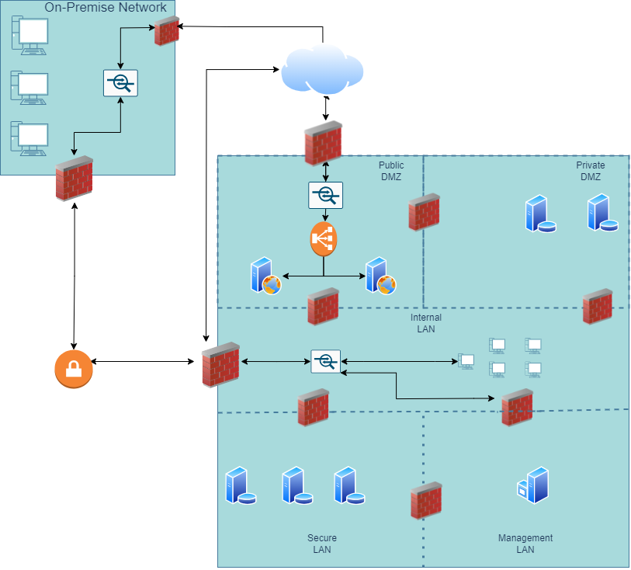
1.1 Designing the Network
Paste your Network Diagram here:
Remove this slide

Slide 5
Section 2
Building a Secure Network Architecture
in Azure

Slide 6
Section 2: Building the Network
After designing the network architecture, you now present your design to XYZ's stakeholders. They're all on board with your design, and have given you the green light to start building the architecture out in Azure.
So your next task is to go the Project Workspace in the classroom, and build out the enterprise network in Azure!
If you are accessing Azure with the Udacity classroom workspace, there will be a Resource Group in Azure called ‘entp-project’ that has already been created for you.
If you are accessing Azure using your own Azure account, first of all you should create a resource group called ‘entp-project’.
This ‘entp-project’ resource group is where you will create all the components that make up this project. When creating VMs in this section, please only use Standard_B1s for your VM size and the Linux Ubuntu 18.04 image.
Insert screenshots of your network on the following pages, showing completion of each of the specified tasks.

Slide 7
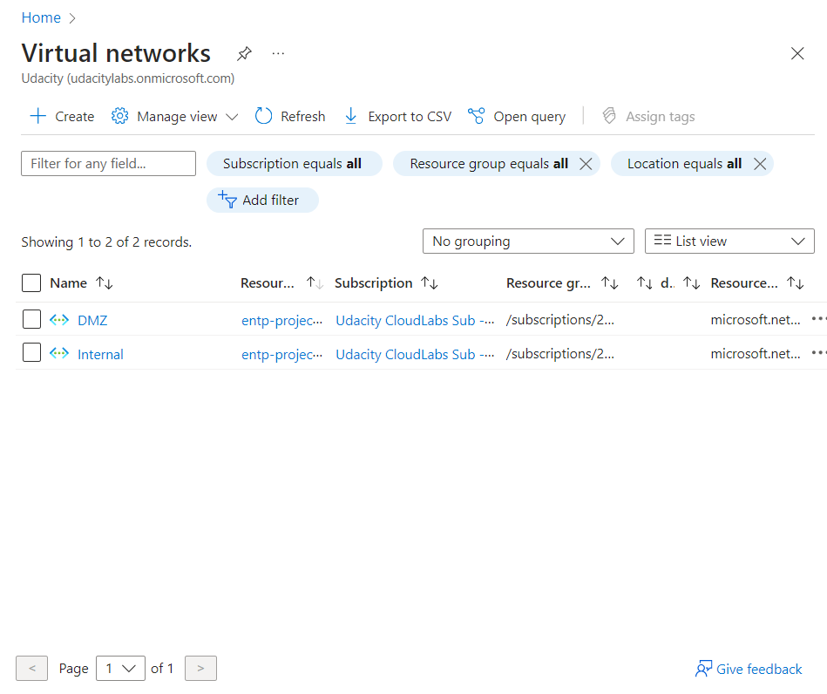
2.1.1 Screenshot
Create two Azure Virtual Networks in the resource group ‘entp-project’. Label one for your DMZ and one as your Internal.

Slide 8
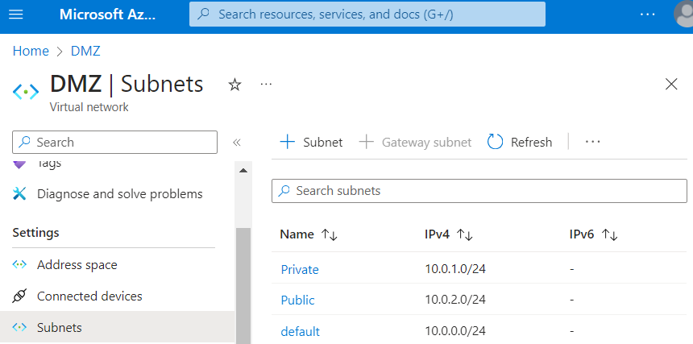
2.1.2 Screenshot
Create 2 subnets within your DMZ - subnets should be public and private.

Slide 9
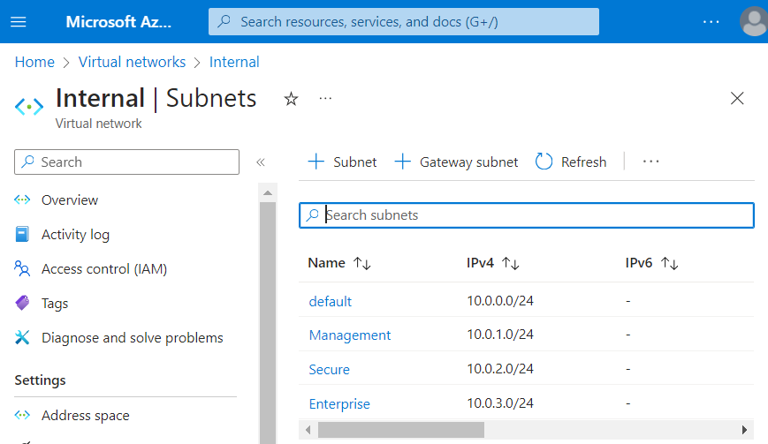
2.1.3 Screenshot
Create three subnets in your internal network and label them Management, Secure, and Enterprise.

Slide 10
2.2 Creating Virtual Machines
In this next section you will create Virtual Machines in your subnets. You will create 2 VMs in your DMZ and 3 VMs in your internal network. Please only use the Standard_B1s VM size and the Linux Ubuntu 18.04 image.
Insert screenshots on the following pages, showing completion of each of the specified tasks.

Slide 11
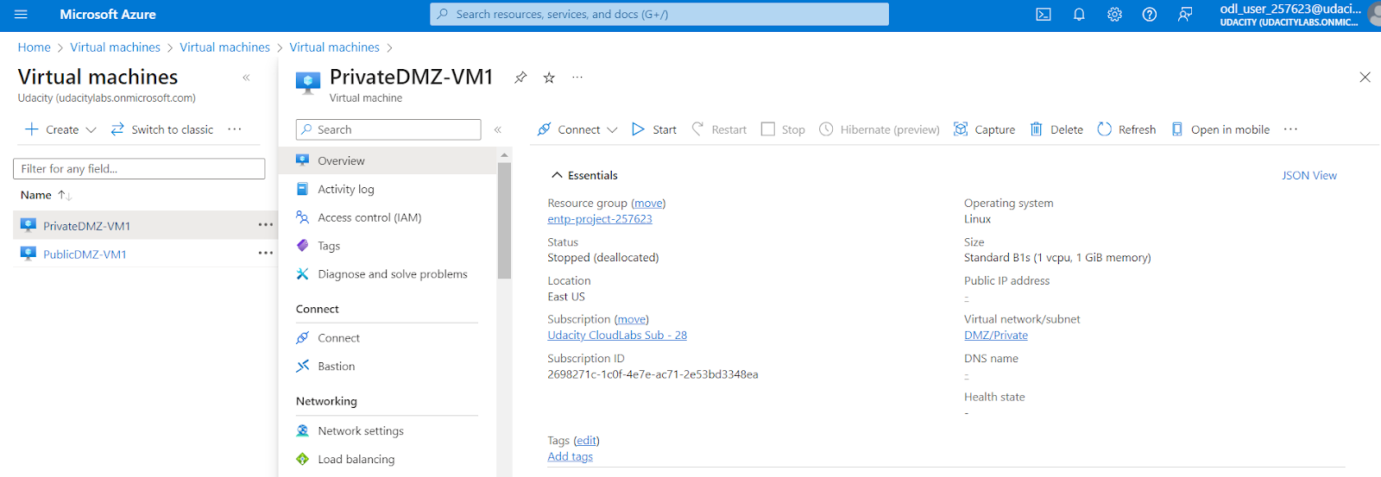
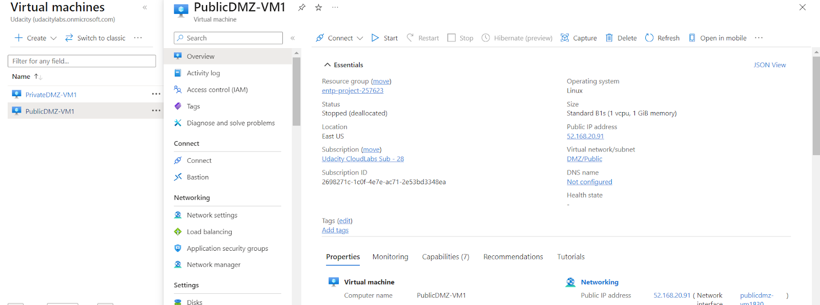
2.2.1 Screenshot
Create one VM in each of your public and private DMZ subnets. Please only use Standard_B1s for your VM size and select the Linux Ubuntu 18.04 image, otherwise you will encounter an error.

Slide 12
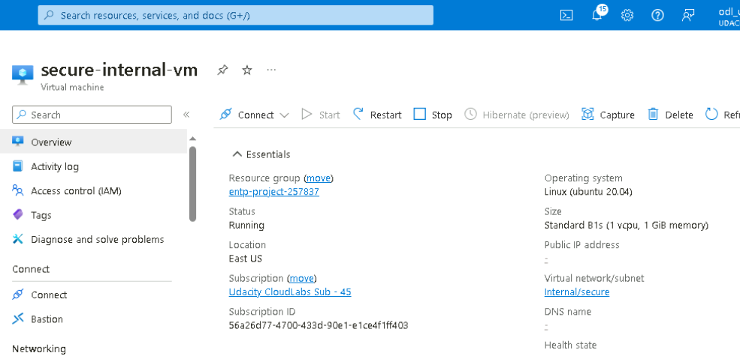
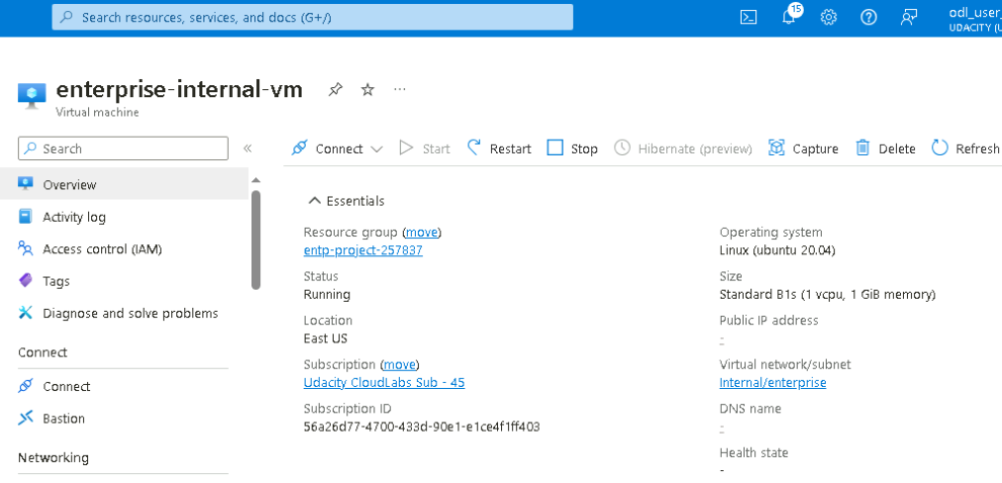

2.2.2 Screenshot
Create one VM in each of your Management, Secure, and Enterprise internal subnets. Please only use Standard_B1s for your VM size and select the Linux Ubuntu 18.04 image, otherwise you will encounter an error.

Slide 13
2.3 Secure Routing
In this next section you will configure secure routing within your Virtual Network and subnets. Follow secure best practices when creating network traffic rules.
Insert screenshots on the following pages, showing completion of each of the specified tasks.

Slide 14
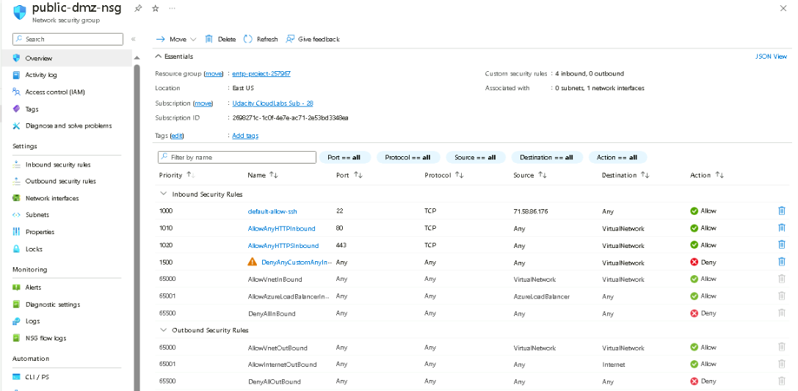
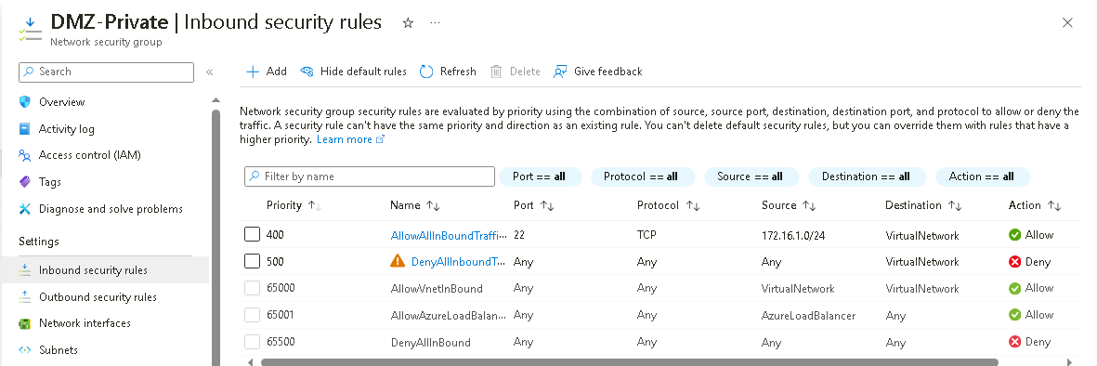
2.3.1 Screenshot
Traffic rules in your DMZ.

Slide 15
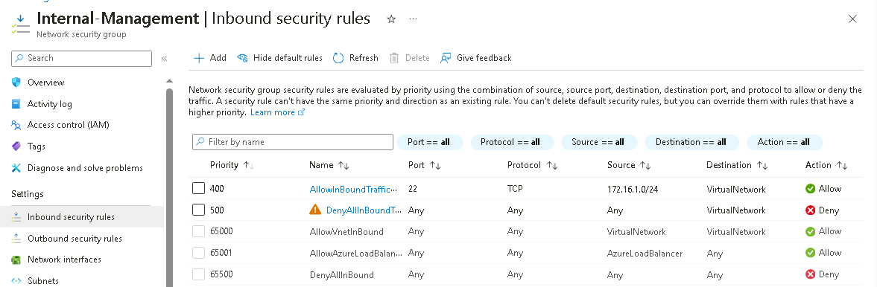
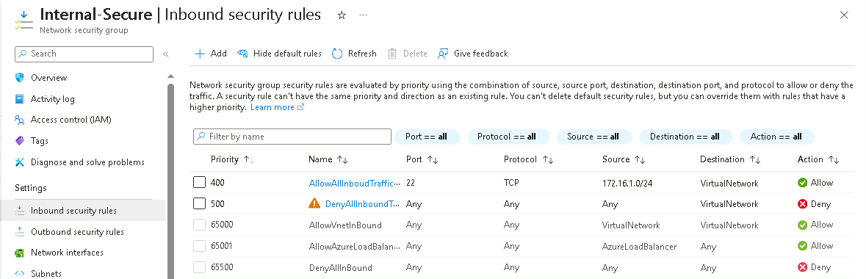

2.3.2 Screenshot
Traffic rules in your Internal network.

Slide 16
2.4 VPN Access
In this next section you will create a VPN to secure access to your internal network. After creating your VPN, test your VPN connection and attempt connecting to one of your VMs in your internal network.
Insert screenshots on the following pages, showing completion of each of the specified tasks.

Slide 17
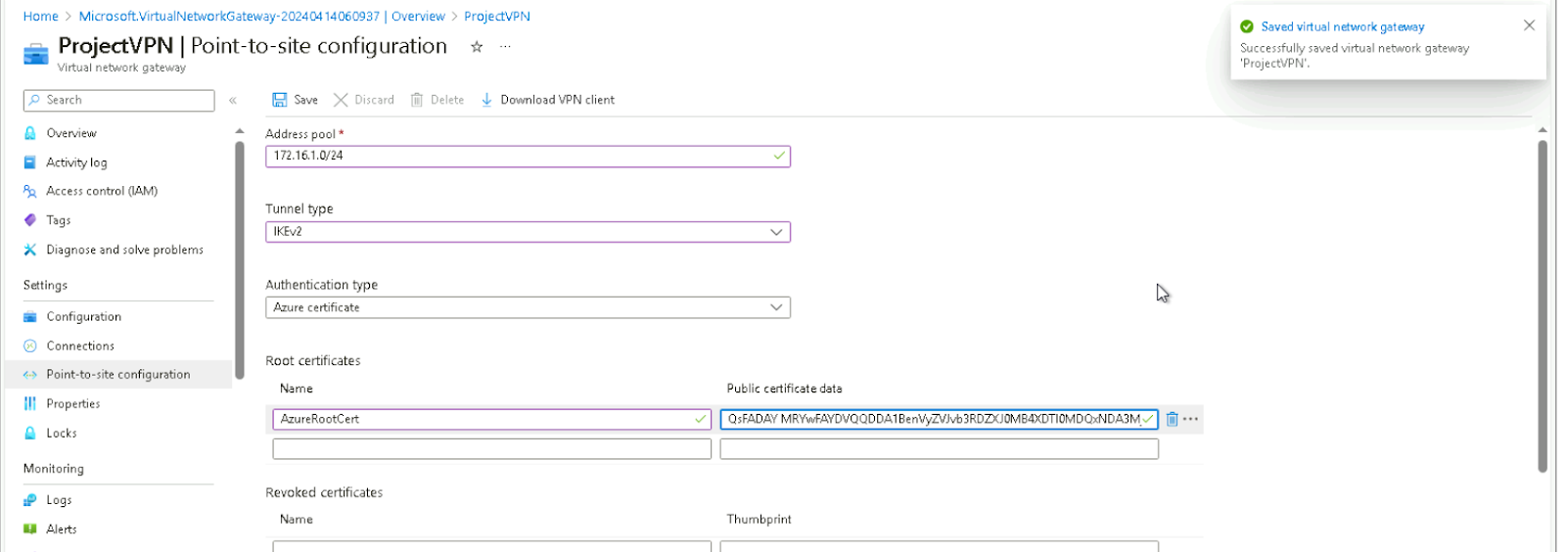
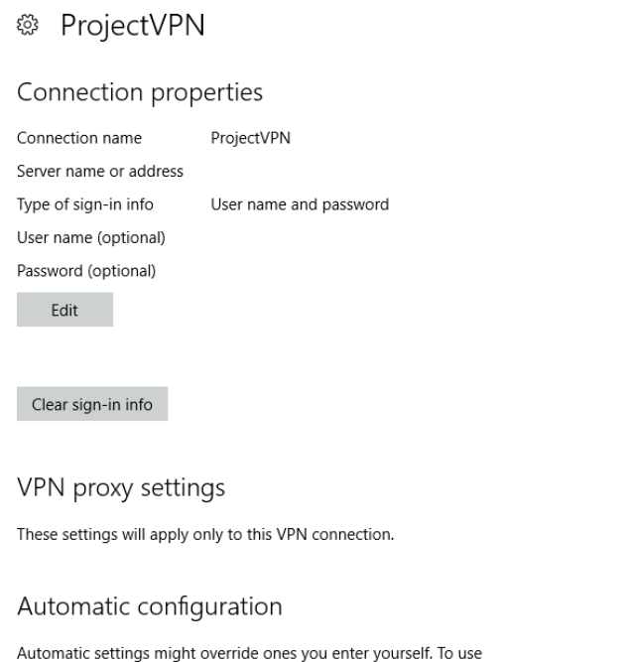
2.4.1 Screenshot
Create a VPN to connect to your internal network.

Slide 18
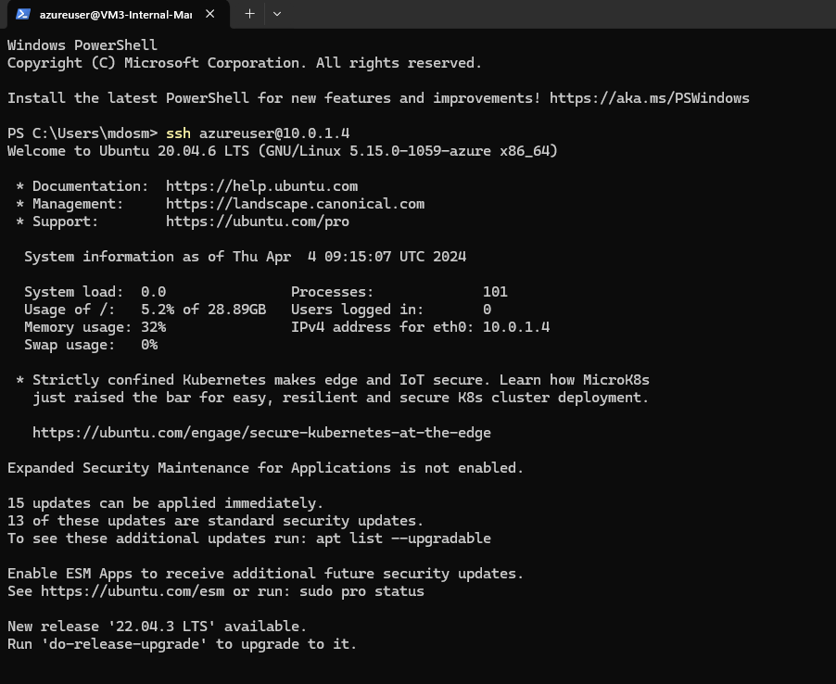
2.4.2 Screenshot
Test VPN connection by connecting to one of the VMs in your internal network.

Slide 19
Section 3
Continuous Monitoring with a SIEM

Slide 20
Section 3: Build the SIEM
Now that you've built a secure network architecture and a Zero Trust model, you're ready to wrap up your contract and finish the last piece of work. Your last task is to set up a solution to monitor the enterprise network and alert you about potential attacks.
For this section, you will continue working in the Project Workspace in the classroom, then provide screenshots of your work here in this document.
Insert screenshots on the following pages, showing completion of each of the specified tasks.

Slide 21
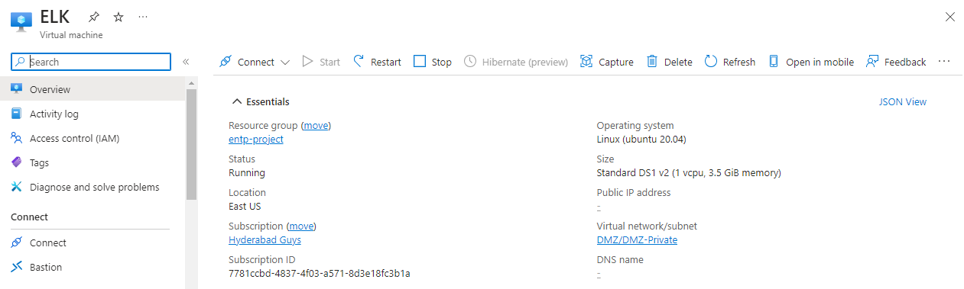
3.1.1 Screenshot
Create a VM in your private DMZ. On that VM, go through the process to create an ELK Server. For your Elk Server use the VM size DS1_v2 and Linux Ubuntu 18.04 image.

Slide 22
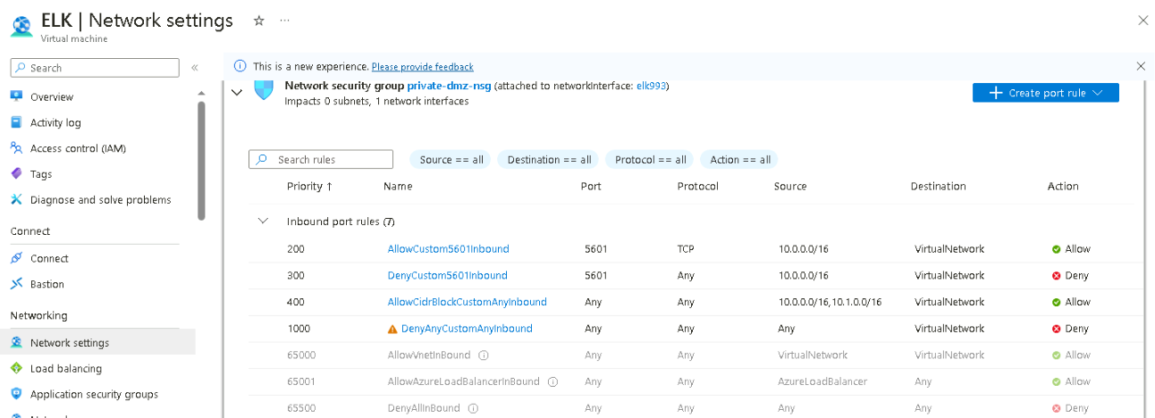
3.1.2 Screenshot
Set up routing to only allow traffic inbound to the server from both your virtual networks, and make sure Kibana is only accessible when you're on the network.

Slide 23
3.2 Ingest Logs
In this next section, you will start setting up ingest sources for your ELK server.
Insert screenshots on the following pages, showing completion of each of the specified tasks.

Slide 24
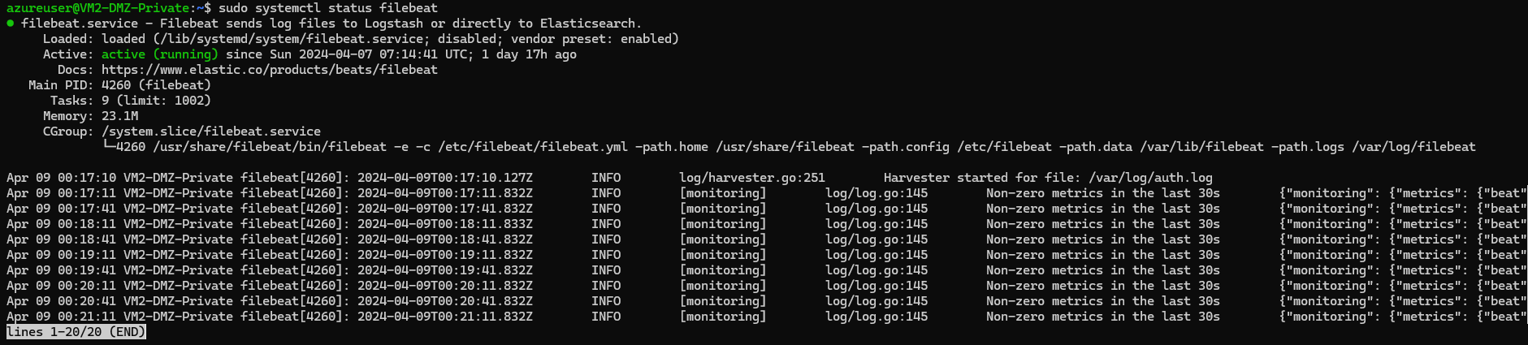
3.2.1 Screenshot
Install Filebeat on your web servers and show the Filebeat service as active.

Slide 25
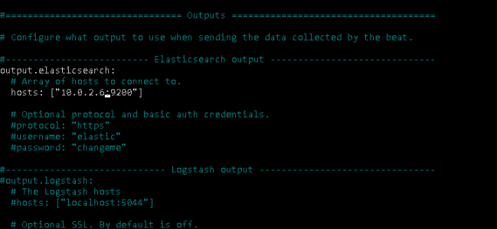
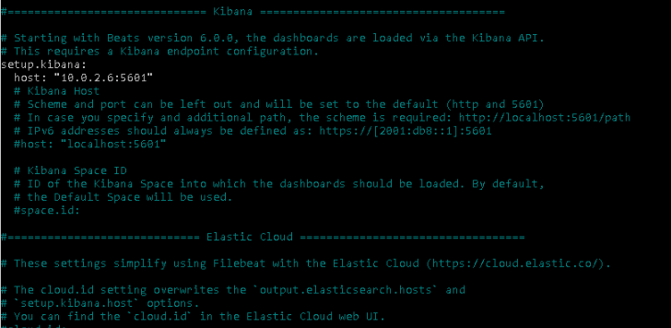
3.2.2 Screenshot
Configure Filebeat to route web server logs to Elasticsearch.

Slide 26
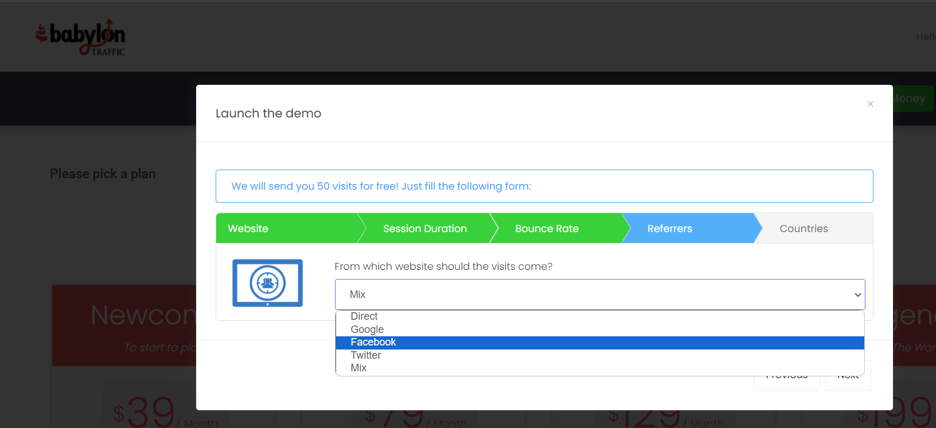
3.2.3 Screenshot
Simulate web traffic to your web servers using https://www.babylontraffic.com.

Slide 27
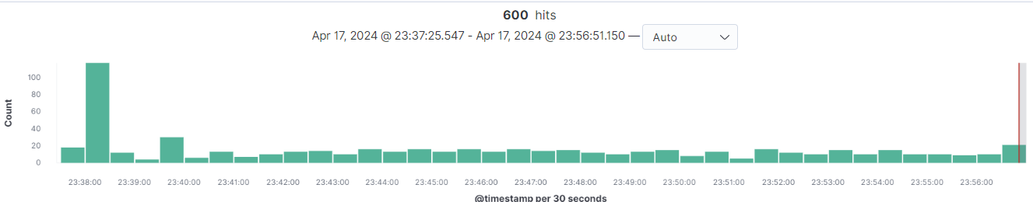
3.2.4 Screenshot
Web server logs appear in Kibana.

Slide 28
3.3 Build Alerts
In this next section, you will create alerts on the simulated web traffic you see. Build alerts to alert you of possible DoS, brute force, and probing attacks.
Insert screenshots on the following pages, showing completion of each of the specified tasks.

Slide 29
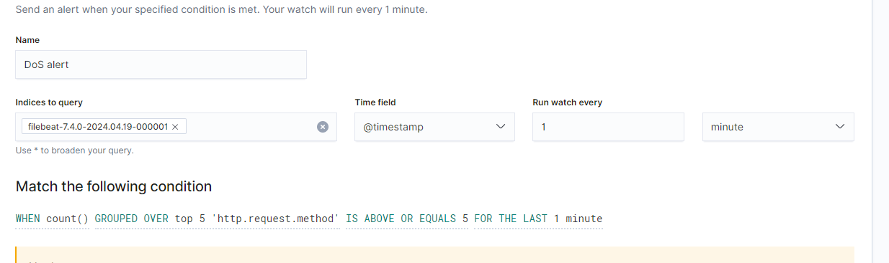
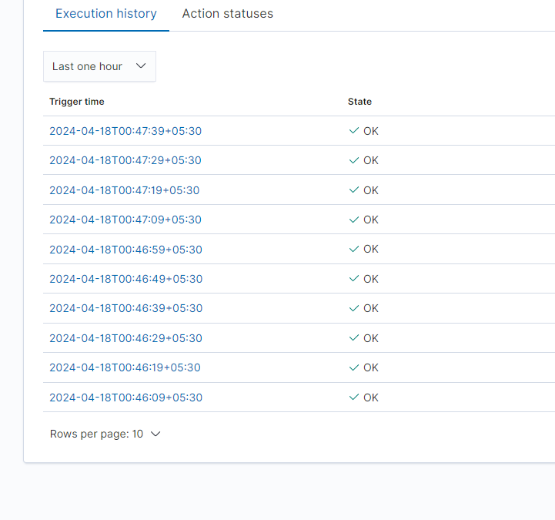
3.3.1 Screenshot
Create an alert for DoS attack.

Slide 30
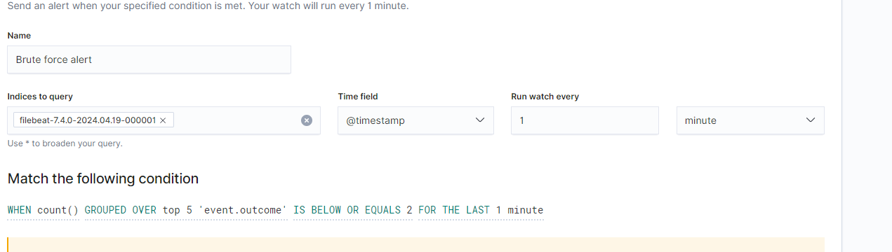
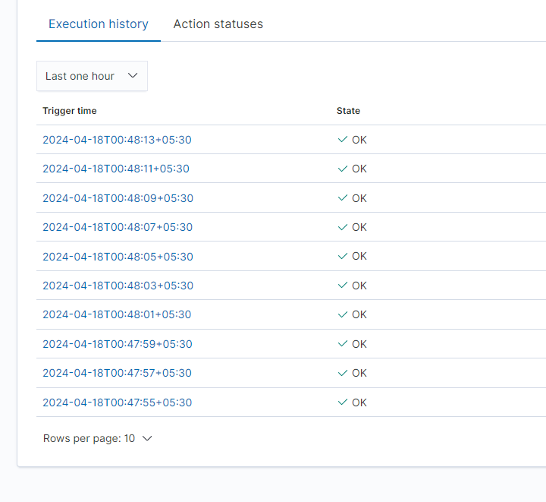
3.3.2 Screenshot
Create an alert for Brute Force attack.

Slide 31
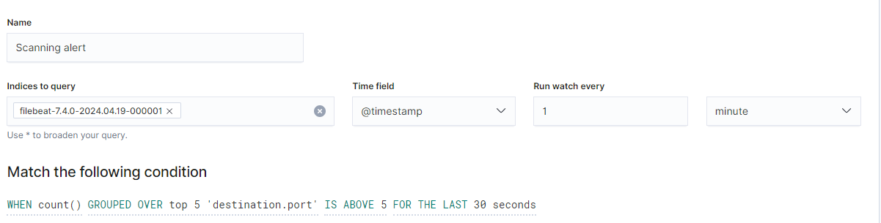

3.3.3 Screenshot
Create an alert for a scanning attack. During the scan, an attacker is looking to identify what ports are open.

Slide 32
3.4 Incident Response Playbook
Write a playbook below, detailing what the set of steps would be in response to each of the alerts you created in the last section 4.3. Add more pages if you need.
Scanning Attack Playbook
1. Preparation:
- Define the roles and responsibilities of the incident response team.
- Develop a comprehensive inventory of all systems, networks, and assets.
- Implement robust security controls such as firewalls, intrusion detection systems (IDS), and antivirus software.
- Establish baseline network activity and behavior to identify anomalies during scans.
- Create a communication plan to notify stakeholders during a scanning attack.
2. Detection & Analysis:
- Monitor network traffic and system logs for signs of unusual scanning activities.
- Utilize intrusion detection and prevention systems (IDPS) to identify and alert on scanning attempts.
- Deploy network and host-based scanning tools to proactively detect unauthorized scanning activities.
- Investigate any suspicious activities or alerts to determine the scope and severity of the scanning attack.
- Collect and analyze data from scanning tools to identify the attacker's methods and targets.
3. Containment, Eradication, and Recovery:
- Isolate affected systems or segments of the network to prevent further spread of the scanning activity.
- Implement temporary mitigations such as blocking IP addresses or turning off vulnerable services.
- Conduct a thorough investigation to identify the root cause of the scanning attack and eliminate any malware or unauthorized access.
- Restore affected systems from clean backups to ensure their integrity and security.
- Implement permanent fixes and security enhancements to prevent similar scanning attacks in the future.
4. Post-Incident Activity:
- Conduct a post-incident review to assess the incident response process's effectiveness and identify areas for improvement.
- Update documentation and procedures based on lessons learned from the scanning attack.
- Provide training and awareness sessions for employees to recognize and respond to scanning attacks.
- Share findings and insights with relevant stakeholders to enhance overall security posture.
- Continuously monitor and evaluate the network for any signs of recurring scanning activities.

Slide 33
Denial of Service attack:
1: Preparation
1.1 Define roles and responsibilities: Identify the team members involved in the incident response process, including their specific roles and responsibilities.
1.2 Establish communication protocols: Ensure a transparent and efficient method of communication among team members during an incident.
1.3 Develop response procedures: Create a step-by-step guide for responding to a DoS attack, including specific actions to be taken during each of the incident response process.
1.4 Implement monitoring and alerting systems: Set up systems to monitor network traffic and detect any abnormal patterns that may indicate a DoS attack.
2: Detection & Analysis
2.1 Identify the attack: Use monitoring and alerting systems to detect the presence of a DoS attack and analyze the nature and scope of the attack.
2.2 Determine impact: Assess the attack's impact on the organization's systems and services, including any potential disruptions to normal operations.
2.3 Collect evidence: Gather evidence related to the attack, including network logs, traffic data, and other relevant information useful for investigation and potential legal action.
3: Containment, Eradication, and Recovery
3.1 Contain the attack: Take immediate action to mitigate the attack's impact and prevent further damage to the organization's systems and services.
3.2 Eradicate the attack: Identify and eliminate the source of the attack, whether it be a specific IP address, a compromised system, or other means of attack.
3.3 Recover normal operations: Restore affected systems and services to their normal state and ensure that any data or configurations affected by the attack are correctly restored.
4: Post-Incident Activity
4.1 Review and analyze: Conduct a post-incident review to investigate the organization's response to the attack and identify any areas for improvement.
4.2 Update response procedures: Incorporate any lessons learned from the incident into the organization's incident response procedures and update them accordingly.
4.3 Communicate with stakeholders: Inform relevant stakeholders, such as customers, partners, and regulatory authorities, about the attack and the organization's response.
4.4 Implement preventative measures: Take steps to prevent future DoS attacks, such as implementing additional security controls, conducting employee training, and staying updated with security best practices.

Slide 34
Brute Force Attack Playbook
Preparation:
- Define the roles and responsibilities of the incident response team, including who will lead the response to a brute force attack.
- Develop and maintain an inventory of all critical systems and applications susceptible to brute force attacks.
- Implement robust authentication mechanisms such as multi-factor authentication (MFA) to mitigate the risk of successful brute force attacks.
- Deploy intrusion detection and prevention systems (IDPS) to monitor for brute force attempts and alert on suspicious activity.
- Establish response procedures and escalation paths for addressing brute force attacks, including stakeholder communication channels.
2. Detection & Analysis:
- Monitor system logs, authentication logs, and network traffic for signs of repeated login failures or unusual authentication patterns.
- Configure automated alerts to notify the incident response team of potential brute force attacks.
- Utilize security information and event management (SIEM) tools to correlate and analyze data from multiple sources for more accurate detection.
- Investigate any suspicious login attempts to determine the brute force attack's source, target, and method.
- Gather evidence such as IP addresses, timestamps, and user accounts involved in the attack for further analysis.
3. Containment, Eradication, and Recovery:
- Immediately block or throttle IP addresses exhibiting brute force behaviour to prevent further unauthorized login attempts.
- Change passwords or lockout affected user accounts to mitigate the risk of unauthorized access.
- Review system and application configurations to identify and address any vulnerabilities exploited during the brute force attack.
- Implement additional security controls such as account lockout policies or rate limiting to deter future brute force attacks.
- Restore any compromised accounts or systems from clean backups to ensure their integrity and security.
4. Post-Incident Activity:
- Conduct a post-incident analysis to assess the effectiveness of the response to the brute force attack and identify areas for improvement.
- Update security policies and procedures based on lessons learned from the incident, including strengthening password policies and enhancing monitoring capabilities.
- Provide training and awareness sessions for users and IT staff on recognizing and responding to brute force attacks.
- Share findings and recommendations with relevant stakeholders to enhance overall security posture and prevent similar incidents in the future.
- Continuously monitor and analyze login activity to detect and respond to any resurgence of brute force attacks.

Slide 35
Section 4
Designing a
Zero Trust Model

Slide 36
Section 4: Zero Trust Model
XYZ is elated with the work you've done so far! But they've been hearing about this new buzzword "Zero Trust" and are curious as to what it is and what the architecture would look like in a Zero Trust model. So your next task below is to design a Zero Trust model, then explain the differences between your network architecture and your Zero Trust model.
Design a Zero Trust model of your network architecture using https://app.diagrams.net/.
Make sure to incorporate the following into your design:
- Identity
- Devices
- Apps
- Network
- Data
- Infrastructure
- Trusted and Untrusted Devices
- Controls

Slide 37
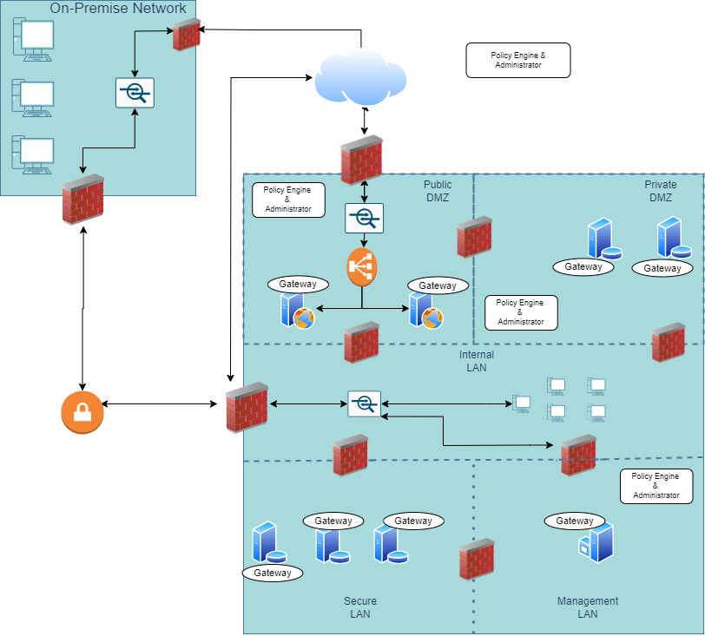
4.1 Zero Trust Model
Paste your Zero Trust model diagram here:
Remove this slide

Slide 38
4.2 Modern Architecture vs. Zero Trust
Write a detailed comparative analysis of the differences between your Zero Trust model and your secure network architecture design.
1. Access Control: In a traditional network, access is granted based on trust, while in a zero-trust model, access is given based on the principle of least privilege, meaning that users and devices are only given access to the resources they need to perform their job functions.
2. Identity Management: In a traditional network, identity management is often centralized, while in a zero-trust model, identity management is distributed and integrated with access control.
3. Authentication: In a traditional network, authentication is typically performed at the network perimeter, while in a zero-trust model, authentication is performed at every access point.
4. Authorization: In a traditional network, authorization is based on the user's role or group membership, while in a zero-trust model, authorization is based on the user's identity, context, and risk level.
5. Encryption: In a traditional network, encryption is often used to secure data in transit, while in a Zero Trust model, encryption is used to secure data at rest and in transit.
6. Segmentation: In a traditional network, segmentation separates different parts of the network, while in a Zero Trust model, segmentation is used to create micro-perimeters around sensitive resources.
7. Monitoring: In a traditional network, monitoring is typically performed at the network perimeter, while in a zero-trust model, monitoring is performed at every access point and throughout the network.
8. Incident Response: In a traditional network, incident response is often reactive, while in a Zero Trust model, incident response is proactive and includes continuous monitoring and threat hunting.
9. Compliance: In a traditional network, compliance is often achieved through network security policies, while in a zero-trust model, compliance is achieved through a combination of network security policies and identity and access management policies.
10. User Experience: In a traditional network, the user experience is often prioritized over security, while in a Zero Trust model, security is prioritized over the user experience.

