Slide 1




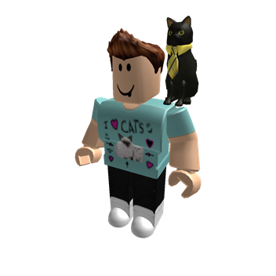
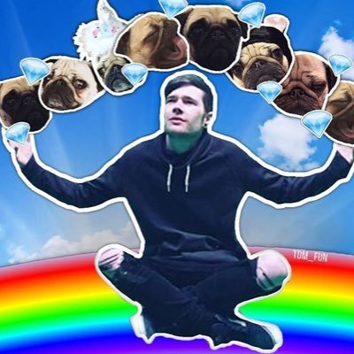
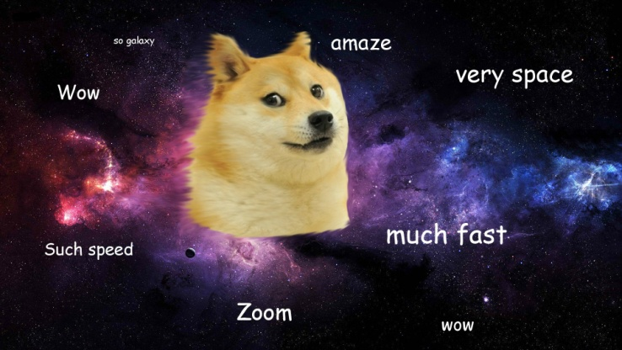

All About Me!

Slide 2


Facts about me!
My name is Harvey
I was born on the 23rd August 2007
I have a little brother named Andy(he is very annoying)
I go to Kogarah Public School in class 5/4V

Slide 3

My Friends
I have a lot of friends. Here are some in our class. Aditya,Kieth,Aiden,Jack,Alan,Swetansh,Mason and a few more.

Slide 4

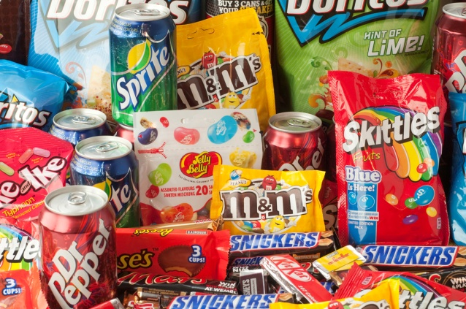
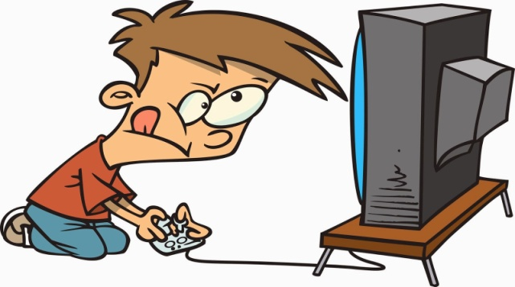


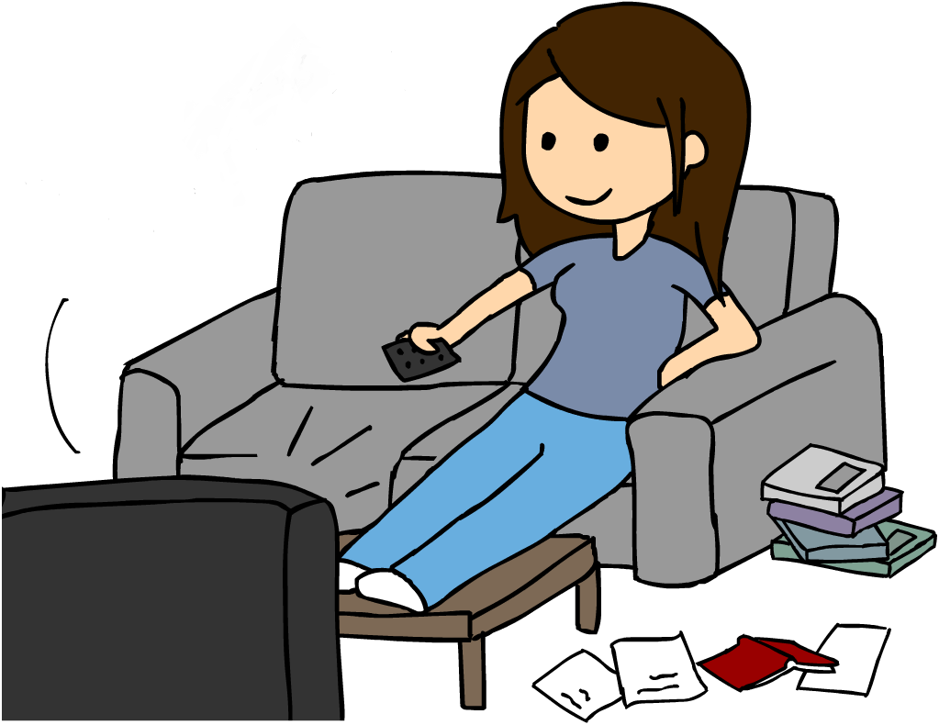
My Likes
I like to play video games, play sports, food, music, watching TV and lots more.

Slide 5

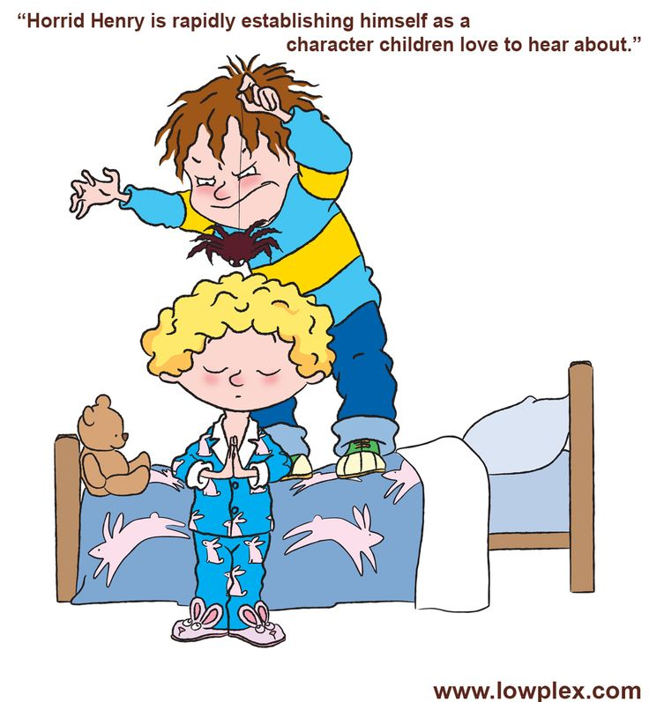


My dislikes
Andy(my little brother who is very naughty and annoying.)
Homework
Tutoring
Capsicum

Slide 6
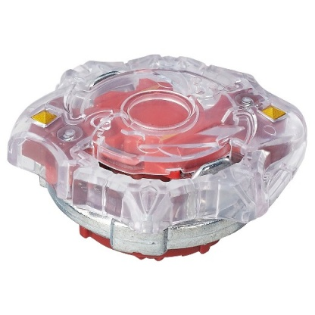




Some of the Best experiences
Getting my first Beyblade (Spryzen S1)
Opening my first Booster Box(Evolutions)
Sleeping
Breathing

Slide 7
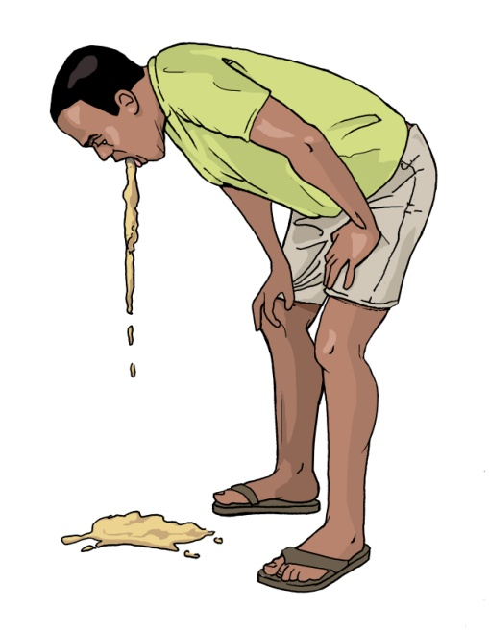

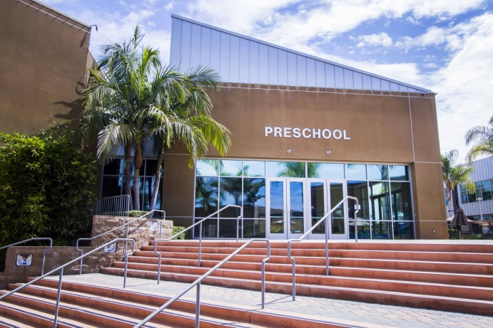
Some of my worst experiences
My little brother gets born(Sorry Andy)
Going to preschool
Going on a scary ride at Lunar Park and vomit all over Mum with diarrhoea.

Slide 8




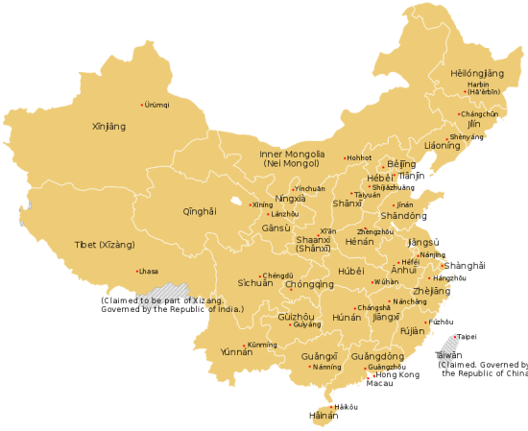
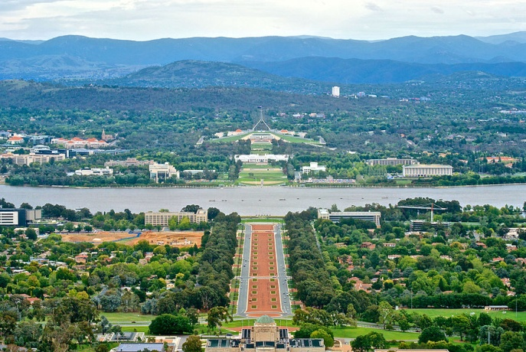

Places I went before
I went to China, New Zealand, Canberra, Queensland, Hong Kong and around Sydney.

Slide 9

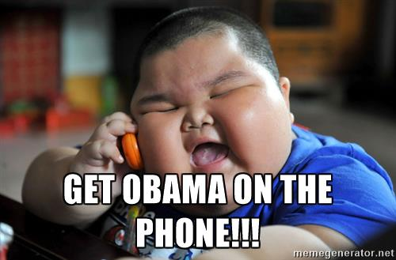


The end

