Slide 1

CCDS25-0476 / FINAL YEAR PROJECT
Building a Food Recognition
and Classification Model
to Count Calories
LIM XIN WEI
Matric. No. U2240093B
Supervisor Dr. Josephine Chong Leng Leng
Examiner Dr. Gu Chloe
College of Computing and Data Science · Nanyang Technological University
Notes:
Good morning.
I am Xin Wei.
Today I’ll be presenting to you my FYP
building a food recognition and classification model to count calories.

Slide 2
Outline
01
Problem & Motivation
Why food image classification matters
02
Literature Review
Three architectural paradigms, research gaps, contributions
03
Research Methodology
Datasets, cleaning pipeline, training protocol,
evaluation frameworks
04
Results & Discussion
Performance hierarchy, error analysis, learning rate study
05
Limitation, Future Work & Demo
Synthesis, limitations, next steps
2 / 32
Notes:
This is the outline of my presentation.
Towards the end ill show a live demo of an app I created.

Slide 3

01 / PROBLEM & MOTIVATION
Diet, health, and the tracking problem
Singapore's response
Diet is one of the few
Healthier SG — national initiative for preventive care, targeting the “3H” problems (hyperglycemia, hypertension, hyperlipidemia)
MODIFIABLE
risk factors for chronic disease
But preventive care needs accurate dietary data.
Diabetes · Obesity · Cardiovascular disease
Manual food logging is tedious, error-prone, and quickly abandoned — people are not good at eyeballing portions or nutrient content.
3 / 32
Notes:
One question we always ask is “what to eat”
but this is ironic because most people don’t know what they are putting into their bodies.
Diet is one of the few major risk factors for chronic disease that we can actually change—unlike genetics.
Excess fats, sodium, and sugar are directly linked to chronic diseases, resulting in major health and economic costs globally.
In Singapore, this is exactly what Healthier SG targets—addressing the ‘3H problems’.
But preventive care depends on accurate dietary data—and this is where the system breaks down.
Manual food logging is tedious, error-prone, and often abandoned.
Most people fail to consistently track their meals or accurately estimate the portions they eat.

Slide 4
01 / PROBLEM & MOTIVATION
Automation via food image recognition
GOAL:
Failure:
Replace manual food logging
Errors propagate through every downstream step
›
›
›
Capture
Classify
Look up
Estimate
food photo
deep-learning model
nutritional database
calories + macros
Classification the foundation of the pipeline
4 / 32
Notes:
This is where automation via food image recognition comes in.
Where the goal is to replace manual logging entirely
The pipeline works as such:
First we take a picture of the food,
Classify the food class using a trained model,
looked up its nutritional content from a food database
and then an estimate of the calorie and macro-nutritional values are returned.
As you can see classification accuracy is the foundation of the entire pipeline.
If the system fails to classify the food correctly, errors propagate through every downstream step—from nutritional lookup to calorie estimation.
Which is why food image classification is the focus of my research.

Slide 5
01 / PROBLEM & MOTIVATION
Deep learning architectures—food classification
Vision Transformers (ViTs)
Different dishes, very similar appearance
Convolutional Neural Networks (CNNs)
local inductive biases to capture spatial patterns
self-attention to model long-range dependencies.
RESEARCH QUESTION
Which deep-learning paradigm — CNN, Vision Transformer, or a Cross-paradigm inspired architecture — is best suited to fine-grained food image classification?
5 / 32
Notes:
2 deep learning architectural paradigms dominate the food classification field
Convolutional Neural Networks and Vision transformers
They operate fundamentally different from each other when processing an image
CNNS use local inductive biases to capture spatial patterns,
While Vision Transformers, which use self-attention to model long-range dependencies.
But what if we introduced a third contender?
Leading to my research question:
Which paradigm — CNN, Vision Transformer, or a Cross paradigm inspired architecture — is best suited to fine-grained food image classification?

Slide 6
02 / LITERATURE REVIEW
Three architectural paradigms
CNN
VISION TRANSFORMER
Cross-paradigm architecture
ResNet50
ViT-Base
ConvNeXt-Base
Sliding convolutional kernels
Image as patch sequence + global self-attention
Purely convolutional — no attention
Strong local inductive bias
spatial locality, translation equivariance
Models long-range dependencies
weak inductive biases
7×7 depthwise · LayerNorm · GELU
inverted bottleneck
Mature in food classification literature
Recent works: ViT > CNN baselines (2023–24)
Recent works: competitive or superior to ViT
Note: ConvNeXt is purely convolutional — not a hybrid. It adopts Transformer design principles within a CNN backbone.
6 / 32
Notes:
I reviewed works related to the three different architectural paradigms for food classification.
Which include CNNs, Vits and cross-paradigm architectures, which are modernized improvements of the CNNs and ViT paradigm

Slide 7
02 / LITERATURE REVIEW
Three architectural paradigms - CNNs
Study | Approach | Dataset | Key Results | Strengths | Limitations
Bu et al. [27] | Transfer learning + ensemble of multiple CNNs (VGG19, ResNet50, MobileNetV2, AlexNet) | Food-11 | 96.88% accuracy, 95.43% F1-score | High accuracy; ensemble improves robustness | High computational cost; slower inference
Karabay et al. [28] | Transfer learning with deep CNNs (best: ResNet-152) | CAFD, Food1k, CAFD+Food1k | Top-1: 88.70%, Top-5: 98.59% | Strong performance with region-specific data; highlights dataset importance | Class imbalance; struggles with similar dishes; only single-food classification
7 / 32
Notes:
Starting with, CNNs.
a classical approach when it comes to any image classification task.
A study from Bu who utilized an ensemble of CNNs achieved a high accuracy of 96%,
However, he noted that an ensemble results in high computational cost and slower inference speed,
This motivated me to train and evaluate models individually rather than creating an ensemble.
Karabay’s study utilized a deeper resenet variant, achieving competitive accuracy scores,
Hes experiment used a combination of region specific and generic datasets
And noted strong performance with region specific data
But it introduced class imbalance and increased fine grained complexity.
This leads me to take on a challenge of using a dataset with class imbalance and to evaluate how the errors differ between paradigms

Slide 8
02 / LITERATURE REVIEW
Vision Transformers (ViTs)
Study | Approach | Dataset | Key Results | Strengths | Limitations
Banerjee et al. [29] | Vision Transformer (ViT-B16) for classification + nutritional regression | Food-101, Recipe1M+ | 92.3% accuracy, 8.5% MAE | Captures global relationships in multi-ingredient dishes; outperforms CNNs | Higher computational cost; requires large datasets
Gao et al. [30] | Enhanced ViT (AlsmViT) with AugmentPlus, LayerScale, improved MLP | Food-101, Vireo Food-172 | 95.17%, 94.29% accuracy | State-of-the-art performance; strong feature extraction | Increased model complexity; training cost
8/ 232
Notes:
following the introduction of the transformer architecture in NLP
Recent works have shifted their attention, pun intended, towards vision transfomers for image classification tasks,
Studies between 2023 and 2024 consistently showed ViTs outperforming CNNs on food classification
Both Banerjee and Gao obtained state of the art performance in their experiment
noting the strong feature extraction capabilities from the self attention mechanism
the drawbacks of ViTs is that it is data intensive to train along with its associated training cost

Slide 9
02 / LITERATURE REVIEW
Cross-paradigm – CNN inspired ViT
Study | Approach | Dataset | Key Results | Strengths | Limitations
Ze Liu et al. [31] | Swin Transformer (hierarchical ViT with shifted window attention) | General vision benchmarks | Improved efficiency with linear complexity | Captures both local and global features; scalable | Still computationally intensive vs CNNs
Xiao et al. [32] | Swin-DR (Swin Transformer + deep residual networks) | FoodX-251, UEC Food-256 | 81.07%, 82.77% accuracy | Combines CNN + Transformer strengths; good for fine-grained tasks | Moderate accuracy; increased model complexity
9/324
Notes:
The Swin transformer is an example of a CNN inspired ViTs
The difference is that self-attention computed within local windows and not across the entire image.
but fundamentally since it is still a vision transformer, its the data intensive nature required to train still persist
This motivates the choice of cross paradigm architecture chosen to be ViT inspired CNN

Slide 10
02 / LITERATURE REVIEW
Cross-paradigm – ViT inspired CNN
Study | Approach | Dataset | Key Results | Strengths | Limitations
Ze Liu et al. [33] | ConvNeXt (modernised CNN inspired by Transformers) | Image classification benchmarks | Competitive against ViTs | Retains CNN efficiency with improved global modeling | Still limited vs full attention mechanisms
Bingöl [34] | ConvNeXt | Turkish food datasets | Highest accuracy across datasets | Strong performance vs ViT & Swin | Dataset-specific validation
Zheng et al. [23] | CNNs + Supervised Contrastive Learning (SCL) | FoodSG-233 | EfficientNetV2 > ConvNeXt (Top-1 accuracy) | Shows effectiveness of optimisation strategies | ConvNeXt slightly underperforms compared to EfficientNetV2
10/ 32
Notes:
Such as Convnext
Convnext is a modernised CNN with improvements inspired by vision transformers.
It uses larger convolution kernels, LayerNorm instead of BatchNorm, GELU activations, and an inverted bottleneck structure.
Ze Liu study showed that obtained competitive performance against ViTs,
while retaining CNNs efficiency with improved global modelling
Bingol’s study reviewed that convnext outperformed both ViT and Swin on a Turkish dataset

Slide 11
02 / LITERATURE REVIEW
Optimisation techniques in prior work
Benchmark datasets discussed in detail in Methodology
TRAINING STRATEGIES
HANDLING CLASS IMBALANCE
Transfer learning
ImageNet pretrained weights — faster convergence and better generalisation in data-limited settings.
Data augmentation
random crops, rotations, flips, colour perturbations — robust to lighting, viewpoint, scale.
Class-weighted loss
weights inversely proportional to class frequency — penalise minority-class misclassifications.
Stratified sampling
preserve class proportions across train / val / test splits to prevent evaluation bias.
11/32
Notes:
There are reoccurring optimization techniques used in prior work
Training strategies typically employ transfer learning
Initializing models with ImageNet pretrained weights,
data augmentation during model training helps to simulate real-world variation.
Datasets where class imbalance is present,
class-weighted loss functions and stratified sampling during dataset split

Slide 12
02 / LITERATURE REVIEW
Research gaps & proposed contributions
GAPS IN THE LITERATURE
THIS PROJECT'S CONTRIBUTIONS
1 Limited systematic comparisons across paradigms
Prior work compares specific models, not paradigms under matched protocols.
1
Controlled paradigm comparison
ResNet50, ViT-Base, ConvNeXt-Base under identical training, preprocessing, and HP tuning
2
Primary evaluation on SGFood-233
Fills the SEA gap; class imbalance + fine-grained inter-class similarity
2 Southeast Asian cuisines under-represented
Most benchmarks centre Western, Chinese, or Japanese food.
3
Food-101 as secondary benchmark
Verifies findings generalise beyond a single dataset
12/ 32
Notes:
two gaps emerge in the literature
First, although prior work evaluated individual architectures,
there's been limited systematic comparison across paradigms under standardized conditions.
Most studies compare specific models rather than holding training conditions constant and evaluating the paradigms themselves.
Second, Southeast Asian cuisines remain under-represented.
Most works use Western, Chinese, or Japanese benchmarks.
This project addresses both gaps directly.
By conducting controlled comparison of the three paradigms from training all the way to evaluation
The primary dataset is SGFood-233, which addresses the SEA gap
Food-101 was used as the secondary benchmark to verify findings aren't an artefact of a single dataset generalizes

Slide 13
03 / RESEARCH METHODOLOGY
Dataset selection
Selection criteria · computational feasibility · task alignment · generalisability
DATASET | VERDICT
ISIA Food-500, Food2K | Excluded — too large for available hardware
UEC-Food256, VireoFood-172 | Excluded — task misalignment (multiple food detection / ingredient retrieval)
SGFood-233 | Primary · 203,655 images · 233 classes · 18.8× class imbalance
Food-101 | Secondary · established benchmark for cross-dataset validation
13 / 32
Notes:
Onto methodology.
Datasets was selected based on task alignment, generalizability, and computational feasibility.
ISIA Food-500 and Food2k were excluded as the datasets were too computationally large.
UEC-Food256 and VireoFood-172 were excluded due to task misalignment.
As mentioned, SGFood-233 is the primary dataset used
While Food-101 is the secondary benchmark

Slide 14
03 / RESEARCH METHODOLOGY
Data cleaning pipeline
1
Integrity check
Truncated, corrupt, or invalid images
THE NOVEL PIECE
Exact duplicates → MD5 hash
2,409 removed (incl. 2,394 cross-class label conflicts)
Why a 3 / 3 consensus?
2
Three architectures with fundamentally different feature-extraction paradigms agreeing on a wrong label is a high-precision noise signal — not just an ambiguous example.
3
Near duplicates → Perceptual hash
3,094 removed (Hamming ≤ 8)
4
Mislabel detection → 3-model consensus
Flag if all three architectures unanimously disagree with label
5
Human review via Streamlit UI
271 kept · 650 removed · 1,296 relabelled
14 / 32
Notes:
This is the data cleaning pipeline for SgFood233
It first does an integrity check for corrupt images
Then within and cross class duplicated images are removed.
The fourth stage detects for potentially mislabelled images
The images were reviewed manually using a streamlit UI.

Slide 15
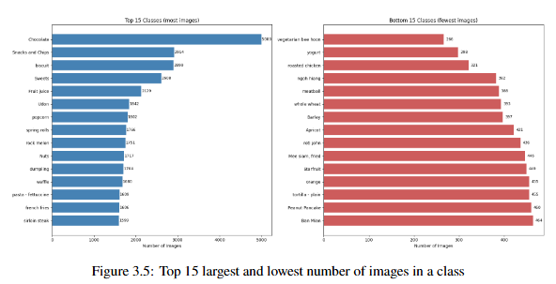
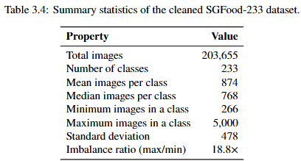
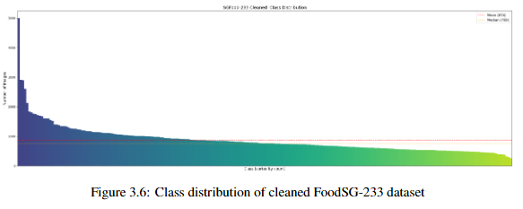


03 / RESEARCH METHODOLOGY
Summary statistics & data split
Data split used in this study
75% TRAIN
15% VAL
10% TEST
Final experiments · stratified sampling preserves class balance
15/ 32
Notes:
Here are the summary statistics after data cleaning.
The final cleaned SGFood-233 dataset has over 200,000 images,
Covering 233 Singaporean food classes,
with a class imbalance ratio of 18.8 times
Which can be observed from the class distribution plot
Subsequently, the dataset underwent a 75/15/10 train-validation-test split.

Slide 16
03 / RESEARCH METHODOLOGY
Models and identical training protocol
MODEL | PARADIGM | PARAMS | KEY FEATURE
ResNet50 | Pure CNN | 25.6 M | Residual connections
ViT-Base / 16 | Pure ViT | 86.6 M | 16×16 patch self-attention
ConvNeXt-Base | Transformer-inspired CNN | 88.6 M | 7×7 depthwise · LayerNorm · GELU
IDENTICAL TRAINING PROTOCOL — the basis for fair comparison
Initialisation ImageNet-1k pretrained → fine-tuned per dataset
Image size 224 × 224 · Batch 64 · 10 epochs
Optimiser AdamW · LR = 1×10⁻⁴ · weight decay 1×10⁻⁴
Loss Cross-entropy · early stopping (patience 3)
Augmentation Random crop, horizontal flip, ±15° rotation, colour jitter
Normalisation ImageNet statistics — identical across all three models
16 / 32
Notes:
ResNet50 was chosen as the representative model for CNN
ViT-Base 16×16 patches for the Vision Transformer
and ConvNeXt-Base for the cross-paradigm model, particularly a Transformer-inspired CNN.
All models were Initialized with ImageNet pretrained weights and fine-tuning on the dataset.
All models had the same hyperparameter configurations and same data augmentations.

Slide 17


03 / RESEARCH METHODOLOGY
Evaluation metrics
Three families of metrics — each answers a different question about model behaviour
1 CLASSIFICATION
2 PER-CLASS
3 EMBEDDING GEOMETRY
Headline performance
Class-level diagnostics
Feature space quality
Top-1 Accuracy
primary headline metric
Per-class Precision, Recall, F1
Silhouette score
cosine + Euclidean + PCA-256
Identifies
easiest, hardest, biggest cross-architecture gaps
Top-5 Accuracy
practical relevance for user-facing apps
Centroid distances
inter-class separation in feature space
Macro-F1
treats all 233 classes equally
Weighted-F1
frequency-weighted by class size
WHY MACRO-F1, NOT MACRO ACCURACY? Macro Accuracy ignores false positives — Macro-F1 penalises both error directions equally, essential under SGFood-233's 18.8× class imbalance.
17 / 32
Notes:
Here are some of the evaluation metrics used
Classification metrics include.
Top-1 & Top-5 accuracy,
Macro-F1 and Weighted-F1 are both class-balanced metrics
Macro-F1 weights all 233 classes equally, while Weighted-F1 weights by class frequency
Per-class metrics
mainly look at F1 computed per class.
Embedding geometry metrics
silhouette scores and centroid distances were calculated to quantify how well classes separate in each model's feature space.

Slide 18
03 / RESEARCH METHODOLOGY
Error analysis framework
Trace misclassifications back to architectural mechanisms — go beyond aggregate accuracy.
1 CONFUSION PATTERNS
2 PER-CLASS PERFORMANCE
Architecture-sensitive vs invariant errors
Easiest, hardest, biggest cross-architecture gaps
233×233 confusion matrix; shared & unique pairs
Per-class P, R, F1; rank by gap
3 EMBEDDING SPACE GEOMETRY
4 GRAD-CAM ATTENTION
Cluster quality and class separability
Where does each model look?
Silhouette (cosine + Euclidean + PCA-256) · t-SNE × 5 seeds · centroid distances
Grad-CAM on the final feature layer
18 / 32
Notes:
The metrics mentioned are utilized in the error analysis framework which helps us trace the misclassifications back to architectural mechanisms going beyond the aggregate results.
We look at confusion patterns.
Where we identify different failure modes, supported by
per-class performance F1 scores
embedding space geometry
Grad-CAM attention maps

Slide 19
03 / RESEARCH METHODOLOGY
Learning rate HP robustness study
Question Does the baseline ranking ConvNeXt > ViT > ResNet50 hold when each model trains at its own best learning rate?
→
STAGE 1 · SENSITIVITY SWEEP
STAGE 2 · FINAL EVALUATION
5 epochs at each of 5 learning rates
10 epochs at each model's best LR
{1×10⁻⁵, 5×10⁻⁵, 1×10⁻⁴, 3×10⁻⁴, 1×10⁻³}
Final test-set evaluation
Identifies each architecture's optimal LR
Top-1 · Top-5 · Macro-F1 · Weighted-F1
All other hyperparameters held constant — isolates the effect of learning rate
19 / 32
Notes:
Lastly, a learning rate study was conducted to ensure the performance hierarchy observed is robust
This is because different architectures are known to have different optimal learning rates during fine-tuning
There are 2 parts to this study
Stage 1 is a sensitivity sweep — where all 3 architectures were trained at 5 different learning rates for 5 epochs to find its optimal LR
Stage 2 serves as the final evaluation — each model was trained for 10 epochs at its optimal learning rate derived from stage 1

Slide 20
04 / RESULTS & DISCUSSION
A consistent performance hierarchy
SGFood-233 test set — each model trained at its optimal LR for 10 epochs
MODEL | TOP-1 | TOP-5 | MACRO-F1 | WEIGHTED-F1
ResNet50 | 78.68% | 93.48% | 0.7755 | 0.7855
ViT-Base | 81.91% | 94.43% | 0.8072 | 0.8175
ConvNeXt-Base | 84.06% | 95.66% | 0.8304 | 0.8396
ConvNeXt > ViT > ResNet50
Consistent across all four metrics · same ranking holds on Food-101 (secondary benchmark)
20/ 32
Notes:
Here is the final classification results obtained from the 3 models trained at their optimal learning rate on SGFood-233 held out test set
Across all four metrics we observe a performance ranking that: ConvNeXt outperforms ViT, which outperforms ResNet50.
ConvNeXt achieves 84.1% Top-1 accuracy on the SGFood-233 test set, which is 2.2 percentage points above ViT and 5.4 points above ResNet50.
Importantly, this ranking is also reflected on Food-101 secondary benchmark, and the hierarchy isn’t an artefact of one dataset
But aggregate metrics only tell us that ConvNeXt wins.
The more interesting question is why — and what kinds of errors each paradigm makes.
Let’s discuss about this.

Slide 21
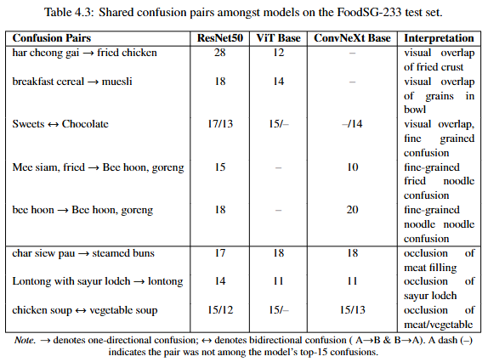
04 / RESULTS & DISCUSSION
Shared confusions
Architecture-sensitive confusions
233×233 confusion matrix; shared & unique pairs
Architecture-invariant confusions
Silhouette (cosine + Euclidean + PCA-256) · t-SNE × 5 seeds · centroid distances
21 / 32
Notes:
First, lets look at the shared confusions amongst the 3 models
Based on the table of top confusion pairs we see 2 categories of confusions
architecture-sensitive confusions and AIC
architecture-sensitive confusions are confusions where 2 models confuse one class for another,
indicative that there may be an underlying reason to their shortcomings, compared to the remaining model which did not have confusions
The second are architecture-invariant confusions:
where all models share identical rates of confustions of misclassifying one class for another.

Slide 22
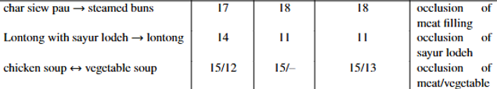
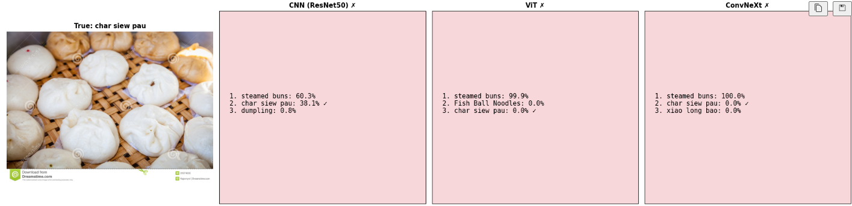
04 / RESULTS & DISCUSSION
Architecture Invariant Confusions
22/ 32
Notes:
Lets debunk the architecture-invariant confusions first since it is rather straightforward
Can you guess why all the models mistake this char siew pau image for steam buns?
You might be thinking: this is in fact steamed buns as I cant tell what the filling of the pao is
This is exactly one of fundamental challenges when it comes to image classification: occlusion
Since the key ingredient of meat filling is not visible, all the models generalize the class to be steamed buns
This case can be extended to the other 2 shared confusions as well

Slide 23
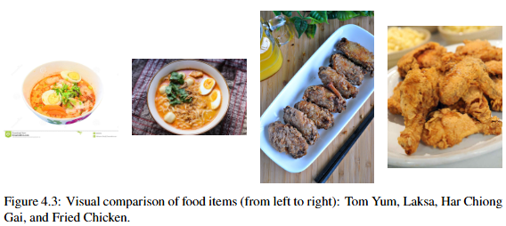
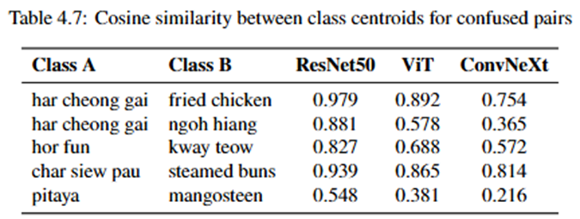

04 / RESULTS & DISCUSSION
Architectural unique failure signatures
RESNET50
Local Texture Trap
EXAMPLE
Har Cheong Gai → Fried Chicken
MECHANISM
3×3 kernels + decaying effective receptive field → predictions dominated by local texture patches
23 / 32
Notes:
Now lets look at the architectural unique failures starting with, ResNet50.
Resnet50’s failure mode is the local texture trap
the 3×3 kernels results in a sharply decaying effective receptive field
Results in predictions being made based off localized texture features
missing the broader structural context of the dish
The clearest example is Har Cheong Gai misclassified as Fried Chicken.
This is quantified by the cosine similarity between the class centroids in ResNet50's embedding space
we observe a value of 0.979 which is very close to 1, meaning their centroids are almost overlapping.

Slide 24
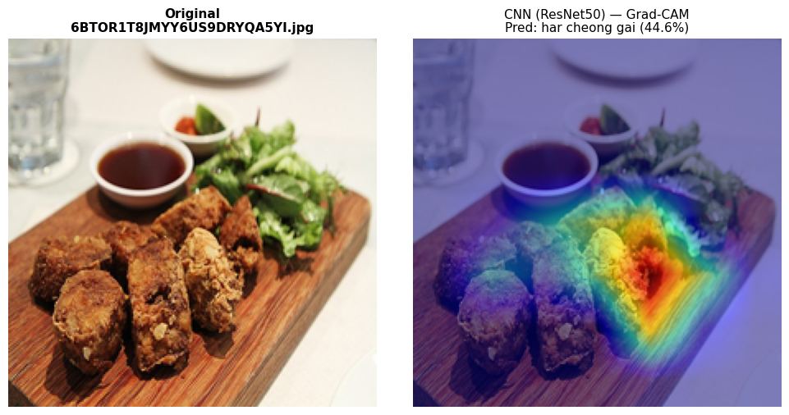
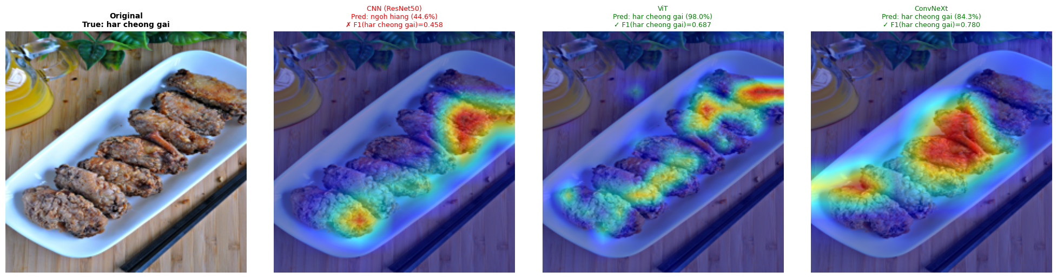
04 / RESULTS & DISCUSSION
Grad-CAM evidence
RESNET50
ATTENTION
OUTCOME
Fragmented hotspots
on shared fried-texture regions
Misclassified as Ngoh Hiang
44.6%
24/ 32
Notes:
Grad-CAM evidence reveals
ResNet50's heatmap is focusing more on a single spot with some fragmented traces.
The model focuses on the crust.
And mistakes it for Ngoh Hiang, which is understandable since they share similar visual properties as can be seen in the image at the top.
ViT’s attention heatmap spreads across the entire dish, encoding holistic scene composition. Resulting in the correct prediction.
Due to ConvNeXt’s larger 7 by 7 kernels, its attention covers a larger area, encompassing across several chicken pieces, resulting in a correct prediction

Slide 25
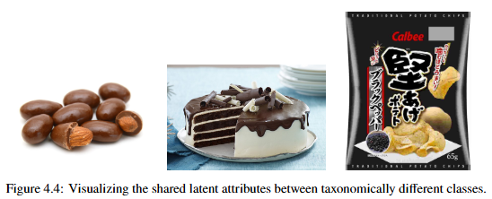
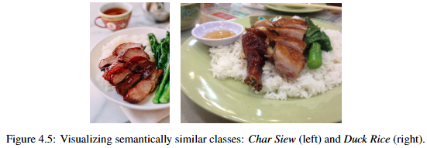
04 / RESULTS & DISCUSSION
Architectural unique failure signatures
VIT
Semantic Attractor Collapse
EXAMPLE
Cake / Nuts / Snacks → Chocolate
MECHANISM
Global self-attention abstracts to scene-level understanding → over abstracts, visually distinct classes collapse to a shared semantic
25/ 32
Notes:
Next ViT
ViT’s failure mode is the semantic attractor collapse.
Global self-attention computes pairwise relationships across all 196 patches
This is great for scene-level understanding,
but over-abstracts when the task requires fine-grained discrimination.
Take the example of the Nuts, Cake, Snacks-and-Chips class.
On their own they share no visual similarity to chocolate
But this changes when it they have an element of chocolate:
chocolate-coated nuts, chocolate-flavoured cake, chocolate-bar packaging
Which semantically attracts them to be misclassified under the chocolate class
This extends to the char siew and duck rice class both sharing the visual semantics of rice on meat

Slide 26
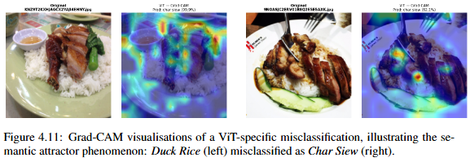
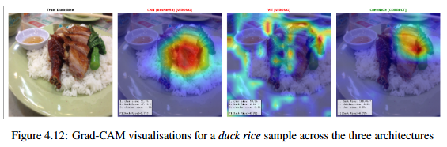
04 / RESULTS & DISCUSSION
Grad-CAM evidence
VIT
ATTENTION
Diffuse activation
across the entire plate, miss discriminative texture
98.0%
26 / 32
Notes:
Grad-CAM evidence reveals
resnet50 failing due to being too concentrated on a single texture spot of the meat section
Vits attention is diffused across the plate, missing the discriminative meat texture, over generalizing into a misclassification of char siew rice
convnext has an equal distribution of attention focus more on the precise meat component, correctly predicting the class

Slide 27
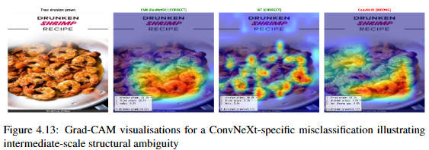
04 / RESULTS & DISCUSSION
Architectural unique failure signatures
CONVNEXT
Intermediate-Scale Ambiguity
EXAMPLE
Drunken Prawn → Fried Prawn
MECHANISM
7×7 kernels resolve the texture trap, but remain local → fail on subtle, spatially-distributed cues
27 / 32
Notes:
Lastly, ConvNeXt’s failure mode is due to intermediate-scale ambiguity.
Taking the example of misclassifying drunken prawn for fried prawn,
ConvNeXt focuses on the overall prawn structure
but fails to distinguish the finer details of smooth coating from the fried texture.
This highlights a trade-off—larger kernels capture object-level features well, but reduce sensitivity to finer texture details.
In contrast, smaller kernels or ViT’s global attention are better suited for picking up these subtle surface differences.

Slide 28
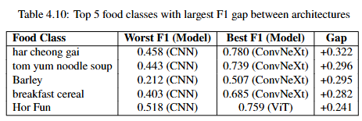
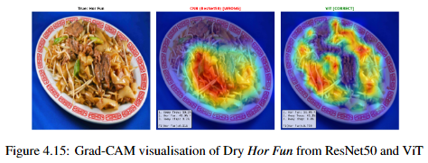
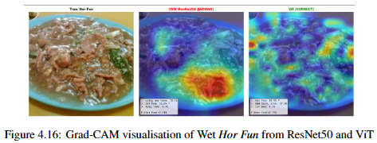



04 / RESULTS & DISCUSSION
Intra-class Variation
WHY?
Intra-class variation requires compositional invariance – recognize ingredients and structure, not just appearance. The same global-attention mechanism that causes semantic-attractor errors elsewhere becomes an asset here — it unifies distinct presentations of the same class.
28 / 32
Notes:
The prior examples were related to low inter-class variation.
Moving on to high intra-class variation
Among the five food classes with the largest cross-architecture F1 gaps, we observe that ViT takes first place when it comes to Hor Fun class instead of convnext
Why?
Hor Fun has two distinct variants— dry and wet respectively.
They look very different, but they are categorized as the same dish.
So the model needs compositional invariance—recognising the ingredients and structure, not just appearance.
Vision Transformers global attention, helps to capture these relationships relationships across the entire image.
In contrast, ResNet50 and ConvNeXt rely on local patterns, and struggle when visual features vary widely.
Interestingly, the semantic attractor that was ViTs downfall has become its advantage in this case.

Slide 29
05 / CONCLUSION
Architectural paradigm doesn't just affect how much error a model produces —
it determines what kind of error.
DEMONSTRATED THROUGH
Mechanistic error analysis Three distinct, architecturally-grounded failure modes — texture trap, semantic attractor, intermediate-scale ambiguity.
Aggregate performance ConvNeXt > ViT > ResNet50, consistent across all four metrics, on both SGFood-233 and Food-101.
Robustness verification Ranking holds at each model's optimal LR; ConvNeXt is 4–6× more LR-tolerant than alternatives.
IMPLICATION Transformer-inspired design principles proved more valuable than the self-attention mechanism itself for fine-grained food classification.
29 / 32
Notes:
To conclude, a key takeaway is that model architecture doesn’t just affect how much error is produced—it determines the type of error.
We have observed this through
the mechanistic error analysis.
The aggregate performance hierarchy was also verified to be robust
Through the learning rate study
Overall, we observed that for fine-grained food classification, ConvNeXt achieved the best performance.

Slide 30
05 / CONCLUSION & FUTURE WORK
Limitations & future work
LIMITATIONS
FUTURE WORK
Computational constraints
Single RTX 5060 Ti · ~2 hr/epoch · capped at 10 epochs
→
Efficiency–accuracy trade-off study
Inference latency, FLOPs, parameter counts, memory footprint vs. accuracy
Narrow HP study
Learning-rate-only sweep; no full multi-dimensional tuning
→
Expanded architectural coverage
Additional backbones per paradigm (e.g. EfficientNet for CNN) to test if hierarchy and failure modes generalise
Human judgement in cleaning
Final keep / remove / relabel decisions still subjective
→
End-to-end dietary pipeline
SAM3 segmentation + volume estimation for multi-food images and portion-aware calorie estimation
30 / 32
Notes:
Some limitations include:
Computational constraints --- all training was done on a single GPU, training of each epoch took 2 hours hence I capped all the trainings to 10 epochs due to time constraint, should time not be a concern extended trainings could result in better performance.
This extends to the next limitation of a narrow HP study, thus only learning rate was studied in detail.
Lastly, there could be human errors in the data cleaning process, when choosing to relabel, keep or remove images
Some future works include
Conducting a study on each models efficiency and accuracy trade offs
We could also expand the architectural coverage such as the swin cnn inspired vit paradigm
And lastly, we could create a more holistic end to end dietary estimation pipeline including segmentation and volume estimation for portion aware calorie estimation.

Slide 31
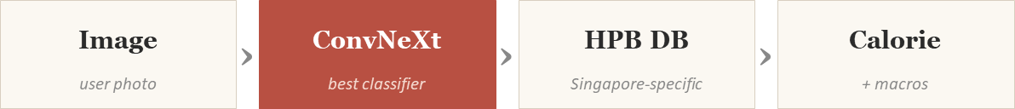
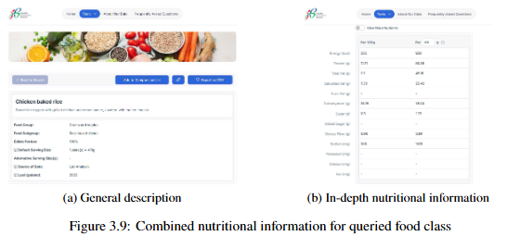
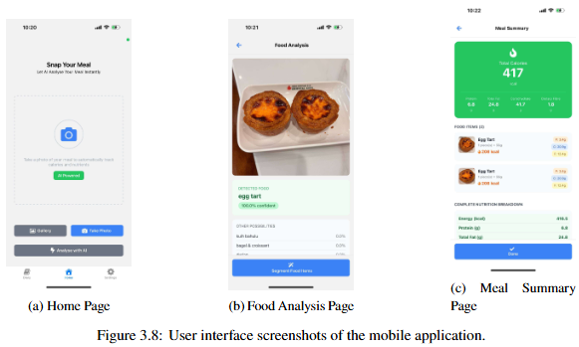
05 / DEMO
From methodology to MVP
NUTRITIONAL DATABASE
MOBILE APP MVP
Singapore HPB
Three core screens
31 / 32
Notes:
ready to see a demo?

Slide 32
CCDS25-0476 / Q&A
Thank you.
Questions?
Building a Food Recognition and Classification Model to Count Calories
Lim Xin Wei · U2240093B · College of Computing and Data Science, NTU
Notes:
Thank you.

Slide 33
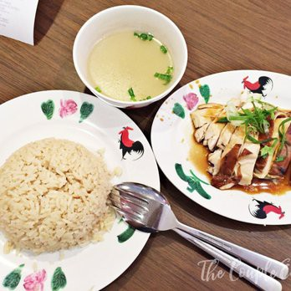
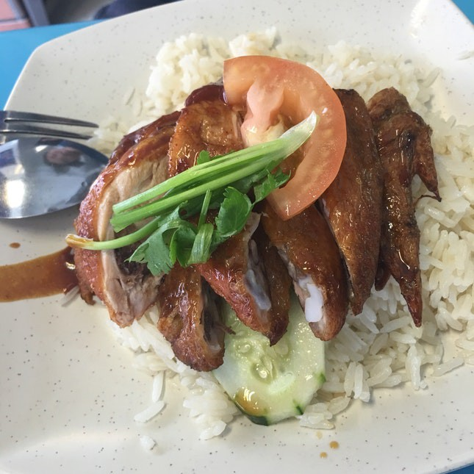
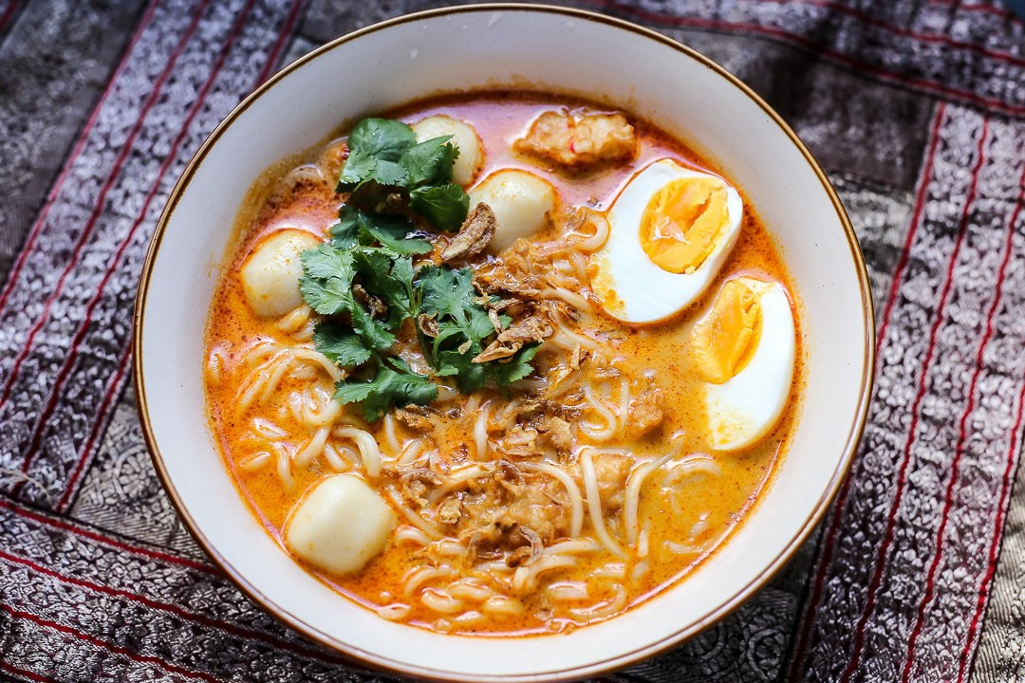
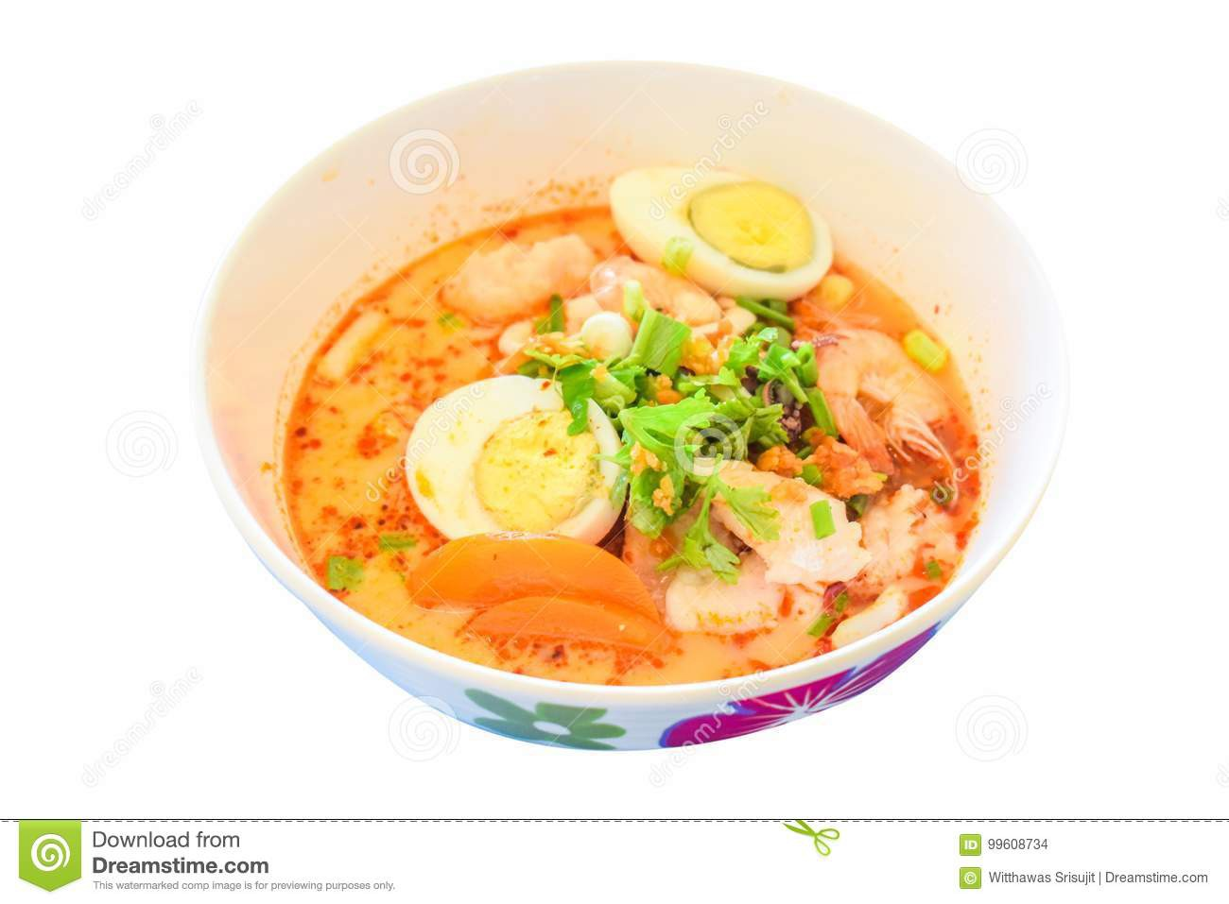
01 / PROBLEM & MOTIVATION
What makes food classification hard
HIGH INTRA-CLASS VARIATION
Same dish, very different presentations
Variations in plating, garnish, cooking style, lighting, angle, and occlusion within a single class.
LOW INTER-CLASS VARIATION
Different dishes, very similar appearance
e.g. chicken rice vs. roasted duck rice · laksa vs. tom yum
5 / 24
Notes:
However, food classification is technically much harder than it looks.
It's a fine-grained vision task, meaning the differences between classes can be very subtle. This exists in the form of:
High-intra-class variation where a dish can vary greatly in appearance. And conversely, low-inter-class variation where 2 different dishes may look similar.
Under the Singapore context,
High-intra class variation is visible in these images of Chicken rice, differing terms of how the rice and meat are plated, the cut of the meat served, cooking style and accompanying garnishes.
Low inter-class variation can be seen in the case of laksa and tom yum.
Are you able to tell which is which? When I first showed this to Dr Chong she herself had a hard time differentiating the two
These are exactly the cases where a classifier needs to pick up on fine details to get it right.
On top of that, real-world capture conditions add lighting, angle, and occlusion variability — none of which the classifier gets to control.

Slide 34
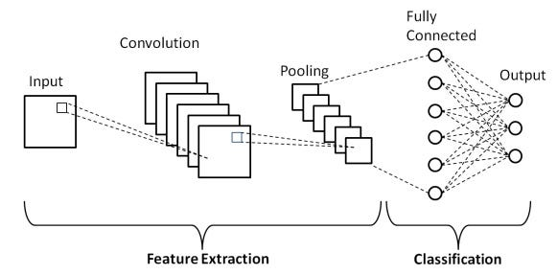
02 / LITERATURE REVIEW
Three architectural paradigms
CNN
ResNet50
Sliding convolutional kernels
Strong local inductive bias
spatial locality, translation equivariance
Mature in food classification literature
6 / 24

Slide 35
02 / LITERATURE REVIEW
Three architectural paradigms
Study | Approach | Dataset | Key Results | Strengths | Limitations
Bu et al. [27] | Transfer learning + ensemble of multiple CNNs (VGG19, ResNet50, MobileNetV2, AlexNet) | Food-11 | 96.88% accuracy, 95.43% F1-score | High accuracy; ensemble improves robustness | High computational cost; slower inference
Karabay et al. [28] | Transfer learning with deep CNNs (best: ResNet-152) | CAFD, Food1k, CAFD+Food1k | Top-1: 88.70%, Top-5: 98.59% | Strong performance with region-specific data; highlights dataset importance | Class imbalance; struggles with similar dishes; only single-food classification
CNN
ResNet50
Sliding convolutional kernels
Strong local inductive bias
spatial locality, translation equivariance
Mature in food classification literature
6 / 24
Notes:
Prior work shows that CNN-based approaches are highly effective for food recognition.
For example, Bu achieved high accuracy of above 96% using a CNN ensemble, but at the cost of computational efficiency.
Similarly, Karabay’s study obtained strong performance, and noted that dataset plays a critical role, particularly facing challenges related to class imbalance and fine-grained.

Slide 36
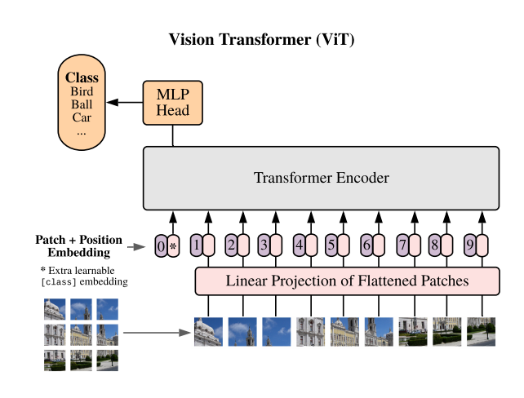
02 / LITERATURE REVIEW
Three architectural paradigms
VISION TRANSFORMER
ViT-Base
Image as patch sequence + global self-attention
Models long-range dependencies
weak inductive biases
Recent works: ViT > CNN baselines (2023–24)
6 / 24
Notes:
Vision Transformers, introduced by Dosovitskiy.
ViTs treat an image as a sequence of patches and apply self-attention globally.

Slide 37
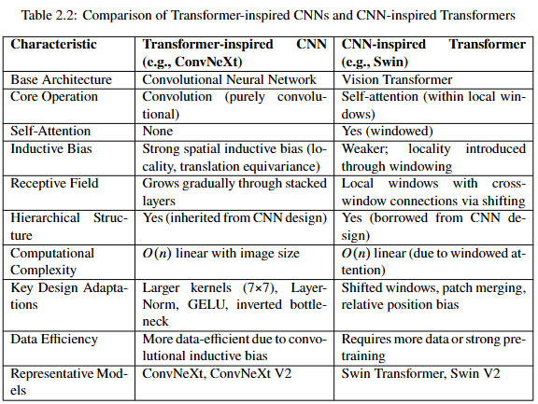
02 / LITERATURE REVIEW
Three architectural paradigms
Cross paradigm architecture
ConvNeXt-Base
Purely convolutional — no attention
7×7 depthwise · LayerNorm · GELU
inverted bottleneck
Recent works: competitive or superior to ViT
Note: ConvNeXt is purely convolutional — not a hybrid. It adopts Transformer design principles within a CNN backbone. (Transformer inspired CNN)
6 / 24
Notes:
Lastly, cross-paradigm architectures.
Namely, there are 2 sub-categories.
Transformer-inspired CNN such as ConvNeXt, introduced by Liu in 2022; and CNN-inspired Transformers, such as Swin.

Slide 38
03 / RESEARCH METHODOLOGY
Dataset selection & splits
Selection criteria · task alignment · generalisability · computational feasibility
DATASET | VERDICT
ISIA Food-500, Food2K | Excluded — too large for available hardware
UEC-Food256, VireoFood-172 | Excluded — task misalignment (multiple food detection / ingredient retrieval)
SGFood-233 | Primary · 203,655 images · 233 classes · 18.8× class imbalance
Food-101 | Secondary · established benchmark for cross-dataset validation
Two splits used in this study
75% TRAIN
25% VAL
75% TRAIN
15% VAL
10% TEST
Mislabel detection phase
Final experiments · stratified sampling preserves class balance
9 / 24
Notes:
Onto methodology.
Datasets was selected based on task alignment, generalizability, and computational feasibility.
ISIA Food-500 and Food2k were excluded as the datasets were too computationally large.
UEC-Food256 and VireoFood-172 were excluded due to task misalignment.
SGFood-233 was chosen as the primary dataset
While Food-101 serves as the secondary benchmark to verify that findings were well generalized.
2 dataset splits were used.
An initial 75 25 train-validation split was used to models, used in the data cleaning pipeline.
After data cleaning, the dataset underwent a 75/15/10 train-val-test split.

Slide 39
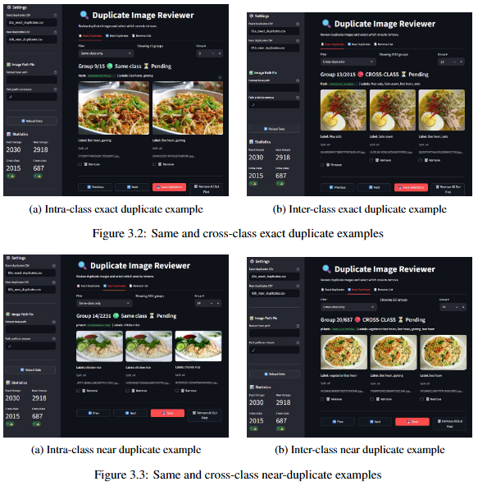
03 / RESEARCH METHODOLOGY
Data cleaning pipeline
1
Integrity check
Truncated, corrupt, or invalid files
THE NOVEL PIECE
Total
Group Count: 5312
Images removed: 5,503
Why a 3 / 3 consensus?
2
Exact duplicates → MD5 hash
2,409 removed (incl. 2,394 cross-class label conflicts)
Three architectures with fundamentally different feature-extraction paradigms agreeing on a wrong label is a high-precision noise signal — not just an ambiguous example.
3
Near duplicates → Perceptual hash
3,094 removed (Hamming ≤ 8)
4
Mislabel detection → 3-model consensus
Flag if all three architectures unanimously disagree with label
5
Human review via Streamlit UI
271 kept · 650 removed · 1,296 relabelled
Result 203,655 cleaned images · 233 classes
10 / 24
Notes:
The data cleaning pipeline has four stages.
First, integrity checks for corrupt or truncated files.
On the right side, you can see what the UI was like when reviewing intra and inter class exact and near duplicate images
MD5 hashes were used in the second stage and
Perceptual hashing was used in the third stage
A total of 5.5k images were removed.

Slide 40
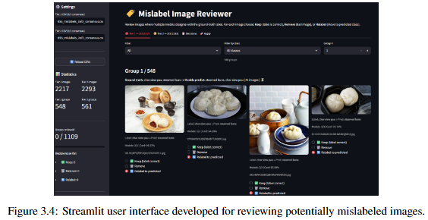
03 / RESEARCH METHODOLOGY
Data cleaning pipeline
1
Integrity check
Truncated, corrupt, or invalid files
THE NOVEL PIECE
Exact duplicates → MD5 hash
2,409 removed (incl. 2,394 cross-class label conflicts)
Why a 3 / 3 consensus?
2
Three architectures with fundamentally different feature-extraction paradigms agreeing on a wrong label is a high-precision noise signal — not just an ambiguous example.
3
Near duplicates → Perceptual hash
3,094 removed (Hamming ≤ 8)
4
Mislabel detection → 3-model consensus
Flag if all three architectures unanimously disagree with label
5
Human review via Streamlit UI
271 kept · 650 removed · 1,296 relabelled
10 / 24
Notes:
The data cleaning pipeline has four stages.
First, integrity checks for corrupt or truncated files.
On the right side, you can see what the UI was like when reviewing intra and inter class exact and near duplicate images
MD5 hashes were used in the second stage and
Perceptual hashing was used in the third stage
A total of 5.5k images were removed.
And as a result,
2,217 images were flagged this way and reviewed manually through a Streamlit interface.
About 1,300 were actually mislabelled and got relabelled, 650 were ambiguous thus removed, and 271 were correct labels that the models simply got wrong.

Slide 41
04 / RESULTS & DISCUSSION
A consistent performance hierarchy
SGFood-233 75/25 train/val split — learning rate=1e-4, batch size=64,10 epochs, AdamW optimizer with cosine annealing)
MODEL | VAL LOSS | VAL ACC | MACRO-F1
ResNet50 | 0.956 | 75.09% | 0.7357
ViT-Base | 1.011 | 80.16% | 0.7899
ConvNeXt-Base | 0.845 | 83.45% | 0.8254
Food-101 75/25 train/val split — learning rate=1e-4, batch size=64,10 epochs, AdamW optimizer with cosine annealing)
MODEL | VAL LOSS | VAL ACC | MACRO-F1
ResNet50 | 0.658 | 81.68% | 0.8168
ViT-Base | 0.502 | 88.84% | 0.8884
ConvNeXt-Base | 0.359 | 92.07% | 0.9207
15 / 24
Notes:
This is the results obtained from the initial training of the 3 models under the 75/25 train/validation split for both SGFood233 and Food101
We can observe a common trend which is the performance hierarchy that ConVNext > Vit > resnet50

Slide 42
04 / RESULTS & DISCUSSION
A consistent performance hierarchy
Model performance on SGFood-233 after data cleaning
MODEL | VAL ACC (BEFORE) | VAL ACC (AFTER) | TEST ACC | MACRO-F1
ResNet50 | 75.09% | 76.11% (+1.02PP) | 76.38% | 0.7479
ViT-Base | 80.16% | 81.03% (+0.87pp) | 81.00% | 0.7971
ConvNeXt-Base | 83.45% | 84.55% (+1.10pp) | 84.54% | 0.8361
ConvNeXt > ViT > ResNet50
same ranking holds on SGFood-233 Before and After data cleaning and on Food-101 (secondary benchmark)
15 / 24
Notes:
The performance ranking still holds after the impact of the data cleaning.
We see a consistent improvement of approximately 1 percentage point across all three architectures so the cleaning pipeline did not particularly bias a model.

Slide 43
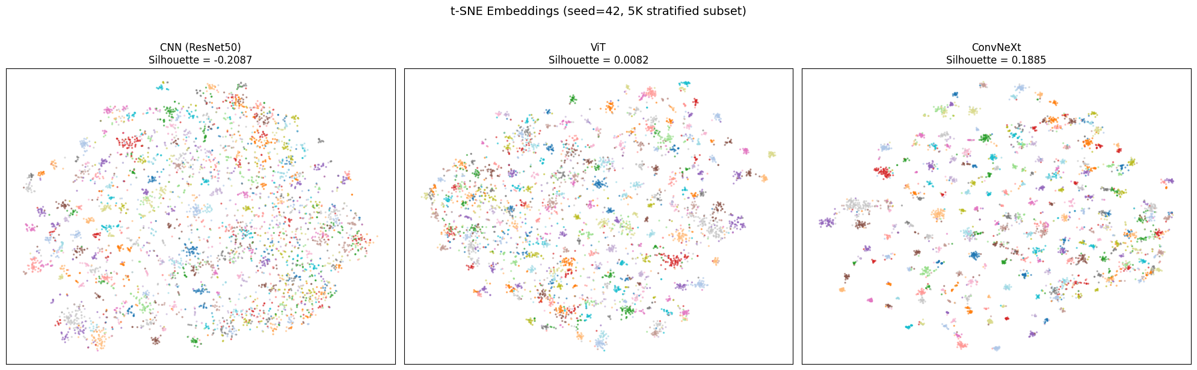
04 / RESULTS & DISCUSSION
Performance mirrors embedding geometry
MODEL | EMB. DIM | SILHOUETTE (PCA-256, cosine)
ResNet50 | 2048 | 0.094
ViT-Base | 768 | 0.143
ConvNeXt-Base | 1024 | 0.304
3.2×
higher class separation
ConvNeXt vs. ResNet50 (PCA-equalised)
MODEL | Mean ± Std
ResNet50 | -0.2083 ± 0.0006
ViT-Base | 0.0079 ± 0.0013
ConvNeXt-Base | 0.1887 ± 0.0009
Amorphous cloud,
heavy class overlap
Partial clustering,
blurred boundaries
Visibly distinct clusters,
clean separation
16 / 24
t-SNE projections of penultimate-layer embeddings for ResNet50, ViT, and ConvNeXt
Notes:
Before discussing about the error analysis, here is a quick rundown on the embedding space analysis.
To compare fairly across architectures with different embedding dimensionalities, I reduced all three to a shared 256-dimensional space using PCA.
The result is the same ranking we saw on aggregate accuracy.
ConvNeXt's silhouette score is roughly 3.2 times higher than ResNet50’s, and twice that of ViT, indicating substantially stronger class separation.
The t-SNE projections on the slide help visualise this.
ResNet50 produces an amorphous cloud with heavy class overlap.
ViT shows partial clustering with blurred boundaries.
ConvNeXt forms visibly distinct clusters.
The silhouette results were verified across five random seeds, with a low standard deviations under 0.002.
Moving on to what kinds of errors each architecture makes through the error analysis investigation

Slide 44
04 / RESULTS & DISCUSSION
Architectural unique failure signatures
Each architecture has a distinct failure mode, traceable to its spatial-modelling mechanism
RESNET50
VIT
CONVNEXT
Local Texture Trap
Semantic Attractor Collapse
Intermediate-Scale Ambiguity
EXAMPLE
EXAMPLE
EXAMPLE
Har Cheong Gai → Fried Chicken
Cake / Nuts / Snacks → Chocolate
Drunken Prawn → Fried Prawn
MECHANISM
MECHANISM
MECHANISM
3×3 kernels + decaying effective receptive field → predictions dominated by local texture patches
Global self-attention abstracts to scene-level concepts → visually distinct classes collapse to a shared semantic
7×7 kernels resolve the texture trap, but remain local → fail on subtle, spatially-distributed cues
Architecture doesn't just affect how much error — it determines what kind.
17 / 24
Notes:
This is the intellectual core of the project. Each architecture has a distinct failure signature, and each one is traceable to its spatial-modelling mechanism.
First, ResNet50 — the local texture trap. Its unique confusions all involve dishes that share dominant local textures but differ in global context. The clearest example is Har Cheong Gai — prawn-paste-coated chicken — being misclassified as plain Fried Chicken. The cosine similarity between these two class centroids in ResNet50's embedding space is 0.979 — they're essentially overlapping. This is exactly the documented CNN texture bias surfacing in the food domain: 3×3 kernels with sharply decaying effective receptive fields mean predictions are dominated by surface-level patches, missing the broader structural context.
Second, ViT — semantic attractor collapse. ViT's unique confusions involve visually dissimilar classes — Cake, Nuts, Snacks-and-Chips — all collapsing into a misclassification as Chocolate. These classes share no visual similarity, but they share a semantic attribute: chocolate-flavoured cake, chocolate-coated nuts, chocolate-bar packaging. Global self-attention computes pairwise relationships across all 196 patches from layer one, which is excellent for scene-level understanding, but over-abstracts when the task requires fine-grained discrimination. The Duck Rice → Char Siew confusion makes this concrete — ViT's diffuse attention spreads over the entire plate rather than the discriminative meat texture.
Third, ConvNeXt — intermediate-scale structural ambiguity. ConvNeXt sits in the middle. Its 7×7 depthwise convolutions cover roughly 5.4× the spatial area of ResNet's 3×3 kernels, so it avoids the texture trap. But the kernels remain local — there's no global patch-to-patch comparison like ViT. So ConvNeXt fails on subtle, spatially distributed cues: distinguishing a drunken prawn's wine glaze from a fried prawn's batter, or whole wheat from whole grain bread.
The synthesis matters. Architecture isn't just a knob for how much error you get — it determines what kind of error. Each paradigm trades one error type for another.

Slide 45
04 / RESULTS & DISCUSSION
Grad-CAM evidence
Same Har Cheong Gai input → three attention patterns → three outcomes
RESNET50
VIT
CONVNEXT
ATTENTION
ATTENTION
ATTENTION
Fragmented hotspots
on shared fried-texture regions
Diffuse activation
across the entire plate
Cohesive activation
over chicken pieces
OUTCOME
OUTCOME
OUTCOME
Misclassified as Ngoh Hiang
Correct — driven by holistic scene context
Correct — spatially-grounded reasoning
44.6%
98.0%
high
Architectural mechanism produces both the embedding geometry AND the visual attention pattern.
18 / 24
Notes:
Grad-CAM gives us a direct visual of these mechanisms in action. This slide shows the same Har Cheong Gai image fed to all three architectures.
ResNet50's heatmap is fragmented — small hotspots concentrated on shared fried-texture regions. The model's attention literally fits the texture-trap description. It misclassifies as Ngoh Hiang.
ViT's heatmap spreads across the entire plate, encoding holistic scene composition. It gets the answer right at 98% confidence, but the reasoning is global-scene rather than object-specific.
ConvNeXt's heatmap is the most coherent — activation covers the chicken pieces as connected entities, with more structured spatial boundaries than ViT's diffuse spread. This is the principled middle ground: wide enough to avoid the texture trap, but local enough to preserve spatial specificity.
So the architectural mechanism we hypothesised on the previous slide produces both the embedding geometry and the visual attention pattern. The story is consistent at all three levels of analysis.

Slide 46
04 / RESULTS & DISCUSSION
Convergence at the extremes
Per-class F1 extremes show near-complete overlap across all three architectures
BEST 5 CLASSES
WORST 5 CLASSES
pitaya · rambutan · mangosteen · tumpeng · soursop
whole wheat · barley · mee siam fried · bee hoon soto · mee kuah
Distinctive, unambiguous fruit forms with no close visual neighbours.
Any architecture handles them.
Amorphous textures or fine-grained noodle confusions.
No architecture handles them well.
IMPLICATION
Architectural choice matters most in the middle of the difficulty spectrum — where discriminative features exist but require the right spatial-modelling mechanism.
Spearman correlation per-class silhouette ↔ accuracy ρ > 0.85, p < 10⁻⁶⁷ for all three architectures
19 / 24
Notes:
A natural question is: Where does architecture actually matter?
Not at the extremes.
The easiest and hardest classes are the same across all models—easy ones have clear features, and hard ones are ambiguous for all.
Accuracy strongly tracks class separability, regardless of architecture.
So the difference shows up in the middle—where features exist but require the right spatial modelling mechanisms to discern.

Slide 47
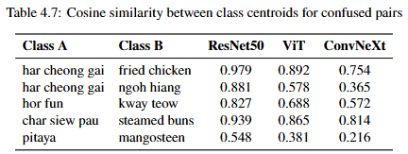
04 / RESULTS & DISCUSSION
Geometric validation via centroid proximity
Each architecture has a distinct failure mode, traceable to its spatial-modelling mechanism
RESNET50
Local Texture Trap
EXAMPLE
Har Cheong Gai → Fried Chicken
MECHANISM
3×3 kernels + decaying effective receptive field → predictions dominated by local texture patches
17 / 24
Notes:
Looking at the cosine similarity between the class centroids in ResNet50's embedding space
we observe a value of 0.979 which is very close to 1, meaning their centroids are almost overlapping.
The local texture trap is attributed to the 3×3 kernels with sharply decaying effective receptive fields results in predictions being dominated by surface-level patches, missing the broader structural context.

Slide 48
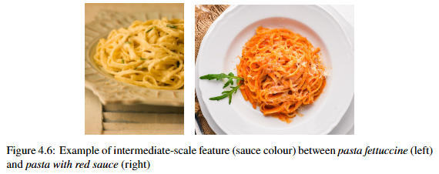
04 / RESULTS & DISCUSSION
Architectural unique failure signatures
CONVNEXT
Intermediate-Scale Ambiguity
EXAMPLE
Drunken Prawn → Fried Prawn
MECHANISM
7×7 kernels resolve the texture trap, but remain local → fail on subtle, spatially-distributed cues
17 / 24
Notes:
Lastly, ConvNeXt’s failure mode is due to intermediate-scale ambiguity.
Its 7×7 depthwise convolutions cover roughly 5.4× the spatial area of ResNet's 3×3 kernels, so it avoids the texture trap.
But the kernels remain local — there's no global patch-to-patch comparison like ViT.
So ConvNeXt fails on subtle, spatially distributed cues

Slide 49
04 / RESULTS & DISCUSSION
Grad-CAM evidence
CONVNEXT
ATTENTION
Cohesive activation
over chicken pieces
OUTCOME
Correct — spatially-grounded reasoning
high
18 / 24
Notes:
For Drunken Prawn vs Fried Prawn, the key difference is surface texture.
ConvNeXt focuses on the overall prawn structure but fails to distinguish the smooth coating from the granular fried texture.
This highlights a trade-off—larger kernels capture object-level features well, but reduce sensitivity to fine texture details.
In contrast, smaller kernels or ViT’s global attention are better suited for picking up these subtle surface differences.

Slide 50
04 / RESULTS & DISCUSSION
Hyperparameter robustness
LR SENSITIVITY PROFILES
ResNet50
monotonically increasing · prefers high LR
ViT
sharp peak at 5×10⁻⁵ · collapses at high LR
ConvNeXt
broad peak · graceful degradation
4–6×
more LR-tolerant — and the ranking holds at every model's optimal LR
21 / 24
Notes:
You may ask, what if the fixed configurations favoured one model over the others
Hence leading us to the learning rate robustness study.
The five learning rates sweep spans two orders of magnitude, and each architecture revealed a distinct optimization profile.
ResNet50 prefers high learning rates.
Conversely, ViT favours lowering learning rates
Whereas ConvNeXt has the broadest tolerance

Slide 51
05 / CONCLUSION
Architectural paradigm doesn't just affect how much error a model produces —
it determines what kind of error.
DEMONSTRATED THROUGH
Aggregate performance ConvNeXt > ViT > ResNet50, consistent across all four metrics, on both SGFood-233 and Food-101.
Mechanistic error analysis Three distinct, architecturally-grounded failure modes — texture trap, semantic attractor, intermediate-scale ambiguity.
Robustness verification Ranking holds at each model's optimal LR; ConvNeXt is 4–6× more LR-tolerant than alternatives.
IMPLICATION Transformer-inspired design principles proved more valuable than the self-attention mechanism itself for fine-grained food classification.
22 / 24
Notes:
The central finding from this project is that architectural paradigm doesn't just affect how much error a classifier produces — it determines what kind of error. That claim was supported through three methodological lenses.
Aggregate performance showed a consistent ranking — ConvNeXt outperforms ViT, which outperforms ResNet50 — across all four metrics, on both SGFood-233 and Food-101.
Mechanistic error analysis identified three distinct, architecturally-grounded failure modes: ResNet50's texture trap, ViT's semantic attractor collapse, and ConvNeXt's intermediate-scale structural ambiguity. Each one is traceable to a specific spatial-modelling mechanism.
And robustness verification through the learning rate study confirmed that the ranking holds when each model is evaluated at its own optimal learning rate — so it's not an HP artefact.
The broader implication is that for fine-grained food classification, Transformer-inspired design principles — the 7×7 kernels, LayerNorm, GELU activations, inverted bottlenecks — proved more valuable than the self-attention mechanism itself. ConvNeXt achieves the best of both worlds without ever introducing attention.
On the practical side, the calorie-estimation MVP is delivered — a mobile app built on ConvNeXt and Singapore's HPB nutritional database.

