Slide 1
Example 2
Matt Morris

Slide 2
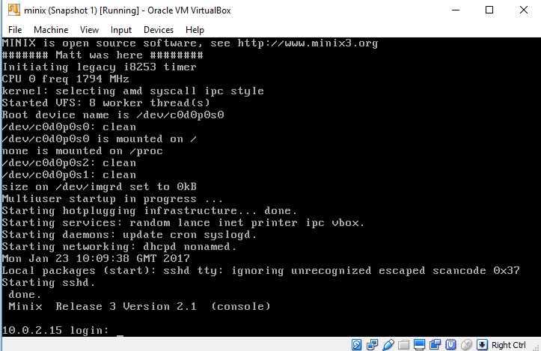
Part 1 – Modify the boot message
cd to /usr/src/kernel
Copy main.c to another folder (/home/ preferably)
open /kernel/main.c
Find boot message and add your own (printf();)
Rebuild kernel and reboot

Slide 3
Part 2 – Create patchfile
diff: to calculate the difference between two files (or
directories).
$ diff file1.txt file2.txt > diff.txt
patch: alter a file based on a patch file (generated by diff).
$ patch file1.txt diff.txt

Slide 4
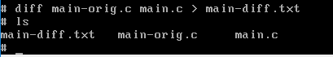
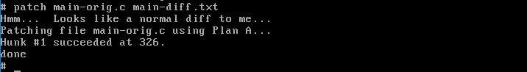
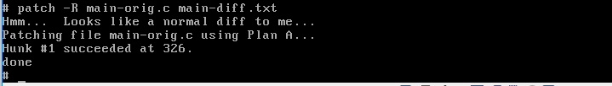
Part 2 – Create patchfile

Slide 5
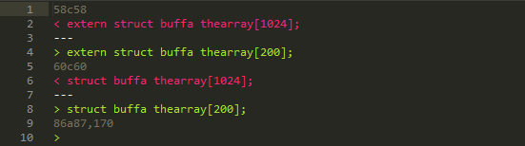
Part 2 – Create patchfile
A stands for added, d for deleted and c for changed

Slide 6
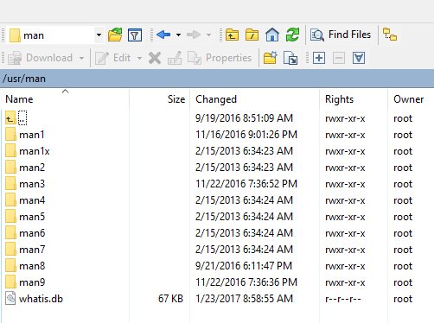
Man pages
Located at /usr/man

Slide 7
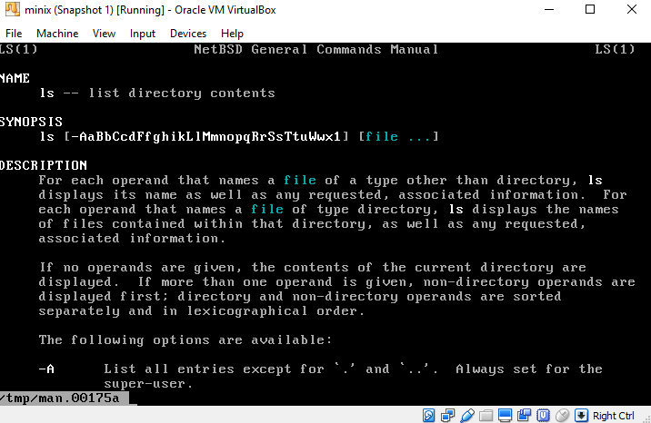
Man pages
To access, type:
$ man <any command>
Go to this site to understand the syntax:
http://liw.fi/manpages/
or
Just copy an existing man file and wing it
*what I did*

Slide 8
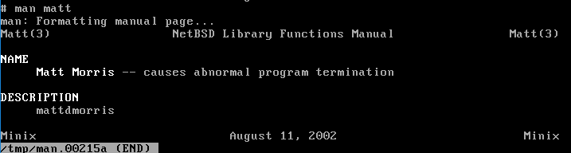
Part 3 – Create Man page
Put your first and last name after NAME
Put your ufl username in the DESCRIPTION

