Slide 1
Binder

Slide 2
Outline
What：Binder是什么
Why：为什么选择Binder作为Android主要的IPC机制
How：Binder的基本工作原理

Slide 3
What
Binder是一个分布式的组件架构，它类似于COM和CORBA
产品：BeOS/Palm OS
openBinder的开源项目 ：
http://www.angryredplanet.com/~hackbod/openbinder/docs/html/index.html

Slide 4
Why
1，性能
2，传输效率
3，安全性
4，易用性
5，其他因素

Slide 5
Binder特点
（1）binder驱动硬件要求低
（2）只需一次内存拷贝
（3）以进程uid作为通信过程中的身份鉴别标志
（4）RPC机制

Slide 6
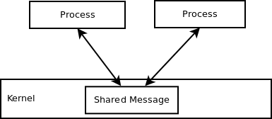
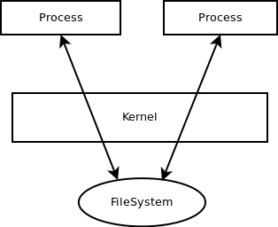

IPC分类

Slide 7
How
主要组成模块：
Server
Client
ServiceManager
Binder驱动

Slide 8
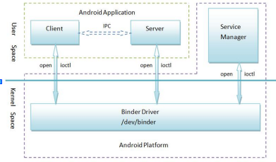
工作原理

Slide 9
Service Manager成为守护进程
int main(int argc, char **argv)
{
struct binder_state *bs;
void *svcmgr = BINDER_SERVICE_MANAGER;
bs = binder_open(128*1024);
if (binder_become_context_manager(bs)) {
LOGE("cannot become context manager (%s)\n", strerror(errno));
return -1;
}
svcmgr_handle = svcmgr;
binder_loop(bs, svcmgr_handler);
return 0;
}

Slide 10
Server和Client获得Service Manager接口
sp<IServiceManager> defaultServiceManager()
{
if (gDefaultServiceManager != NULL)
return gDefaultServiceManager;
AutoMutex _l(gDefaultServiceManagerLock);
if (gDefaultServiceManager == NULL) {
gDefaultServiceManager = interface_cast<IServiceManager>(
ProcessState::self()->getContextObject(NULL));
}
return gDefaultServiceManager;
}

Slide 11
interface_cast<IServiceManager>(ProcessState::self()->getContextObject(NULL));
==>
new BpServiceManager(new BpBinder(0))

Slide 12
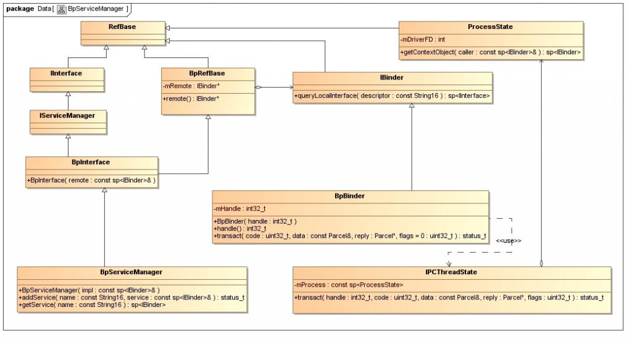

Slide 13
Server的启动与注册
int main(int argc, char** argv)
{
sp<ProcessState> proc(ProcessState::self());
sp<IServiceManager> sm = defaultServiceManager();
......
MediaPlayerService::instantiate();
......
ProcessState::self()->startThreadPool();
IPCThreadState::self()->joinThreadPool();
}

Slide 14
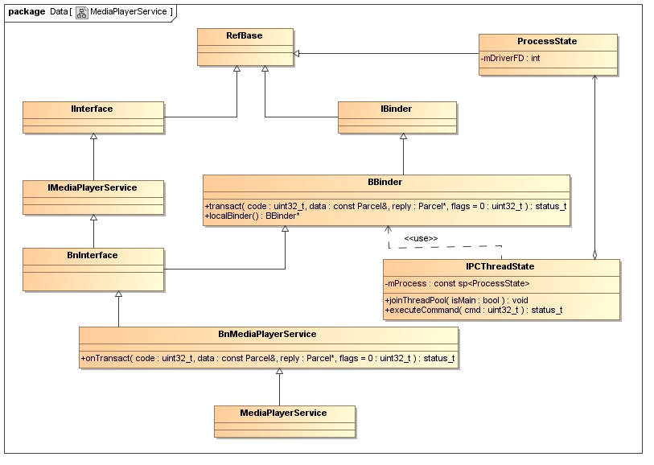

Slide 15
Client通过ServiceManager获取服务
getMediaPlayerService()
{
......
sp<IServiceManager> sm = defaultServiceManager();
sp<IBinder> binder;
do {
binder = sm->getService(String16("media.player"));
if (binder != 0)
break;
usleep(500000); // 0.5 s
} while(true);
......
sMediaPlayerService = interface_cast<IMediaPlayerService>(binder);
......
return sMediaPlayerService;
}

Slide 16
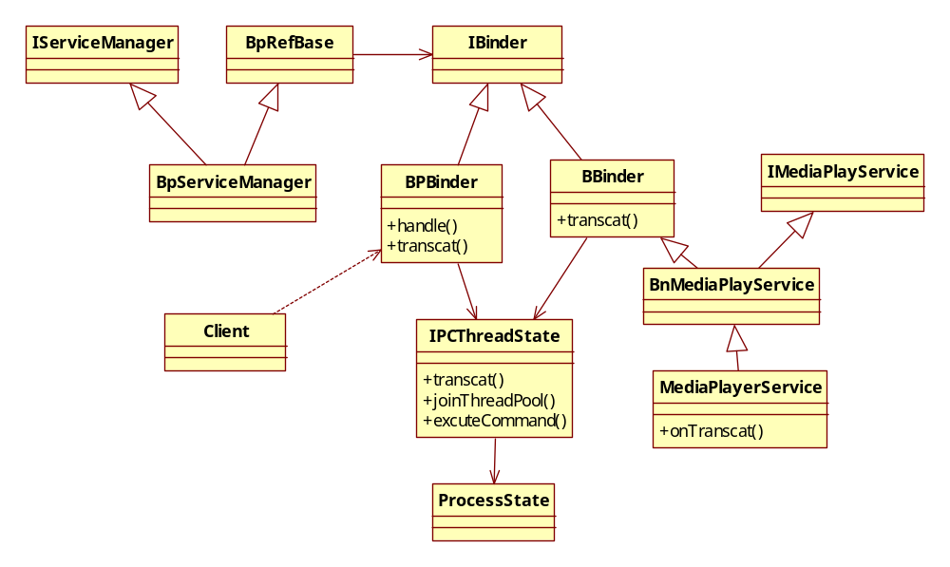
总框架

Slide 17
The End
Thanks!

