Slide 1

Classification tasks. kNN method
Classification tasks kNN Quality metrics Use of kNN in practice

Slide 2

Classification tasks

Slide 3




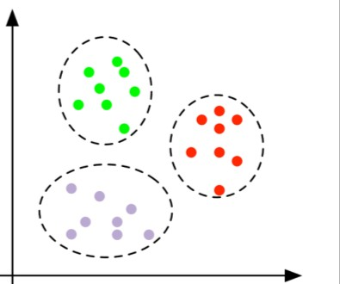
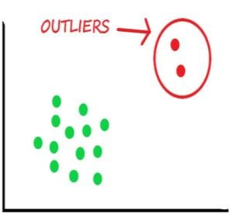
Tasks of Machine Learning
With teacher
Supervised learning
Without teacher
Unsupervised learning
Classification
Regression
Clustering
Dimensionality reduction
Anomaly detection

Slide 4
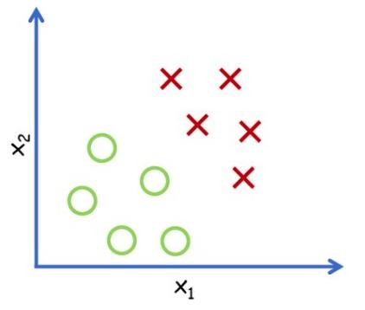
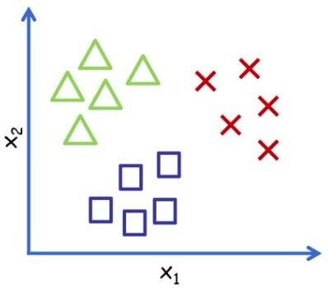
Classification task
Goal – forecast the target from the defined list of possible options
Binary classification
Multiclass classification

Slide 5
Classification task
Goal – forecast the target from the defined list of possible options
Binary classification
Multiclass classification
Credit risk scoring (will give back / not give back)
Spam detection (spam / not spam)
Medical diagnosis (ill / not ill)
Client churn (leave / will not leave)
Symbol recognition (numbers, letters)
Customer classification (frequency of spending)
Illness stages (beginning, stage 1, stage 2, …)

Slide 6
Classification algorithms
kNN
Logistic regression
Decision Tree
Random Forest
Gradient Boosting
SVM
Naive Bayes
Neural Networks

Slide 7
kNN algorithm

Slide 8
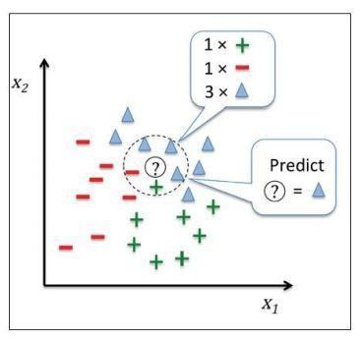
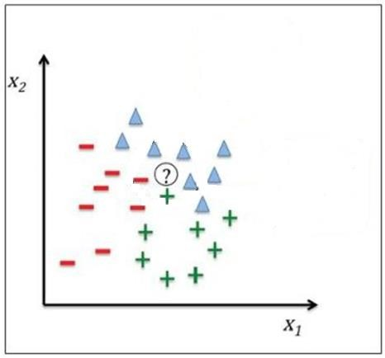
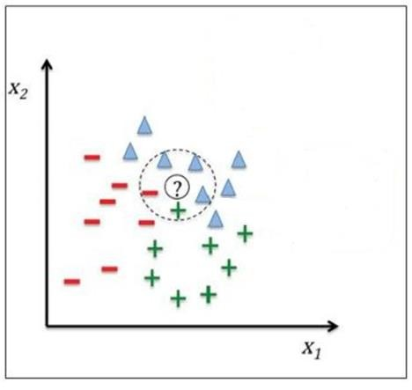
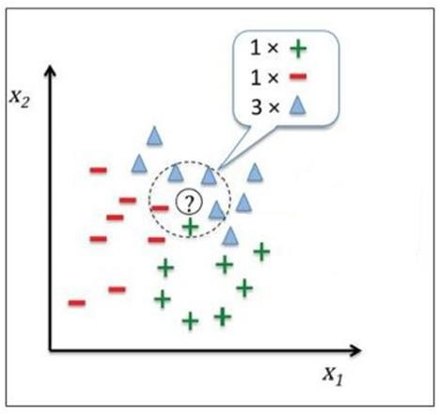
Algorithm kNN (K-Nearest Neighbors)

Slide 9
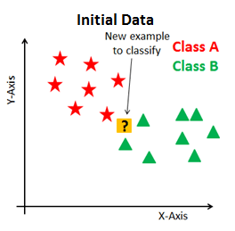
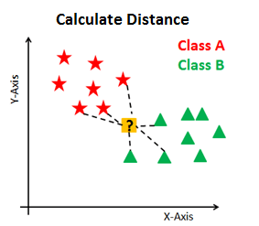
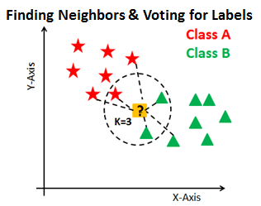
Algorithm kNN
Task – define class for new point given existing labeled dataset
Calculate the distance from new point to all known in the dataset
Choose k nearest and assign to new point the most popular class

Slide 10







Distance metrics
Which distance metrics do you know?
1. Euclidian metric
For points p = (p1, p2,…, pn) and q = (q1, q2,…, qn) the segment length is equal:
2. Manhattan metric

Slide 11
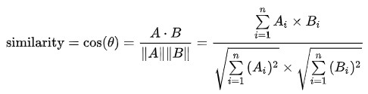
Distance metrics
3. Cosine distance

Slide 12
Pros and cons of kNN
Pros:
+ Simple realization
+ Doesn’t require training
+ Easy to interpret
Cons:
Low speed on large amount of data
Choice of metric
Sensitive to outliers => has a tendency to overfit
Working poorly, when there are many features, because of ”dimensionality curse"

Slide 13
Data normalization

Slide 14
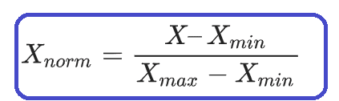
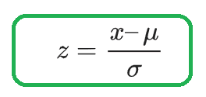
Data normalization
In practice, next feature normalization methods are most common:
Minimax — linear data transformation in the range of [0..1], where min and max normalized values are equal to 0 and 1 correspondingly:
Z-score data normalization in the range of [-1..1] based on the mean value and standard deviation: dividing the difference between the variable and the mean by the standard deviation;

Slide 15
Metrics of the quality of classification

Slide 16
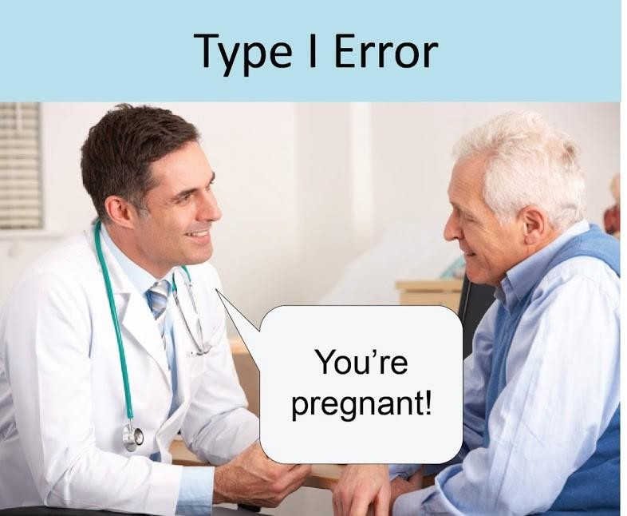
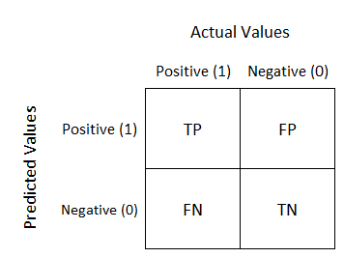
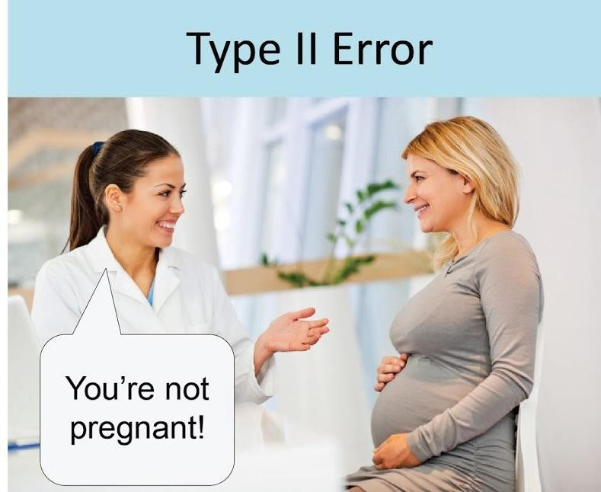
Error matrix (confusion matrix)
TP
FP
TN
FN

Slide 17
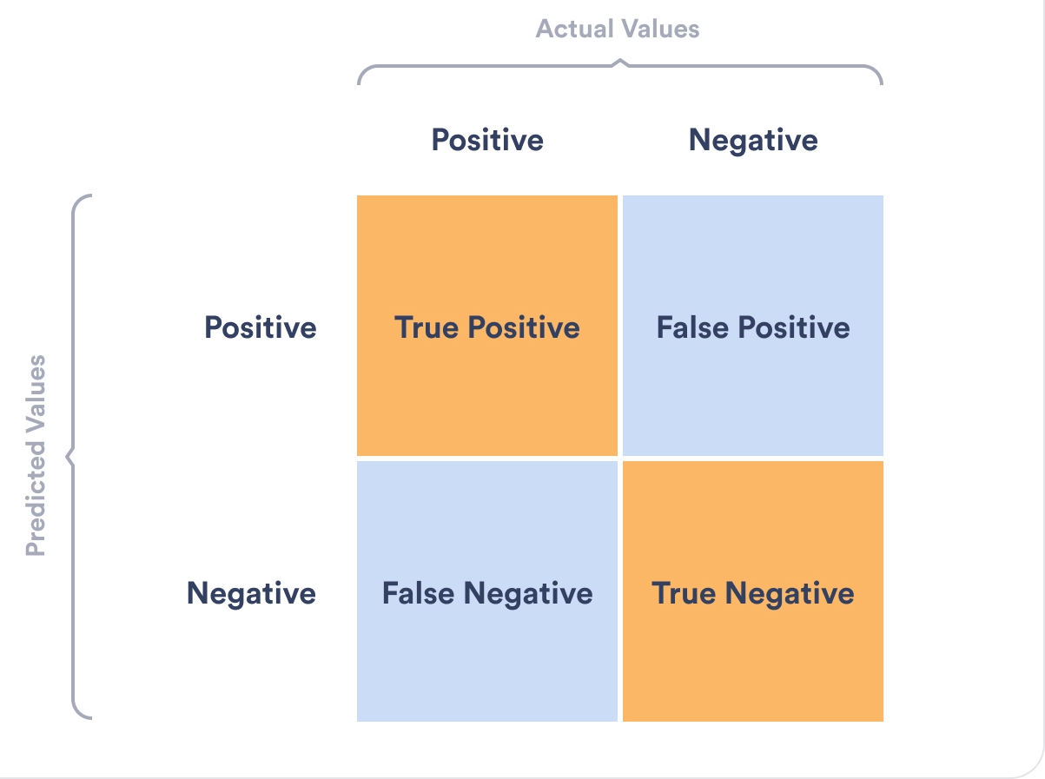
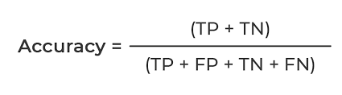
Accuracy
Accuracy – of all correctly classified objects

Slide 18
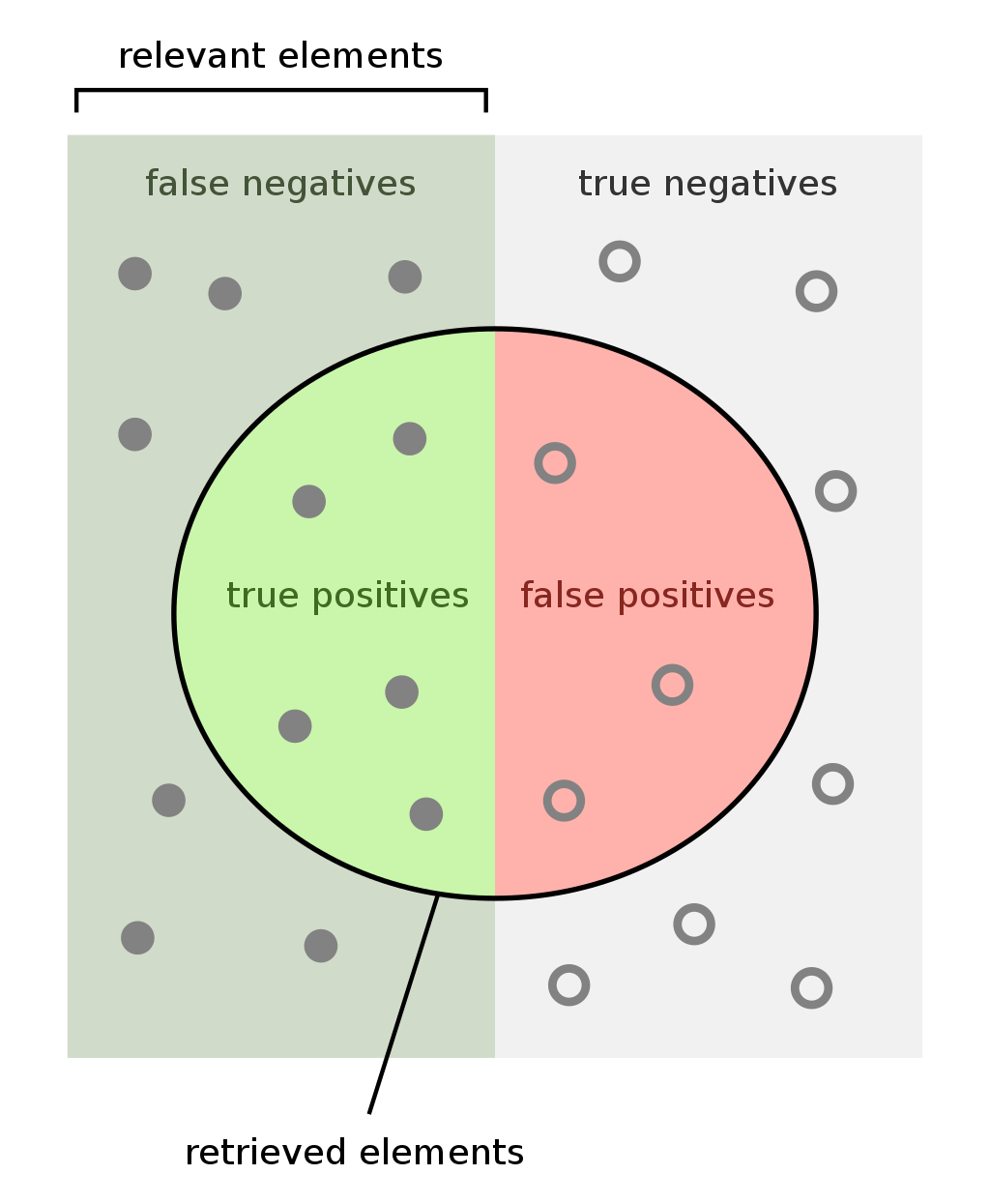
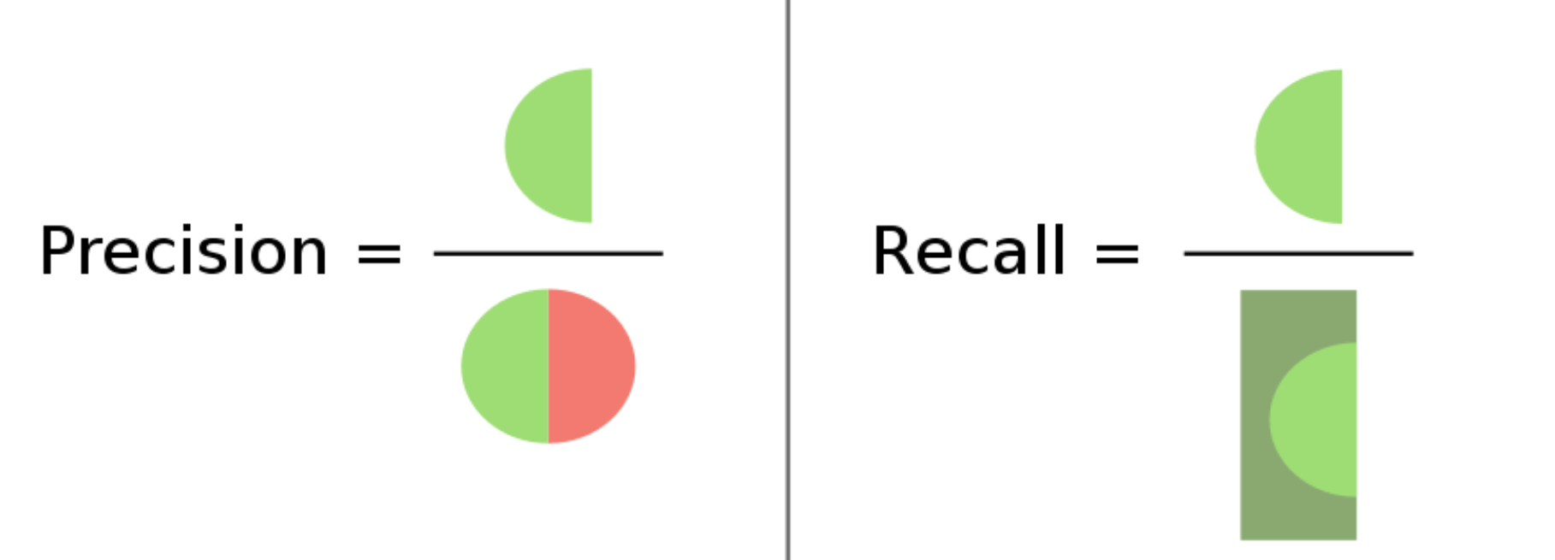


Precision & recall
Precision – the proportion of objects called positive by the classifier and at the same time really being positive
Recall - proportion of positive class objects found by the algorithm out of all positive class objects

Slide 19

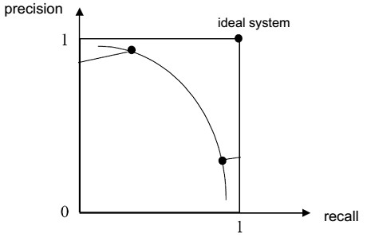

Quality of metrics
1) Proportion of correctly classified objects (Accuracy)
TP | FP
FN | TN
Precision:
Shows what proportion of objects that are called positive by the classifier and at the same time are really positive
Recall:
Shows what proportion of objects of a positive class out of all objects of a positive class was found by the algorithm
F1-score:
F-score (F1 score) is a joint assessment of accuracy and recall - geometric mean

Slide 20
Model Training

Slide 21
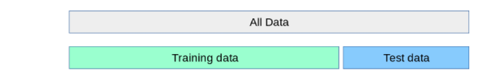
Model training
Model training

Slide 22
Model training
Model training
Model evaluation

Slide 23
Model training
Model training
Model evaluation
Why can't the model be evaluated on the training set?

Slide 24
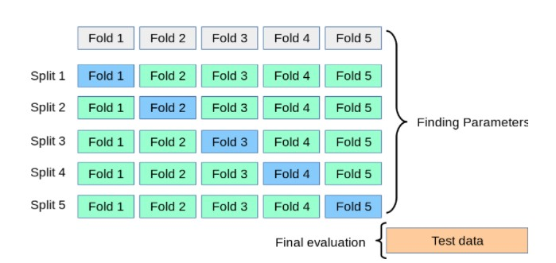
Parameter choice
k-fold cross-validation

Slide 25
We covered …
What type of tasks classification is related to?
1
Give examples of classification?
2
How is the class label defined in kNN?
3
What quality metrics do exist?
4

