Slide 1



Introduction to NLP & Text Classification
PyCon Ireland 2023
12.11.2023
omen in AI Ireland
Nabanita Roy & Liliya Akhtyamova

Slide 2


The WAI TEAM today!
Nabanita Roy
Women in AI Ireland
Senior Data Scientist at EY
https://www.linkedin.com/in/nabanita-roy/
Liliya Akhtyamova
Women in AI Ireland
Senior Data Scientist & ML Engineer at iCIMS
https://www.linkedin.com/in/datawhizette/

Slide 3


Slide 4
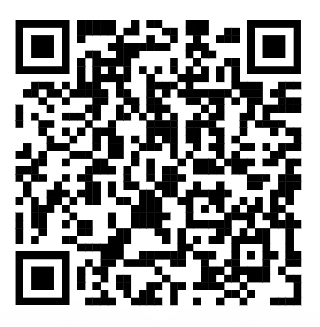
Agenda QR – Code to GitHub
What is Natural Language Processing (NLP)
NLP Tasks
Text Vectorization Techniques
Text Preprocessing
Text Classification Methods
Model Evaluation for Text Classification
End-to-End Example
Practice

Slide 5
Natural Language Processing
Natural Language Processing (NLP) - a section of Data Science devoted to how computers analyze natural (human) language. NLP allows you to apply machine learning algorithms to text and speech.

Slide 6
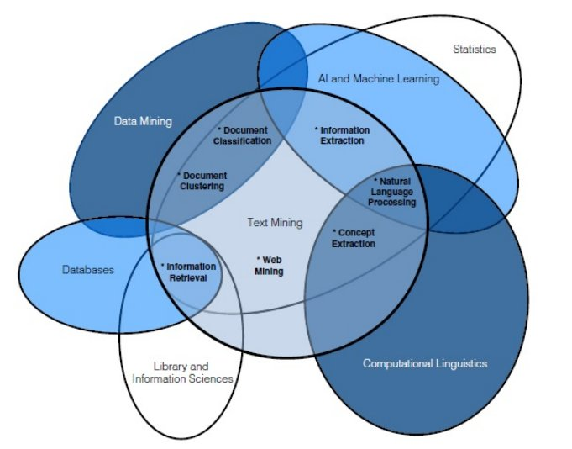
Natural Language Processing

Slide 7
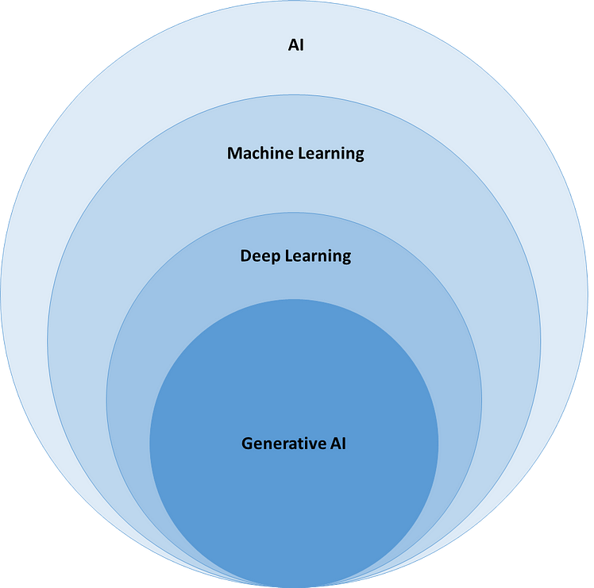
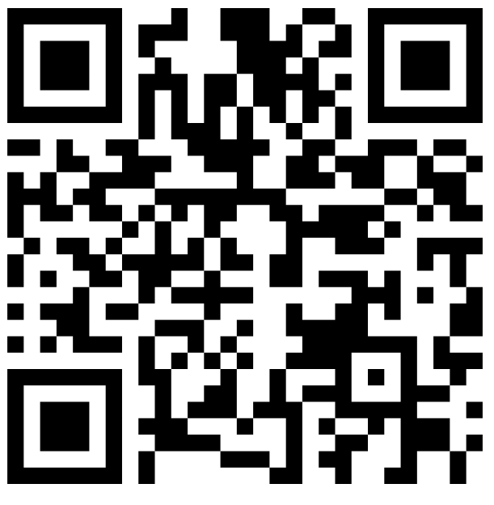
Where does NLP fit here? Menti: 8215 9464

Slide 8
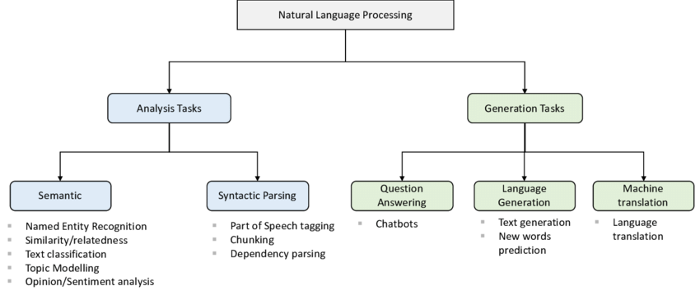
NLP Tasks Overview
Menti: 8215 9464
Source: https://www.researchgate.net/figure/NLP-Tasks-Categorized-in-Two-Broader-Categories-Analysis-Tasks-light-blue-and_fig4_343323519

Slide 9
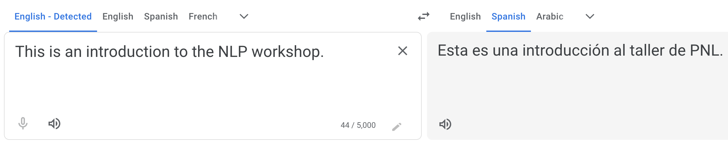

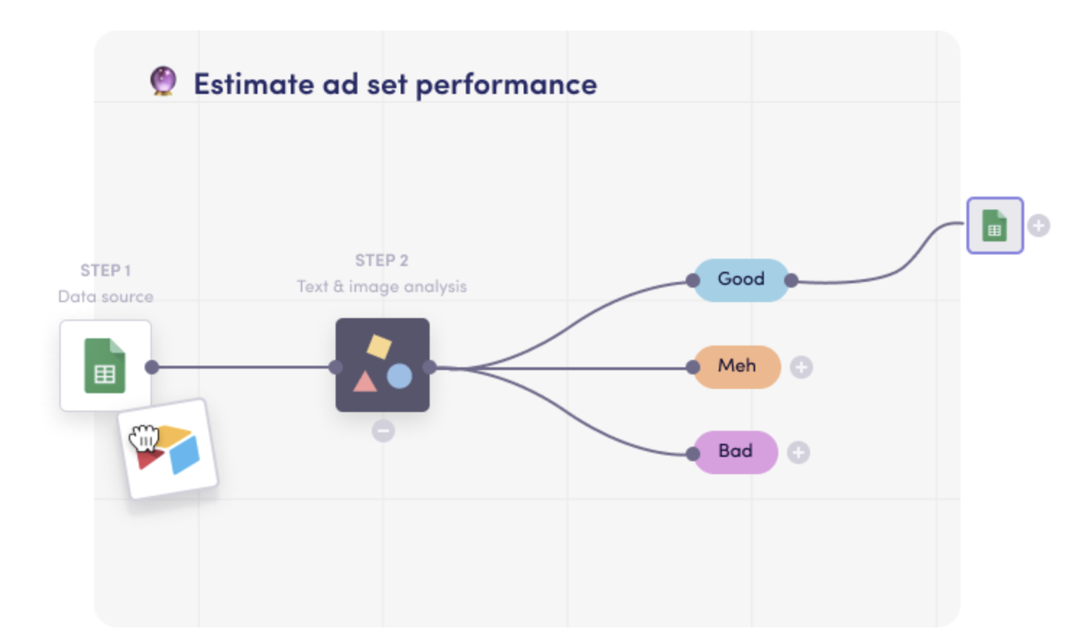

NLP Tasks
Machine Translation
Classification
Spam filtration
Sentiment analysis
Spoiler detection

Slide 10
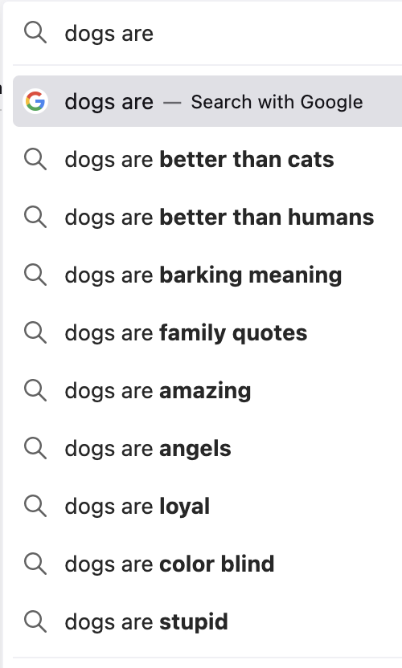

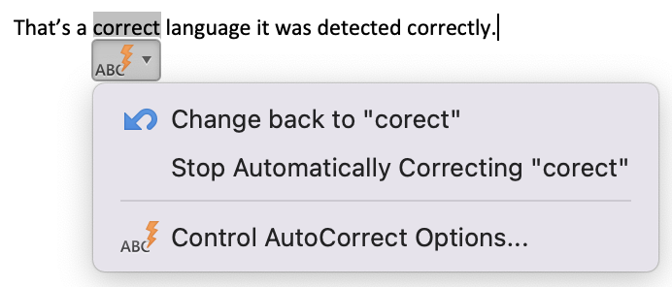
NLP Tasks
Autocompletion
Autocorrection
Chatbots - GenAI (Wohoo!)

Slide 11

How do computers understand words?
Through numbers (and then bits)
Need to encode words (or parts of words, sentences, whole documents) into numbers. That process is called text vectorization, and numerical representations of texts are called embeddings
Most popular types of embeddings are word embeddings
Funny video – how automated systems can struggle to understand human language:
Scottish Elevator - Voice Recognition - ELEVEN !

Slide 12
Text Vectorization Techniques
Bag Of Words (Count Vectorizer)
Term Frequency and Inverse Document Frequency (TF-IDF)
Word2Vec
Transformers

Slide 13
Text Vectorization Techniques
Bag Of Words (Count Vectorizer)
Term Frequency and Inverse Document Frequency (TF-IDF)
Word2Vec
Transformers

Slide 14
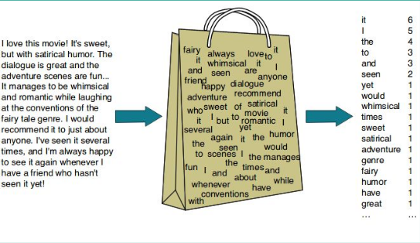
Bag of Words
Bag of Words (BoW) is a model that is represented as an unordered set of words included in the processed text.
Simple, but
“I love dogs, hate cats” == “I love cats, hate dogs” for BoW
Still, may suffice for the global context: movie sentiment analysis, restaurant feedback, etc as the details of feedback message are less important

Slide 15
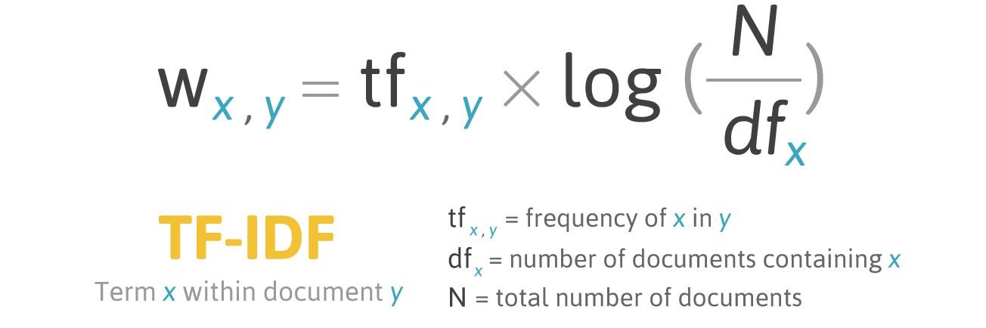
TF-IDF (Term Frequency – Inverse Document Frequency)
TF-IDF (Term Frequency - Inverse Document Frequency) is an algorithm that uses the frequency of words to determine how relevant those words are to a given document.
The weight of a word is proportional to the frequency of occurrence of this word in the document and inversely proportional to the frequency of occurrence of the word in all documents in the collection.

Slide 16
Preprocessing
Problems:
long vectors (word embeddings) => expensive computation
Same words with little difference in writing are considered different, i.e. “cup” vs “cups”, “finalize” vs “finalise”

Slide 17
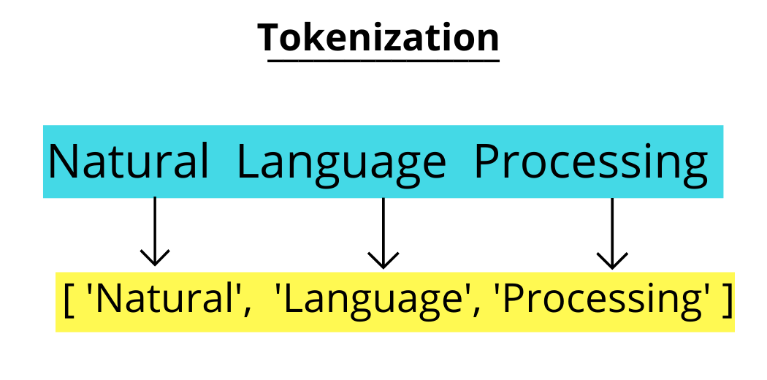
Types of text preprocessing
Tokenization,
Noise removal (stop words, lowercasing, punctuation, etc)
Stemming,
Lemmatization.
Most important – tokenization.
It’s the process of breaking a stream of textual data into words, terms, sentences, symbols, or some other meaningful elements called tokens

Slide 18
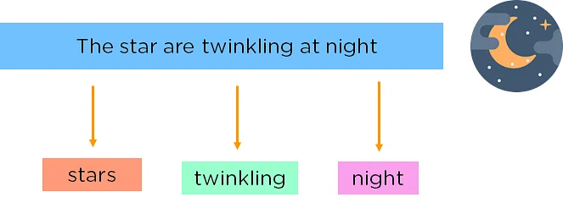
Stop words
Stop words are words that are thrown out of the text during text processing. When we apply machine learning to texts, such words can add a lot of noise, so it is necessary to get rid of irrelevant words.
Stop words are usually articles, interjections, conjunctions, etc., which do not carry a semantic meaning.
At the same time, one must understand that there is no universal list of stop words, everything depends on the specific case.

Slide 19
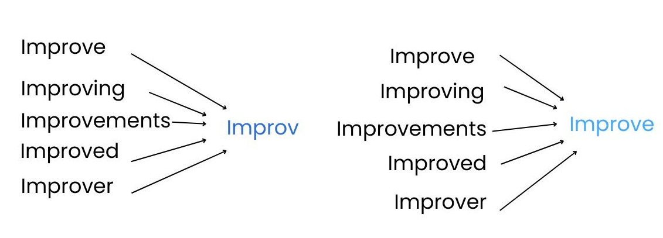
Word normalization
Stemming is the process of finding the stem of a word for a given source word. The stem of the word does not necessarily coincide with the morphological root of the word and does not have to be an existing word in the language. Stemming is a crude heuristic process that cuts off "excess" from the root of words, often resulting in the loss of derivational suffixes.
Lemmatization brings all occurring word forms to one, normal dictionary form. Lemmatization uses vocabulary and morphological analysis to eventually bring the word to its canonical form, the lemma.

Slide 20
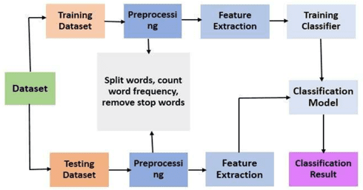
General Text Classification steps
Getting the dataset
Train/(dev)/test split
Preprocessing
Feature extraction
Training
Evaluation

Slide 21
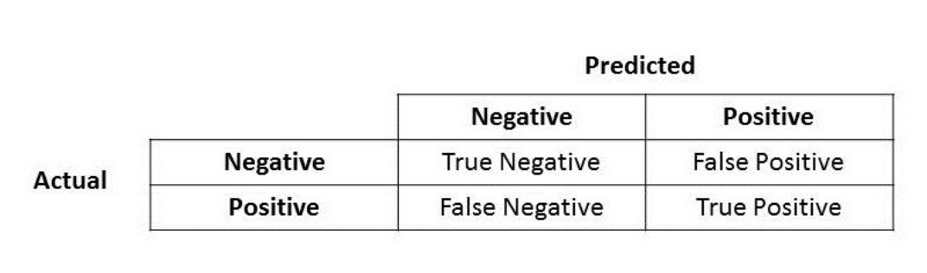
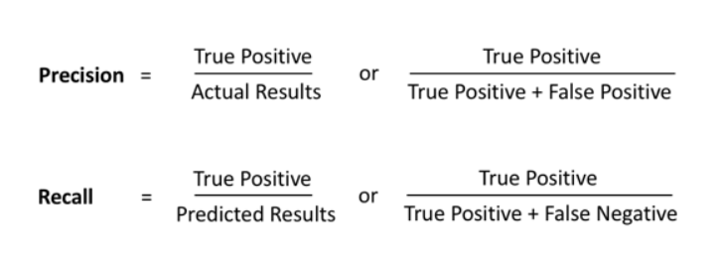
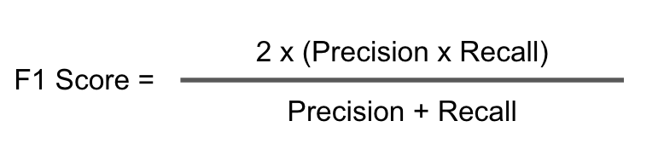
Model Evaluation
Recall
Precision

Slide 22
Walkthrough time…

Slide 23

Let’s get practical!
QR – Code to GitHub

Slide 24
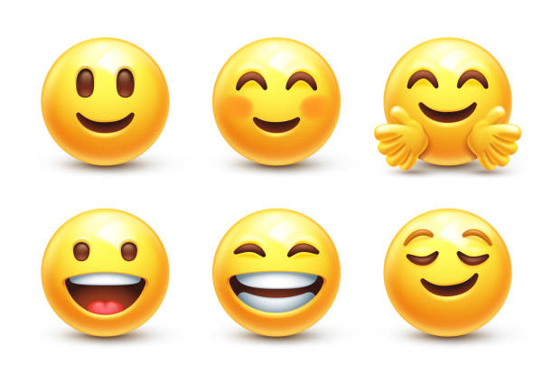
Thank you!

