Slide 1

Sense and Testability
Design Dilemmas in the real world
Roy Osherove
Typemock
  Roy@Osherove.com
  Blog: ISerializable.com

Slide 2

Me
The Art Of Unit Testing
  ArtOfUnitTesting.com
Typemock
  Next generation Isolation platform (Isolator)
  Next generation testing tools (shhhh..)

Slide 3
Agenda
Why should I Care about testability?
Defining a testable system
Examples of implementing and refactoring testable code
  Extract interface, Virtual methods..
  Dependency Injection and IoC Containers
Legacy Code
Silver Bullets

Slide 4
Before we start
Design examples will be in code
This is just one way to do design
I’m Assuming you have experience with Nunit or MS Test

Slide 5
Why Should I Care?
Framework author
Maintainable System
Extensible System
Code Quality

Slide 6
Automated Unit/Acceptance Testing Is Important
Helps with Regression Testing
  Maintainable System
Finds bugs early
  Code Quality
Better understanding of the requirements
API Documentation
“Executable” Requirements

Slide 7
Unit Level Testing Requires Testability
How easily can you
  Create a new instance?
  Get a consistent result?
  Test just X without Y?
  Control inputs and outputs from X?
  Isolate X from its dependencies?

Slide 8
Two kinds of testability
Testable application
Test Enabling Framework
  ASP.NET MVC, WebForms
  Sharepoint
  MS CRM
  WCF, WF

Slide 9



Slide 10
What is a Unit-Testable System
For each piece of coded logic in the system, a unit test can be written easily enough to verify it works as expected while keeping the PC-COF rules

Slide 11
Partial runs are possible
Configuration is not needed
Consistent pass/fail result
Order does not matter
Fast

Slide 12
Consistent pass/fail result for each test
Can you trust your test?
Logic:
Throw if Bad validation
Return true/false based on …
bool CanPurchase(Person p)
{
  If(Validator.IsNotValid(p))
  {
  throw new Exception(“…”);
  }
  return
  p. SSID !=null&&
  p.SubscriptionType!=null
  && p.CreditOnFile>0;
}
Problems:
Validator has a bug
How do you control Validator to validate or not?

Slide 13
Interface based design
Design
Extract Interface for Validator
Test
Send in a “fake” validator
IValidator validator;
bool CanPurchase(Person p)
{
If(this.validator.IsNotValid(p))
  {
  throw new Exception(“…”);
  }
  return
  p. SSID !=null&&
  p.SubscriptionType!=null
  && p.CreditOnFile>0;
}

Slide 14
Demo
Interface based design & testing
PersonLogic
PersonLogicTests

Slide 15

"Injecting" Dependencies
Constructor injection
Property Injection
Factory Injection
Virtual Method Injection
Class
constructor
Fake Dependency

Slide 16
"Injecting" Dependencies
Constructor injection
Property Injection
Factory Injection
Virtual Method Injection
Class
Fake Dependency
Property

Slide 17
"Injecting" Dependencies
Constructor injection
Property Injection
Factory Injection
Virtual Method Injection
Class
Fake Dependency
Factory

Slide 18
"Injecting" Dependencies
Constructor injection
Property Injection
Factory Injection
Virtual Method Injection
Class
Fake Dependency
Derived:class
Override GetX()

Slide 19
The Dependency problem
MyExceptionHandler
(IDataWriter)
MyLogger
(IExceptionHandler,
IDataWriter)
PersonLogic
(ILogger,
IValidator)
MyDataWriter
MyValidator
(IOverrides)
MyOverrides
(IExceptionHandler)
PersonLogic pl= new PersonLogic();
Notes:
How do you make sure two classes get the same instance of a dependency?
how can you gain control of an instance that you send in? (like a mock)

Slide 20
Inversion Of Control Containers
Spring.NET
Castle.Windsor
StructureMap
Microsoft Unity Application Block

Slide 21

Demo
PersonLogicWithIOC

Slide 22
Containers
Make sure everyone uses container.Resolve
Abstract the container to your own type
Your tests may also use a container
But you may want to inject manually

Slide 23
Where were we?
Consistency
Had a dependency problem
Added interfaces to be able to replace object
Used containers to help resolve dependencies automatically

Slide 24
Fast run times
What happens when you have 1000 tests?
Logic:
Throw if Bad validation
Return true/false based on …
bool CanPurchase(Person p)
{
  If(Validator.IsNotValid(p)
  {
  throw new Exception(“…”);
  }
  return
  p. SSID !=null&&
  p.SubscriptionType!=null
  && p.CreditOnFile>0;
}
Problems:
Validator takes a long time

Slide 25
No Configuration needed
How easy it is to get latest and run the tests?
Config file is needed
Person GetPerson(int id)
{
  String connectionString=
  Settings.ConnectionString;
  …
}

Slide 26
Solving Configuration with override
Design:
Extract dependency into virtual method
Test:
Inherit from class under test
Override method in derived class
Use derived class in tests
Person p(int id)
{
  String connectionString=
  getConnectionString();
  …
}
Protected virtual string getConnectionString()
{
…
}

Slide 27
Demo
Inherit & Override
MyConfigBasedClass

Slide 28



Test Order does not matter for consistent results
Test 2
Resource
(DB, static..)
Test 1

Slide 29
Test Order does not matter for consistent results
Test changing and maintenance hurts (Tests depend on each other)
Verify insert works
Verify Delete
Order?
Rollback external state
bool Insert(Person p)
{
  //insert person to database
}
bool Delete(Person p)
{
  //Delete person from database
}

Slide 30
Test Order does not matter for consistent results
Design:
May not need to change
Test:
Rollback data after each test
[TestCleanup]
Public void TearDown()
{
//Cleanup changed resource
}

Slide 31
Demo
Rollback Database
DatabaseTests

Slide 32
Partial runs of tests produce consistent results
Sometimes you want to run only some of the tests
Some systems will only rerun failed tests
bool Insert(Person p)
{
  //insert person to database
}
bool Delete(Person p)
{
  //Delete person from database
}

Slide 33
Are Singletons Evil?
How do you instantiate it for testing?
Shared resource between tests
Single Responsibility
Global Variables
Tight Coupling
State that lasts forever
Threading?

Slide 34
It Depends
MySingleton.Instance ← Could be evil
Using a container ← not so much evil

Slide 35
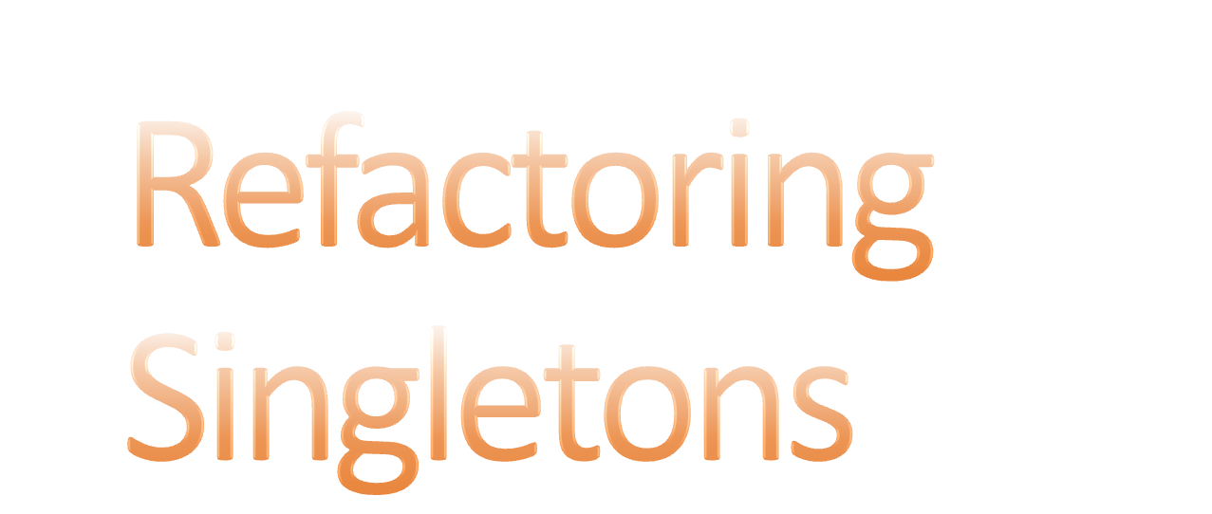
Demo
MySingleton

Slide 36
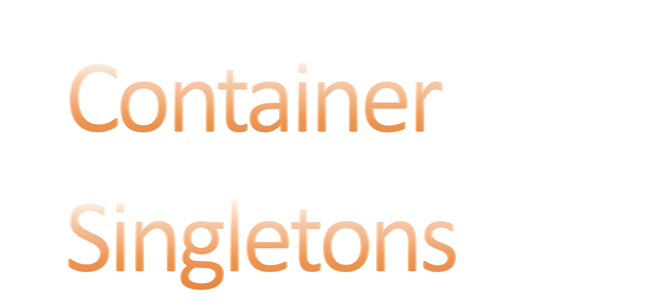
Demo
SingletonLogicTests

Slide 37
The GOD Method
One huge do-it-all method
Prevents Maintenance, impossible to test
Avoid by Design:
Keep Single Responsibility Principle
Calls to little methods

Slide 38
Pitfalls and traps
Singletons & statics
Hard coded dependencies
Configuration based objects
Constructors that use external dependencies
Private Stateless Methods
Convert static to instance
Extract Interface
  Use Fake
Inherit & override
  Use TestableXXX
Extract hard coded dependency to different class
Extract to helper class or static helper method

Slide 39
Test Driven Dev/Design
Tests have to use a testable class
Test-first means testable-design-first
Decoupled design and architecture
More control on state simulations

Slide 40
Design Guidelines
Avoid BDUF
Interface based Designs
Try to avoid Singletons
IoC containers
Avoid GOD Methods – Use Polymorphism instead
Virtual by default
New X()… → Factory.MakeX()
Single Responsibility for class and method

Slide 41


Slide 42
Legacy code
Integration testing
Refactor only as needed

Slide 43
But I Can't\Won't
Unable to refactor or redesign legacy code
Using 3rd party libraries (Sharepoint, WCF)
Typemock
JMockit

Slide 44
Key points
Design for testability leads to Agility
Common patterns
  Recognizing test challenges in the design
  Refactoring the design for testability
Test Driven Development leads to a testable design
Testable code == Well designed, decoupled design

Slide 45
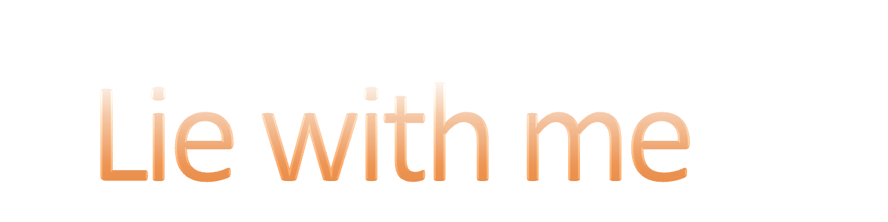
Song

Slide 46
My Design is now complete
All that’s left is coding,
and we can ship
I don’t need tests
my code just works
And that agile crowd’s a bunch of jerks

Slide 47
Lie with me
I promise, I’ll believe!
Lie with me
Oh please, please!

Slide 48
My project’s ship date won’t be late
The SharePoint object model’s great
MS CRM is so much fun
I’d rather be shot by a gun

Slide 49
Lie with me
I promise, I’ll believe!
Lie with me
Oh please, please!

Slide 50
Thank you!
Roy@Osherove.com
ISerializable.com (blog)

