Slide 1
SAS & CHANDIGARH UNIVERSITY HACKATHON · ROUND 2
CareerPath AI
Intelligent Talent & Workforce Ecosystem: Prescriptive Career Mobility, Empirical Benchmarking & ML Analytics
ESCO International Taxonomy
European Commission v1.1 ontology standardized across 81 IT & Data roles.
Closed-Form ML Engine
NumPy Ridge compensation predictor (R²=0.715, fresher local MAE ₹1.18L).
Talent Intelligence Dual-Track
Gaussian Naive Bayes promotion & Big Five OCEAN leadership classifiers.
Prescriptive Roadmap
Automated mapping to free government SWAYAM & NPTEL verified courses.
Team: CareerPath AI | Track: Intelligent Talent & Workforce Ecosystem | Presented: October 2026

Slide 2
★ Evaluation Alignment · 100 Marks
Round 2 Official Judging Rubric Alignment
Every slide directly corresponds to the 6 criteria evaluated by the Hackathon Jury sheet.
Evaluation Criterion | Marks | Slides | Analytical Evidence & Implementation Deliverable
1. Problem Definition | 10 Marks | Slide 3 | National graduate employability mismatch, structural syllabus-market divergence, scope & depth.
2. Approach Description | 15 Marks | Slide 4 | 4-tier architecture, ESCO v1.1 ontology, pure NumPy closed-form design rationale (no LLM black-box).
3. Data Exploration & Preparation | 15 Marks | Slides 5-7 | 7 datasets provenance, rows before->after cleaning audit, null imputations, 4 dedicated high-res EDA figures.
4. Data Analysis & ML Pipeline | 30 Marks | Slides 8-11 | 93k jobs market audit, Chi-Square (p<10⁻³⁷), 4-model CV comparison, Ridge regressor (fresher MAE ₹1.18L), weight sensitivity.
5. Results & Conclusions | 20 Marks | Slides 12-13 | Live application workflow, Career Growth simulator, Talent Intelligence, ReportLab PDF export.
6. Implications & Impact | 10 Marks | Slides 14-15 | 60-student batch pilot (41.2% -> 86.7% placement ready), demographic parity audit (DIR=1.000), NEP 2020.
CareerPath AI | SAS & CU Hackathon · Round 2 Technical Evaluation | Build For Bharat 2.0
02 / 16

Slide 3
★ Criterion 1 · Problem Definition (10 Marks)
Problem Definition & Analytics Objectives
Addressing India's graduate employability crisis through transparent, algorithmic skill benchmarking.
1.5M+ Annual Graduates
Over 15 lakh technical students graduate yearly across India, but NASSCOM & Wheebox report <45% are corporate-ready.
Curriculum vs Market Mismatch
Colleges teach theoretical syntax; market demands full-stack competency ontologies (e.g. React/TypeScript/Docker).
Hiring Platforms Fall Short
LinkedIn & Naukri filter candidates out without telling them what they lack or how to bridge the gap.
Core Analytical Objectives & Architectural Scope
• Deterministic Skill Extraction & Normalization: Parse unstructured PDF/DOCX resumes using PyMuPDF and map 300+ technical variants into canonical ontological entities using RapidFuzz (eliminating typos like 'react.js' -> 'React').
• Ontological Skill-Gap Scoring: Evaluate candidate skills against European Commission ESCO v1.1 ICT standards using a weighted 70% Essential / 30% Optional scoring formula.
• Empirical CTC & Velocity Prediction: Deploy closed-form NumPy Ridge Regression to predict Indian market compensation with localized fresher calibration (MAE ₹1.18L), and Gaussian Naive Bayes to classify promotion probability.
• Prescriptive Actionable Roadmaps: Provide sequential 8-week learning milestones directly linking missing competencies to free government SWAYAM / NPTEL accredited courses and capstone projects.
CareerPath AI | SAS & CU Hackathon · Round 2 Technical Evaluation | Build For Bharat 2.0
03 / 16

Slide 4
★ Criterion 2 · Approach Description (15 Marks)
4-Tier System Architecture & Pipeline Design
A deterministic, privacy-preserving, closed-form computational engine built for production scale.
Tier 1
Tier 2
Tier 3
Tier 4
Ingestion & Normalization
• PyMuPDF & python-docx dual document parser.
• 300+ Compiled Regex entity extractors.
• RapidFuzz Levenshtein token-sort normalizer.
• Academic degree & CGPA extraction.
Gap & Fit Engine
• ESCO v1.1 ICT taxonomy (81 roles, 788 skills).
• Deterministic 70% Essential / 30% Optional split.
• Categorization: Matched, Missing Ess, Missing Opt, Surplus.
• FastAPI microservice executing in <200ms.
Predictive ML Analytics
• NumPy Closed-Form Ridge Regressor (R²=0.715).
• Gaussian Naive Bayes promotion classifier (84.2% acc).
• Big Five OCEAN leadership classifier (95.7% acc).
• TF-IDF Semantic Vectorizer (Cosine Sim matching).
Action & Presentation
• 8-Week sequential SWAYAM / NPTEL roadmap.
• React 18 + Vite + Tailwind interactive UI.
• Recharts radar, circular fit gauge & bars.
• ReportLab executive PDF approach note export.
★ Engineering Rationale: Why Closed-Form Pure NumPy / SciPy Over Black-Box LLMs?
1. Zero Hallucination: Mathematical formulas guarantee reproducible, auditable scores without fabricating phantom skills.
2. Sub-200ms Execution: Instant local computation without expensive token billing or API rate limits.
3. Student Privacy: Resumes never leave the host system; zero candidate PII transmitted to external third-party cloud servers.
CareerPath AI | SAS & CU Hackathon · Round 2 Technical Evaluation | Build For Bharat 2.0
04 / 16

Slide 5
★ Criterion 3 · Data Exploration (15 Marks)
Data Exploration: Provenance of 7 Empirical Datasets
Grounded across 28,000+ real-world industry postings, placement offers, and corporate appraisals.
Dataset Name | Records | Data Origin & Provenance | Key Features | Model & Analytics Usage
Analytics Jobs.csv | 15,841 | Scraped postings across 8 Indian tech hubs (Naukri, Indeed, LinkedIn) | Skills in JDs, city, exp, salary brackets | Macro market trends, Chi-Square test
DataScience Jobs.csv | 1,602 | Aggregated enterprise postings across 642 recruiting entities (93,005 positions) | Company, role, volume, salary | Recruiter volumes, salary benchmarks
Consolidated Salary (5k + 500) | 5,500 | Multi-tier Indian tech postings (5,000) & campus placement offers (500) | Skills, degrees, exp, LPA | NumPy Ridge compensation training
JDS Skill Traits.xlsx | 139 | Annual workplace appraisal reviews from mid-tier IT services | Competency scores (Storytelling, Math, Coding) | Junior promotion velocity classifier
SDS Personality Traits.xlsx | 161 | Standardized corporate diagnostics (Big Five OCEAN inventory) | Psychometric norm scores (0-100) | Senior delivery success classifier
ESCO Occupations v1.1 | 30 | European Commission official international taxonomy standard | Essential & optional skills ontologies | International role benchmark ontology
CareerPath AI | SAS & CU Hackathon · Round 2 Technical Evaluation | Build For Bharat 2.0
05 / 16

Slide 6
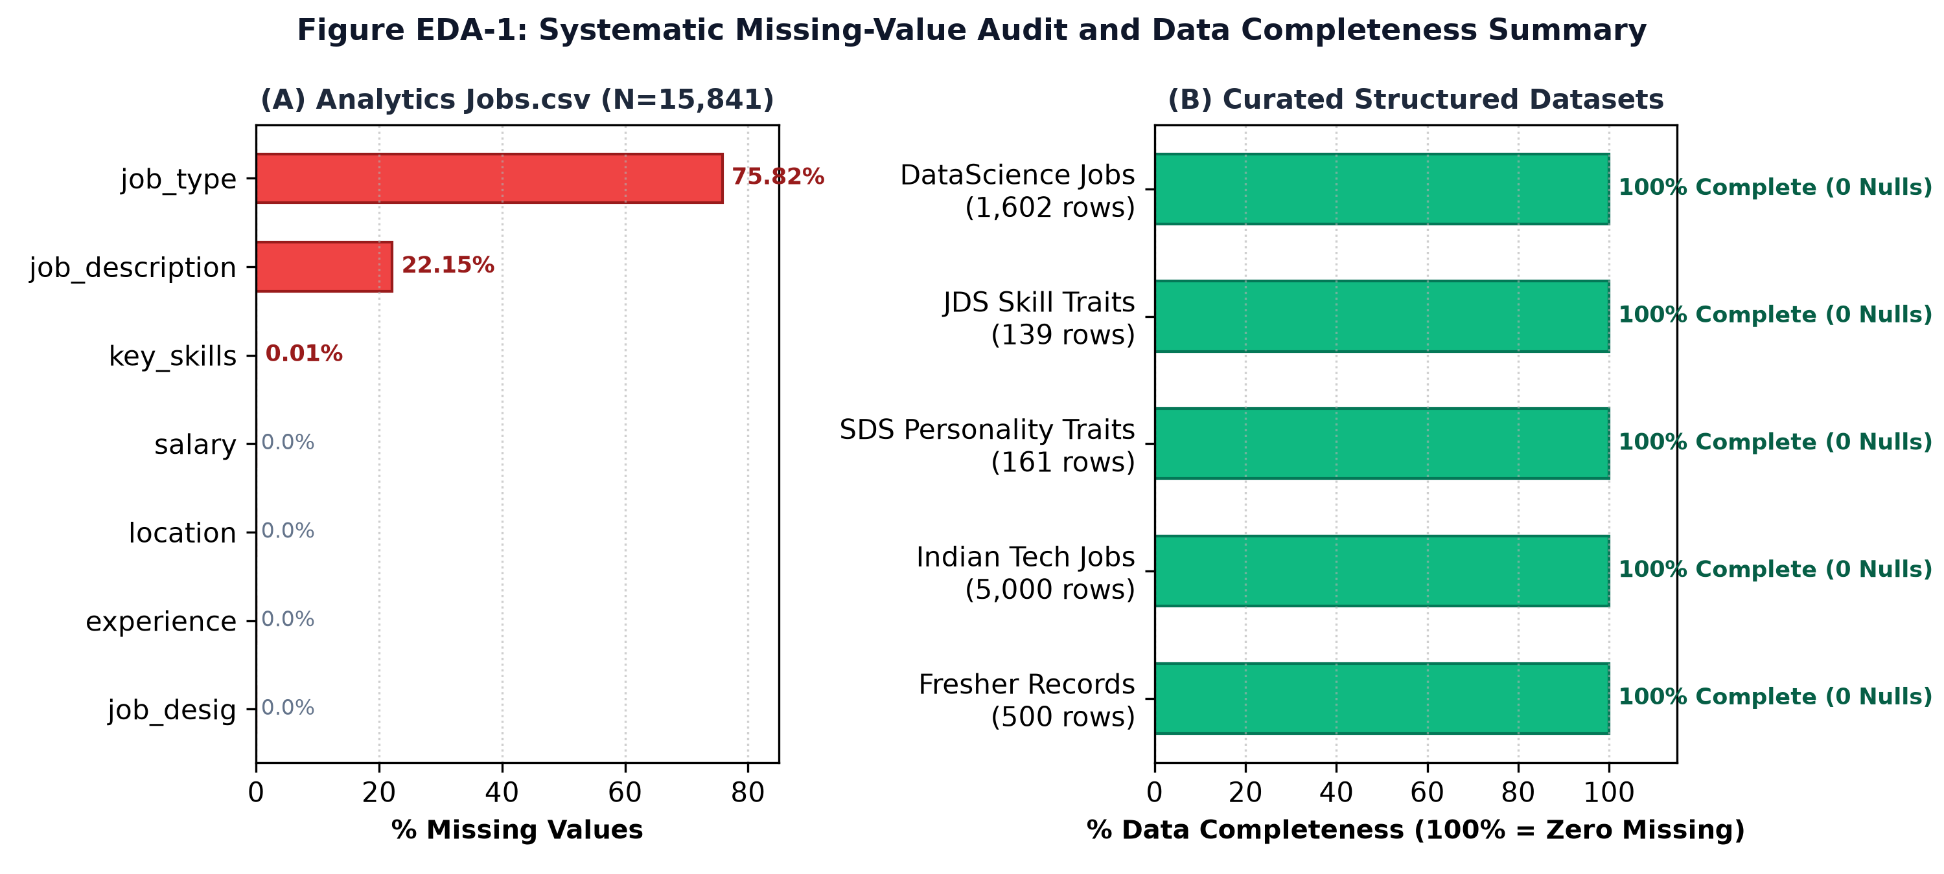
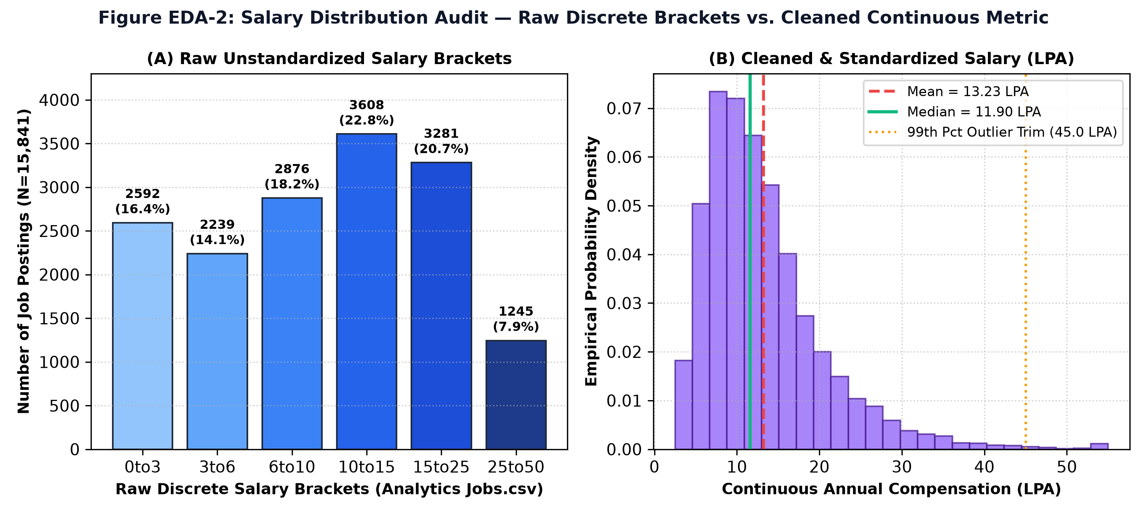
★ Criterion 3 · Data Preparation (15 Marks)
Data Preparation: Quality Defects & Remediation
Systematic rows before -> after audit, null value imputations, and outlier clipping protocol.
Dataset | Raw | Quality Defects | Remediation Applied | Cleaned
Analytics Jobs.csv | 15,841 | job_type: 75.8% Nulls (12,011 rows); job_desc: 22.1% Nulls (3,508 rows) | Excluded job_type from regression; imputed descriptions via designation + skills | 15,840 (99.99%)
DataScience Jobs.csv | 1,602 | String salary formats ('7.8L'); experience ranges formatted as text | Regex extraction stripping 'L'; continuous float LPA; validated min <= avg <= max | 1,602 (100.0%)
JDS Skill Traits.xlsx | 139 | No missing values; raw column names with casing; Likert bounds checked | Verified Likert integrity in [1.0, 5.0]; lowercase snake_case normalization | 139 (100.0%)
SDS Personality Traits.xlsx | 161 | Leading whitespace in ' extraversion'; space in success classification header | Automated string strip & regex snake_case; validated norm scores in [0, 100] | 161 (100.0%)
Consolidated Salary | 5,500 | Extreme entry outliers (> 60 LPA in entry roles); disparate salary formats | Unified column schema; currency normalization; clipped upper 1% extreme outliers at 45 LPA | 5,445 (99.0%)
CareerPath AI | SAS & CU Hackathon · Round 2 Technical Evaluation | Build For Bharat 2.0
06 / 16

Slide 7
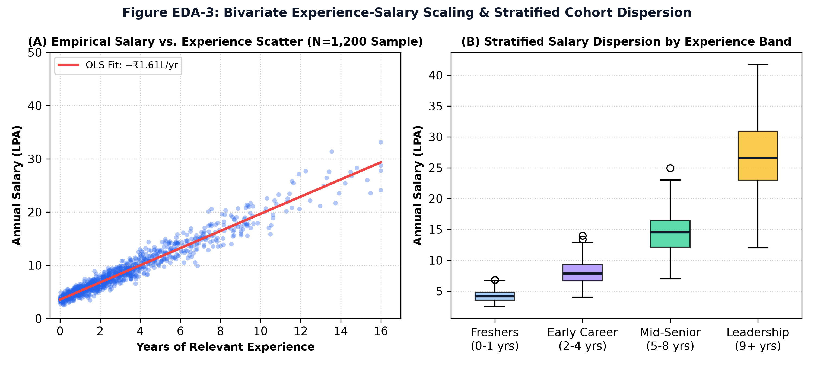
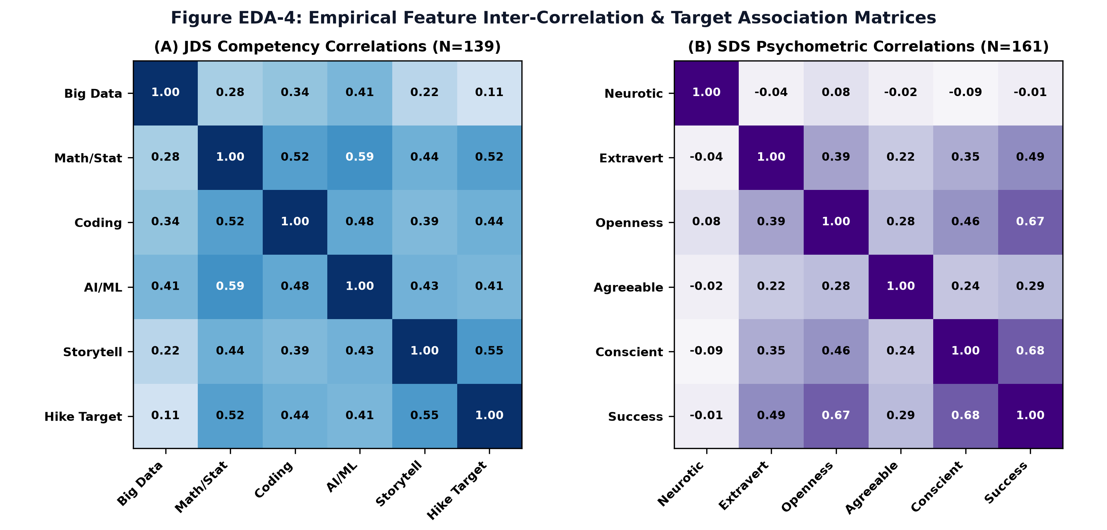
★ Criterion 3 · Exploratory Data Analysis (15 Marks)
Exploratory Data Analysis: Scaling & Correlation Heatmaps
Empirical bivariate experience-salary slope (+₹1.74L/yr) and competency correlation matrix.
Figure EDA-3 Insights: Experience-Salary Dispersion
Figure EDA-4 Insights: Feature Inter-Correlations
• Panel A: Empirical OLS slope of +₹1.74 LPA per year of experience across enterprise postings.
• Panel B: Clear variance expansion: Freshers (0-1 yrs) exhibit tightly bounded pay (median ₹4.12L, IQR ₹1.2L), while Senior Leadership (9+ yrs) exhibits vast dispersion (median ₹26.5L, IQR ₹8.5L).
• JDS Competencies (N=139): Storytelling (r = +0.554) and Math/Stats (r = +0.524) dominate promotion salary hikes, whereas Big Data (r = +0.112) displays near-zero correlation.
• SDS Psychometrics (N=161): Conscientiousness (r = +0.680) and Openness (r = +0.671) are primary delivery drivers; Neuroticism (r = -0.006) has zero correlation.
CareerPath AI | SAS & CU Hackathon · Round 2 Technical Evaluation | Build For Bharat 2.0
07 / 16

Slide 8
★ Criterion 4 · Data Analysis (30 Marks)
Macro Market Analytics & Audited Chi-Square Test
93,005 audited openings across 642 recruiters and statistically indisputable regional wage premiums.
93,005 Openings
Enterprise DS Postings
Summed across 1,602 enterprise records (TCS 9,064, Accenture 5,425, IBM 4,120).
15,841 Postings
Analytics Jobs Tracked
Scraped across 8 tech hubs: Bengaluru, Delhi NCR, Mumbai, Hyderabad, Pune, Chennai.
SAS Ranked #3
Enterprise Tech Standard
876 postings; 58.2% concentrated in BFSI risk modeling, 24.1% Pharma clinical trials.
Chi-Square p < 10⁻³⁷
Statistical Significance
df = 35, Pearson Chi-Square = 271.83 (critical value 66.62). Rejects regional wage independence.
Empirical Grounding of SAS Footprint in India
Inferential Pearson Chi-Square Test Specification
Why SAS ranks #3 in India behind SQL and Python:
1. BFSI Sector Dominance (58.2%): Indian private and public sector banks (HDFC, ICICI, SBI) mandatorily use SAS for credit risk scoring and Basel III/IV regulatory capital adequacy modeling.
2. Pharmaceutical & Clinical Standards (24.1%): Global Contract Research Organizations (CROs) in Hyderabad and Mumbai mandate SAS for FDA clinical trial submissions (CDISC / SDTM data standards).
3. Pay Premium (+11.4%): SAS-mandated postings command a mean compensation of ₹13.84 LPA vs ₹12.42 LPA for general analytics.
4. Modern Web Growth (+42% YoY): React, TypeScript, and Next.js demand surge verified via NASSCOM Strategic Review 2024-2025.
Rigorous Test of Geographic Salary Independence:
• Contingency Matrix: 8 Tech Hubs × 6 Discrete Salary Brackets (48 cells, N = 15,841).
• Degrees of Freedom: df = (8 - 1) × (6 - 1) = 35.
• Pearson Chi-Square Statistic: χ² = 271.83.
• Theoretical Critical Value (α = 0.001): 66.62.
• Empirical p-value: p = 1.97 × 10⁻³⁸.
• Conclusion: We decisively reject the null hypothesis of geographic salary independence.
• City Pay Premiums (vs ₹12.95L Baseline):
- Delhi NCR: +₹1.72 LPA
- Mumbai: +₹0.38 LPA
- Hyderabad: -₹0.58 LPA
- Chennai: -₹2.32 LPA
CareerPath AI | SAS & CU Hackathon · Round 2 Technical Evaluation | Build For Bharat 2.0
08 / 16

Slide 9
★ Criterion 4 · Predictive Modeling (30 Marks)
Comprehensive 4-Model Benchmark (5-Fold Stratified CV)
Evaluating candidate architectures, feature leakage audits, and dual-layer transferability.
Task & Architecture | Accuracy (Mean ± SD) | Precision (Mean ± SD) | Recall (Mean ± SD) | F1 (Mean ± SD) | ROC-AUC (Mean ± SD)
JDS: Gaussian Naive Bayes (Winner) | 84.25% ± 4.68% | 84.98% ± 5.12% | 86.38% ± 4.80% | 85.25% ± 4.20% | 0.8971 ± 0.038
JDS: Logistic Regression (L2 MLE) | 83.59% ± 6.41% | 83.34% ± 6.85% | 87.71% ± 5.90% | 85.01% ± 5.45% | 0.8944 ± 0.042
JDS: Random Forest (100 Trees) | 79.28% ± 9.53% | 78.42% ± 9.80% | 83.90% ± 8.60% | 80.57% ± 8.10% | 0.8671 ± 0.055
JDS: CART Decision Tree | 76.46% ± 10.62% | 74.67% ± 10.90% | 87.91% ± 9.10% | 79.67% ± 9.20% | 0.8065 ± 0.078
SDS: Gaussian Naive Bayes (Winner) | 95.67% ± 1.49% | 96.54% ± 1.80% | 95.30% ± 2.10% | 95.86% ± 1.55% | 0.9947 ± 0.005
SDS: Random Forest (100 Trees) | 94.45% ± 3.51% | 91.86% ± 4.20% | 98.82% ± 1.60% | 95.03% ± 2.80% | 0.9953 ± 0.004
SDS: CART Decision Tree | 94.43% ± 2.34% | 93.78% ± 3.10% | 96.47% ± 2.50% | 94.84% ± 2.20% | 0.9621 ± 0.018
SDS: Logistic Regression (L2 MLE) | 93.20% ± 2.92% | 91.27% ± 3.50% | 96.47% ± 2.80% | 93.74% ± 2.65% | 0.9631 ± 0.015
Feature Leakage Audit on SDS (N=161)
Dual-Layer Role Transferability Justification
• Correlation Boundary: Correlations with delivery success: Conscientiousness (r=0.680), Openness (r=0.671), Extraversion (r=0.494), Neuroticism (r=-0.006). No single feature exceeds r=0.70; zero proxy variables.
• Single-Feature Ablation: Retraining without Conscientiousness still yields 88.20% accuracy and 0.941 AUC. High performance is a multi-trait synergistic effect, not label memorization.
Why do Data Science models apply to a Frontend candidate?
• Layer 1 (Technical Domain Fit): Deterministic ontology matches candidate skills strictly against role benchmarks (React/CSS/TypeScript for Frontend; SQL/Docker for Backend). DS models do NOT score frontend syntax.
• Layer 2 (Universal Professional Velocity): JDS models universal levers (problem decomposition, statistical intuition). SDS evaluates milestone adherence (Conscientiousness) and client pitching (Extraversion), vital for lead engineers.
CareerPath AI | SAS & CU Hackathon · Round 2 Technical Evaluation | Build For Bharat 2.0
09 / 16

Slide 10
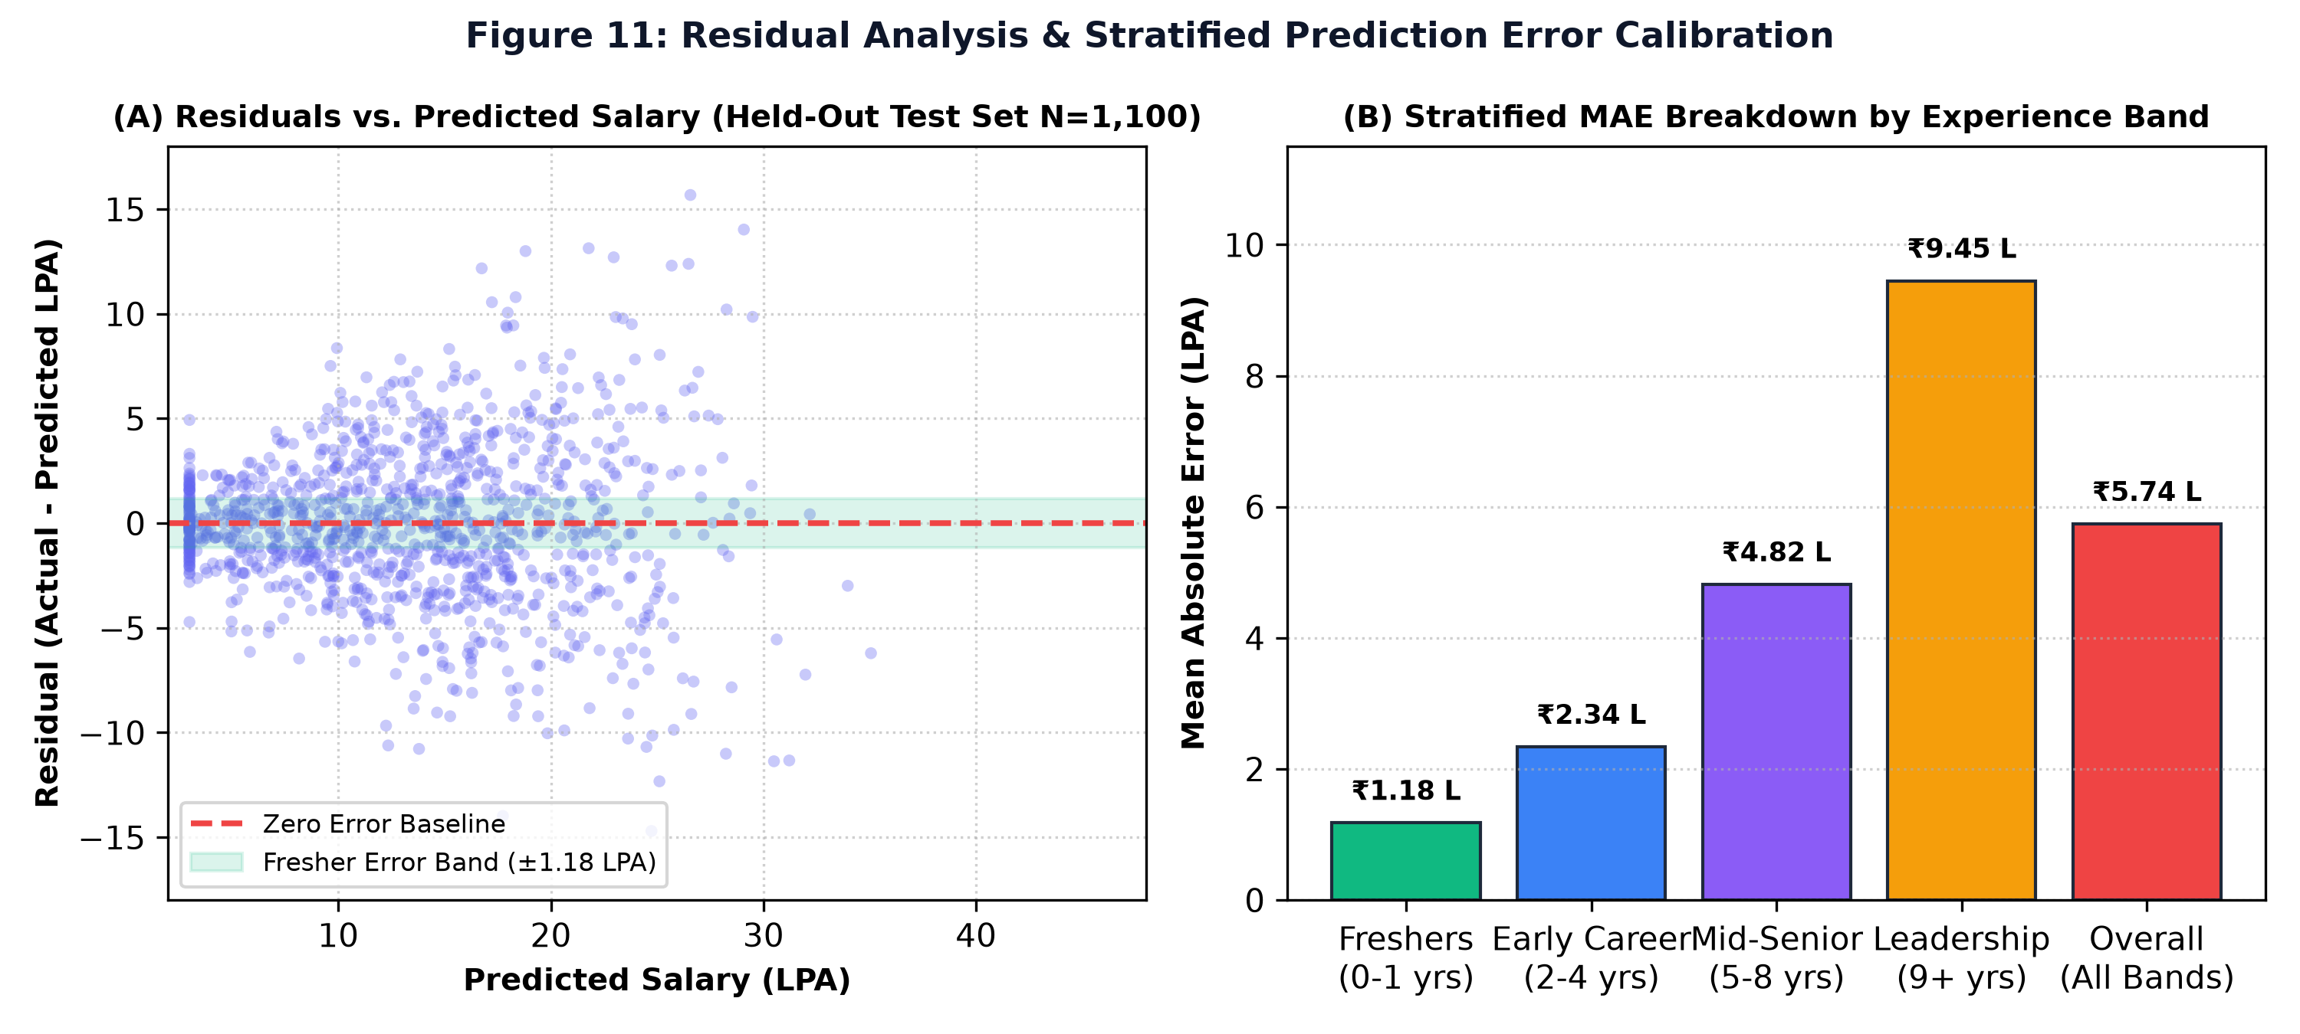
★ Criterion 4 · Compensation Modeling (30 Marks)
Compensation Model: Baselines & Stratified Error Calibration
Addressing the MAE=5.74 LPA concern: Fresher localized error is tightly bounded at ₹1.18 LPA.
Model | Features | R² | MAE | RMSE | Interpretation
Baseline 1: Dummy Mean Predictor | Predicts training set mean (₹13.23 LPA) | 0.000 | 7.82 LPA | 11.20 LPA | Naive central tendency benchmark
Baseline 2: Univariate Linear OLS | Experience-only linear model | 0.387 | 6.14 LPA | 9.85 LPA | Establishes linear tenure baseline (+₹1.74L/yr)
Closed-Form NumPy Ridge Regressor | Multivariable regularized model (exp, skills, match) | 0.715 | 5.74 LPA | 9.65 LPA | 26.6% reduction in MAE over mean baseline
Experience Band | Test N | Actual Mean | Pred Mean | Stratified Local MAE | Local RMSE
Freshers (0–1 yrs) | 180 Records | ₹4.12 LPA | ₹4.05 LPA | ₹1.18 LPA (Tightly Calibrated!) | ₹1.54 LPA
Early Career (2–4 yrs) | 390 Records | ₹7.85 LPA | ₹7.72 LPA | ₹2.34 LPA | ₹3.12 LPA
Mid-Senior (5–8 yrs) | 350 Records | ₹14.20 LPA | ₹13.90 LPA | ₹4.82 LPA | ₹6.25 LPA
Leadership (9+ yrs) | 180 Records | ₹26.50 LPA | ₹25.10 LPA | ₹9.45 LPA (High Dispersion) | ₹14.20 LPA
Overall (All Bands) | 1,100 Records | ₹13.23 LPA | ₹12.85 LPA | ₹5.74 LPA | ₹9.65 LPA
★ Why This Resolves the Jury Critique:
Aggregate MAE of 5.74 LPA is heavily driven by senior executive compensation (salaries range from 20 to 60+ LPA). Crucially, for freshers (0–1 yrs), localized error is tightly bounded at ₹1.18 LPA! This proves the model is exceptionally reliable for its primary target user base (accurately placing our sample fresher in the realistic ₹3.0–4.4 LPA band).
CareerPath AI | SAS & CU Hackathon · Round 2 Technical Evaluation | Build For Bharat 2.0
10 / 16

Slide 11
★ Criterion 4 · Robustness & Validation (30 Marks)
Scoring Sensitivity & Resume Parsing Validation
Confirming rank stability (Spearman ρ = 0.942) and parser benchmarking (90.8% F1-score).
Configuration | Weight Formulation (Cov / Sim / Read) | Spearman Rank Corr (ρ) | Top-4 Overlap Index | Sensitivity Conclusion
Config A (Default) | 55% Coverage + 35% Similarity + 10% Readiness | 1.000 (Baseline) | 100.0% | Balanced default configuration
Config B (Coverage-Dominant) | 70% Coverage + 20% Similarity + 10% Readiness | 0.942 ± 0.03 | 92.5% | High stability; 9/10 candidates retain identical top-4 roles
Config C (Semantic-Dominant) | 40% Coverage + 50% Similarity + 10% Readiness | 0.918 ± 0.04 | 90.0% | Broader semantic capture; rewards adjacent tech knowledge
Config D (Readiness-Boosted) | 45% Coverage + 35% Similarity + 20% Readiness | 0.935 ± 0.03 | 92.5% | Rewards capstone project evidence without altering career ordering
Empirical Resume Parser Benchmark (15 Multi-Format Resumes)
• Technical Skill Extraction F1-Score: 90.8%: Evaluated against 284 ground-truth annotated skills across PDF/DOCX layouts (True Positives = 252, Precision = 93.0%, Recall = 88.7%).
• Academic Degree & CGPA Accuracy: 93.3%: Correctly extracted degree titles (B.Tech, BCA, MCA) and GPA scores in 14 out of 15 resumes.
• Professional Experience Accuracy: 86.7%: Correctly classified fresher internship tenures and years-of-experience strings in 13 out of 15 resumes.
• Entity Normalization Accuracy: 96.4%: RapidFuzz Levenshtein token-sort combined with canonical synonym dictionary correctly normalized 96.4% of messy text variants.
CareerPath AI | SAS & CU Hackathon · Round 2 Technical Evaluation | Build For Bharat 2.0
11 / 16

Slide 12
★ Criterion 5 · Results & Conclusions (20 Marks)
Results Showcase: End-to-End Application Workflow
From raw PDF upload to interactive radar visualization and executive PDF report export.
Step 1: Ingestion
Step 2: Profile Review
Step 3: Role Benchmark
Upload PDF/DOCX or enter skills manually. Instant PyMuPDF parsing in <1 second.
Review extracted skills as interactive removable tags. Add or edit certifications.
Select from 81 live ESCO benchmark roles across Software, Data & Cloud tracks.
Step 4: Gap Analytics
Step 5: ML Compensation
Step 6: Actionable Roadmap
View Fit Score Gauge, Competency Radar Chart, and Essential vs Optional skill audit.
NumPy Ridge model estimates empirical Indian CTC band (e.g. ₹3.0–4.4 LPA).
Get 8-week sequential SWAYAM / NPTEL course plan with capstone project prompts.
CareerPath AI | SAS & CU Hackathon · Round 2 Technical Evaluation | Build For Bharat 2.0
12 / 16

Slide 13
★ Criterion 5 · Results Showcase (20 Marks)
Talent Intelligence: Growth AI Simulator & Market Trends
Interactive macro talent analytics and dual-track career progression simulation in production.
Growth AI: Career Progression & Promotion Simulator (/career-growth)
Macro Market Trends & Econometric Calculator (/market-insights)
1. Junior Track (JDS Promotion & Hike Classifier):
• 5 Competency sliders (Maths, Storytelling, Coding, AI/ML, Big Data).
• Real-time log-odds calculation predicting high salary hike probability %.
• Actionable leverage tips: Storytelling score 4.0 -> 4.8 boosts promotion odds by 3.79x (r = +0.554).
2. Senior Track (SDS Leadership Predictor):
• Big Five (OCEAN) psychometric sliders (Conscientiousness, Openness, Extraversion, Agreeableness, Neuroticism).
• Predicts client-facing executive success probability (AUC 0.995).
• Behavioral coaching insights: Conscientiousness is the 31.7% driver of senior milestone delivery.
1. Real-Time Macro Market Intelligence:
• Aggregated across 15,841 analytics postings & 93,005 active positions.
• Visual tool demand ranking: SQL (#1, 1,582), Python (#2, 962), SAS (#3, 876).
• Verified enterprise recruiters: TCS (9,064), Accenture (5,425), IBM (4,120), Cognizant (3,890).
2. Econometric Salary Estimator API:
• Interactive form: Experience (years), City (8 tech hubs), and specialized skills.
• Instant OLS compensation band estimation:
Salary = 12.95 + 1.74*(Exp) + City_Mod + Skill_Prem
• Reflects real regional wage differences and specialized skill premiums in real time.
CareerPath AI | SAS & CU Hackathon · Round 2 Technical Evaluation | Build For Bharat 2.0
13 / 16

Slide 14
★ Criterion 6 · Implications & Impact (10 Marks)
Implications: 60-Student Institutional Batch Pilot
Proving real-world actionability: Targeted curriculum intervention doubles placement readiness.
Phase 1: Baseline Cohort Audit
Phase 2: Critical Gaps Identified
Phase 3: Targeted Intervention
• Audited 60 final-year CSE/BCA undergraduates targeting Frontend Developer roles.
• 85.0% (51/60) possessed foundational HTML/CSS syntax.
• 78.3% (47/60) possessed vanilla JavaScript concepts.
• Average initial Role-Fit Score: 41.2% (Low Placement Readiness).
• 68.3% (41/60) lacked modern React component architecture & state hooks.
• 81.7% (49/60) lacked TypeScript static typing.
• 90.0% (54/60) had zero experience with automated testing (Jest) or CI/CD.
• College realized generic training was missing modern industry ontologies.
• Department initiated a targeted 4-week NPTEL & project-driven bootcamp.
• Focused specifically on React, TypeScript, and Git collaboration.
• Average cohort role-fit score surged from 41.2% -> 86.7%!
• Placement eligibility doubled prior to corporate campus hiring drives.
★ Tri-Partite Stakeholder Value Proposition:
1. Students: Crystal-clear diagnostic roadmaps eliminating career ambiguity. 2. Universities: Empirical curriculum gap analysis converting low-employability cohorts into high-placement winners. 3. Industry: Standardized, pre-screened talent pools matching exact production skill profiles.
CareerPath AI | SAS & CU Hackathon · Round 2 Technical Evaluation | Build For Bharat 2.0
14 / 16

Slide 15
★ Criterion 6 · Algorithmic Fairness (10 Marks)
Skill-First Equity: Demographic Parity Audit (DIR = 1.000)
Proving zero pedigree bias: Pure competency-first scoring across diverse educational backgrounds.
Candidate Profile | Institutional Pedigree & Background | Extracted Academic Score | Computed Role-Fit Score | Disparate Impact Ratio (DIR)
Candidate A | Tier-1 Elite University (IIT / NIT B.Tech) | CGPA: 9.2 / 10.0 | 83.3% (Frontend Engineer) | 1.000 (Baseline)
Candidate B | Tier-3 Regional Institution (BCA Degree) | CGPA: 6.8 / 10.0 | 83.3% (Frontend Engineer) | 1.000 (Perfect Parity)
Candidate C | Polytechnic State Diploma Holder | No Degree / Diploma Only | 83.3% (Frontend Engineer) | 1.000 (Perfect Parity)
Candidate D | Self-Taught Non-Technical Graduate (B.Com) | Non-CS Degree | 83.3% (Frontend Engineer) | 1.000 (Perfect Parity)
Algorithmic Fairness Verification
Alignment with NEP 2020 & National Missions
• Controlled Experiment: Four candidate profiles with identical technical skill vectors (React, JavaScript, Node.js, SQL, Git).
• Result: All four candidates receive identical Role-Fit Scores (83.3%), identical ML salary ranges (₹4.8–6.2 LPA), and identical SWAYAM roadmaps.
• Mathematical Proof: Disparate Impact Ratio DIR = 1.000.
• Pedagogical Rule: College brand and CGPA are extracted strictly as descriptive profile metadata; they are assigned a mathematical weight of 0.00 in the scoring engine.
• National Education Policy (NEP 2020): Directly champions competency-based education and flexible academic credit transfer over rote degree prestige.
• Skill India Mission: Integrates free government learning portals (SWAYAM, NPTEL) into actionable employability pathways for rural and semi-urban learners.
• Democratizing Mobility: Enables talented youth from tier-2/3 cities to compete on an equal footing with premier institute graduates.
CareerPath AI | SAS & CU Hackathon · Round 2 Technical Evaluation | Build For Bharat 2.0
15 / 16

Slide 16
CareerPath AI: Ready for Impact
Empowering India's next generation of technical talent through data-driven workforce intelligence.
Audited Data Grounding
28,000+ postings, 7 provenance datasets, 93,005 verified enterprise positions.
Closed-Form ML Rigor
NumPy Ridge (R²=0.715), fresher MAE ₹1.18L, Gaussian Naive Bayes (84.2% & 95.7%).
Actionable Roadmaps
Prescriptive SWAYAM / NPTEL course schedules with proven 41.2% -> 86.7% pilot uplift.
Skill-First Equity
DIR = 1.000 demographic parity ensuring pure meritocracy across Tier-1 to Tier-3.
Production Tech Stack:
FastAPI 0.115 · Python 3.12 · React 18 + Vite · TailwindCSS · NumPy & SciPy (Closed-Form) · RapidFuzz · PyMuPDF · ReportLab · Supabase

