Slide 1

Metaprogramming in Ruby

Slide 2
Definition
Metaprogramming is writing code that manipulates language constructs at runtime.
Ruby is one of the most flexible languages for metaprogramming
Notes:
In other words, almost every structure (classes, instance methods and variables, constants) can be accessed at runtime.

Slide 3
Characteristics
Code that writes code
Reduce lines of code
Dynamic programming
Notes:
Example: Active Record
active record como maneja metaprogramación, en la clase no hay un set y un get por cada campo del modelo, sino que cuando se invoca al setter o getter se crea el attribute correspondiente
5.times do
class MYClass
puts 'Testing'
end
end
binding.pry
class D
def x
'x'
end
end
class D
def y
'y'
end
end
# obj = D.new
# obj.x
# obj.y

Slide 4
Open Classes
IF multiple classes were declared multiple times, what would happen?
Ruby reopens classes
The class keyword in Ruby is more like
a scope operator than a class
declaration

Slide 5
Grep
Use here to lookup methods
Grep to avoid monkey patching
Notes:
Grep ayuda a buscar metodos por expresión regular, ideal para no sobreescribir inadvertidamente métodos
Mencionar el riesgo de las classes abiertas

Slide 6
Instance variables
There is no connection between instance variables and object class.
obj.instance_variables
Instances variables reside in objects
Notes:
class MyClass
def my_method
@v = 1
end
End
1# obj = MyClass.new
# obj.instance_variables
# obj.my_method
# obj.methods.grep(/my/)
# var_name = 'v'
# obj.instance_variables.include?("@#{var_name}".to_sym)

Slide 7
Instance methods
Methods that are only accessible by creating an instance of the corresponding class.
String.instance_methods == "abc".methods
String.methods == "abc".methods
Notes:
Correr comandos para ver resultados
Instance_methods(inherited)

Slide 8
Setting Instance Variables
We can set instance variables anytime by:
my_instance.instance_variable_set(:@var, ‘Testing’)
my_instance.instance_eval(‘@var = Testing’)
Notes:
Correr comandos para ver resultados
Instance_methods(inherited)

Slide 9
Getting Instance Variables
We can get instance variables anytime by:
my_instance.instance_variable_get(:@var)
my_instance.instance_eval(‘@var’)
Notes:
Correr comandos para ver resultados
Instance_methods(inherited)

Slide 10
For constanTs, classes too
This is also available for setting and getting constances and classes:
Cons_get
Cons_set
Class_variable_set
Class_variable_get
Notes:
Correr comandos para ver resultados
Instance_methods(inherited)

Slide 11
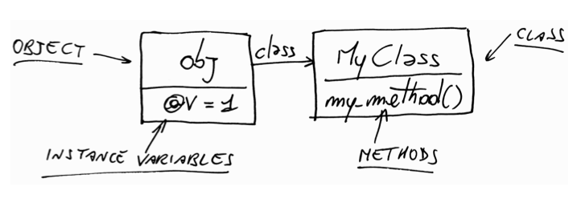
Classes themselves are nothing but OBJECTS
Notes:
‘Hello Juampi’.class => String
String.class => Class
Mencionar superclass

Slide 12
Constants
Arranged as a file system tree
Name starts with a Capital
Module.nesting
Module.constants

Slide 13
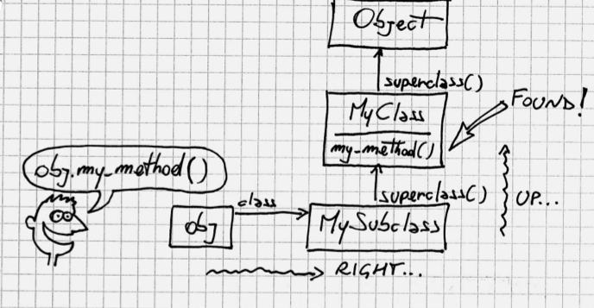
Method Lookup
Ancestors
Notes:
Ancestors

Slide 14
summary
When you call a method, Ruby goes right into the class of the receiver and then up the ancestors chain, until it either finds the method or reaches the end of the chain.
Every time a class includes a module, the module is inserted in the ancestors chain right above the class itself.
When you call a method, the receiver takes the role of self.
When you’re defining a module (or a class), the module takes the
role of self.
Instance variables are always assumed to be instance variables of
self.
Any method called without an explicit receiver is assumed to be a
method of self.

Slide 15
METHODS
Notes:
Differences between Java and Ruby

Slide 16
Dynamic Dispatch: SEND
To call methods dynamically
Name of method is an argument
Notes:
SendTest.rb
For testing, send llama a publicos y privados

Slide 17

Dynamic Dispatch: DEFINE_METHOD
To define methods dynamically
Name of method and params are arguments

Slide 18
METHOD_MISSING
To catch calls to missing methods
Optional: Receive method name, args and block as parameters.

Slide 19
RESPOND_TO?
Default: check whether or not method is defined.
BUT
It can be overwritten for our convenience

Slide 20
What is not an object in ruby?
Most things in Ruby are objects
Blocks are not
You need an object to execute the code of a block

Slide 21
DRG metaprogramming examples
https://github.com/dresources/biogenidecformulary/blob/master/lib/site_config.rb
https://github.com/dresources/novartisformulary/blob/staging/app/models/publisher_formulary.rb#L486

