Slide 1
Quantum Unsupervised Learning
Researched & Implemented by Bo-Hyun, Seo
Supervised by PostDoc. Woo-Young, Song
Division of Computer Science & Software Engineering

Slide 2
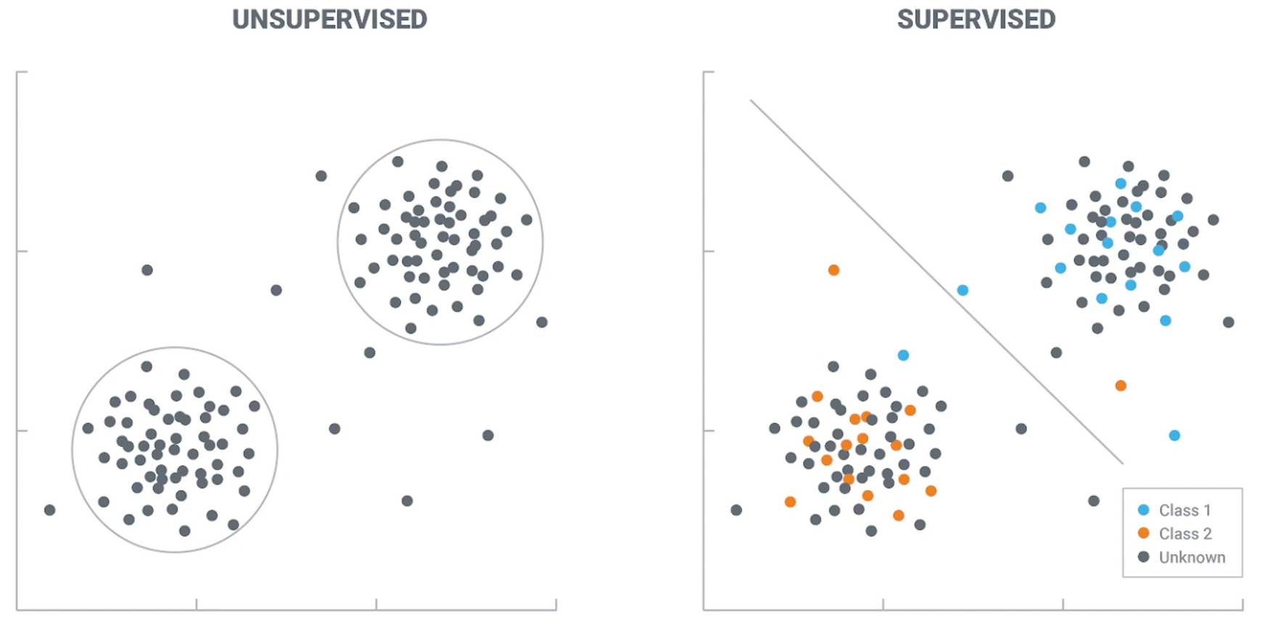
Basic Concept of Unsupervised Learning
Compare with Supervised Learning

Slide 3
Simulating Algorithm
Such as CAT vs DOG Flow
Notes:
classification duck, not duck
training, test, validation
developer already give answer = give label each class
unsupervised = cluster each similar class ,no label
use only algorithms

Slide 4
Quantum Support Vector Clustering
Qiskit lib
Notes:
in qiskit support library -> QSVC algorithm (kernel method)

Slide 5
Support Vector Machine
Classic Computer
Supervised binary classification $train.set:T=\{x_{1},x_{2},...,x_{M}\},x_{i}∈R^{s}$
$$class.map:c_{T}→\{+1,-1\}$$
$$test.set:S=\{x_{1}^{′},x_{2}^{′},...,x_{m}^{′}\}$$
$Aclassificationmapforallxisunknown:$ $map:c:x→\{+1,-1\},∀x$

Slide 6
Support Vector Machine
Classification Problem
$Supervisedbinaryclassification$: $train.set:T=\{x_{1},x_{2},...,x_{M}\},x_{i}∈R^{s}$
$$class.map:c_{T}→\{+1,-1\}$$
$$test.set:S=\{x_{1}^{′},x_{2}^{′},...,x_{m}^{′}\}$$
$Aclassificationmapforallxisunknown:$ $map:c:x→\{+1,-1\},∀x$
$$Goal:findaclassmap\overset{˜}{c}:T∪S→\{+1,-1\}thatagreeswellwiththeunknownmapcdeterminingalltruelabels.$$
Notes:
line fitting align -> feature들을 적절히 margin범위 외로 들도록 align

Slide 7
Linear SVC
Linear system
Linear decision function : ${\overset{˜}{c}}_{\text{SVM}}(x)=sign(w^{T}x-b)$
$$\min_{w∈R^{s},b∈R}||w||^{2}\text{s. t.}y_{i}(w^{T}x_{i}-b)≥1$$
support vector
Notes:
dot line = fitting feature -> very good feature.
if margin라인 안에 들어오는 feature는 Support Vector Regression 회귀법으로 역연산 가능.
SVC한정 마진라인 안에 들어오는 feature들은 매우 좋지 않은 feature data.

Slide 8
Kernelized SVC
Non-Linear system
Non-Linear feature transform :$ϕ:R^{s}→V,\text{where}V\text{a Hilbert space}{\overset{˜}{c}}_{\text{SVM}}(x)=sign(⟨w,ϕ(x)⟩_{ν}-b)$
Linear in feature space, but nonlinear in the original space ; Kernel trick is to rewrite the SVM problem to only explicitly depend on : $k(x,x^{′})=⟨ϕ(x),ϕ(x^{′})⟩_{ν}$
not the feature vectors : $ϕ(x).$
Notes:
numerical line fitting align arrange -> compare to linear system & non-linear

Slide 9
Kernelized SVC
Classic Computer
$$Originaldata:x∈R^{2}$$
$$Featuremapϕ(x)=(x_{1},x_{2},x_{1}^{2}+x_{2}^{2})∈R^{3}$$
$$Kernelk(x,x^{′})=ϕ(x)⋅ϕ(x^{′})=x⋅x^{′}+||x||^{2}||x^{′}||^{2}$$
Notes:
non-linear -> use kernel method -> increase one-D

Slide 10
Quantum SVM
$$\begin{matrix}ψ:R^{s} & →S(2^{q}) \\ x & ↦|ψ(x)⟩⟨ψ(x)|\end{matrix}$$
$$\begin{matrix}k(x,x^{′}) & =tr[|ψ(x^{′})⟩⟨ψ(x^{′})||ψ(x)⟩⟨ψ(x)|] \\ & =|⟨ψ(x^{′})|ψ(x)⟩|^{2} \\ & =|⟨0|E(x^{′})^{†}E(x)|0⟩|^{2}\end{matrix}$$
Notes:
qiskit -> generate quantum circuit

Slide 11
QSVC
Basic Concept (used qiskit)
Notes:
empty 동그라미, 네모 = train set
full 동그라미, 네모 = test set
line fitting align -> this problem —>cannot solve, because it is non-linear system.
so, use kernel method==>increase one-dimension

Slide 12
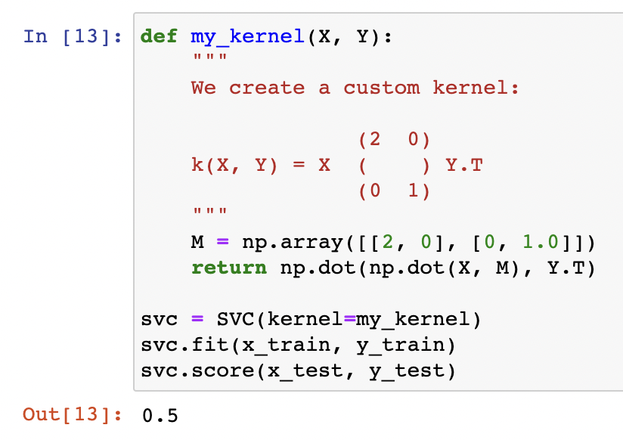
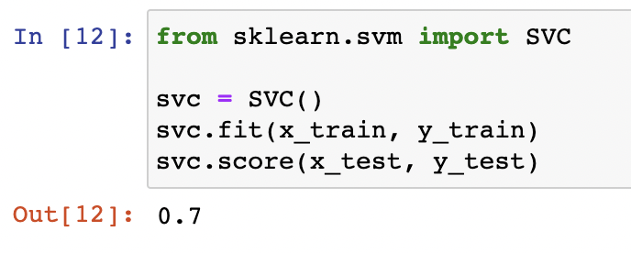
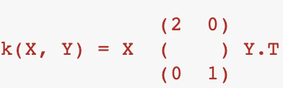
Compare with Classic & Quantum
Notes:
customize kernel method -> my researching kernel method ==> X,Y value —>np.array range=Y.transpose
result=50% <- so bad

Slide 13
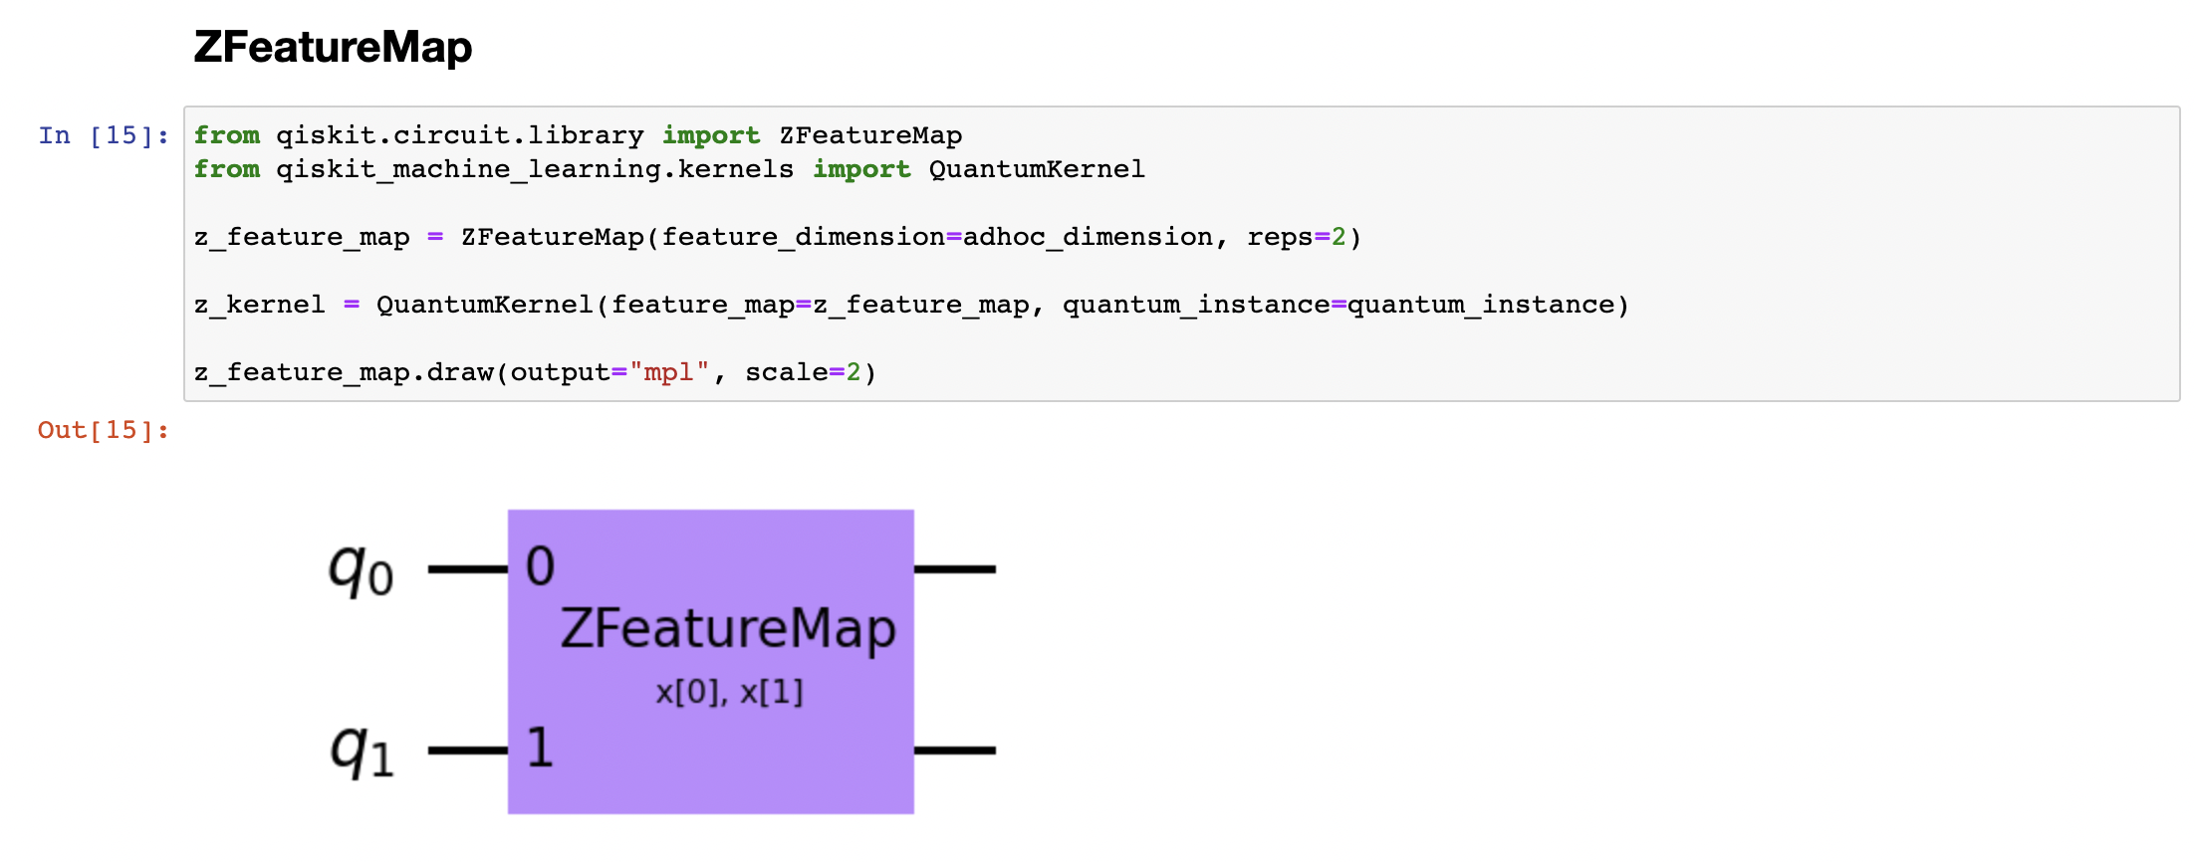
Quantum Neural Network
Qiskit
Notes:
entire ZfeatureMap q0, q1 -> two qubit —-input—-> output data structure

Slide 14
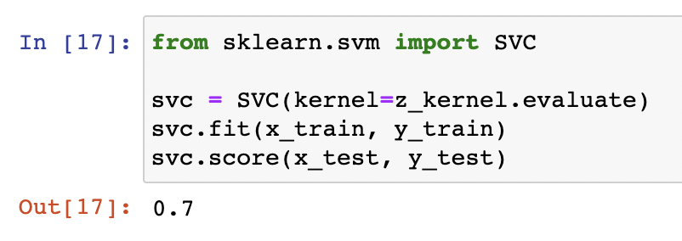
ZFeatureMap
Decompose Qubit
Notes:
zfeaturemap -> decompose -> Detail circuit logic

Slide 15
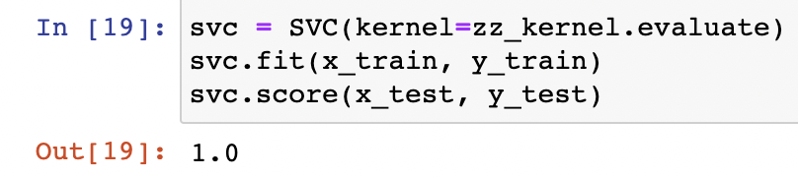
ZZFeatureMap
Notes:
아다마르 게이트, 페이즈 게이트, cnot 게이트
acc. 100% <- ?

