Slide 1
Senior Travel
Companion
Helping families support older parents
before and during a tour
Hackathon concept and UI prototype
01
Notes:
Timing: 20 seconds.
Senior Travel Companion helps adult children support older parents when they cannot travel together. We focus on parents aged sixty and above who join organised tours. The child helps choose the trip, the parent uses a simple interface, and the guide provides local support. This is our proposed product, illustrated through a UI prototype.

Slide 2
The family support gap
“Can Mum manage the trip,
and who can help if plans change?”
Before the trip
During the trip
Suitability and important tour details
can be difficult to assess.
Children need context. Parents need
an easy way to request support.
Primary user / intended payer: adult child End user: parent aged 60+
02
Notes:
Timing: 30 seconds.
Imagine a daughter arranging a holiday for her mother, who prefers short walks. A tour listing may look suitable, but she still needs to understand walking demands and the evidence behind the operator. During the trip, a missed reply gives little context. The parent also needs a simple way to ask for help. These are hypotheses we will validate through family and guide interviews.

Slide 3
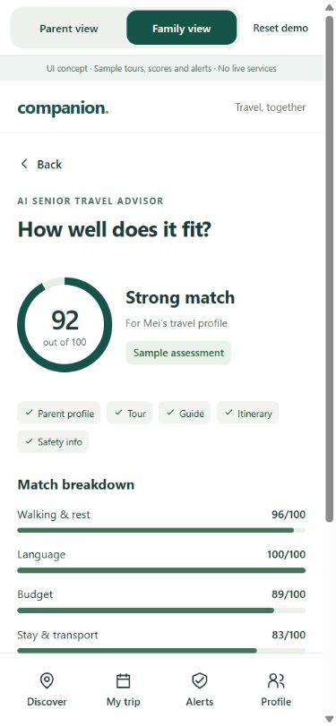
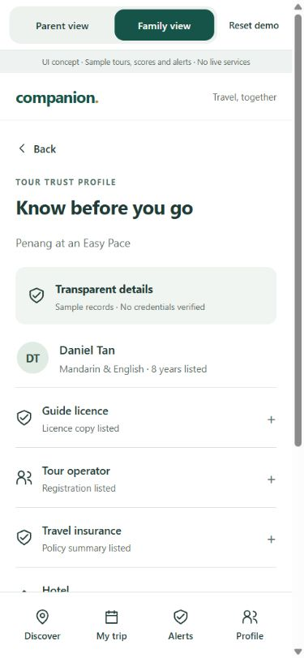
Tour matching with reasons
AI Senior Tour Matcher
Parent preferences compared
with tour requirements.
AI Travel Advisor
Suitability Score with reasons,
mismatches and unknowns.
Tour Trust Profile
Guide, licence, insurance, hotel
and transport evidence.
03
Notes:
Timing: 40 seconds.
The child enters a parent profile with walking tolerance, rest needs, language and budget. The proposed matcher compares it with tour, guide, itinerary and safety information. Explicit rules calculate suitability, while the AI advisor explains the fit and missing information. For example, a forty-minute walk should be flagged for a parent who prefers twenty minutes. The Trust Profile shows supporting evidence and review status. Our displayed scores are fixed demo values, and neither suitability nor a trust profile guarantees safety.

Slide 4
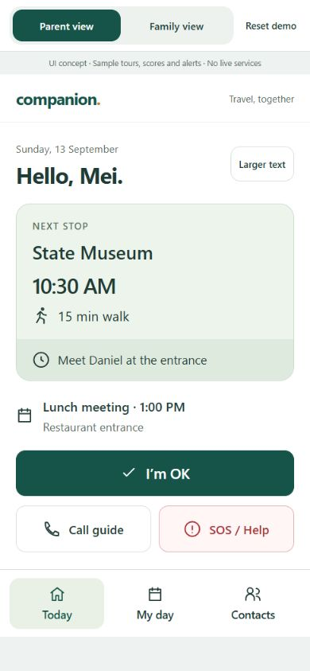
Simple actions for older travellers
One clear next step
Next stop and meeting information
on the home screen.
Easy check-in
A prominent “I’m OK” action.
Help within reach
Call guide or open SOS / Help.
04
Notes:
Timing: 35 seconds.
Parents should not need to learn a complex dashboard. Senior Simple Mode brings the next stop and meeting details to the main screen. The largest action lets them say I am okay. Calling the guide and requesting help remain easy to find. We use short labels and prominent controls, with detailed planning in the child view. We still need usability testing with older adults, including text scaling and whether users understand the help actions.
Sources: https://www.w3.org/WAI/older-users/ and https://www.w3.org/WAI/WCAG22/Understanding/target-size-enhanced.html

Slide 5
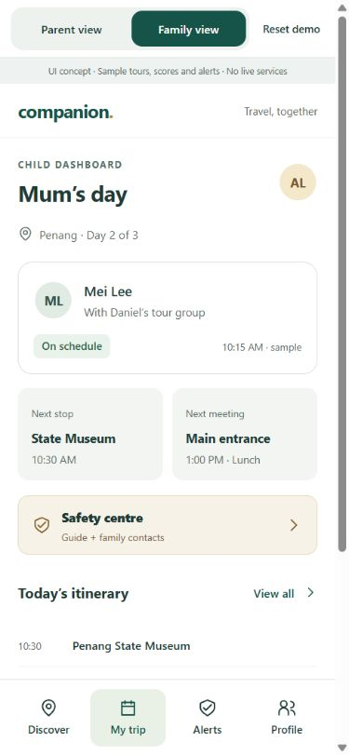
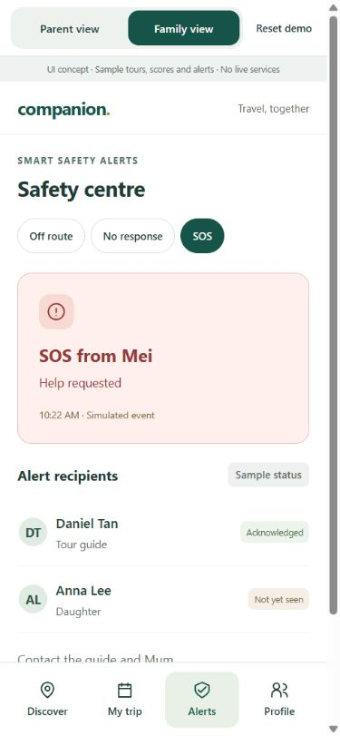
Shared context when help is needed
Child Dashboard
Itinerary and latest status
in the same trip view.
Smart Safety Alerts
SOS, overdue check-ins and
possible route deviations.
Guide assists locally.
Child follows the response remotely.
05
Notes:
Timing: 35 seconds.
The child dashboard would combine the itinerary with the latest check-in and help request. If a parent requests rest or sends SOS, the proposed alert workflow contacts the authorised guide and child. The guide can respond locally while the child supports remotely. Later, we would test missed check-ins and location deviations. The app must show stale data and separate acknowledgements. These screenshots simulate the workflow. They do not send notifications or provide emergency response.

Slide 6
Our proposed difference
TourRadar
Tour discovery and physical ratings
TripIt
Travel plans and itinerary sharing
Life360
Family location sharing and SOS
Our focus: parent-specific tour selection
connected to family and guide support
06
Notes:
Timing: 30 seconds.
Existing products already solve useful parts of this problem. TourRadar offers senior tours and physical ratings. TripIt organises and shares itineraries. Life360 supports location sharing and SOS. Our proposed difference is joining parent-specific tour selection with support during travel, connecting the parent, child and guide. We are not claiming these individual features are unique. We need to validate whether this connected workflow matters enough for families to adopt and pay for.
Sources: https://www.tourradar.com/pa/seniors ; https://help.tourradar.com/en/operators/group-type-guide-type-physical-ratings ; https://help.tripit.com/en/support/solutions/articles/103000063304-getting-started ; https://www.life360.com/location-sharing ; https://support.life360.com/hc/en-us/articles/23053474049687-SOS-Alerts

Slide 7
A focused implementation stack
Flutter
FastAPI + Supabase
Parent, child and guide interfaces
APIs, trip data and access controls
LangChain + NVIDIA NIM
Geoapify Routing API
Evidence-based match explanations
Proposed route distance and duration
FCM + persistent worker for notifications and scheduled checks
Planned stack. Current prototype uses HTML, CSS and JavaScript.
07
Notes:
Timing: 30 seconds.
Our planned frontend is Flutter, backed by FastAPI and Supabase for profiles, trips and permissions. LangChain sends relevant evidence to NVIDIA NIM to explain matches. Backend rules control scoring and alerts. For routing, Geoapify is a lower-cost MVP candidate, subject to local coverage tests. FCM and a persistent worker handle notifications and overdue events. The existing demo uses HTML, CSS and JavaScript. These integrations are planned, and we will confirm provider limits before implementation.
Sources: https://docs.flutter.dev/platform-integration/web ; https://supabase.com/docs/guides/database/overview ; https://docs.langchain.com/oss/python/langchain/structured-output ; https://docs.api.nvidia.com/nim/re/reference/llm-apis ; https://www.geoapify.com/pricing/ ; https://firebase.google.com/docs/cloud-messaging

Slide 8
The next milestone
One profile. One suitable tour.
One shared trip.
Next: working check-ins across two devices
Then: guide response and older-user testing
Current status: UI prototype with sample data
08
Notes:
Timing: 20 seconds.
Our next milestone is one working trip across two devices: a child creates a profile, reviews a match and receives a parent check-in. Then we test guide acknowledgement and usability with older adults. Today we have the interface concept. Our goal is to help families choose a suitable tour and stay connected when they cannot travel together.

