Slide 1
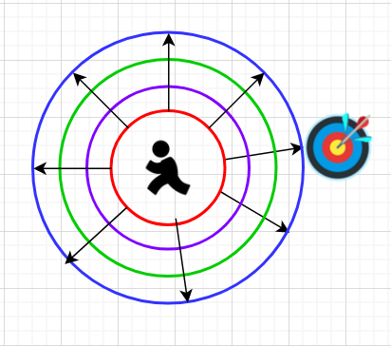
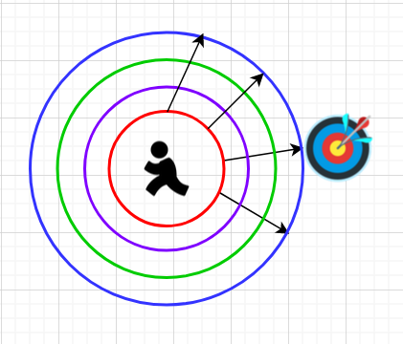
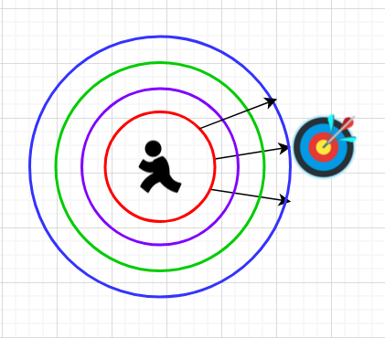
BFS search Dijkstra Search A* Search
Searches on all directions
Search is more narrowed down
using edge weights (or costs)
Search is further enhanced by
narrowing down possible paths
to those with lowest costs and
least distance (Manhattan distance)

