Slide 1

Brain Tumor Detection Using Efficient NetB7+ Isolation Forest
Group members :
Aayush Koli (A030)
Siddhant Roy (A045)
Girikratna Sharma (A080)
Capstone Project Mentor’s name(s):
Mr Dharmesh Rathod

Slide 2
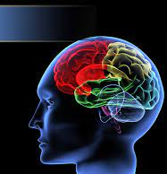
Introduction
A brain tumor is the growth of abnormal cells in the brain. There are many types of brain tumors, but this study will focus on meningioma, pituitary, and glioma tumor.
Meningiomas start from the membranes that surrounds the brain and surrounds the central nervous system
Pituitary tumors are lumps that are inside the skull
Gliomas are a general term for tumors that arise from brain tissues other than nerve cells and blood vessels
Deep learning algorithms and Machine learning techniques have been and are still playing a big role in detection of brain tumors.
The deep learning models previously used to classify brain tumors are slow and consist of many parameters.

Slide 3
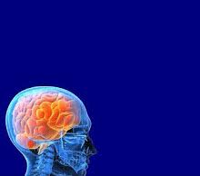
Introduction
As a result, training these models is time consuming and requires a lot of memory.
This poses a great challenge when it comes to deploying these models on resource-restricted mobile devices.
Mobile intelligence needs faster mobile processors, more storage space, smaller but more accurate models, and even the assistance of other network nodes.

Slide 4

Problem description
Accurate and fast diagnosis of brain tumor is crucial as it involves the selection of the most appropriate treatment method for saving a patient’s life.
Previously implemented deep learning models on brain tumor classification like vgg16,Resnet etc are complex and slow .
Performing real-time performance with these models requires dedicated hardware.
This may result in delayed diagnosis, treatment and therefore may increase the chances of a patient’s death.
The models are also difficult and impossible to deploy on mobile devices due to their complexity.
The proposed Capstone project will address the problem of complexity by using combination of EfficientNetB7 model and Isolation Forest .

Slide 5

Objectives
Gather and perform
Gather and perform pre-processing on the dataset.
Develop
Develop an EfficientNetB7+Isolation Forest model and compare it to lone EfficientNet B7 model for classification of brain tumors. Compare the models based on accuracy and complexity.
Segment
Segment the brain tumor using image processing techniques.
Dependency
Reduce dependency on radiologist based on their eyes analysis

Slide 6
Significance of study
The development of smaller networks is important as it is linked to the possibility of deploying the models on mobile platforms and fast .
This study’s findings will help medical practitioners generate fast and reliable diagnosis of brain tumor through the implementation of EfficientNetB7.

Slide 7

Literature Review
Tehreem Masood, Arfan Jaffar, Md, AND SHEERAZ AKRAM compare pretrained models like AlexNet, VGG16, VGG19, ResNet50, InceptionV3, DenseNet121, and all variants of the EfficientNet model chosen for their excellent feature extraction and image classification with "Improved Multiclass Brain Tumour Detection via Customised Pretrained EfficientNetB7 Model." A free multiclass dataset of 3264 MRI images was used.
Kang, Ullah and Gwak (2021:6) proposed a system that used pretrained deep learning models to extract features and then fed those features to machine learning models.
The results showed that DenseNet-169 deep feature alone is a good choice when the size of the MRI dataset is very small and the number of classes is 2, and the ensemble of DenseNet-169, ShuffleNet V2, and MnasNet deep features is a good choice when the size of MRI dataset is large and there are four classes (normal, glioma tumor, meningioma tumor, and pituitary tumor). They also discovered that in most cases, SVM with RBF kernel outperforms other ML classifiers for the MRI-based brain tumor classification task.

Slide 8
Literature Review cont.
The paper “MRI-based brain tumor detection using convolutional deep learning methods and chosen machine learning techniques” by Soheila Saeedi, Sorayya Rezayi, Hamidreza Keshavarz and Sharareh R. Niakan Kalhori presents two deep learning techniques and a number of machine learning strategies for diagnosing three different types of tumours, including gliomas, meningiomas, and pituitary gland tumours, as well as healthy brains free of tumours, using magnetic resonance brain images, allowing doctors to identify tumours with high accuracy in their early stages.
From all the techniques implemeneted we discovered that the EfficientNetB7 hasn’t been implemented to classify brain tumors. So, this study will develop the model in brain tumor classification along with vgg-16 then compare the results based on accuracy and complexity.

Slide 9
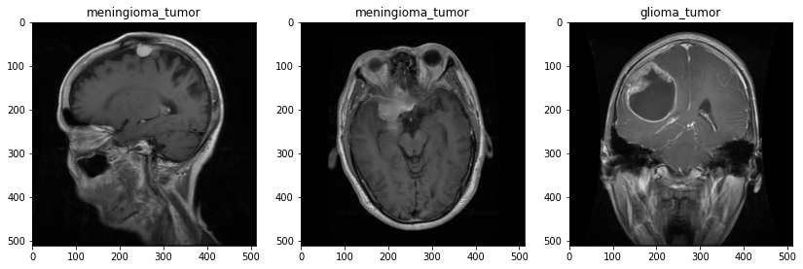
Dataset Sample

Slide 10
Methodology: Image Pre-processing
The MRIs came in different sizes and were therefore resized as per requirement of the different models presented in this study.
The “preprocess_input” function was used for pre-processing the images along with “ImageDataGenerator”.
The “ImageDataGenerator” takes the original image and replaces it with a new pre-processed image.

Slide 11
DATA SPLIT
In the table below we have considered to take 46% of training set ,47% of validation set and 7% of testing set.
TRAINING | VALIDATION | TESTING | TOTAL
46% | 47% | 7%
2870 | 2890 | 394 | 6154

Slide 12
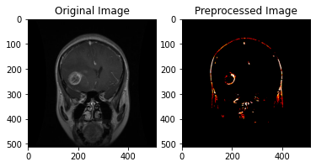
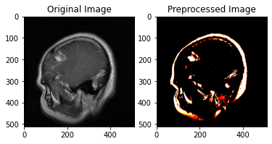
Image Pre-processing Results

Slide 13
Methodology: model development and fine-tuning
All models were fine-tuned on the same parameters.
They were fine tuned on the following parameters namely, optimizers, dropout, number of epochs and batch size.
The goal of fine tuning was to get the optimum hyper-parameters for the final models.

Slide 14
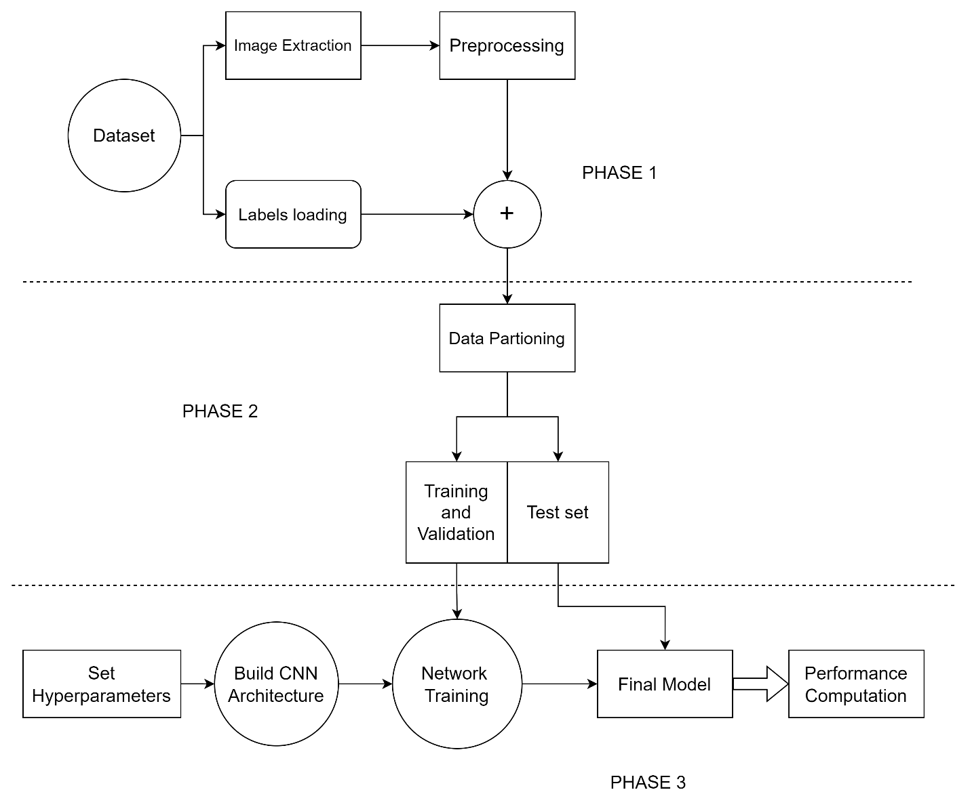
BLOCK DIAGRAM

Slide 15
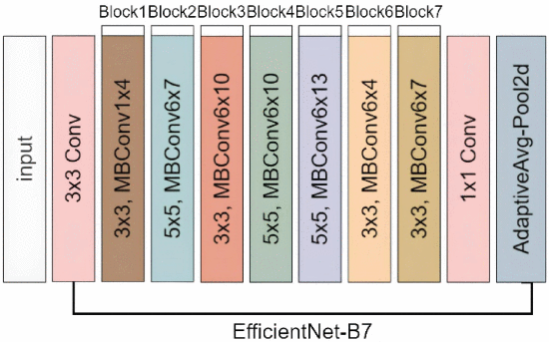
Final Model
[2]
We found that EfficientNetB7 gave best results for the chosen parameters of interest, namely accuracy in terms of number of trainable parameters and accuracy
Then we go onto combining the model with Isolation Forest

Slide 16
LETS LOOK AT OUR COLAB FILE
FOR THE CODE NOW ------------>

Slide 17
Results
Accuracy of Efficient B-7 model W/O Outlier Detection
Accuracy of Efficient B-7 model With Isolation Forest
 | Accuracy
ACCURACY | 92%
F1 SCORE | 0.92
 | Accuracy
ACCURACY | 97.86%
F1 SCORE | 0.97

Slide 18
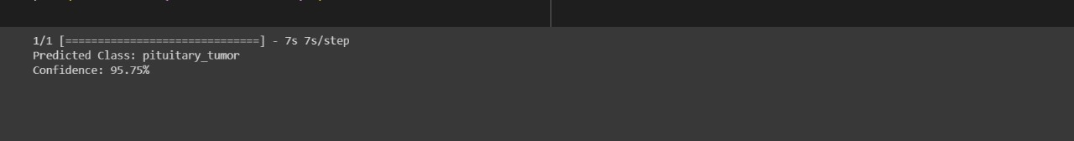
Results
Then on loading the data we have seen the model predicting correctly with confidence around 96%. On loading a test Mri image of brain having pituitary tumor , we get the following result :

Slide 19
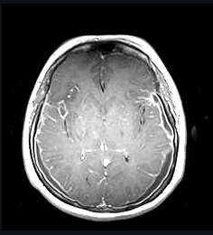
Challenges and Areas of Future Research
Improve our segmentation techniques as for other images it shows there exist a tumor where there is none(in the image on the side it shows as if there is a small tumor it can be misinterpreted as an early stage of a tumor)
Improve and add more performance measurement techniques of our models

Slide 20
References
Brain tumor detection using magnetic resonance images with a novel convolutional neural network model; Mesut Toğaçar, Burhan Ergen, Zafer Cömert; 2020
H. M. T. Khushi, T. Masood, A. Jaffar, M. Rashid and S. Akram, "Improved Multiclass Brain Tumor Detection via Customized Pretrained EfficientNetB7 Model," in IEEE Access, vol. 11, pp. 117210-117230, 2023, doi: 10.1109/ACCESS.2023.3325883.
Tumor Detection in the Brain using Faster R-CNN; R. Ezhilarasi and P. Varalakshmi; 2018; IEEE
Malathi, M., & Sinthia, P. (2019). Brain tumour segmentation using convolutional neural network with tensor flow. Asian Pacific journal of cancer prevention: APJCP, 20(7), 2095.
Joseph, S. S., & Dennisan, A. (2023). Optimised CNN based brain tumour detection and 3D reconstruction. Computer Methods in Biomechanics and Biomedical Engineering: Imaging & Visualization, 11(3), 796-811.
Gaur, L., Bhandari, M., Razdan, T., Mallik, S., & Zhao, Z. (2022). Explanationdriven deep learning model for prediction of brain tumour status using MRI image data. Frontiers in genetics, 13, 448.

