Slide 1
A Study on Physical Fitness
Mousam Sinha
Sreejit Roy
Vaishnavi Jaiswal
December 25, 2021
ISI Delhi, SMU
A Study on Physical Fitness
December 25, 2021

Slide 2
INTRODUCTION
The dataset contains various measures of heart and pulse rates taken on men in a physical fitness course.
The following are defined:
Y := oxygen used to complete the given task.
X1 := age of the participant.
X2 := weight of the participant.
X3 := time to run a given distance on a treadmill.
X4 := measure of pulse-rate at rest.
X5 := average pulse-rate during the run.
X6 := maximum pulse-rate during the run.
For the purpose of this study, Y is taken as the response variable; the remaining as explanatory variables.
ISI Delhi, SMU
A Study on Physical Fitness
December 25, 2021

Slide 3
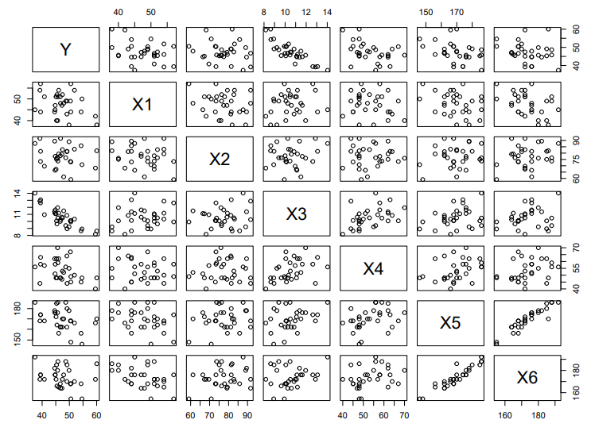
PRELIMINARY ANALYSIS
For the given dataset, the multiplot is as follows:
Also note that the correlation between X5 and X6 is 0.93.
ISI Delhi, SMU
A Study on Physical Fitness
December 25, 2021

Slide 4
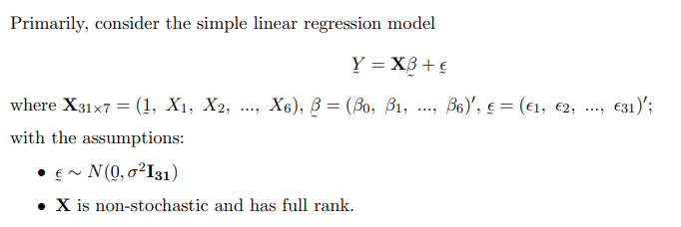
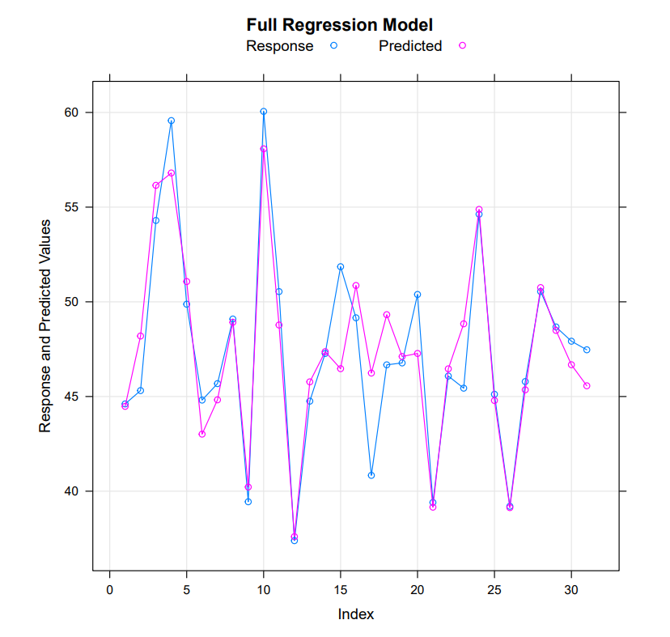
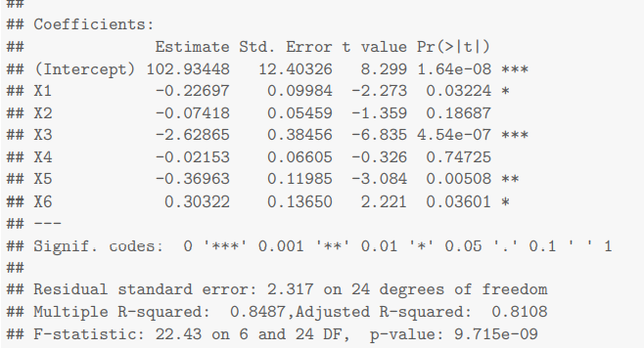
FITTING THE MODEL
ISI Delhi, SMU
A Study on Physical Fitness
December 25, 2021

Slide 5
VERIFICATION OF ASSUMPTIONS
Along with model, the following assumptions were made:
• Errors are independently normally distributed with mean 0 and constant variance.
• X is non-stochastic and has full rank.
In particular, we test for the following assumptions:
Homoscedasticity
Normality of error terms
Absence of autocorrelation
independence of explanatory variables
We assume the non-stochastic nature of explanatory variables.
ISI Delhi, SMU
A Study on Physical Fitness
December 25, 2021

Slide 6
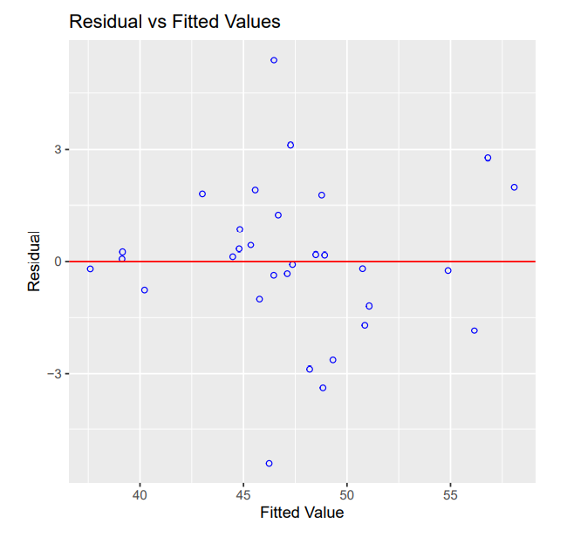

HOMOSCEDASTICY
Breusch–Pagan test is performed for obtaining a formal conclusion about whether heteroscedasticity is present or not.
We conclude that there is no heteroscedasticity in the data-set
ISI Delhi, SMU
A Study on Physical Fitness
December 25, 2021

Slide 7
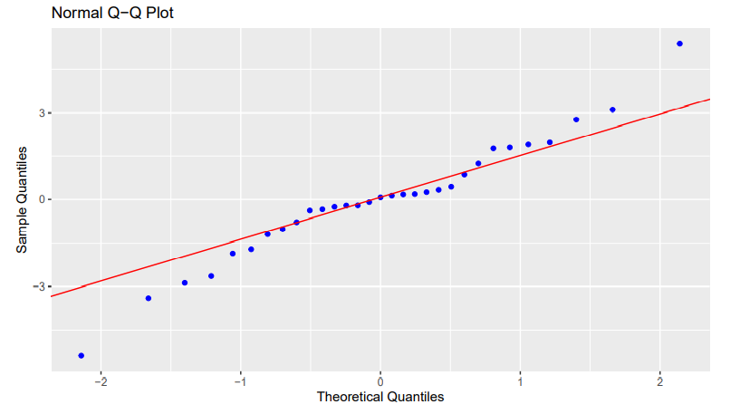
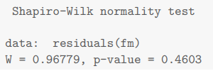
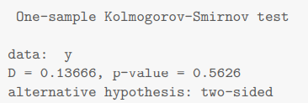
NORMALITY
Tests for normality of error terms:
We conclude that the assumption of normality is valid.
ISI Delhi, SMU
A Study on Physical Fitness
December 25, 2021

Slide 8
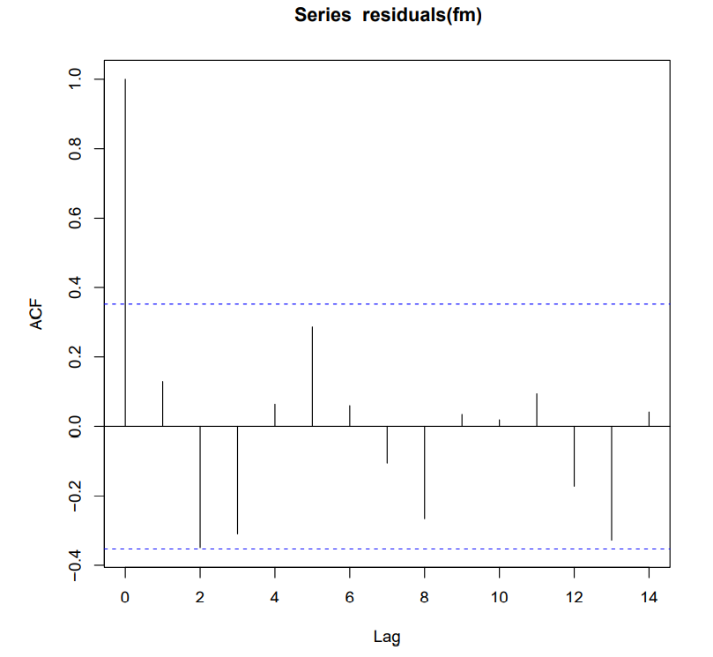
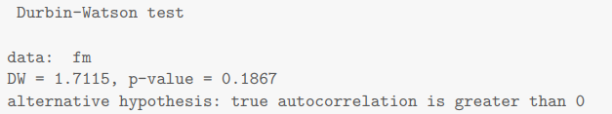
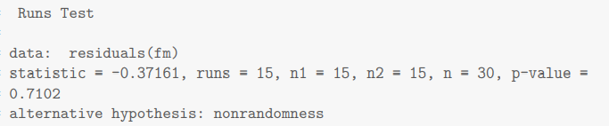
AUTOCORRELATION
Tests are performed to validate the claim that errors are not autocorrelated:
We conclude that the residuals are not auto-correlated.
ISI Delhi, SMU
A Study on Physical Fitness
December 25, 2021

Slide 9
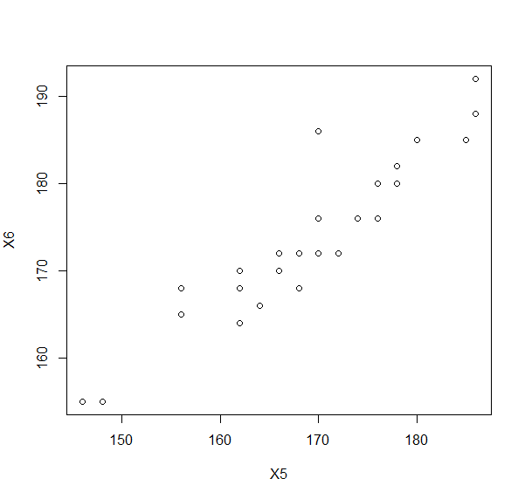
MULTICOLLINEARITY
A model is said to have multicollinearity when its regression matrix is not of full rank. To verify the claim, the following are calculated:
VIF (Variance Inflation Factor)
Condition Number for the regression matrix is 132.8558.
Due to high condition number and VIF values for X5 and X6, we suspect that there is a presence of multicollinearity.
ISI Delhi, SMU
A Study on Physical Fitness
December 25, 2021

Slide 10
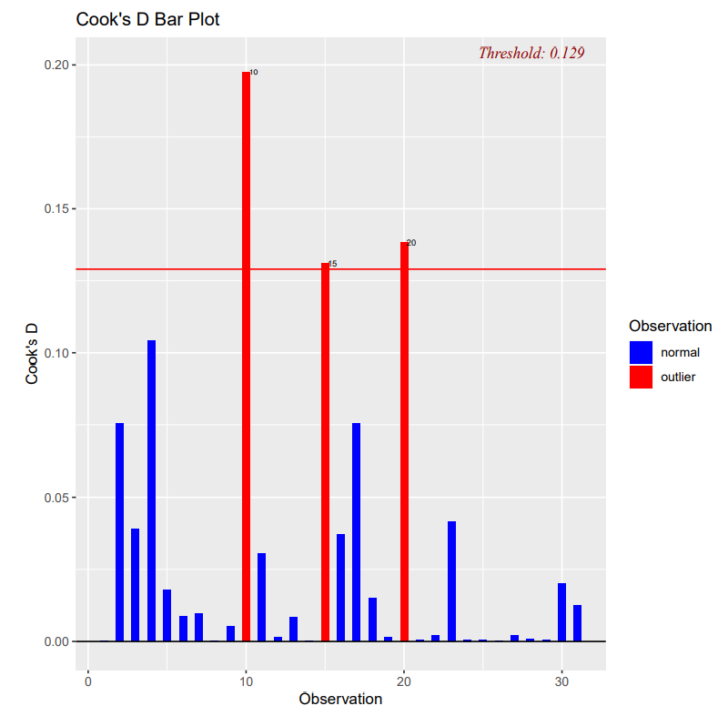
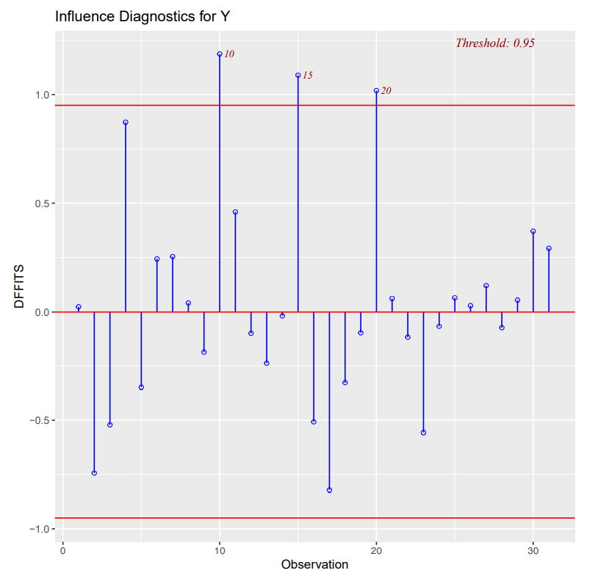
DETECTION OF INFLUENTIAL POINTS
ISI Delhi, SMU
A Study on Physical Fitness
December 25, 2021

Slide 11
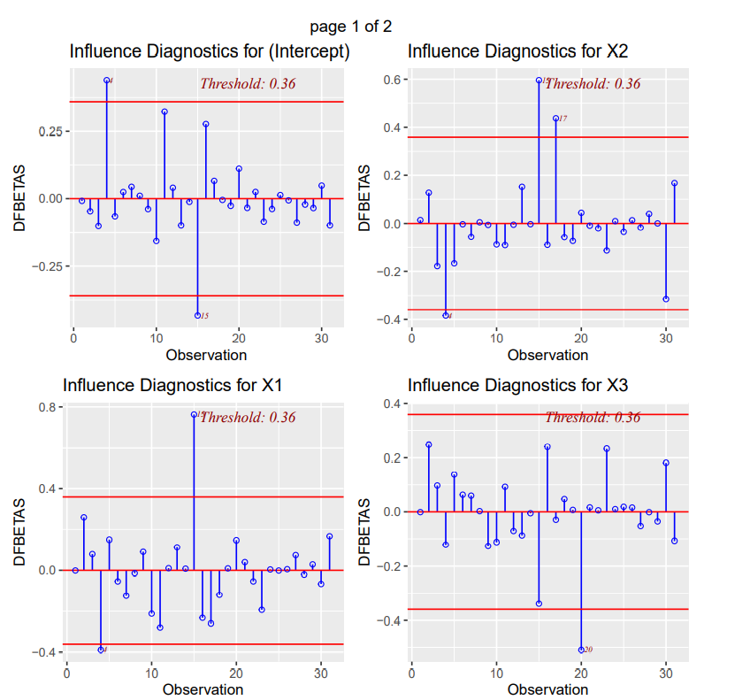
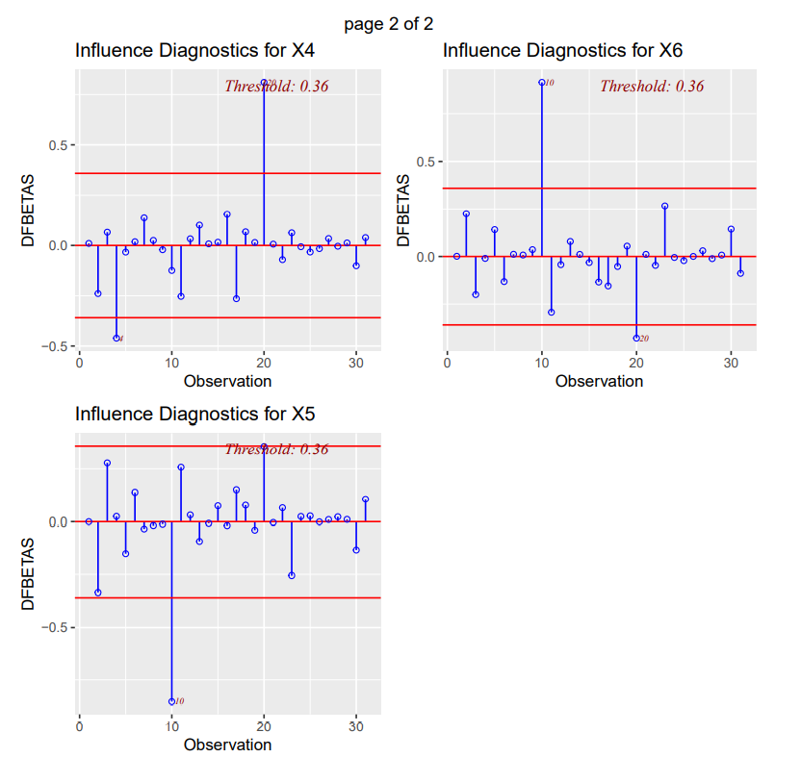
DETECTION OF INFLUENTIAL POINTS
ISI Delhi, SMU
A Study on Physical Fitness
December 25, 2021

Slide 12
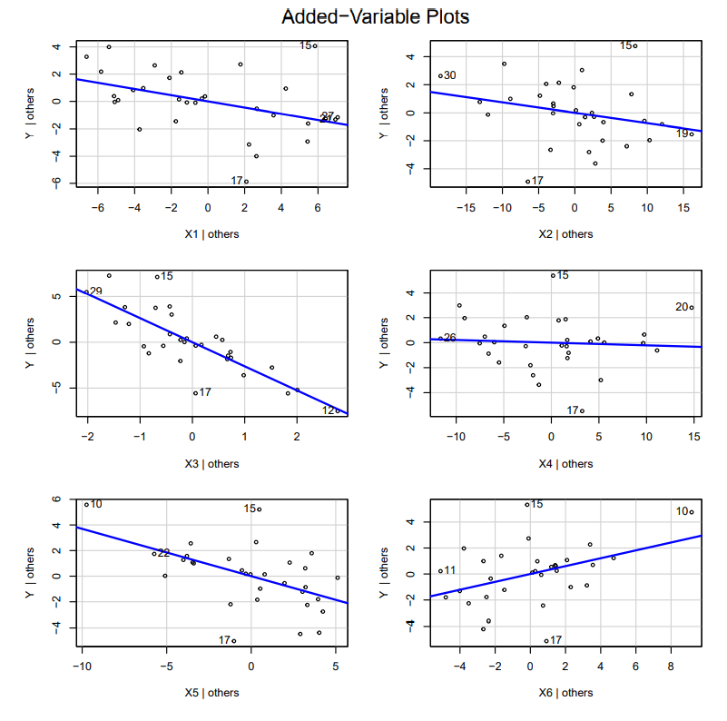
DETECTION OF INFLUENTIAL POINTS
This plot gives the relationship between response variable and a regressor variable when other variables are held constant.
Each added variable plot notes four different values, two of which are points with highest residuals, the others are those with highest partial leverage.
We conclude on the basis of these plots, that 15th and 17th points are definitely outliers
ISI Delhi, SMU
A Study on Physical Fitness
December 25, 2021

Slide 13
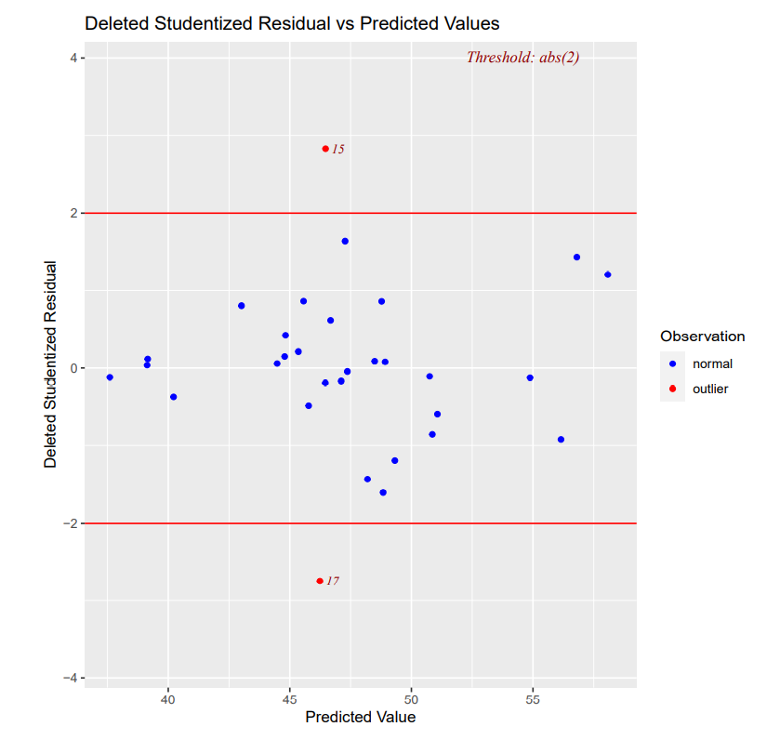
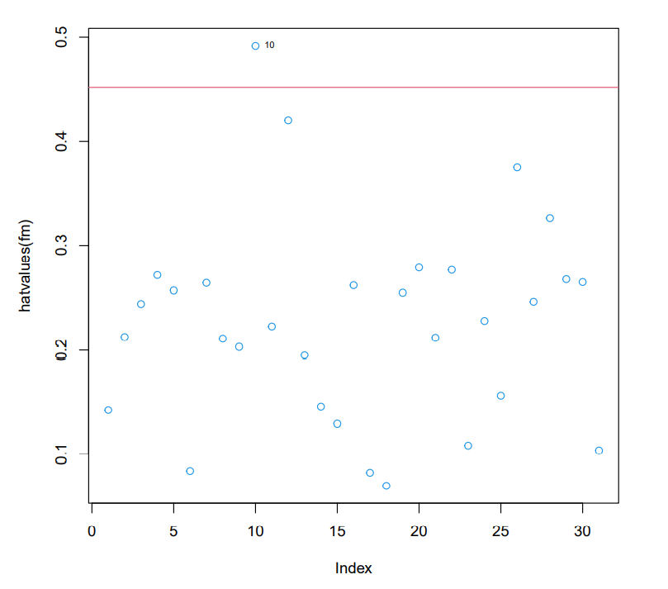
DETECTION OF INFLUENTIAL POINTS
ISI Delhi, SMU
A Study on Physical Fitness
December 25, 2021

Slide 14
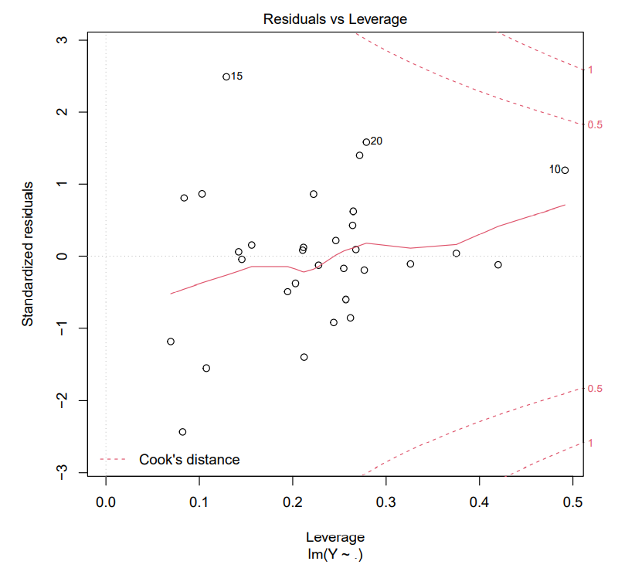
DETECTION OF INFLUENTIAL POINTS
On the basis of the above plots, we note that 15th is an outlier; 10th point is high leverage.
We also note that 20th is an influential point, mostly because it has moderately high residual as well as leverage.
Finally we can conclude that that the following observations are outliers: 15th , 17th, and 20th. And the 10th observation has high leverage.
ISI Delhi, SMU
A Study on Physical Fitness
December 25, 2021

Slide 15


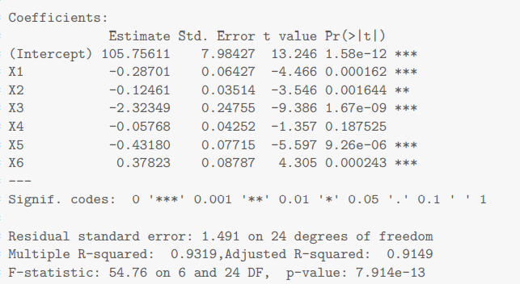
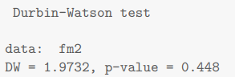
REMEDY FOR OUTLIERS
We remove 15th, 17th, and 20th observations from the dataset and fit the full model. We estimate the Y values for the 15th, 17th, and 20th observations from this model. Then we use the obtained Y values as observed values in the dataset. Then we use the newly formed dataset for fitting the full model again.
Heteroscedasticity, non-normality, and autocorrelation are not present. Multicollinearity still exists, which is obvious as multicollinearity mainly depends on the regression matrix.
ISI Delhi, SMU
A Study on Physical Fitness
December 25, 2021

Slide 16
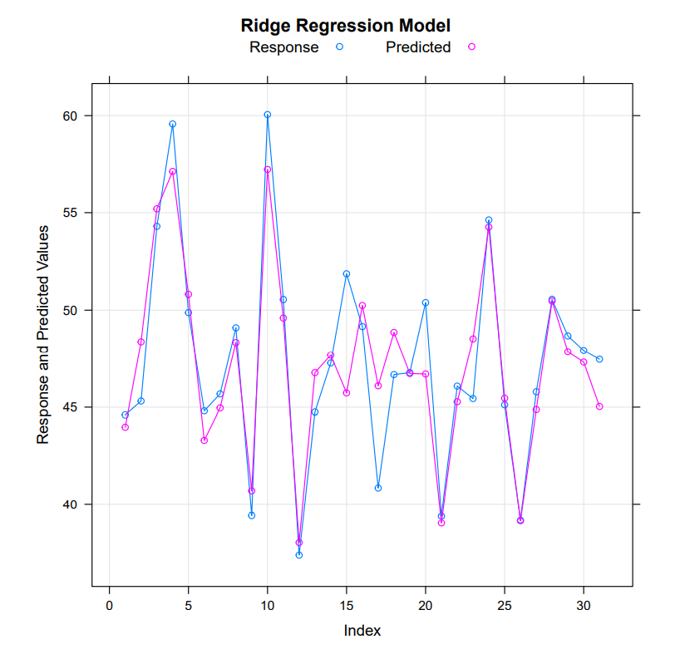
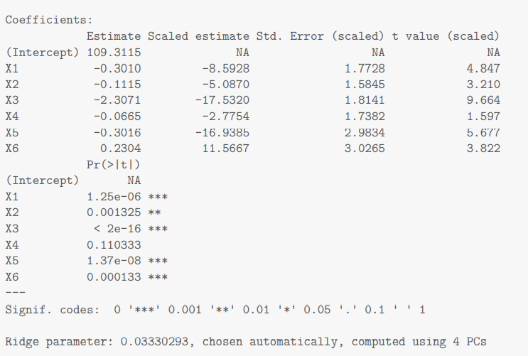
RIDGE REGRESSION
Ridge regression is performed as a remedy for multicollinearity.
ISI Delhi, SMU
A Study on Physical Fitness
December 25, 2021

Slide 17


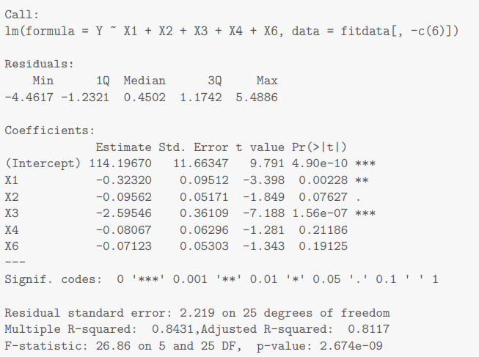


REMOVING COVARIATES : RUNPULSE
Another possible way of removing multicollinearity is that of selecting subsets of explanatory variables. We remove Run pulse (X5) from the list of explanatory variables and fit the model.
Here, the problem of multicollinearity is resolved in this model. Also note that all explanatory variables are not significant.
ISI Delhi, SMU
A Study on Physical Fitness
December 25, 2021

Slide 18
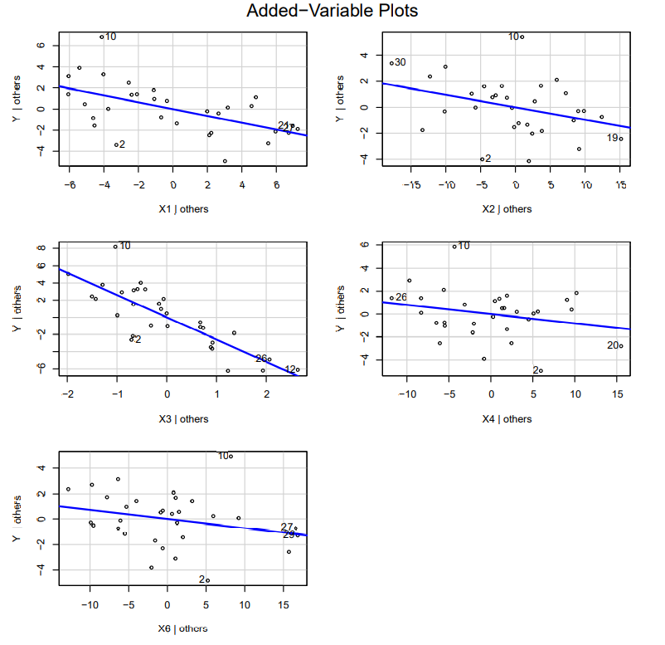
MODEL SELECTION
We consider the added variable plot for the considered model.
For a preliminary analysis based on the added variable plots, we notice that X2 and X4 are expected not to have highly significant effect on the response.
ISI Delhi, SMU
A Study on Physical Fitness
December 25, 2021

Slide 19
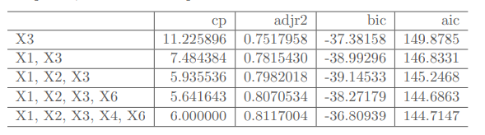
SUBSET SELECTION
We consider all the possible subsets and choose best model from models of each size (number of regressor variables).
The given table table compares the obtained models (5 models) in terms of AIC, BIC, Adjusted R-squared, and Mallow’s Cp.
In terms of Mallow’s cp and AIC, the fourth model seems to be the best.
In terms of adjusted R-squared, model 5 is the better one.
The third model is best in terms of BIC.
ISI Delhi, SMU
A Study on Physical Fitness
December 25, 2021

Slide 20
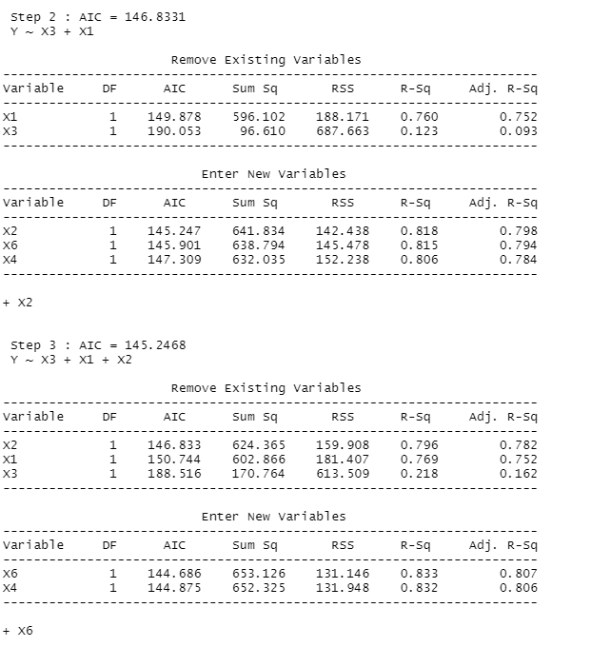
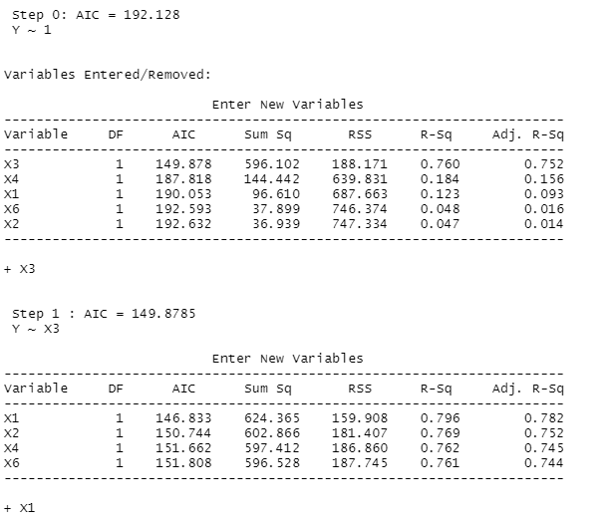
STEPWISE SELECTION METHOD
Candidate terms : X1, X2, X3, X4, X6
ISI Delhi, SMU
A Study on Physical Fitness
December 25, 2021

Slide 21
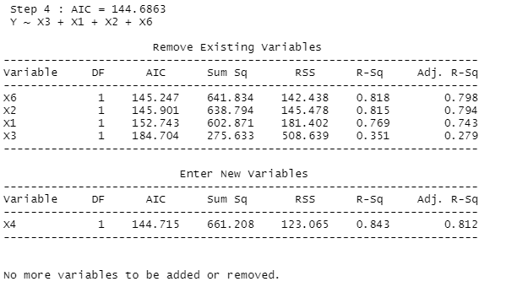
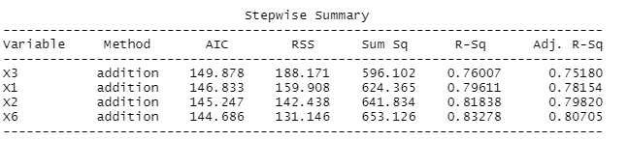
STEPWISE SELECTION METHOD
The stepwise selection method chooses the model Y on X1, X2, X3, and X6.
This model is preferable in terms of Mallow’s cp and AIC also.
The adjusted R-square for this model is 0.807, which is close to the model preferable in terms of adjusted R-squared criterion.
Therefore, we select model 4 (i.e., Y on X1, X2, X3, and X6) among all possible subsets of model 1 (i.e., Y on X1, X2, X3, X4, and X6).
ISI Delhi, SMU
A Study on Physical Fitness
December 25, 2021

Slide 22

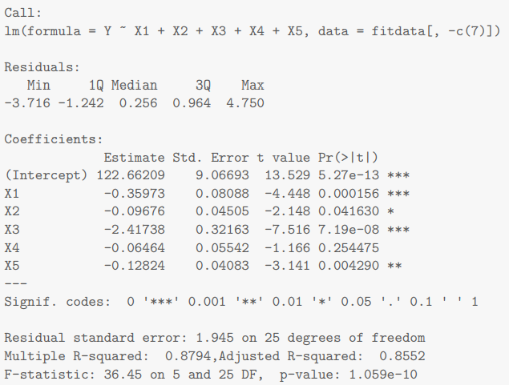



REMOVING COVARIATES : MAXPULSE
We remove Max pulse (X6) from the list of explanatory variables and fit the model.
Here, the problem of multicollinearity is resolved in this model. Also note as that in the previous case, all explanatory variables are not significant.
ISI Delhi, SMU
A Study on Physical Fitness
December 25, 2021

Slide 23
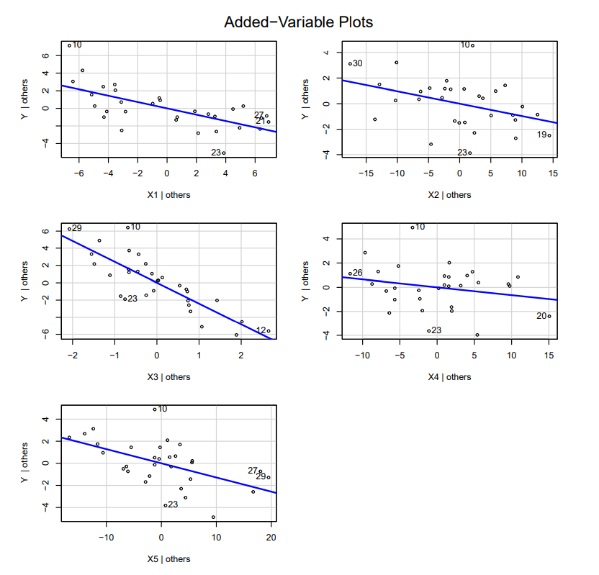
MODEL SELECTION
We consider the added variable plot for the considered model (After removing Max Pulse).
For a preliminary analysis based on the added variable plots, we notice that X2 and X4 are expected not to have highly significant effect on the response.
ISI Delhi, SMU
A Study on Physical Fitness
December 25, 2021

Slide 24
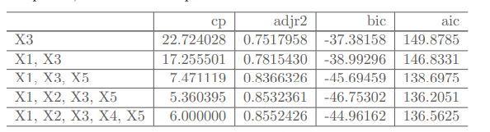
SUBSET SELECTION
We consider all the possible subsets and choose best model from models of each size (number of regressor variables).
The given table table compares the obtained models (5 models) in terms of AIC, BIC, Adjusted R-squared, and Mallow’s Cp.
In terms of Mallow’s cp, BIC, and AIC, the fourth model seems to be the best.
In terms of adjusted R-squared, model 5 is the better one, although the adjusted R-squared is very close for model 4 and 5.
ISI Delhi, SMU
A Study on Physical Fitness
December 25, 2021

Slide 25
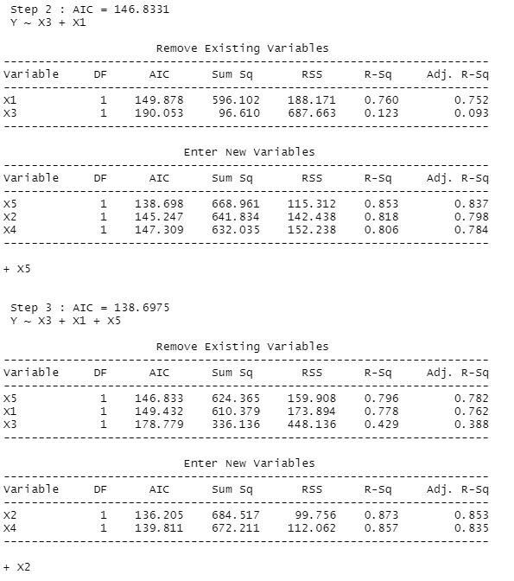
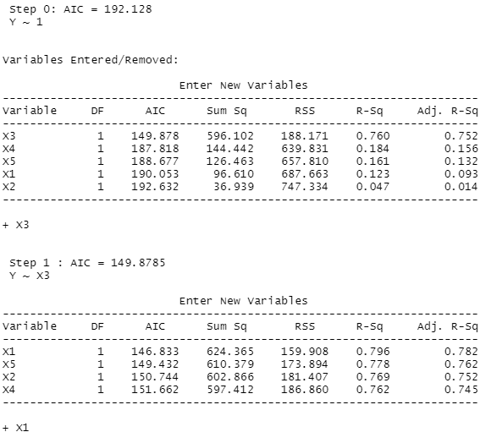
STEPWISE SELECTION METHOD
Candidate terms : X1, X2, X3, X4, X5
ISI Delhi, SMU
A Study on Physical Fitness
December 25, 2021

Slide 26
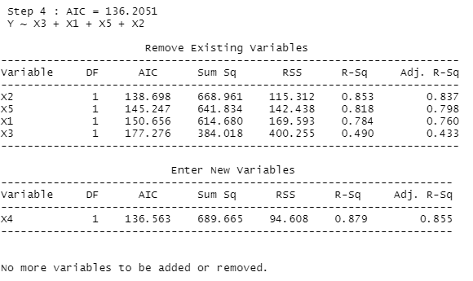
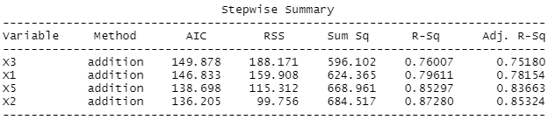
STEPWISE SELECTION METHOD
The stepwise selection method chooses the model Y on X1, X2, X3, and X5, which is also preferable in terms of the other criteria. Therefore, we select model 4 (i.e., Y on X1, X2, X3, and X5) among all possible subsets of model 1 (i.e., Y on X1, X2, X3, X4, and X5).
ISI Delhi, SMU
A Study on Physical Fitness
December 25, 2021

Slide 27


SELECTING THE FINAL MODEL
We compare the models selected from previous slides on the basis of various criteria such as AIC, BIC, Mallow’s Cp and Adjusted R-Squared
From the above table, it is easy to observe that model B is better than model A. Therefore, we choose model B (i.e., Y on X1, X2, X3, and X5) as our final model.
ISI Delhi, SMU
A Study on Physical Fitness
December 25, 2021

Slide 28

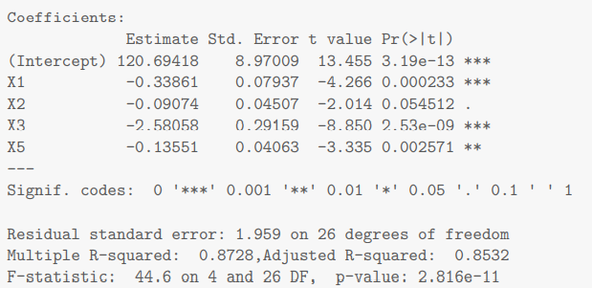
FINAL VERIFICATION
As our final model, we take:
Summary of the model:
ISI Delhi, SMU
A Study on Physical Fitness
December 25, 2021

Slide 29
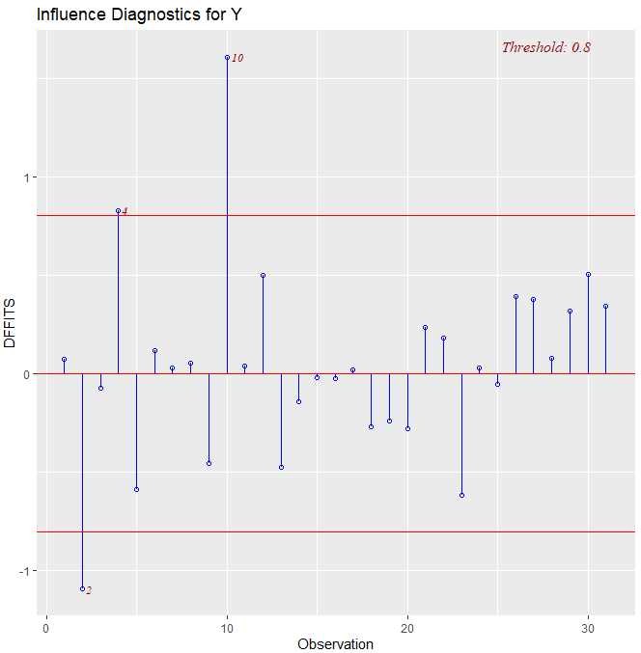
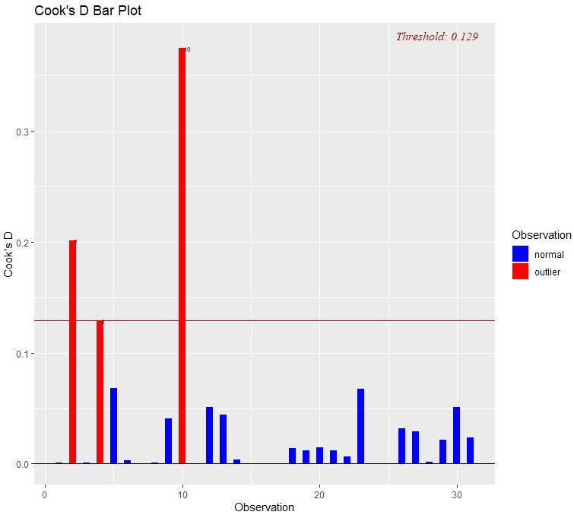
CHECKING FOR INFLUENTIAL POINTS
ISI Delhi, SMU
A Study on Physical Fitness
December 25, 2021

Slide 30
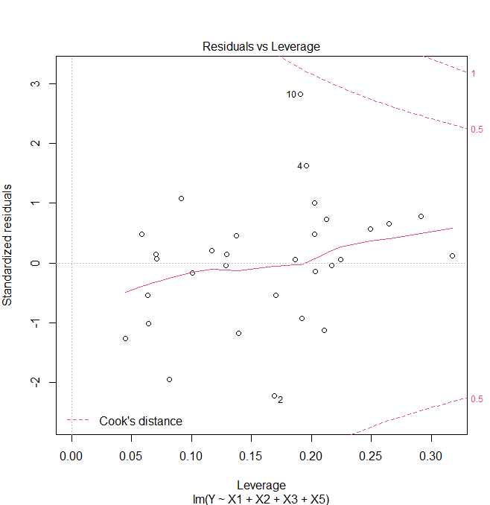
CHECKING FOR INFLUENTIAL POINTS
We have 2nd, 4th, and 10th as potential influential points. Among these, we only remove the 10th point, as this differs from the most.
The other two points can be removed, but are not, as this will lead to huge data loss for a small dataset like this one
We thus remove the 10th point from the dataset altogether and fit the model B again.
ISI Delhi, SMU
A Study on Physical Fitness
December 25, 2021

Slide 31
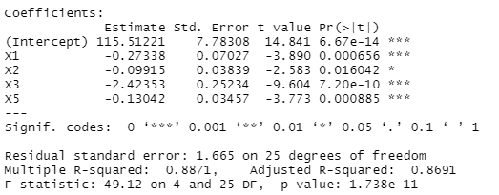
MODEL B AFTER DELETING 10TH OBSERVATION
Summary of the model:
ISI Delhi, SMU
A Study on Physical Fitness
December 25, 2021

Slide 32
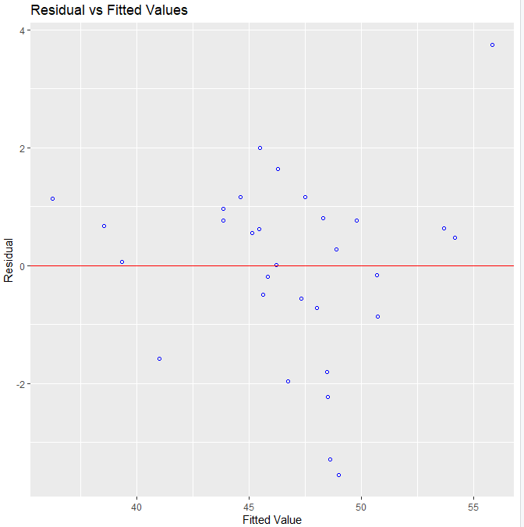
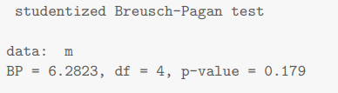
VERIFYING ASSUMPTIONS : HOMOSCEDASCITY
We can observe that there is no heteroscedasticity in the fitted model based on the plot and the p-value of the Breusch-Pagan test.
ISI Delhi, SMU
A Study on Physical Fitness
December 25, 2021

Slide 33
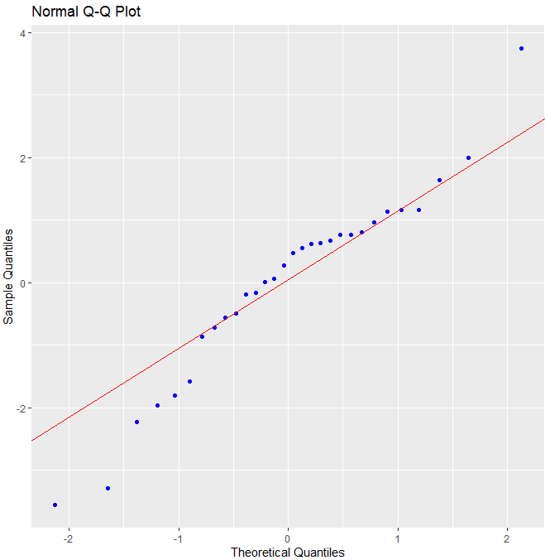
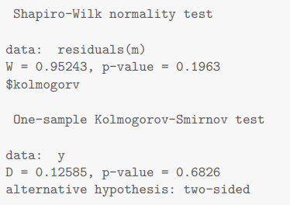
NORMALITY
We conclude that the assumption of normality is not violated.
ISI Delhi, SMU
A Study on Physical Fitness
December 25, 2021

Slide 34
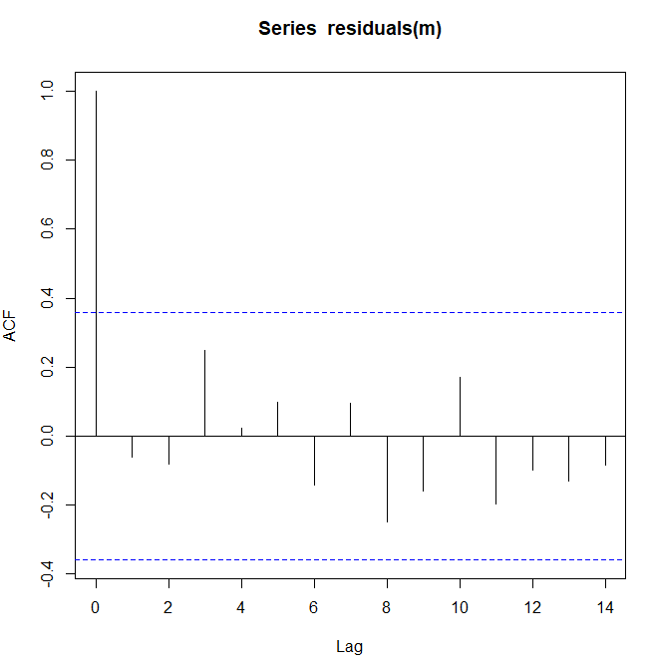
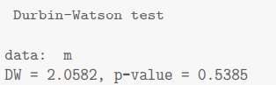

AUTOCORRELATION & MULTICOLLINEARITY
We can conclude that the errors are not coming from AR(1) model.
VIF (Variance Inflation Factor)
We can conclude that the problem of multicollinearity is solved.
ISI Delhi, SMU
A Study on Physical Fitness
December 25, 2021

Slide 35
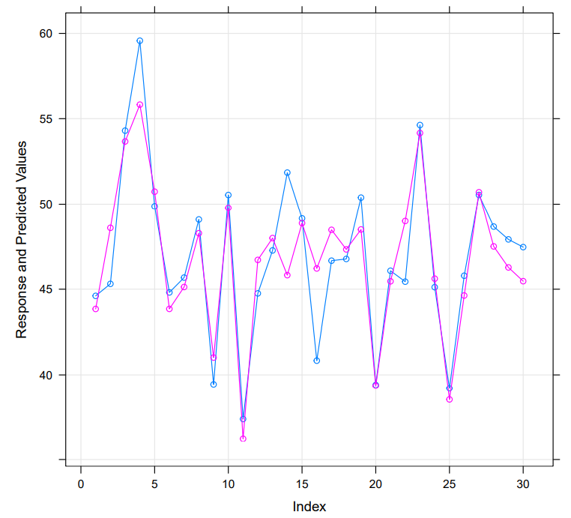

OBSERVED VS PREDICTED PLOT
ISI Delhi, SMU
A Study on Physical Fitness
December 25, 2021

Slide 36
THANK YOU
Mousam Sinha
Sreejit Roy
Vaishnavi Jaiswal
December 25, 2021
ISI Delhi, SMU
A Study on Physical Fitness
December 25, 2021

