Slide 1
MAJOR PROJECT
Curanet
Interoperability of Electronic Health Records
using Hyperledger Fabric
Chirag K Poojary – NNM22CS050
Pavan C – NNM22CS122
Royston Akash Dsouza – NNM22CS146
Guide: Dr. Puneeth R P | NMAM Institute of Technology, Nitte

Slide 2
PROBLEM
Problem & Motivation
$10M+
89%
50–150MB
~15 TPS
Avg. Breach Cost
Hospitals Hit by Ransomware (2024)
Imaging Files Too Large for Chain
Ethereum – Too Slow for Healthcare
Core Problem
Requirements
Fragmented EHR systems → lack of secure, auditable sharing across healthcare stakeholders.
Hospitals, labs, pharmacies, and clinics all run isolated databases with no cross-organisation sharing. A patient visiting a new specialist must start from scratch.
🔐 Confidentiality – only authorised access
🔒 Integrity – tamper-proof immutable records
🕵️ Provenance – full audit trail & history
⚙️ Access Control – role-based permissions
📊 Auditability – transparent ledger
🌐 Standards-based Interoperability (FHIR/HL7)

Slide 3

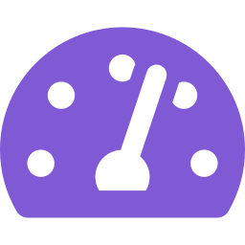

OUR SOLUTION
Curanet – What We Built
A permissioned blockchain + IPFS platform giving patients control, ensuring full auditability, and solving the Healthcare Trilemma.
Security
Scalability
Interoperability
✓ Permissioned Hyperledger Fabric
✓ Off-chain IPFS (no ledger bloat)
✓ FHIR ready data layer
✓ X.509 certificates + TLS
✓ CouchDB rich-query world state
✓ Cross-hospital patient referrals
✓ AES-256 encrypted IPFS files
✓ Raft ordering consensus
✓ Unified patient history view
✓ Immutable audit trail on ledger
✓ 120 TPS peak throughput
✓ Role-based multi-org access

Slide 4


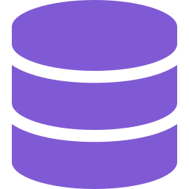



TECH STACK
Technology Stack
Hyperledger Fabric 2.5
Chaincode (Node.js)
CouchDB
Permissioned blockchain
Raft consensus · MSP · CA
Smart contract logic
RBAC · Access control lists
World state + rich
JSON query indexes
IPFS + Pinata
Node.js / Express
React.js
Off-chain file storage
Content-addressed CIDs
Fabric SDK gateway
REST API endpoints
Role-based portal
Admin · Doctor · Patient

Slide 5
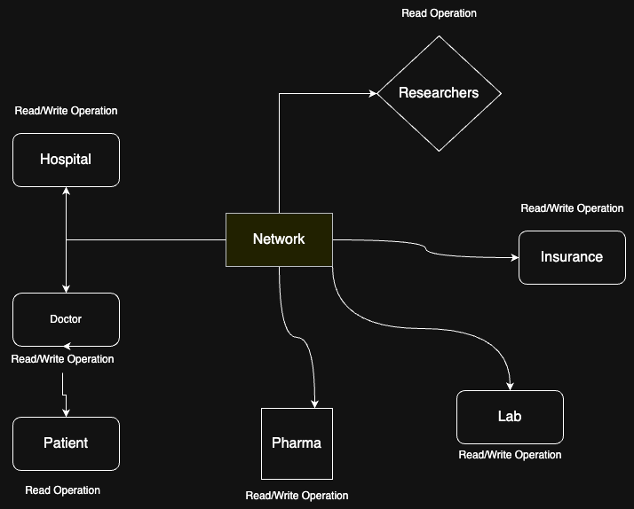
ARCHITECTURE
System Architecture – Three-Tier Design
Frontend Layer
· React.js Role-Based Portal
· Patient / Doctor / Admin Dashboards
· Real-time data via REST API
Backend & Blockchain Layer
· Node.js + Express (18+ endpoints)
· Hyperledger Fabric 2.5 Network
· Node.js Chaincode (Smart Contracts)
· CouchDB World State Database
Storage Layer
· IPFS + Pinata CDN off-chain storage
· AES-256 encrypted medical files
· Content Identifiers (CIDs) on-chain

Slide 6
CHAINCODE
Features & Smart Contract Logic
System Features
onboardPatient()
Register patient + consent flags
📋 Add / View / Update EHRs on blockchain
onboardDoctor()
Hospital onboards doctor with dept
🔐 Role-based access control (patient, doctor, admin)
addRecord()
Doctor adds IPFS record for patient
🔒 Immutable transaction records
grantAccess()
Patient grants doctor access
📦 IPFS for large data like scans & images
revokeAccess()
Patient removes doctor access
📊 Real-time status dashboard for stakeholders
🔎 Audit trails and data provenance
requestAccess()
Doctor requests → patient approves
🚨 Emergency break-glass access workflow
createEmergencyRequest()
Break-glass emergency workflow
✅ Patient-controlled grant / revoke access
queryHistoryOfAsset()
Full immutable audit trail

Slide 7
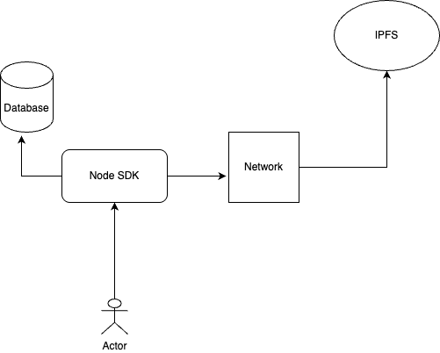
DATA FLOW
Transaction Lifecycle – How Data Flows
1
Login
Identity verified by Fabric CA / MSP. X.509 cert loaded from wallet.
2
Upload File
Medical report → AES-256 encrypted → pushed to IPFS. CID returned.
3
Propose Tx
Backend sends transaction proposal (CID + metadata) to endorsing peers.
4
Endorse
Peers execute chaincode, sign ReadWriteSet. Multi-org policy satisfied.
5
Order
Orderer (Raft) batches transactions into a block, broadcasts to all peers.
6
Commit
Peers validate & append block to ledger. CouchDB World State updated.
7
Access Check
Query time: chaincode checks ACL. Returns CID only if caller is authorised.

Slide 8





SECURITY
Encryption Technologies Used
Fabric CA – X.509 Certificates
TLS Encryption
AES Encryption (Off-Chain Files)
Fabric Certificate Authority issues X.509 certificates for all network participants. Every identity (hospital, doctor, patient) has a unique signed certificate that governs their permissions on the network.
All communication between peers, orderers, and clients is encrypted using TLS. This prevents man-in-the-middle attacks and ensures data in transit is never readable by unauthorised parties.
Files stored in IPFS are encrypted using AES before upload. Even if IPFS content is accessed by an adversary, the file is unreadable without the decryption key.
On-Chain Integrity
Future Enhancement – ABE
Only the encrypted hash (CID) is stored on the blockchain — never the raw file. This prevents tampering: any modification to the file would produce a different hash, immediately detected.
Attribute-Based Encryption (ABE) is planned for fine-grained, policy-driven access control — allowing data decryption only when a requestor satisfies a defined attribute policy (e.g. role = doctor AND hospital = HOSP-01).

Slide 9







SECURITY & CONSTRAINTS
Security, Privacy & Communication Constraints
Security & Privacy Decisions
Communication Constraints
Permissioned network → only authorised identities allowed
Latency:
Blockchain consensus adds delay compared to a centralised database. Every write goes through endorsement → ordering → commit cycle.
Role-based access enforced directly in chaincode
IPFS files encrypted, only hash stored on blockchain
Scalability:
Network performance is limited by the number of peers and endorsement policies. More orgs = more overhead.
Audit trails maintained for every transaction
Storage:
Off-chain storage avoids blockchain bloat
Large medical images (50–150MB) are unsuitable for on-chain storage → solved with off-chain IPFS integration.
CouchDB allows efficient rich queries
Network Dependency:
IPFS retrieval depends on peer availability. Solved using Pinata CDN + local IPFS node caching.
Fabric endorsement policies ensure correctness
Interoperability:
Production scaling: Raft ordering, multiple orgs
Requires FHIR adapters to connect with legacy hospital information systems.

Slide 10
IPFS INTEGRATION
IPFS Integration – Decentralised Storage
Decentralised Storage Implementation
How It Works
→ Integrated IPFS for storing large medical files (X-rays, MRIs, lab reports, scans)
Upload
Doctor uploads medical file (X-ray, MRI, PDF)
→ Implemented file upload mechanism to IPFS
→ Store IPFS content hashes on blockchain for immutability
Encrypt
File AES-256 encrypted before leaving the server
→ Created retrieval system for accessing medical documents
Pin IPFS
Encrypted file pushed to IPFS via Pinata CDN
→ Reduced on-chain storage costs by keeping large files off-chain
Benefits Achieved
CID
Content Identifier (CID) returned as unique hash
✓ Decentralised and distributed file storage
Ledger
CID + metadata written to Hyperledger Fabric ledger
✓ Content-addressable storage with cryptographic hashing
✓ Reduced blockchain bloat
✓ Fast retrieval of medical images and documents
Retrieve
Authorised user fetches CID from chain → downloads file

Slide 11
IMAGE PROCESSING
Image Processing for Medical Files
Challenge
Results Achieved
• Medical images (DICOM, JPEG) can be 50–150MB in size
✓ Original: 25MB → Compressed: 16MB (36% reduction)
• Browser struggles to display high-resolution medical images
✓ Maintains diagnostic quality for medical review
Image Compression (sharp.js)
const sharp = require('sharp');
async function compressImage(inputFile) {
// Compress JPEG with 85% quality
// Achieves 30-40% size reduction
// while maintaining diagnostic quality
const compressed = await sharp(inputFile)
.jpeg({
quality: 85,
mozjpeg: true // Better algorithm
})
.toBuffer();
return compressed;
}

Slide 12
LATENCY
Latency Challenges & Solutions
Problem : Slow Blockchain Transactions
Initial Performance: 8–12 seconds per transaction
Root Causes: Multiple endorsement requirements · Large block sizes · No database indexing
→ Solution: Database Indexing (CouchDB)
A. Database Indexing (CouchDB)
const indexes = [
{ fields: ['patientId'] }, // All records for patient
{ fields: ['doctorId'] }, // All patients for doctor
{ fields: ['recordId'] }, // Direct record lookup
{ fields: ['patientId','timestamp'] } // Recent records
];
// Query time: 3-5s → 0.4-0.7 seconds

Slide 13
KEY FEATURE
Latency Summary & Emergency Break-Glass Access
🚨 Emergency Break-Glass Access
Latency Challenge Summary
1
Patient Pre-Consent
Challenge
Impact
Solution
Result
Patient enables breakGlassConsent flag in their profile
Slow blockchain
transactions
8–12s wait,
poor UX
Database
indexing
2–3s
transactions
2
Doctor Requests
createEmergencyRequest() — stored as PENDING on ledger
Large medical
images
50–150MB,
slow upload
Compression
+ IPFS
30–40% smaller,
2–4s download
3
Hospital Approves
processEmergencyRequest() → APPROVE or REJECT
4
Access Granted
Performance Metrics
EMERGENCY_ACCESS key created linking doctor to patient
120 TPS
85 ms
2–4s
Peak
Query Latency
Write Latency
5
Auditable Revocation
revokeEmergencyAccess() → status set REVOKED on ledger

Slide 14
PERFORMANCE
Performance Analysis & Benchmarks
120 TPS
85 ms
2–4 s
2.1 s
Peak Throughput
Query Latency
IPFS Retrieval
Write Latency
via Hyperledger Caliper
CouchDB indexed (was 450ms)
Pinata CDN (was 8–15s)
Full commit cycle
Why Curanet Wins
✓ Faaster than Ethereum for healthcare
✓ Immutable audit trail for compliance
✓ No ledger bloat — IPFS off-chain storage
✓ Fine-grained patient access control
✓ Emergency break-glass access built-in

Slide 15
CONCLUSION
What We Achieved & What's Next
✓ Fully functional permissioned blockchain EHR system on Hyperledger Fabric 2.5
Future Scope
✓ REST API endpoints — registration, records, access control, admin & audit
→ Insurance org (Org2MSP) integration
✓ Emergency break-glass access with hospital approval & full revocation workflow
→ Attribute-Based Encryption (ABE)
✓ Patient-controlled access: grant, revoke, and approve doctor access requests
→ HL7/FHIR API compliance layer
✓ AES-256 encrypted off-chain IPFS storage — no ledger bloat, full privacy
→ Pharmacy prescription module
✓ Image compression (36% size reduction) + thumbnail generation for fast preview
→ Researcher consent & data sharing
✓ CouchDB indexing: query latency reduced from 3–5s to 0.4–0.7 seconds
→ Reward tokens for patient consent
→ Mobile app (React Native)
"Secure · Scalable · Interoperable — Healthcare Data, Reimagined with Blockchain"

