Slide 1


The Noise Measured by Back-illuminated Silicon Sensors
Roy T. Smart¹, Charles C. Kankelborg¹, and Jacob D. Parker²
¹Montana State University
²NASA/GSFC
246th Meeting of the American Astronomical Society
June 9th, 2025
Notes:
Hi everyone, thanks for joining me today, my name is Roy Smart and I am a PhD student at Montana State University.
Today I’d like to talk about some work that we did on modeling the noise measured by back-illuminated silicon imaging sensors that are often used in astrononmy.

Slide 2
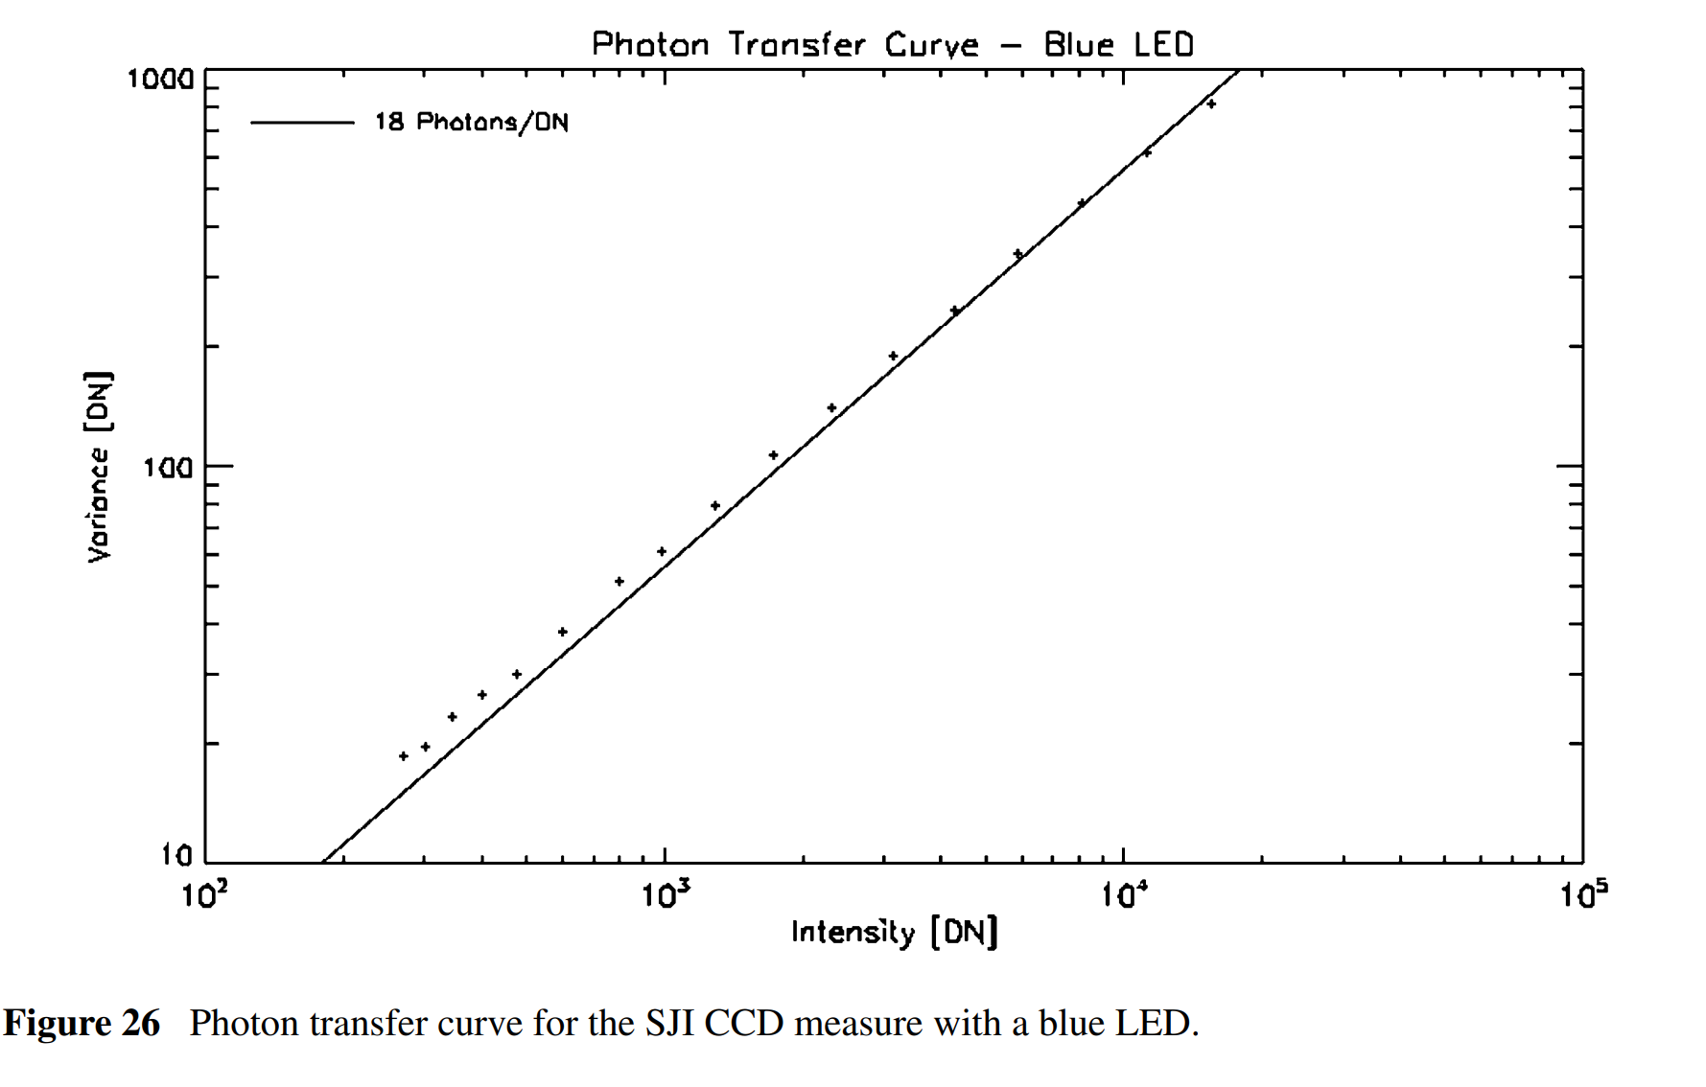
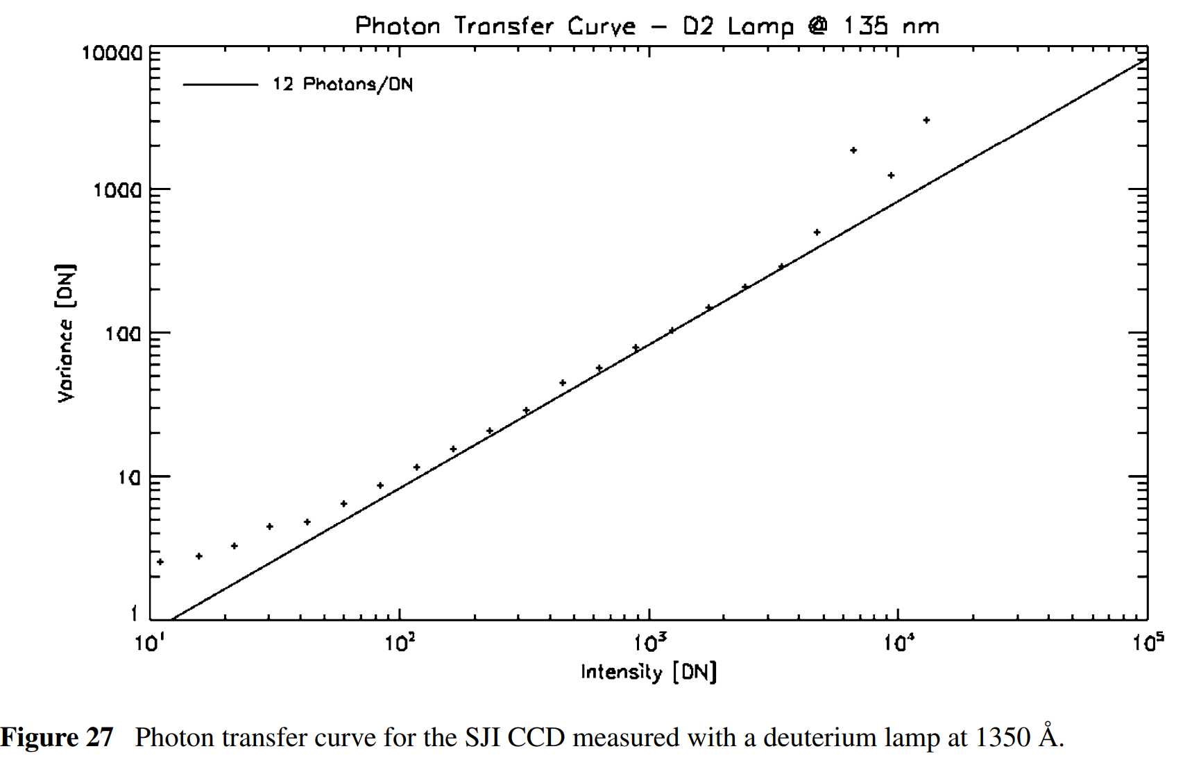
IRIS Noise Mystery
IRIS measures less noise than predicted (Wulser et al. 2018).
  Photon transfer curve is too shallow
    Expected slope ratio > 2
    Measured slope ratio = 1.5
  SNR is ~25% better than expected
Notes:
An I’d like to begin with a minor mystery: on the left are two photon-transfer curves for the Interface Region Imaging Spectrograph, or IRIS from Wulser et al 2018.
A photon transfer curve plots the observed variance of a flat field as a function of the mean value.
The top plot is a photon-transfer curve in blue light and the bottom is the same but for ultraviolet light at 1350 angstroms.
From theoretical considerations, the IRIS team expected that the slope ratio between these two curves to be greater than 2 but they measured only 1.5
This is good news, as IRIS has about 25% better signal-to-noise ratio than expected, but why?

Slide 3
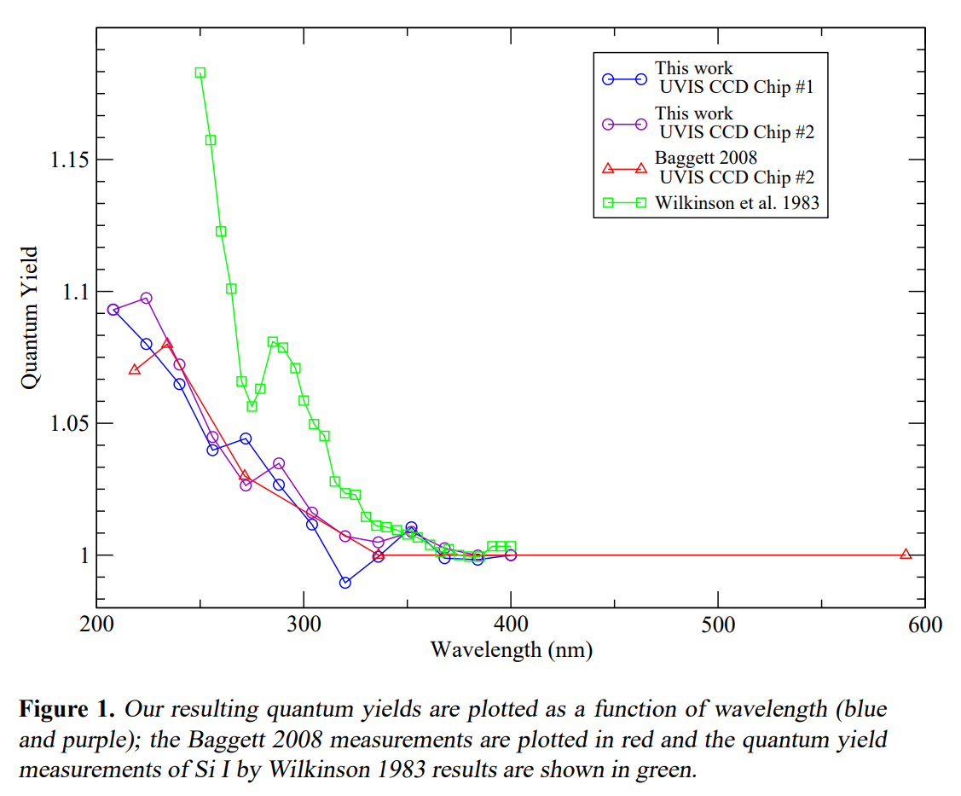
HST/WFC3 Noise
Wide Field Camera 3 (WFC3) on Hubble also has this issue (Marinelli & Green 2024)
  “Quantum yield” is lower
    Expected ~1.7 @ 200 nm
    Measured 1.09 @ 200 nm
  SNR is ~25% better than expected

Slide 4
Outline
Signal
  Quantum yield
  Charge-collection efficiency
  Absorption
Noise
  Simple noise model
  Shot noise
  Fano noise
  Partial-charge collection noise
Results

Slide 5
Signal

Slide 6
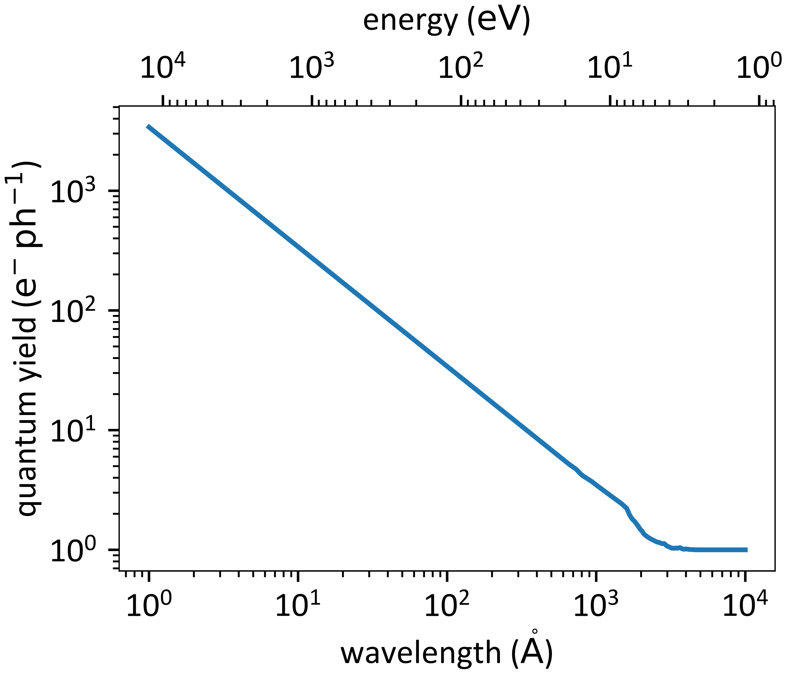
Quantum Yield
Quantum yield (QY) is the number of electron-hole pairs generated per photon
QY increases as photon energy increases
  QY = E / (3.65 eV) where E is the energy of the photon
Ramanathan & Kurinsky (2020) QY model

Slide 7
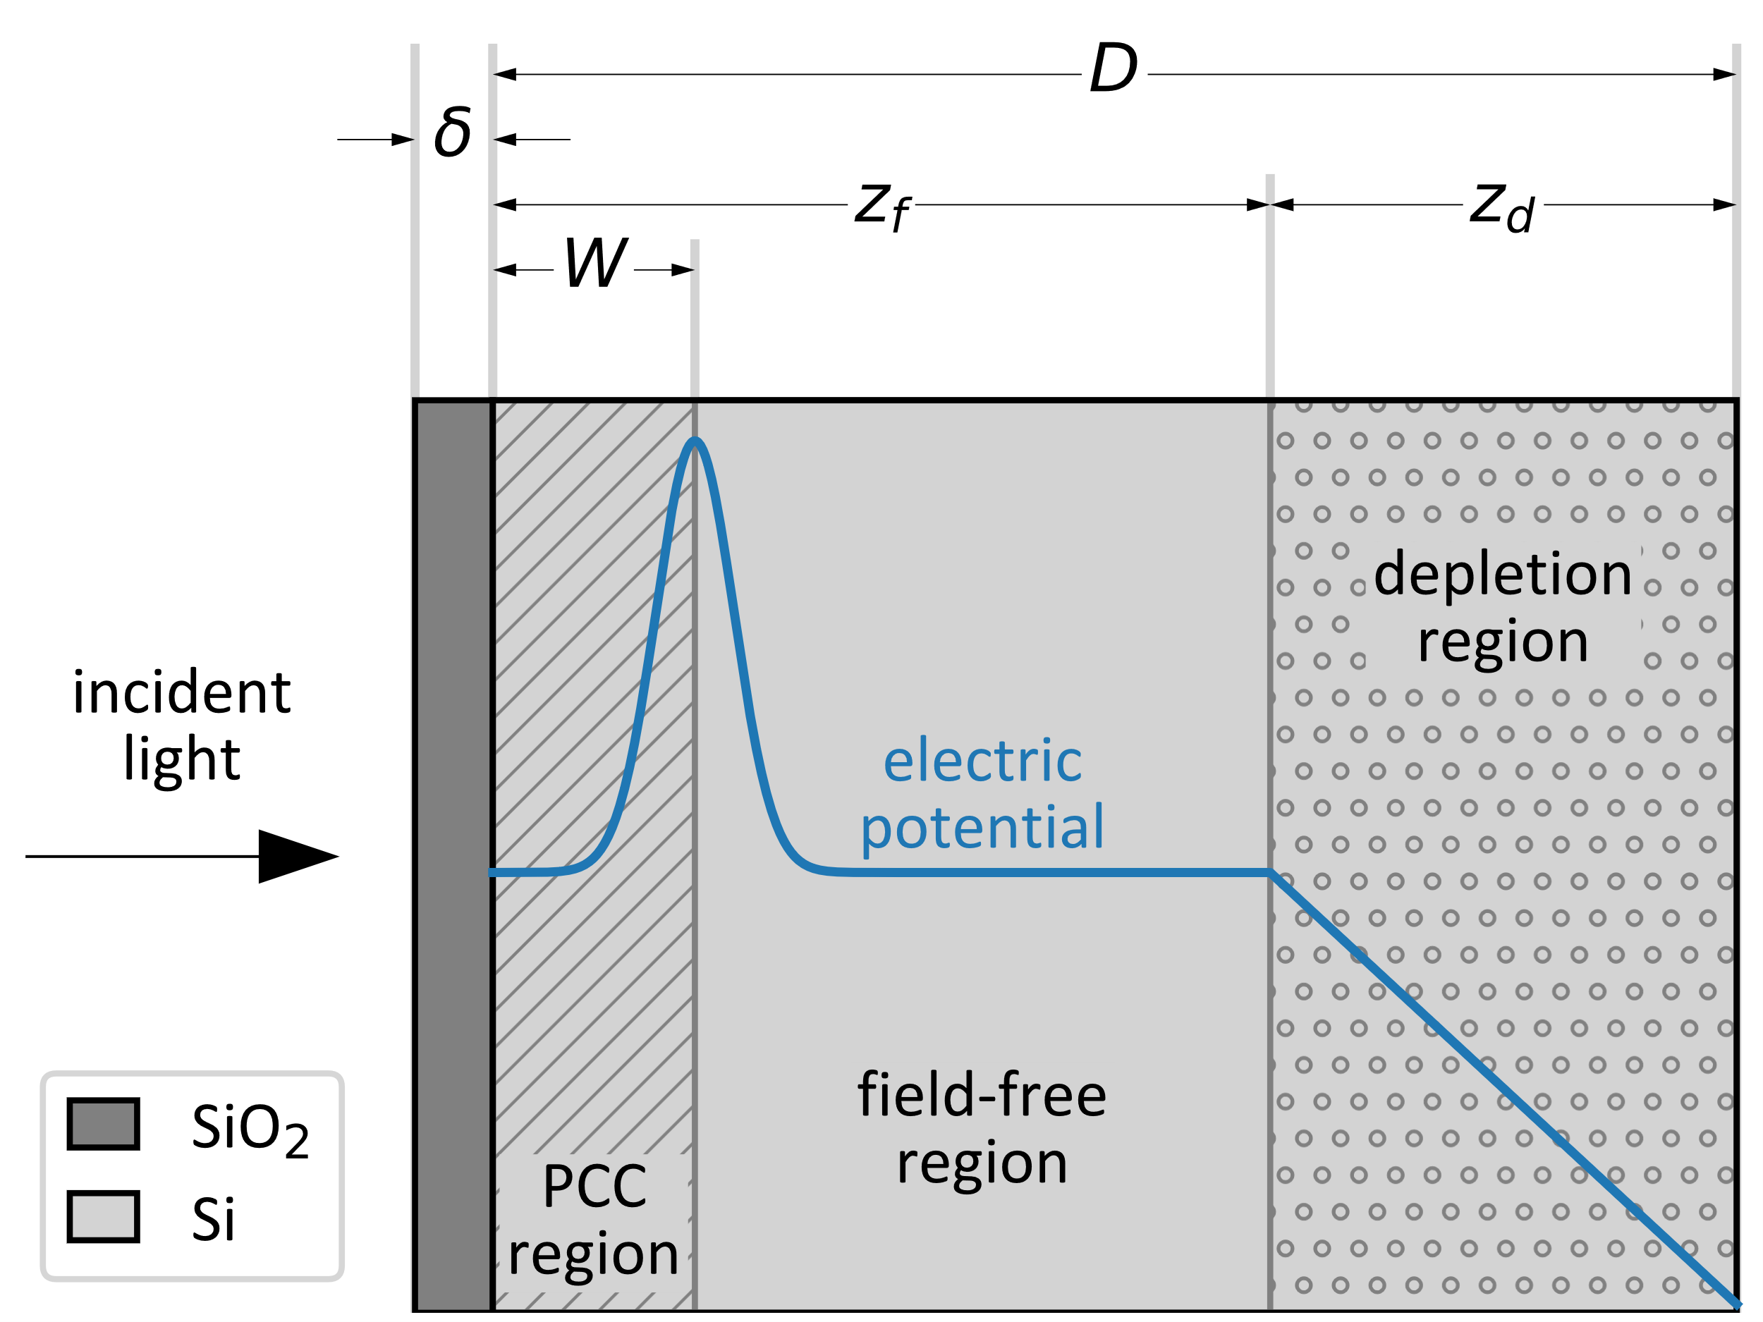
Back-illuminated Sensor Model
Thin layer of silicon dioxide (~1 nm)
Light-sensitive silicon (16 μm)
  Partial-charge collection (PCC) region (~100 nm)
  Field-free region
  Depletion region (8 μm)

Slide 8
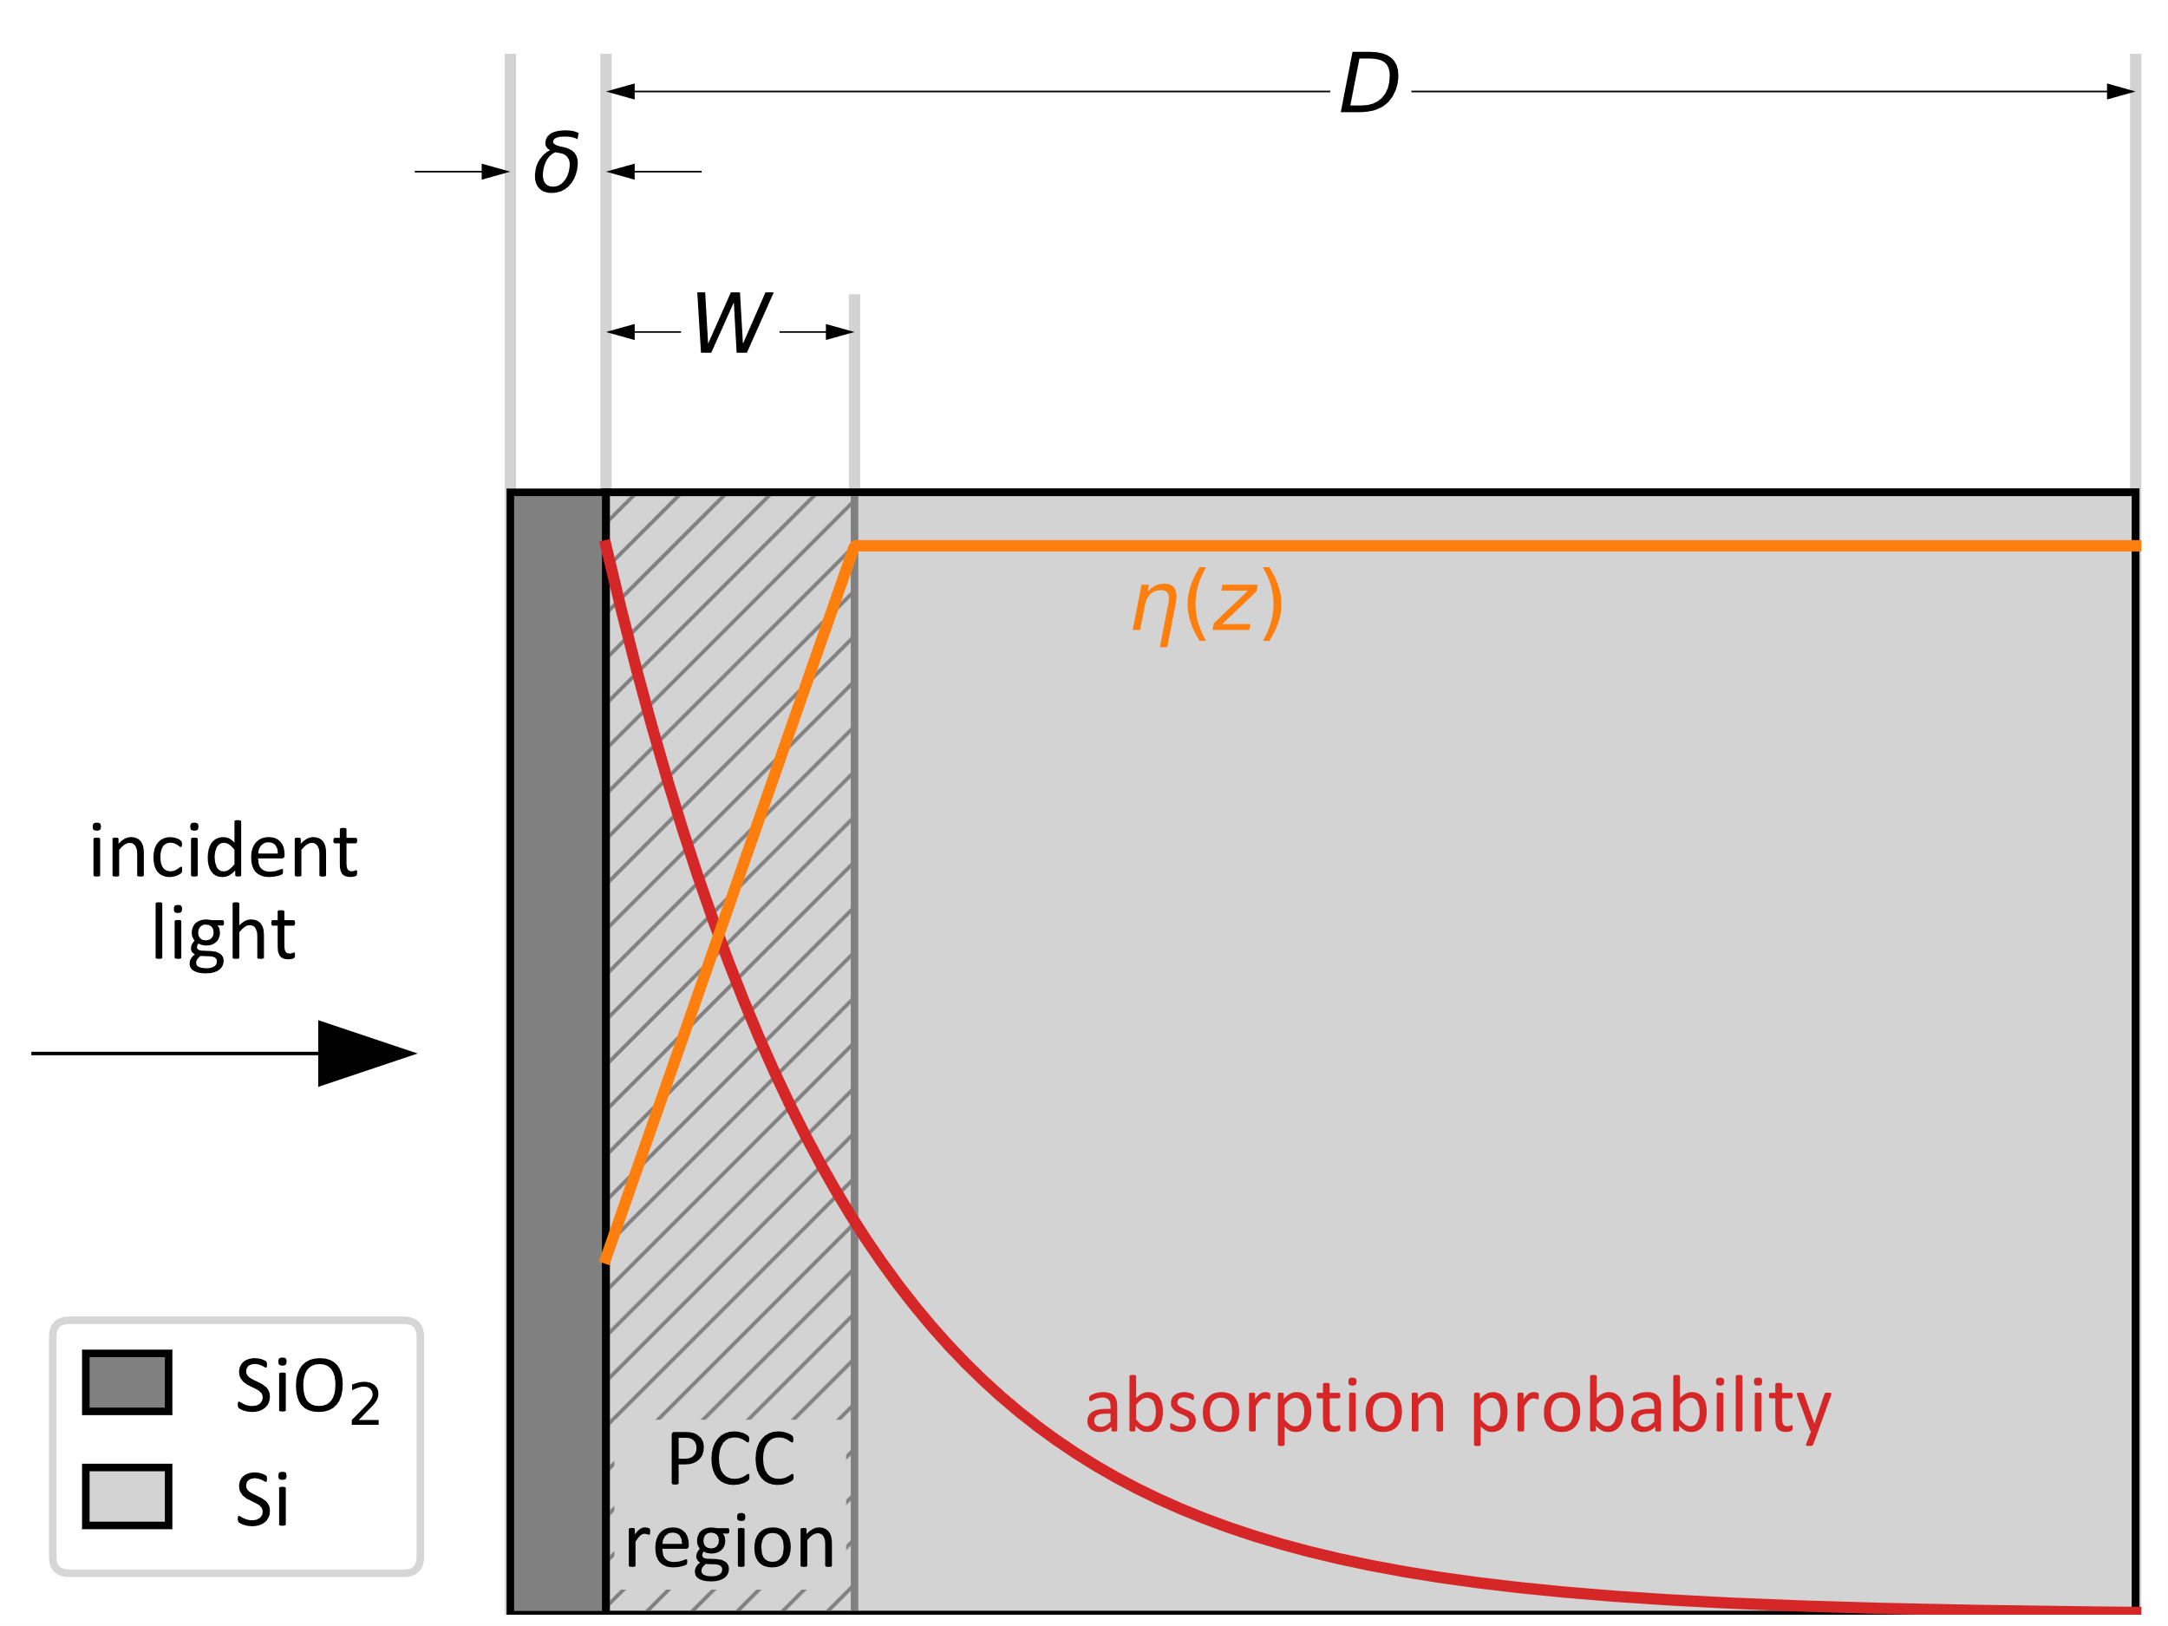
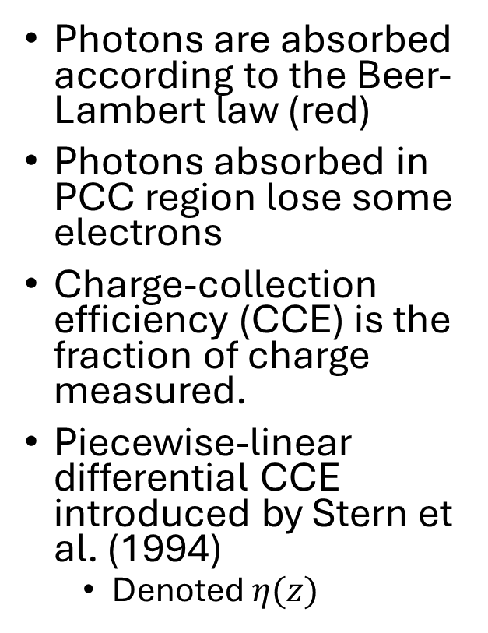
Partial-Charge Collection
Photons are absorbed according to the Beer-Lambert law (red)
Photons absorbed in PCC region lose some electrons
Charge-collection efficiency (CCE) is the fraction of charge measured.
Piecewise-linear differential CCE introduced by Stern et al. (1994)
  Denoted $η(z)$

Slide 9
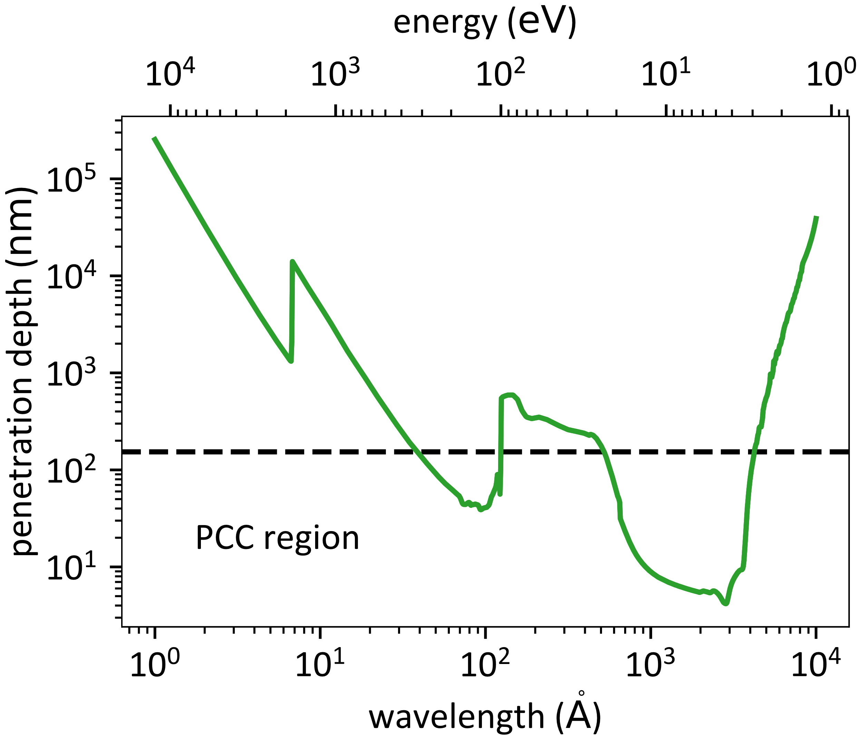
Penetration depth
Some ultraviolet wavelengths have a penetration depth smaller than the PCC region
  ~40 – 100 A
  ~500 – 4500 A
Sensor is much less efficient in these regions
Notes:
This is a plot of pen depth vs wavelength. PCC happens near the surface, so only wavelengths that dip below this line are significantly affected by PCC.
Twin axes for CCE

Slide 10
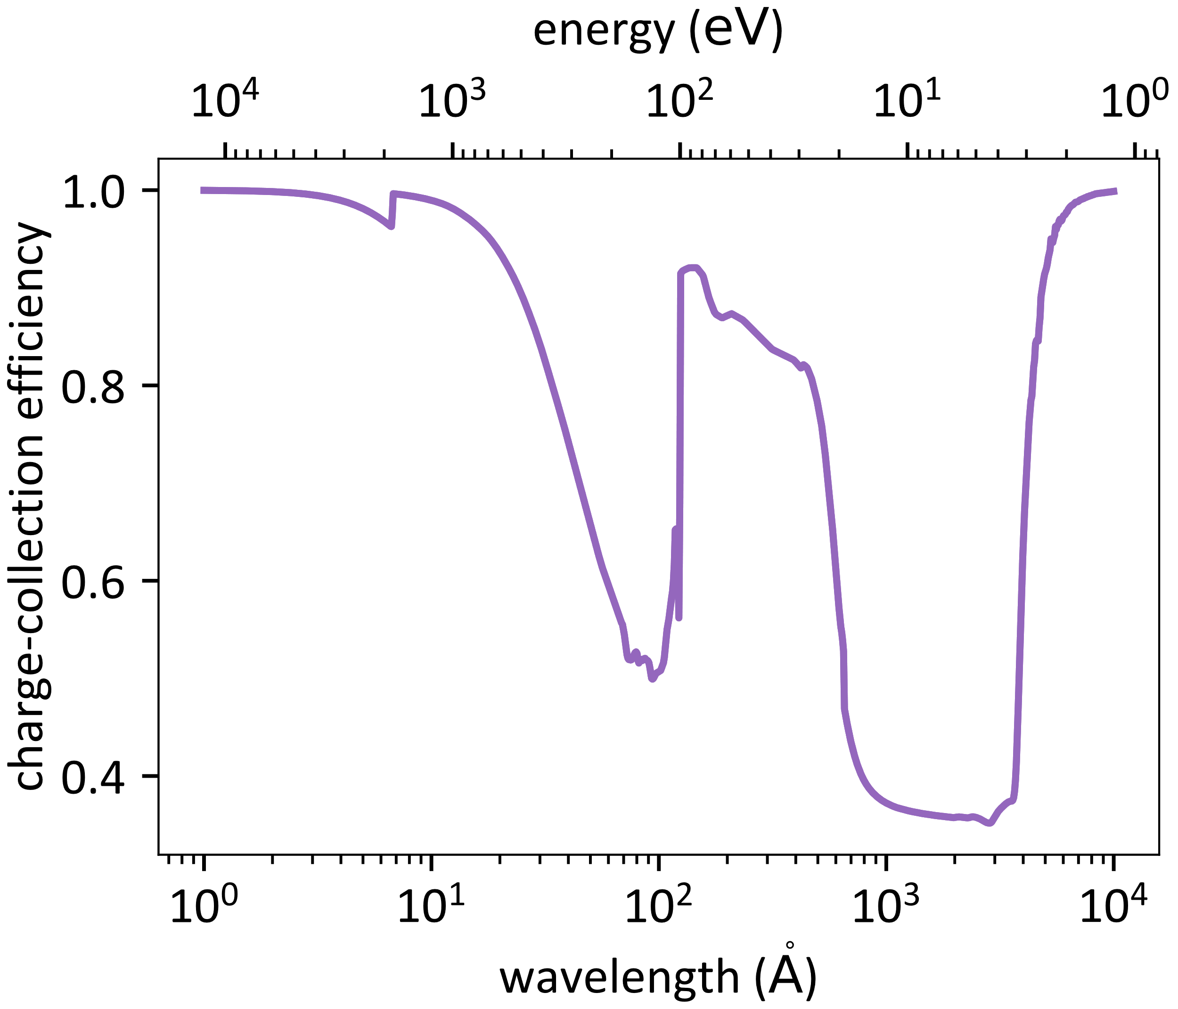
Average Charge-Collection Efficiency
Integrate Beer-Lambert law against differential CCE
Average CCE is needed for correct photometry
Notes:
This is a plot of pen depth vs wavelength. PCC happens near the surface, so only wavelengths that dip below this line are significantly affected by PCC.
Twin axes for CCE

Slide 11
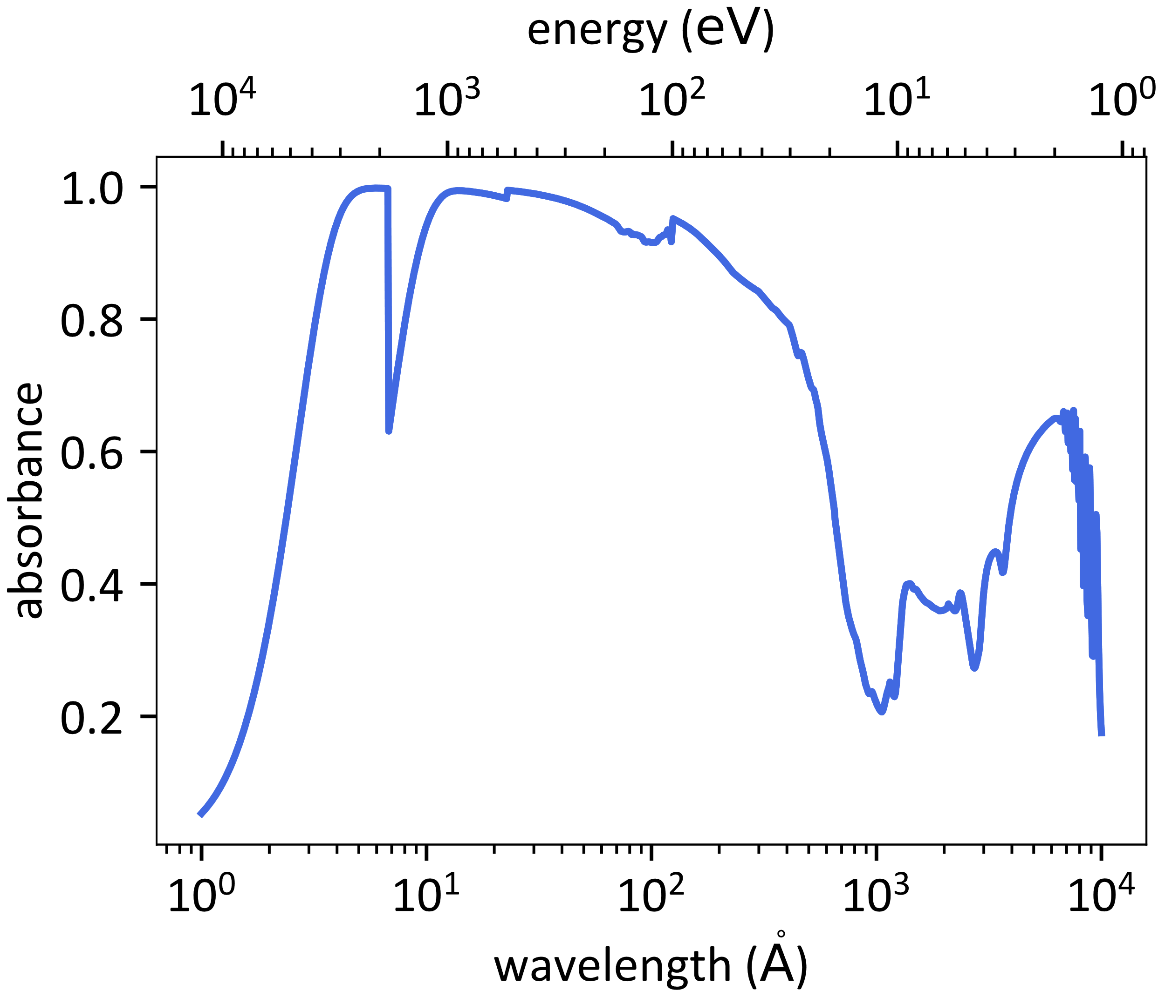
Absorbance
Energy absorbed by light-sensitive layer
  Reflections from each interface
  Oxide absorption
  Transmittance through entire sensor
Computed using standard optical constants (Henke 1993, Palik 1997)
Notes:
This is a plot of pen depth vs wavelength. PCC happens near the surface, so only wavelengths that dip below this line are significantly affected by PCC.
Twin axes for CCE

Slide 12


Quantum Efficiency
Quantum Efficiency (QE) is the factor used to convert from incident photons to measured electrons
Allowed to be larger than one!
$$\text{QE}≡ \frac{N_{e}}{N_{γ}}$$
$$=\text{QY} × \text{CCE} × \text{Absorbance}$$

Slide 13
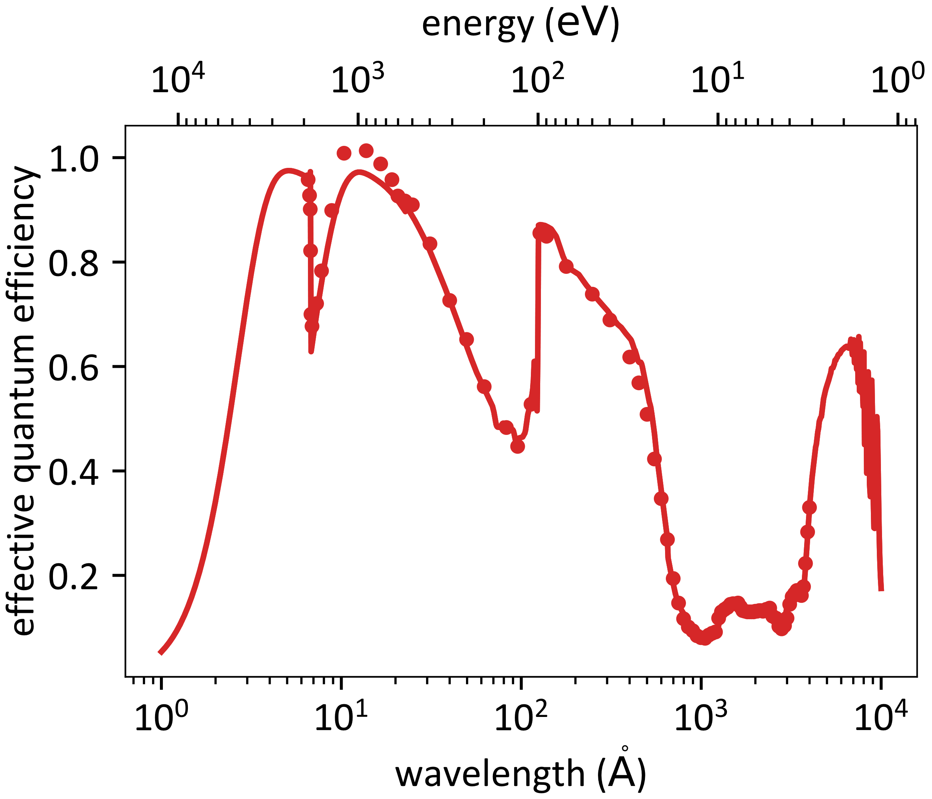

Effective Quantum Efficiency (EQE)
$$\text{EQE}=\text{CCE} × \text{Absorbance}$$
Measured quantity
  Compare sensor to NIST photodiode
Between 0 and 1
Often used to compute QE

Slide 14
Noise

Slide 15
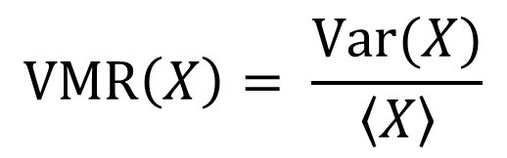
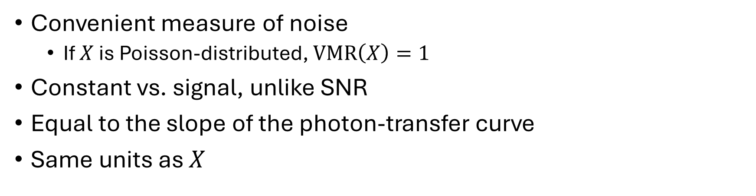
Variance-to-mean ratio
$$\text{VMR}\left(X\right)= \frac{\text{Var}(X)}{\left\langle X\right\rangle }$$
Convenient measure of noise
  If $X$ is Poisson-distributed, $\text{VMR}\left(X\right)=1$
Constant vs. signal, unlike SNR
Equal to the slope of the photon-transfer curve
Same units as $X$

Slide 16
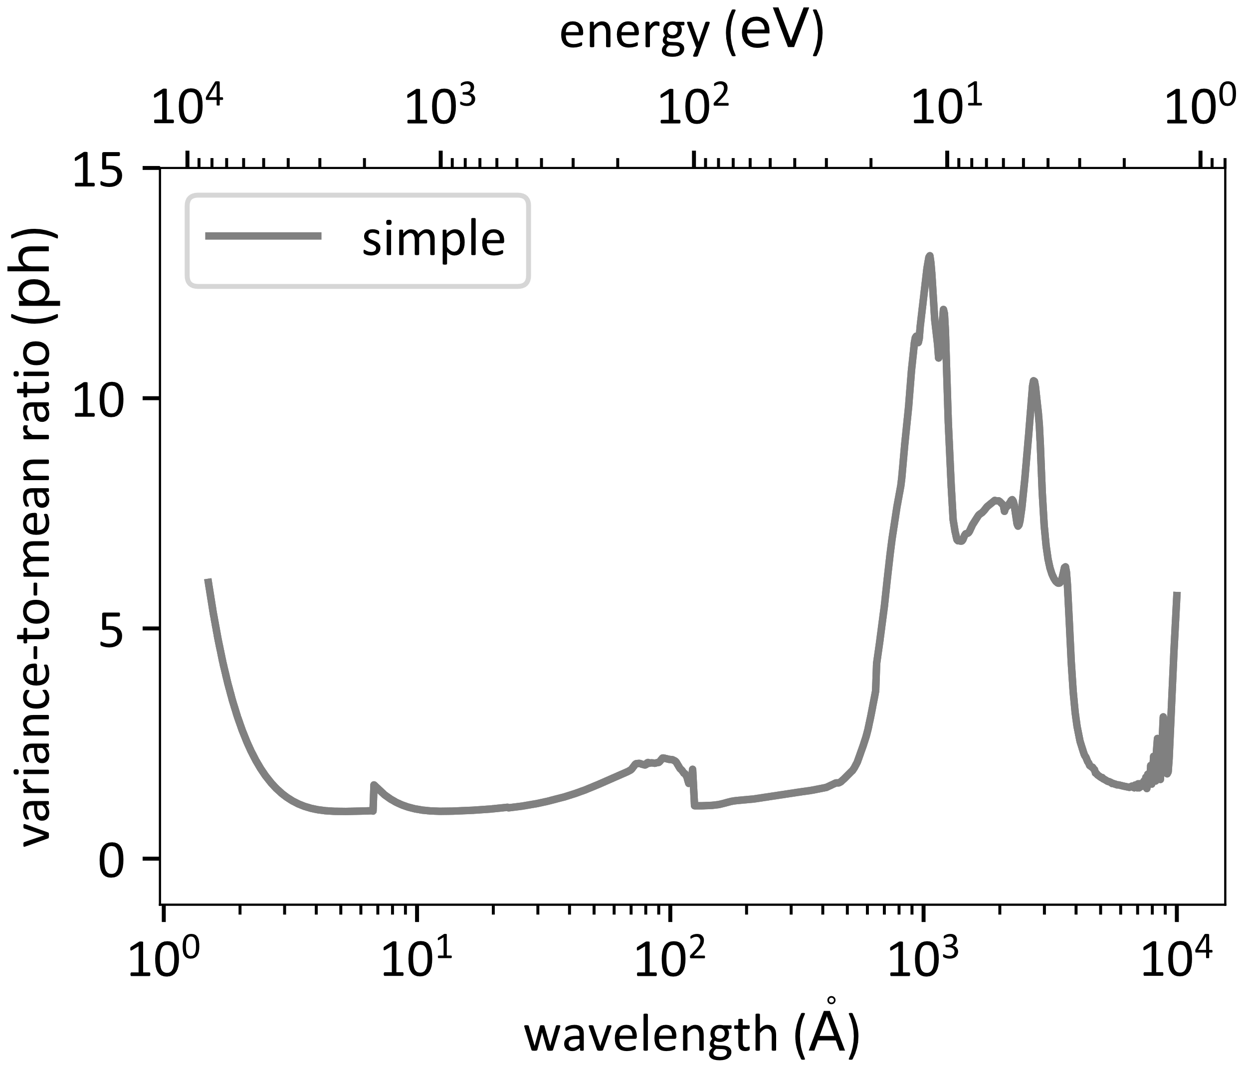

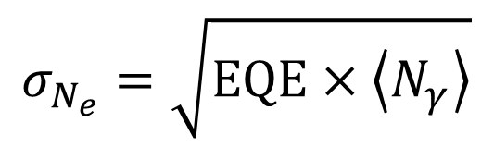
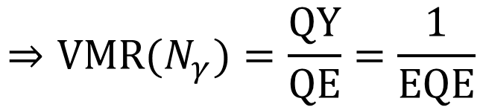
Simple Noise Model
Shot noise only
All-or-nothing charge collection
Used by IRIS and WFC3
$$σ_{N_{e}}=\sqrt{\text{EQE}×\left\langle N_{γ}\right\rangle }$$
$$⇒\text{VMR}\left(N_{e}\right)=\text{QY}$$
$$⇒\text{VMR}\text{(}N_{γ}\text{)}=\frac{\text{QY}}{\text{QE}}=\frac{1}{\text{EQE}}$$

Slide 17
A Slightly More Complicated Noise Model
Shot noise
Fano noise
  Inherent randomness in the charge-generation process
PCC noise
  Uncertain CCE due to random absorption depth

Slide 18
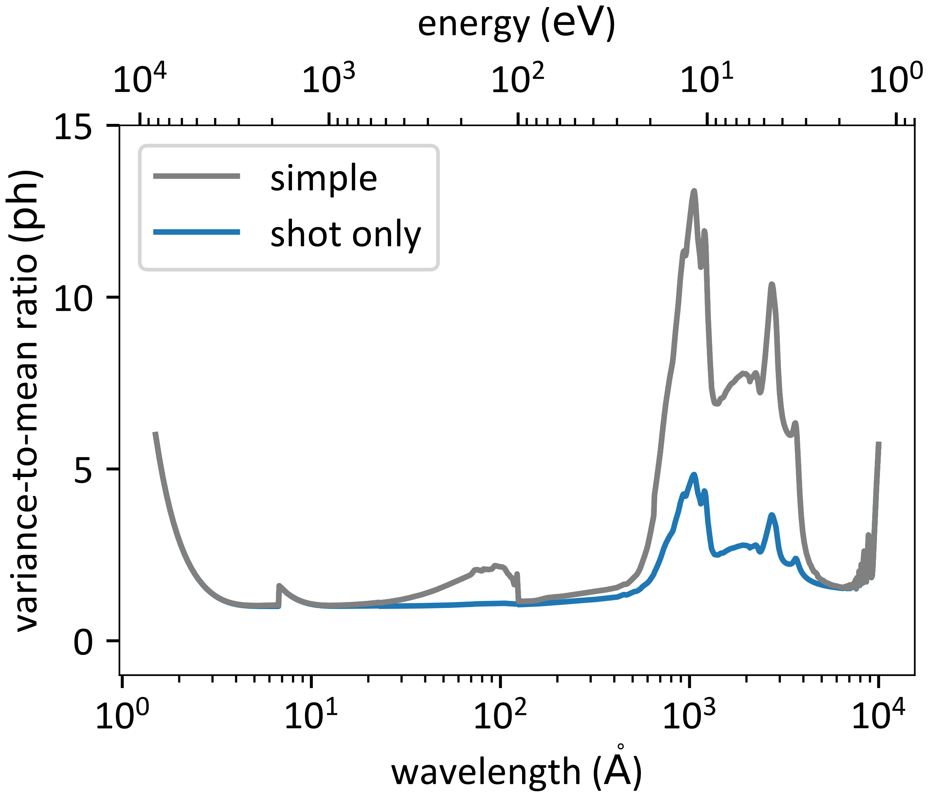
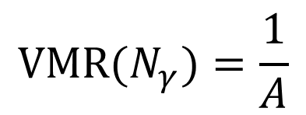

Shot Noise
Absorbed photons are Poisson-distributed
$$N_{γ}^{′} \sim \text{Poisson}\text{(}A ×\left\langle N_{γ}\right\rangle \text{)}$$
$$\text{VMR}\text{(}N_{γ}\text{)}=\frac{1}{A}$$

Slide 19
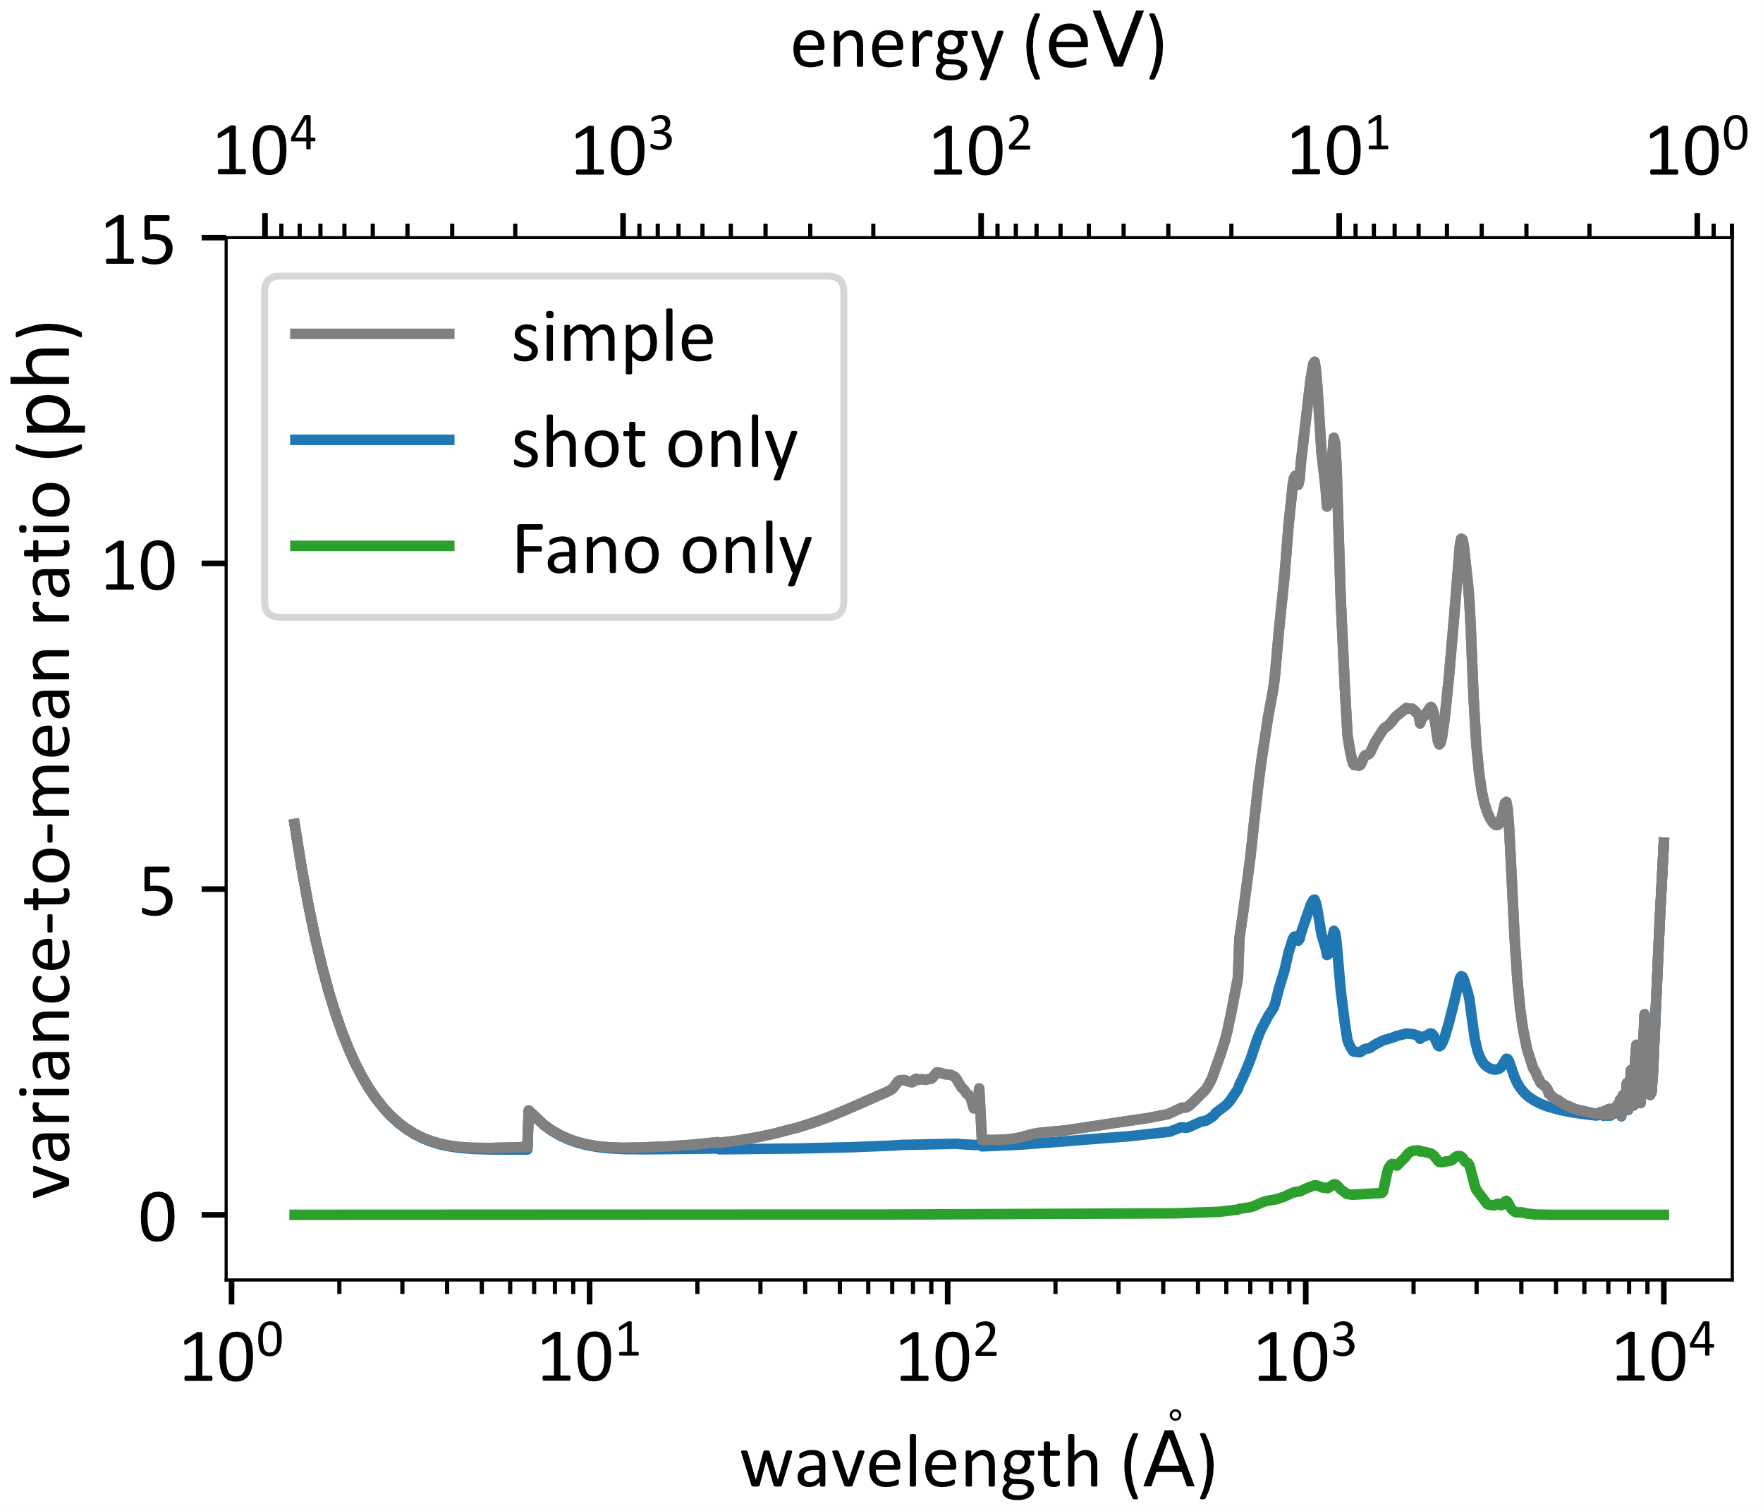
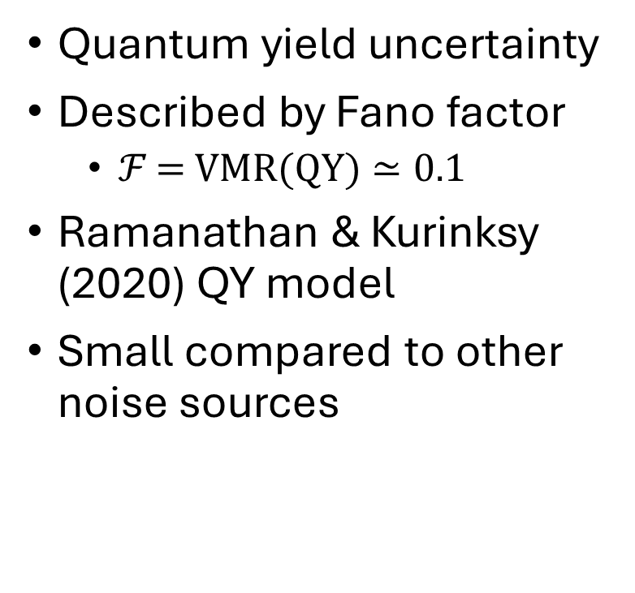
Fano Noise
Quantum yield uncertainty
Described by Fano factor
  $ℱ\text{ = }\text{VMR}\text{(}\text{QY})≃0.1$
Ramanathan & Kurinksy (2020) QY model
Small compared to other noise sources

Slide 20
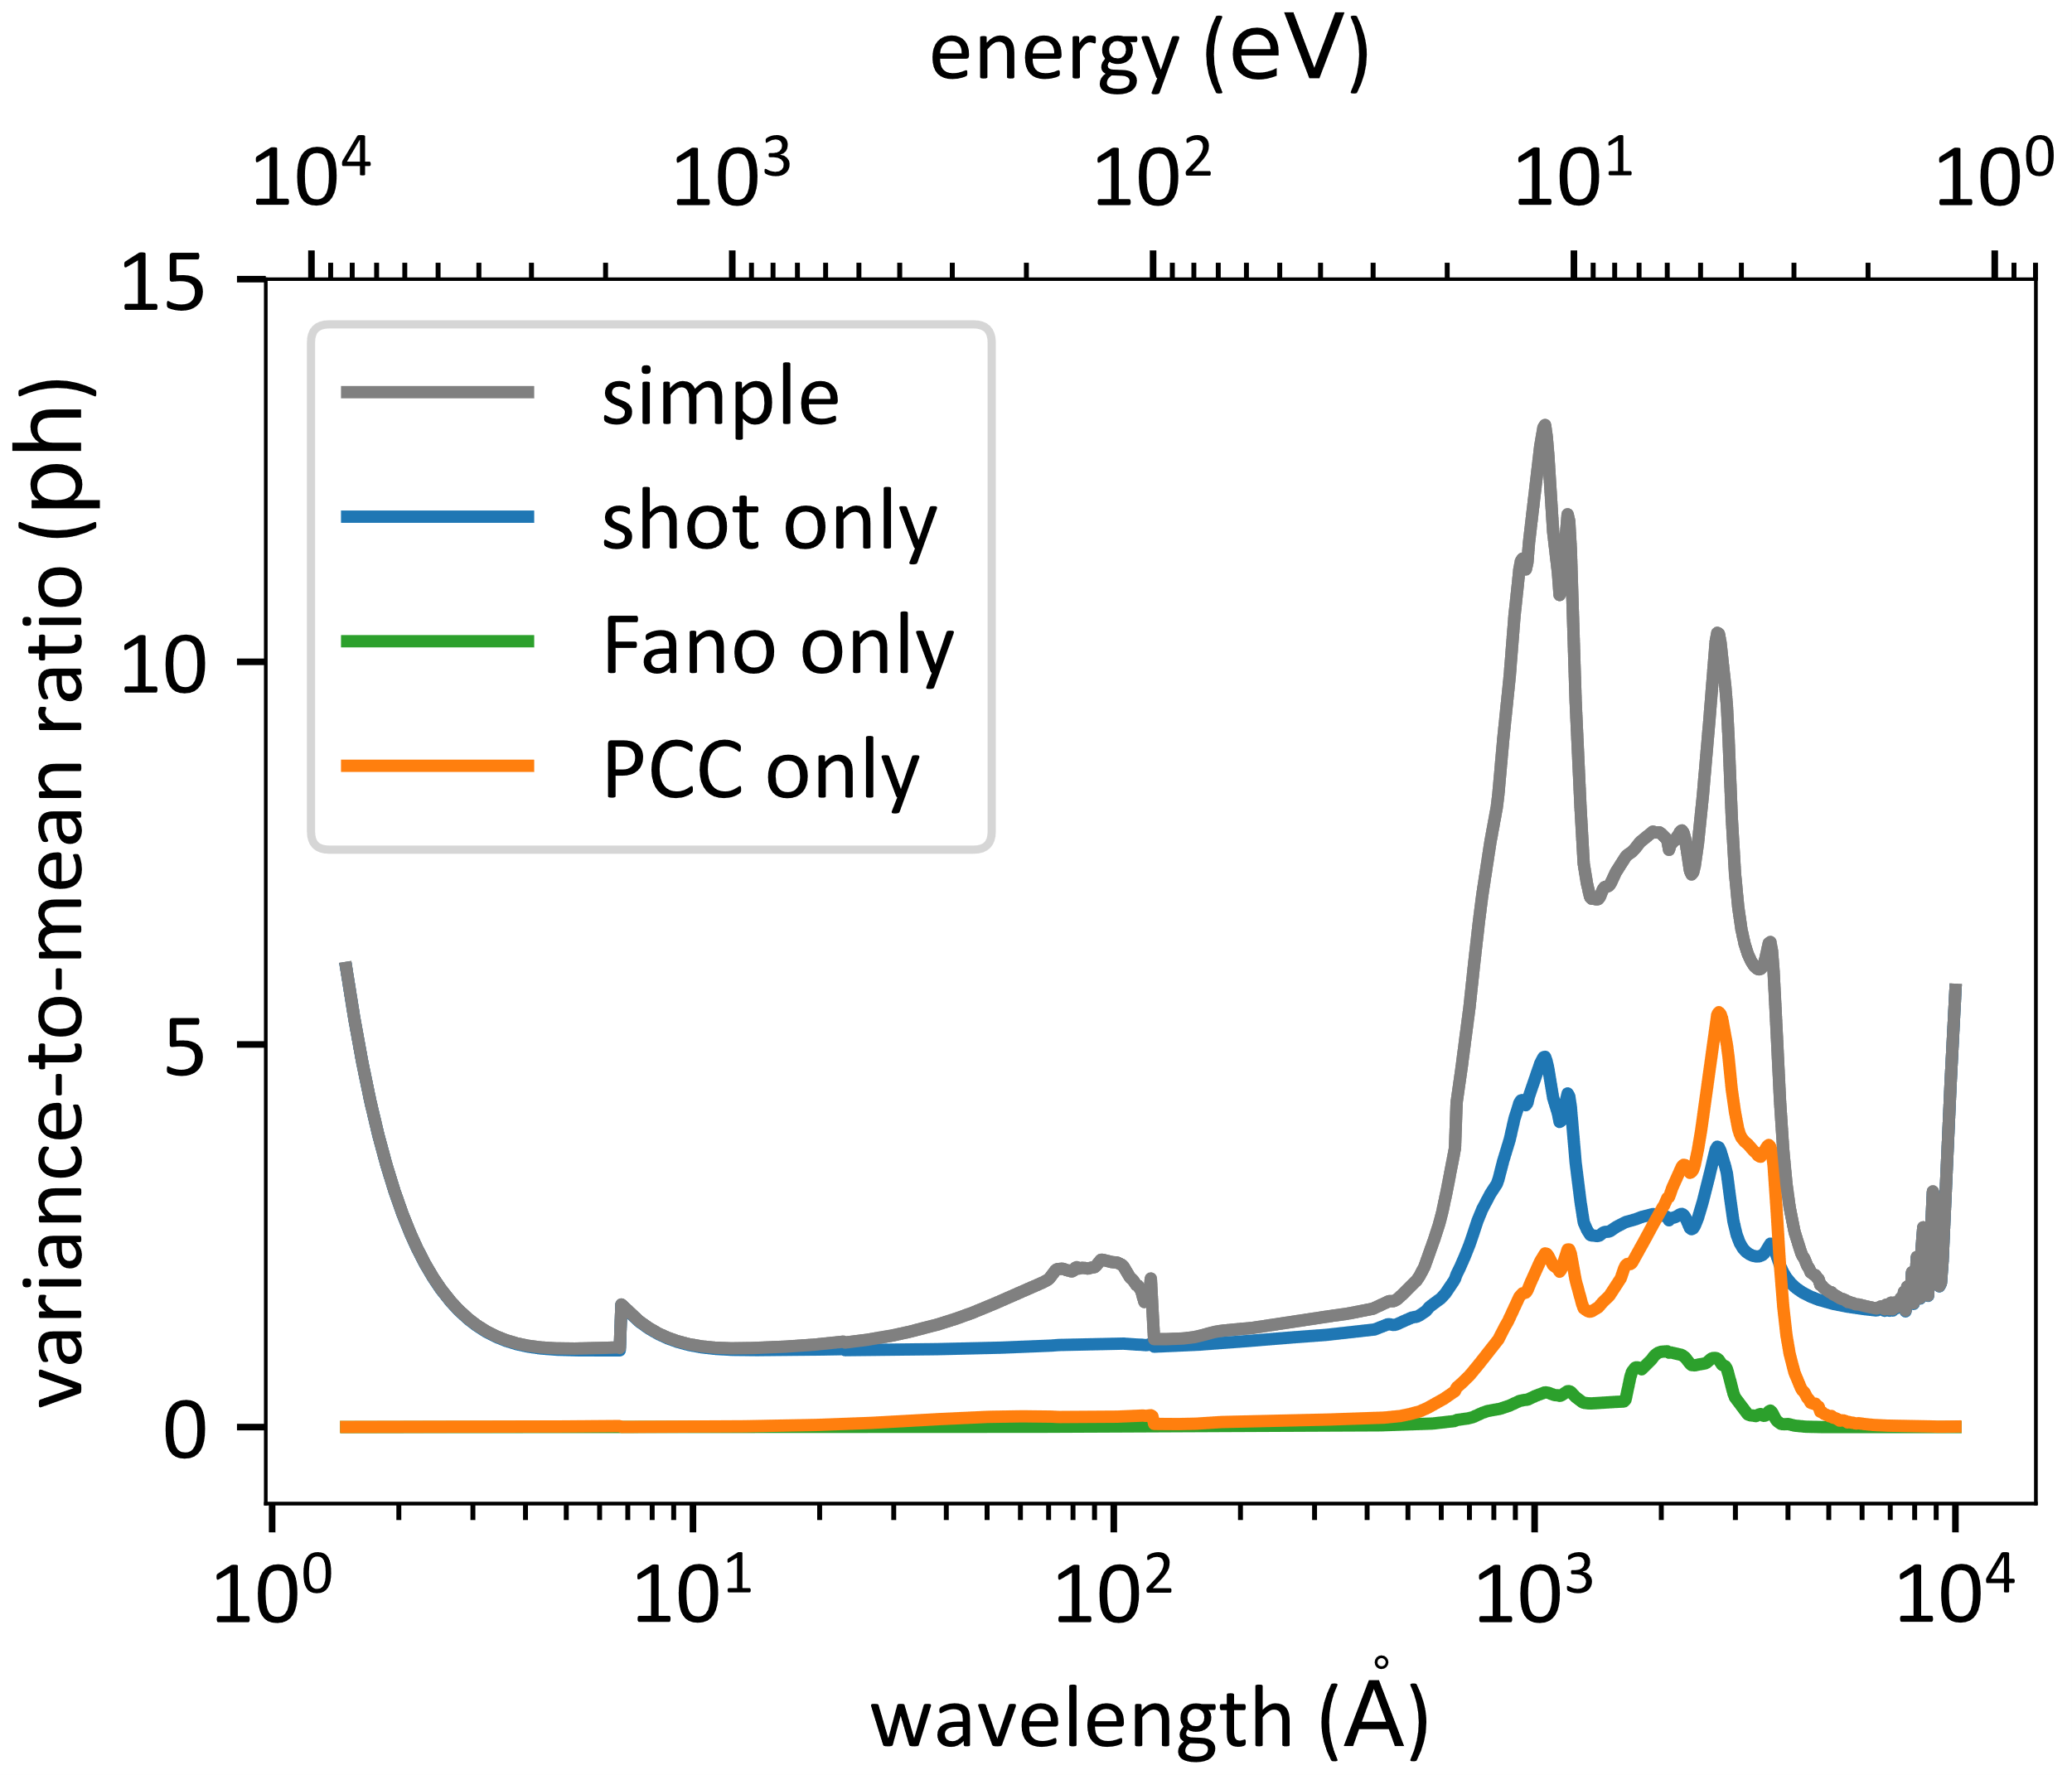
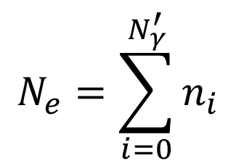

PCC Noise
Since each photon is absorbed at a different depth, each experiences a different CCE.
$$n_{i}←\text{Binomial}\left({\text{QY}}_{i}, η\left(z_{i}\right)\right)$$
$$N_{e}=\sum_{i=0}^{N_{γ}^{′}}{n_{i}}$$

Slide 21
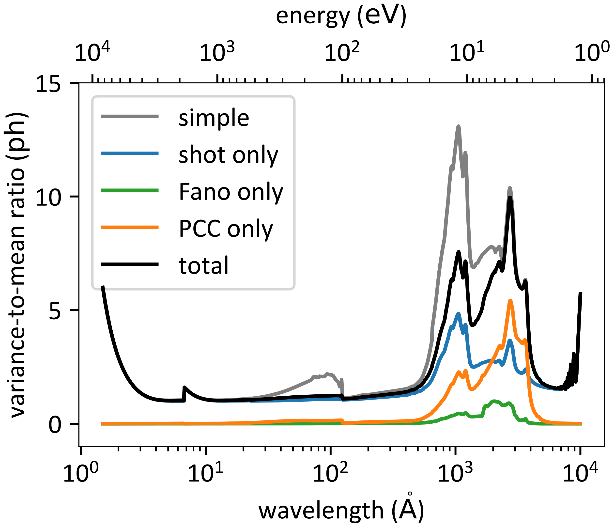
Total Noise
Sum of shot, Fano, and PCC noise
VMR is smaller than the simple model in the UV
The partial events improve the noise performance

Slide 22
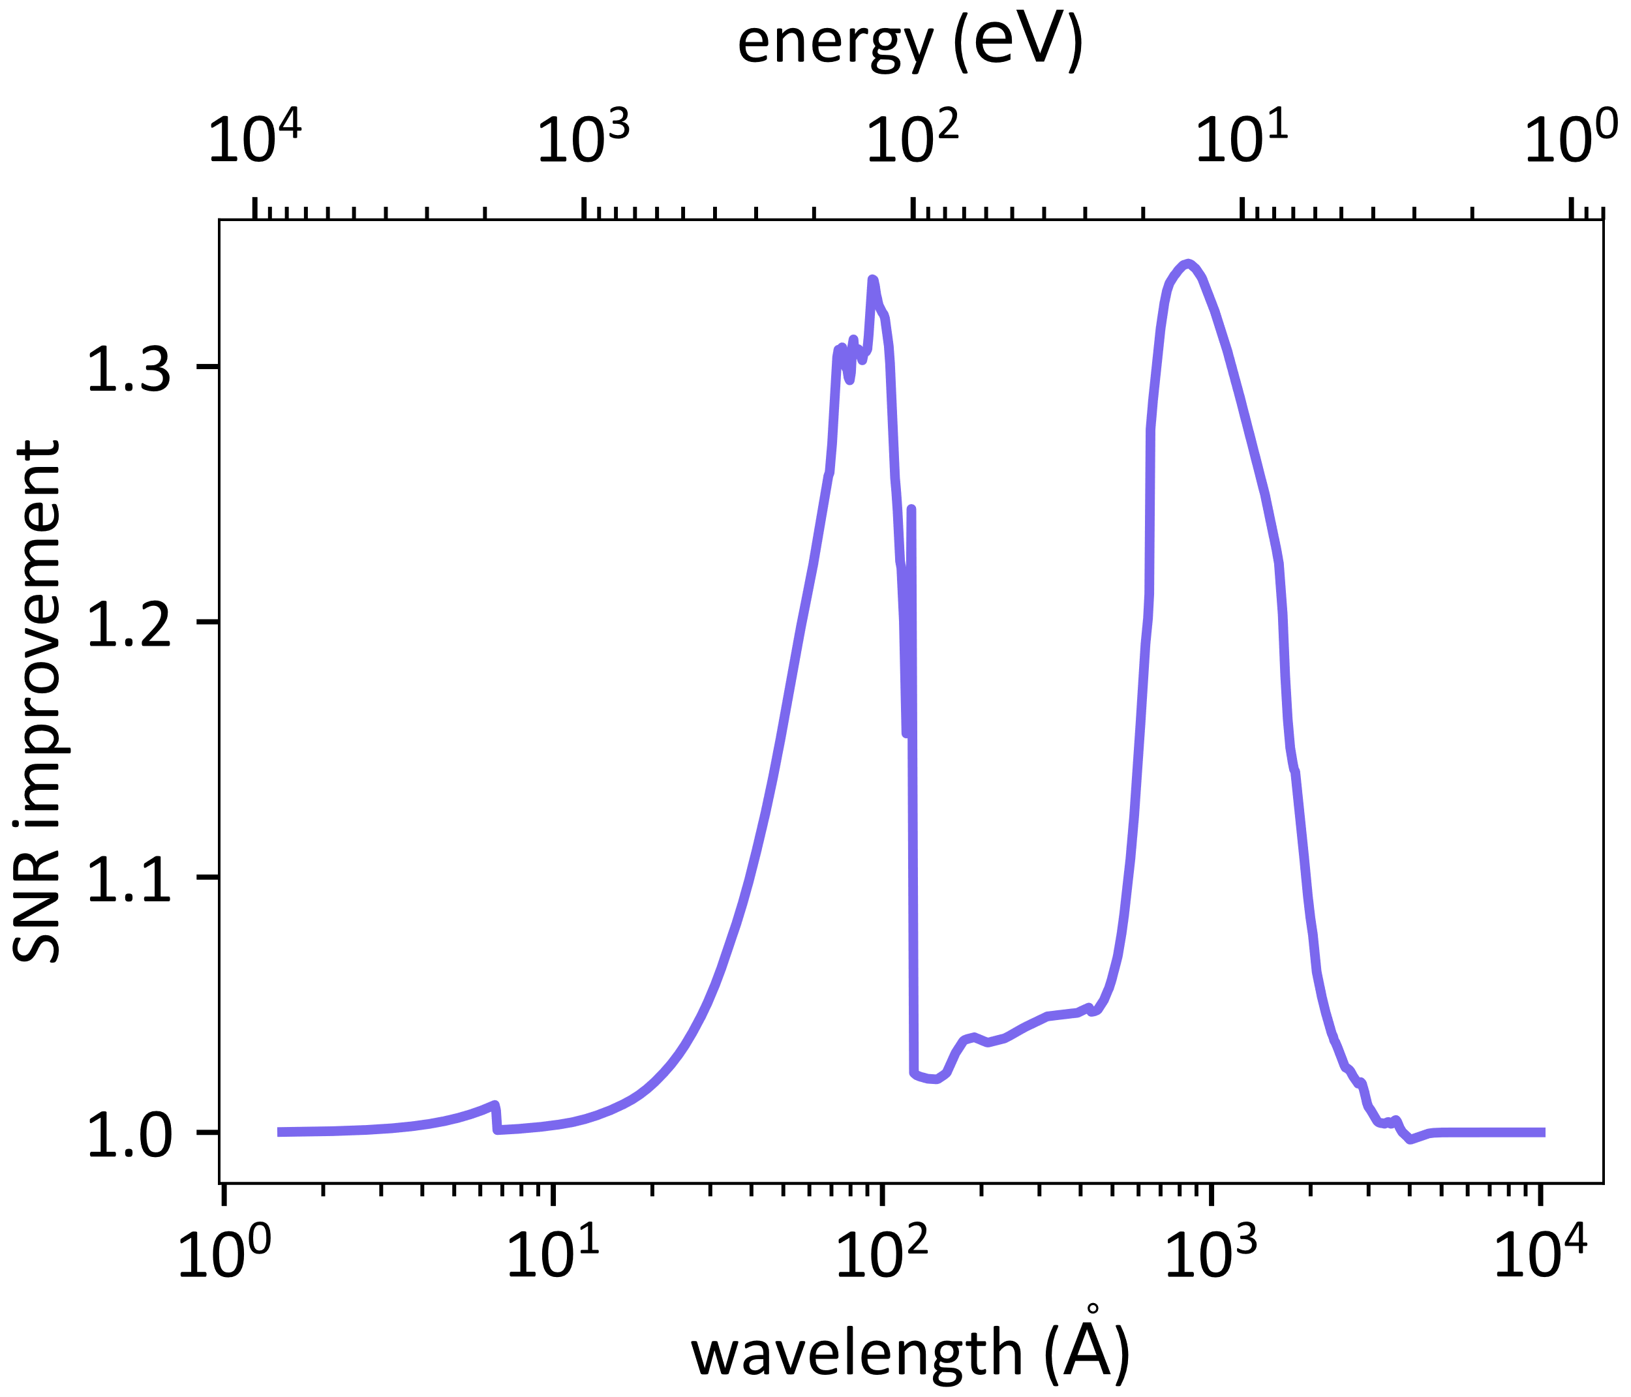
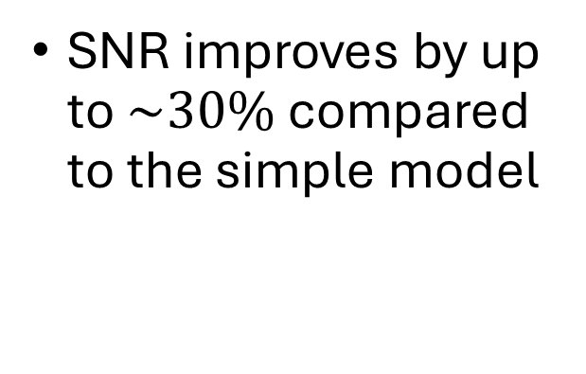
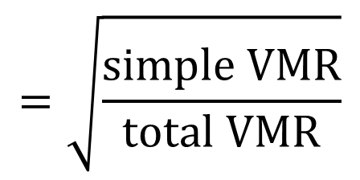
SNR improvement
$$=\sqrt{\frac{\text{simple} \text{VMR}}{\text{total} \text{VMR}}}$$
SNR improves by up to $\sim 30\%$ compared to the simple model

Slide 23
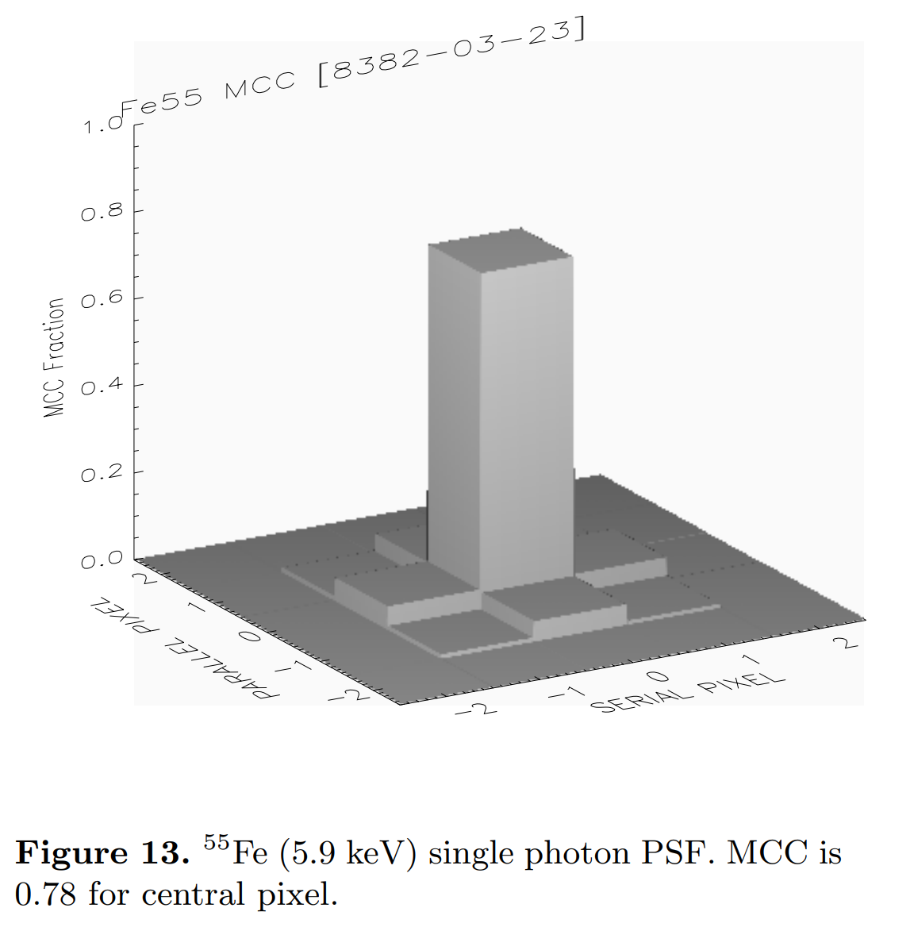
Charge spreading?
Charge spreading is when electrons diffuse into adjacent pixels.
Proportional to size of field-free region
Could explain the discrepancy since this increases the correlations between pixels
Stern et al. (2003)

Slide 24
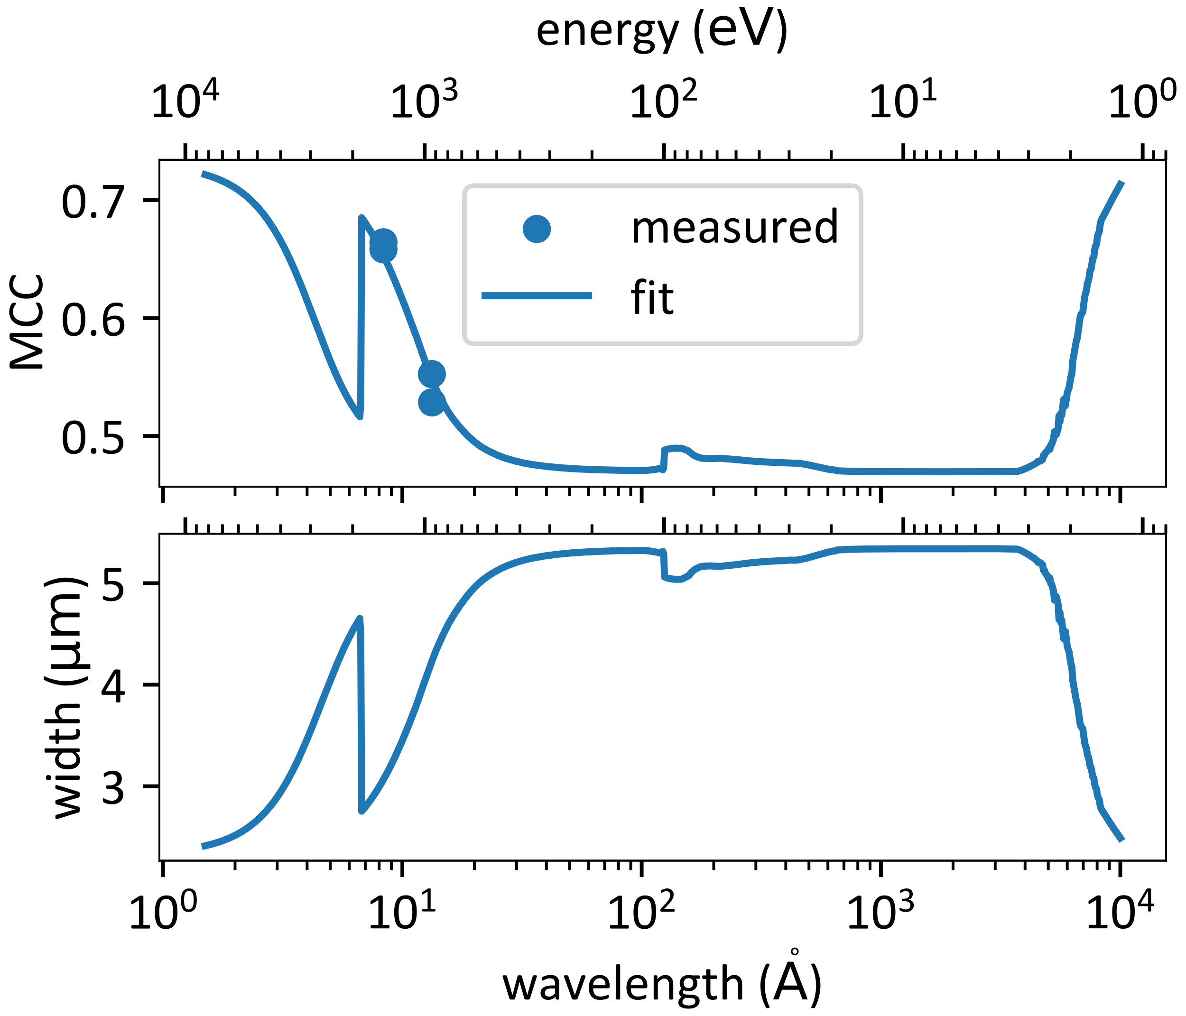
Mean Charge Capture (MCC)
Average fraction of charge captured by central pixel
Janesick (2001) charge spreading model
Stern et al. (2004) measurements
Fit size of field-free region
Predicts a similar amount of charge spreading for both UV and visible light

Slide 25
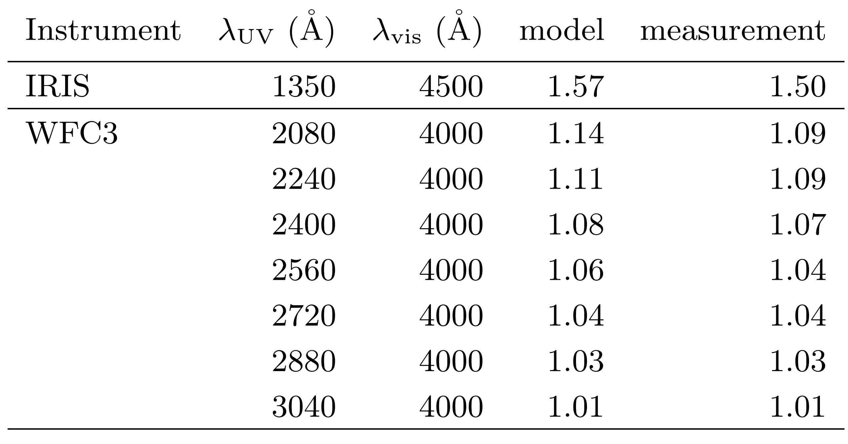
Compare to Measurements

Slide 26
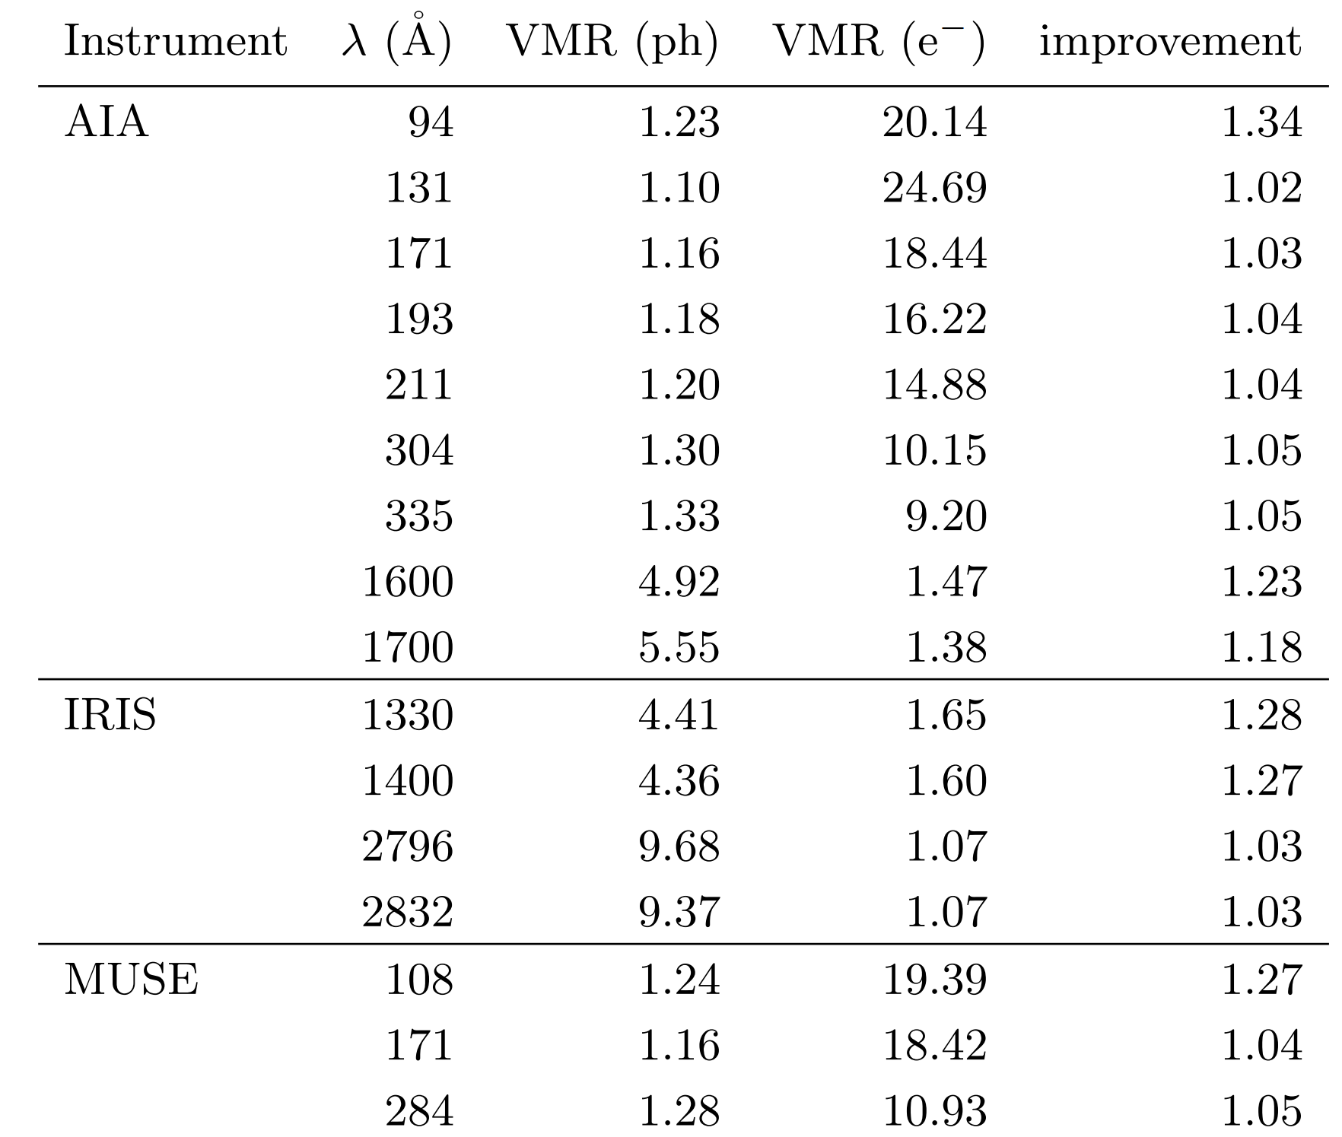
Affected Instruments
AIA
  94 Å
  1600 Å
  1700 Å
IRIS
  1330 Å
  1400 Å
MUSE
  108 Å

Slide 27
Conclusions
Partial-charge collection is mostly responsible for IRIS noise mystery
Charge spreading is less important
Need to use a more complicated expression to compute noise
The model predicts better SNR in some wavelengths than designers expected
Results affect AIA, IRIS, WFC3, ESIS, FURST, and MUSE.
Code provided in the optika.sensors Python module.
  Published on PyPI

