Slide 1
Playing nice with other Android Apps
Roy van de Water

Slide 2
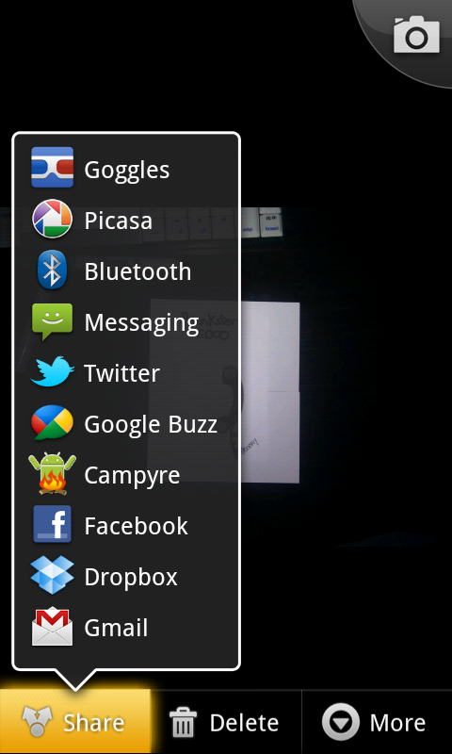

Slide 3
Text

Slide 4
Link

Slide 5
Pictures

Slide 6
Videos

Slide 7
Contact

Slide 8
Location

Slide 9
Intent

Slide 10


Slide 11
from: com.royvandewater.prankster.Prankster
to: com.royvandewater.prankster.Sharer
subject: Share this!
body: <Context>, <Variables>

Slide 12
Context context = (Context)this;
Intent intent =
new Intent(context, Sharer.class);
intent.putExtra("key", "value");
startActivity(intent);

Slide 13
public void onCreate(Bundle bundle){
Intent intent = this.getIntent();
String value =
intent.getExtraString(“key”);
}

Slide 14
from: com.royvandewater.prankster.Prankster
to: Anyone that can handle 'text/plain'
subject: Share this!
body: <EXTRA_SUBJECT>, <EXTRA_TEXT>

Slide 15
Intent intent =
new Intent(ACTION_SEND);
intent.putExtra(Intent.EXTRA_SUBJECT,
"subject");
intent.putExtra(Intent.EXTRA_TEXT,
"body");
startActivity(intent);

Slide 16
public void onCreate(Bundle bundle){
Intent intent = this.getIntent();
String subject =
intent.getExtraString(
Intent.ACTION_SUBJECT);
String body =
intent.getExtraString(
Intent.ACTION_TEXT);
}

Slide 17
<activity android:name=".Prankster">
<intent-filter>
<action android:name="android.intent.action.SEND" />
<category android:name="android.intent.category.DEFAULT" />
<data android:mimeType="text/plain" />
</intent-filter>
</activity>

Slide 18


Slide 19


Slide 20
Source:
http://bit.ly/prankster5000

Slide 21
Roy van de Water
@royvandewater
http://bit.ly/playing-nice

