Slide 1

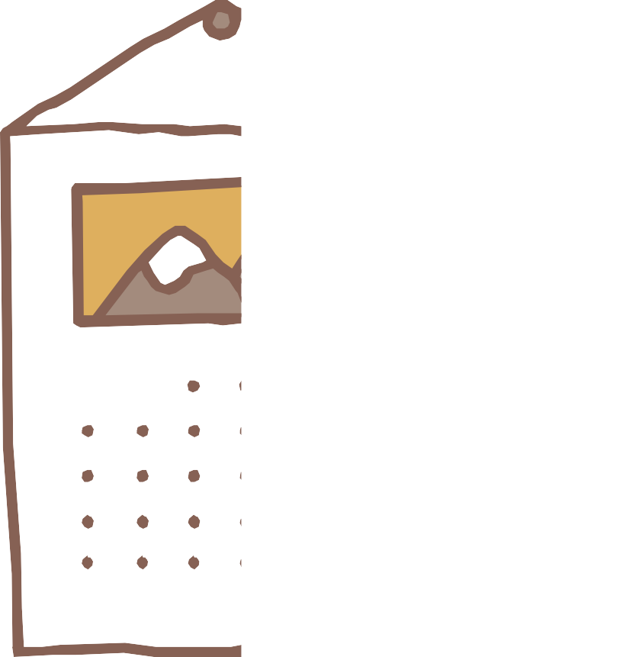


NEONURTURE INCUBATOR
Design that Matters (DTM)

Slide 2

OUR TEAM
Sakshi Pandey Sakshi Tulsyan Sapna Saini Tanishka Singh Royal
Rishank

Slide 3



INTRODUCTION
Many developing-country hospitals struggle to keep premature babies warm.
Imported incubators often break and cannot be repaired.
NeoNurture was designed as a low-cost, locally fixable incubator.

Slide 4
BACKGROUND
Neonatal hypothermia is a major cause of infant deaths.
Hospitals rely heavily on donated equipment.
70–90% of donated incubators fail within a year due to lack of parts.

Slide 5
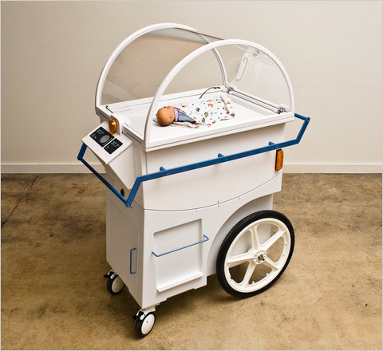
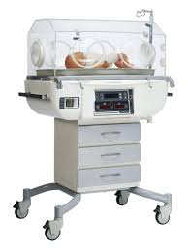
Some images of Incubator

Slide 6
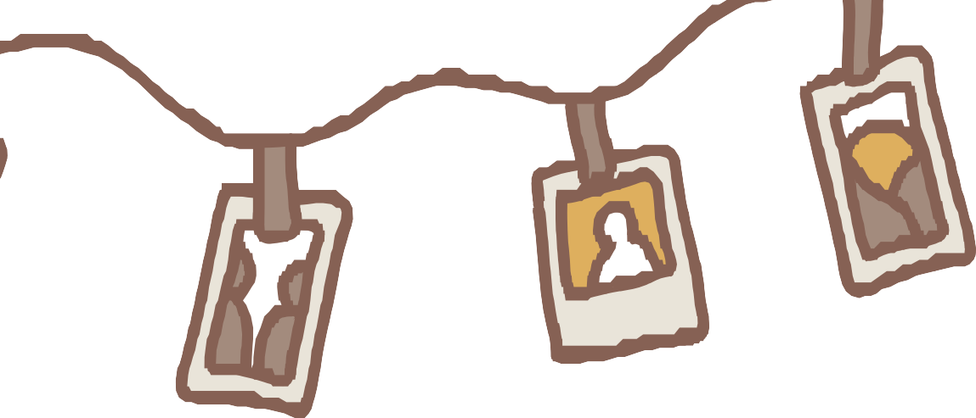
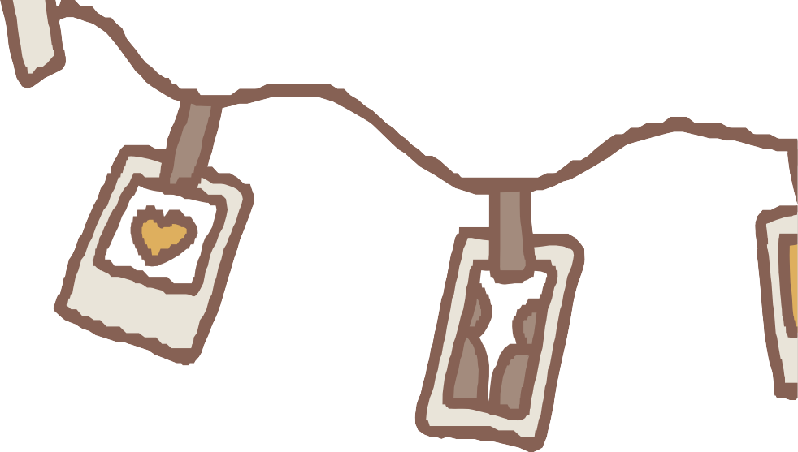
PROBLEMS
Main problem:
Existing incubators break down, and hospitals cannot repair them.
Challenges:
Proprietary spare parts unavailable Lack of biomedical technicians Unreliable electricity
Dusty, humid, hot environments

Slide 7




EMPATHISE
1
Designers visited hospitals in
2
Vietnam and other countries.
Observed nurses,
technicians, and patient flow.
Studied real environmental
constraints.

Slide 8


INSIGHTS FROM
EMPATHY WORK
Nurses need simple, intuitive devices.
Technicians cannot fix medical machines.
BUT… mechanics can repair anything on motorcycles or cars.
Car parts are cheap, available, and familiar.

Slide 9
DEFINE
1
How might we design an
2
Key needs:
incubator that can be easily
^{r}epaired with parts and skills
Safe temperature control
available locally?
Easy to clean
Redundant systems
Low cost and low complexity

Slide 10
IDEATE STAGE
1
Brainstorming around using
2
automotive parts:
Engine temperature sensors for contr_{ol}
Car headlights as heating
elements
Car battery for backup power
Auto fans for airflow
Dashboard indicators for alerts

Slide 11
SELECTED CONCEPT:
“CAR PARTS
INCUBATOR”
2
1
Chosen idea: build an
Benefits:
incubator from standard
automotive components.
Cheap
Locally repairable
Easy to source
Durable in harsh environments

Slide 12
PROTOTYPE
Prototypes included:
Cardboard/foam models for
^{M}odular shell for easy cleaning
sizing
Battery backup system
Functional units with bulbs +
fans

Slide 13
FEATURES OF NEONURTURE
INCUBATOR
Uses car headlights as heat source
Auto temperature sensors Car fan for air circulation Dashboard lights for alerts
Powered by mains + car battery Easy-open design for cleaning

Slide 14
TESTING IN CLINICS
1
Conducted testing with:
Environmental tests
→
dust, heat,
Nurses →
usability and
humidity
controls
Power outage simulations →
battery
Technicians
→
repairability
reliability

Slide 15
IMPACT& LIMITATION
1
Impact:
2
Proved a low-cost,
repairable medical device is
Limitations:
possible.
Influenced global thinking on
^{Did n}ot reach mass manufacturing
“design for repairability”.
due to regulatory hurdles.
Became a teaching model
worldwide.

Slide 16

https://youtube.com/shorts/CDodr3rrmKU?si=Y1tlrhyvQWYZFD08

Slide 17
CONCLUSION
NeoNurture shows how design thinking can solve real healthcare challenges.
Key insight: Design for the systems that already work locally. Result: an incubator that mechanics—not specialists—can fix.
A powerful case of human-centered innovation

Slide 18


Thank You

