Slide 1
Fridge2Fork
Rank recipes to minimize food waste
Recommender Systems Workshop · Tel Aviv University
Mid-Semester Check-in

Slide 2
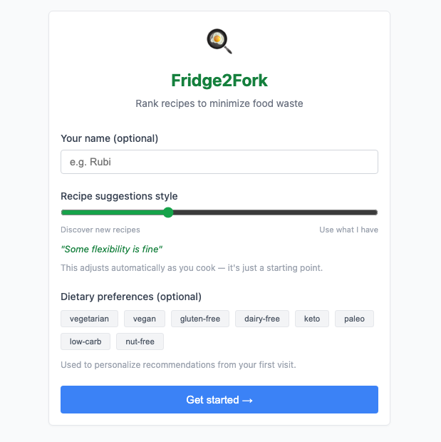
What we built and why
Your pantry is packed. Things get lost and expire in the back. Even when you catch one, you have no idea how to combine it. 231,000 recipes. Which one saves your ingredients?
Preference signal
Collaborative filtering · Content-based
Feasibility signal
Expiry urgency · Ingredient match
A normal recommender asks: what will you enjoy? We ask: what will you enjoy — while minimizing your food waste?

Slide 3
The main dataset – food.com
1.07M
231k
explicit ratings
unique recipes
76%
0.0024%
are 5-star
matrix density
Positivity bias: users only rate what they cooked and enjoyed — global mean ≈ 4.4, not 3.0.

Slide 4
Architecture
Frontend
Backend
Data + Models
React + TypeScript
FastAPI · Python
SQLite · models/
— Onboarding · Pantry · Feed
— Routers: /users /pantry /recipes
— Users · Pantry · Recipes · Events
REST / JSON
DB + models
— Browse · Profile · Shopping
— Services: scoring · expiry · match
— cf_model.pkl (Funk SVD)
— ML: serve_cf · serve_cb · cold_start
— item_sim.npz · cb_matrix.npz
Food.com dataset — 231k recipes · 1.07M ratings — trained offline, loaded at server start

Slide 5
Database schema
users
user_events
id · name · beta · diet_tags · has_cf · has_cb
user_id · recipe_id · event_type · rating · n_missing
beta = per-user ingredient weight, starts 0.35, drifts over time
"rate" trains CF · "cook" feeds beta updater · "skip" excludes 7d
pantry_items
user_id · ingredient (canonical) · raw_name · expiry_date
shopping_list_items
"Tnuva 3%" stored as "milk" — bridges brand names to Food.com vocab
user_id · ingredient · source_recipe_id · is_checked
recipes
id · name · ingredients_csv · tags_csv · avg_rating
Read-only. Seeded once from Food.com. 231k rows.

Slide 6
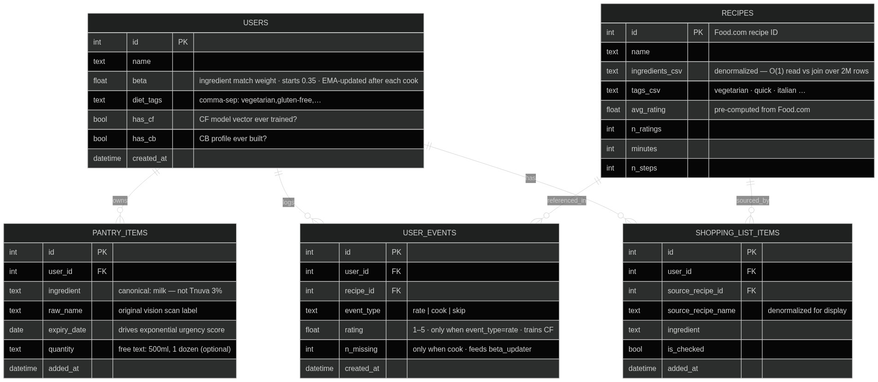
Database schema - diagram

Slide 7
Scoring & ranking
final_score = 0.35 × CF + 0.10 × CB + 0.35 × expiry + β × match
CF 35%
CB 10%
Collaborative filtering — user taste from rating history
Content-based — TF-IDF cosine sim against pantry profile
Expiry 35%
Match β%
Exponential decay e^(−days/3) — urgency amplifier
Fuzzy pantry overlap. β per-user, learned from cook history
→ Candidates min-max normalized per component before blend. Top 60 reranked with MMR for diversity.

Slide 8
Collaborative filtering — two modes
Cold start (0 ratings)
Warm (≥ 5 ratings)
Item-based CF
Biased Matrix Factorization
— No user vector exists yet
— Funk SVD · 50 latent factors · SGD
— Seed: diet tags + pantry items
predicted(u,r) = μ + b_u + b_r + U[u]·V[r]
— Item-item cosine similarity matrix
— 890k ratings · 35k users · 3-fold CV
— "Who liked these? What else did they like?"
— RMSE 0.61 vs baseline 1.12
Blend: α = n_ratings / 5 → cf = (1−α) × item_based + α × biased_MF → no jump at 5

Slide 9
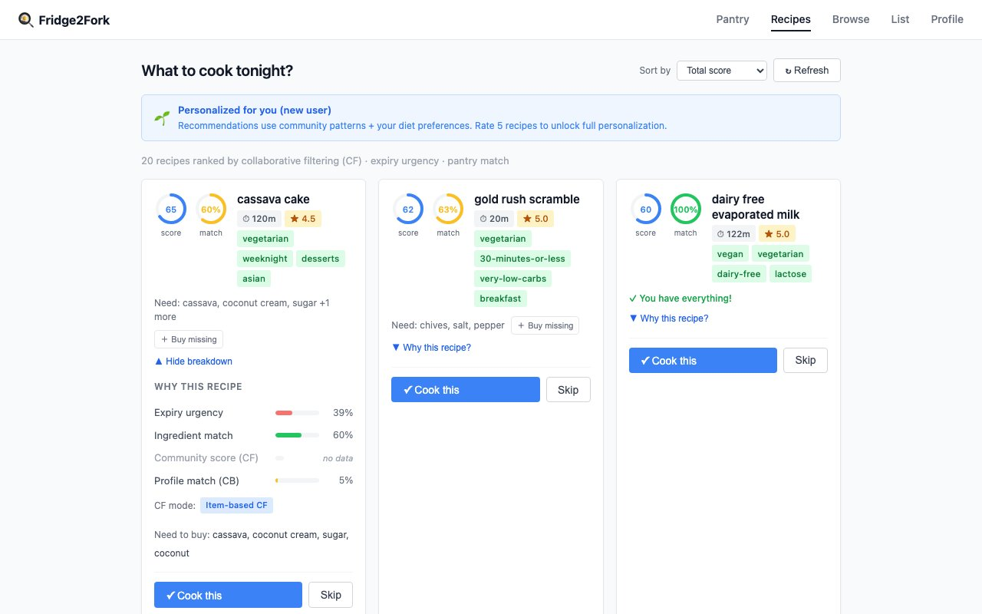
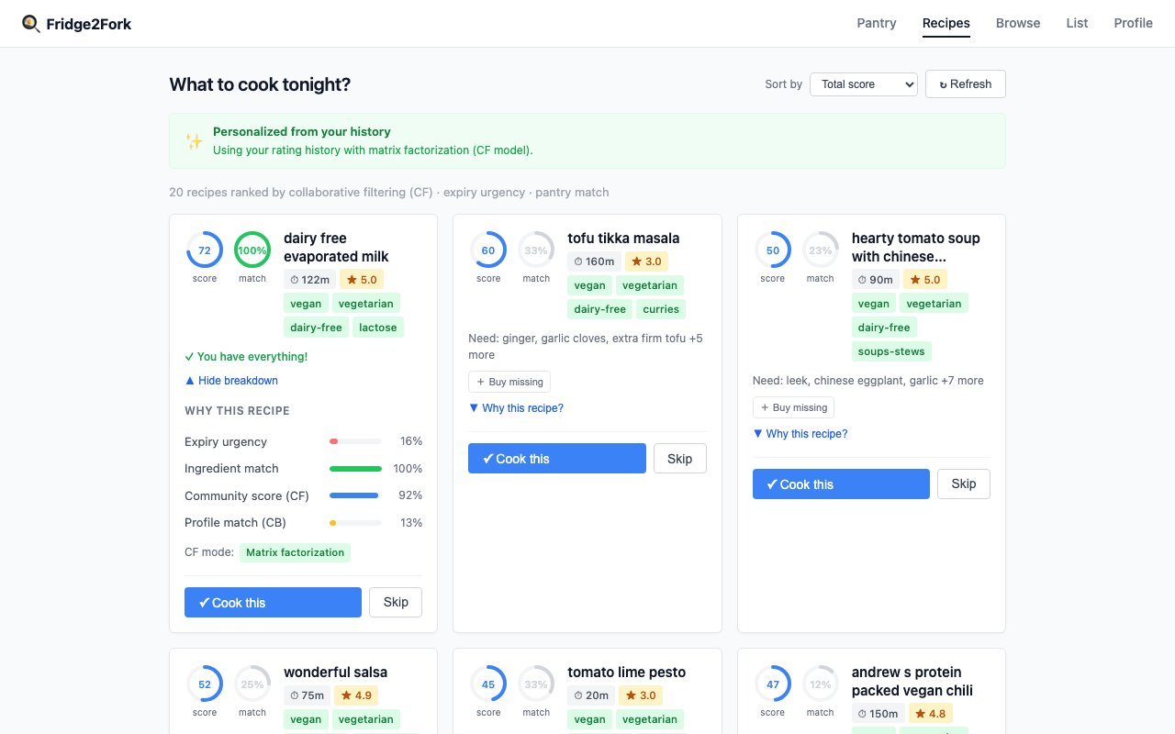
Cold → Warm
New user · Item-based CF · CF mode badge visible
Returning user · Matrix factorization · CF + history

Slide 10
Content-based filtering
TF-IDF over ingredients
Represent recipes
1
Every recipe → TF-IDF vector over ingredient tokens (20k vocab).
"Saffron" = rare → high weight. "Salt" = everywhere → near zero.
Build user profile
2
Cold: pantry ingredients as the profile vector.
Warm: weighted avg of rated recipes (weight = rating − 3.0).
5★ pulls toward, 1★ pulls away.
Score by cosine similarity
3
sim(user_profile, recipe_vector)
Weight in final formula: 10% — CF dominates, CB adds margin.
CF outperforms CB. CB used at 10% weight — it adds signal at the margin.

Slide 11
Offline learning — and what adapts at runtime
Model is static, personalization isn't
Trained offline, static on disk
Adapts per user
β update (EMA after each cook)
cf_model.pkl
revealed_β = 1 − avg_missing / threshold
Funk SVD
new_β = 0.85 × current + 0.15 × revealed
item_sim_matrix.npz
CB taste profile (rebuilt every request)
Weighted avg of rated TF-IDF vectors.
No retraining — fresh on every request.
Rate a pasta 5★ tonight → reflected tomorrow.
Item-item cosine, top-50
cb_matrix.npz
TF-IDF for 231k recipes
CF user vector (computed every request)
Fold-in against frozen item factors – user position solved live from their ratings in the DB
App ratings are captured but on default not fed back into retraining
Heavy ML Item factors are fixed. Who you are within that space is computed fresh every request.

Slide 12
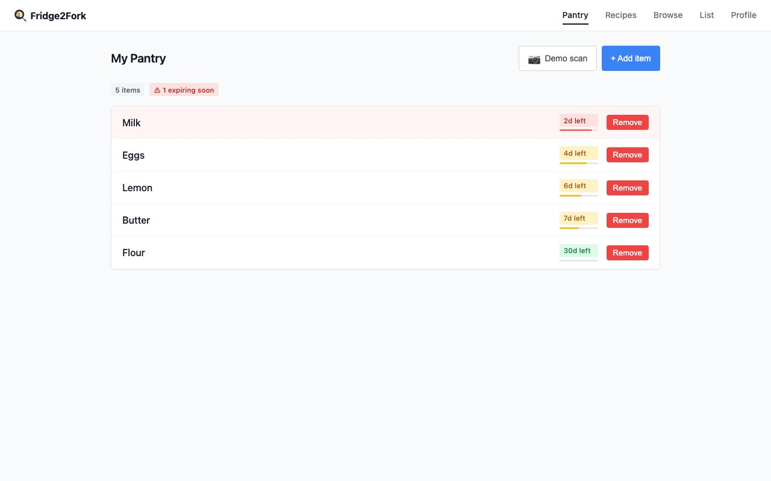
Pantry — expiry urgency in practice
📷 Vision scan → canonical name
GPT vision strips brand → "milk"
⏱ Expiry decay
e^(−days/3) · tomorrow = 0.72 urgency
🔗 Canonicalization
Bridges real-world labels to Food.com vocab

Slide 13
Ranking pipeline — from 231k to 20
candidate gen · scoring · calibration · MMR
1
Candidates
~200 recipes via Bayesian avg quality filter.
Drop: skipped (7d) · diet mismatches.
2
Score all four components
CF (item-based or MF) · CB (TF-IDF cosine) · expiry e^(−days/3) · ingredient match
3
Min-max normalize
Each component normalized across the candidate pool — so weights (35/10/35/β%) actually mean what they say.
4
Weighted blend → sort top 60
final = 0.35·CF + 0.10·CB + 0.35·expiry + β·match
5
MMR diversity rerank → top 20
MMR = 0.7·score − 0.3·max_Jaccard_to_selected
Prevents 20 variations of the same dish.

Slide 14
Future work – TO FILL
Food Part:
Cold Start
Total score: Expiry, match, and dynamic beta adapting
AI Vision: For expiry canonization
MMR: Rank diversity
Drinks Part
.
General
Integration of Both Parts of the product (UI, E2E)

Slide 15
What lives where
DB vs model files
Database (changes per session)
Model files (trained once, static)
— User profiles, beta values
cf_model.pkl
biased MF weights, 35k users
— Pantry items + expiry dates
item_sim_matrix.npz
top-50 neighbors, ~51k recipes
— Event history: cook · skip · rate
cb_matrix.npz
TF-IDF, 231k recipes
— Shopping lists
cb_vectorizer.pkl
20k ingredient vocab
This specific user's state today
Collective knowledge of 197k Food.com users
At serving time: DB gives who you are + what's in your fridge. Model files give the collective taste knowledge. Scoring fuses both.

Slide 16
Thank you

