Slide 1
RETAIL SALES IN NEW ZEALAND
GROUP 37
PUJA. (S3795543)
ROY WONG KHER YUNG (S3835352)
YEN-TING LIU (S3750625)

Slide 2
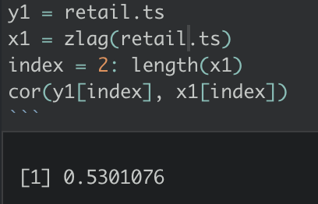
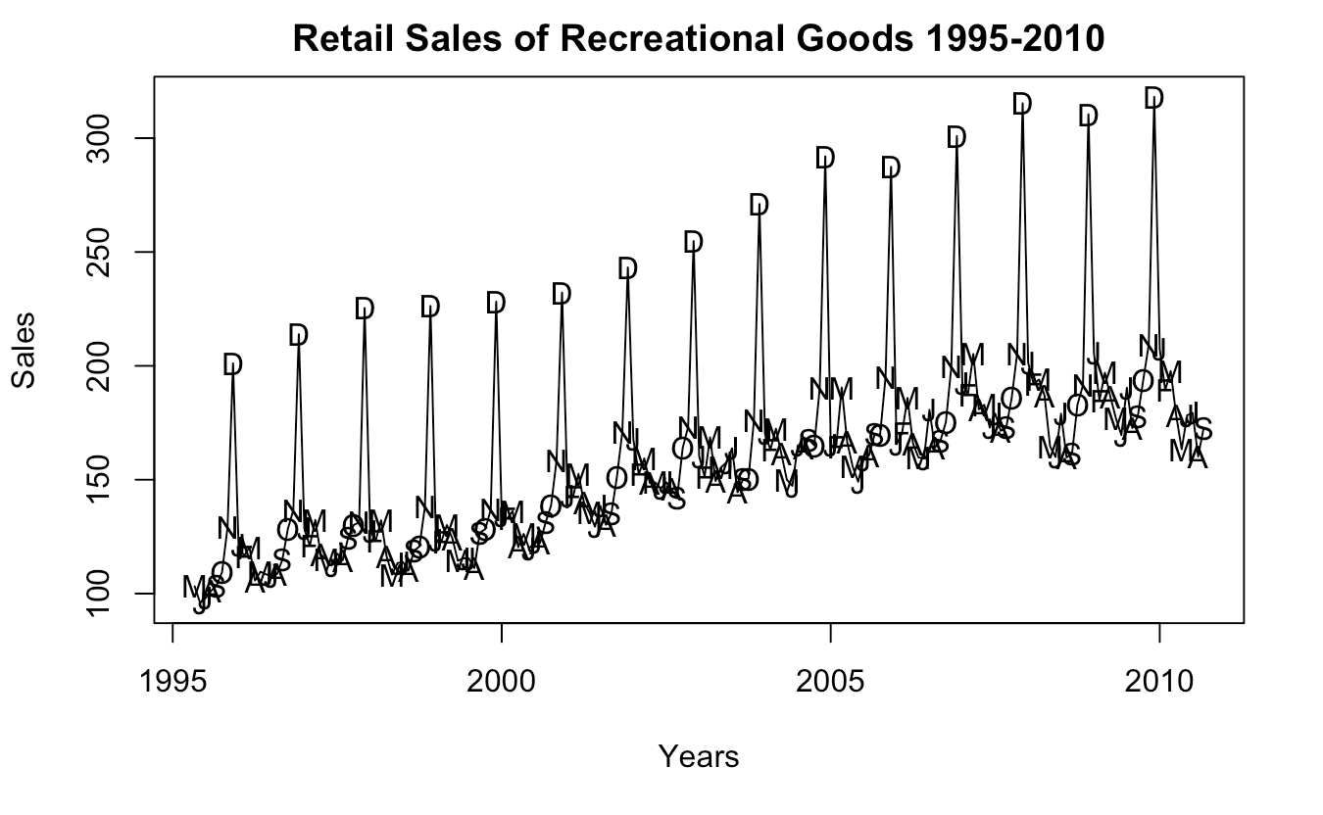
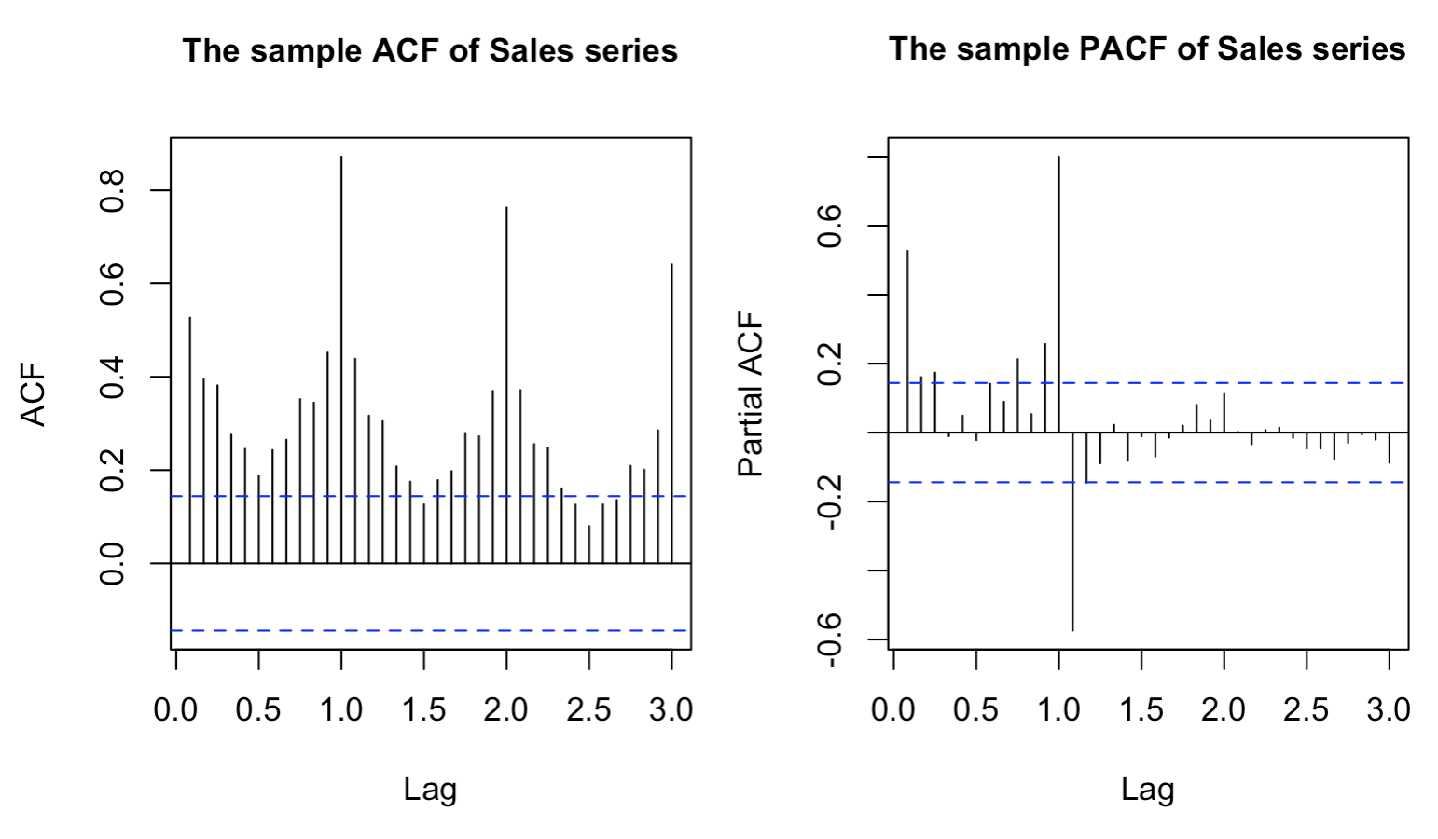
INITIAL DATA

Slide 3
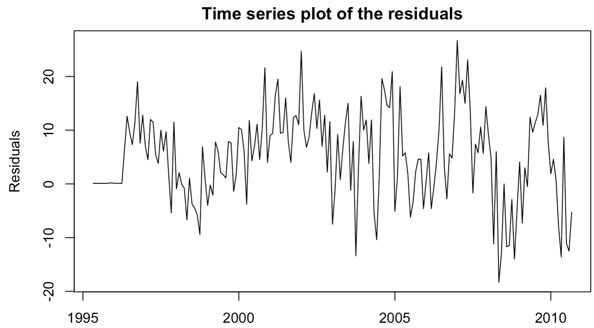
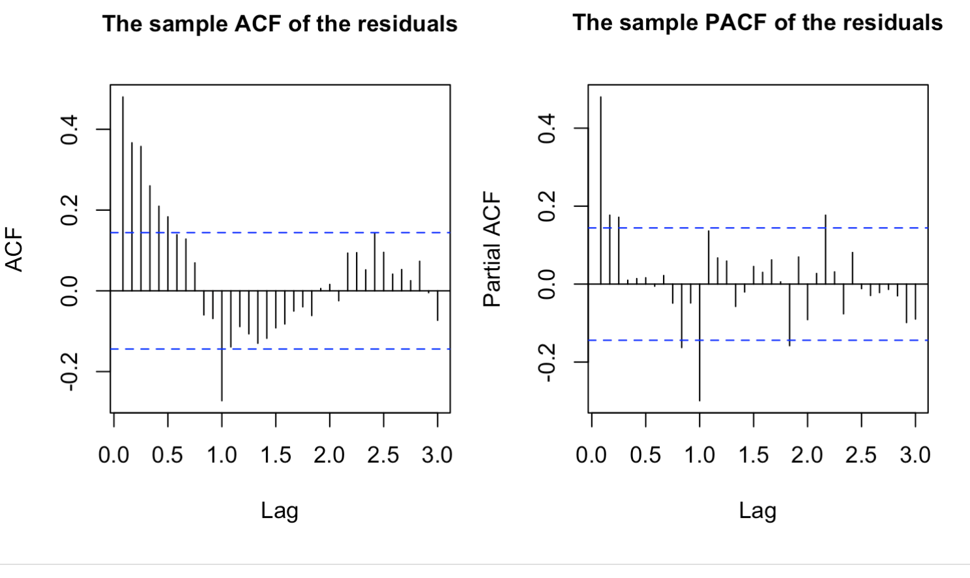
ADDING SEASONAL PARAMETER : D=1,P=1,Q=1
Presence of significant correlation at seasonal lag1 in ACF.
Significant correlation at lag 1 and slightly significant correlation at seasonal lag 2 in PACF.
We can go on with ordinary differencing .
PS: Before differencing we did perform Log and Box-Cox transformation but they didn’t help with non-stationarity.

Slide 4
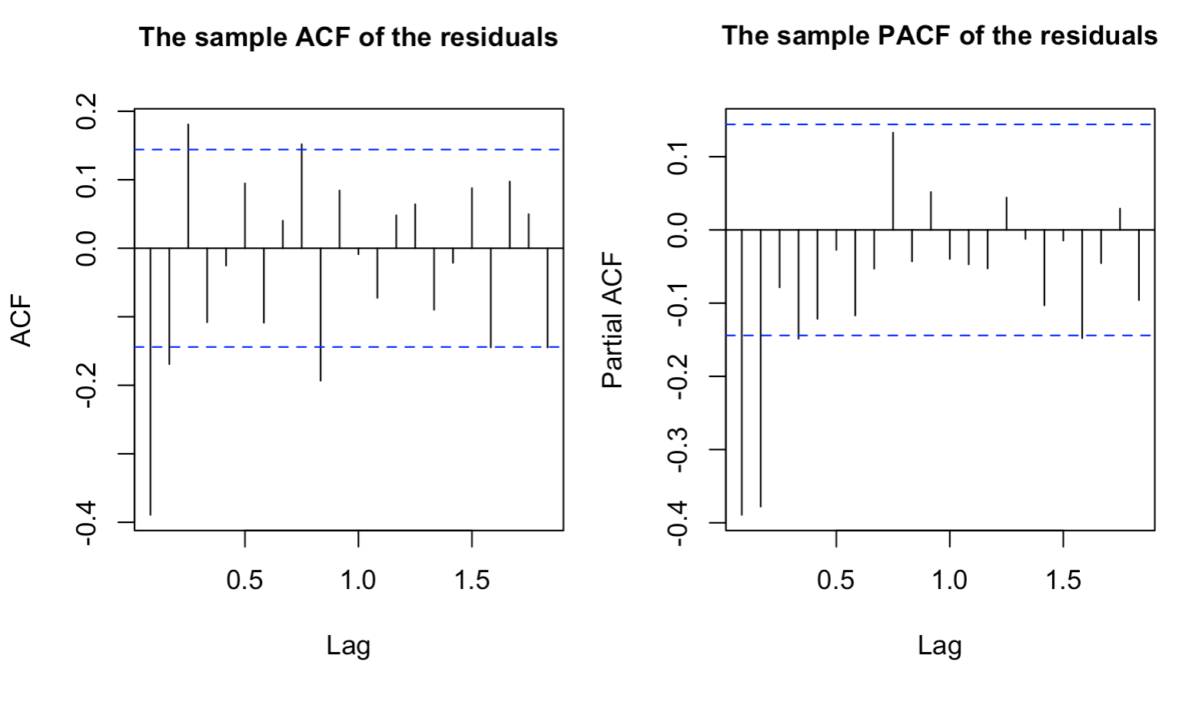
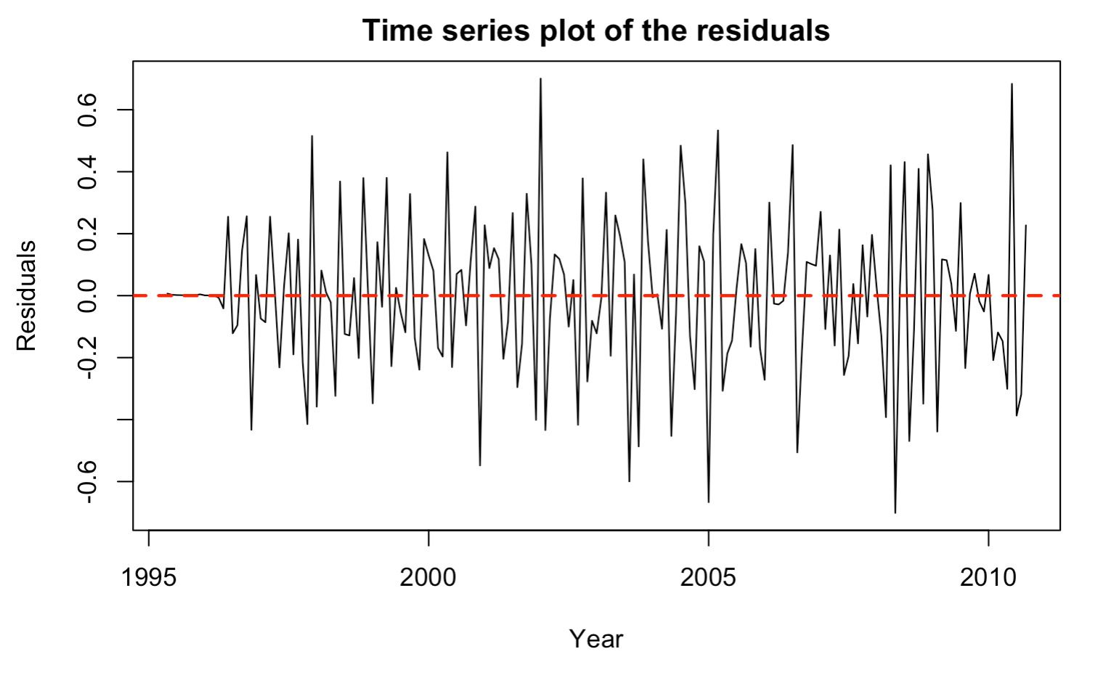
ORDINAL DIFFERENCING : d=1

Slide 5
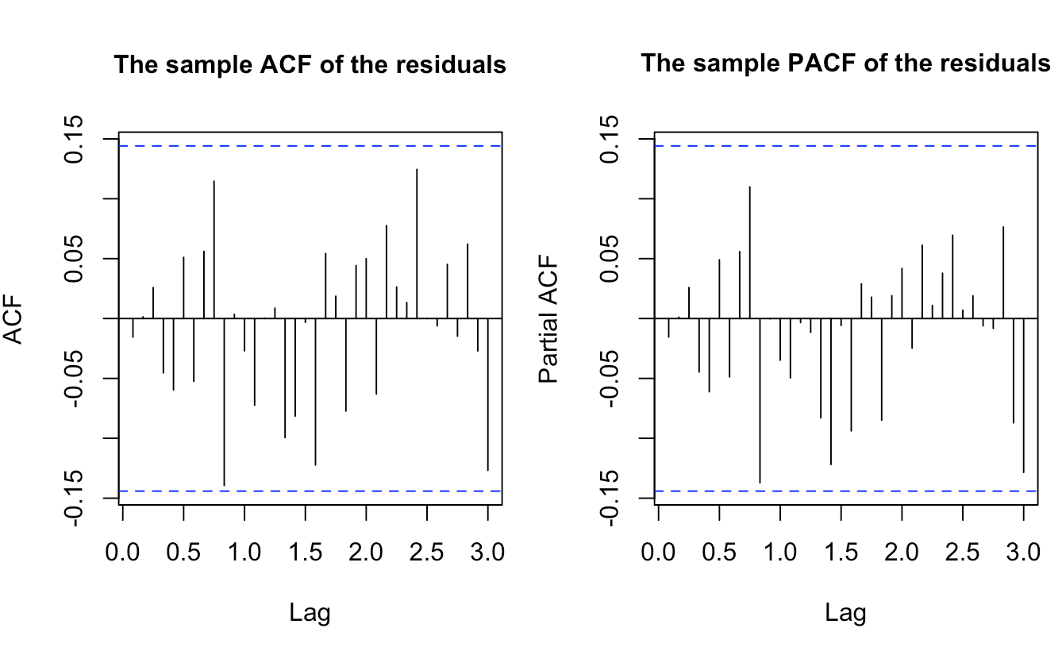
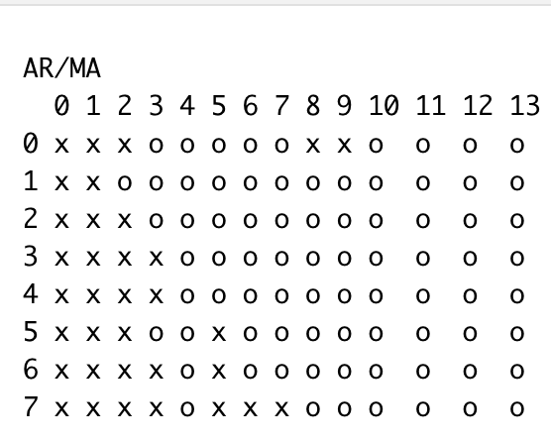
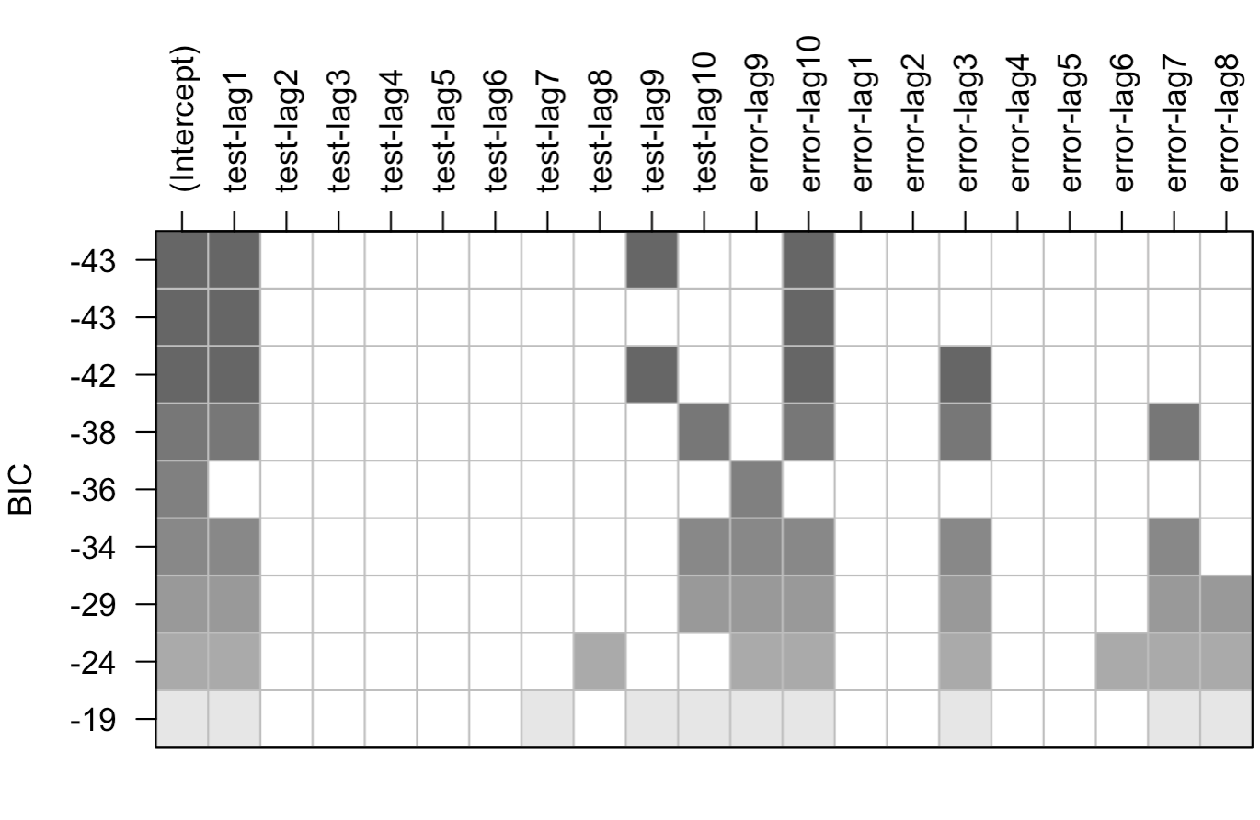
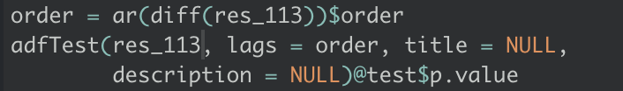
MODEL SPECIFICATION
SARIMA(1,1,3)x(1,1,1)_12
5
{SARIMA(1,1,0)X(1,1,1)_12}
{SARIMA(1,1,2)X(1,1,1)_12}
{SARIMA(1,1,3)X(1,1,1)_12}
{SARIMA(2,1,3)X(1,1,1)_12}
{SARIMA(2,1,4)X(1,1,1)_12}
{SARIMA(3,1,4)X(1,1,1)_12}
0.01

Slide 6

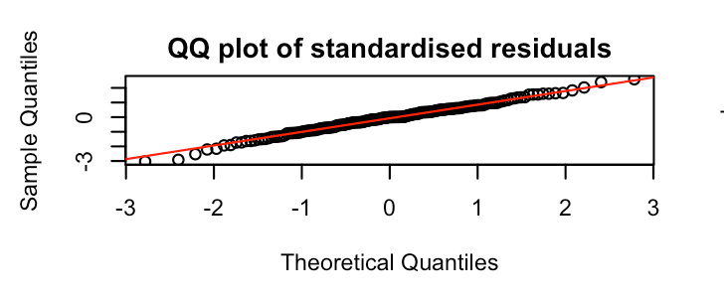
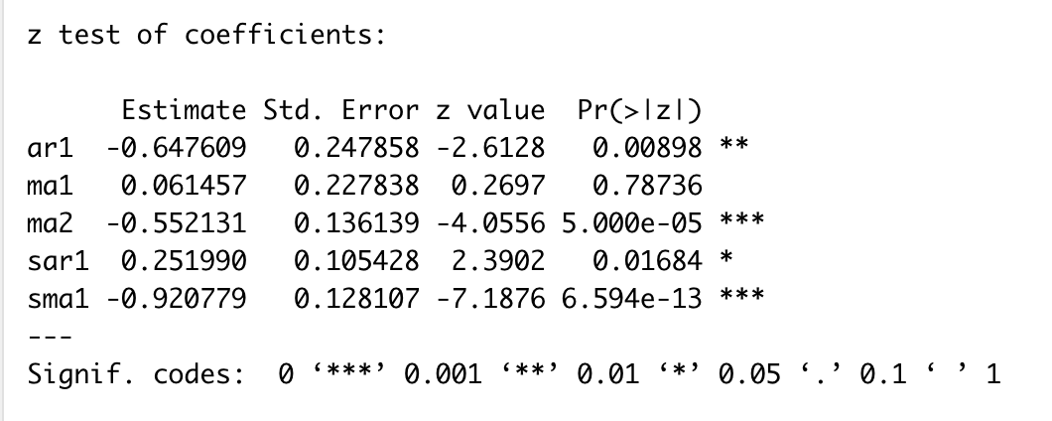
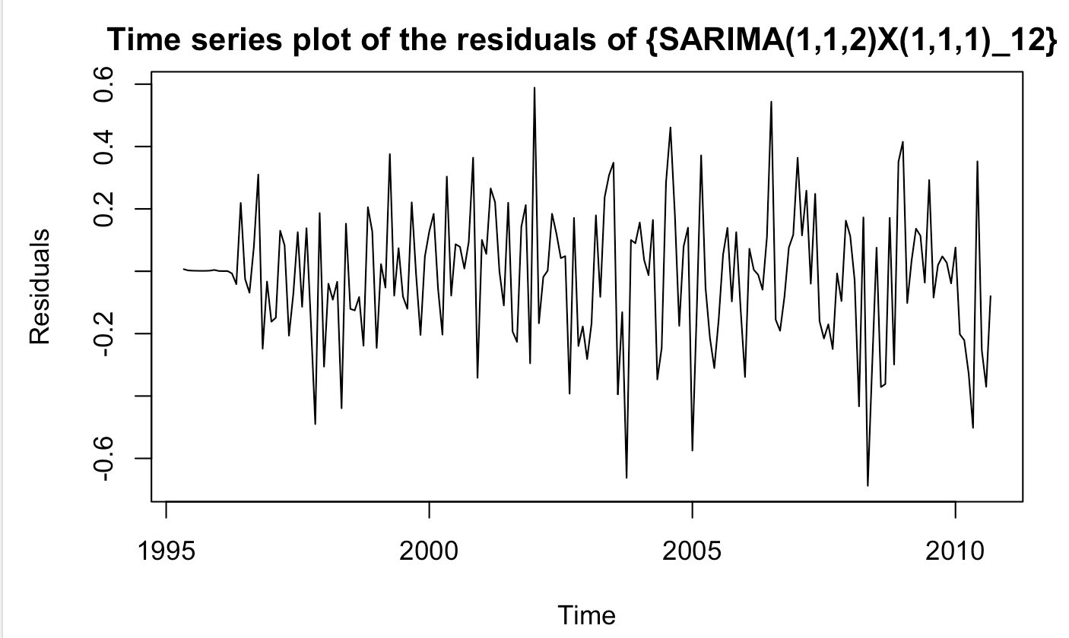
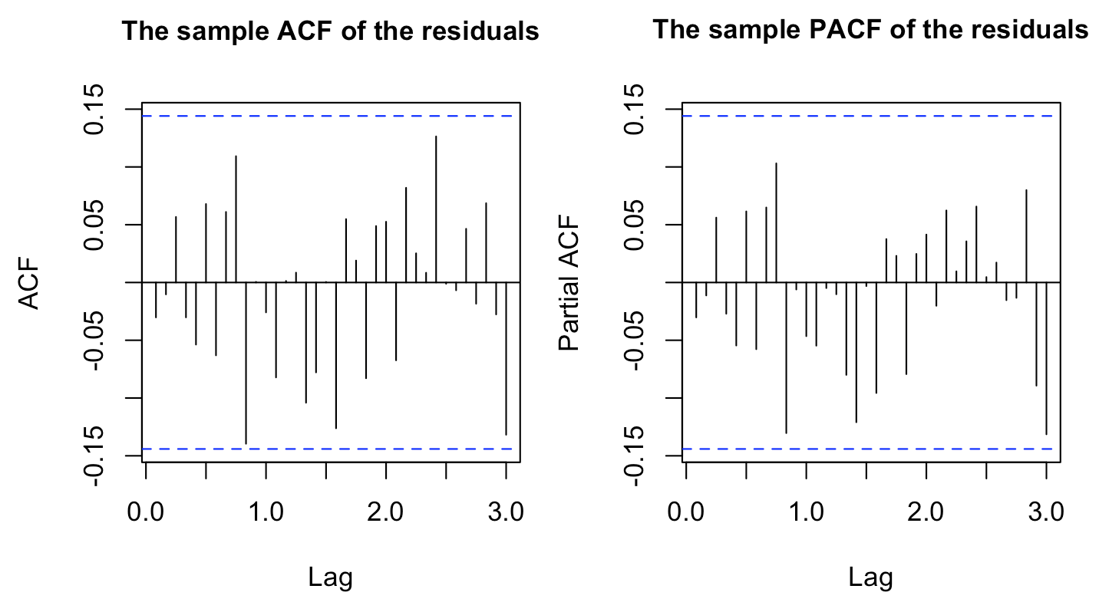
Parameter Estimation {SARIMA(1,1,2)X(1,1,1)_12}

Slide 7
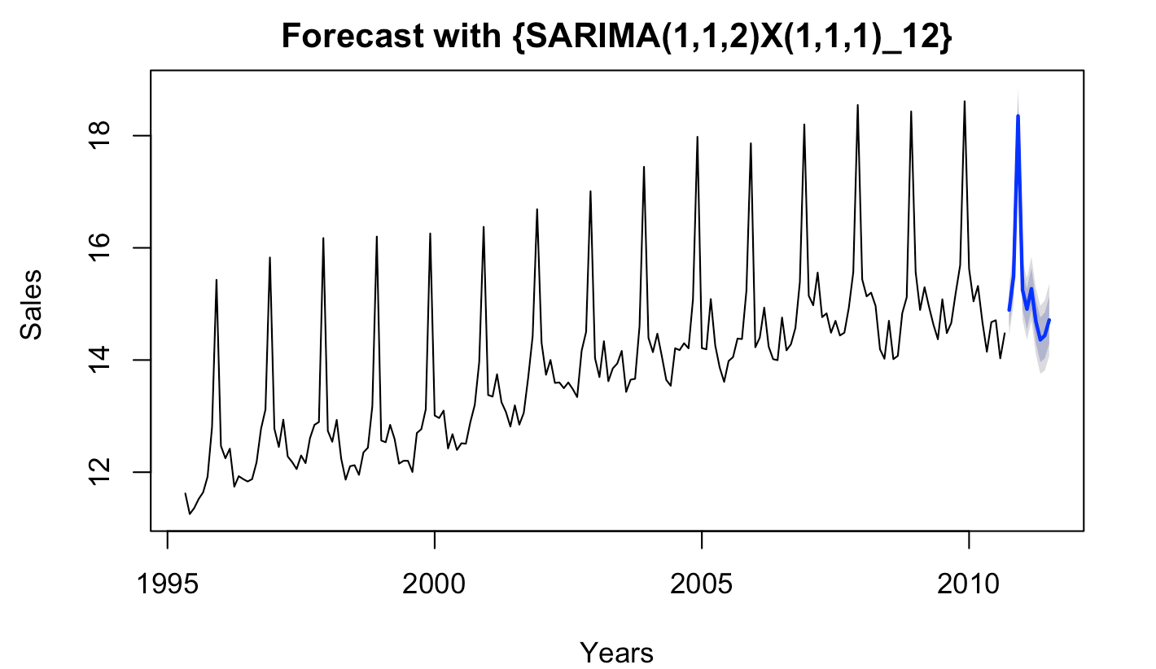
FORECAST
THANKYOU!

