Slide 1
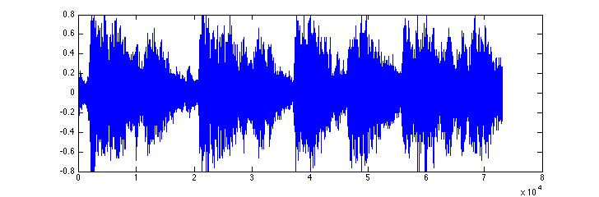
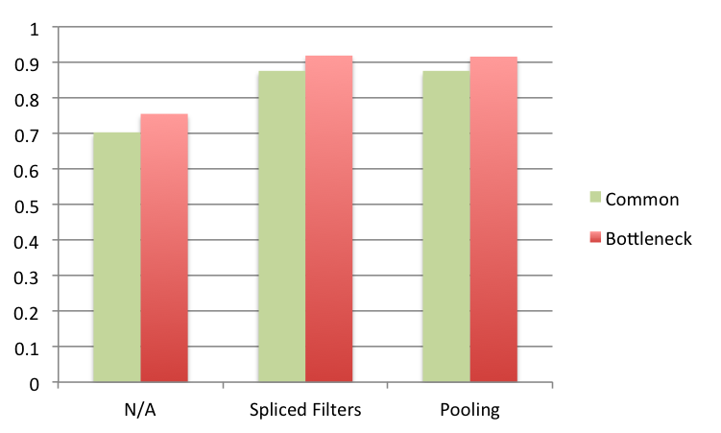
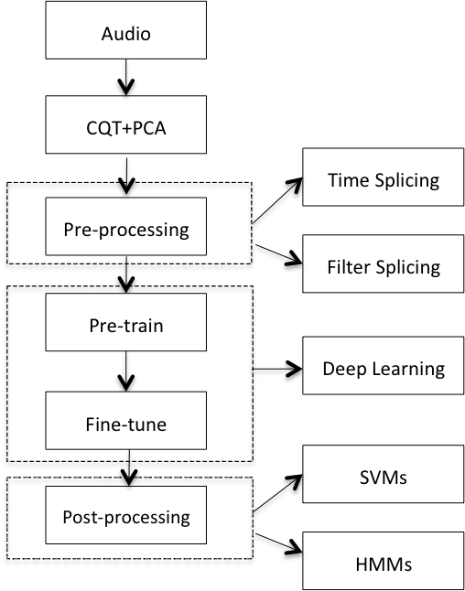

CHORD DETECTION USING DEEP LEARNING
Xinquan Zhou, Alexander Lerch
Georgia Institute of Technology Center for Music Technology
OVERVIEW
WHAT IS CHORD DETECTION?
RESULTS
Chord detection can contribute to applications such as music similarity measures, sematic analysis and etc.
Extraction of chord annotation of music from audio signals
First, three different post classifiers are compared: the maximum of the softmax output (Argmax), an SVM, and an HMM.
Several studies indicate that deep learning methods can be very successful when applied to Music Information Retrieval (MIR) tasks, especially when used for feature learning
Start End Chord
0s 0.5s C Major
0.5s 1.2s G Major
1.2s 2.3s E Minor
…
Classifier | Argmax | SVMs | HMMs
WCSR | 0.648 | 0.645 | 0.755
Table 1. Evaluation results of Weighted Chord
Symbol Recall (WCSR)
Exploration of Deep Learning for chord detection
Fig 1. Overview of a general chord detection
Selecting HMMs as post classifiers, the performance of both common architecture and bottleneck one is evaluated.
PROPOSED METHOD
CONCLUSION
Investigated Deep Learning for learning high-level features for chord detection
Employed time splicing and convolution methods for pre-processing
Applied Hidden Markov Models (HMMs) to features that Deep Learning extracts for decoding the final chord sequence
Our model is able to learn high-level probabilistic representations for chords detection
The choice of appropriate input filtering can significantly affect the system performance.
HMMs or Viterbi decoding algorithm fits the task better than the static classifiers
The use of a bottleneck architecture is advantageous.
Fig 3. Results of different architectures
Future Work
Finally, we present the results of Chordino with the default settings, computed on our dataset and compare it with our system.
Learning a pitch class vector instead of chord likelihood by incorporating multi-label
Finding a way to design the preprocessing filters systematically.
Method | WCSR
Chordino | 0.625
Proposed (w/o max pooling) | 0.919
Proposed (with max pooling) | 0.916
Reference
[1] Philippe Hamel and Douglas Eck. “Learning features from music audio with deep belief networks.” In ISMIR, pages 339–344. Utrecht, The Netherlands, 2010.
[2] Frantisek Grezl, Martin Karafi´at, Stanislav Kont´ar, and J Cernocky. “Probabilistic and bottleneck features for lvcsr of meetings.” In Proceedings of the International Conference on Acoustics, Speech and Signal Processing (ICASSP) , volume 4, pages IV–757. IEEE, 2007.
[3] Eric J Humphrey and Juan Pablo Bello. “Rethinking automatic chord recognition with convolutional neural networks.” In Proceedings of the International Conference on Machine Learning and Applications (ICMLA) , volume 2, pages 357–362. IEEE, 2012.
Table 2. Final results
Our dataset is a 317-piece
collection composed of Beatles,RWC pop, Zweieck and Queens.
Fig 2. Illustration of the proposed method
For more information, please contact royzxq@gmail.com

Slide 2
CHALLENGES
Chord is changing along with time, such time information is significant
First exploration using deep neural networks on chord detection
Trade-off between accuracy and flexibility

Slide 3
Filter1
Output1
Input
Filter2
Output2
Splice
Pooling
…
…
FilterN
OutputN

Slide 4
Audio
CQT+PCA
Preprocessing
Time splicing
Filter splicing
Pre-training
Deep Learning
Fine-tuning
Postprocessing
SVMs
HMMs
Annotation

Slide 5
1024 Nodes
1024 Nodes
Layer 6
…
…
512 Nodes
1024 Nodes
Layer 5
…
…
256 Nodes
1024 Nodes
Layer 4
…
…
256 Nodes
1024 Nodes
Layer 3
…
…
512 Nodes
1024 Nodes
Layer 2
…
…
1024 Nodes
1024 Nodes
Layer 1
…
…

