Slide 1
Project Challenge:
Heart Disease Analysis
Applied Data Science with Python for Beginners Bootcamp Contest #1
Tina Munda
January 2026
Notes:
Title + objective

Slide 2
Introduction
Objective: Which factors are associated with heart disease in a clinical sample (N=303)?
Dataset: Cleveland Clinic evaluation sample (not general population!)
Sample size: 303 patients
Variables:
  age,
  sex,
  resting blood pressure in mm Hg (trestbps),
  serum cholestorol in mg/dl (chol),
  chest pain type (cp),
  exercise-induced angina (exang),
  fasting blood sugar (fbs),
  maximum heart rate achieved in exercise test (thalach),
  heart_disease (yes or no)
Notes:
Dataset + variables + sample size (303)

Slide 3
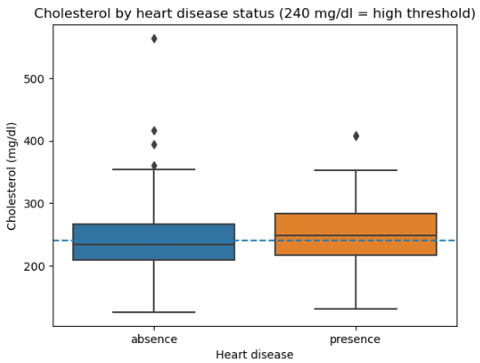
Benchmarks / thresholds – cholesterol vs 240 mg/dl
Question: For each subgroup (yes_hd, no_hd), is mean cholesterol significantly greater than 240 mg/dl (the “high cholesterol” threshold)?
Results:
  Heart disease (presence): Mean cholesterol 251.47 mg/dl (+11.47 above 240);
  one-sample t-test vs 240
  p(one-sided)=0.0035 → significantly higher!
  No heart disease (absence): Mean cholesterol 242.64 mg/dl (+2.64 above 240);
  one-sample t-test vs 240
  p(one-sided)=0.264 → not significantly higher.
Conclusion: In this sample, only the heart disease group shows evidence that average cholesterol exceeds the “high cholesterol” threshold.
Notes:
Cholesterol finding (mean + t-test p + boxplot + 240 line)

Slide 4
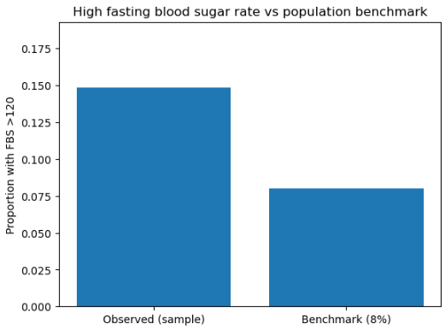
Benchmarks / thresholds – fasting blood sugar (fbs) vs 8% population benchmark
Question: Is the rate of FBS >120 mg/dl in this sample consistent with an 8% population baseline (1988), or is it higher?
Results:
  High FBS (>120): 45 patients → 14.85% (45/303)
  Expected at 8%: ~24 patients (0.08 × 303)
  Binomial test (H1: rate > 8%): p = 4.69e−05 → significantly higher!
Conclusion: This clinical sample shows an elevated high-FBS rate compared to the 8% benchmark (expected ~24, observed 45), suggesting this clinical sample is not representative of the general population (from 1988) on this metric.
observed 45 vs expected 24
Notes:
FBS finding (14.85% vs 8% + binomial p + bar chart)

Slide 5
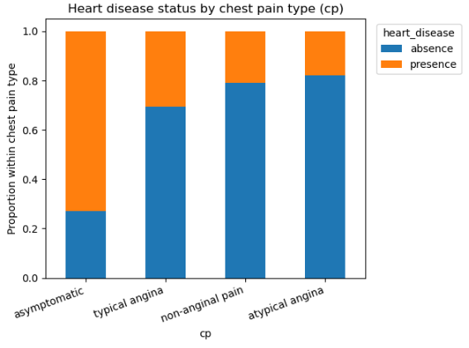
Symptom + exercise signals – kind of chest pain vs heart disease
Question: Is chest pain type (cp) associated with whether a patient will ultimately be diagnosed with heart disease?
Results (contingency table + χ² test):
  Yes, chest pain type and heart disease diagnosis are significantly associated in this sample
    Chi-square test: p = 1.25e−17 → statistically significant association!
  Among all cp types, asymptomatic patients show the highest heart disease count: 105 presence vs 39 absence (105/144 = 72.9% presence). Other pain types skew toward absence (e.g., atypical angina: 9/50 = 18% presence).
Conclusion: Chest pain type is strongly associated with heart disease diagnosis; in this sample, asymptomatic patients are much more likely to be diagnosed with heart disease.
Notes:
Chest pain & thalach (boxplot by cp + Tukey takeaway: asymptomatic lowest)

Slide 6
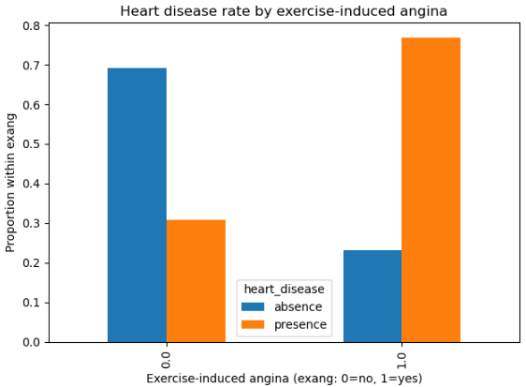
Symptom + exercise signals – exercise-induced angina vs heart disease
Question: Is exercise-induced angina (exang) associated with whether a patient will ultimately be diagnosed with heart disease?
Results (2×2 contingency table + χ² test):
  No exercise-induced angina (exang = 0): 30.9% (63/204) diagnosed with heart disease
  Exercise-induced angina present (exang = 1): 76.8% (76/99) diagnosed with heart disease
  Chi-square test of independence: p = 1.41e−13 → significant association
Conclusion: Exercise-induced angina is a strong indicator in this sample: patients experiencing exercise-induced angina (exang=1) are much more likely to have heart disease.
Notes:
exang & diagnosis (stacked bar + chi-square p)

Slide 7
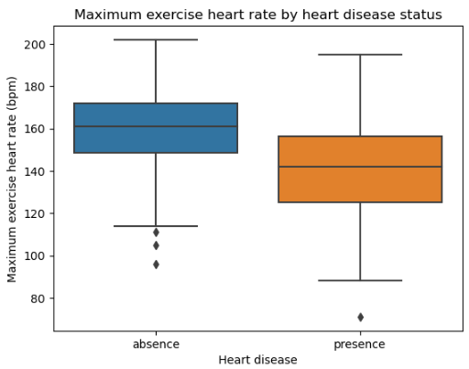
Symptom + exercise signals – maximum exercise heart rate vs heart disease
Question: Is maximum exercise heart rate (thalach) associated with whether or not a patient will ultimately be diagnosed with heart disease?
Results:
  Patients with heart disease reached a lower max heart rate, ~19 bpm lower on average :
    Mean difference: −19.12 bpm; median difference: −19.0 bpm
    Two-sample t-test: p = 3.46e−14 → statistically significant!
Conclusion: Patients diagnosed with heart disease achieve a substantially lower maximum heart rate during the exercise test (≈ 19 bpm lower).
Notes:
Thalach finding (~−19 bpm + test p + boxplot)

Slide 8
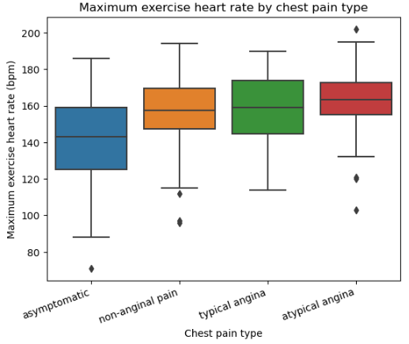
Symptom + exercise signals – maximum exercise heart rate by chest pain type
Question: a) Do patients with different chest pain have the same average maximum exercise heart rate (thalach), or does at least one chest pain group have a different average thalach? b) If so, which of those pairs are significantly different?
Results a) (4-group comparison):
  Side-by-side- boxplots show clear differences in typical thalach across cp categories (asymptomatic appears lowest).
    One-way ANOVA: p = 1.91e−10 → at least one pair of chest pain types has a different mean thalach.
Results b) (Tukey HSD, FWER=0.05):
  Asymptomatic vs atypical angina: +21.74 bpm (p-adj < 0.001) → significant
  Asymptomatic vs non-anginal pain: +14.73 bpm (p-adj < 0.001) → significant
  Asymptomatic vs typical angina: +15.28 bpm (p-adj = 0.0081) → significant
  All other pairwise comparisons: not significant (p-adj ≥ 0.248)
Conclusion: a) People with typical angina, non-anginal pain, atypical angina, and asymptomatic people do not all have the same average thalach. b) The overall difference is driven by the asymptomatic group, which has a significantly lower mean thalach than each of the other chest pain types; the other three types have similar average thalach.
Notes:
Chest pain & diagnosis (stacked bar + chi-square p=1.25e−17)

Slide 9
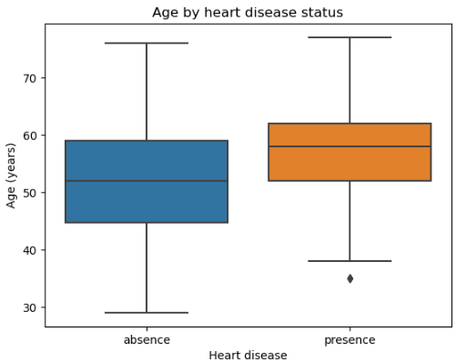
Demographics/vitals – age vs heart disease
Question: Is age associated with whether a patient will ultimately be diagnosed with heart disease?
Results (group comparison + Welch t-test):
  With heart disease (presence): mean age 56.6 years (median 58)
  Without heart disease (absence): mean age 52.6 years (median 52)
    Difference: +4.0 years on average (+6 years at the median)
  Welch t-test: p = 7.06e−05 → statistically significant
Conclusion: In this sample, heart disease is significantly associated with older age; the diagnosed group is several years older on average.
Notes:
age & diagnosis (boxplot + t-test p + mean diff)

Slide 10
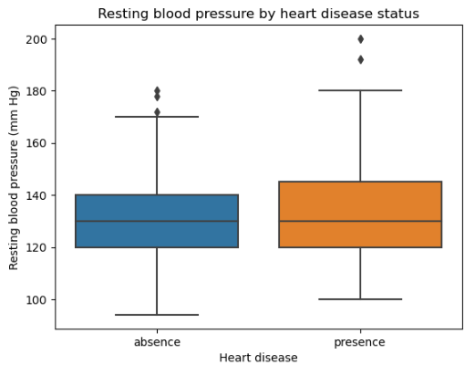
Demographics/vitals – resting blood pressure vs heart disease
Question: Is resting blood pressure (trestbps) associated with whether a patient will ultimately be diagnosed with heart disease?
Results:
  Resting BP is higher in the heart disease group by about +5.32 mm Hg on average
    Mean difference +5.32; median difference 0.0
    Two-sample t-test: p = 0.00855 → statistically significant!
Conclusion: Resting blood pressure shows a small but significant association with heart disease; the average is higher in the heart disease group, though the median is unchanged.

Slide 11
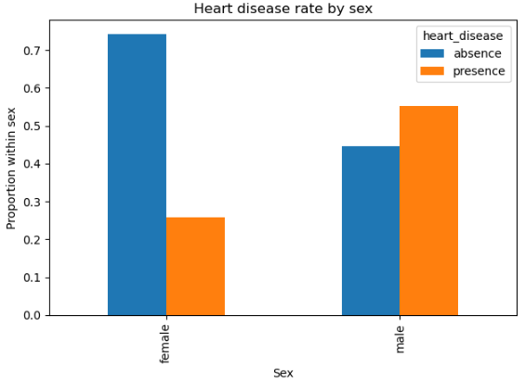
Demographics/vitals – sex vs heart disease
Question: Is sex associated with whether a patient will ultimately be diagnosed with heart disease?
Results (2×2 table + χ² test):
  Female: 25.8% (25/97) diagnosed with heart disease
  Male: 55.3% (114/206) diagnosed with heart disease
  Chi-square test: p = 2.67e−06 → statistically significant association
Conclusion: In this clinical sample, males are more likely to be diagnosed with heart disease than females.
Notes:
age & diagnosis (boxplot + t-test p + mean diff)

Slide 12
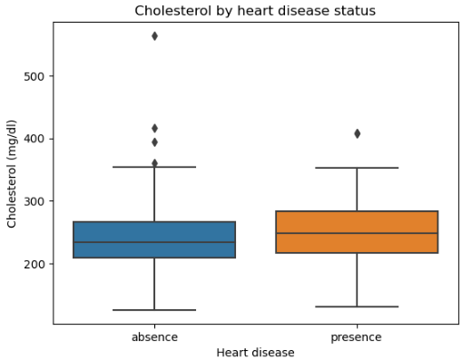
Demographics/vitals – cholesterol vs heart disease
Question: Is cholesterol (chol) associated with whether a patient will ultimately be diagnosed with heart disease?
Results:
  Cholesterol is higher in the heart disease group, but the difference is modest
    Mean difference +8.83 mg/dl; median difference +14.5 mg/dl.
    Two-sample t-test: p = 0.137 → not statistically significant
Conclusion: In this sample, cholesterol is not a strong discriminator between heart disease vs no heart disease (despite being above the 240 mg/dl threshold within the heart disease group(see slide 3)).

Slide 13
Key takeaways
Symptom + exercise signals are the strongest markers: chest pain type (χ² p = 1.25e−17) and exercise-induced angina (HD rate 76.8% vs 30.9%, χ² p = 1.41e−13) show large separation.
Exercise capacity differs strongly by diagnosis: patients with heart disease reached ~19 bpm lower max exercise heart rate (p = 3.46e−14).
Demographics/vitals add signal: heart disease patients are older (+4 years mean; p ≈ 7.06e−05) and have slightly higher resting BP (+5.3 mmHg; p = 0.0086).
Lab tests tell a nuanced story: heart-disease group‘s mean cholesterol is >240 (threshold test), but cholesterol is not a strong between-group discriminator (two-sample p ≈ 0.137). High FBS is elevated vs 8% benchmark (14.85% vs 8%, p = 4.69e−05).
Notes:
Key takeaways + limitations + “what next”

Slide 14
Recommendations Limits
For quick screening in similar clinical settings, prioritize symptom/exercise indicators: cp, exang, and thalach (largest separations).
Use age + resting BP as supportive risk context.
Continue monitoring metabolic risk (chol, FBS) even if they’re weaker discriminators here – they matter for prevention and overall cardiovascular risk.
Not a general-population sample (clinic evaluation cohort): rates (e.g., FBS) won’t match population baselines.
Associations ≠ causation; unmeasured confounders (meds, comorbidities, lifestyle) may drive patterns.
Some subgroups are small (e.g., typical angina), and multiple comparisons can inflate false positives (Tukey helps for cp–thalach pairs).
Notes:
Key takeaways + limitations + “what next”

