Slide 1


Airline Travel safety: DEMYSTIFYING THE FACTS A Comparative Analysis with Road Accidents
Rojan Khatri
Bellevue University

Slide 2

INTRODUCTION
Objective
Addressing concerns and presenting data-driven insights to reinforce the safety of airline travel.
Overview
Providing an analysis of airline safety data compared to road accidents, highlighting key findings and statistics.
Importance
Countering negative media coverage and promoting informed decision-making.

Slide 3
Dataset Overview
Fatality Analysis Reporting System(FARS)
Airline Accident Data
A supplemental dataset incorporated from National Transportation Safety Board (NTSB). It covers a wide range of variables related to accidents and incidents within the aviation industry.
This dataset is provided by the National Highway Traffic Safety Administration (NHTSA) and contains comprehensive information on road accidents in the United States. FARS captures data on fatal crashes, including details on the number of fatalities and other relevant variables.

Slide 4
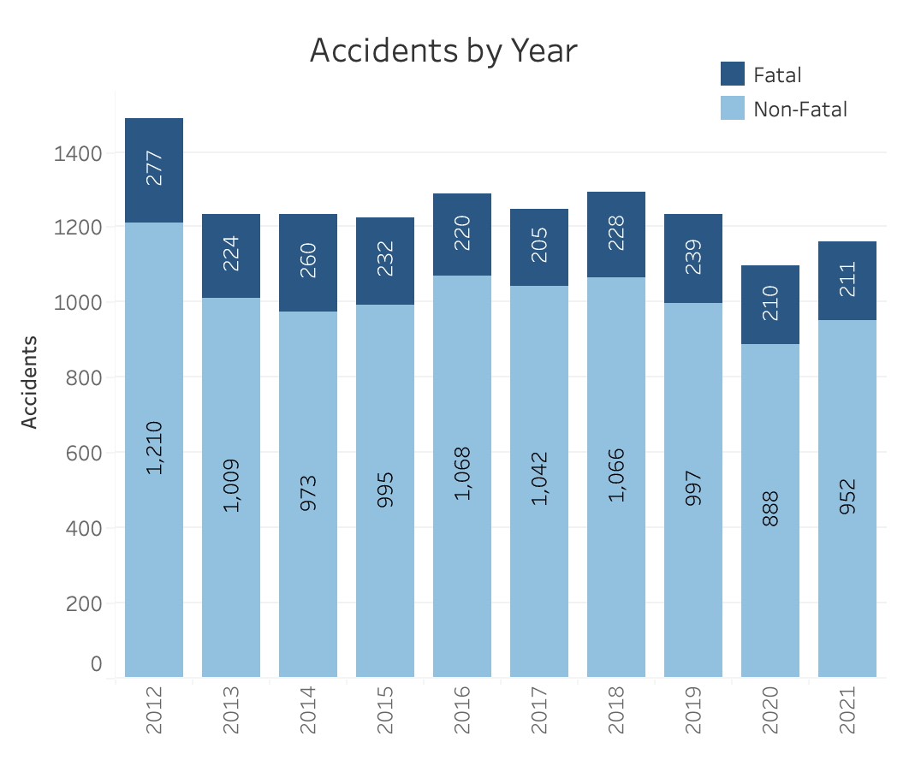
Airline Accidents By Year
Trends in Fatal Accidents
Relatively consistent pattern with some variations throughout the years.
Highest number of fatal accidents in 2012 with 277 incidents, while the lowest number was recorded in 2020 with 210 incidents.
Despite some fluctuations, no clear upward or downward trend.
Trends in Non-Fatal Accidents
Similar pattern, with slight variations from year to year.
The highest number of non-fatal accidents was recorded in 2012 with 1,210 incidents, and lowest number was observed in 2020 with 888 incidents.
Like fatal accidents, there is no significant trend indicating a consistent increase or decrease.
Overall Safety
The number of airline accidents, both fatal and non-fatal, remains relatively low in comparison to the total number of flights.

Slide 5
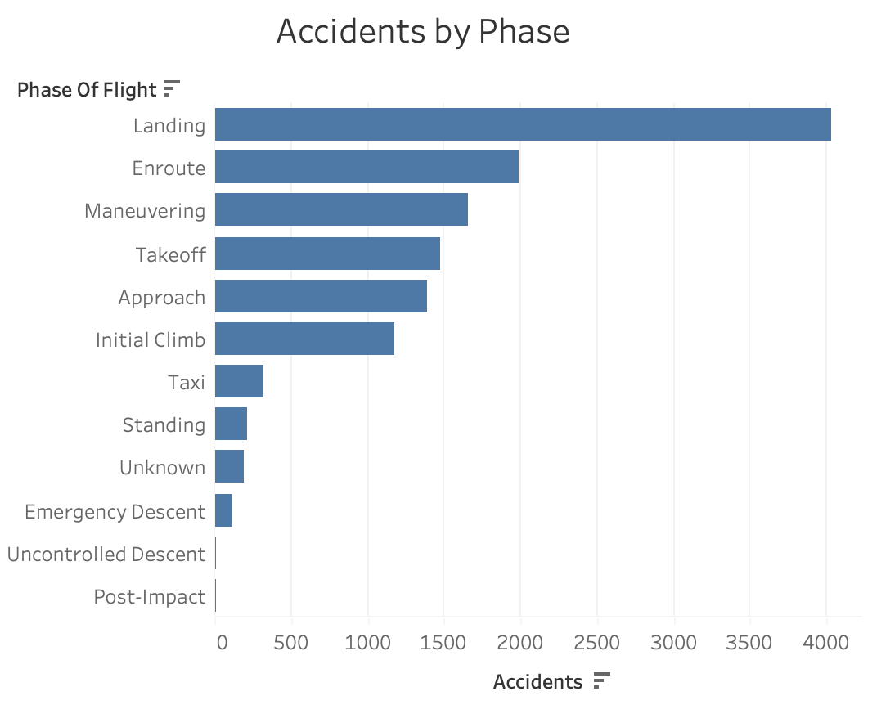
Airline Accidents By Phase of Flight
The data provided represents the distribution of airline accidents by the phase of flight
Landing phase has the highest number of recorded accidents with 4,032 incidents, emphasizing the importance of focused safety measures during this critical stage.
Enroute phase follows closely with 1,989 accidents, highlighting the need for continuous monitoring and risk mitigation during cruising altitude.
Takeoff phase recorded 1,475 accidents, indicating the significance of meticulous procedures and attention to detail during the initial stages of flight.
Approach phase experienced 1,385 accidents, underscoring the need for precision and vigilance during the final stages of landing.
Other phases, including energy descent, initial climb, and maneuvering, also had reported accidents, though at lower frequencies compared to landing, enroute, and takeoff.

Slide 6
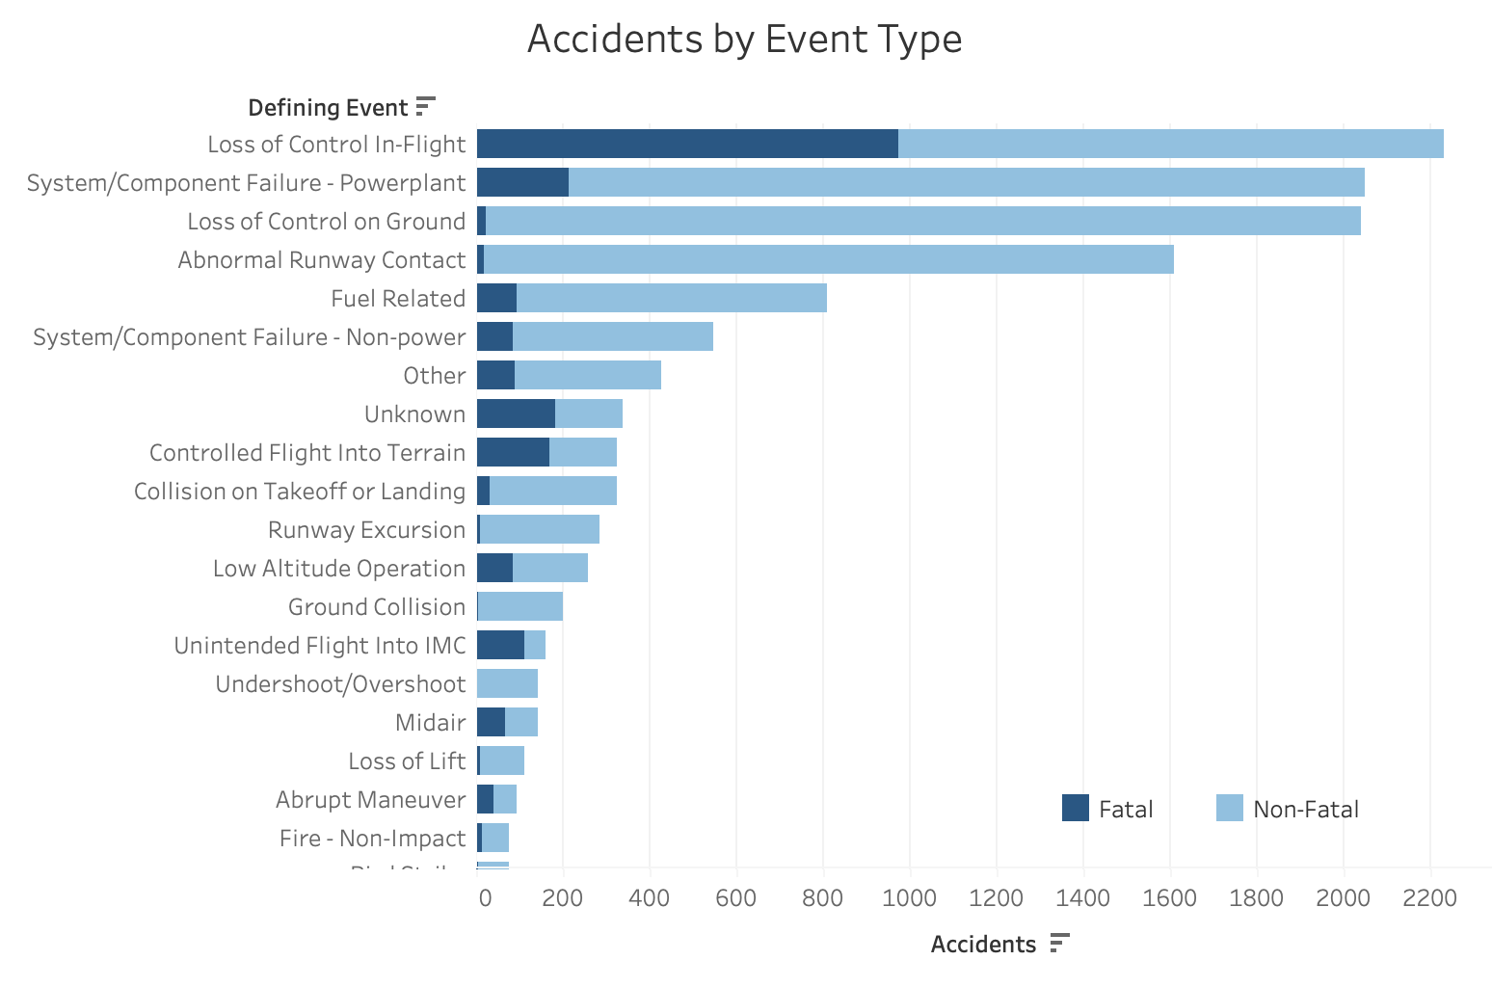
Airline Accidents By Phase of Flight
The data provided represents the distribution of airline accidents by the event type.
Loss of control in-flight accidents accounted for the highest number of fatalities, with 976 recorded incidents, highlighting the criticality of maintaining control during flight.
Collision on takeoff or landing accidents resulted in 33 fatalities, emphasizing the need for enhanced runway safety and collision avoidance measures.
Fires, both non-impact and post-impact, were reported to have caused fatalities, with 14 and 1 incidents respectively, underlining the importance of fire prevention and response protocols.
System/component failures, both in the powerplant and non-power systems, were responsible for a significant number of fatal accidents, with 214 and 86 incidents respectively, indicating the necessity for robust maintenance and monitoring procedures.

Slide 7
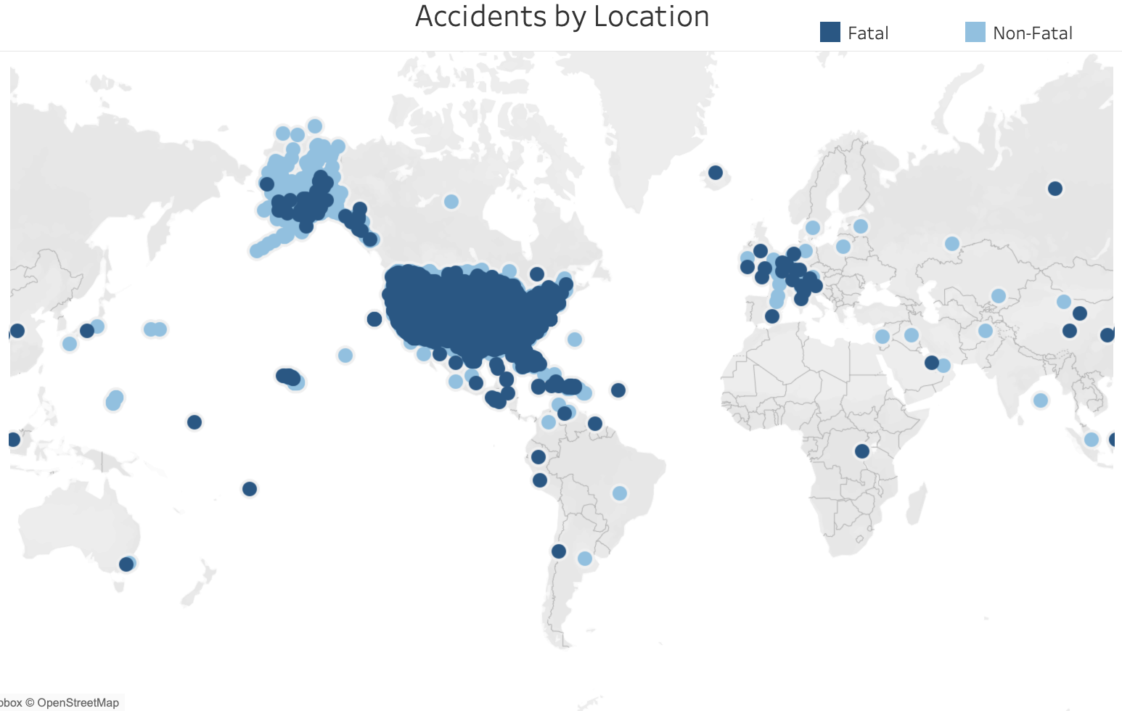
Airline Accidents By Region
The United States accounted for a staggering 98.6% of all recorded airline accidents, with a total of 12,293 incidents, indicating the highest concentration of accidents among the regions.
France reported the second-highest number of accidents, with 22 recorded incidents, highlighting a significant difference compared to the United States.
The Bahamas and Mexico both had 22 and 21 accidents respectively, showing a relatively lower frequency of accidents compared to the United States and France.
The data emphasizes the dominance of the United States in terms of airline accidents, with a disproportionately higher number of incidents compared to other regions.

Slide 8
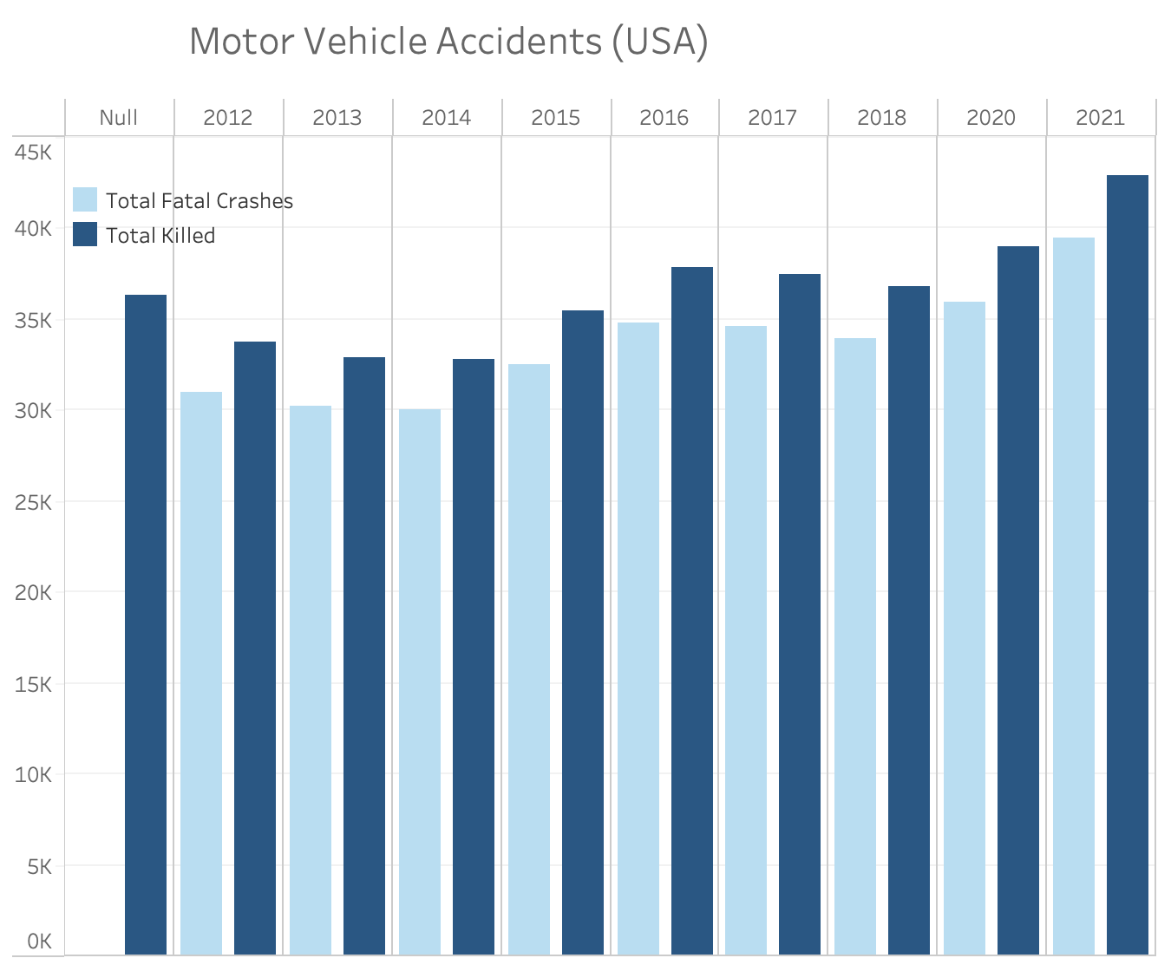

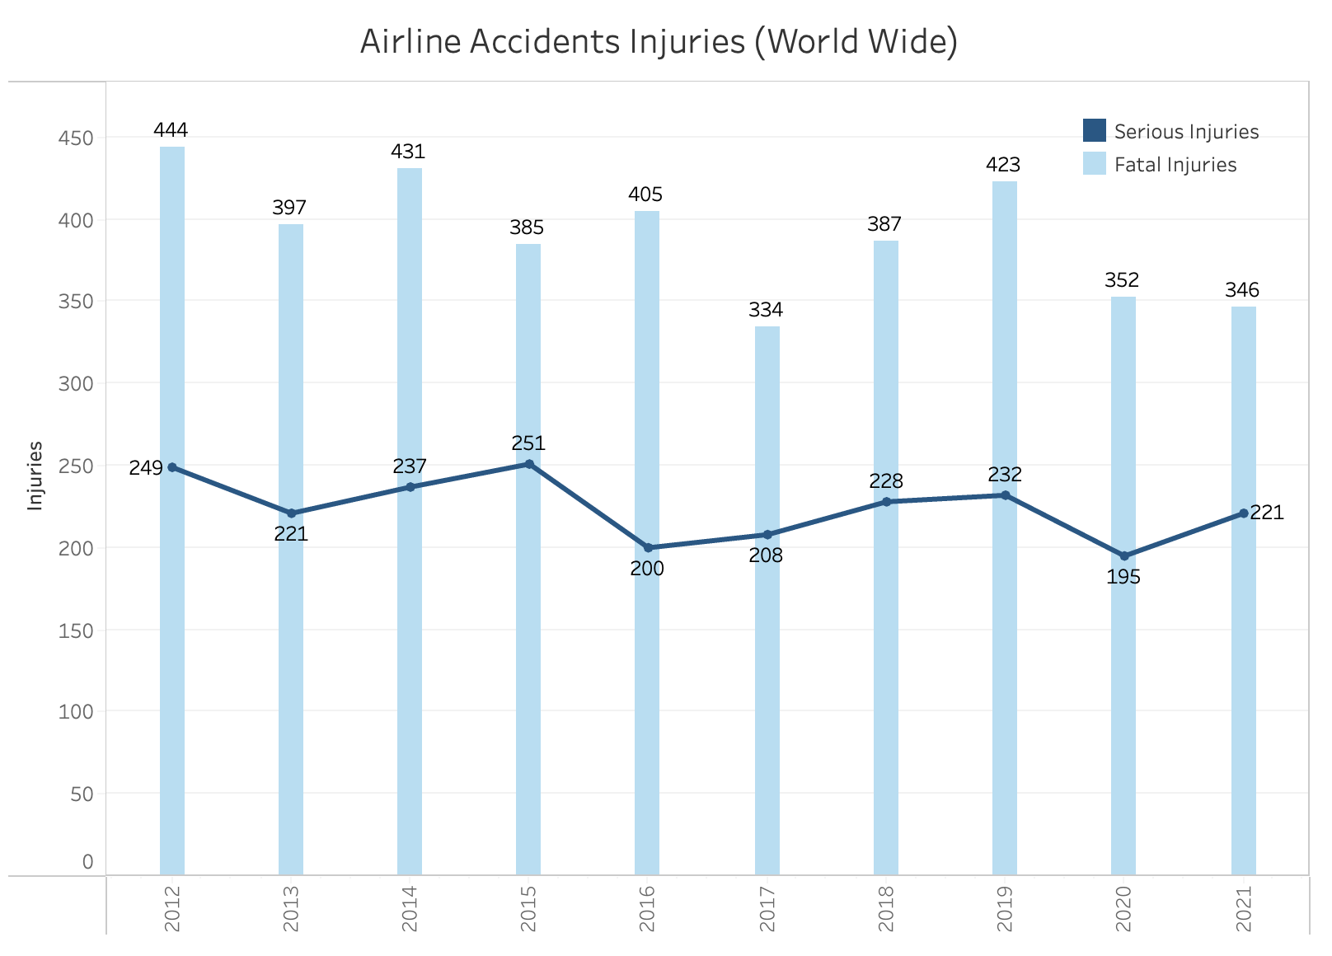
Comparative Analysis: Airline vs. Road Accidents
The focus on motor vehicle incidents in the United States is justified by the fact that 98.6% of the airline incidents in the dataset occurred within the United States. This comparison allows us to examine the contrast between the two major transportation modes within the same geographical region.
In terms of fatalities, road accidents caused significantly more deaths, with a total of 429,39 fatalities compared to 346 fatalities in airline incidents.
However, when considering the frequency of accidents, road accidents were more prevalent, with an average of 71,770 incidents per year compared to an average of 215 airline incidents per year.
While road accidents had a higher overall fatality rate, airline incidents had a higher fatality rate per incident, with an average fatality rate of 1.6% compared to 0.4% for road accidents.

Slide 9

Conclusion
The United States dominates in terms of airline accidents, accounting for 98.6% of all incidents suggesting the need for comprehensive safety measures and continuous improvement efforts within the country
The analysis reveals a consistently low number of airline accidents compared to road accidents, emphasizing the superior safety of airline travel.
Airline travel continues to maintain a high level of safety, with a remarkably low frequency of accidents compared to road incidents.
The findings have significant implications for internal decision-making within the aviation industry, highlighting the success of existing safety measures and the importance of maintaining a strong safety culture.
The data also provides valuable insights for combating negative media coverage and addressing public perceptions. By emphasizing the consistently low number of airline accidents, the industry can reassure the public about the safety of air travel and maintain public trust.
The analysis underscores the fact that airline travel is a significantly safer mode of transportation compared to road travel, as evidenced by the disproportionately higher number of road accidents and fatalities.
The implications of these findings extend beyond the aviation industry, emphasizing the need for continued efforts in road safety measures to reduce the frequency and severity of road accidents.

Slide 10

Thank You

