Slide 1

NFL game arrest
Rojan Khatri
DSC-530
Bellevue University

Slide 2
Outline
Introduction
Data Source
Histogram
Correlation Matrix
Summary

Slide 3
Introduction
NFL is more than just sports in USA . The game day holds special place for fans and loyalty stays even when they move out of city or state. Sometime fans take it to next level and start fighting and get in trouble when their team underperform. Everyone one wants to enjoy the game but at times you hear about the brawl, stabbing and shooting happening during NFL games. This dataset consists of public records requests made by the Washington Post to police departments that oversee security at each NFL stadium. The main dataset includes fields such as the day of the week, which teams were playing on which home field, and the score of the game, between 2011 and 2015.
Interest:
Are the arrest likely to increase if home team lost the game?
Does the number of arrest increase during divisional games ?
Does the number of arrest increase as the season progress?
Challenges:
Not all the teams reported data for analysis.
Each team play divisional opponents twice other than that no guarantees team play against each other.
No proof that arrests are entirely game related.

Slide 4
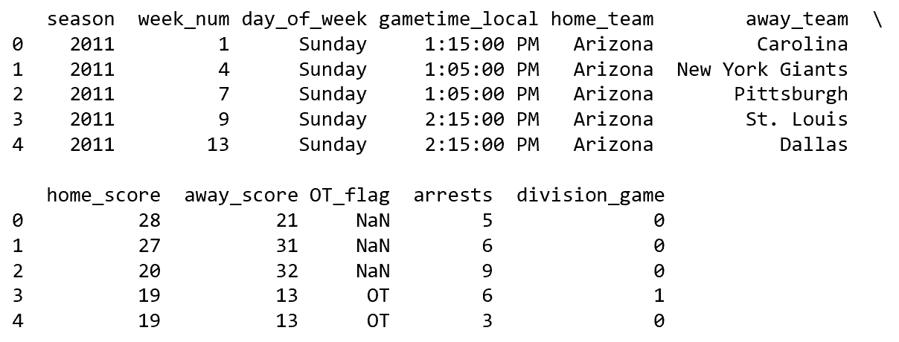
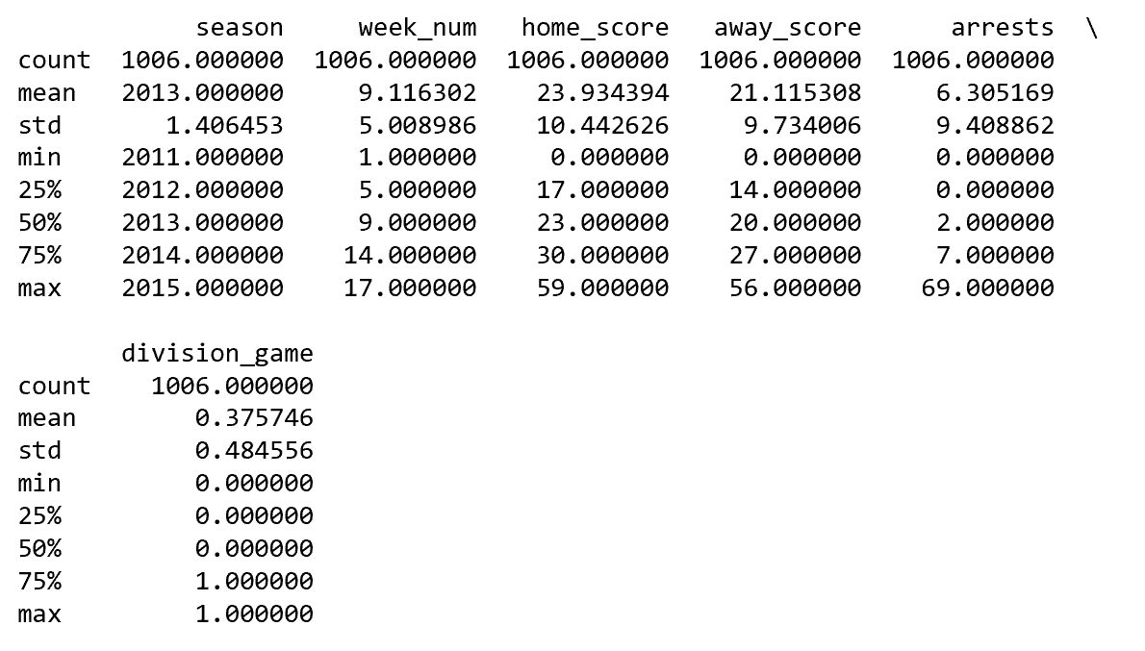
Data Source
Data source

Slide 5
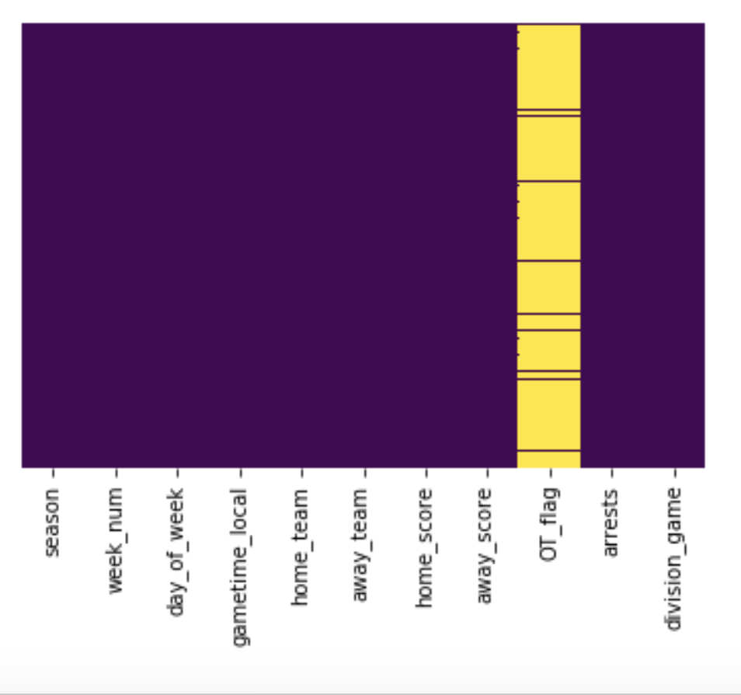
Tidying Data
NA only present in OT flag.
NOT used this variable for analysis.

Slide 6
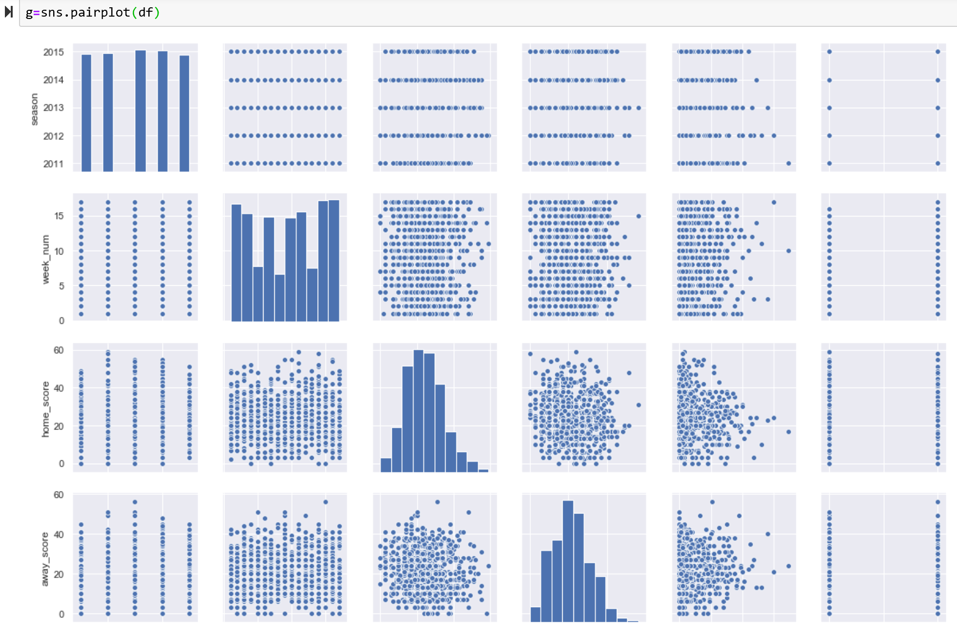
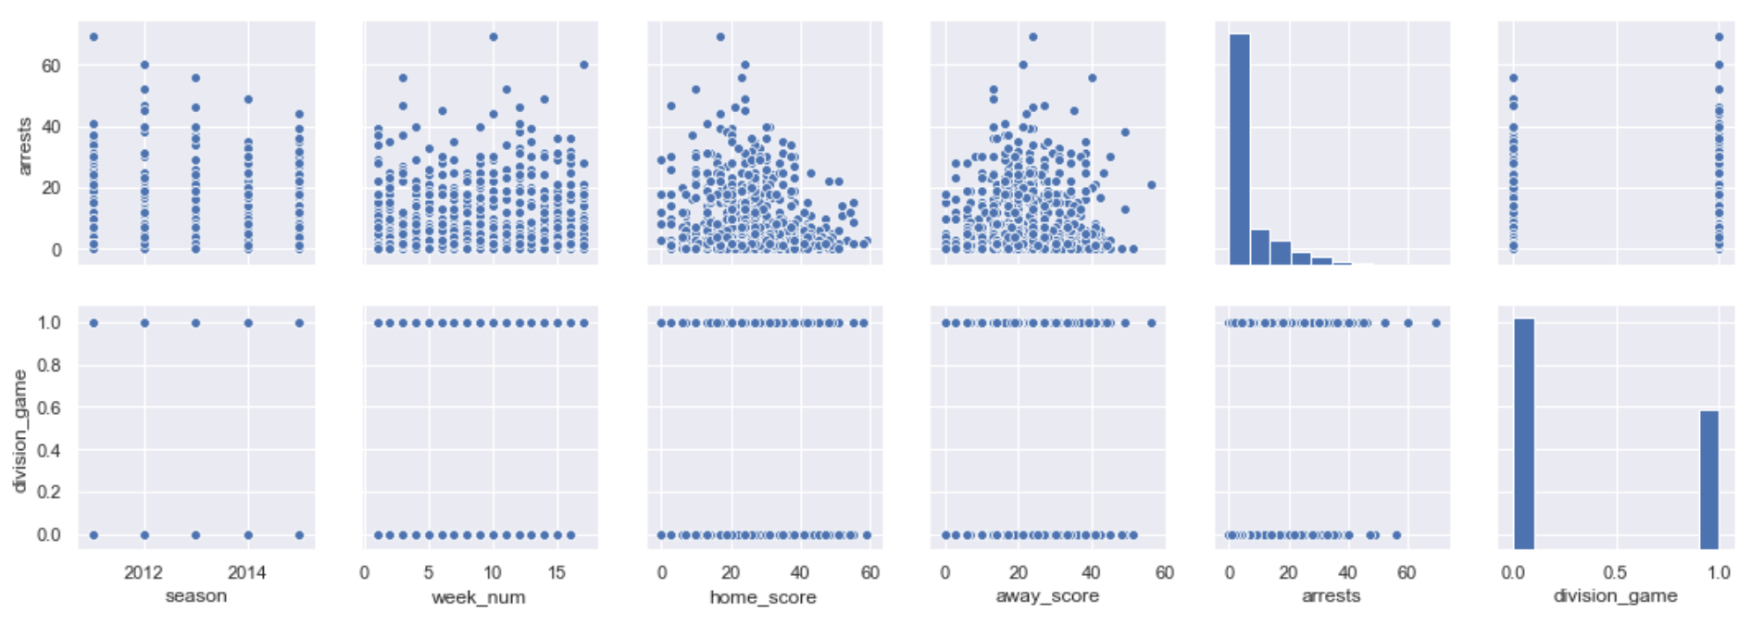
Histogram

Slide 7
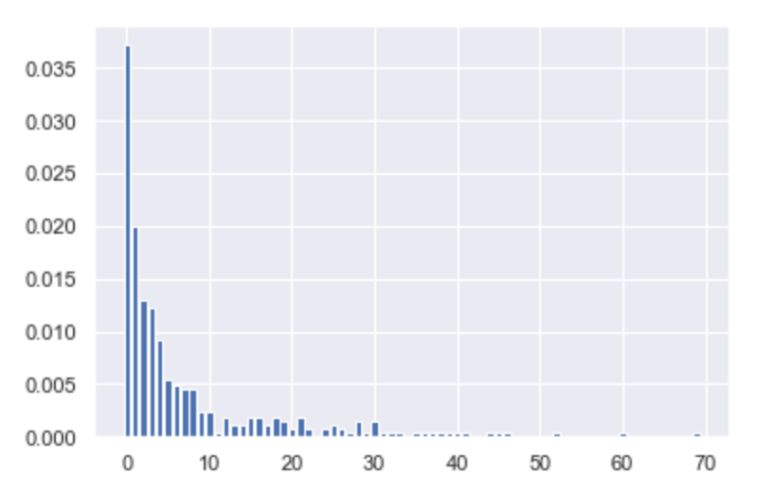
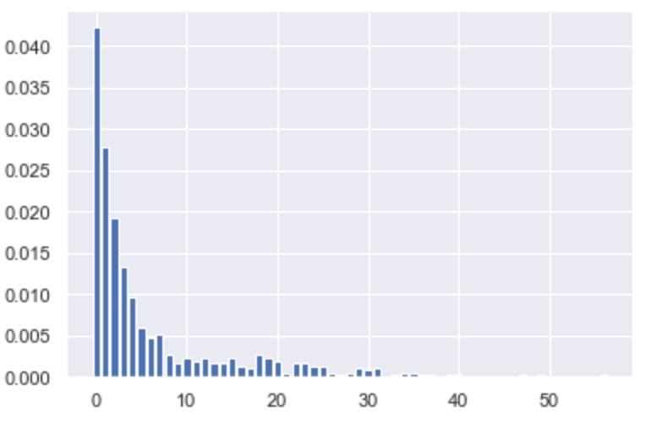
PMF Comparison
PMF for Divisional Games
PMF for Non-Divisional Games

Slide 8

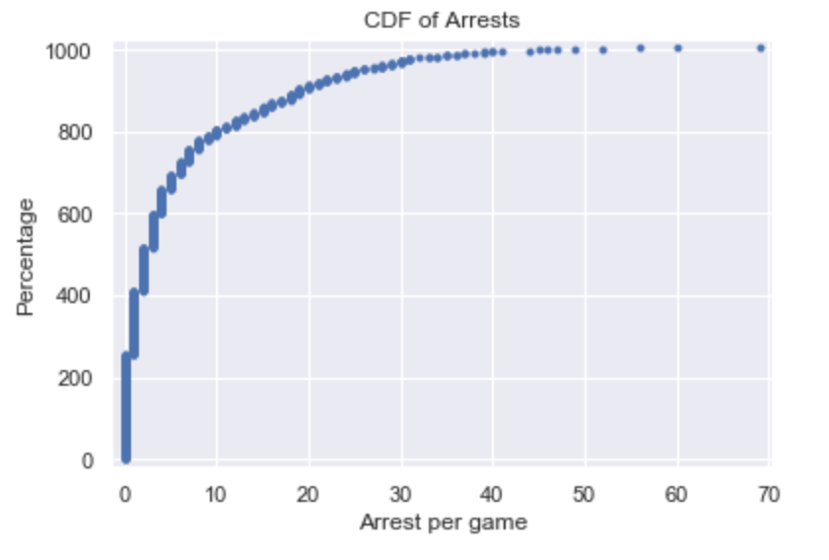
CDF of NFL arrests

Slide 9
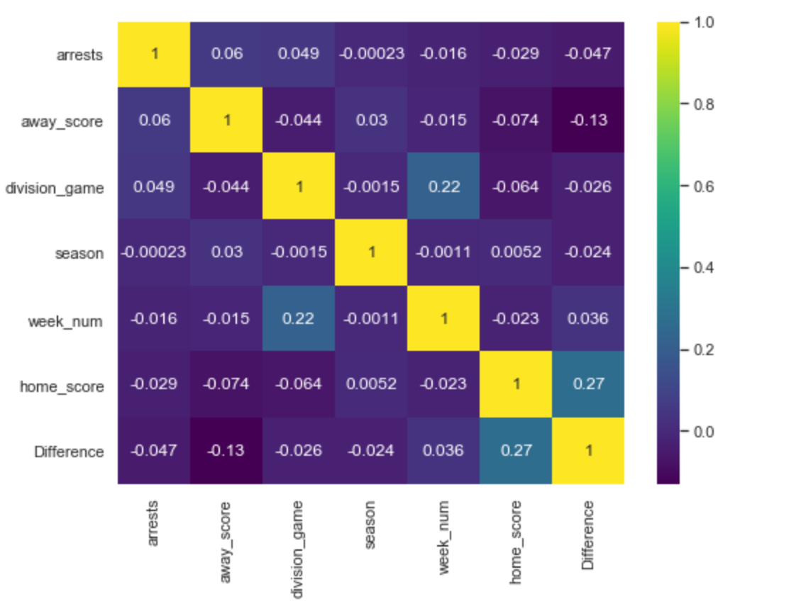
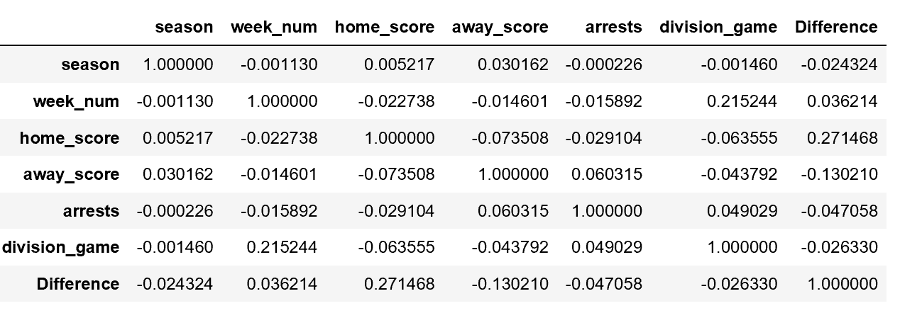
Correlation Matrix

Slide 10

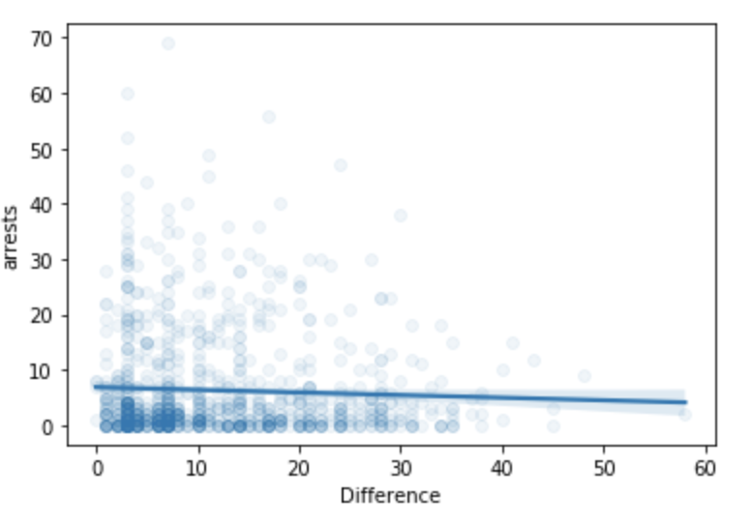
Correlation Difference vs. arrests
Correlation = -0.047
Spearman Rank Correlation Coefficient -0.009
Chi-square Statistics 1874.492 p-value 1.000
P value is 1, which suggests that variables are independent of each other.
It proves null hypothesis and variables are not correlated.

Slide 11
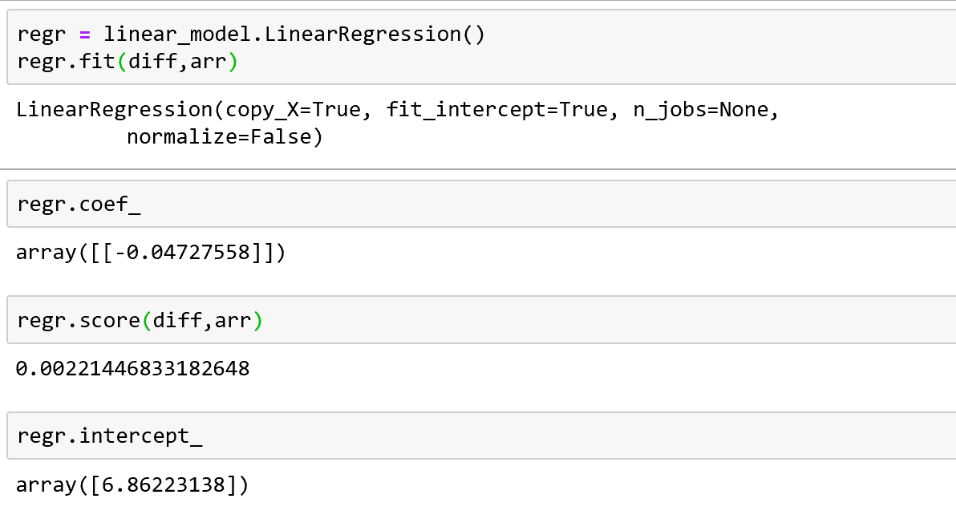
Linear Regression

Slide 12
Conclusion
There seemed to be strong correlation between the score difference and the number of arrest but while calculating linear regression the score was only 2.2% which would not be efficient model to predict the number of arrest based on the score difference. More analysis needs to be conducted to create model to predict the number of arrest. Possibly combining the categorical variable divisional game and difference might be able to predict the number of arrests.

