Slide 1
MACHINE LEARNING TRAINING
Ensemble Learning
& Gradient Boosting
From majority voting to XGBoost — the theory behind the notebooks
2 sessions · 4 hours · hands-on Colab notebooks
Notes:
Welcome. Two sessions: ensembles today, boosting and XGBoost next. Everything on these slides has a runnable cell in the Colab notebooks.

Slide 2
What we'll cover
Two sessions, one continuous story: how to make many weak models into one strong one
SESSION 1
SESSION 2
Ensemble Learning Methods
XGBoost & Gradient Boosting
Why ensembles work at all
Bias, variance and the decision tree
Voting · Bagging · Random Forest
Extra Trees · AdaBoost · Stacking
Choosing the right ensemble
Gradient boosting from first principles
Gradient descent in function space
What XGBoost changed, and why
Early stopping & hyper-parameters
Imbalance, interpretation, pitfalls
Notes:
Session 1 builds intuition with parallel ensembles. Session 2 goes deep on sequential ones. The second half of each session is the notebook.

Slide 3
01
Ensemble Learning Methods
Many models, one answer

Slide 4
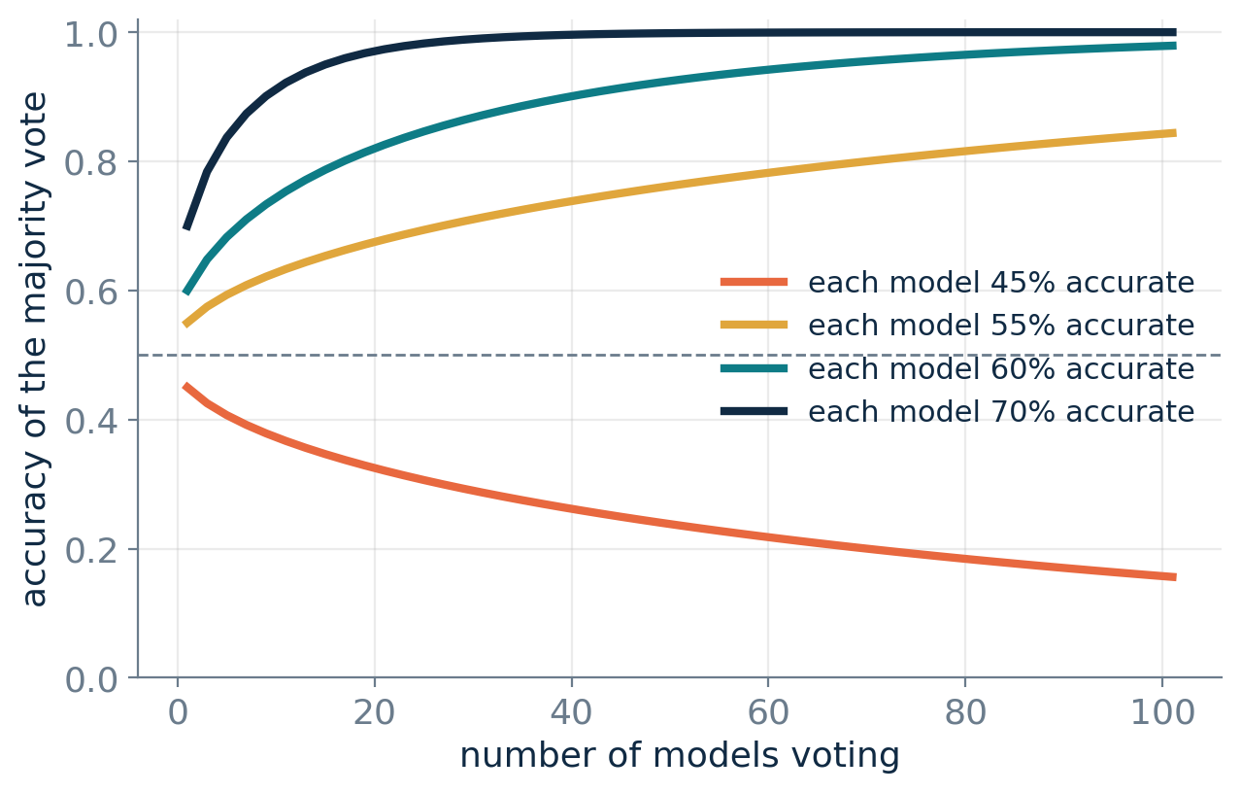
THE CORE IDEA
A crowd beats an expert — under one condition
If each model is better than a coin flip
Majority voting drives the ensemble's accuracy towards 100% as you add more members.
If each model is worse than a coin flip
Voting drives accuracy towards 0%. Averaging bad models makes things worse, not better.
100 models that are each 60% right vote their way to ~98% accuracy.
Notes:
Condorcet's Jury Theorem, 1785. The key word in the whole slide is *independent* — the next slide is about why that word is the hard part.

Slide 5
THE CATCH
Real models make the same mistakes
So every ensemble method is an answer to one question: how do I make my models disagree usefully?
1
Voting
2
Bagging
3
Random Forest
Use genuinely different algorithms — tree, SVM, kNN, logistic regression.
Give each model a different random sample of the ROWS.
Different rows AND a random subset of COLUMNS at every split.
4
Extra Trees
5
Boosting
6
Stacking
Rows, columns, and random split thresholds too.
Train each model on what the previous ones got WRONG.
Let a meta-model learn whom to trust, and when.
Notes:
Frame the rest of session 1 with this slide — each method is just a different diversity engine.

Slide 6
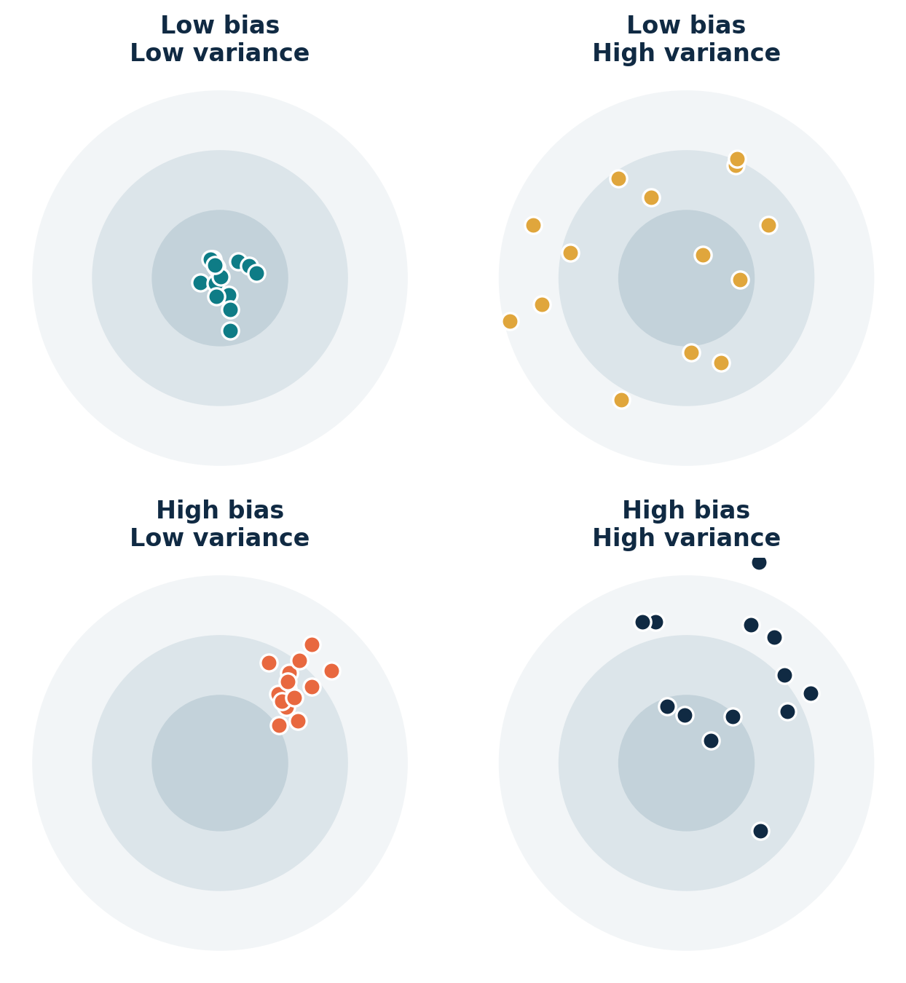
FOUNDATION
Bias and variance — the map you navigate by
Error = Bias² + Variance + Noise
BIAS — wrong assumptions
The model is too simple to capture the pattern. It is wrong in the same way every time. A tree stump has high bias.
VARIANCE — sensitivity to the data
Change a few training rows and the model changes completely. A fully-grown decision tree has high variance.
Bagging attacks variance. Boosting attacks bias.
Notes:
This one slide decides which family you reach for. Deep overfitting base models -> bag them. Shallow underfitting base models -> boost them.

Slide 7
THE BUILDING BLOCK
Why almost every ensemble is built from trees
✓
Strengths
✗
Weaknesses
Cheap and fast to train
Handle numeric + categorical together
Capture non-linearity and interactions
No scaling or normalisation needed
Robust to outliers in the inputs
Very high variance — unstable
Poor at smooth or linear relationships
Cannot extrapolate beyond the data seen
A deep tree memorises its training set
One tree alone rarely wins anything
The weakness on the right is exactly what bagging feeds on.

Slide 8
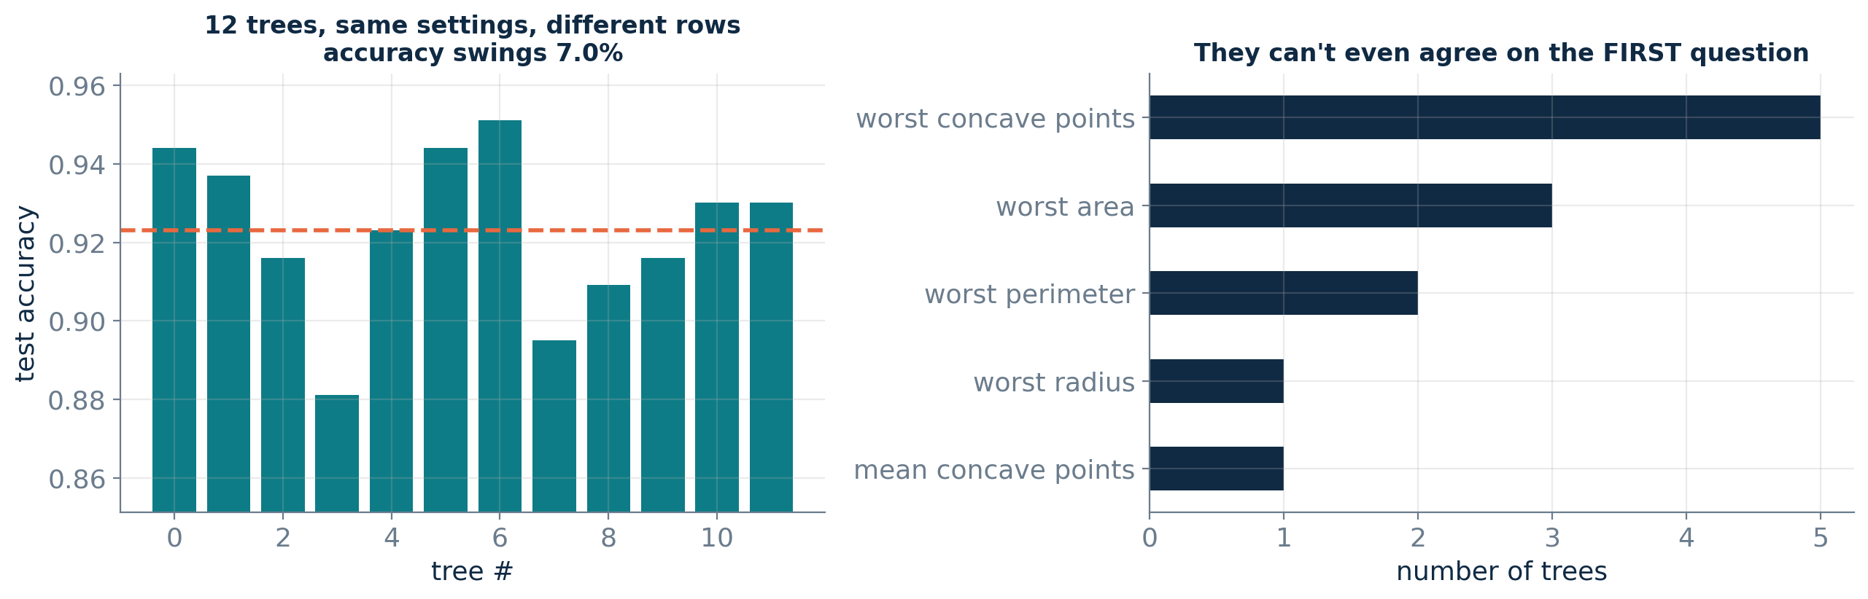
THE MOTIVATION
The same algorithm, twelve different answers
Twelve trees, identical settings — only the training rows differ
Individually this instability is a bug. Collectively, it is exactly the diversity an ensemble needs.
Notes:
Ask the room: which feature is 'most important' here? The trees disagree on the very first question. That's variance you can average away.

Slide 9
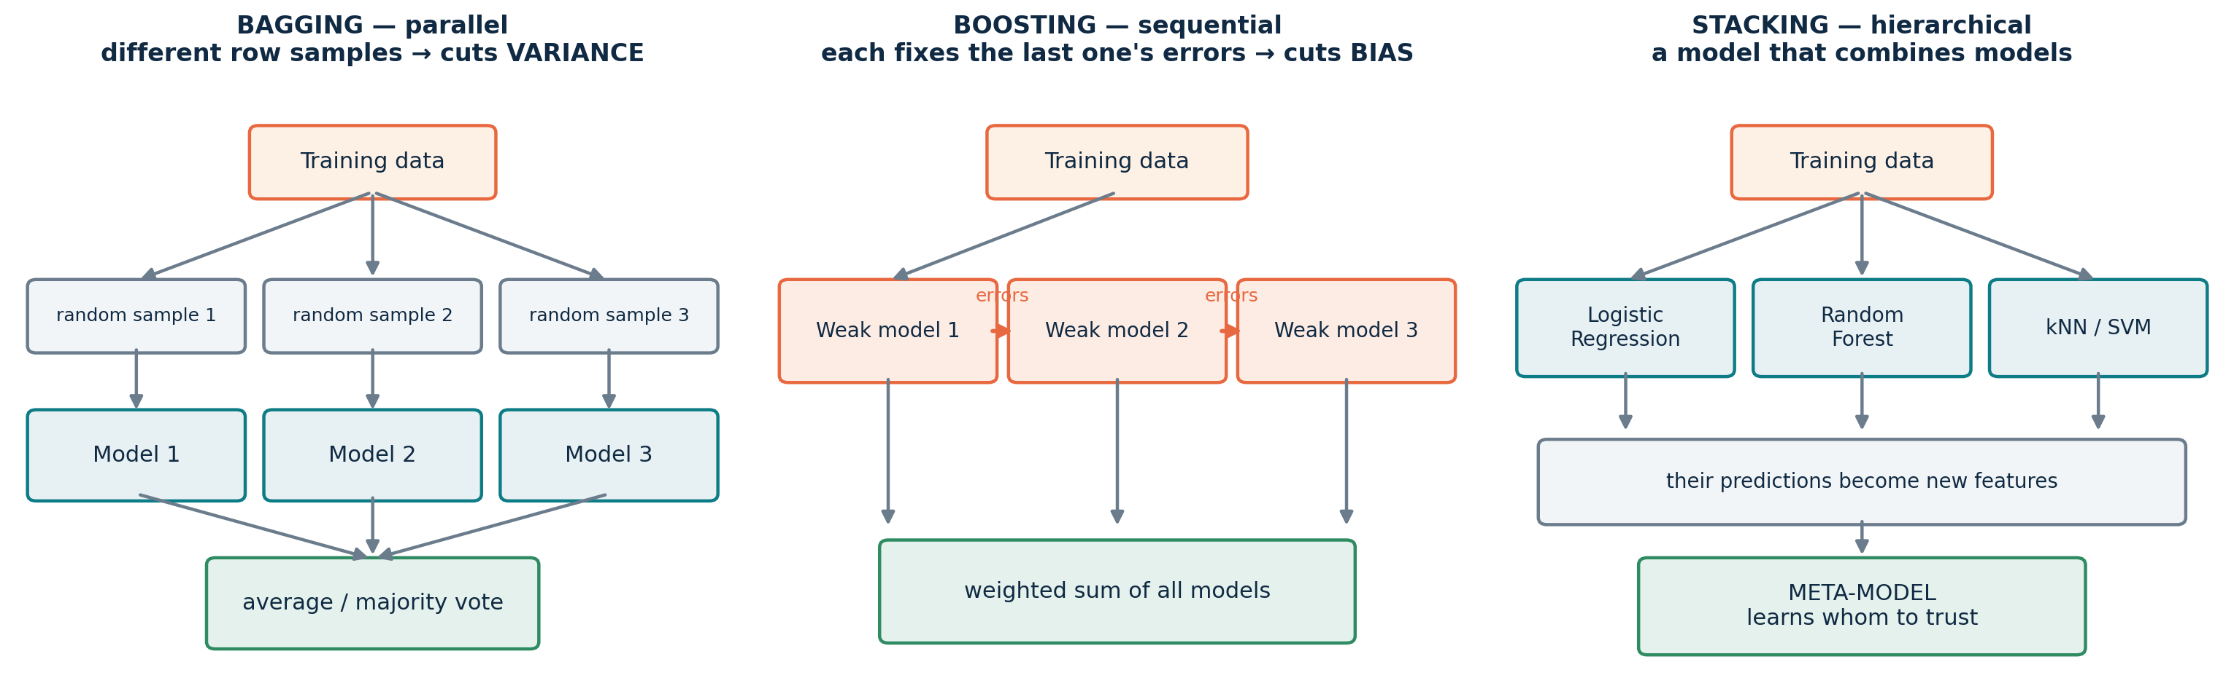
THE MAP
Three ways to combine models
Bagging trains in parallel · Boosting trains in sequence · Stacking trains a model on top of models
Notes:
Come back to this slide at the end of each method. Everything in both sessions lives in one of these three columns.

Slide 10
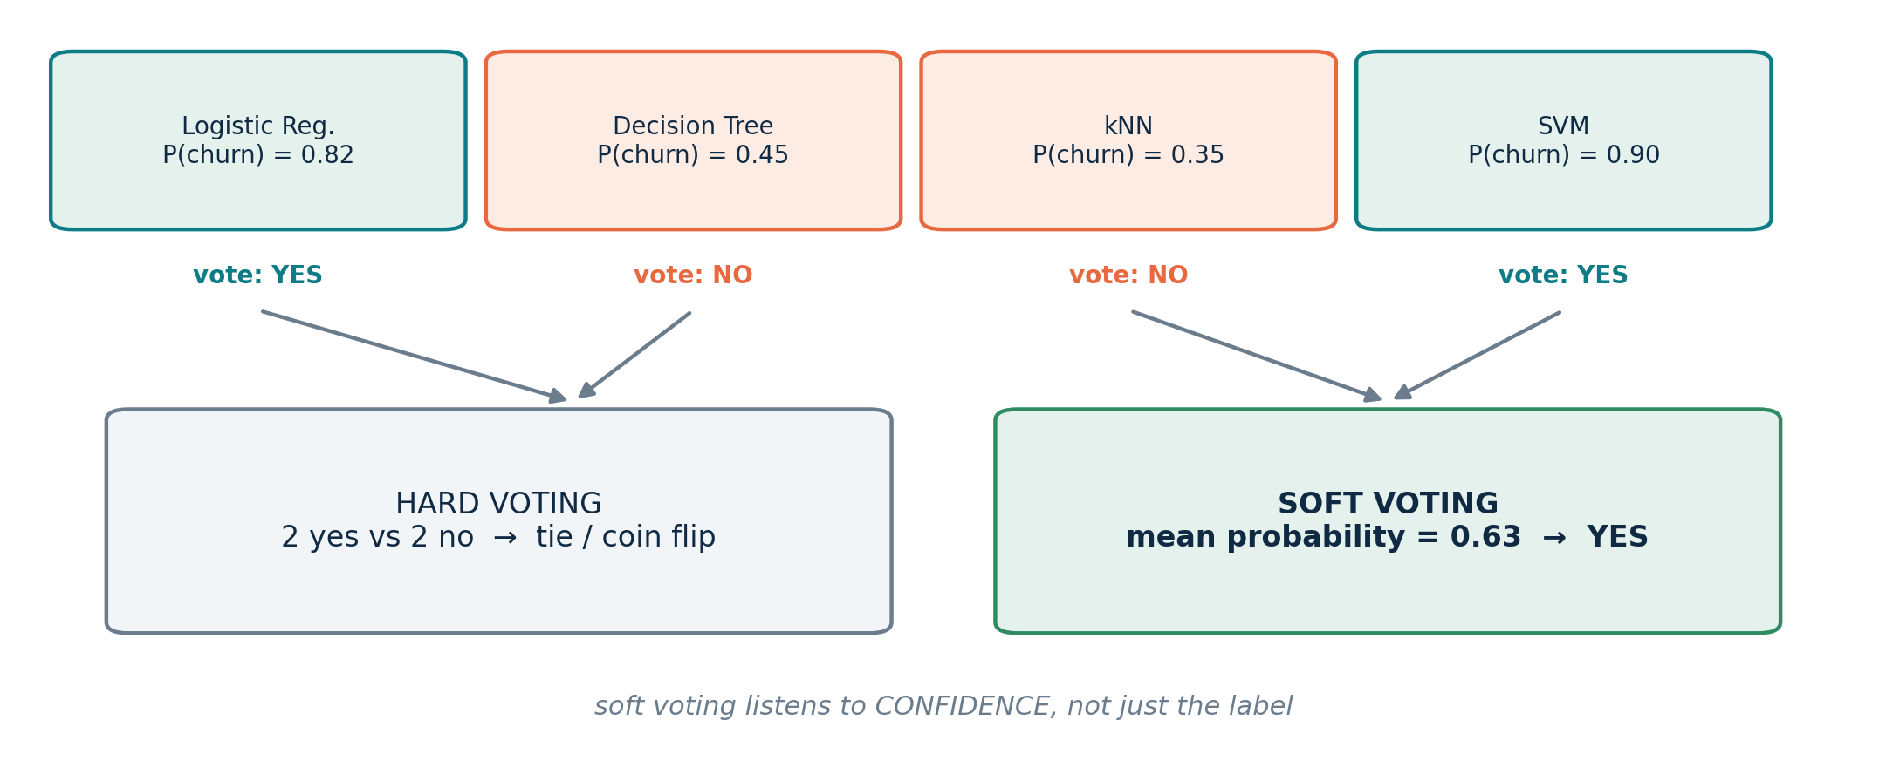
METHOD 1 — VOTING
Hard voting counts labels. Soft voting weighs confidence.
Use soft voting
Whenever your models can output calibrated probabilities. A model that is 90% sure should outvote one that is 51% sure.
Watch out
Members must be comparably good. One weak member drags the whole ensemble down — or use weights.
Simplest ensemble there is: same data, different algorithms, one combined answer.

Slide 11
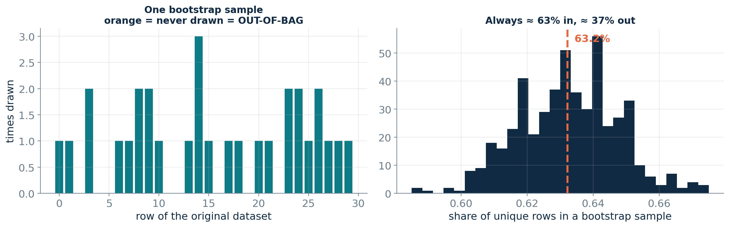
METHOD 2 — BAGGING
The bootstrap: sample N rows, with replacement
Bootstrap AGGregating — Breiman, 1996
63.2% in
36.8% out-of-bag = free validation
Each model sees about two-thirds of the unique rows — enough to learn, different enough to disagree.
Score each tree on the rows it never saw. No holdout set needed: set oob_score=True.

Slide 12
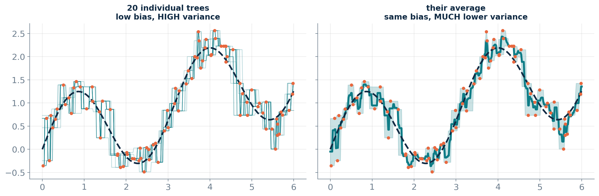
METHOD 2 — BAGGING
Averaging cancels the noise, keeps the signal
Same bias, far less variance. Bagging never makes the average model worse — it makes it steadier.
Notes:
Point out that the black dashed true curve sits inside the shaded band on the right. Bias is unchanged; the wobble is gone.

Slide 13
METHOD 2 — BAGGING
Bagging in practice
Setting | What it does | Typical
estimator | Any model — trees, kNN, SVM | deep decision tree
n_estimators | How many models to average | 100 – 500
max_samples | Rows given to each model | 1.0 (N with replacement)
max_features | Columns given to each model | 1.0 (< 1.0 = random subspace)
oob_score | Free out-of-bag validation score | True
n_jobs | Parallel workers — bagging is embarrassingly parallel | -1
More trees never hurt
The accuracy curve rises and then flattens. It never turns back down. Extra trees only cost you time.
Use a HIGH-variance base model
Bagging removes variance, so give it something with plenty to remove: fully grown, unpruned trees. Bagging a linear model achieves almost nothing.

Slide 14
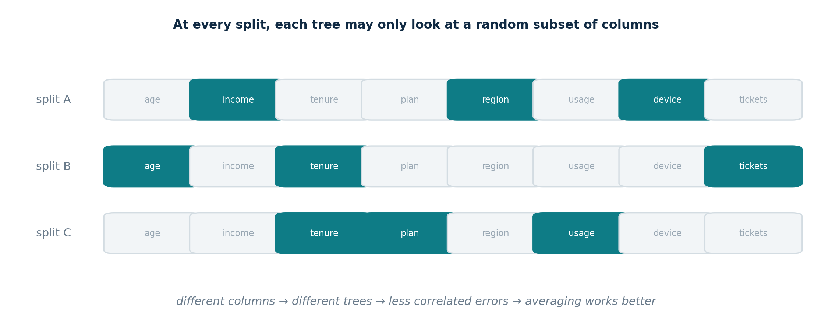
METHOD 3 — RANDOM FOREST
Random Forest = bagging + column randomness
Why bother?
In plain bagging every tree splits on the same dominant feature first, so the trees end up nearly identical — and averaging near-identical models buys you nothing. Hiding most columns at each split forces the trees apart.

Slide 15
METHOD 3 — RANDOM FOREST
Why decorrelation matters more than more trees
Var(average) = ρ σ² + (1 − ρ)/B · σ²
Parameter | Start with
n_estimators | 300 – 500
max_features | 'sqrt' for classification
max_depth | None — leave trees deep
min_samples_leaf | 1, raise to 3-5 if noisy
class_weight | 'balanced' if imbalanced
n_jobs | -1
B = number of trees ρ = correlation between them
The second term vanishes as you add trees — that is the easy half.
The first term only shrinks if the trees become LESS correlated.
max_features is the dial that lowers ρ. It trades a little extra bias per tree for a big drop in correlation.

Slide 16
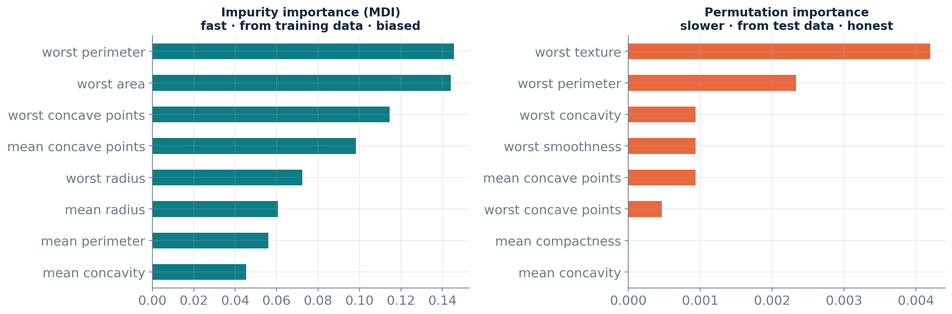
INTERPRETATION
Two ways to ask 'which features matter?'
⚠ Both are misleading when features are correlated
If two columns carry the same signal, the model uses one and the other looks worthless. Neither ranking means 'this feature causes the outcome' — for that you need SHAP, or an experiment.

Slide 17
METHOD 4 — EXTRA TREES
Extremely Randomised Trees
One more turn of the randomness dial — and it is usually free
 | Random Forest | Extra Trees
Rows per tree | bootstrap sample | the whole training set
Columns per split | random subset | random subset
Split threshold | the BEST cut point | RANDOM cut points, best of those
Training speed | fast | faster — no threshold search
Bias / variance | low / low | slightly higher / lower
Best on | most tabular data | noisy data, many weak features
30-second experiment
Swap RandomForestClassifier for ExtraTreesClassifier. Same API, same parameters.
Why it works
Random thresholds add bias to each tree but decorrelate them further — often a net win.

Slide 18
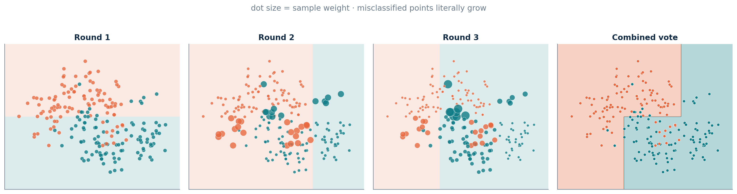
METHOD 5 — BOOSTING
AdaBoost: make the hard examples louder
1
Start with equal weights on every row
2
Train a weak model — a depth-1 stump
3
Increase the weight of every row it got wrong
4
Give each stump a vote proportional to its accuracy
Notes:
Marker size is the sample weight. By round 3 the model is spending all its attention on the boundary points.

Slide 19
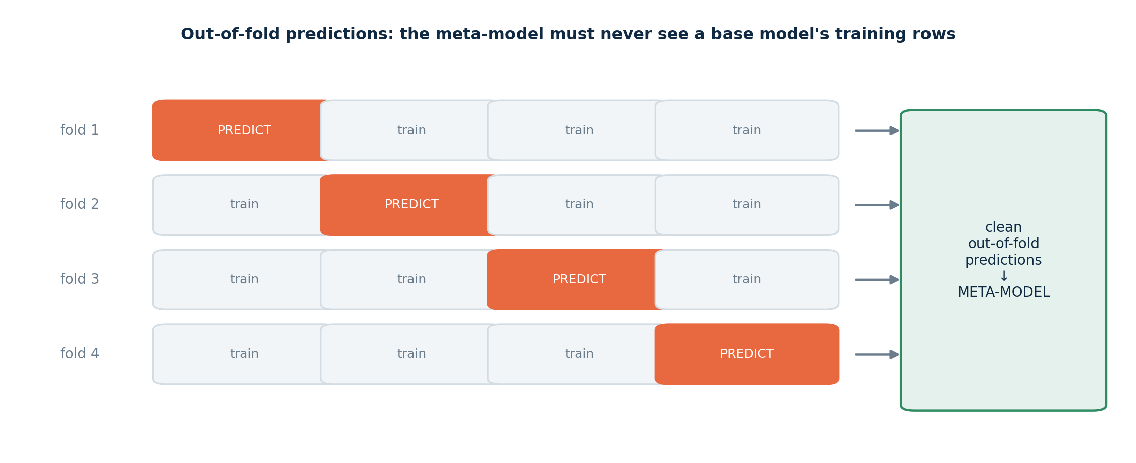
METHOD 6 — STACKING
Stacking: learn the combination rule
Voting uses a fixed rule. Stacking trains a model to find a better one.
Keep the meta-model simple
Cost: (K+1) × everything
Logistic or ridge regression. A complex meta-model just overfits the prediction matrix.
Five base models with 5-fold CV means 30 model fits. Budget for it before you promise it.

Slide 20
THE SUMMARY SLIDE
Bagging vs Boosting — everything on one page
 | Bagging / Random Forest | Boosting
Base learners | Deep trees — low bias, high variance | Shallow trees — high bias
Trained | Independently, in parallel | Sequentially, on the previous errors
Reduces | Variance | Bias (and variance, via shrinkage)
More estimators | Never hurts — the curve flattens | CAN overfit — needs early stopping
Noise & outliers | Robust | Sensitive — it keeps chasing hard rows
Tuning effort | Low — good out of the box | Higher — rate × rounds × depth
Parallelisable | Fully | Only within a tree
Typical accuracy | Very good | Usually the winner on tabular data
Notes:
This is the slide people photograph. Pause here.

Slide 21
DECISION GUIDE
Which ensemble should I reach for?
Strong baseline in five minutes, barely any tuning
→ Random Forest
Noisy data, many irrelevant features, need speed
→ Extra Trees
Best possible tabular accuracy, and you can tune
→ XGBoost / LightGBM
A single model that overfits and you want it stabilised
→ Bagging
You already have several good, different models
→ Soft voting, then Stacking
A regulator or a stakeholder will read the model
→ Random Forest or a single tree + SHAP
Time series? Never use plain K-fold — use TimeSeriesSplit, whichever ensemble you pick.

Slide 22
02
Gradient Boosting
& XGBoost
Building models that learn from their own mistakes

Slide 23
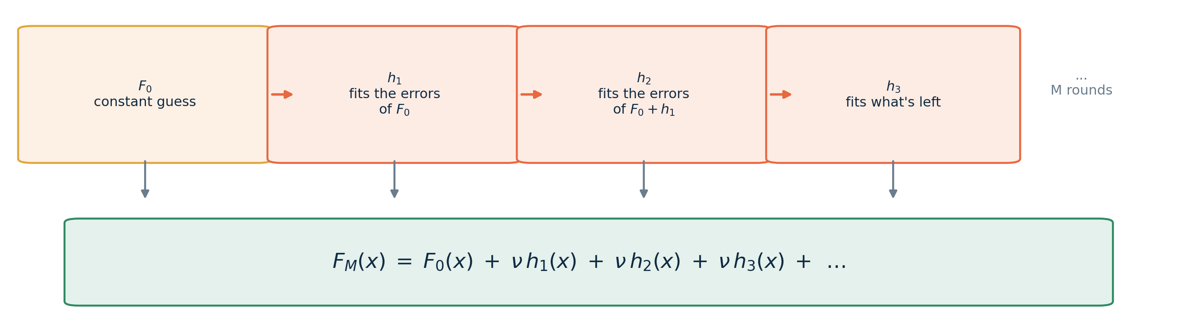
THE SHAPE OF THE MODEL
A boosted model is one long sum
F₀
hₘ
ν
A constant first guess — the mean, or the log-odds of the base rate
A weak learner: a shallow regression tree, usually depth 3 to 8
The learning rate — shrinks every step so no single tree dominates

Slide 24
TWO FLAVOURS OF BOOSTING
AdaBoost re-weights rows. Gradient boosting re-targets them.
 | AdaBoost (1997) | Gradient Boosting (2001)
Mechanism | Increase the WEIGHT of misclassified rows | Fit the next tree to the NEGATIVE GRADIENT of the loss
What the next tree sees | The same labels, different weights | A brand new target: the errors themselves
Loss function | Exponential loss, fixed | Any differentiable loss you like
Covers | Classification first | Regression, classification, ranking, counts, survival
Why gradient boosting took over
Swapping the loss function changes what 'the error' means — and nothing else in the algorithm has to change. That single idea turns one method into a framework, and it is the reason XGBoost can do regression, ranking and Poisson counts with the same engine.

Slide 25
FIRST PRINCIPLES
The whole algorithm, in nine lines
For squared error, the negative gradient IS the residual — so 'follow the gradient' means 'fit the leftovers'
F = mean(y) # F0: a constant
repeat M times:
r = y - F # what we still get wrong
h = DecisionTree().fit(X, r)
F = F + lr * h.predict(X) # take a small step
L = ½(y − F)²
Differentiate with respect to F and you get −(y − F). The negative gradient is exactly the residual — no calculus needed at runtime.
Everything else is engineering
XGBoost, LightGBM and CatBoost all run this loop. What they add is regularisation, smarter split-finding and speed.
In the notebook, this hand-written loop matches scikit-learn's GradientBoostingRegressor to 0.000000.

Slide 26
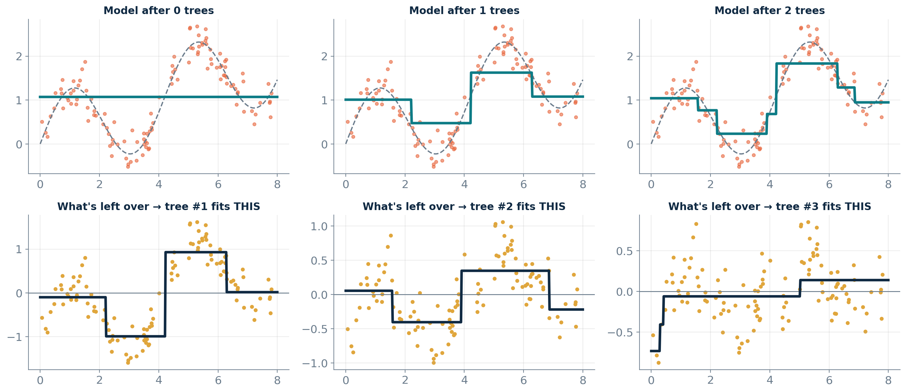
WATCH IT LEARN
Each tree fits what the last one left behind
Bottom row: at stage 0 the leftovers are still a clean sine wave — all the signal is sitting in the errors.

Slide 27
THE MATHS
Gradient descent — but on the function, not the weights
Ordinary gradient descent
Gradient boosting
θ ← θ − ν ∇θ L
F(x) ← F(x) − ν ∂L/∂F
You adjust the PARAMETERS of a fixed model.
You add a whole new FUNCTION to the model.
The loss you choose decides what 'the error' means:
Task | Loss | The tree is fitted to | XGBoost objective
Regression | Squared error | y − F | reg:squarederror
Robust regression | Absolute error | sign(y − F) | reg:absoluteerror
Classification | Log loss | y − σ(F) | binary:logistic
Counts | Poisson | y − e^F | count:poisson
Ranking | Pairwise | — | rank:pairwise

Slide 28
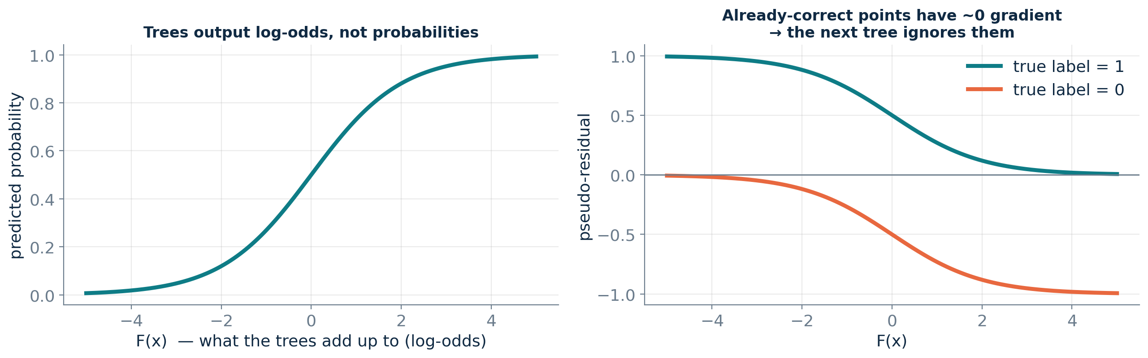
CLASSIFICATION
For classification, the trees live in log-odds space
Why boosting naturally focuses on hard cases
A confidently-correct row has a pseudo-residual of almost zero, so the next tree simply ignores it. Nobody has to re-weight anything — the gradient does it automatically.

Slide 29
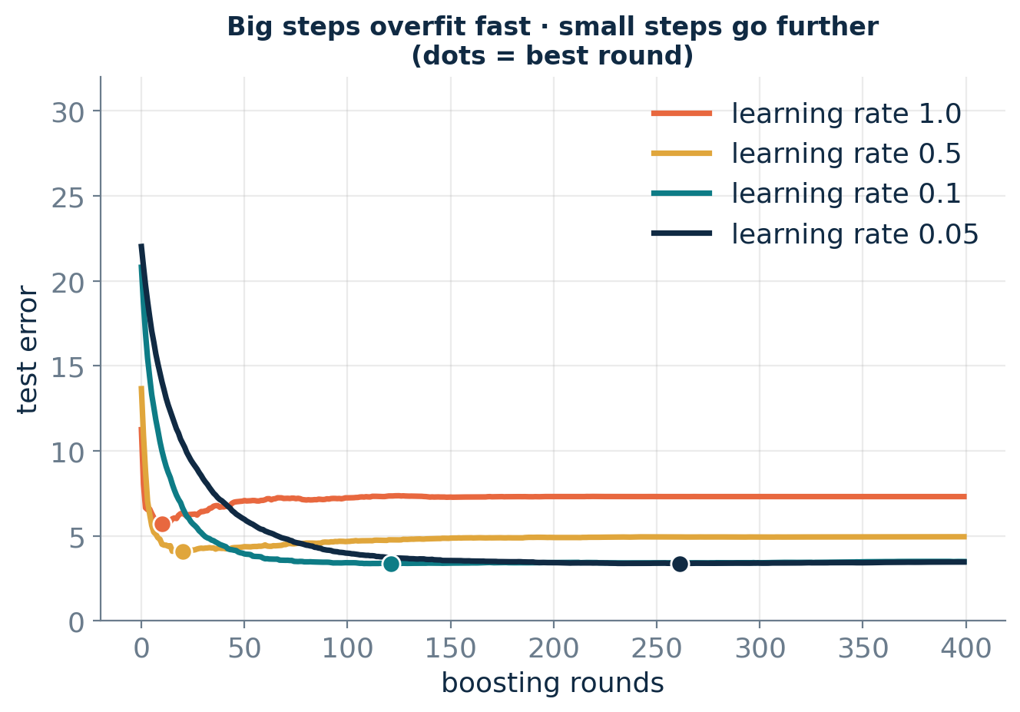
THE KEY TRADE-OFF
Learning rate and number of rounds are one knob, not two
Halve the rate, double the rounds
Smaller steps generalise better — this is shrinkage regularisation — but cost proportionally more compute.
⚠ Boosting has a BEST number of rounds
Unlike bagging, the curve turns back up. Adding trees past the minimum actively makes your model worse.
Rule of thumb: fix the rate at 0.05–0.1, then let early stopping choose the number of rounds.

Slide 30
ENTER XGBOOST
What XGBoost actually changed
Chen & Guestrin, 2016 — five upgrades to the loop we just wrote
1
Regularised objective
2
Second-order optimisation
3
Sparsity-aware splits
Penalties on the number of leaves and the size of leaf values, built into the split criterion itself.
Uses the curvature of the loss, not just the slope — giving a closed-form best leaf value.
Missing values get a learned default direction at every split. No imputation required.
Points 4 and 5 — not the maths — are the reason XGBoost took over Kaggle.
4
Histogram split finding
5
Systems engineering
Bucket each feature into ~256 bins once, then scan bins instead of sorting rows.
Cache-aware layout, multi-core, out-of-core, GPU, distributed training.

Slide 31
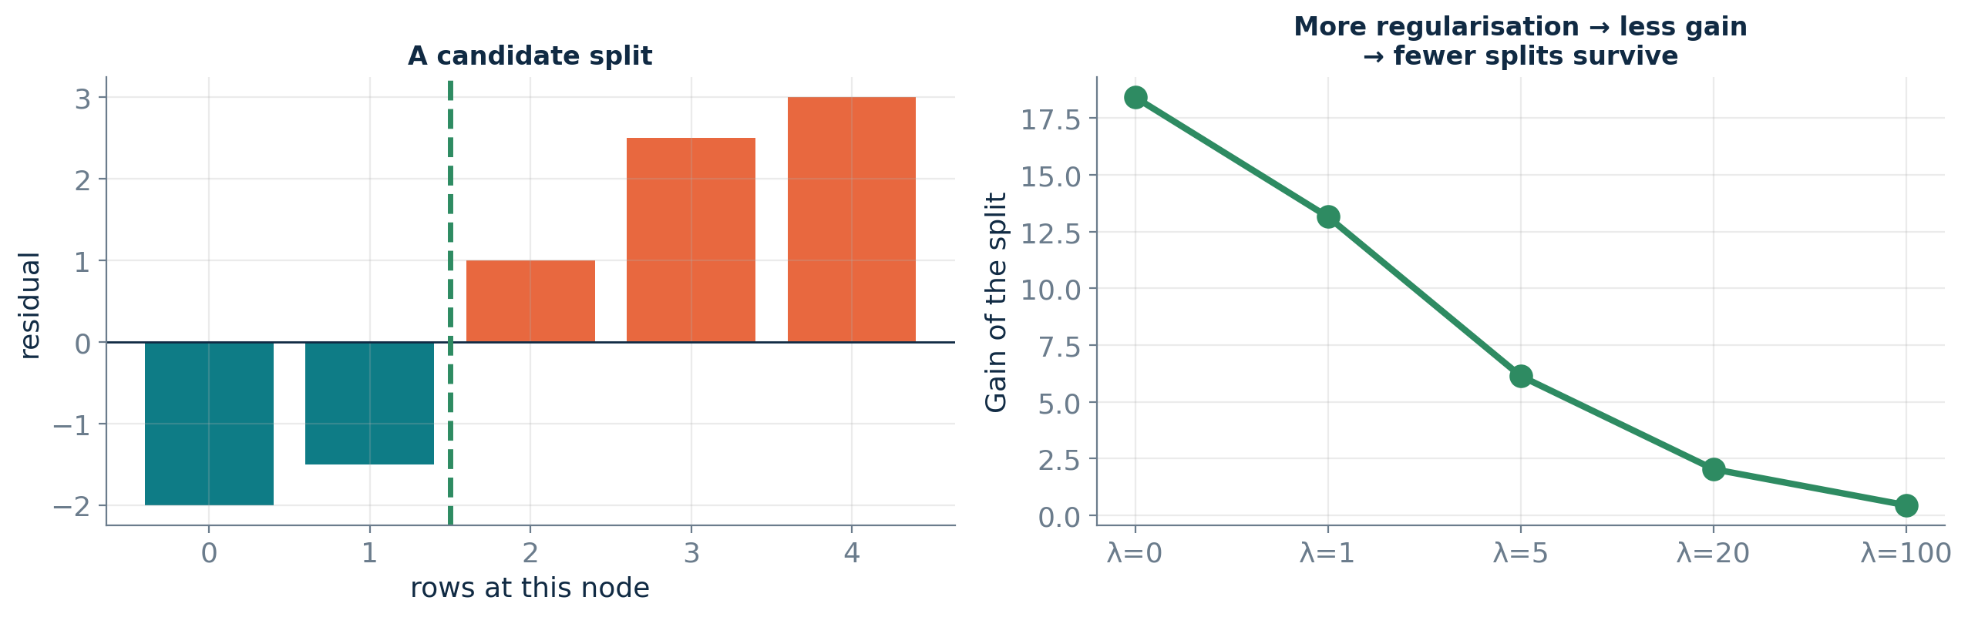
UPGRADE 1 + 2
Regularisation moves inside the split decision
Similarity = (Σ gᵢ)² / (Σ hᵢ + λ) Gain = Sim(left) + Sim(right) − Sim(parent) − γ
g = gradient · h = curvature · λ = L2 on leaf values · γ = minimum gain to bother splitting
Negative gain → prune
The split is simply never made. Pruning by arithmetic, not by a max_depth guess.
Your regularisation dials
reg_lambda smooths leaf values. gamma refuses weak splits. Both make trees more conservative.

Slide 32
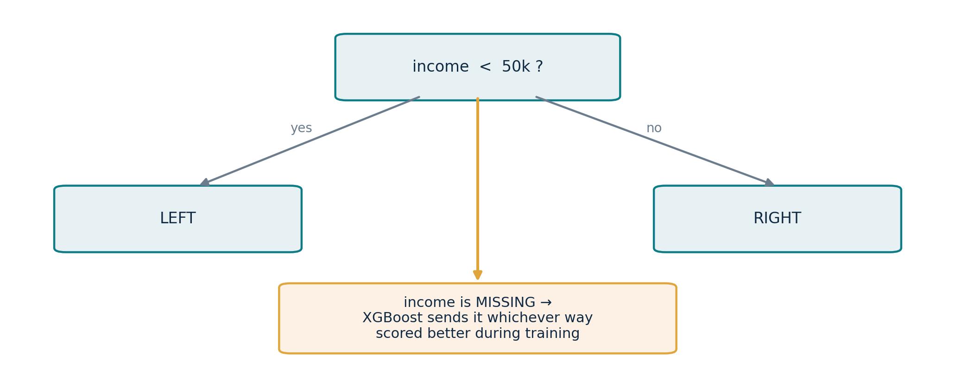
UPGRADE 3
Missing values are a feature, not a problem
How it works
At each split XGBoost tries sending all the NaNs left, then all of them right, and keeps whichever scored better.
⚠ Powerful and dangerous
If a blank means something real — 'brand new customer' — this is a genuine signal. If it is an artefact of your data pipeline that won't exist in production, the model has learned a leak. Always ask WHY it is missing.

Slide 33
UPGRADE 4 + 5
Histogram binning: same accuracy, a fraction of the cost
60,000 rows × 40 features × 120 trees, measured in the notebook
exact
Sort every feature at every node to find the perfect cut point. Correct, and slow.
hist — the default since 2.0
Bin once into ~256 buckets, then scan buckets. Almost the same accuracy, ~16× faster here.

Slide 34
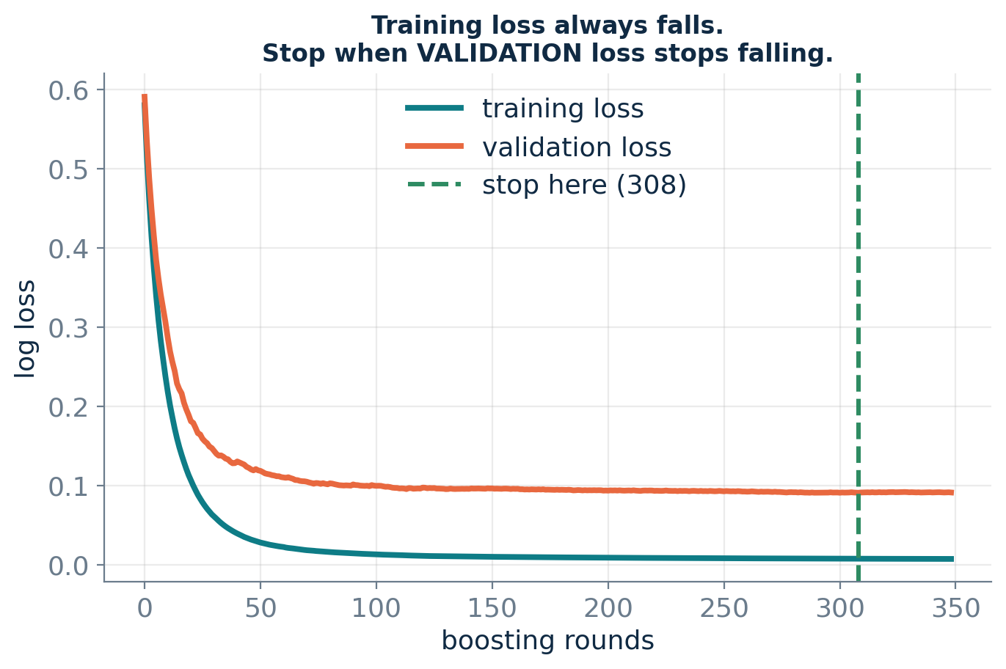
THE FEATURE YOU'LL USE DAILY
Early stopping: let the data choose the number of trees
How to use it
Set n_estimators far too high, pass a validation set, set early_stopping_rounds=50. XGBoost keeps the best iteration for you.
⚠ Not on the test set
Early stopping IS model selection. Use a third split, or xgb.cv. Stopping on your test set inflates the score you report.

Slide 35
TUNING
Thirty knobs. You will touch eight.
Tree complexity
Randomness
Shrinkage & penalties
max_depth
subsample
learning_rate
3 – 8
0.6 – 1.0
0.01 – 0.1
min_child_weight
colsample_bytree
reg_lambda
1 – 20
0.5 – 1.0
0 – 100
gamma
colsample_bylevel
reg_alpha
0 – 5
0.5 – 1.0
0 – 10
How much can one tree memorise?
Bagging, applied inside boosting.
How big a step, how smooth the leaves.
min_child_weight, gamma and reg_lambda are three levers on the same idea — you rarely need all three.

Slide 36
A WORKFLOW THAT WORKS
A sane starting recipe
1
Baseline first — a dummy model and a logistic regression. Always.
XGBClassifier(
n_estimators = 2000, # let early stopping cut it
learning_rate = 0.05,
max_depth = 5,
min_child_weight = 2,
subsample = 0.8,
colsample_bytree = 0.8,
early_stopping_rounds = 50)
2
Fit the recipe above with early stopping. This is usually 95% of the final score.
3
RandomizedSearchCV over depth, min_child_weight, subsample and lambda.
Random search beats grid search
4
Only then: feature engineering — which moves the needle more than step 3.
Only a few parameters actually matter, and you never know which. Random search gives you more distinct values of each for the same budget.

Slide 37
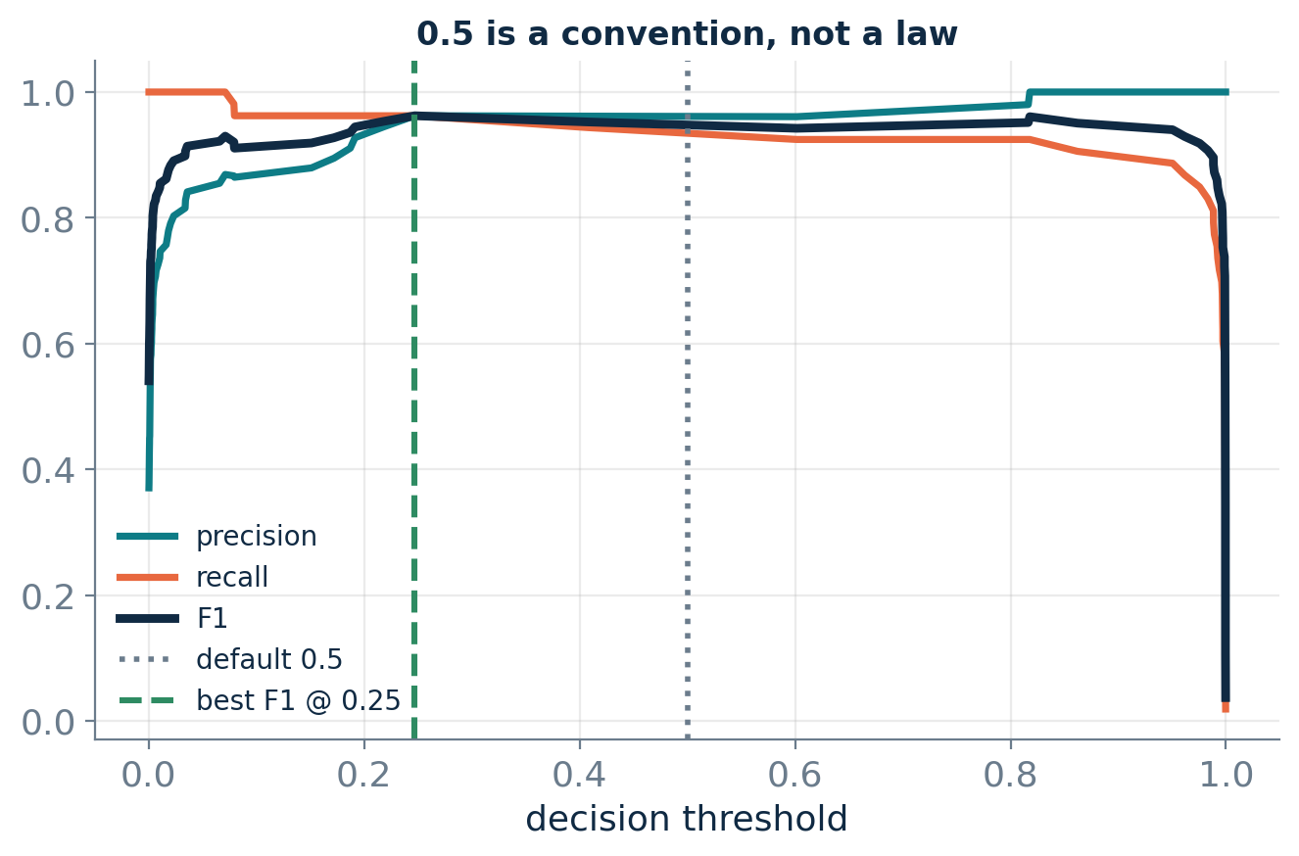
IMBALANCED PROBLEMS
0.5 is a convention, not a decision rule
Two independent levers
scale_pos_weight changes what the model LEARNS. Moving the threshold changes how you USE it. Pick one.
Use the right metric
Under imbalance, ROC-AUC flatters you. Report PR-AUC and recall.
Let the business decide
Set the threshold from the cost of a miss vs a false alarm.

Slide 38
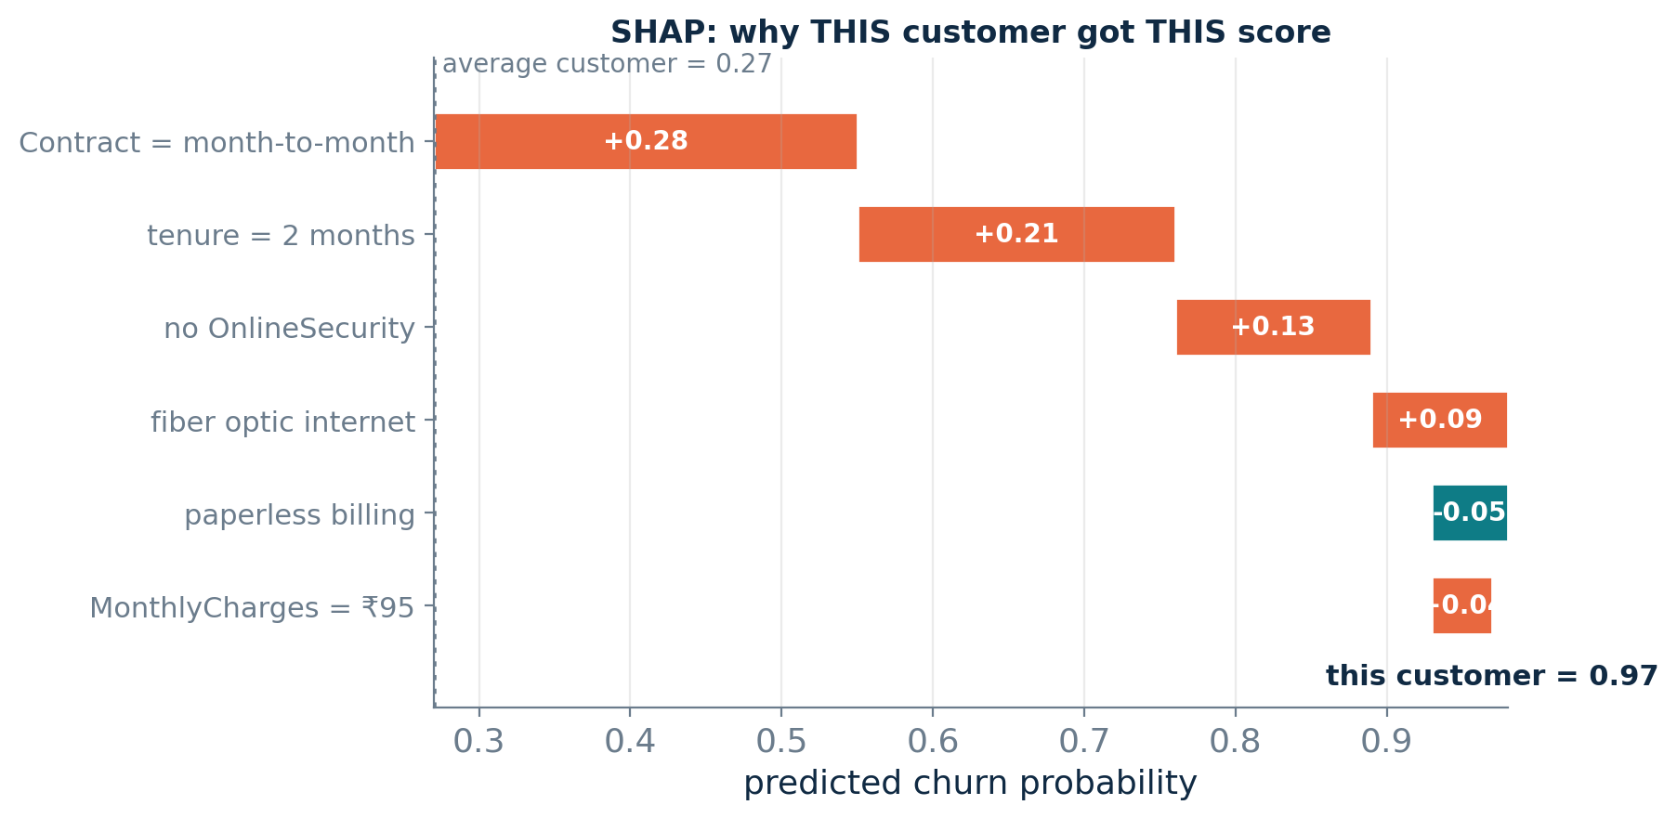
INTERPRETATION
Explaining a boosted model
Global importance tells you what matters on average. SHAP tells you why THIS row got THIS score.
gain
Average loss reduction from splits on the feature. This is the one to quote.
weight
How often the feature was split on. Biased towards continuous features.
cover
How many rows those splits touched. How BROADLY it acts.
SHAP — the one to show a stakeholder
Splits every individual prediction into per-feature contributions that add up exactly to the score.

Slide 39
THE ECOSYSTEM
XGBoost vs LightGBM vs CatBoost
 | XGBoost | LightGBM | CatBoost
Tree growth | Level-wise | Leaf-wise | Symmetric
Speed on wide data | Fast | Fastest | Fast
Small datasets | Solid | Can overfit | Most robust
Categorical features | Native (1.6+) | Native | Best in class
Overfitting tendency | Medium | Higher | Lowest
Defaults out of the box | Needs tuning | Needs tuning | Usually good
Practical advice
They land within ~1% of each other
Start with XGBoost. Move to LightGBM at millions of rows, CatBoost for many high-cardinality categories.
On most problems the library is not your bottleneck. Feature engineering is.

Slide 40
BEFORE YOU SHIP
Six ways this goes wrong in production
!
Target leakage
!
Early stopping on the test set
0.99 AUC on a real business problem means a leak, not a breakthrough. Find the feature that won't exist at prediction time.
That is model selection. Your reported score is now optimistic.
!
Random K-fold on time series
!
Trusting 'weight' importance
You just trained on the future. Use TimeSeriesSplit.
It favours continuous features. Use gain, or SHAP.
!
Forgetting calibration
!
Expecting extrapolation
scale_pos_weight distorts probabilities. If you need real probabilities, calibrate.
Trees predict a flat line outside the range they were trained on. Never forecast a trend with them.

Slide 41
WHAT YOU CAN DO NOW
From here, the notebooks
Explain boosting as gradient descent in function space — and code it in nine lines
Choose between bagging and boosting, and justify it with bias and variance
Train, early-stop, tune and interpret an XGBoost model on messy real data
Pick the right metric and the right decision threshold for an imbalanced problem
Name the failure modes before they reach production
01_Ensemble_Learning_Methods.ipynb 02_XGBoost_and_Gradient_Boosting.ipynb
Notes:
Hand over to the notebooks. Everything on these slides has a runnable, plotted cell.

