Slide 1

INTRODUCTION TO C++ Compete McGill 2018-2019
>Compete McGill_

Slide 2
QUICK FACTS
C++ is a statically typed, compiled, general-purpose, case-sensitive, free-form programming that supports procedural, object-oriented, and generic programming.
It was created by Bjarne Stroustrup in 1983 at Bell Labs
C++ is an extension of C programming and the programs written in C language can run in C++ compiler. (originally named “C with Classes”)
C++ is regarded as a middle-level language, as it comprises a combination of both high-level and low-level language features.

Slide 3
C++ vs C
C | C++
C is a Procedural Language | C++ is a non Procedural, Object Oriented Language
Top down approach is used in Program Design | Bottom up approach used in Program Design
Multiple Declaration of global variables are allowed. | Multiple Declaration of global variables are not allowed.
C requires all the variables to be defined at the starting of a scope. | C++ allows the declaration of variable anywhere in the scope i.e. at time of its First use.
In C, malloc () and calloc () Functions are used for Memory Allocation and free () function for memory Deallocating. | In C++, new and delete operators are used for Memory Allocating and Deallocating.

Slide 4
STRUCTURE OF C++

Slide 5
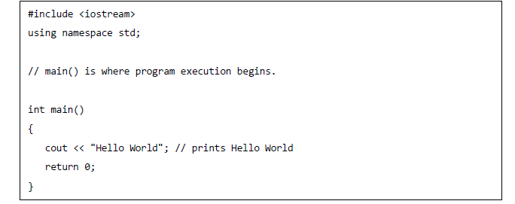
SIMPLE PROGRAM IN C++

Slide 6
DATA TYPES
Primary Data Type | int, float, char, void
User Defined Data Type | structure, union, class, enumeration
Derived Data Type | array, function, pointer, reference

Slide 7
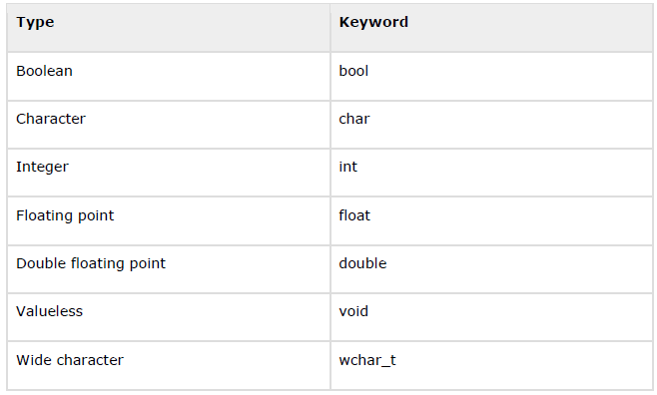
Primitive Built-in Types

Slide 8
typedef Declarations
We can create a new name for an existing type using typedef.
Simple syntax to define a new type with typedef:
typedef type newname; //syntax
typedef int feet; // this tells compiler that feet //is another name for int
feet distance; //this declaration is legal and //creates an int variable called //distance

Slide 9
VARIABLE SCOPES Local Variables
#include <iostream.h>
int main ()
{
int a, b;
int c; // Local variable declaration
a = 10;
b = 20; // actual initialization
c = a + b;
cout << c;
return 0;
}

Slide 10
Global Variables
#include <iostream.h>
//Global variable declaration
int g;
int main()
{
//Local variable declaration
int a, b;
//Actual initialization
a=10;
b=20;
g=a+b;
cout<<g;
return 0;
}

Slide 11
IF – ELSE IF - ELSE
Same as Java.
if(boolean_expression 1) { // Executes when the boolean expression 1 is true } else if( boolean_expression 2) { // Executes when the boolean expression 2 is true } else if( boolean_expression 3) { // Executes when the boolean expression 3 is true } else { // executes when the none of the above condition is true. }

Slide 12
FOR LOOPS
Same as Java
for ( init; condition; increment ) { statement(s); }
#include <iostream> using namespace std; int main () { // for loop execution for( int a = 10; a < 20; a = a + 1 ) { cout << "value of a: " << a << endl; } return 0; }

Slide 13
WHILE LOOPS
Same as Java
while(condition) { statement(s); }
#include <iostream> using namespace std; int main () { // Local variable declaration: int a = 10;
// while loop execution while( a < 20 ) { cout << "value of a: " << a << endl; a++; } return 0; }

Slide 14
DO-WHILE LOOPS
do { statement(s); } while( condition );
#include <iostream> using namespace std; int main () { // Local variable declaration: int a = 10;
// do loop execution do { cout << "value of a: " << a << endl; a = a + 1; } while( a < 20 ); return 0; }

Slide 15
FUNCTIONS
A function is a set of statements to perform some task.
Every C++ program has at least one function, which is main().
Syntax of a function in C++
return-type function-name(parameters)
{
//statements
}

Slide 16
Ex:
#include <iostream.h>
int sum(int x, int y); //declaring function
int main()
{
int a = 12;
int b = 40;
int c = sum (a,b); //calling function
cout<<c;
}
int sum(int x, int y) //defining function
{
return (x+y);
}

Slide 17
PASSING PARAMETERS BY VALUE VS BY REFERENCE
If a function is without argument, which means it doesn’t take any parameter, it can be called directly using its name.
For functions with arguments, there are two ways of calling them:
1) Pass by value ➔ function(int var)
Variable is passed into the function and can be changed, but changes are not passed back.
2) Pass by reference ➔ function(int &var)
Variables is passed into the function and can be changed, changes are passed back.

Slide 18
ARRAYS
C++ provides a data structure, the array, which stores a fixed-size sequential collection of elements of the same type.
All arrays consist of contiguous memory locations. The lowest address corresponds to the first element and the highest address to the last element.
Syntax for declaring an array:
type arrayName[arraySize]; //type can be any valid C++ data type
double balance[10];
double balance[5] = {1000.0, 2.0, 3.4, 17.0, 50.0};
double balance[] = {1000.0, 2.0, 3.4, 17.0, 50.0};

Slide 19
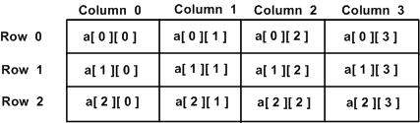
MULTI-DIMENSIONAL ARRAYS
int a[3][4] = { {0, 1, 2, 3} , /* initializers for row indexed by 0 */ {4, 5, 6, 7} , /* initializers for row indexed by 1 */ {8, 9, 10, 11} /* initializers for row indexed by 2 */ };

Slide 20
POINTERS TO ARRAYS
double *p; double balance[10]; p = balance;
#include <iostream> using namespace std; int main () { // an array with 5 elements. double balance[5] = {1000.0, 2.0, 3.4, 17.0, 50.0}; double *p; p = balance;
// output each array element's value cout << "Array values using pointer " << endl; for ( int i = 0; i < 5; i++ ) { cout << "*(p + " << i << ") : "; cout << *(p + i) << endl; } cout << "Array values using balance as address " << endl; for ( int i = 0; i < 5; i++ ) { cout << "*(balance + " << i << ") : "; cout << *(balance + i) << endl; } return 0; }

Slide 21

WAIT WHAT? (Sidenote)
char a[] = "hello"; char *p = "world";
a[3] // Returns “l”
p[3] // also returns “l”
a[3] → start at location a, move 3 past it, fetch character there.
p[3] → start at location p, fetch pointer, add 3 to pointer, fetch character at this new address.

Slide 22
POINTERS TO MULTIDIMENSIONAL ARRAYS
#include <stdio.h> int x[3][5] = { { 1, 2, 3, 4, 5 }, { 6, 7, 8, 9, 10 }, { 11, 12, 13, 14, 15 } }; int (*pArr35)[3][5] = &x; // &x is a pointer to an array of 3 arrays of 5 ints. int (*pArr5a)[3] = x; // x decays from an array of arrays of 5 ints to // a pointer to an array of 5 ints, // x is a pointer to an array of 5 ints.
int (*pArr5b)[5] = &x[0]; // &x[0] is a pointer to 0th element of x, // x[0] is an array of 5 ints, // &x[0] is a pointer to an array of 5 ints.
int *pInta = x[0]; // x[0] is 0th element of x, // x[0] is an array of 5 ints, // x[0] decays from an array of 5 ints to // a pointer to an int.
int *pIntb = *x; // x decays from an array of arrays of 5 ints to // a pointer to an array of 5 ints, // x is a pointer to an array of 5 ints, // *x is an array of 5 ints, // *x decays from an array of 5 ints to // a pointer to an int. int *pIntc = &x[0][0]; // x[0][0] is 0th element of x[0], // where x[0] is an array of 5 ints, // x[0][0] is an int, // &x[0][0] is a pointer to an int.

Slide 23
Side note: Dynamic Arrays
size_t size = 10;
int sarray[10];
int *darray = new int[size];
// do something with them:
for(int i=0; i<10; ++i){
sarray[i] = i;
darray[i] = i;
}
// don't forget to delete darray when you're done
delete [] darray;

Slide 24
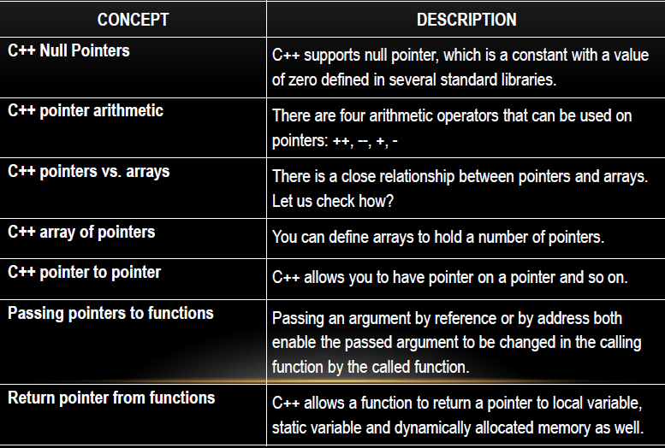
C++ Pointers In Detail

Slide 25
INPUT/OUTPUT
scanf
printf
cin
cout

Slide 26
scanf & printf
#include <stdio.h> int main () { char str1[20], str2[30]; printf("Enter name: "); scanf("%s", str1); printf("Enter your website name: "); scanf("%s", str2);
printf("Entered Name: %s\n", str1); printf("Entered Website:%s", str2); return(0); }

Slide 27
scanf & printf FORMATTERS
%s - string, reads characters until whitespace (space, enter or tab)
%c - character, reads a single character
%3c - reads 3 characters into specified array
%d - decimal integer, reads into specified int (can read in + or -)
%f - floating point, reads into specified float (can read in + or -, as well as e or E)

Slide 28
FLOAT & DECIMAL FORMATTERS
%4.2f // Prints width 4, 2 decimal places, 3.1415 becomes 3.14
%ld // Prints out long
%10d // Prints number number preceding with blanks to fill up 10 characters.
%010d // Prints number preceding with zeros to fill up 10 characters
Read more at home.

Slide 29
cin & cout
#include <iostream> using namespace std; int main() { char name[50]; cout << "Please enter your name: "; cin >> name; cout << "Your name is: " << name << endl; }

Slide 30
cin vs scanf
scanf is faster than cin normally
E.g. (from GeeksForGeeks):
cin takes ~2s to read a dummy file of 17MB
scanf takes ~0.4s to read a dummy file of 17MB
We can turn off synchronization for all the iostream standard streams and then cin is actually faster than scanf:
cin without synchronization takes ~0.2s to read a dummy file of 17MB.
Turning off synchronization means that we cannot use both scanf() and cin in a program

Slide 31
Turning Off Synchronization
#include<iostream>
using namespace std;
int main()
{
char buffer[256];
ios_base::sync_with_stdio(false);
while (cin >> buffer)
{
}
return 0;
}

Slide 32
STANDARD TEMPLATE LIBRARY (STL)
The Standard Template Library (STL) is a set of C++ template classes to provide common programming data structures and functions such as lists, stacks, arrays, etc.
It is a library of container classes, algorithms, and iterators. It is a generalized library and so, its components are parameterized. A working knowledge of template classes is a prerequisite for working with STL.
STL has four components
Algorithms
Containers
Functions
Iterators

Slide 33
CONTAINERS
Containers or container classes store objects and data. There are in total seven standard “first-class” container classes and three container adaptor classes and only seven header files that provide access to these containers or container adaptors.
CONTAINERS: VECTOR
Sequence
Dynamic Array

Slide 34
CONTAINERS: VECTOR
Sequence container that can change size
As a side note - containers are objects that hold data of the same type.
Sequence means they’re stored in a linear sequence (continuous memory locations).
#include <vector>
using namespace std;
vector<int> v;

Slide 35
CONTAINERS: VECTOR
#include <vector>
//...
size_t size = 10;
std::vector<int> array(size); // make room for 10 integers,
// and initialize them to 0
// do something with them:
for(int i=0; i<size; ++i){
array[i] = i;
}

Slide 36
CONTAINERS: VECTOR
std::vector<int> array;
try{
array.at(1000) = 0;
}
catch(std::out_of_range o){
std::cout<<o.what()<<std::endl;
}

Slide 37
CONTAINERS: VECTOR
#include <vector>
#include <iostream>
//...
std::vector<char> array;
char c = 0;
while(c != 'x'){
std::cin>>c;
array.push_back(c);
}

Slide 38
CONTAINERS: SETS
Sets are a type of associative containers in which each element has to be unique, because the value of the element identifies it. The value of the element cannot be modified once it is added to the set, though it is possible to remove and add the modified value of that element.
Associative
Ordered
Set
Unique Keys

Slide 39
CONTAINERS: SETS
#include<iostream>
#include<set>
#include<string>
int main()
{
std::set<std::string> setOfNumbers;
// Lets insert four elements
setOfNumbers.insert("first");
setOfNumbers.insert("second");
setOfNumbers.insert("third");
setOfNumbers.insert("first");
// Search for element in set using find member function
it = setOfNumbers.find("fourth");
if(it != setOfNumbers.end())
std::cout<<"'fourth' found"<<std::endl;
else
std::cout<<"'fourth' not found"<<std::endl;
return 0;
}

Slide 40
CONTAINERS: SETS
#include <iostream>
#include <map>
#include <iterator>
using namespace std;
int main()
{
std::set<std::string> setOfNumbers;
// Lets insert four elements
setOfNumbers.insert("first");
setOfNumbers.insert("second");
setOfNumbers.insert("third");
setOfNumbers.insert("first");
setOfNumbers.erase("third");
return 0;
}

Slide 41
CONTAINERS: MAPS
Maps are associative containers that store elements in a mapped fashion. Each element has a key value and a mapped value. No two mapped values can have same key values.
Associative
Ordered
Map
Unique Keys

Slide 42
CONTAINERS: MAPS
int main()
{
map <int, int> gquiz1;
// empty map container
// insert elements in random order
gquiz1.insert(pair <int, int> (1, 40));
gquiz1.insert(pair <int, int> (2, 30));
gquiz1.insert(pair <int, int> (3, 60));
gquiz1.insert(pair <int, int> (4, 20));
gquiz1.insert(pair <int, int> (5, 50));
gquiz1.insert(pair <int, int> (6, 50));
gquiz1.insert(pair <int, int> (7, 10));
}

Slide 43
CONTAINERS: MAPS
// assigning the elements from gquiz1 to gquiz2
map <int, int> gquiz2(gquiz1.begin(), gquiz1.end());
// remove all elements up to element with key=3 in gquiz2
gquiz2.erase(gquiz2.begin(), gquiz2.find(3));
// remove all elements with key = 4
int num;
num = gquiz2.erase (4);

Slide 44
ITERATORS
#include<iostream>
#include<set>
#include<string>
int main()
{
std::set<std::string> setOfNumbers;
// Lets insert four elements
setOfNumbers.insert("first");
setOfNumbers.insert("second");
setOfNumbers.insert("third");
setOfNumbers.insert("first");
// Only 3 elements will be inserted
std::cout<<"Set Size = "<<setOfNumbers.size()<<std::endl;
// Iterate through all the elements in a set and display the value.
for (std::set<std::string>::iterator it=setOfNumbers.begin(); it!=setOfNumbers.end(); ++it)
std::cout << ' ' << *it;
std::cout<<"\n";
return 0;
}

Slide 45
ITERATORS
#include<set>
#include<string>
int main()
{
std::set<std::string> setOfNumbers;
// Lets insert four elements
setOfNumbers.insert("first");
setOfNumbers.insert("second");
setOfNumbers.insert("third");
setOfNumbers.insert("first");
// Search for element in set using find member function
std::set<std::string>::iterator it = setOfNumbers.find("second");
if(it != setOfNumbers.end())
std::cout<<"'second' found"<<std::endl;
else
std::cout<<"'second' not found"<<std::endl;
// Search for element in set using find member function
it = setOfNumbers.find("fourth");
if(it != setOfNumbers.end())
std::cout<<"'fourth' found"<<std::endl;
else
std::cout<<"'fourth' not found"<<std::endl;
return 0;
}

Slide 46
LOWER & UPPER BOUNDS
upper_bound() is a standard library function in C++ defined in the header . It returns an iterator pointing to the first element in the range [first, last) that is greater than value, or last if no such element is found. The elements in the range shall already be sorted or at least partitioned with respect to val.
lower_bound() in C++ returns an iterator pointing to the first element in the range [first, last] which does not compare less than val. The elements in the range shall already be sorted or at least partitioned with respect to val.

Slide 47
LOWER & UPPER BOUNDS
// set::lower_bound/upper_bound #include <iostream> #include <set> int main () { std::set<int> myset; std::set<int>::iterator itlow,itup; for (int i=1; i<10; i++) myset.insert(i*10);
// 10 20 30 40 50 60 70 80 90 itlow =myset.lower_bound(30); itup=myset.upper_bound (60); myset.erase(itlow,itup); // 10 20 70 80 90
std::cout << "myset contains:"; for (std::set<int>::iterator it=myset.begin(); it!=myset.end(); ++it) std::cout << ' ' << *it; std::cout << '\n'; return 0; }

Slide 48
MAGINC INCLUDE STATEMENT!
#include <bits/stdc++.h>

Slide 49
CLASSES
#include <bits/stdc++.h>
using namespace std;
class Geeks
{
// Access specifier
public:
// Data Members
string geekname;
// Member Functions()
void printname()
{
cout << "Geekname is: " << geekname;
}
};
int main() {
// Declare an object of class geeks
Geeks obj1;
// accessing data member
obj1.geekname = "Abhi";
// accessing member function
obj1.printname();
return 0;
}

