Slide 1

Senior Design Project
Rozerin Yıldız
Muğla Sıtkı Koçman University
Department of Computer Engineering
Advisor
Dr. Tuğba ÖNAL SÜZEK
Muğla Sıtkı Koçman University
Department of Computer Engineering

Slide 2
Skin Disease Detection Application

Slide 3

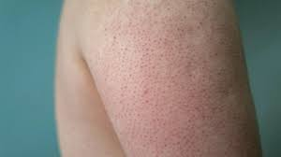
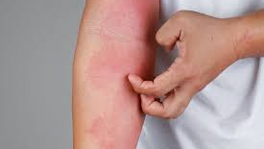
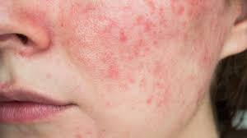
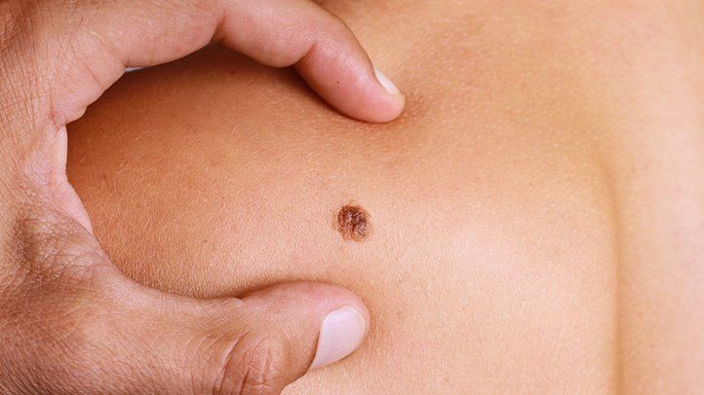
Diseases
Eczema
Keratosis Pilaris
Melanoma
Rosacea

Slide 4
Collecting Dataset
Eczema
https://www.kaggle.com/datasets/shubhamgoel27/dermnet
eczema-atopic dermatisis
https://www.kaggle.com/datasets/shubhamgoel27/dermnet
https://www.kaggle.com/datasets/ismailpromus/skin-diseases-image-dataset

Slide 5
Collecting Dataset
Keratosis Pilaris
https://cdn.mdedge.com/files/s3fs-public/Document/September-2017/082030177.pdf
https://cdn.mdedge.com/files/s3fs-public/Document/September-2017/082030177.pdf
https://onlinelibrary.wiley.com/doi/full/10.1111/j.0736-8046.2004.21103.x?casa_token=6C-p8TjwbtIAAAAA%3ABwiEC8gk33S9z1AsIKW6kQblirCU2pl7QLWdZwhFG77zARSfFLhr0sxOS4TZlKsI9yfuVxtleLKiHQ
https://onlinelibrary.wiley.com/doi/full/10.1111/j.1610-0387.2006.05933.x?casa_token=_7kIQ0IWdZoAAAAA%3AAFrG9FA5mf5d5EnfZNJKcetEVnk6x8awaXOU0m3S7rZ8CRK32mQv8wX2HZJmg0kH_XNb-n8d_WN-8Q
https://jamanetwork.com/journals/jamadermatology/article-abstract/410006
https://onlinelibrary.wiley.com/doi/full/10.1111/j.1468-3083.2010.03772.x?casa_token=-AcVn4o2ZmkAAAAA%3AiBDhikYX_hS0sbxgtyva165R8h-Lt-sdfDWyWOsTTyjPUPdlIhSu86lS03u539beAZ0rYQOgSLmtkg
https://onlinelibrary.wiley.com/doi/full/10.1111/j.1468-3083.2010.03772.x?casa_token=-AcVn4o2ZmkAAAAA%3AiBDhikYX_hS0sbxgtyva165R8h-Lt-sdfDWyWOsTTyjPUPdlIhSu86lS03u539beAZ0rYQOgSLmtkg
https://www.sciencedirect.com/science/article/pii/S0190962205004251?casa_token=lh9V0wnixS4AAAAA:RDPDwLtlRb9nL8R8tpglPIT55R0FRU1ZwBia3NPpTt88LhJo1AnvxGIv3sD9jPcJsAXpfl4LfA
https://cdn.mdedge.com/files/s3fs-public/Document/September-2017/083020083.pdf
https://www.tandfonline.com/doi/full/10.3109/14764172.2010.502456?casa_token=SnDCJACfsOIAAAAA%3AyYrQI-sQSWAKQOaif2XJpN46vp83TWH2QYaUqCp8V6S88gS8jRGdd0WPUP1QUC8ucFL7rTtBigvc
https://journals.lww.com/dermatologicsurgery/Fulltext/2009/10000/Successful_Treatment_of_Severe_Keratosis_Pilaris.24.aspx?casa_token=iyTDS2OgHxwAAAAA:0CCZvMmLbFhO5qHilvy9s1tOuMbSFNUK7Rt5UWBtvj-FQyZse8ZsYGQGHbnBBYPLuKhsWxjF52kxbWnqEGsM
https://escholarship.org/uc/item/8w90x9zb
https://onlinelibrary.wiley.com/doi/full/10.1046/j.1468-3083.2002.00472.x?casa_token=YpTQbggTphQAAAAA%3Av1ZyUb_US_gdGYyFP9pSxSLb1qQP7_IGx7YhMUKtexmd1PLtVySQOEgPCubkND0SMSzUAkIM3NnFUg
https://onlinelibrary.wiley.com/doi/full/10.1111/j.1525-1470.2011.01616.x?casa_token=ZoRT6mdQiJIAAAAA%3AgtEA1AB-lBJKMyPV5m6nctjiG5i4sDm4Ujdh1yE2ifYbm4qYkv4Rf6ZQ7BogUOlkvi3O2w7GENrQgQ
https://downloads.hindawi.com/journals/specialissues/795326.pdf#page=27
https://www.hindawi.com/journals/drp/2015/205012/
https://onlinelibrary.wiley.com/doi/full/10.1111/j.1525-1470.2006.00166.x?casa_token=8sLxO3cvxi8AAAAA%3AsypW7HMlLT6U7G8aKUijE3mfVuiJ_dFPB7isjGPGGaF93jd4r0T_fFaEPlRCj8kOzCg3CMWOldcoiA
https://onlinelibrary.wiley.com/doi/full/10.1111/1346-8138.12442?casa_token=XBvoWaAbh8EAAAAA%3A_kiNFL5KpWuN4jJD9gbEUDJlXCQsm5mZlX1NARvLTZyhb51sT7N_0n321qhy5x6VmGhIl_Lq_usqrg
https://onlinelibrary.wiley.com/doi/full/10.1111/pde.14267?casa_token=n8UAbj7ek4gAAAAA%3AtMBZs7kSdNhOcp9lLxW4XSLYh38-bkugrIuPx4sn53pKm7YlEdSMy-mBJZ4Aj7CKXQpdlnfIPOAg8w
https://synapse.koreamed.org/articles/1045338
https://www.tandfonline.com/doi/full/10.3109/09546634.2012.660518?casa_token=JFy12f9KhIQAAAAA%3A-m1OF-CStniGZGjMetmIUQqnF6tDm5D-F4JHva3-ai8dgtW27tGA1g1liLRTI0qXoEy0m8qWyTEf
https://www.tandfonline.com/doi/full/10.3109/14764172.2011.581290?casa_token=UMiV_wapY4sAAAAA%3Aj3zyQWjInMPKIx4Bhj3h8G_7Q-kyu4eYpXarp6Qxg-4R8TItghJWY4zjZgUlFcEnEpNXneZFwv6H
https://onlinelibrary.wiley.com/doi/full/10.1002/ajmg.a.40478?casa_token=gnIMcnn5VjIAAAAA%3AVV-0uDpzRTWK8VblAb1OchwJ5qnsHwtf13A9FOZlSRyCOILfTMBoCN-lSMkiSsYFqu5VWDcyCaKX3A
https://www.jaadcasereports.org/article/S2352-5126(19)30049-9/fulltext
https://www.spandidos-publications.com/10.3892/mmr.2018.9342
https://www.ncbi.nlm.nih.gov/pmc/articles/PMC5551315/
https://link.springer.com/article/10.1007/s10103-020-02956-w //tekrar bak

Slide 6
Collecting Dataset
Rosacea
https://www.kaggle.com/datasets/amellia/face-skin-disease
https://www.kaggle.com/datasets/amrragababdelaziz/dermnet-and-skin-disease

Slide 7
Collecting Dataset
Melanoma
https://www.kaggle.com/c/siim-isic-melanoma-classification/data?select=jpeg

Slide 8
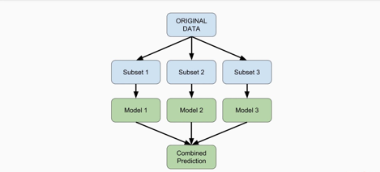
Model
ENSEMBLE LEARNING

Slide 9
Which learning algorithms?
Artificial Neural Network
Random Forest
Decision Tree

Slide 10




Slide 11
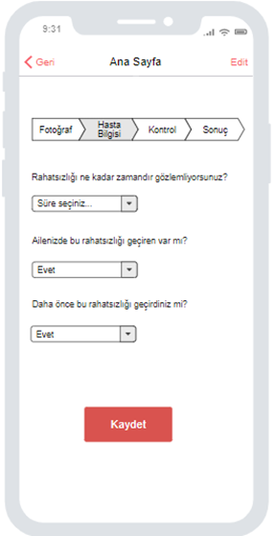
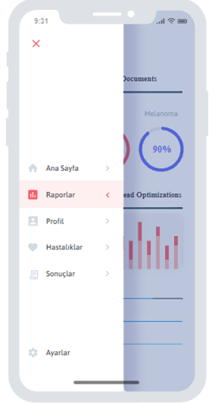
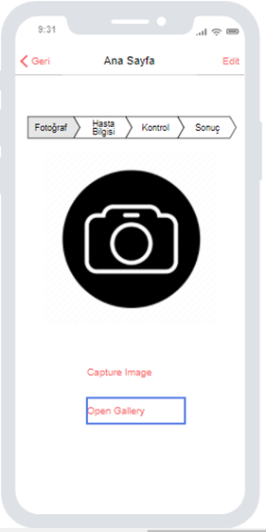
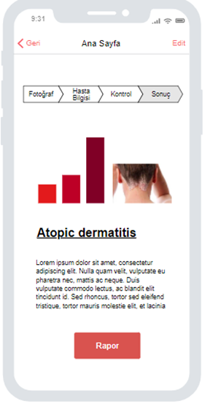
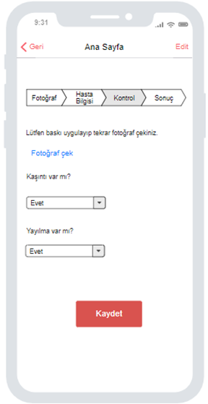
Mobile Application
Flutter – Dart Language

Slide 12
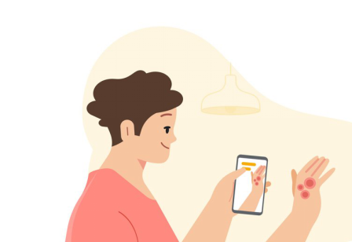
How to use it?

Slide 13
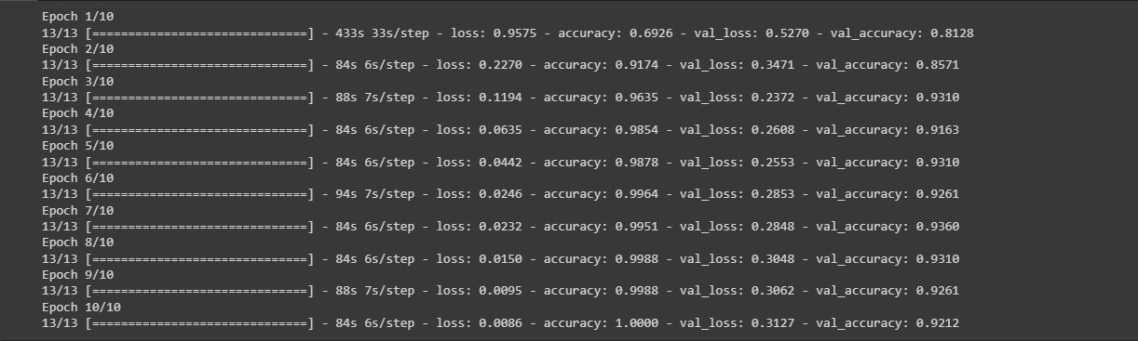
Overfitting!

Slide 14
Future works
GET MODEL USING ENSEMBLE LEARNING AND SAVE IT
Create a mobIle applIcatIon
TestIng the mobIle applIcatIon

Slide 15
Thank you!
Rozerin Yıldız

Slide 16
References
https://www.google.com/url?sa=i&url=https%3A%2F%2Fwww.healthline.com%2Fhealth%2Fkeratosis-pilaris-treatment&psig=AOvVaw0xlvHtZnsjG4VbF7LehJOZ&ust=1672930737829000&source=images&cd=vfe&ved=0CBAQjRxqFwoTCNjtquWWrvwCFQAAAAAdAAAAABAE
https://www.apothecopharmacy.com/blog/eczema-vs-dry-skin-how-to-tell-the-difference/
https://www.everydayhealth.com/melanoma/metastatic-melanoma/
https://towardsdatascience.com/a-comprehensive-guide-to-convolutional-neural-networks-the-eli5-way-3bd2b1164a53
https://en.wikipedia.org/wiki/Scikit-learn
https://logicoretech.com/services/python-and-django-development/
https://venturebeat.com/ai/facebook-and-microsoft-launch-pytorch-enterprise-support-program/

