Slide 1


ONTOLOGY APPLICATION
IN HEALTHCARE
DATA HARMONIZATION
Coursework 3
ROZINA M (B00857003)
MSc Artificial Intelligence
Ulster University

Slide 2
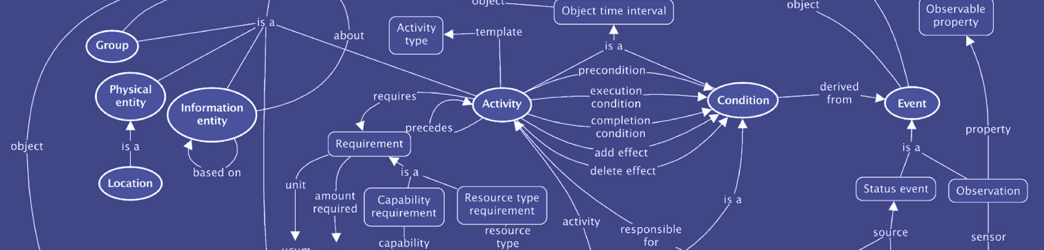
Table Of Contents
Introduction 5. Ontology Metadata 9. Ontology Specifications
Healthcare Ontology Models 6. Abbreviation Problem 10. Ontology Visualization
Bio-Ontological Resources 7. Knowledge Representation Problem 11. Conclusion
Tools Used 8. Clinical Ontology Implementation 12. References

Slide 3

Introduction
The Ontology concept was first used in the discipline of Philosophy, means “the study of being”
Vast volume of biological literature have made data access tedious and time consuming
Connecting the data from scientific texts to regulated terminology or databases with biomedical applications is just as important as extracting it from scientific texts
Another feature of biomedical literature is the widespread use of acronyms, which raises two important concerns- the need of Acronym repository data and regulated vocabularies
This practice, among other things, requires the harmonization of datasets in usage.
This is a precondition for improving the quality, data reusability, and interoperability of datasets.

Slide 4
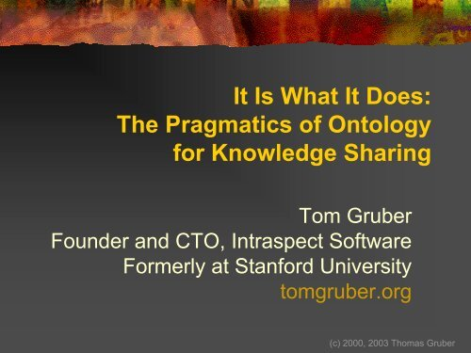
Healthcare Ontology Models
In the year 1993, Gruber proposed one among the trendiest definitions for ontology in the stream of artificial intelligence and computing
Healthcare Ontologies commenced with the growth of GO (Gene Ontology, 1998)
OBO Foundry started with their efforts on data harmonization in 2007
NCBO, similarly, had their implementations in place for healthcare ontology models
“Ontology being a conceptual representation of a clear specification”
-Gruber, 1993

Slide 5

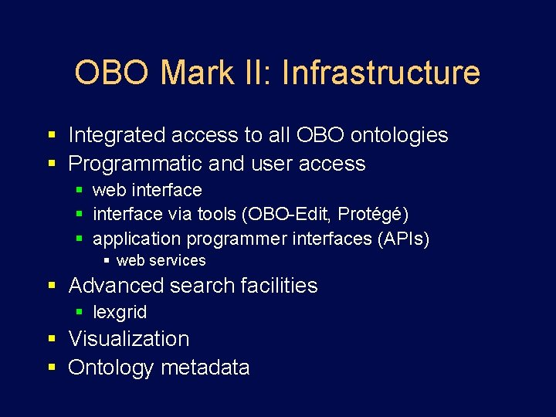
Bio-Ontological Resources
OBO/NCBO Bio-Medical Portal
Covers approximately 500 biomedical ontologies
Commonly used as an umbrella organization for biomedical related ontologies
The Foundry project intends to improve information management in the biomedical field.
The class 'specimen,' for instance, has been utilized in over 30 ontologies.
As a result, organized file formats, knowledge representation, and database systems all employ these Identifiers.

Slide 6



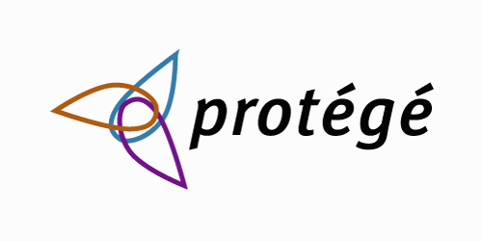

Tools Used
OWL
RDF
PROTÉGÉ 5.5
VIZ. TOOLS
Web Ontology Language representing objects, things & relationships
Resource Description Framework- aids data formats combining easier with triples & semantic rules
A free, open-source ontology builder and framework for constructing ontologies
For Analytics & Visualization on Ontology Design

Slide 7
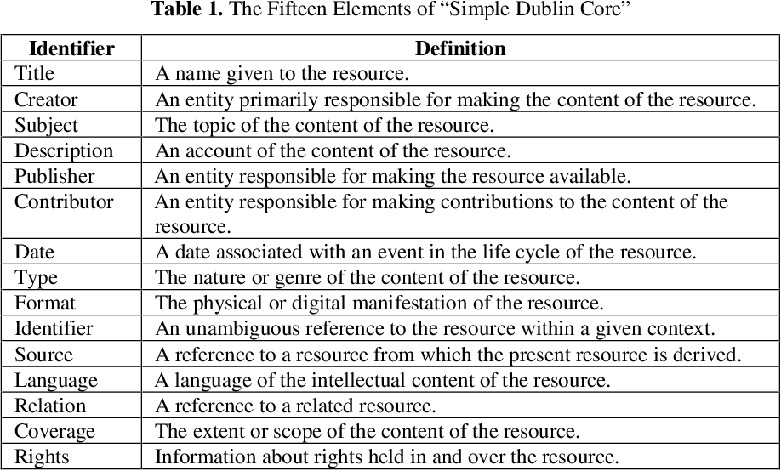
Ontology Metadata
Ontology Metadata was created using the Dublin
Core protocol definition found at DCMI Metadata
Terms.
Comprises of the following:
Name: To construct the URI of the word, a token is attached to the URI of a DCMI container.
Label: The terms’ designated human-readable label.
URI: The Uniform Resource Identifier (URI) is a number that is used to represent a term.
Definition: A declaration that encapsulates the meaning and notion of the term.
Type of Term: Attribute, class, data type, or terminology encoding technique is the term type

Slide 8
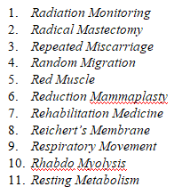
Abbreviation Problem
“The application of an ontology helps to address the problem of abbreviation.”
The definition of the abbreviation (RM) in health care, for instance, might be one of the following:
Helps to define numerous abbreviation explanations and making much easier to refer for an ongoing medication
This would be a great repository for research work, where building metadata basis abbreviations aids to arrive at conclusions much better and precise
Addition of 'synonym' metadata representations for related constructs

Slide 9
Knowledge Representation Problem
Specific 1
Use of ontology to solve the Knowledge representation problem
Specific 2
Heavy smoker
(HCO_119)
A smoker who reports consuming 20 cigarettes or more per day
rdfs:
isDefinedBy
The amount of cigarettes with each category of smoker may be justified employing ontology definitions
It shows how a researcher classifies heavy smokers.
Specific 3
To circumvent various definitions of the identical term, an ontology system is used.

Slide 10
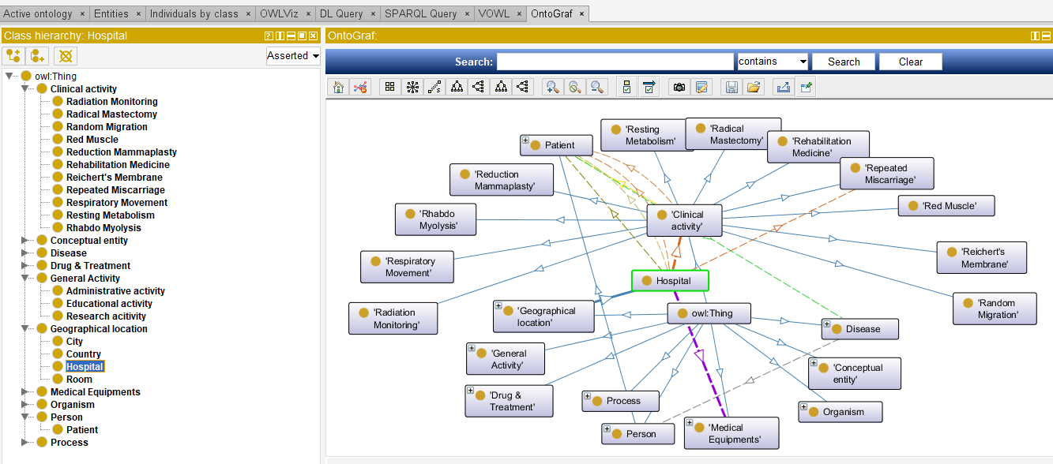
Clinical Ontology Implementation

Slide 11
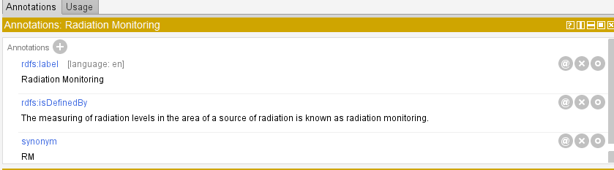
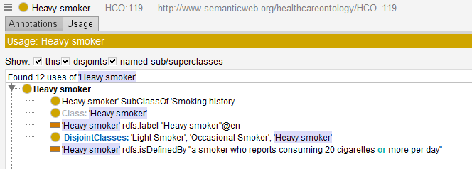
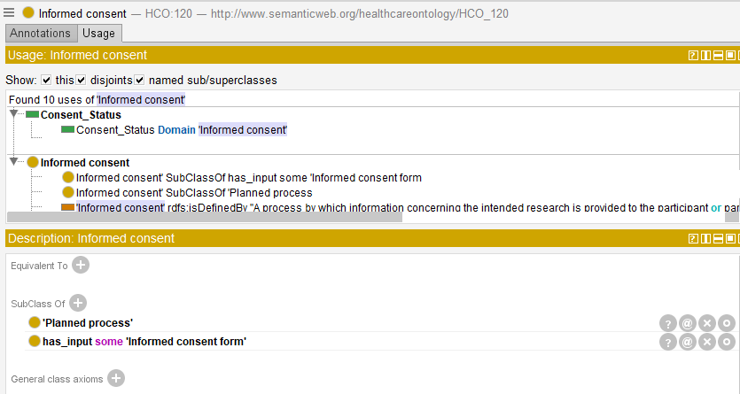
Ontology Specifications
Class Hierarchies & Annotations

Slide 12
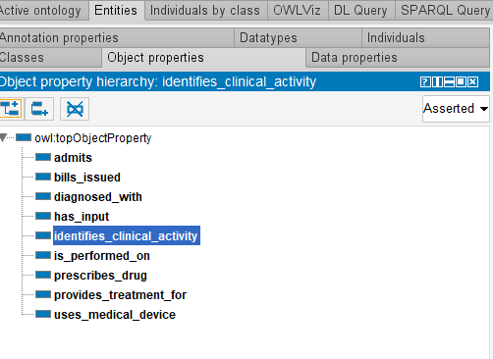
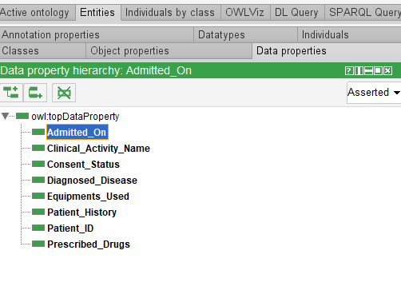
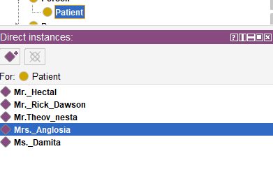
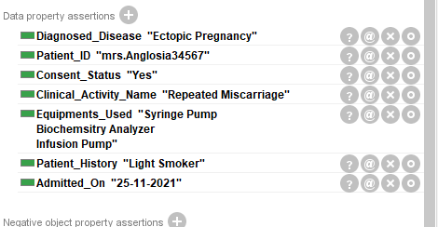
Ontology Specifications
Data ,Object Properties & Individuals Creation

Slide 13
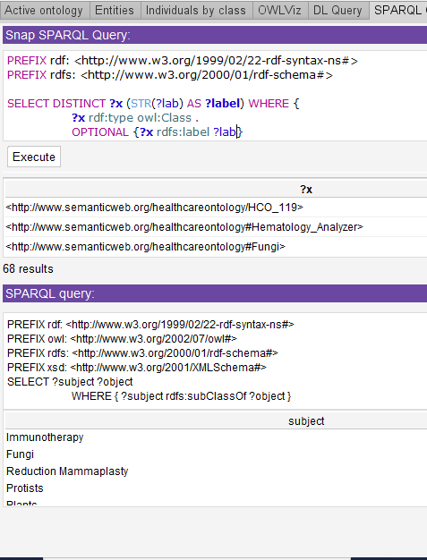
Ontology Specifications
Querying Ontology

Slide 14
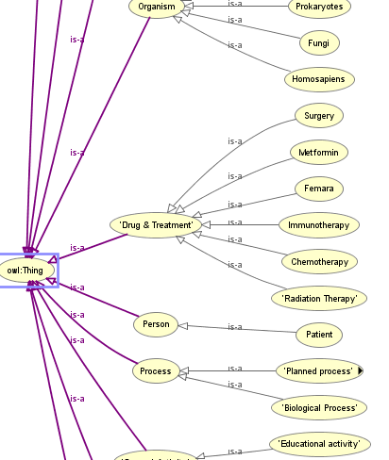
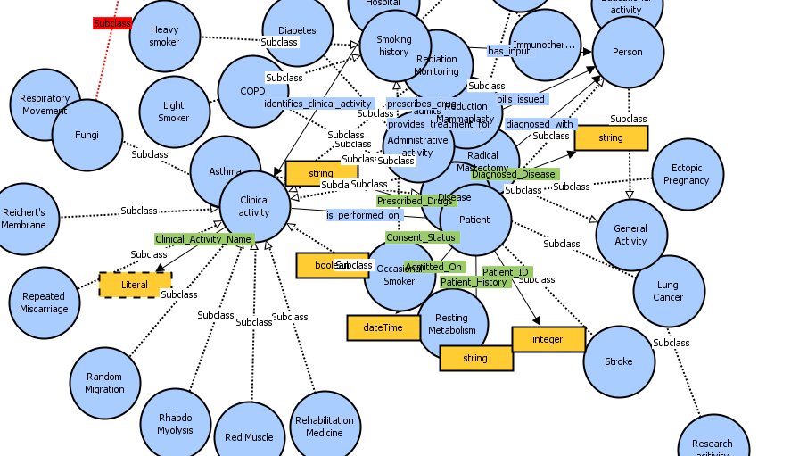
Ontology Visualization
By default, we can visualize ontology using OWLViz and Ontographs.
Also, various plugins available online to do ontology visuals, such as VOWL, ClueGo, VAMP plugins etc.

Slide 15
Conclusion
Conceptual integration is the most difficult aspect of healthcare data unification.
We'll need adequate common semantics as well as conceptualization to do this.
Developing a standard ontology for clinical data requires a participative and integrated approach.
The usage of ontology has proven to be extremely valuable for both technical knowledge as well as making sense of spoken words among a diverse group of people in the biomedical field.
“Overall, More Improvements are always focused for high-level future scope to better represent the knowledge”

Slide 16

References
Ashburner, Michael, Catherine A. Ball, Judith A. Blake, David Botstein, Heather Butler, J. Michael Cherry, Allan P. Davis, et al. 2000. “Gene Ontology: Tool for the Unification of Biology.” Nature Genetics 25 (1): 25–29.
Bodenreider, Olivier, and Robert Stevens. 2006. “Bio-Ontologies: Current Trends and Future Directions.” Briefings in Bioinformatics 7 (3): 256–74.
Borst, Willem Nico, and W. N. Borst. 1997. “Construction of Engineering Ontologies for Knowledge Sharing and Reuse.” Https://research.utwente.nl/.../construction-of-Engineering-Ontologies-for-Knowledge-S...https://research.utwente.nl/en/publications/construction-of-engineering-ontologies-for-knowledge-sharing-and-
“DCMI Metadata Terms.” n.d. Accessed November 4, 2021. https://www.dublincore.org/specifications/dublin-core/dcmi-terms/
DuCharme, Bob. 2013. Learning SPARQL, 2nd Edition. O’Reilly Media, Inc.
Gruber, Thomas R. 1993. “A Translation Approach to Portable Ontology Specifications.” Knowledge Acquisition 5 (2): 199–220.

Slide 17


