Slide 1
Attendance w/ openCV
https://github.com/cmusatyalab/openface

Slide 2
3 Steps Face Recognizer
Record a Face and Insert into Database
Train a Dataset
Recognize Faces

Slide 3
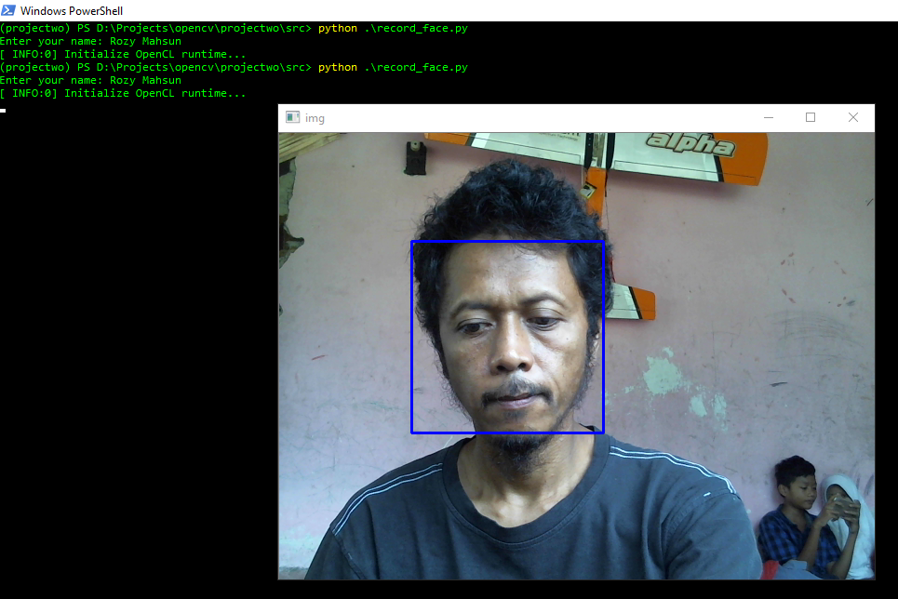
Record a Face and Insert into Database
D:\Projects\opencv\projectwo\src> python .\record_face.py

Slide 4
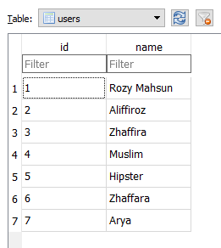
Record a Face and Insert into Database (cont.)
Table in database

Slide 5
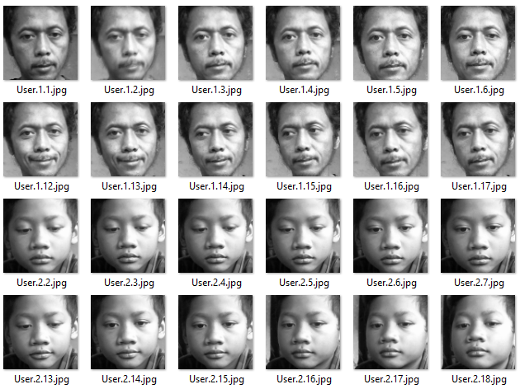
Record a Face and Insert into Database (cont.)
Recorded faces stores in directory
D:\Projects\opencv\projectwo\src\dataset

Slide 6
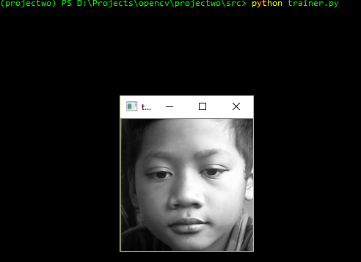
Train a Dataset
D:\Projects\opencv\projectwo\src> python trainer.py

Slide 7
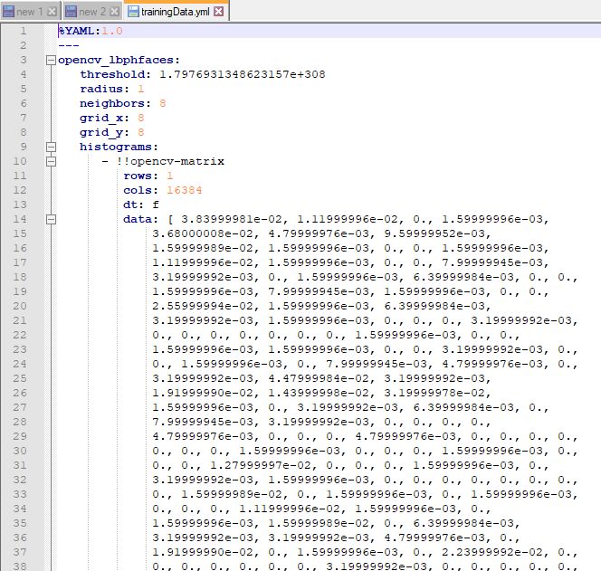
Train a Dataset (cont.)
.yml file format generated
D:\Projects\opencv\projectwo\src> python trainer.py

Slide 8
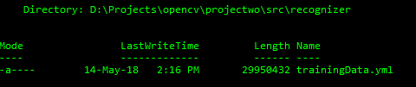
Train a Dataset (cont.)
.yml file format generated
D:\Projects\opencv\projectwo\src\recognizer

Slide 9
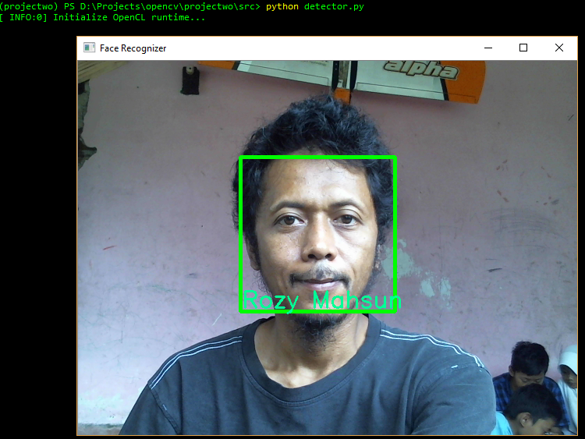
Recognize Faces
D:\Projects\opencv\projectwo\src> python detector.py

Slide 10
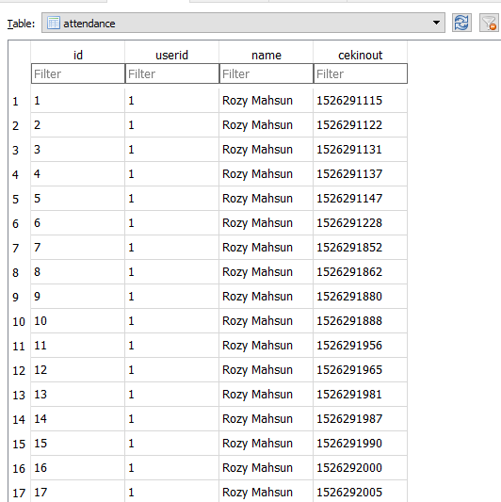
Attendance Data

Slide 11
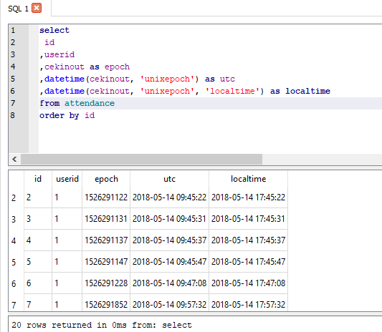
Attendance Data

Slide 12
End
thanks

