Slide 1
Encryption and Decryption of Text By Using Caesar Cipher
Rajath Prabhu

Slide 2
AGENDA
Introduction​
Overview
​AIM
Tools
​System Requirements
Conclusion

Slide 3
Introduction
In the ever-evolving landscape of information security and cryptography, the Caesar Cipher stands as an iconic and enduring symbol of the earliest methods employed to protect sensitive information. Named after Julius Caesar, who is believed to have employed this technique for secure communication during his time, the Caesar Cipher represents a foundational concept in the history of encryption.
At its core, the Caesar Cipher is a substitution cipher, one of the simplest forms of encryption, which involves replacing each letter in a message with another letter in the alphabet. The distinguishing feature of the Caesar Cipher is its use of a fixed key, which determines the number of positions each letter is shifted in the alphabet. This seemingly basic yet ingenious method can provide a degree of confidentiality and security, making it a fundamental building block in the field of cryptography.
This project report delves into the intricacies of the Caesar Cipher, exploring its history, principles, and practical applications. It aims to provide a comprehensive understanding of how this ancient encryption technique works, its strengths and weaknesses, and its relevance in today's world of advanced encryption methods and cyber threats.

Slide 4
OVERVIEW

Slide 5
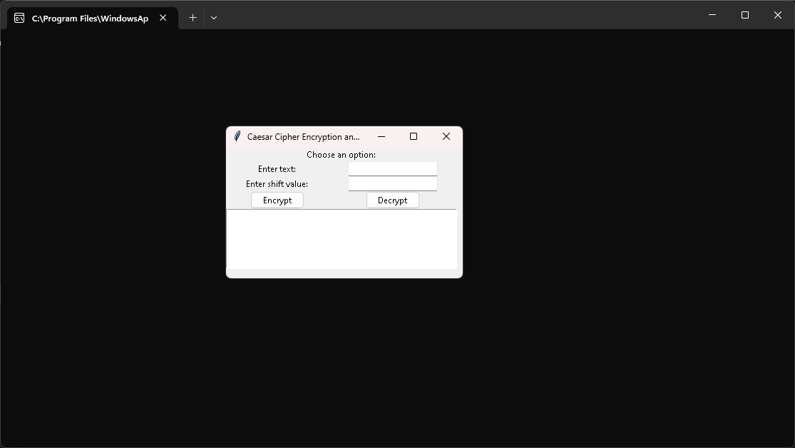
Encryption and Decryption of Text By Using Caesar Cipher

Slide 6
AIM

Slide 7
The primary aim of this project is to delve into the historical significance and practical application of the Caesar Cipher, a classical encryption technique. We aim to explore the historical context in which Julius Caesar employed this cipher and understand its evolution in the realm of cryptography. Our project seeks to dissect the mechanics of the Caesar Cipher, unraveling how it encrypts and decrypts messages using a fixed key. We will conduct a thorough security analysis, assessing both its strengths and vulnerabilities, particularly its susceptibility to brute force attacks due to its limited keyspace.
AIM:

Slide 8
Additionally, we will implement the Caesar Cipher and provide demonstrations of its operation, highlighting its educational value as a foundational concept for teaching encryption basics. Comparisons with contemporary encryption methods will be made to underline the evolution of cryptographic techniques. Lastly, we will investigate historical and modern-day applications of the Caesar Cipher, showcasing its role in securing information while acknowledging its limitations in today's cybersecurity landscape.

Slide 9
TOOLS USED:
FRONT END LANGUAGES
Python

Slide 10
SYSTEM REQUIREMENTS
Hardware Requirements:
Computer with either Intel Pentium processor or AMD processor.
128MB DDR RAM or 40GB hard disk drive
Software Requirements:
Windows 98/2000/XP operating system.
Microsoft Visual Studio 6.0

Slide 11
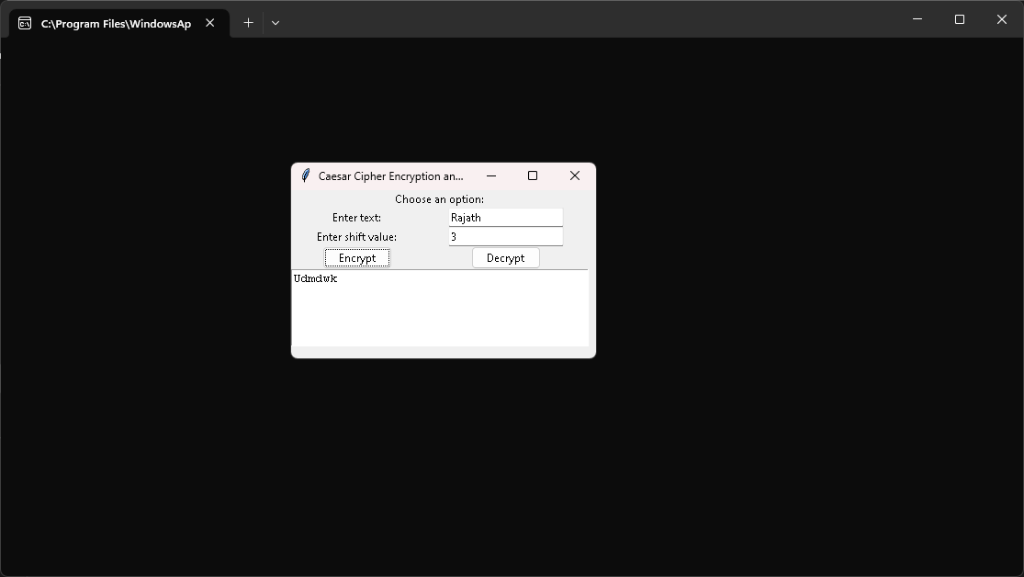

SCREENSHOTS

Slide 12
CONCLUSION
In conclusion, this project has provided a comprehensive exploration of the Caesar Cipher, shedding light on its historical significance, mechanics, security aspects, and practical applications. Through this journey, several key takeaways emerge:
First and foremost, the Caesar Cipher, although a rudimentary encryption technique, serves as a critical stepping stone in the world of cryptography. Its simplicity makes it an excellent tool for educational purposes, allowing learners to grasp fundamental encryption concepts and the importance of key management.
The project highlighted the Caesar Cipher's operation, demonstrating how it encrypts and decrypts text by shifting characters based on a fixed key value. However, it is crucial to acknowledge its limitations, particularly its susceptibility to brute force attacks due to its restricted key space. In today's sophisticated cybersecurity landscape, the Caesar Cipher is insufficient for safeguarding sensitive information.

Slide 13
THANK YOU
RAJATH PRABHU

