Slide 1
Design of 3 Bit Gray To Binary Converter
Group Number:- 13
Group Members:-
Nishant Gupta (2024393)
Pranav Ramanathan (2024424)
Sushruth S G (MT26215)
Hrithik R (MT26165)
Guided By :-
Dr. Anuj Grover
Sameer Tiwari
Vishal Vishwakarma

Slide 2
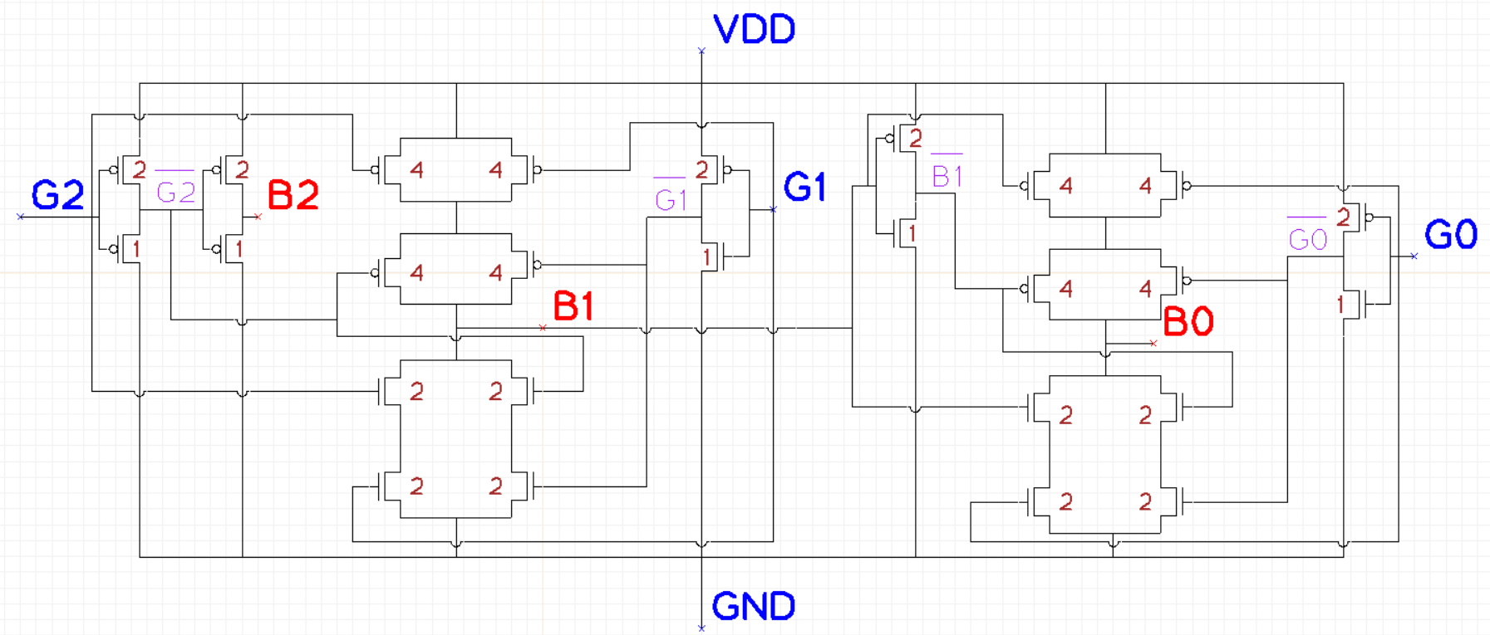
Schematic + Sizing

Slide 3
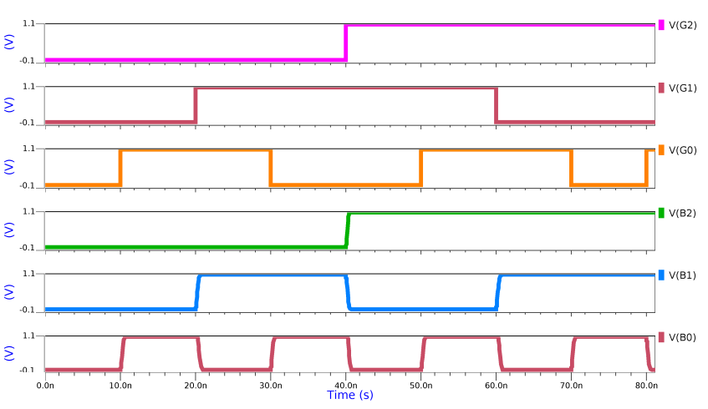
Stimuli For Verification & Verification Plan

Slide 4
Stimuli For Verification & Verification Plan
Corner | Parameter | B2 | B1 | B0
SS | RISE | 3.6687E-10 | 4.9978E-10 | 4.7821E-10
SS | FALL | 3.8011E-10 | 4.8771E-10 | 5.2637E-10
SS | TPLH | 2.0061E-10 | 2.4898E-10 | 2.4400E-10
SS | TPHL | 2.0295E-10 | 2.6270E-10 | 2.3184E-10
SS | DELAY | 2.0178E-10 | 2.5629E-10 | 2.3792E-10
FF | RISE | 2.6600E-10 | 3.5481E-10 | 3.2276E-10
FF | FALL | 2.3605E-10 | 3.0197E-10 | 3.5089E-10
FF | TPLH | 1.3637E-10 | 1.4521E-10 | 1.6474E-10
FF | TPHL | 1.3175E-10 | 1.7735E-10 | 1.3548E-10
FF | DELAY | 1.3406E-10 | 1.6128E-10 | 1.5011E-10
G2 | G1 | G0 | B2 | B1 | B0
0 | 0 | 0 | 0 | 0 | 0
0 | 0 | 1 | 0 | 0 | 1
0 | 1 | 1 | 0 | 1 | 0
0 | 1 | 0 | 0 | 1 | 1
1 | 1 | 0 | 1 | 0 | 0
1 | 1 | 1 | 1 | 0 | 1
1 | 0 | 1 | 1 | 1 | 0
1 | 0 | 0 | 1 | 1 | 1

Slide 5
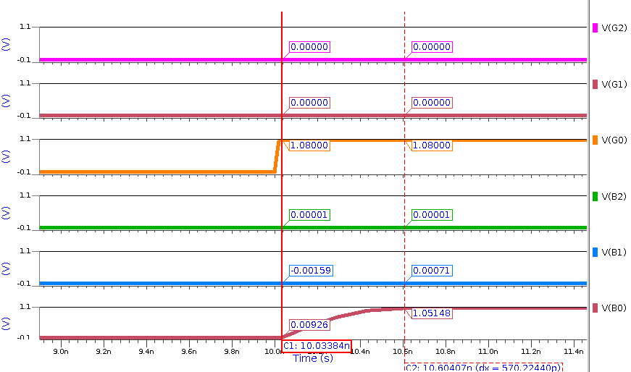
Stimuli For Verification & Verification Plan
TT
Power @ 100 MHz TT
Parameter | B0 | B1 | B2
RISE | 3.8506E-10 | 4.1958E-10 | 3.1630E-10
FALL | 4.2690E-10 | 3.8666E-10 | 3.1692E-10
TPLH | 2.0325E-10 | 2.1547E-10 | 1.6533E-10
TPHL | 1.7684E-10 | 1.9089E-10 | 1.6504E-10
DELAY | 1.9004E-10 | 2.0318E-10 | 1.6519E-10
Power
Parameter | B0
P_STATIC_AVG | 7.0115E-07
P_DYNAMIC | 3.2697E-05

Slide 6
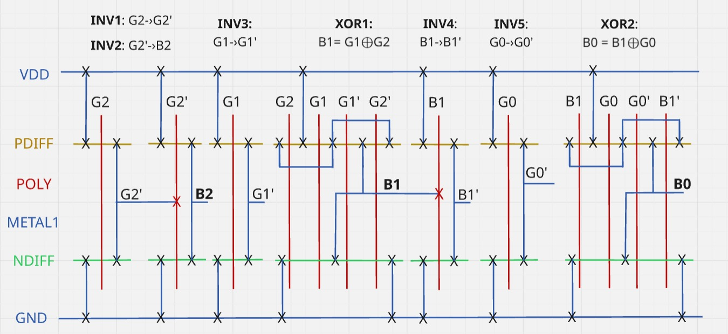
Stick Diagram

Slide 7
Future Work + Work Distribution
Completed Work:
Schematic & Sizing :- Nishant Gupta
Verification & Pre layout :- Sushruth S G & Hrithik R
Stick Diagram :- Pranav Ramanathan
Future Work:
Layout and PEX
Pre Layout vs Post Layout Analysis
Power Analysis

