Slide 1
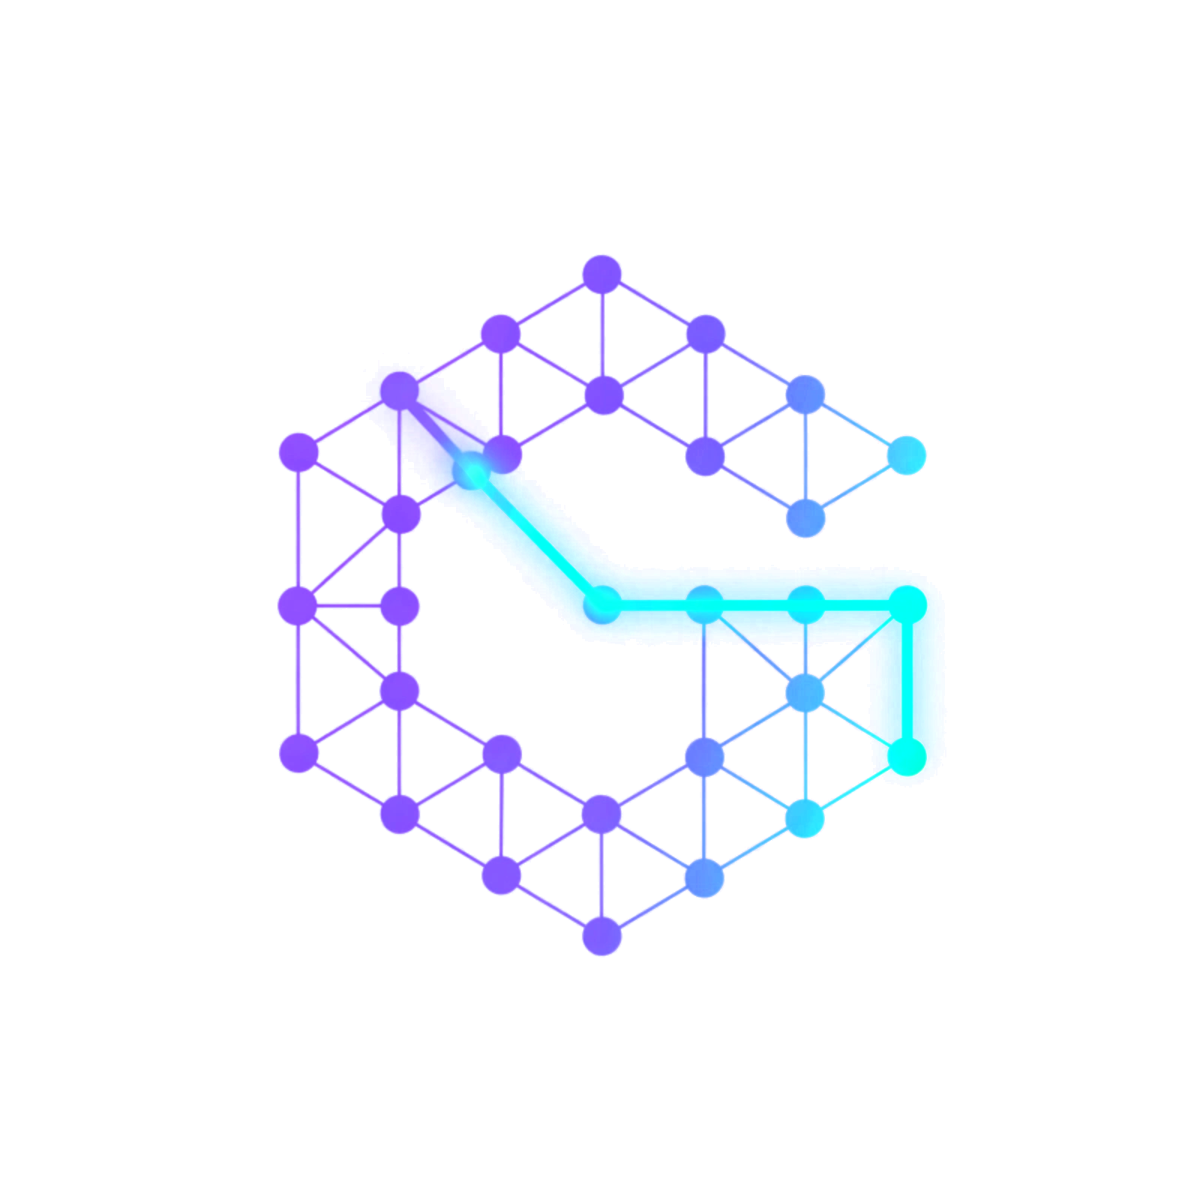
CodeGraph
See, question and repair a multi-repo system from one dashboard, with a human approving every change to code.
View Graph
Ask AI
Fix Bugs
Hackathon
Notes:
One-liner: CodeGraph turns a multi-repo codebase into a live knowledge graph, then puts three workflows on top: View Graph, Ask AI and Fix Bugs. A human approves every change to code.

Slide 2
THE PROBLEM
Six repos, one system, no shared view
Links are invisible
Agents guess
Trust is missing
A call in tb-discovery-mfe lands in a Java endpoint in tb-selection-xapi. No single tool shows that link across repos.
General coding agents grep, miss cross-repo consumers, and change code with no audit trail.
Teams won't accept unattended AI changes. They need evidence at every step, and a way to stop the agent.
THE SIX REPOS
tb-common-mfe
tb-discovery-mfe
tb-marketing-xapi
tb-discovery-xapi
tb-selection-xapi
kairos-fabric
Blue: micro-frontends Amber: TypeScript API Pink: Java APIs Green: design-system library
CodeGraph | Hackathon
2
Notes:
Our product spans six repos: two micro-frontends, three experience APIs (one TypeScript, two Java) and a shared design-system library. A frontend call in one repo reaches an endpoint in another, and no single tool shows that link.

Slide 3
THE SOLUTION
One graph, three workflows
SEE
QUESTION
REPAIR
View Graph
Ask AI
Fix Bugs
Explore how repos, files, components, endpoints, tables and packages connect, including links across repos.
Ask in plain English and get an answer with real file names and line numbers.
Paste an error. An agent finds the cause, proves it with a failing test, fixes it minimally and opens a PR through 4 human gates.
No code changes
Read-only
Branch only. Never merges.
SHARED FOUNDATION
Cross-repo knowledge graph
Graphify + Neo4j
React dashboard
React Flow
Cursor SDK agents
grounded by the graph
CodeGraph | Hackathon
3
Notes:
Three workflows on one foundation: a cross-repo knowledge graph built by Graphify in Neo4j, a React dashboard drawing it with React Flow, and Cursor SDK agents grounded by the graph.

Slide 4
ARCHITECTURE
How the pieces fit together
6 work repos
source code
Graphify
extract and link
Neo4j
knowledge graph
FastAPI
port 8000
React dashboard
port 5173
read only
Ask AI agent
read-only
Repo checkouts
read and edit
Fix Bugs agent
gated
edit, test, git
STACK
GitHub
open PR
state.json
Python + FastAPI, Neo4j, tree-sitter, React 19 + Vite, @xyflow/react + dagre, Cursor SDK, gh CLI
CodeGraph | Hackathon
4
Notes:
Graphify extracts nodes and edges from the six repos and pushes them to Neo4j. FastAPI serves the graph to the React dashboard and hosts the two agents. Ask AI is read-only; Fix Bugs edits, tests and opens PRs on GitHub, and records progress in state.json.

Slide 5
GRAPHIFY
A deterministic graph builder: no LLM at build time
PER REPO
1
Collect files
2
Base AST
3
Framework rules
4
Tag with repo
skip node_modules, dist, build…
tree-sitter: functions, classes, calls
Fastify, React, Next.js, Spring, SQL
ids prefixed <repo>::
ALL REPOS TOGETHER
CURRENT GRAPH
5
Package graph
6
Link pass
7
Dedupe, push
13.2k nodes
package.json to package nodes
resolve edges across repos
validate, MERGE into Neo4j
35.9k edges
WHY DETERMINISTIC
The same code always produces the same graph. LLMs only read the graph (Ask AI, Fix Bugs). They never create it. Rebuilds are idempotent per repo.
CodeGraph | Hackathon
5
Notes:
Graphify is a customized fork of the open-source safishamsi/graphify with a deterministic multi-repo path. No LLM at build time: same code, same graph. LLMs only read the graph. Run: python -m graphify.codegraph --repos repos.json --push, or press Rebuild in the dashboard. Stats are a snapshot: about 13,200 nodes and 35,900 edges.

Slide 6
THE KEY IDEA
Extractors observe. Linkers connect.
tb-discovery-mfe
tb-selection-xapi
ProductList
component | fetch('/api/products')
fetches | INFERRED
GET /api/products
endpoint | Spring controller
resolved by the global link pass
THREE WAYS THE LINK PASS CONNECTS REPOS
Pending calls
Service calls
Proxy routes
Match (method, path) to a global endpoint registry. Tolerates :param segments and API-client wrappers.
An env var like SELECTION_XAPI_BASE_URL becomes a calls_service edge to a service node, then narrows to real endpoints.
A Next.js catch-all route links to the repo it forwards to (proxies_to). A bare /api/:path* is never linked.
CodeGraph | Hackathon
6
Notes:
Extractors observe one file at a time; linkers connect. An extractor can only say component X calls GET /api/products, target unknown, so it records a pending edge. After all repos are extracted the link pass builds a global (method, path) registry and resolves each pending call. Also follows API-client wrappers, service calls via env-var base URLs, and Next.js proxy routes. Resolved cross-repo edges are INFERRED (dashed); calls_service is EXTRACTED.

Slide 7
WORKFLOW 1
View Graph: progressive disclosure on React Flow
1
All-repos map
NEIGHBORHOOD OF ProductList (ILLUSTRATIVE)
One box per repo, one arrow per repo pair, labelled with counts
ProductsPage
formatPrice()
2
Pick a repo
ProductList
focus
Repo in the middle, entry points around it: packages, pages, endpoints
ProductList.tsx
GET /api/products
3
Neighborhood
A node plus everything one hop away, in any repo. Click to walk.
Left: used by / parent. Right: uses / children.
Dashed = inferred, other repo.
13.2k
35.9k
6
88
839
nodes
edges
repos
endpoints
components
CodeGraph | Hackathon
7
Notes:
13,000 nodes on one canvas is unreadable, so we never draw the whole graph. Explore starts on the All-repos map: one box per repo and one merged arrow per repo pair, with counts. Pick a node and you see its neighborhood: the node plus everything one hop away, in any repo. Click a neighbor to walk. The Tree view browses a repo like a file explorer. React Flow gives pan/zoom/minimap; dagre lays out.

Slide 8
WORKFLOW 2
Ask AI: answers with real files and line numbers
Question
plain English
Graph context
keyword subgraph
Agent
opens real files
Answer
file:line + chips
Read-only, enforced by the SDK
Graph is a map: if it disagrees with a file, the agent trusts the file
read
grep
glob
ls
One conversation is one agent: follow-ups keep context, and resume after restart
The agent has no shell, edit or delete tool. Read-only is set at agent creation, not requested in the prompt.
Live status in the UI: "Running grep..." instead of a bare spinner
No graph match? The agent searches the code itself and says so
CodeGraph | Hackathon
8
Notes:
Ask AI pre-fetches a small keyword-based subgraph (up to 8 keywords, 25 nodes, 6 neighbors each) and puts it in the prompt so the agent knows where to look. The agent's toolset is restricted to read, grep, glob, ls; that is enforced by the SDK at agent creation, not requested in the prompt. If the graph and a file disagree, the agent trusts the file and says so. Runs in a background thread; UI polls live status.

Slide 9
WORKFLOW 3
Fix Bugs: test-proven fixes, four human gates
1
2
3
4
Analyze
and locate
G1
Root
cause
G2
Reproduce
on unfixed code
G3
Fix and
open PR
bugfix.md
rootcause.md
repro.md
fix.md
Each gate is a mandatory human approval. Stage 3 falls back to Stage 2 if the hypothesis was wrong.
G4
RUN DONE: PR LEFT OPEN
After Gate 4, merge_status: not_merged. A person reads the diff and the artifacts, then merges (or doesn't).
No source edits before Gate 3
Scope fence
Never merges
Only tests and .pipeline/ files
Fixed at Gate 2; widening re-opens it
Agent may not run gh pr merge
CodeGraph | Hackathon
9
Notes:
Paste an error; the agent works through four stages with four mandatory human gates. Stages 1 to 3 may not touch source: only .pipeline/<slug>/ files and test files. Stage 3 exists to falsify the hypothesis; if the failing test fails for a different reason, we return to root cause. When Gate 4 is approved the run is done: the pipeline stops at an open PR and never merges. A person reviews and merges.

Slide 10
WHAT MAKES IT DIFFERENT
Not just "ask an agent to fix it"
Test-first and falsifiable
Preservation from the graph
Every gate is mandatory
The root cause is a claim. A test that fails for the wrong reason sends the run back to Stage 2.
Blast radius, including consumers in other repos, decides what must not change.
Silence or a blanket "looks fine" is not approval. Rejection loops back.
Scope fence
"No test" is stated, never silent
Runs survive restarts
Gate 2 fixes which files and functions may change. Leaving it means re-approval.
For races or env-only bugs, repro.md gives the reason and manual steps.
state.json is the single source of truth. The same agent resumes by id.
CodeGraph | Hackathon
10
Notes:
Why not just ask an agent to fix it? The hypothesis is a claim and stage 3 exists to falsify it. Preservation tests come from the graph's blast radius, including consumers in other repos. Headless approvals: the agent writes a pending_gate marker in state.json and stops; the dashboard shows it; approve or revise resumes the same agent.

Slide 11
SAFETY MODEL
A human keeps the last word on every change
WORKFLOW
CAN IT CHANGE CODE?
GUARDRAIL
View Graph
No source edits
Read endpoints. Rebuild only rewrites the graph (fast-forward git pull).
Ask AI
No
SDK-enforced toolset: read, grep, glob, ls. No shell or edit tool exists.
Fix Bugs
Branch only
4 gates, no edits before Gate 3, scope fence, minimal change, no merge.
OTHER CONTROLS
Optional bearer token on every route except /health
CORS origin allowlist
Secrets only in .env files
LLMs never create graph nodes or edges
CodeGraph | Hackathon
11
Notes:
Ask AI's read-only guarantee is technical: the toolset has no edit tool. Fix Bugs is different: its guardrails are rules the agent must follow, because it has a shell and git. That's why gates, scope fence and no-merge are backed by a human at every step and the last decision stays with a person.

Slide 12
WHAT'S NEXT
Future work
Incremental rebuilds
More extractors
Graph diffs and trails
Instead of full rebuilds, plus repo-relative paths
Other frameworks and message queues, plus unresolved-fetch checks
Saved trails, shareable node links, diff between rebuilds
Semantic search
Multi-user approvals
Isolated worktrees + metrics
Better graph context for Ask AI
Identity and per-repo owners
Safer runs, and time per gate, revise rate, falsified hypotheses
See it. Question it. Repair it.
A live graph of the system, answers with evidence, and fixes a human approves at every gate.
CodeGraph | Hackathon
12
Notes:
Close: see, question and repair the system, with evidence at each step and a person deciding what merges.

