Slide 1
Per-site deep-regolith thermal conductivity K_d at Apollo 15 & 17
A converged, guess-independent retrieval — progress update
R. P. Gregorio · Kasai Laboratory, Institute of Science Tokyo · 17 June 2026
Notes:
Good morning. I'll walk through where the Apollo heat-flow K_d retrieval stands. The headline: we now retrieve the deep regolith conductivity separately at Apollo 15 and 17, with a forward model fixed to converge to a true steady state independent of its starting guess. I'll cover how that fix came about, the new K_d numbers and how they're justified, how they depend on the basal heat flux, and the computing side — including a possible C++ port and the cores question.

Slide 2
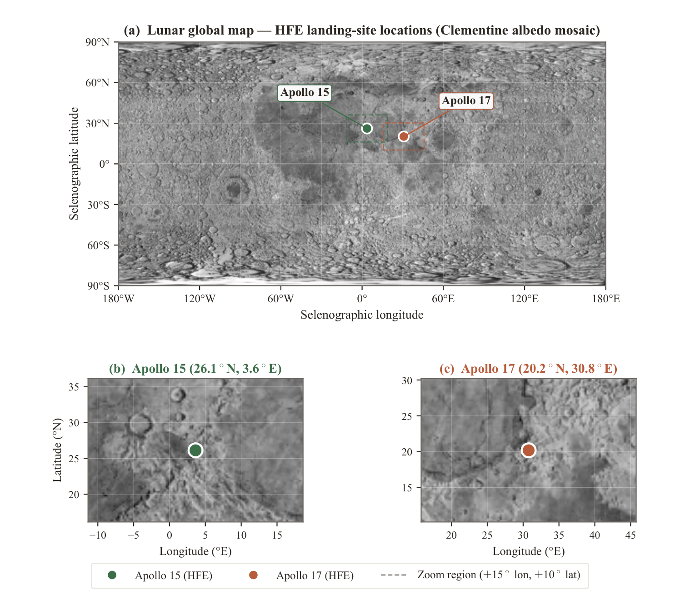
Why retrieve K_d per site?
Motivation
• K_d (deep regolith conductivity) sets the deep temperature gradient and the heat escaping the Moon.
• Published models use ONE global K_d — the two HFE boreholes may genuinely differ.
• Per-site K_d feeds subsurface thermal / ice-stability models and future missions.
Notes:
K_d is the deep thermal conductivity of the regolith — it controls how steeply temperature rises with depth and how much internal heat reaches the surface. Standard practice uses a single global value, but Apollo 15 at Hadley and 17 at Taurus-Littrow sit in different terrains. If their conductivities differ, a global value is wrong for both. Getting them per site matters for anyone modelling the subsurface.

Slide 3
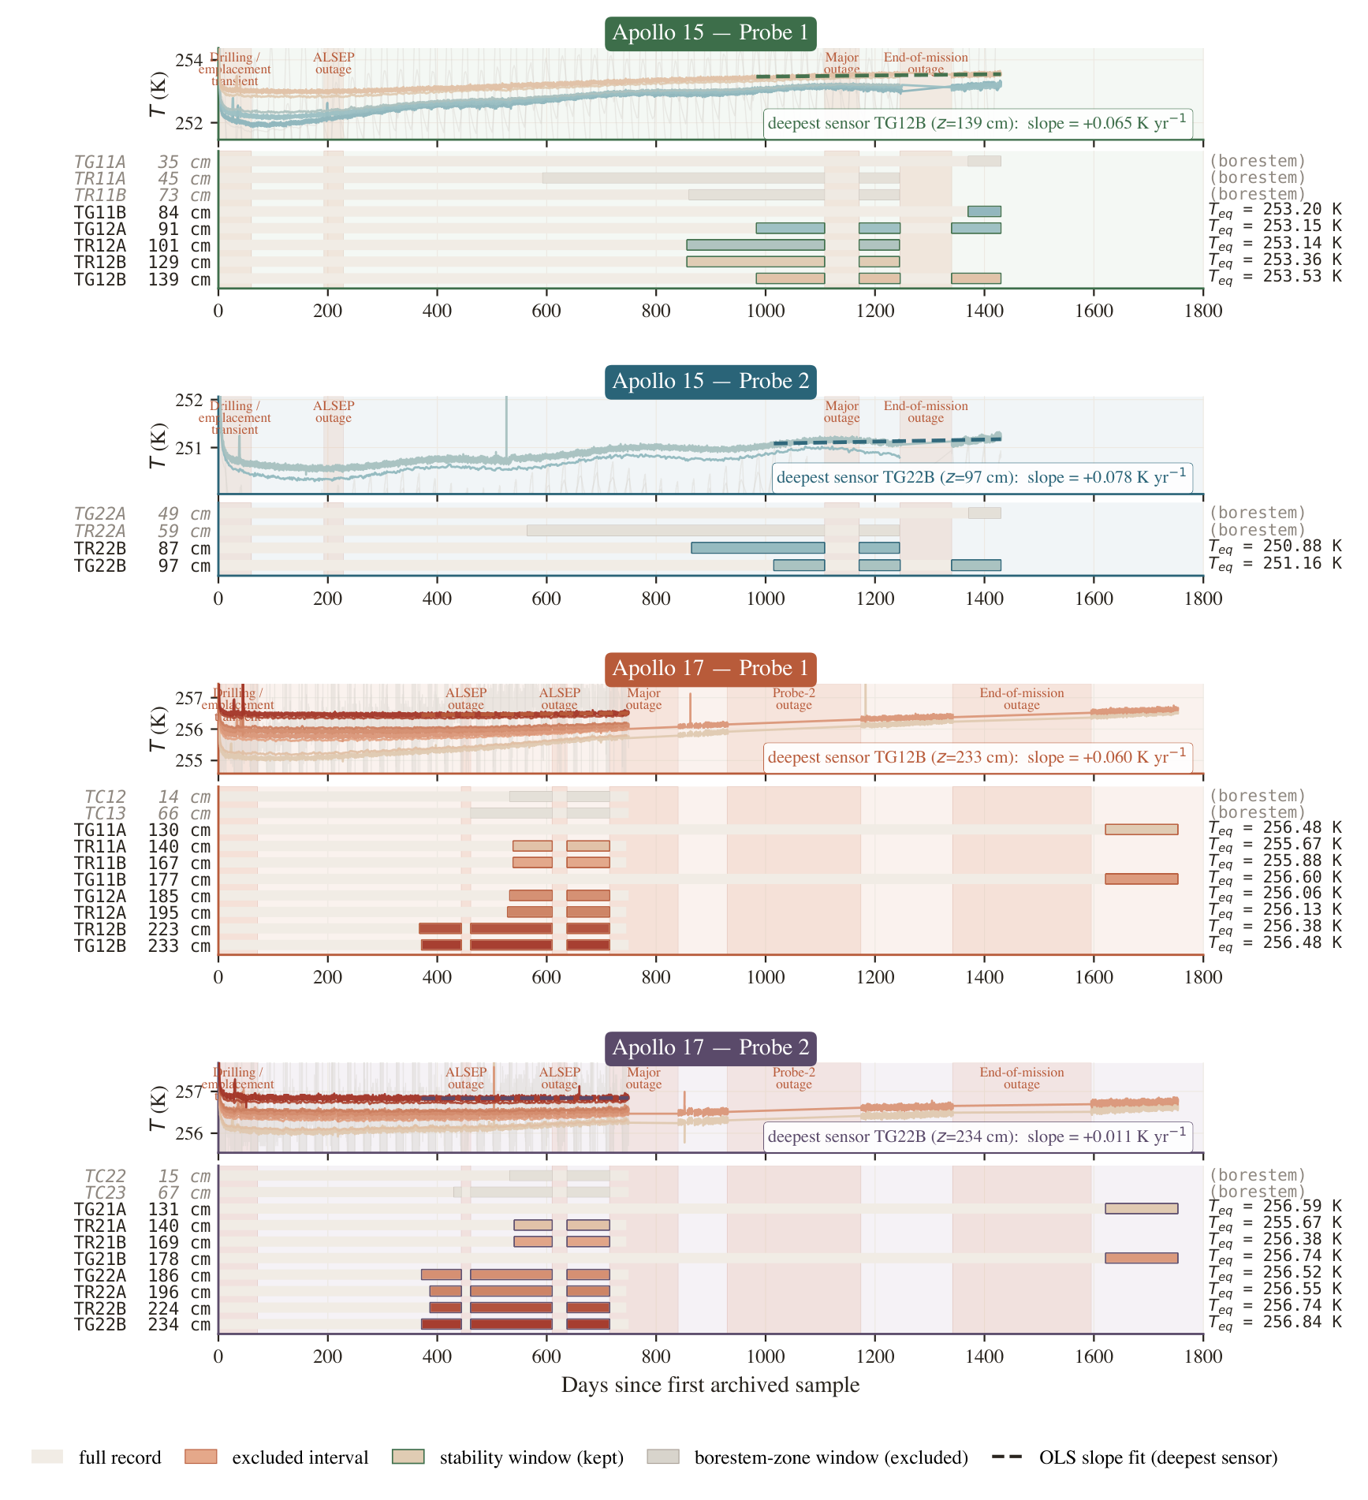
The data: restored Apollo HFE record (1971–1977)
Motivation
• Nagihara et al. (2018) restoration of the buried-probe temperatures.
• We fit only the settled ‘stability window’ of each sensor (not the noisy startup).
• 80 cm borestem cut (metal stem distorts shallow heat) → N = 7 (A15), 16 (A17) deep sensors.
Notes:
The data is the restored 1971-77 record from Nagihara 2018. Two cleaning steps. First, we use only the late, thermally settled part of each sensor's record — the stability window. Second, the top 80 cm is contaminated by heat conducted down the metal borestem, so we discard sensors above that. That leaves 7 trustworthy deep sensors at Apollo 15 and 16 at Apollo 17 — the numbers we actually fit.

Slide 4
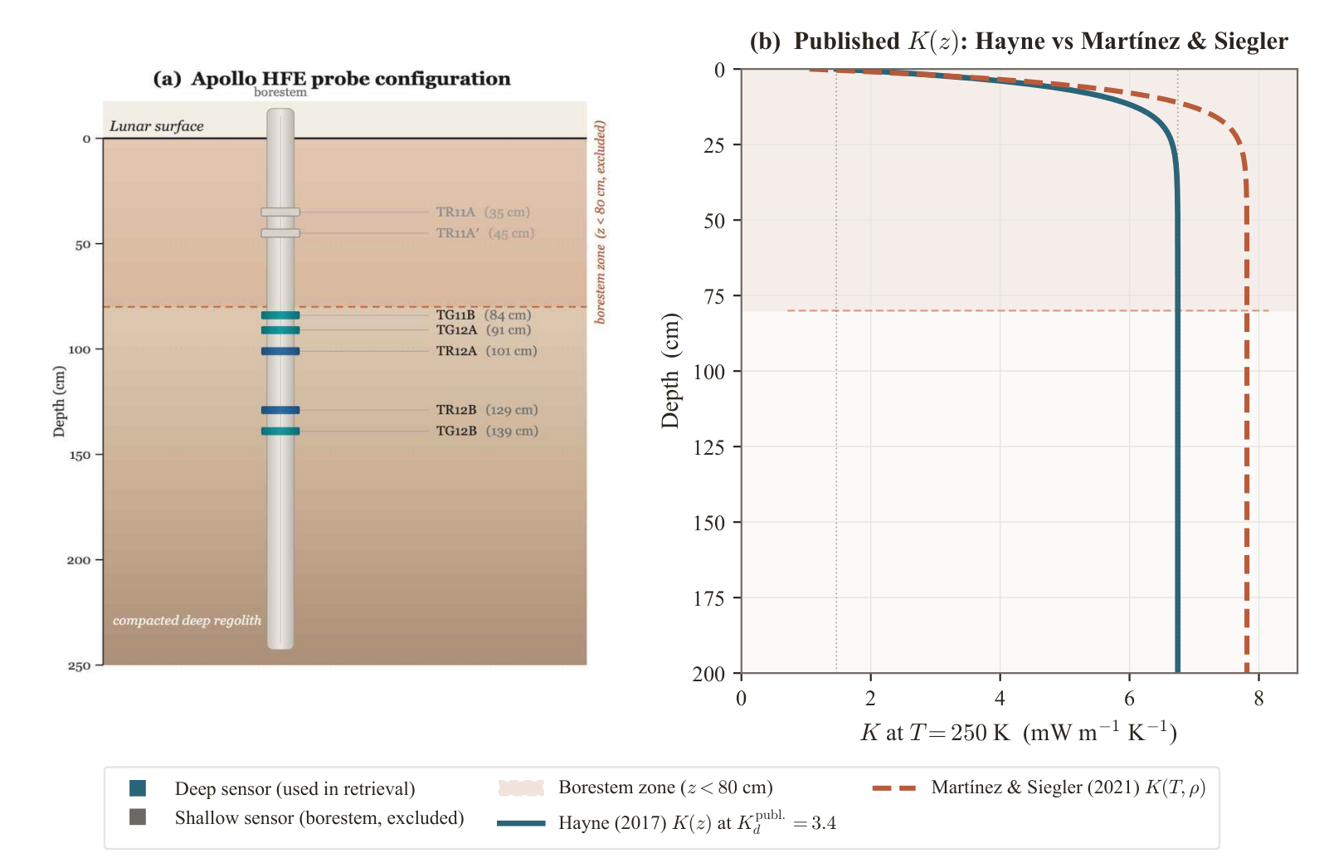
The forward model
Method
• 1-D heat equation in the regolith column; geometric grid (mm at top → 5 m deep).
• Temperature- and depth-dependent conductivity K(T, z) (Hayne 2017 form).
• Surface: full radiative energy balance. Bottom: geothermal flux Q_b.
• Solved to a periodic steady state, then compared to the deep sensors.
Notes:
Under the data sits a standard 1-D heat-conduction model. A grid that's fine near the surface to resolve the daily thermal wave and coarse at depth; conductivity that depends on temperature and depth; sunlight balanced by radiation at the surface; and the Moon's geothermal flux entering at the bottom. We run it until each lunar day repeats — the periodic steady state — and the whole retrieval is just: find the K_d that best matches the sensors.

Slide 5
The problem we found (flag F1)
Equilibrium fix
A fixed ~30-lunation spin-up never reaches steady state at sensor depth.
• The deep column relaxes over ~10³ lunations — far longer than the spin-up.
• So the initial guess (an ‘anchor’ temperature) leaked into the answer → K_d biased by a hidden parameter.
• Worse: the usual ‘ΔT between lunations < 0.01 K’ check passed anyway — it looks converged long before it is.
Notes:
Here's the bug that started all this — flag F1. The model needs a steady state, but the deep column relaxes incredibly slowly, order a thousand lunar days. The old code ran about thirty. So at sensor depth the model still remembered the temperature we started it at — effectively a free knob we'd set by hand, and it biased K_d. The trap is that the standard convergence check, 'did the temperature stop changing between days', passes far too early because the deep drift is so slow. So you get a confident, wrong answer.

Slide 6
The fix: a flux-anchored shortcut
Equilibrium fix
At steady state the deep gradient is fixed: dT/dz = Q_b / K(T, z)
1
Short spin-up (~12 lunations) settles the fast surface skin and pins the anchor temperature at ~0.55 m.
2
From the anchor, integrate dT/dz = Q_b/K straight down — the whole deep profile, instantly.
3
Feed back and repeat 3–5× → converges. No long wait.
Analogy: find a tank's steady level from inflow = outflow, instead of waiting for the sloshing to stop.
Notes:
The fix doesn't wait. It uses a physical fact: at steady state the same heat flows through every layer — the geothermal flux Q_b — so the gradient at every depth is just Q_b divided by conductivity. That's not an unknown to discover; it's fixed by energy conservation. So: step one, a short spin-up, only long enough to settle the fast skin and pin one anchor temperature. Step two, integrate that known gradient straight down to fill the deep profile — instantly. Step three, repeat a few times. Converges in three to five rounds. Like computing a tank's level from inflow equals outflow instead of waiting for it to settle.

Slide 7
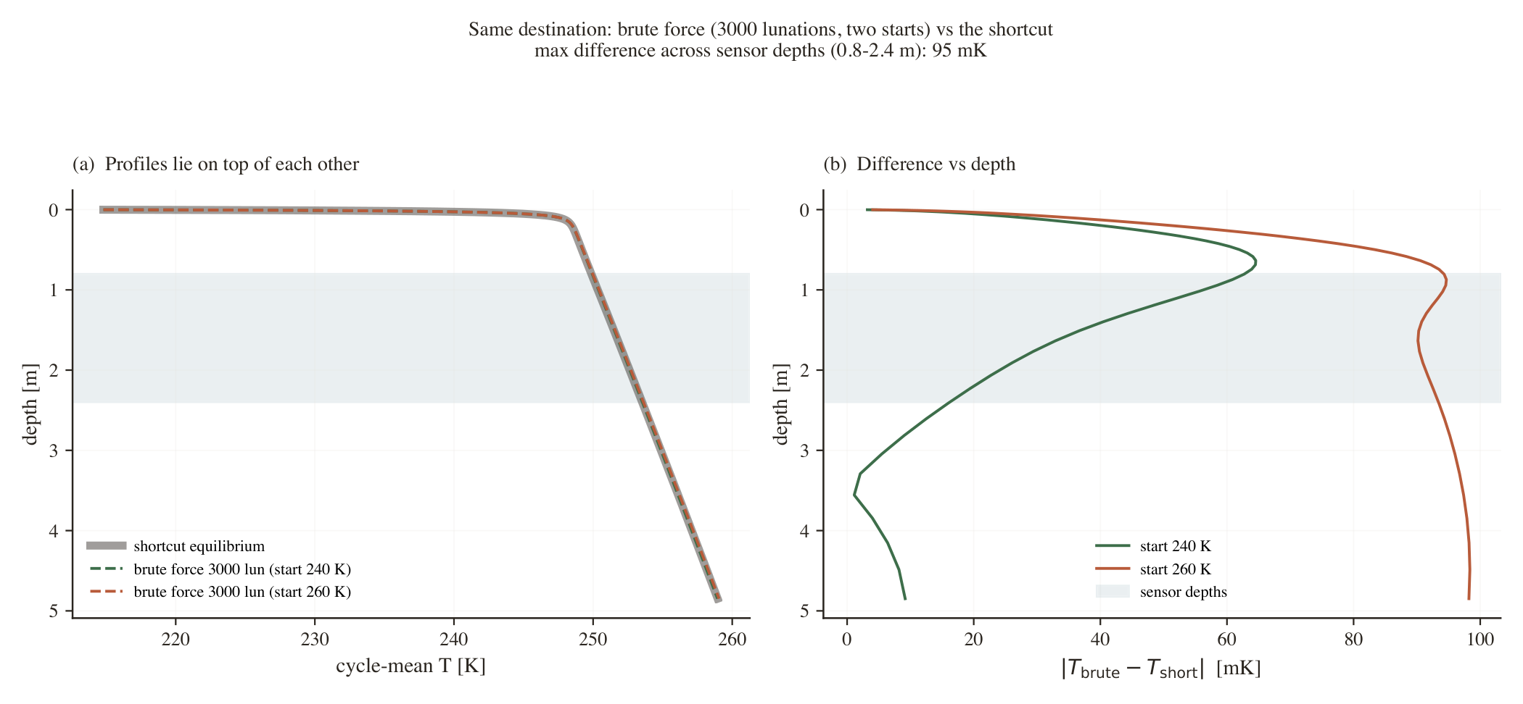
It reaches the true value — proof
Equilibrium fix
• Brute force from 240 K AND 260 K both land on the shortcut's profile.
• Agreement < 0.1 K across the sensor depths.
• Different starting points → one curve = the same steady state.
Notes:
This is the proof the shortcut isn't a trick. I ran the slow brute-force method from two very different starting temperatures — 240 and 260 K — for 3000 lunar days. Both land exactly on the fast method's curve, to under a tenth of a degree, at every depth. Different starting points, same destination. That's what 'the two methods agree' really means, and it's why I trust the shortcut.

Slide 8
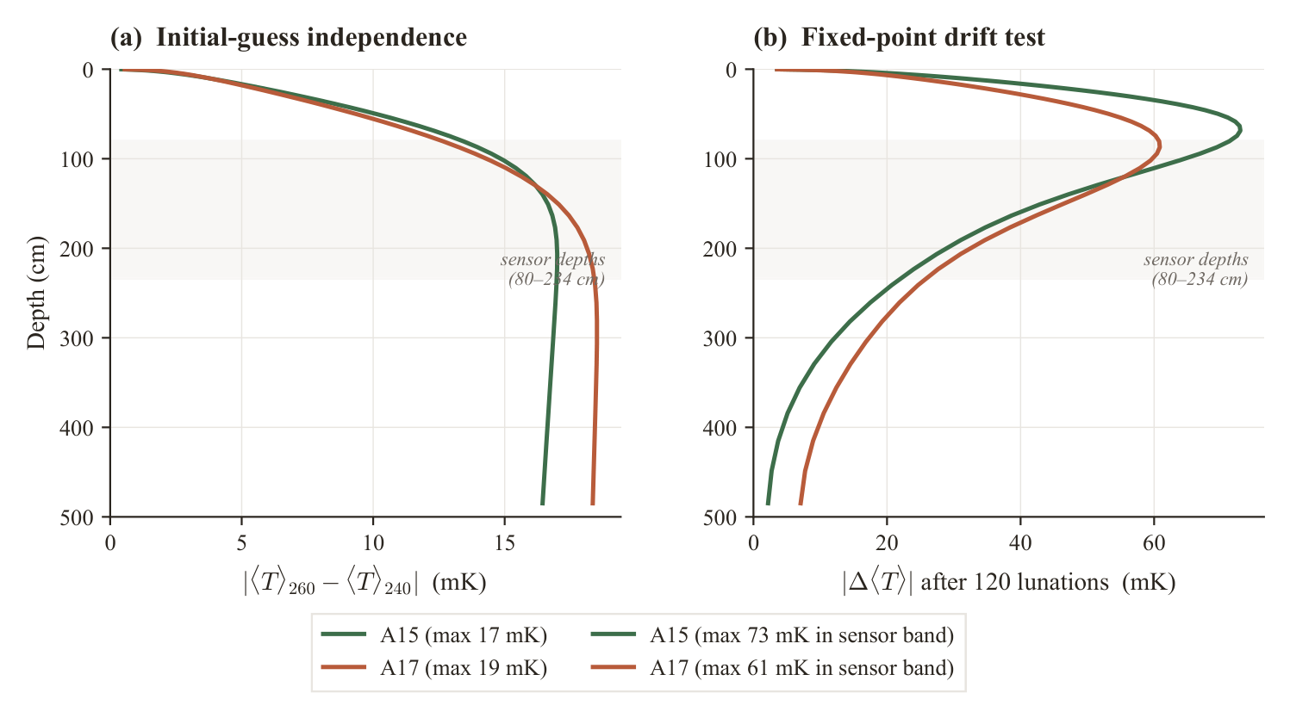
Certified, not assumed — and ~30× faster
Equilibrium fix
• Guess-independence ≤ 0.03 K; deep heat flux closes on Q_b to < 2%.
• The solver returns drift & closure diagnostics — it proves it arrived.
• Same answer in ~9 s vs ~4 min of brute force per solve.
Notes:
Two more things. First, the method certifies itself — every solve returns two diagnostics: how much the anchor temperature drifted (we require under 0.03 K) and how well the deep flux matches Q_b (under 2%). So we never guess whether it converged — it tells us, which is exactly what the old method couldn't do. Second, speed: it reaches the same state in about nine seconds, versus roughly four minutes for brute force — about thirty times faster per solve.

Slide 9
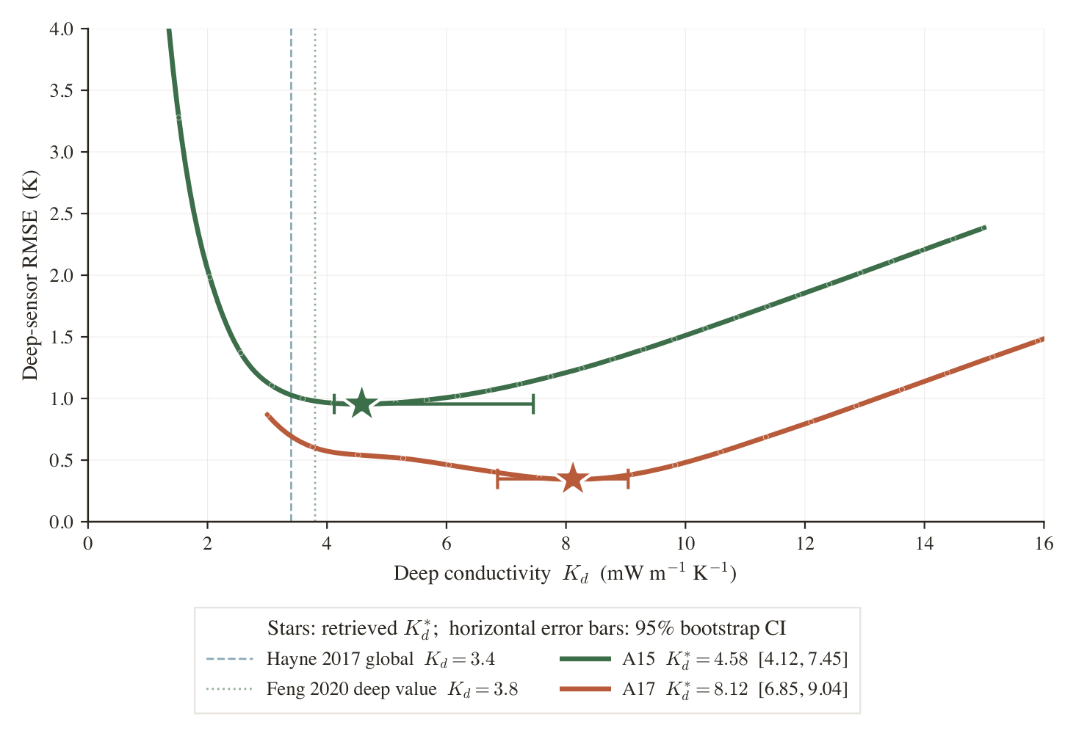
Retrieving K_d: sweep the model against the data
Results
• For each site, vary K_d and compute the deep-sensor RMSE.
• The minimum RMSE gives the best-fit K_d* (sub-grid parabola fit).
• A17's minimum sits at a clearly higher K_d than A15's.
Notes:
Now the retrieval itself. For each site we try a range of K_d values; for each one the converged model predicts the deep temperatures and we measure the misfit — the RMSE — against the sensors. The K_d that minimises that misfit is our estimate. Each curve has a clean single minimum, and the key point: Apollo 17's minimum is at a clearly higher conductivity than Apollo 15's.

Slide 10
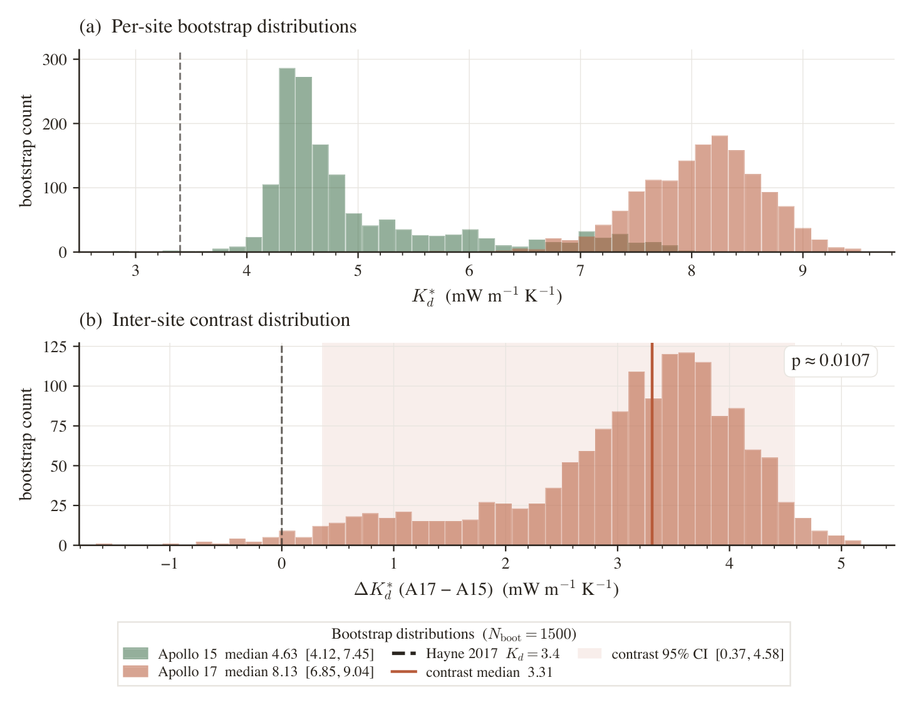
The new K_d values
Results
4.58
mW m⁻¹ K⁻¹ · Apollo 15
95% CI [4.12, 7.45]
8.12
mW m⁻¹ K⁻¹ · Apollo 17
95% CI [6.85, 9.04]
Contrast 3.31 · p ≈ 0.011
Notes:
Here are the headline numbers. Apollo 15: K_d about 4.6 milliwatts per metre per kelvin. Apollo 17: about 8.1 — roughly double. For error bars we bootstrap: resample the sensors 1500 times with realistic depth jitter and re-fit each time. The 95% intervals are shown and barely overlap. The difference is 3.3, with about a 1% chance it's a fluke — p around 0.011. So the contrast is real, not noise.

Slide 11
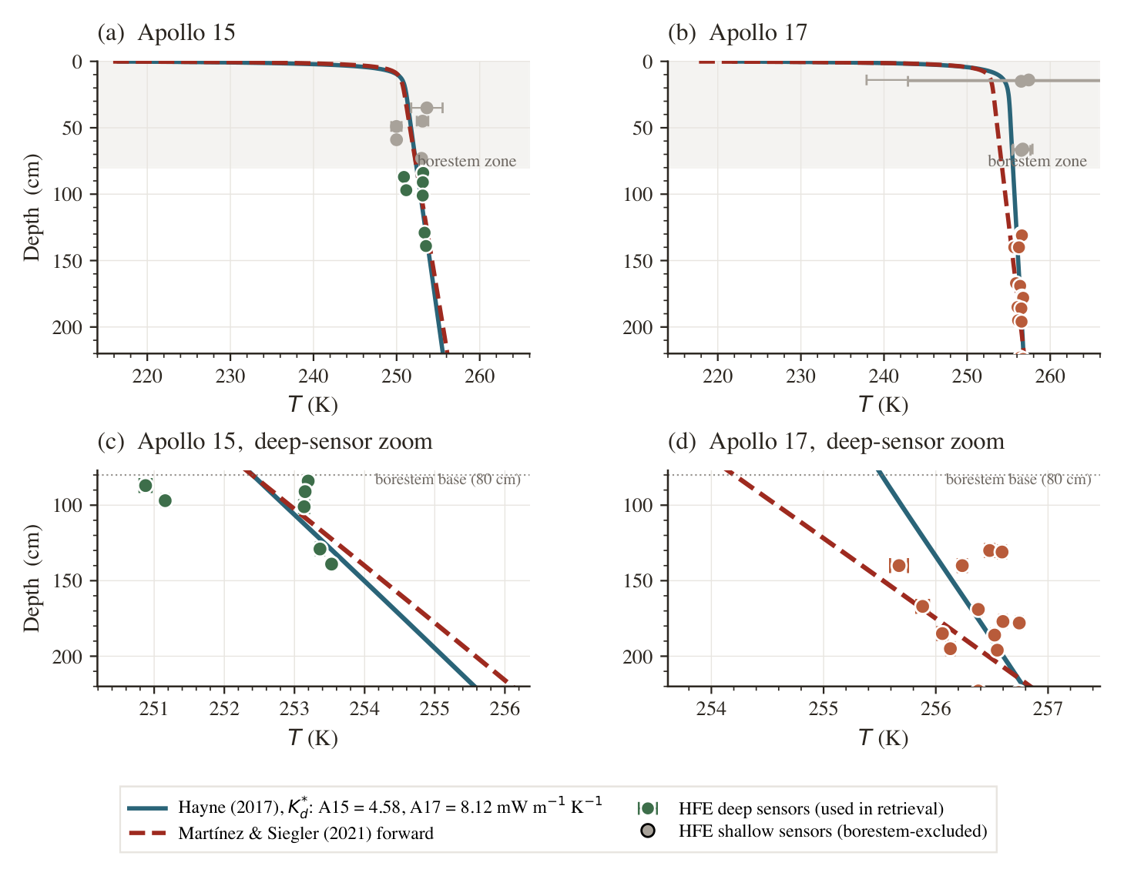
What it means: a better fit, and a real contrast
Results
• Per-site K_d fits the deep sensors far better than the global K_d (halves RMSE at A17).
• A17 conducts heat ~2× more efficiently than A15.
• Supplies the meter-scale T(z) boundary that subsurface retrievals need.
Notes:
What does that buy us? The per-site values fit the actual deep temperatures much better than the one-size-fits-all global value — at Apollo 17 it roughly halves the error. Physically, the regolith at 17 carries heat about twice as effectively as at 15. And practically, it gives the correct deep temperature profile that anyone modelling the subsurface — for ice, for missions — actually needs.

Slide 12
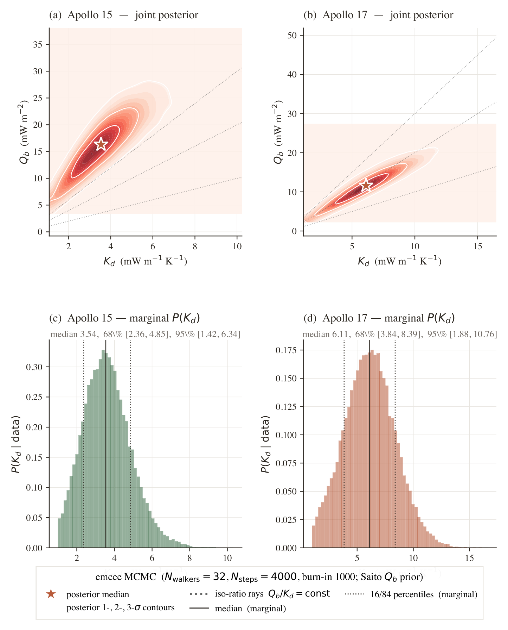
K_d is retrieved conditional on Q_b
K_d – Q_b link
• The deep gradient is Q_b / K — so K_d and Q_b trade off directly.
• We hold Q_b at the published values (A15 = 21, A17 = 15 mW m⁻²).
• Bayesian cross-check: even with Q_b uncertain, A17 > A15 ~83% of the time.
• Direction of the contrast is robust; exact magnitude is conditional.
Notes:
Now the important caveat — the thing you asked about. K_d isn't measured in a vacuum; it's tied to the basal heat flux Q_b, because the gradient is Q_b over K. They're entangled: assume more heat from below and you'd infer a higher conductivity for the same temperatures. We can't pull both out of this data, so we fix Q_b at the published Apollo values — 21 and 15 — and report K_d conditional on them. The figure shows that trade-off. We then checked it Bayesianly: even letting Q_b vary, 17 stays more conductive than 15 about 83% of the time. The direction is robust; the exact gap depends on the flux.

Slide 13
Conductivity contrast, not a flux artifact
K_d – Q_b link
Model fit to both sites | RMSE (K) | ΔAICc
M1: per-site K_d, Q_b fixed | 0.60 | 0.0 (best)
M3: shared K_d, Q_b fixed | 0.67 | 2.71
M2: shared K_d, Q_b free | 0.61 | 3.99
Lowest AICc wins. ΔAICc ≥ ~3 is a meaningful preference for M1.
Notes:
We fit three competing models to both sites at once and compare with AICc (rewards fit, penalises free parameters). Model 1 — a different conductivity per site with flux fixed — wins. The models that force one shared conductivity are worse by ~3-4 AICc units, even when the flux is allowed to float to compensate. So the data prefers a conductivity contrast over a flux contrast — that's what lets us call this a conductivity result.

Slide 14
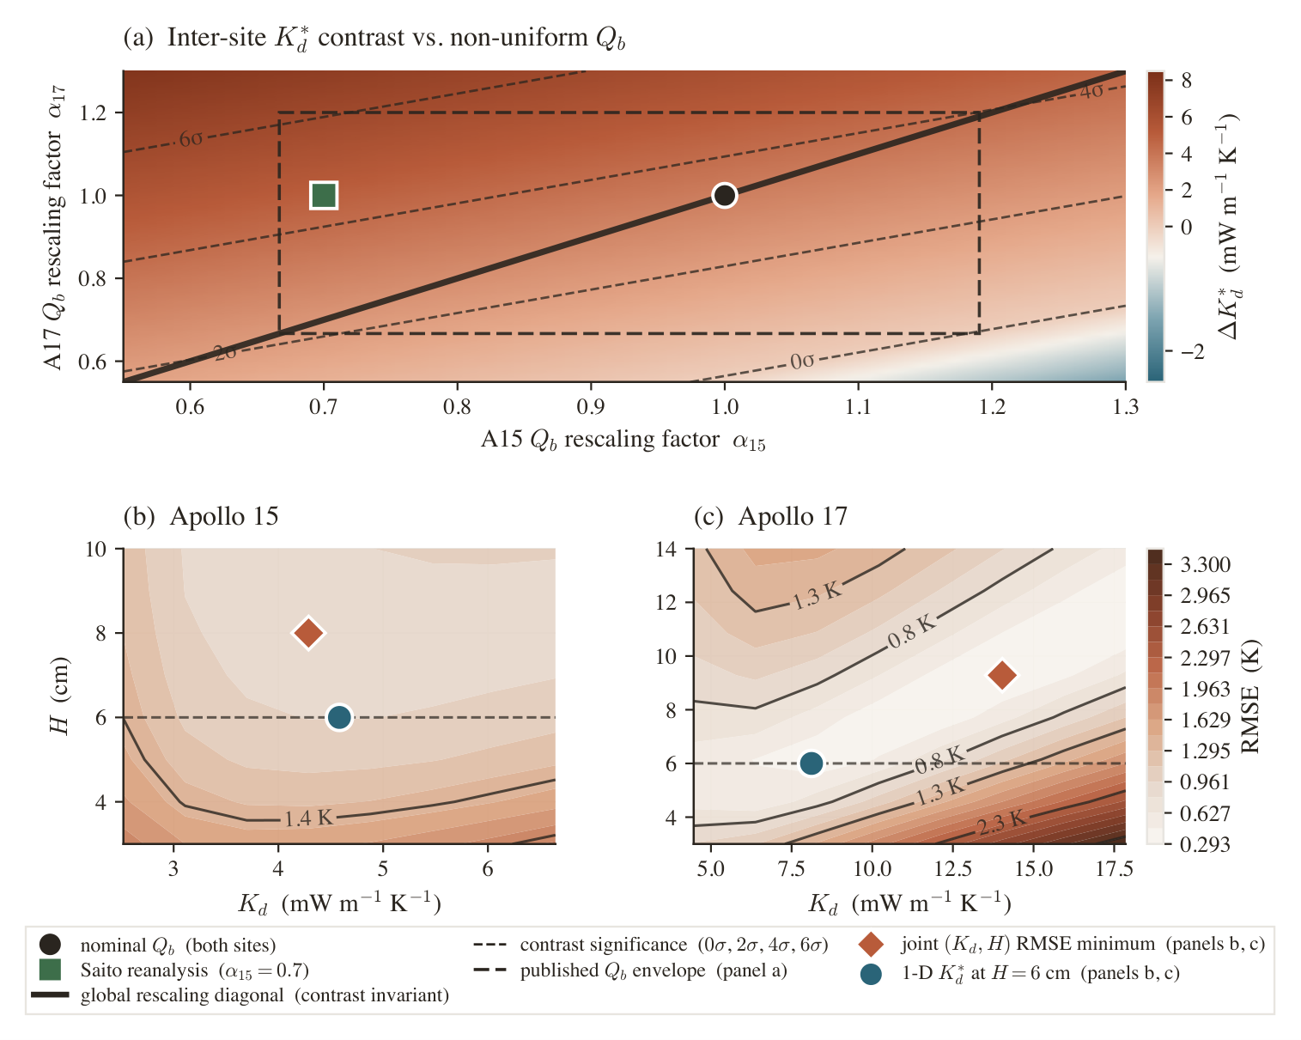
Robustness checks
Cross-checks
• Joint (K_d, H) fit: the conductivity transition depth doesn't rescue a single shared K_d.
• Sensitivity to the borestem cut, stability threshold and albedo — the contrast persists.
Notes:
We stress-tested the result against the model's other knobs. Letting the conductivity's depth-transition scale H vary jointly with K_d doesn't erase the contrast. Neither does moving the borestem cut, changing the stability threshold for selecting data, or perturbing the surface albedo. The two sites stay separated across all of these.

Slide 15
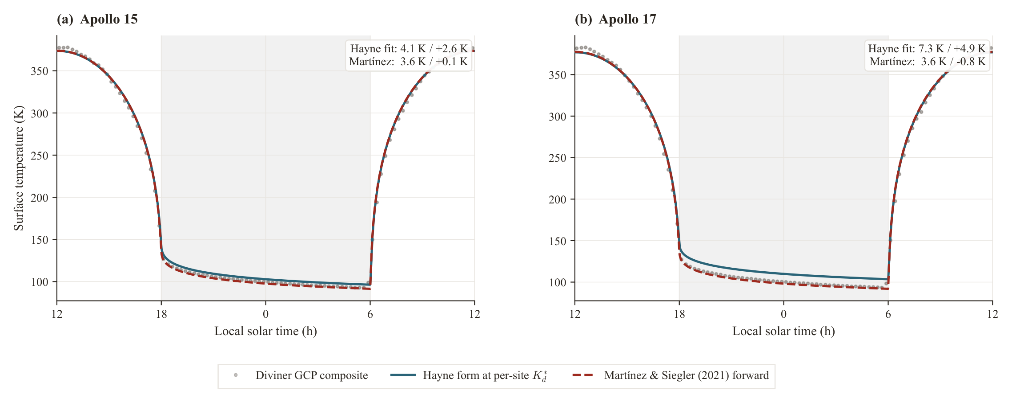
Independent check: Diviner surface temperatures
Cross-checks
• Uses NO heat-flow data: run the model forward with the retrieved K_d.
• Predicted surface day–night curve matches the Diviner orbital composite.
• The deep fit and the surface observations are self-consistent.
Notes:
An independent sanity check that doesn't touch the heat-flow data at all. We take the model with our retrieved K_d and run it forward to predict the surface temperature swing over a lunar day, then compare to what Diviner measured from orbit. They agree. So the model we fit to deep sensors also reproduces the surface — the whole picture is consistent, not tuned to one thing.

Slide 16
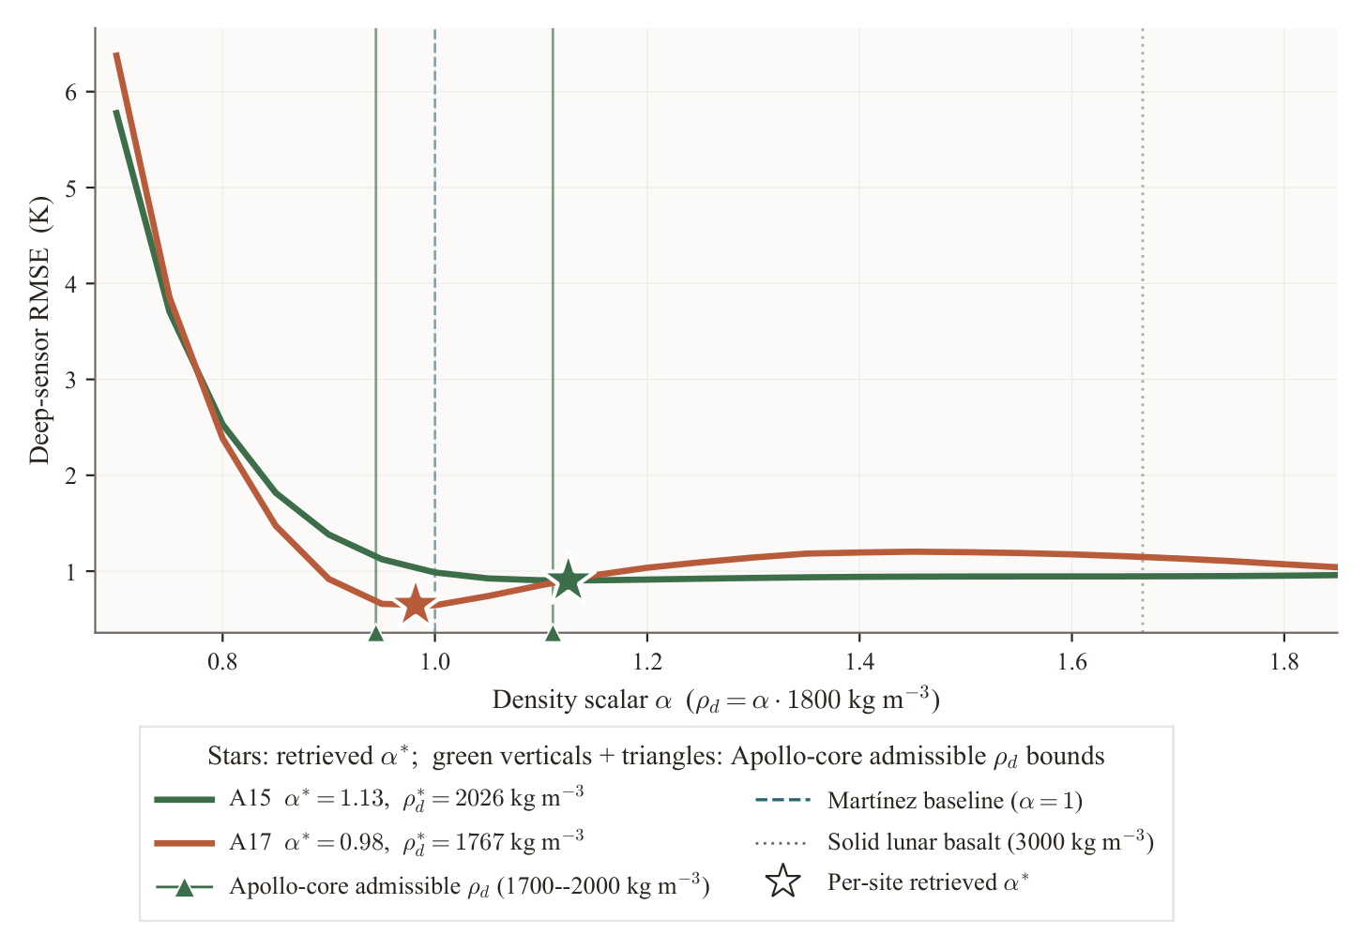
Different conductivity model, same story
Cross-checks
• Repeat with the Martínez & Siegler (2021) K(T, ρ) form instead of Hayne.
• Each site prefers a different deep density (α) — the same contrast, via a different model.
• The conclusion isn't an artifact of one functional form.
Notes:
Finally we checked the contrast isn't an artifact of the particular conductivity formula. We redid it with a completely different published form — Martínez and Siegler's, which depends on density rather than depth. Each site prefers a different deep density, telling the same story. So the result holds across two independent ways of describing the regolith.

Slide 17
Where the uncertainty comes from
Cross-checks
Component (1σ, mW m⁻¹ K⁻¹) | Apollo 15 | Apollo 17
Statistical (bootstrap) | 0.80 | 0.55
Basal flux Q_b | 1.20 | 2.16
Surface albedo A | 0.80 | 3.49
Surface conductivity K_s | 0.53 | 1.96
Borestem / threshold / ρ | ≤0.15 | ≤0.42
Total (quadrature) | 1.75 | 4.61
Q_b and albedo dominate — the K_d–Q_b link showing up in the budget.
Notes:
This breaks down the error bar. The biggest contributors are the basal flux Q_b and the surface albedo — not the statistics. That's the entanglement again: because K_d rides on Q_b, our uncertainty in the flux is one of the largest pieces of our uncertainty in K_d, especially at Apollo 17. It tells us where to push next for tighter numbers.

Slide 18
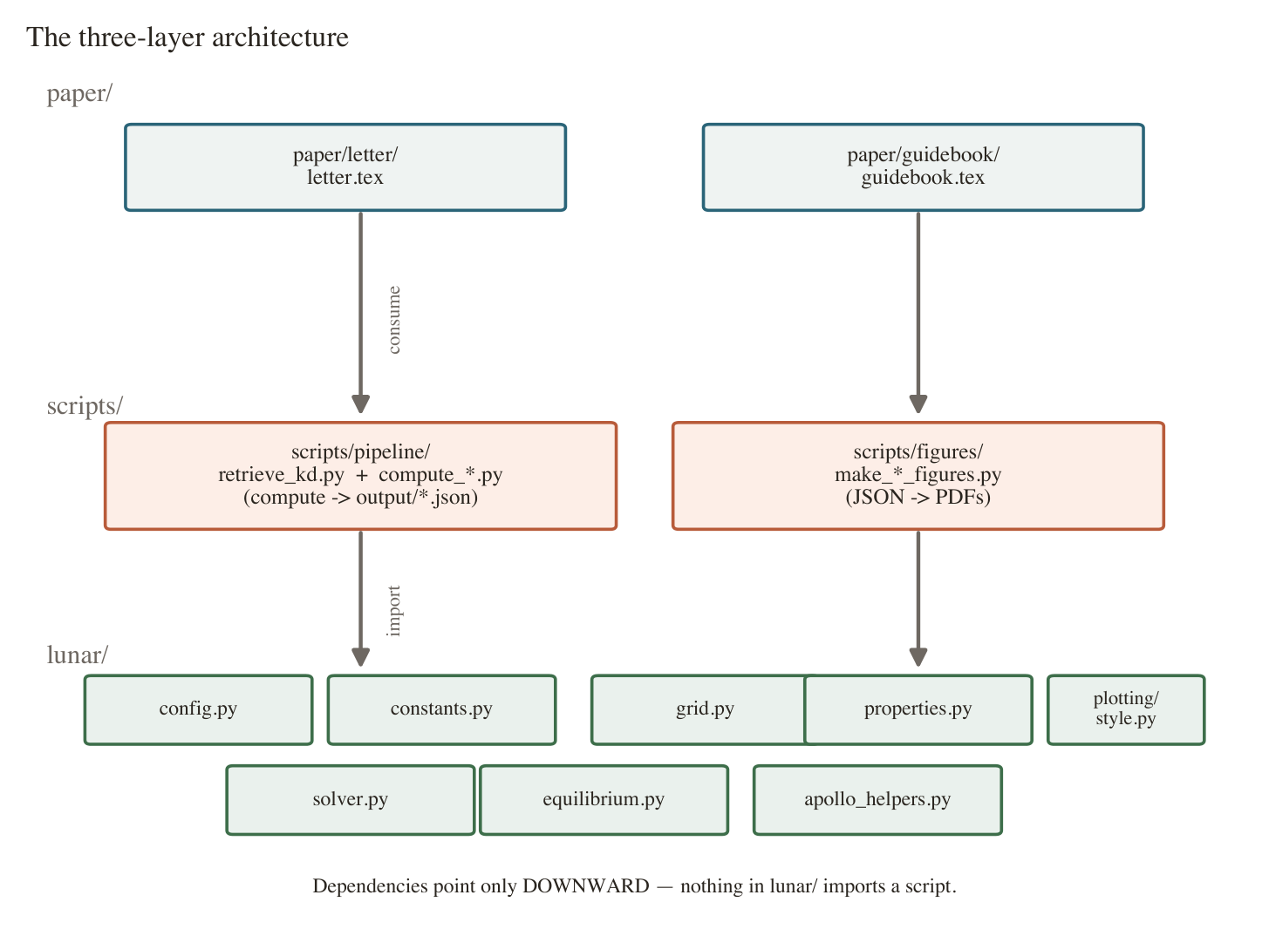
How the code is organized
Computation
• Three layers: a physics engine (lunar/), thin driver scripts, the paper.
• One hub function — run_with() — turns a trial K_d into a settled profile; everything calls it.
• Single config file; 37 automated tests guard the numerics.
Notes:
On the computing side, the code is in three clean layers: a core physics package, thin scripts that drive it, and the paper. There's one hub function, run_with, that takes a trial K_d and returns a converged profile — the sweep, the bootstrap, every figure call it. One configuration file so nothing drifts out of sync, and 37 automated tests.

Slide 19
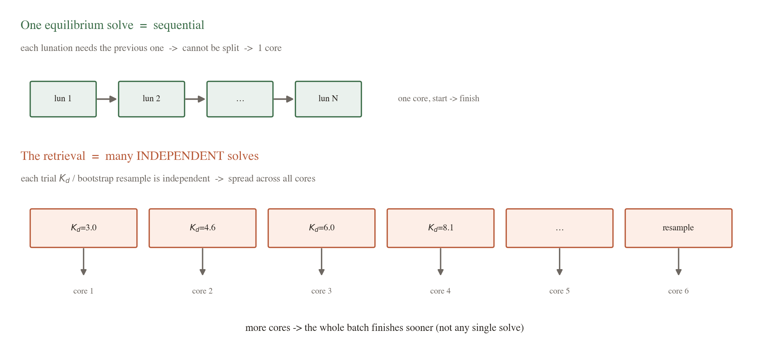
Why one solve uses one core — and where more cores help
Computation
• One equilibrium solve is sequential: each lunation needs the previous — it can't be split.
• But the retrieval runs MANY independent solves (the K_d sweep, the bootstrap).
• Those fan across all cores — more cores speed up the batch, not a single solve.
Notes:
You asked why it only used one core. A single solve marches through lunar days one after another — each depends on the one before — so it physically can't be split; it's one core, start to finish. But the retrieval isn't one solve, it's hundreds of independent ones — every trial K_d, every bootstrap resample. Those are independent, so we hand them out across all your cores at once. So yes, you can absolutely use more cores — they make the whole batch finish sooner; they just can't speed up any single solve.

Slide 20
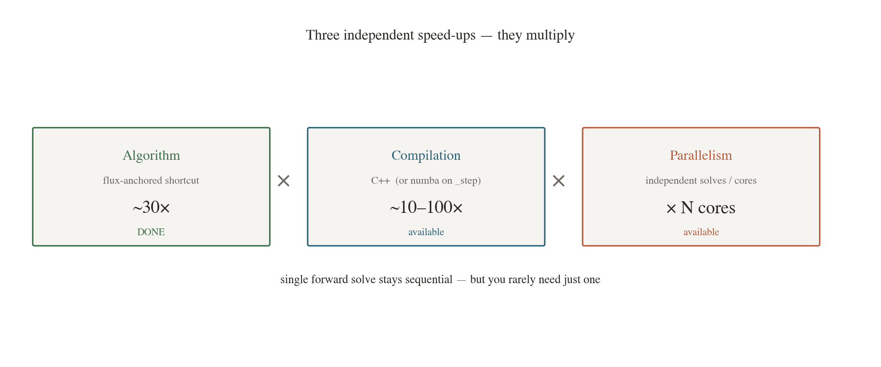
Could part of this be ported to C++?
Computation
• Yes — the inner time-step loop is interpreted Python; compiled code gives ~10–100× there.
• Port the numerics (grid / solver / equilibrium); keep config + analysis in Python.
• For this paper Python is fast enough; C++ pays off at scale (many sites / a mission pipeline).
Notes:
Could we port to C++? Yes, and here's the honest version. The slow part is the inner time-stepping loop, currently plain Python — exactly where a compiled language wins, maybe ten to a hundred times on that loop. The plan: port just the three small numerical modules, keep configuration and analysis in Python. The key point is the speed-ups stack — the algorithm fix already bought about 30x, compilation multiplies that, cores multiply again. For the current paper we don't need it; C++ becomes worth it when we scale to many locations or a mission pipeline.

Slide 21
Summary & next steps
• Fixed a hidden bias (F1) with a fast, self-certifying equilibrium solver.
• New per-site K_d: A15 = 4.6, A17 = 8.1 mW m⁻¹ K⁻¹; contrast 3.3, p ≈ 0.011.
• Conditional on Q_b (21 / 15 mW m⁻²); contrast direction robust; conductivity, not flux (AICc).
• Next: manuscript to JGR: Planets · tighten Q_b · optional C++ for scale.
Notes:
To wrap up: we found and fixed a real bias in the forward model and replaced it with a fast solver that certifies its own convergence. With that we retrieve distinct conductivities at the two sites — about 4.6 and 8.1 — a contrast that's statistically significant and survives our cross-checks. It's conditional on the assumed basal flux, but the direction is robust and the data prefers a conductivity difference over a flux difference. Next steps: finish the JGR Planets manuscript, tighten the flux assumption, and optionally a C++ core if we scale up. Happy to take questions.

