Slide 1
Python

Slide 2
Introduction to Python

Slide 3
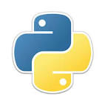
Python
What is Python
Features of Python
Python Application
Python Installation
Python Programming
Python Statements
Python Comments

Slide 4
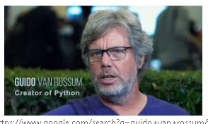
What is Python
The Python programming language is an object-oriented language, which means that it can model real-world entities.
The distinctive feature of Python is that it is an interpreted language.
The Python IDLE (Integrated Development Environment) executes instructions one line at a time
Guido van Rossum named it after the comedy group Monty Python.
Python so powerful:Apart from the constructs that Python provides, you can use the PyPI (Python Package Index). It is a repository of third-party Python modules and you can install it using a program called pip.

Slide 5
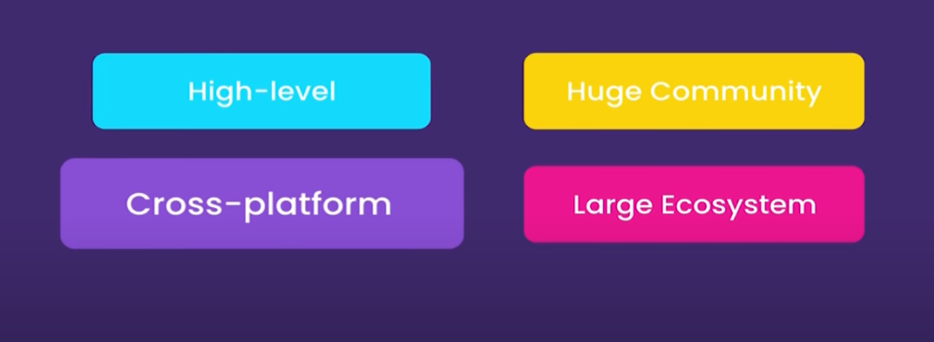
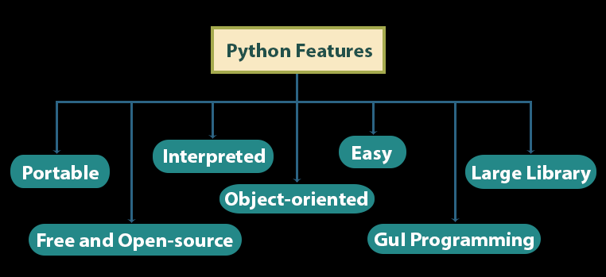
Features of Python
Python Features
Portable
Free & Open Source
Interpreted
Object- Oriented
Easy
GUI Programming
Large Library
A multi-purpose language with a simple and beginner-friendly synatax

Slide 6
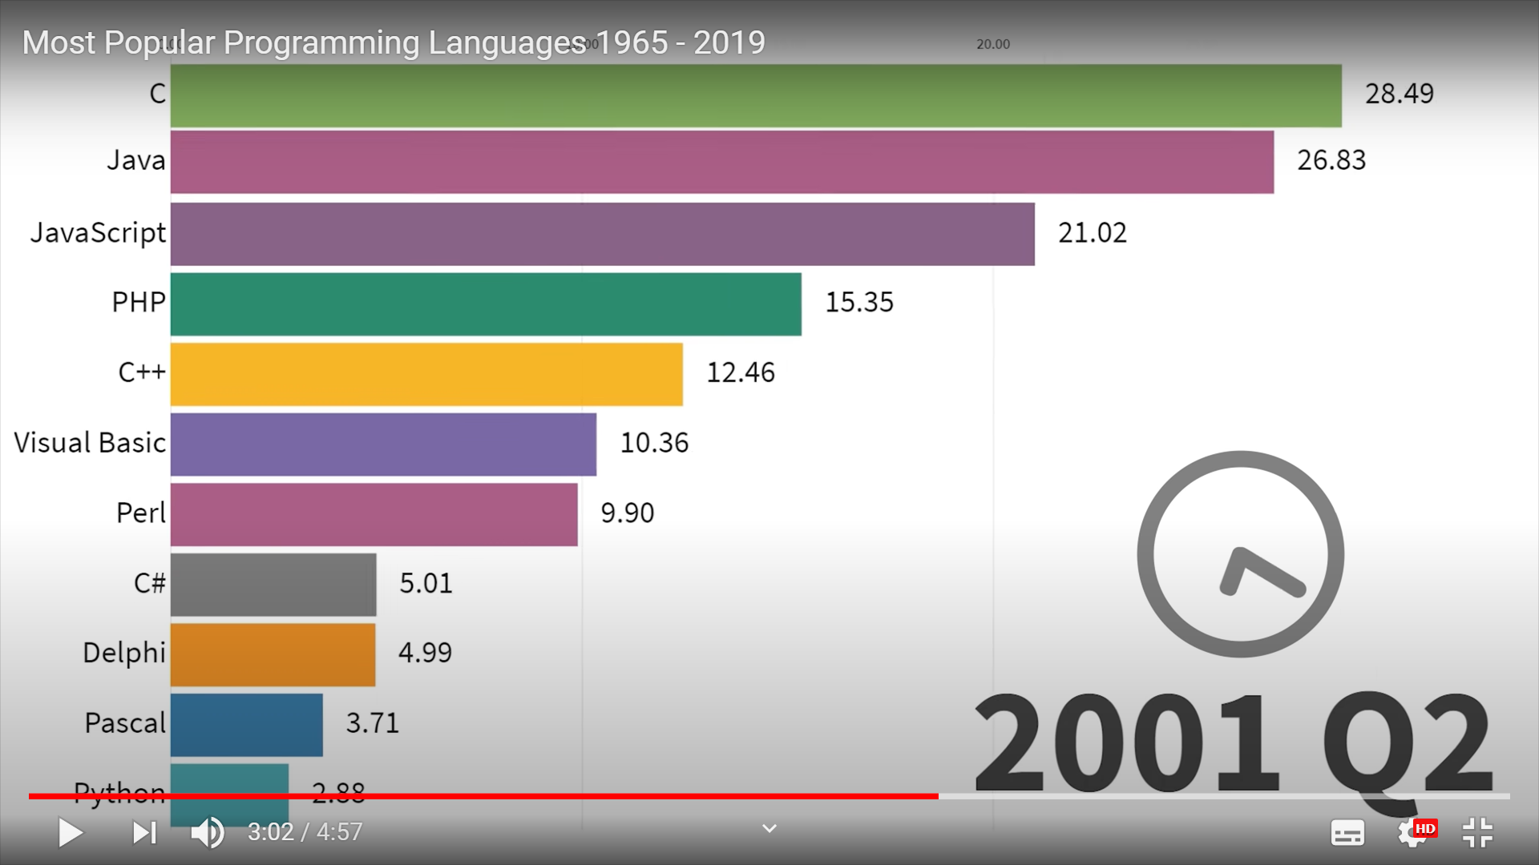
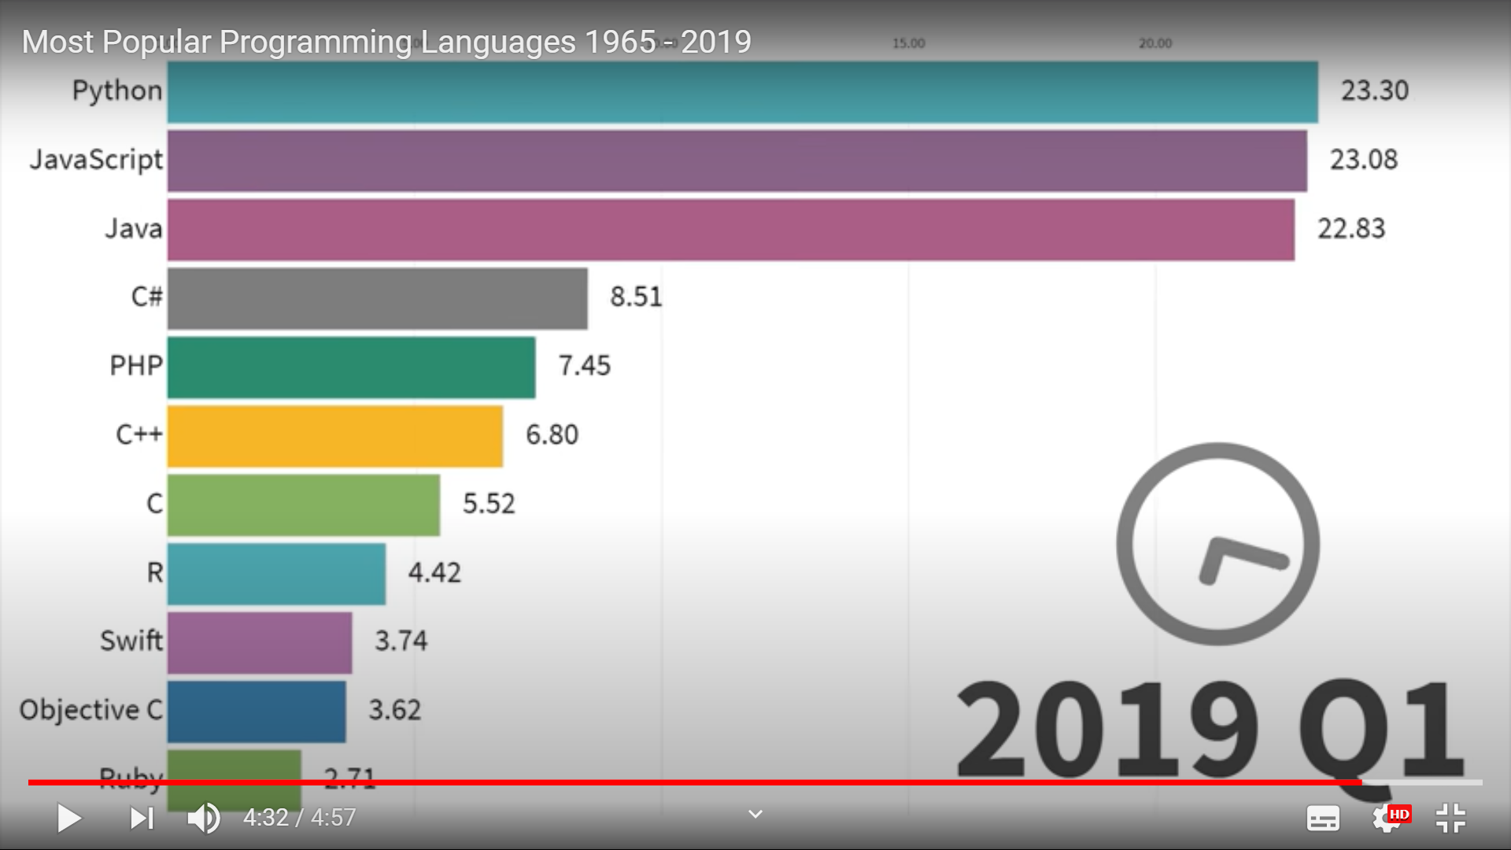
Popularity of PYTHON

Slide 7
Python Application
Build a website
Develop a game
Implement Machine Learning (Give a computer the ability to learn)
Perform Data Analysis
Perform Scripting
Perform Scientific Computing
Build Artificial Intelligence

Slide 8
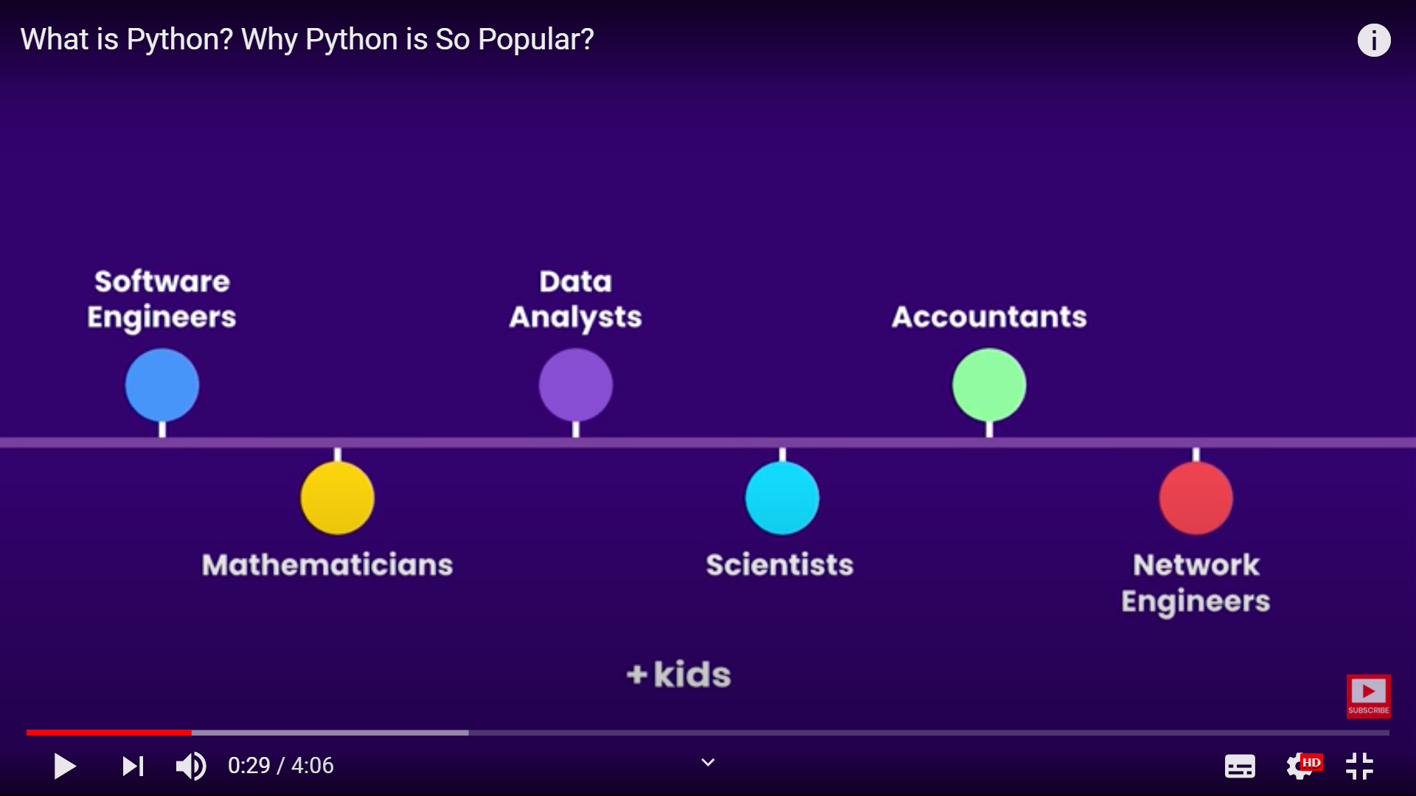
Popularity of PYTHON

Slide 9
Python Installation
To install it, go to the : https://www.python.org/downloads/
Open a command-line or terminal and then type in python and hit Enter .
Python(IDLE – Integrated Development Environment) has two basic modes:
Script
Interactive
Interactive mode is used when an user wants to run one single line or one block of code. It runs very quickly and gives the output instantly
Script Mode is used to write a long piece of Python code or your Python script spans multiple files
Pycharm
https://www.jetbrains.com/pycharm/download/#section=windows
Community Version

Slide 10
Python Programming
Python Keywords
Keywords are the reserved words in Python. Eg:-class ,function ,for ,if etc.
Python Identifier\Variable
Identifier is a name given to class, functions, variables, etc.
An identifier starts with a letter A to Z or a to z or an underscore (_) followed by zero or more letters, underscores and digits (0 to 9).
Keywords cannot be used as identifiers
a =1
_b =‘Hello’
Variable is a name which is used to refer memory location Note: Python is a case-sensitive language. Python is a type inferred language
Standard Output
print("Hello world!")
Standard Input
num = input('Enter a number: ')

Slide 11
Python Statements
Python Statement
Instructions that a Python interpreter can execute are called statements.
For example, a = 1 is an assignment statement.
Multi-line statement
In Python, end of a statement is marked by a newline character. But we can make a statement extend over multiple lines with the line continuation character (\). This is explicit line continuation
a = 1 + 2 + 3 + \
4 + 5 + 6 + \
7 + 8 + 9
In Python, line continuation is implied inside parentheses ( ), brackets [ ] and braces { }.
colors = ['red',
'blue',
'green']
We could also put multiple statements in a single line using semicolons, as follows
a = 1; b = 2; c = 3

Slide 12
Python COMMENTS
Python Indentation
Java use braces { } to define a block of code. Python uses indentation.
Python Comments
Keywords are the reserved words in Python. Eg:-class ,function ,for ,if etc.
# This is a comment, print out Hello
print('Hello')
Multi-line comments
"""This is also a
perfect example of
multi-line comments""“
Docstring in Python
Docstring is short for documentation string. It should be 1st statement in class\function
def double(num):
"""Function to double the value"""
return 2*num

