Slide 1
Modules and Packages

Slide 2
Modules and Packages
Modules in Python
Python import statement
PACKAGES

Slide 3
modules in Python
Modules are used to break down large programs into small manageable and organized files. Furthermore, modules provide reusability of code.
Modules refer to a file containing Python statements and definitions.
A file containing Python code, for e.g.: example.py, is called a module and its module name would be example.
Define most used functions in a module and import it, instead of copying their definitions.
Syntax:import example
Standard modules can be imported the same way as we import our user-defined modules.

Slide 4
Python import statement
import math
print("The value of pi is", math.pi)
Import with renaming
import math as m
print("The value of pi is", m.pi)
Python from...import statement(import specific names from a module)
from math import pi
print("The value of pi is", pi)
Import all names
from math import *
print("The value of pi is", pi)
Notes:
We imported all the definitions from the math module. This makes all names except those beginnig with an underscore, visible in our scope.
Importing everything with the asterisk (*) symbol is not a good programming practice. This can lead to duplicate definitions for an identifier. It also hampers the readability of our code.

Slide 5
Python import statement
Python Module Search Path
While importing a module, Python Interpreter first looks for a built-in module then (if not found) into a list of directories defined in sys.path. The search is in this order.
The current directory.
PYTHONPATH (an environment variable with a list of directory).
The installation-dependent default directory.
Reloading a module
The Python interpreter imports a module only once during a session.
This makes things more efficient.
We can use the reload() function inside the imp module to reload a module.
import imp
imp.reload(my_module)
We can use the dir() function to find out names that are defined inside a module.
Notes:
We imported all the definitions from the math module. This makes all names except those beginnig with an underscore, visible in our scope.
Importing everything with the asterisk (*) symbol is not a good programming practice. This can lead to duplicate definitions for an identifier. It also hampers the readability of our code.

Slide 6
PACKAGES

Slide 7
PACKAGES
Generally we store files grouping together logically and have multiple sub directories. Similar to this, Python has packages for directories and modules for files.
As a directory can contain sub-directories and files, a Python package can have sub-packages and modules
A directory must contain a file named __init__.py in order for Python to consider it as a package. This file can be left empty but we generally place the initialization code for that package in this file.

Slide 8
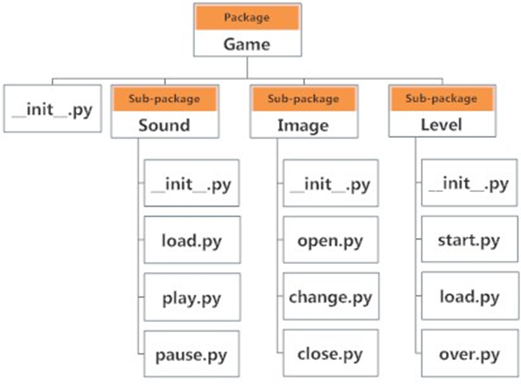
PACKAGES
Importing module from a package We can import modules from packages using the dot (.) operator.To import the start module import Game.Level.start if this module contains a function named select_difficulty(), we can reference by Game.Level.start.select_difficulty(2) from Game.Level import start start.select_difficulty(2) from Game.Level.start import select_difficulty select_difficulty(2)

