Slide 1
Python Object Oriented Programming

Slide 2
Python Object Oriented Programming
Class & objects
Attributes of class
Constructors in Python
OOPs
Inheritance
Encapsulation
Polymorphism
More on inheritance
Multiple Inheritance in Python
Multilevel Inheritance
METHOD RESOLUTION ORDER

Slide 3
Class & objects
Python is a multi-paradigm programming language. Meaning, it supports different programming approach like Object-oriented programming and structured programming.
An object has two characteristics:
attributes
behavior
Parrot is an object,
name, age, color are attributes
singing, dancing are behavior
The concept of OOPs in Python focuses on creating reusable code. This concept is also known as DRY (Don't Repeat Yourself).
In Python, the concept of OOP follows some basic principles:
Inheritance
Encapsulation
Polymorphism

Slide 4
Class & objects
Class
A class is a blueprint for the object.
Example: Class as an sketch of a parrot with labels , real parrots are objects which is inline with the parrot sketch(class).
Syntax:-
class Parrot:
pass
Object
An object is an instance of a class.
Attributes are data of that particular object
Methods(behaviour) are functions defined inside the body of a class.
The first argument of the function in class must be the object itself. This is conventionally called self.
Syntax:-
obj = Parrot()

Slide 5
Attributes of class
Private Variable : Accessible only inside class .
Define on the self with double underscore self.__PriVar1
Protected :Accessible inside class and subclass.
Define on the self with single underscore self._ProtVar1
Public : Accessible anywhere outside or inside the class.
Define on the self self.PubVar1
Notes:
They are used to define the behaviors of an object.

Slide 6
Constructors in Python
Class functions that begins with double underscore (__) are called special functions as they have special meaning.
Of one particular interest is the __init__() function. This special function gets called whenever a new object of that class is instantiated.
This type of function is also called constructors in Object Oriented Programming (OOP). We normally use it to initialize all the variables.
Any attribute of an object can be deleted anytime, using the del statement.
Notes:
They are used to define the behaviors of an object.

Slide 7
Inheritance
Inheritance is a mechanism in which one class acquires the property of another class. For example, a child inherits the traits of his/her parents.
A class that is used as the basis for inheritance is called a base class or parent class. A class that inherits from a baseclass is called a derived class or child class
FATHER
SON
Notes:
They are used to define the behaviors of an object.

Slide 8
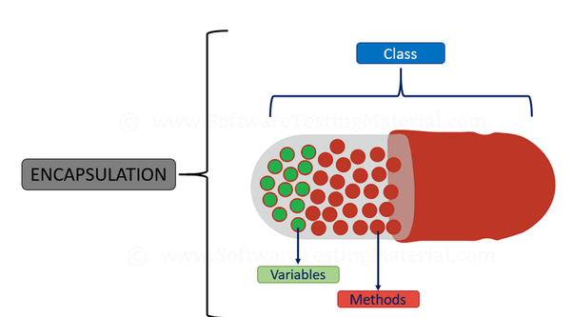
Encapsulation
Encapsulation is a process of wrapping code and data together into a single unit, for example, a capsule which is mixed of several medicines.
This concept is also often used to hide the internal representation, or state, of an object from the outside in other words restricting direct access to some of object's members(i.e) attributes, methods
Notes:
They are used to define the behaviors of an object.

Slide 9
Polymorphism
Polymorphism means the ability to take various forms. In Python, Polymorphism allows us to define methods in the child class with the same name as defined in their parent class.
Example:-A person at the same time can have different characteristic. Like a man at the same time is a father, a husband, an employee. So the same person posses different behavior in different situations.
Notes:
They are used to define the behaviors of an object.

Slide 10
MORE ON inheritance
Method overriding, in object-oriented programming, is a language feature that allows a subclass or child class to provide a specific implementation of a method that is already provided by one of its superclasses or parent classes
Two built-in functions isinstance() and issubclass() are used to check inheritances. Function isinstance() returns True if the object is an instance of the class or other classes derived from it. Each and every class in Python inherits from the base class object.

Slide 11
Multiple Inheritance in Python
Multiple inheritance is a mechanism by which an object or class can inherit characteristics and features from more than one parent object or parent class.
class Father:
pass
class Mother:
pass
class Child(Father, Mother):
pass
FATHER
MOTHER
CHILD

Slide 12
Multilevel Inheritance
Multiple Leel inheritance is a mechanism by which features of the base class and the derived class is inherited into the new derived class.
class GrandFather:
pass
class Father(GrandFather):
pass
class Son(Father):
pass
GRAND FATHER
FATHER
SON

Slide 13
METHOD RESOLUTION ORDER
In the multiple inheritance scenario, any specified attribute is searched first in the current class. If not found, the search continues into parent classes in depth-first, left-right fashion without searching same class twice.

