Slide 1
Python

Slide 2
Database management

Slide 3
Regular expression
DATABASE
DATABASE connection in python
Install My SQL
mysql-connector
Python Database Connection
Creating a Database
Database Operations[CRUD]
Database operation

Slide 4
DATABASE
A database is basically a collection of structured data in such a way that it can easily be retrieved, managed and accessed in various ways. One of the simplest forms of databases is a text database. Relational databases are the most popular database system which includes the following:
MySQL
Oracle Database
SQL server
Sybase
Informix
IBM db2
NO SQL
MySQLdb
MySQLdb is an open-source freely available relational database management system that uses Structured Query Language.

Slide 5
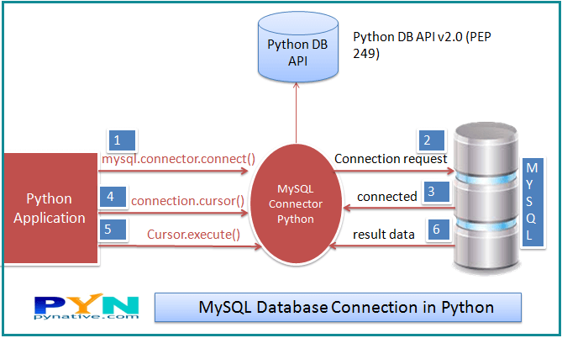
DATABASE connection in python
SQL (Structured Query Language) is a standard language for relational databases that allow users to do various operations on data like, Manipulating, Creating, Dropping, etc. In a nutshell, SQL allows you to do anything with the data.

Slide 6
Install My SQL
Site to download
https://dev.mysql.com/downloads/installer/ [Web community if you are online , otherwise just community version]
Setup Type :
Full
Check Requirements
Don’t select visual studio
Group Replication
Standalone MySQL Server
Accounts & Roles
Provide username and password

Slide 7
mysql-connector
Pycharm
File →Settings→{Project}→Project Interpreter
click + button → search for ‘mysql-connector-python’
Command Prompt
pip install mysql-connector

Slide 8
Python Database Connection
Username-
It is simply the username you give to work MySQL server with, the Default username is root.
Password-
Password is given by the user when you have installed the MySQL database. I am giving password here as ‘password123’
Host Name-
This basically is the server name or IP address on which your MySQL is running, If it is a ‘localhost’, then your IP address is 127.0.0.0
import mysql.connector
mydb=mysql.connector.connect(host="localhost",user="root",passwd="password123")
print(mydb)

Slide 9
Creating a Database
Once the database connection is established, you are ready to create your own database which will be acting as a bridge between your python and MySQL server.
mycursor.execute("create database Pythondb")
You can confirm the same from MySQLWorkbench
In MySQLWorkbench ,From the Menu “Database” →Connect to Database →{provide password} → create a new sql tab for executing queries
COMMIT Operation
Commit is the operation, which gives a green signal to database to finalize the changes, and after this operation, no change can be reverted back.
ROLLBACK Operation
If you are not satisfied with one or more of the changes and you want to revert back those changes completely, then use rollback() method.

Slide 10
Database Operations[CRUD]
Create
Table creation and Record creation in a table.
Read
It is used for fetching useful information from the database.
Update
Updating the table or records in a table.
Delete
Deleting the table or records in a table.

Slide 11
Database operation
Table Creation
mycursor.execute("create table employee(name varchar(250),sal int(20))")
Create Records
sqlformula = "Insert into employee(name,sal) values(%s,%s)"
employees = [("harshit",200000),("rahul", 30000),("avinash", 40000),("amit", 50000),]
mycursor.executemany(sqlformula, employees)
mydb.commit()//SQL statement used for saving the changes

Slide 12
Database operation
Read Records (all records)
mycursor.execute("select * from employee")
myresult = mycursor.fetchall()
for row in myresult:
print(row)
Read Records (single record)
mycursor.execute("select name from employee")
myresult = mycursor.fetchone()
for row in myresult:
print(row)
rowcount − This is a read-only attribute and returns the number of rows that were affected by an execute() method.

Slide 13
Database operation
Update Records
sql = "Update employee SET sal = 70000 WHERE name = 'harshit'"
mycursor.execute(sql)
mydb.commit()
Delete Records
sql = "DELETE FROM employee WHERE name = 'harshit'"
mycursor.execute(sql)
mydb.commit()

