Slide 1
Python

Slide 2
NETWORKING

Slide 3
Networking
NETWORKING - Socket Programming
Sockets
Socket Module
SERVER
CLIENT
Establish client server connection
Transferring Python Objects
Python Pickle Module

Slide 4
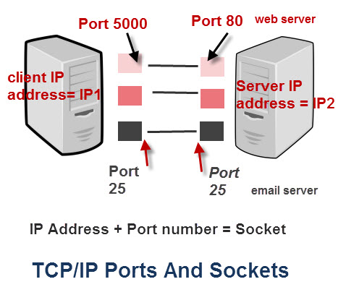
NETWORKING - Socket Programming
The term computer networking refers to linking multiple devices so that they can readily share information and software resources.
Socket programming is a way of connecting two nodes on a network to communicate with each other. One socket(node) listens on a particular port at an IP, while other socket reaches out to the other to form a connection. Server forms the listener socket while client reaches out to the server.

Slide 5
SocketS
sockets are interior endpoints built for sending and receiving data. A single network will have two sockets, one for each communicating device or program.
These sockets are a combination of an IP address and a Port.
A single device can have ‘n’ number of sockets based on the port number that is being used.
Different ports are available for different types of protocols.
Protocol | PortNumber | Python Library | Function
HTTP | 80 | httplib,utrlib,xmlrpclib | Web Pages
FTP | 20 | Ftblib,urllib | File Transfers
NNTP | 119 | nntplib | Unsent news
SMTP | 25 | smtplib | Sending Email
Telnet | 23 | telnetlib | Command Lines
POP3 | 110 | poplib | Fetching Email
Gopher | 70 | gopherlib | Document Transfer

Slide 6
Socket Module
Methods | Description
socket.socket() | used to create sockets (required on both server as well as client ends to create sockets)
socket.accept() | used to accept a connection. It returns a pair of values (conn, address) where conn is a new socket object for sending or receiving data and address is the address of the socket present at the other end of the connection
socket.bind() | used to bind to the address that is specified as a parameter
socket.close() | used to mark the socket as closed
socket.connect() | used to connect to a remote address specified as the parameter
socket.listen() | enables the server to accept connections

Slide 7
SERVER
A server is either a program, a computer, or a device that is devoted to managing network resources. Servers can either be on the same device or computer or locally connected to other devices and computers or even remote. There are various types of servers such as database servers, network servers, print servers, etc.
Connecting to a server:
Note that if any error occurs during the creation of a socket then a socket.error is thrown and we can only connect to a server by knowing it’s ip. You can find the ip of the server by using this :
$ ping www.google.com

Slide 8
SERVER
A server has a bind() method which binds it to a specific ip and port so that it can listen to incoming requests on that ip and port.
A server has a listen() method which puts the server into listen mode. This allows the server to listen to incoming connections.
And last a server has an accept() and close() method. The accept method initiates a connection with the client and the close method closes the connection with the client.
import socket s= socket.socket(socket.AF_INET,socket.SOCK_STREAM) s.bind((socket.gethostname(),1234)) s.listen(2) while True: clt, adr = s.accept() clt.send(bytes("Socket Programming in Python","utf-8"))
NOTE:
AF_INET refers to Address from the Internet and it requires a pair of (host, port) where the host can either be a URL of some particular website or its address and the port number is an integer. SOCK_STREAM is used to create TCP Protocols.

Slide 9
client
A client is either a computer or software that receives information or services from the server. In a client-server module, clients requests for services from servers. The best example is a web browser such as Google Chrome, Firefox, etc. These web browsers request web servers for the required web pages and services as directed by the user. Other examples include online games, online chats, etc.
s=socket.socket(socket.AF_INET, socket.SOCK_STREAM)
s.connect((socket.gethostname(), 2346))
msg=s.recv(1024)
print(msg.decode("utf-8"))
NOTE:
gethostname is used when client and server are on on the same computer. (LAN – localip / WAN – publicip)

Slide 10
Establish client server connection
Run the Server Program. Keep the server running during the entire communication, as Server is the one which serves/fulfills the request.
Run the Client Program, which establishes the connection with server.

Slide 11
Transferring Python Objects
Transfer python objects like sets, tuples, dictionaries, etc. are possible in python.To achieve this, you will need to import the pickle module of Python.
Python pickle module:
Python pickle module comes into picture when you are actually serializing or de-serializing objects in python.
import pickle
mylist=[1,2,'abc']
mymsg = pickle.dumps(mylist)
print(mymsg)
OUTPUT: b’x80x03]qx00(Kx01Kx02Xx03x00x00x00abcqx01e.’
Note:‘b’, meaning it’s converted to bytes.
Serialization and deserialization
Serialization is a process of converting an object into a sequence of bytes which can be persisted to a disk or database or can be sent through streams. The reverse process of creating object from sequence of bytes is called deserialization.

Slide 12
Python Pickle Module
Transfer python objects like sets, tuples, dictionaries, etc. are possible in python.To achieve this, you will need to import the pickle module of Python.
Python pickle module:
Python pickle module comes into picture when you are actually serializing or de-serializing objects in python.
import pickle
mylist=[1,2,'abc']
mymsg = pickle.dumps(mylist)
print(mymsg)
OUTPUT: b’x80x03]qx00(Kx01Kx02Xx03x00x00x00abcqx01e.’
Note:‘b’, meaning it’s converted to bytes.
Serialization and deserialization
Serialization is a process of converting an object into a sequence of bytes which can be persisted to a disk or database or can be sent through streams. The reverse process of creating object from sequence of bytes is called deserialization.

