Slide 1
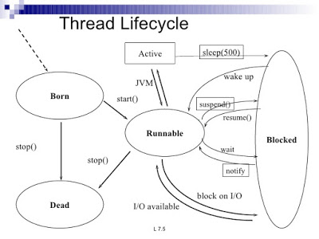
Thread

Slide 2
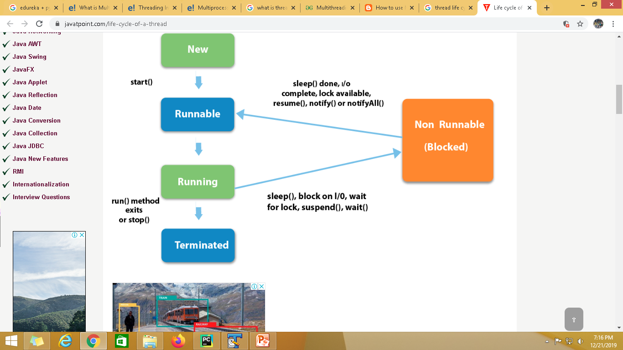
Multitasking in Python

Slide 3
Python

Slide 4
Multithreading

Slide 5
Multithreading
DATABASE
DATABASE connection in python
Install My SQL
mysql-connector
Python Database Connection
Creating a Database
Database Operations[CRUD]
Database operation

Slide 6
Multitasking
Multitasking, in general, is the capability of performing multiple tasks simultaneously. In technical terms, multitasking refers to the ability of an operating system to perform different tasks at the same time.
For instance, you are downloading something on your PC as well as listening to songs and concurrently playing a game, etc. All these tasks are performed by the same OS an in sync. This is nothing but multitasking which not just helps you save time but also increases productivity.
There are two types of multitasking in an OS:
Process-based
Thread-based

Slide 7
thread
A Thread is basically an independent flow of execution.
A single process can consist of multiple threads. Each thread in a program performs a particular task.
For Example, when you are playing a game say FIFA on your PC, the game as a whole is a single process, but it consists of several threads responsible for playing the music, taking input from the user, running the opponent synchronously, etc. All these are separate threads responsible for carrying out these different tasks in the same program.

Slide 8
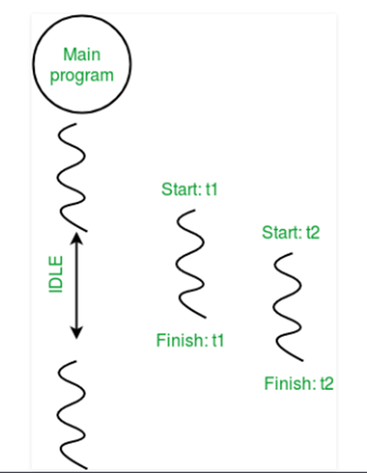
thread
Every process has one thread that is always running. This is the main thread.
This main thread actually creates the child thread objects. The child thread is also initiated by the main thread.

Slide 9
Multithreading in Python
Multithreading in Python can be achieved by importing the threading module.
Threads in Python can be created in three ways:
Without creating a class
By extending Thread class
Without extending Thread class

Slide 10
Multithreading in Python
In order to create a thread in Python, you first need to import the thread library.
To create a new thread, we create an object of Thread class. It takes following arguments:
target: the function to be executed by thread
args: the arguments to be passed to the target function
Syntax
t1 = threading.Thread(target=print_square, args=(10,))
To start a thread
t1.start()
Once the threads start, the current program also keeps on executing. In order to stop execution of current program until a thread is complete, we use join method.
t1.join()

Slide 11
Advantages of using threading
Multithreading has many advantages some of which are as follows:
Better utilization of resources
Simplifies the code
Allows concurrent and parallel occurrence of various tasks
Reduces the time consumption or response time, thereby, increasing the performance.

