Slide 1
Python

Slide 2
Introduction to Python

Slide 3
Regular expression
What is Python?
History
Constructs
Features
Frameworks
Flavors
File Extensions
Applications
Installation
Python vs Java vs C++

Slide 4

What is Python
The Python programming language is an object-oriented language, which means that it can model real-world entities.
The distinctive feature of Python is that it is an interpreted language.
The Python IDLE (Integrated Development Environment) executes instructions one line at a time
Guido van Rossum named it after the comedy group Monty Python.

Slide 5
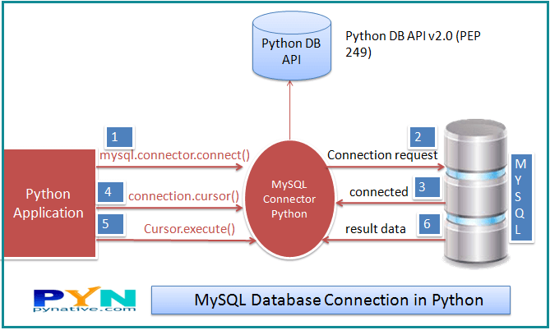
DATABASE connection in python
SQL (Structured Query Language) is a standard language for relational databases that allow users to do various operations on data like, Manipulating, Creating, Dropping, etc. In a nutshell, SQL allows you to do anything with the data.

Slide 6
Install My SQL
Site to download
https://dev.mysql.com/downloads/installer/ [Web community if you are online , otherwise just community version]
Setup Type :
Full
Check Requirements
Don’t select visual studio
Group Replication
Standalone MySQL Server
Accounts & Roles
Provide username and password

Slide 7
mysql-connector
Pycharm
File →Settings→{Project}→Project Interpreter
click + button → search for ‘mysql-connector-python’
Command Prompt
pip install mysql-connector

Slide 8
Python Database Connection
Username-
It is simply the username you give to work MySQL server with, the Default username is root.
Password-
Password is given by the user when you have installed the MySQL database. I am giving password here as ‘password123’
Host Name-
This basically is the server name or IP address on which your MySQL is running, If it is a ‘localhost’, then your IP address is 127.0.0.0
import mysql.connector
mydb=mysql.connector.connect(host="localhost",user="root",passwd="password123")
print(mydb)

Slide 9
Creating a Database
Once the database connection is established, you are ready to create your own database which will be acting as a bridge between your python and MySQL server.
mycursor.execute("create database Pythondb")
You can confirm the same from MySQLWorkbench
In MySQLWorkbench ,From the Menu “Database” →Connect to Database →{provide password} → create a new sql tab for executing queries

Slide 10
Database Operations[CRUD]
Create
Table creation and Record creation in a table.
Read
It is used for fetching useful information from the database.
Update
Updating the table or records in a table.
Delete
Deleting the table or records in a table.

Slide 11
Database operation
Table Creation
mycursor.execute("create table employee(name varchar(250),sal int(20))")
Create Records
sqlformula = "Insert into employee(name,sal) values(%s,%s)"
employees = [("harshit",200000),("rahul", 30000),("avinash", 40000),("amit", 50000),]
mycursor.executemany(sqlformula, employees)
mydb.commit()//SQL statement used for saving the changes

Slide 12
Database operation
Read Records (all records)
mycursor.execute("select * from employee")
myresult = mycursor.fetchall()
for row in myresult:
print(row)
Read Records (single record)
mycursor.execute("select name from employee")
myresult = mycursor.fetchone()
for row in myresult:
print(row)

Slide 13
Database operation
Update Records
sql = "Update employee SET sal = 70000 WHERE name = 'harshit'"
mycursor.execute(sql)
mydb.commit()
Delete Records
sql = "DELETE FROM employee WHERE name = 'harshit'"
mycursor.execute(sql)
mydb.commit()

