Slide 1
Impossible plans can't be saved.
Costly plans need a name on them.
One live picture of the portfolio. An agent that proposes re-plans.
Planners who decide. Built on the Databricks lakehouse.
Rui Dias · Senior FDE take-home

Slide 2
THE PROBLEM AS WE UNDERSTAND IT
One question takes days to answer, and margin depends on it
Margin is fragile
Risk spreads silently
Planning lives in heads
• Single-digit operating margins
• Penalties capped around 5 to 10% of contract
• One slipped milestone can erase a programme's profit
• A few rigs and crews serve 20 to 25 programmes
• One rig down moves risk to other programmes
• Nobody sees it until a date is missed
• Excel and local factory tools
• Constraint knowledge in a few senior planners
• Key-person risk on the core of the business
The question nobody can answer in less than days today
“If this bid lands, or this test rig goes down, what happens to everything else, and to our margin?”
Ferronova · one model, impossible plans refused, people decide
2

Slide 3
WHAT CHANGES
From reconciling spreadsheets to deciding on one live picture
 | Today | With the system
Portfolio view | Assembled by hand, weeks old | Live: every programme, milestone and scarce resource
Rig and crew bookings | Trackers per rig and per crew | One plan of record. A double booking cannot be saved
“What if this bid lands?” | Days of planner work | A scenario in minutes, with its penalty price
A rig goes down | Phone calls, re-plan over days | A costed re-plan waiting the same day; the planner decides
Who decided what | Email threads | Every commit versioned: who, why, at what cost
Ferronova · one model, impossible plans refused, people decide
3

Slide 4
THE HEART OF THE DESIGN
Five rules the plan cannot break
R1
One campaign per rig
and only on a rig that can run that test
R2
Qualified crews only
certified for that vehicle, on those dates
R3
Crews free and inside the window
travel time included, inside the customer's night or weekend access
R4
Halls have a fixed number of bays
parked car-bodies never exceed the physical space
R5
Every plan carries its price
late milestones, penalties, what is recoverable. Costly plans need a director
R1 to R4 block what is physically impossible. R5 prices what is merely expensive. Each is a database rule, tested, not a guideline: it binds planners and the agent alike.
Ferronova · one model, impossible plans refused, people decide
4

Slide 5
HOW IT STAYS SAFE
The agent proposes. The database refuses what is impossible. A person decides.
Rig A breaks down
Agent proposes
Planner improves it
Director signs
Committed as plan v2
10-week outage recorded.
Two test campaigns now conflict.
Moves both campaigns to other capable rigs.
Price: type approval 59 days late, EUR 2.95M.
Pulls another campaign forward.
Price down to EUR 1.4M, 28 days late.
Above the penalty threshold (R5), so a director must approve.
One transaction, versioned, conflicts cleared.
Refused along the way, by the database (17 executable tests)
Attempt | Rule | Who
Book a rig that cannot run brake tests; double-book Rig B | R1 | Agent
Send a crew not qualified for the metro | R2 | Agent
Test outside the customer's window; same crew with no travel time | R3 | Agent
Commit the cheaper plan without a director | R5 | Planner
Ferronova · one model, impossible plans refused, people decide
5

Slide 6
REFUSALS ARE DATA
Every refused change is kept, with the rule that refused it
Audit
Agent learning
Capacity decisions
• Who tried what, when
• Which rule stopped it
• Planner or agent, same log
• Each refusal is feedback for the next try
• History becomes its evaluation set
• Shows which rule it misreads
• Pressure per rig, crew pool, hall
• Sustained refusals justify renting or hiring
• No pressure avoids buying
Resource | Refusals in the test run | Rules | Reading
RIG-B | 4 | R1 | The only free EMC rig: the bottleneck after an outage
CRW-1 | 2 | R3 | One qualified metro crew; windows are tight
Hall H1, bay 1 | 1 | R4 | Parking pressure while batches wait
Ferronova · one model, impossible plans refused, people decide
6

Slide 7
BUSINESS VALUE
Protect margin first, then grow the order book safely
Lever | How | Order of magnitude / year
Avoid penalties | Risk visible weeks earlier, same-day re-plans | EUR 5 to 10M
Recover from disruptions | ~2 weeks recovered per major disruption | EUR 2 to 4M (partly overlaps)
Bid on dates we can meet | Bids checked against real rig and crew capacity | Avoid EUR 70M tail risk on one bid
Capacity on evidence | Refusal pressure shows where to rent or hire | Better-timed capex
Planner capacity | Scenarios in minutes; knowledge captured | Resilience, less key-person risk
How to read it
• Assumes EUR 7.7bn in flight, 6% margin, penalties ~1% of revenue
• Penalty lever alone ≈ 3 to 7% of operating profit
• Board-level case: bid risk and resilience
• Build ≈ EUR 1 to 1.5M, payback < 1 year if the penalty assumption holds
First number to get in week 1: penalties actually paid or accrued in the last 3 years, by milestone. If it is 0.3% of revenue, not 1%, the case rests on bid risk and resilience.
Ferronova · one model, impossible plans refused, people decide
7

Slide 8
THE ORDER WE UNLOCK IT
Each step pays for itself and makes the next one safe. The agent comes last.
1 · See
2 · Commit safely
3 · What-if
4 · Agent proposes
Weeks 0–8
Weeks 6–16
Weeks 12–20
Weeks 18–26
• Sources in, IDs resolved
• Portfolio risk picture
• Read-only, low risk
• Rig, crew, hall bookings
• R1 to R5 enforced
• Trackers retired
• Bid and disruption scenarios
• Price per option
• Better bid decisions
• Rig-down re-plan first
• Planner approves or edits
• Days to hours
Where we push back
The ask is an agent on top. On today's data it would reason over spreadsheets that disagree. Steps 1 and 2 deliver most of the risk reduction and make the agent safe. If we stopped after step 2, Ferronova would already have one trusted plan.
Ferronova · one model, impossible plans refused, people decide
8

Slide 9
WHAT MAKES OR BREAKS IT
Three things decide success. Only one of them is technical.
1 · Planners want to switch
2 · One write path
3 · Data you can trust
• If the app is slower than the lead planner's Excel, it dies
• They see their own rules in the model
• They keep the final say
• Every rig, crew and hall change goes through the plan of record
• Trackers retired, not kept in parallel
• A management decision
• Factories name things differently
• ID crosswalk with named owners
• Penalty terms as data, not contract PDFs
Ferronova · one model, impossible plans refused, people decide
9

Slide 10
OPEN QUESTIONS
What I need from you to firm this up
Business
Technical
• What did penalties cost in the last 3 years, by milestone?
• Which constraint binds most today: rigs, crews or hall space?
• How are penalties written: caps, recovery, force majeure for rig failure?
• Who may accept a plan that makes a customer milestone late?
• At what bid probability should a bid reserve capacity?
• How much autonomy for the agent in year one?
• Direct DB access with change capture on the scheduling tool?
• Which MES per factory, and what can each export, how often?
• Does the register cover batches, rigs and crews, or only programmes?
• Hall space: bays, or metres?
• Lakebase in your region, with the extensions we need?
• How fresh must the picture be: minutes, hours, daily?
Ferronova · one model, impossible plans refused, people decide
10

Slide 11
HOW I WORKED WITH AI
Faster on the mechanical parts, overruled on the judgment calls
Where it moved me faster
Where I overrode it
• [Replace with your own example]
• Drafting DDL, seed data and a test harness
• Time saved went into deciding which rules block and which only price
• [Replace with your own example]
• Checks after the fact detect a double booking; they cannot refuse it
• Agent safety moved out of the prompt, into permissions and constraints
Adapt this slide to your own session before sending.
Ferronova · one model, impossible plans refused, people decide
11

Slide 12
Backup · architecture, data model, agent, planner prototype

Slide 13
BACKUP · ARCHITECTURE
Lakehouse for the picture, Lakebase for the plan of record
Sources
Ingest + conform
Plan of record
Read models
Surfaces + agent
• Scheduling DB
• MES × factories
• PLM
• CRM
• ERP + sheets
• Planner trackers
• Programme register
• Lakeflow Connect, Auto Loader
• Config as data: 1 row per source
• bronze raw, silver conformed
• ID crosswalk + quarantine
• Expectations / DQX
• Lakebase (Postgres)
• Bookings: rig, crew, hall
• Scenarios, approvals, versions
• R1–R4 as constraints
• Gate G1–G6, refusals logged
• gold: milestone risk
• resource load by week
• refusal pressure
• Metric views
• Databricks App: planner
• AI/BI + Genie: leadership
• Agent: service principal
• Tools = UC functions
• Optimiser = black box
• Why Lakebase: Delta enforces only row-level rules. “One campaign per rig at a time” is a cross-row rule. Postgres makes it impossible to save.
• Data quality (is this data trustworthy?) lives in the pipelines. Decision validity (is this plan committable?) lives only at commit.
• Decisions do not round-trip through bronze and silver: the ledger is their system of record, replicated to Delta for history.
Ferronova · one model, impossible plans refused, people decide
13

Slide 14
BACKUP · DATA MODEL
Every rule maps to a database object, scoped by scenario
Rule | Mechanism
R1 one campaign per rig | EXCLUDE (scenario, rig, period &&) + FK rig_capability
R2 qualified crew | FK (crew, design, qual_period) + CHECK period <@ qual_period
R3 in window, crew free | FK (window, site, window_period) + CHECK; EXCLUDE (crew, [mobilise, end))
R4 hall never over-committed | Bays as positions + EXCLUDE (scenario, position, period &&)
R5 every plan priced | v_penalty_exposure; G5 escalates above threshold
No commit on outages | Gate G4 over v_plan_conflicts
No stale overwrite | G2: base_version check under lock on plan_head
Refusals kept | rule_catalog + rejection_log + v_rejection_pressure
Core tables
• Reference: programme, design, design_type_test, milestone, campaign
• Resources: test_rig, rig_capability, crew, crew_qualification, access_window, hall_position
• Plan (by scenario): rig_booking, crew_assignment, hall_occupancy
• Governance: scenario, approval, plan_version, operational_event, guardrail_policy, rejection_log
Ferronova · one model, impossible plans refused, people decide
14

Slide 15
BACKUP · THE AGENT
Scoped to one trigger first: a test rig goes down
Its whole action list
Never touches
Guardrails live in the database
• branch_scenario: open its own draft
• try_move_booking: move a campaign
• try_assign_crew: place a crew
• submit_scenario: hand over with rationale
• Each returns OK or the refusing rule
• Contract dates and penalty terms
• Customer windows, qualifications, rig capabilities
• Factory shop-floor sequencing
• The committed plan, approvals, thresholds
• Bid pricing and customer talks
• RLS: own draft only
• Constraints: every row feasible
• No permission to commit
• G2 stale, G4 reality, G5 cost → director
• MLflow trace + refusal log
Ferronova · one model, impossible plans refused, people decide
15

Slide 16
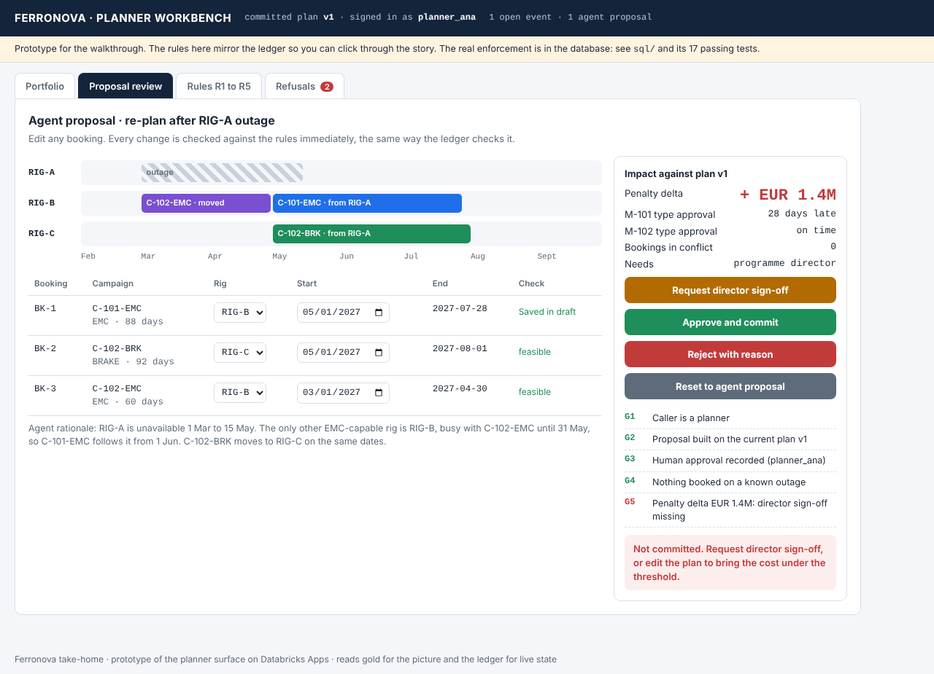
BACKUP · PLANNER PROTOTYPE
planner-prototype.html: the proposal, the price, and the gate
Try it live
• Agent proposal: EUR 2.95M
• Move C-101 to 1 May: refused R1
• Pull C-102-EMC to 1 Mar, then C-101 to 1 May: EUR 1.4M
• Commit: G5 asks for a director
• Director signs: plan v2
Ferronova · one model, impossible plans refused, people decide
16

