Slide 1
Employee Analysis: Employee Satisfaction, Attrition, & Compensation
Presented by:
Revanth Paineni
Charan Sumanth Pulleti
Nandaki Karnati
Sridhar Yemundla
Date: December 4, 2023
Institution: University of New Haven
Github:

Slide 2

Executive Summary
Project Purpose: To analyze the factors influencing employee turnover and devise strategies to enhance retention.
Key Findings:
Identified pivotal factors affecting attrition: job satisfaction, compensation, and work-life balance.
Random Forest Classifier model employed for predictive accuracy in attrition likelihood.
Strategic Planning: Insights enable proactive measures to improve employee engagement and reduce turnover rates.

Slide 3

Introduction
Attrition Defined: The rate at which employees voluntarily exit an organization.
Significance: Attrition impacts operational efficiency, employee morale, and financial stability.
Study Relevance: Addresses the urgent need to understand and manage attrition in today's data-driven business environment.

Slide 4

Literature Review
Previous Research: Studies show job satisfaction and work-life balance are crucial to employee retention.
Knowledge Gaps:
Limited predictive analytics applied to attrition risks.
Existing literature lacks comprehensive modeling to preempt turnover.
Research Questions:
What patterns of attrition can be identified from HR data?
How can these patterns inform HR strategies to reduce turnover?

Slide 5

Methodology
Data Source: IBM HR Analytics Employee Attrition & Performance dataset from Kaggle.
Data Cleaning:
Removed duplicates and handled missing values.
Ensured data integrity for accurate analysis.
Modeling Approach:
Employed Random Forest Classifier for its robustness and effectiveness with categorical data.
One-hot encoding applied to categorical variables.
Model hyperparameters tuned for optimal performance.

Slide 6
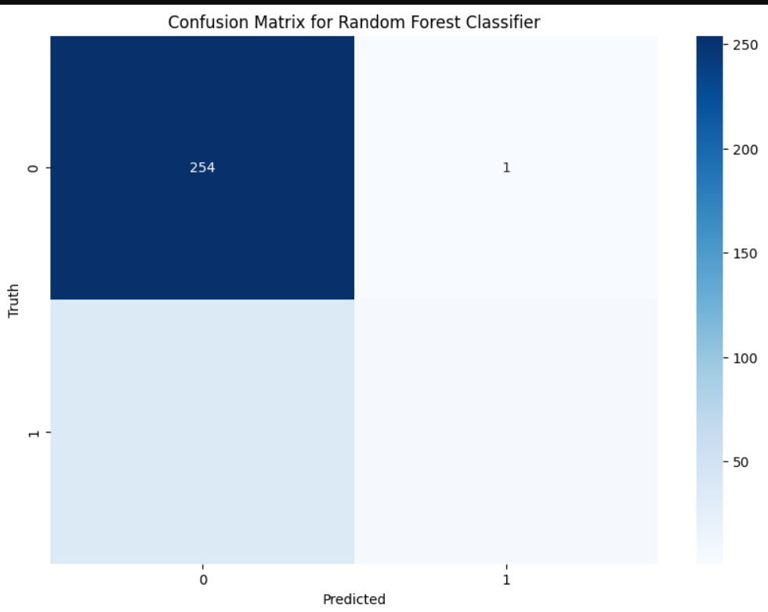
Regression Analysis and Predictive Modelling:
The visualization provided is a confusion matrix for a Random Forest Classifier, a fundamental tool in evaluating the performance of a classification model. The matrix contrasts the actual values (Truth) with the values predicted by the model (Predicted).
From the confusion matrix, we can deduce the following:
True Negatives (TN): The number of instances correctly predicted as the negative class (e.g., employee did not leave) is 254. This indicates that for 254 cases, the model accurately predicted the employees who stayed with the company.
False Positives (FP): There is 1 instance where the model incorrectly predicted the positive class (e.g., employee will leave). This means that one employee was predicted to leave but did not actually leave.
The model's performance, particularly its precision and recall, are critical in determining its practical application. Precision (or Positive Predictive Value) would tell us how reliable the model's predictions are when it predicts an employee will leave

Slide 7
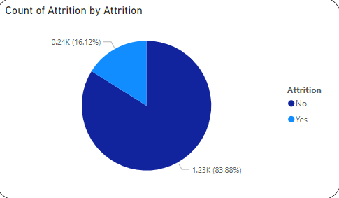
Data Analysis & Visualizations
Attrition Overview:
Approximately 16.12% of employees have left the organization.
Visualized through a clear pie chart representation.
Departmental Breakdown:
Analysis of employee count by department shows distinct attrition trends.
Bar graph illustrates a lower turnover rate in Research & Development compared to Sales and Human Resources.

Slide 8
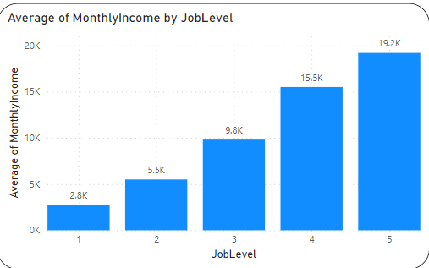
Insights and Implications
Compensation Trends:
Analysis indicates a positive correlation between job level and average monthly income.
Higher job levels tend to correspond with higher earnings, influencing attrition decisions.

Slide 9

Discussions
Predictive Power of Model:
Key predictors identified: job satisfaction, work-life balance, years since last promotion.
Model's Practical Application:
Strong predictive accuracy for non-attrition cases.
Importance of balancing predictive precision with the ability to detect at-risk employees.

Slide 10








Data Collection & Analysis Process
Data Cleaning and Development
Reporting
Deployment

Slide 11

Conclusion
Transformative Potential:
Analysis offers a transformative approach to HR management from reactive to proactive.
Strategic HR Management:
Data-driven insights pave the way for targeted retention strategies and workplace environment enhancement.
Future Research Directions:
Incorporation of broader variables and sophisticated modeling techniques.

Slide 12
References
IBM. IBM HR Analytics Employee Attrition & Performance. Kaggle.
Killham, E. (2022, January 25). Employee Attrition Analytics: The Who, When & Why of Employee Turnover. Perceptyx.

Slide 13
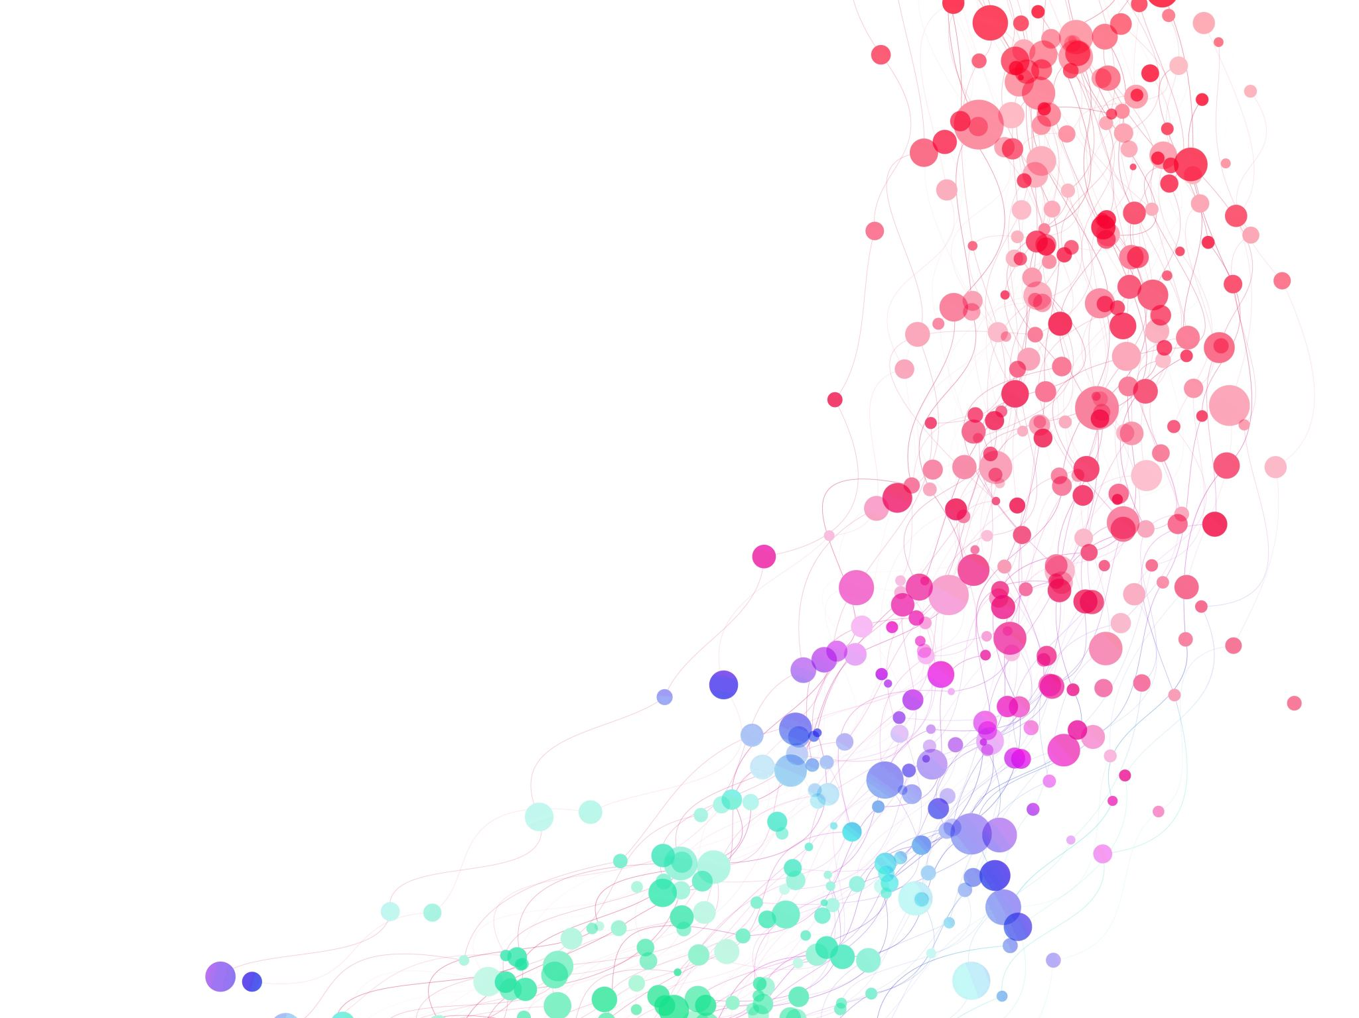
Thank you

